Slide 1
Health and Wellbeing
Ward Profile
Strood North
Medway Council
Public Health Intelligence Team
22/03/2023

Slide 2
Summary: Strood North ward
Version 1.1 © Medway Council, Public Health Intelligence Team, 22/03/2023
Indicator | Compared | Slide
General fertility rate | Similar | 19
MMR one dose (2 yrs) | Worse | 20
DTaP/IPV/Hib/HepB vaccine (2 yrs) | Similar | 21
A&E attendances (0-4 yrs) | Similar | 22
Year 6: Prevalence of excess weight | Similar | 23
Admissions for asthma (<19 yrs) | Similar | 24
Admissions for self-harm (10-24 yrs) | Similar | 25
Smoking prevalence | Higher | 27
Obesity prevalence | Similar | 28
Alcohol admissions | Better | 29
Depression prevalence | Higher | 30
Severe mental illness prevalence | Similar | 31
Cervical screening | Similar | 34
Breast cancer screening | Lower | 35
Bowel cancer screening | Lower | 36
Cancer prevalence | Lower | 37
Deaths from all cancer | Similar | 38
Hypertension prevalence | Similar | 40
Coronary heart disease prevalence | Lower | 41
Deaths from coronary heart disease | Similar | 42
Indicator | Compared | Slide
Stroke prevalence | Lower | 43
Deaths from stroke | Better | 44
Heart failure prevalence | Similar | 45
Atrial fibrillation prevalence | Lower | 46
Deaths from circulatory disease | Similar | 47
Diabetes prevalence | Similar | 49
Chronic kidney disease | Similar | 51
Asthma prevalence | Lower | 53
COPD prevalence | Similar | 54
Deaths from respiratory diseases | Similar | 55
Epilepsy prevalence | Similar | 57
ACSC admissions | Similar | 58
Deaths from all causes | Worse | 60
Deaths considered preventable | Similar | 61
Dementia prevalence | Similar | 63
Emergency admissions falls | Similar | 64
Emergency admissions for hip fractures | Similar | 65
Life expectancy (male) | Similar | 67
Life expectancy (female) | Similar | 68
Households in fuel poverty | Lower | 70
Indicator | Compared | Slide
Unemployment | Similar | 71
Access to hospital | Better | 72
Access to secondary school | Better | 73
Access to garden space | Better | 74
Access to public green space | Better | 75

Slide 3
Contact details
Version 1.1 © Medway Council, Public Health Intelligence Team, 22/03/2023
If you have any questions or would like further information about these profiles, please contact:
Dr Natalie Goldring
Senior Public Health Intelligence Manager
Public Health
Medway Council
natalie.goldring@medway.gov.uk
01634 337271

Slide 4
Resources
Version 1.1 © Medway Council, Public Health Intelligence Team, 22/03/2023
There are other resources available to explore the health and wellbeing needs of Medway's residents:
Medway's Joint Strategic Needs Assessment (JSNA): Contains over 30 topic specific chapters as well as other supporting information, such as an overview of people and place.
Infographics: Summarise key data and information from some of the main JSNA chapters.
Medway Health and Wellbeing Survey: Medway Council’s Public Health team conducted a health and wellbeing survey in 2021 to 2022. Provides estimates of key health states and risk factors at Medway ward and Primary Care Network (PCN) level.
Annual Public Health Reports: Every year the Director of Public Health for Medway Council produces an Annual Public Health Report. These reports take an in depth look at an issue that is having, or has the potential to have, a significant impact on the health of local people.

Slide 5
Introduction

Slide 6
Purpose and rationale
Version 1.1 © Medway Council, Public Health Intelligence Team, 22/03/2023
Profiles have been created for each of the 22 wards in Medway Unitary Authority.
The aim of the ward profiles is to identify the health and wellbeing needs of the ward.
The people and place section provides contextual information about the population characteristics.
The indicators are then grouped into the five main themes of the Medway Joint Health and Wellbeing Strategy (JHWS) 2018 to 2023.
Medway Joint Health and Wellbeing Strategy (JHWS) 2018-2023

Slide 7
LSOA and MSOA data
Version 1.1 © Medway Council, Public Health Intelligence Team, 22/03/2023
Data at several small area levels have been used as building blocks to calculate the ward values: Lower layer Super Output Area (LSOA), Middle layer Super Output Area (MSOA), and GP practice (GP).
  LSOA
    LSOAs have an average population of 1,500 people or 650 households.
    There are 163 LSOAs within Medway and 9 LSOAs in Strood North ward.
  MSOA
    MSOAs have an average population of 7,500 residents or 4,000 households.
    There are 38 MSOAs within Medway and 2 MSOAs in Strood North ward.
  LSOA/MSOA to ward
    To calculate values for each ward, data for several LSOAs or MSOAs are combined.
    LSOAs and MSOAs do not fit exactly into ward boundaries.
    LSOAs and MSOAs are assigned to wards using the Office for National Statistics (ONS) best-fit lookup.

Slide 8
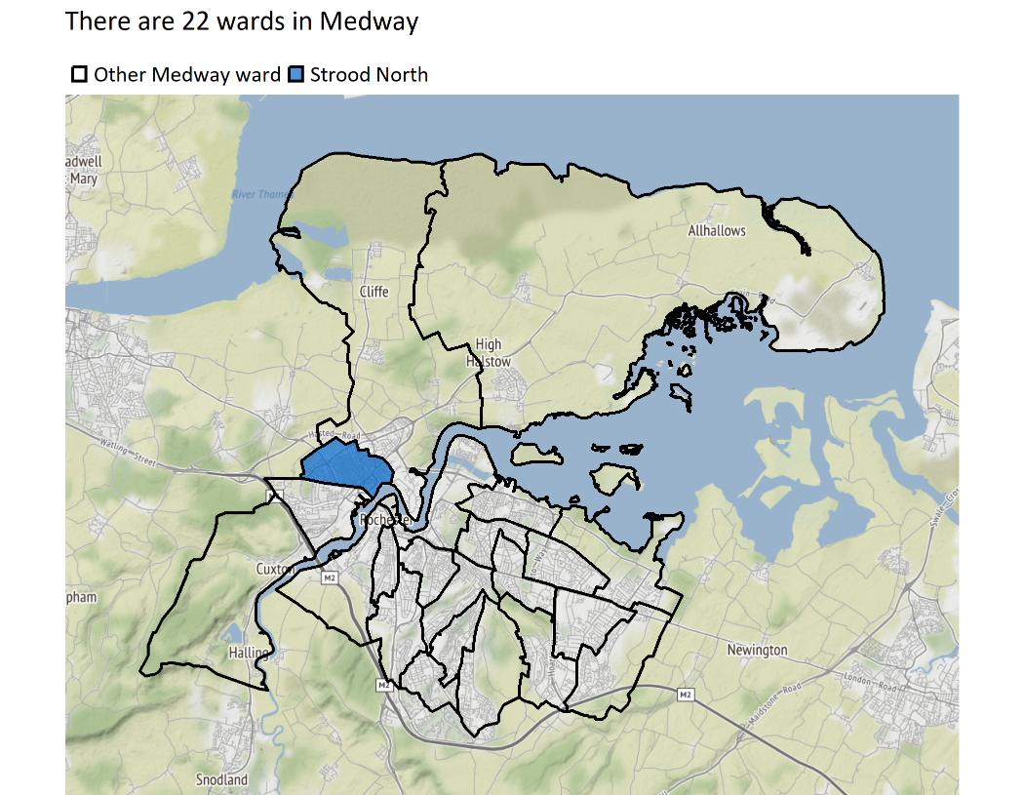
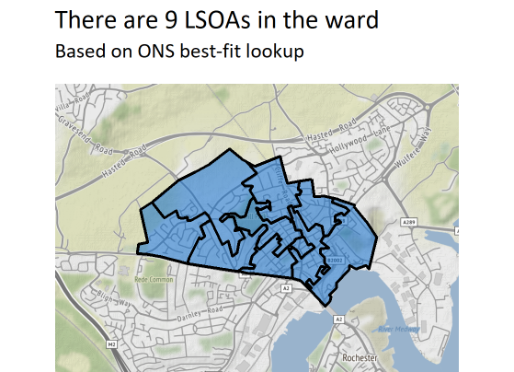
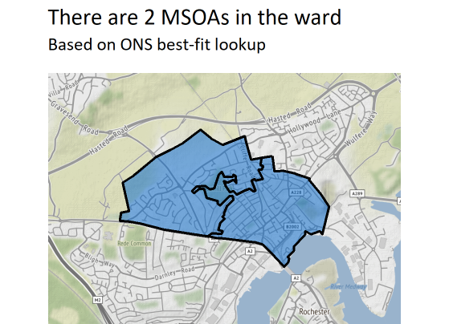
Ward boundaries
Version 1.1 © Medway Council, Public Health Intelligence Team, 22/03/2023

Slide 9
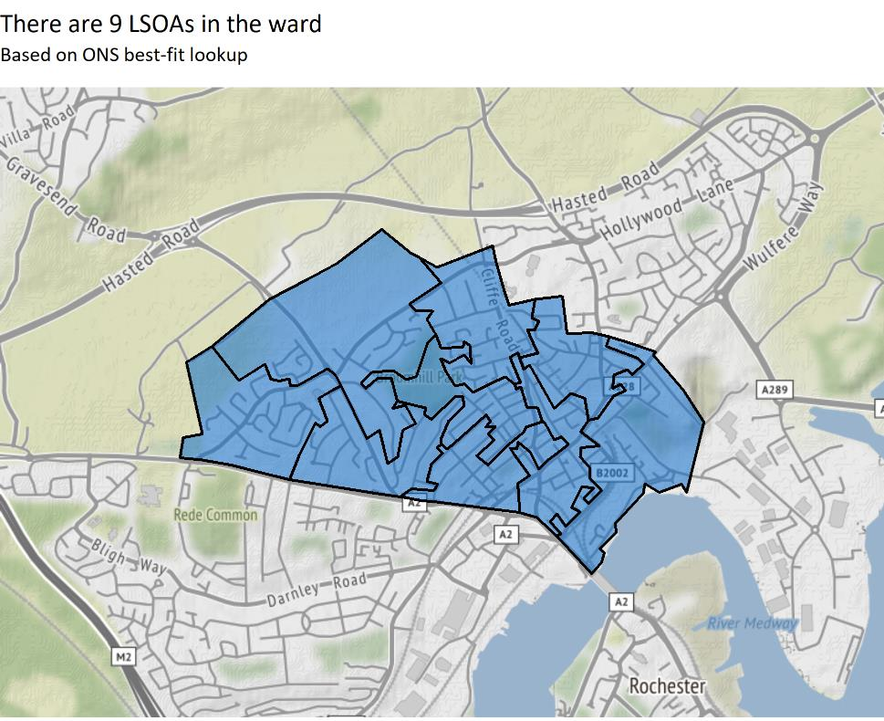
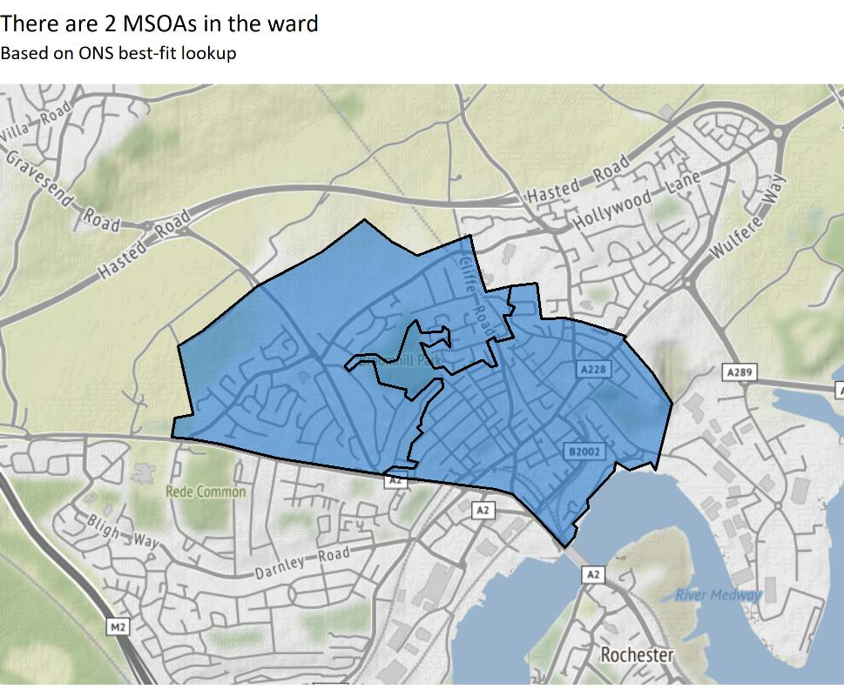
LSOA and MSOA boundaries
Version 1.1 © Medway Council, Public Health Intelligence Team, 22/03/2023

Slide 10
GP practice data
Version 1.1 © Medway Council, Public Health Intelligence Team, 22/03/2023
GP practice level data has been used to create modelled estimates of health condition prevalence for LSOAs and larger geographies, such as wards.
    In short: for each GP practice, health condition prevalence numbers are allocated to LSOAs based on the percentage of that practice's patients living in each LSOA.
    The LSOA level estimates are then aggregated to other geographies, such as ward.
    This methodology has also been used for immunisation and screening indicators.
  Caveats
    It's important to reiterate that these are modelled estimates of local health condition prevalence.
    It's not possible to say for sure how many people in a given LSOA or ward have certain health conditions.
    Some differences in prevalence estimates between areas may reflect variation in the way that GP practices operate, or how they record and measure data, rather than genuine differences in prevalence.

Slide 11
Benchmarking
Version 1.1 © Medway Council, Public Health Intelligence Team, 22/03/2023
    A RAG rating (red, amber, green) has been applied to the indicators to show how well an area is performing compared to a benchmark (England).
    The RAG rating is assigned by comparing an area's value to a reference range, which was created using either confidence intervals (CIs) or a range around the England average (usually 5%).
    Green corresponds to a value that is better than England, red to a value that is worse, and amber indicates that there is no difference.
    Where it is inappropriate to label high or low values as 'better' or 'worse', for example osteoporosis prevalence, the terms 'higher' and 'lower' have been used with neutral colouring: shades of blue from light to dark. Such labelling does not imply that high values of these indicators, for example, are 'worse'.
    An indicator is shaded grey where it is inappropriate to apply a RAG rating due to the methods used in the calculation or the count is less than 10.
    The indicators related to immunisations have been benchmarked against a goal (95%), as the World Health Organization (WHO) recommends that at least 95% of children should be immunised against vaccine-preventable diseases.

Slide 12
Indicator slides explained
Version 1.1 © Medway Council, Public Health Intelligence Team, 22/03/2023

Slide 13
People and place

Slide 14
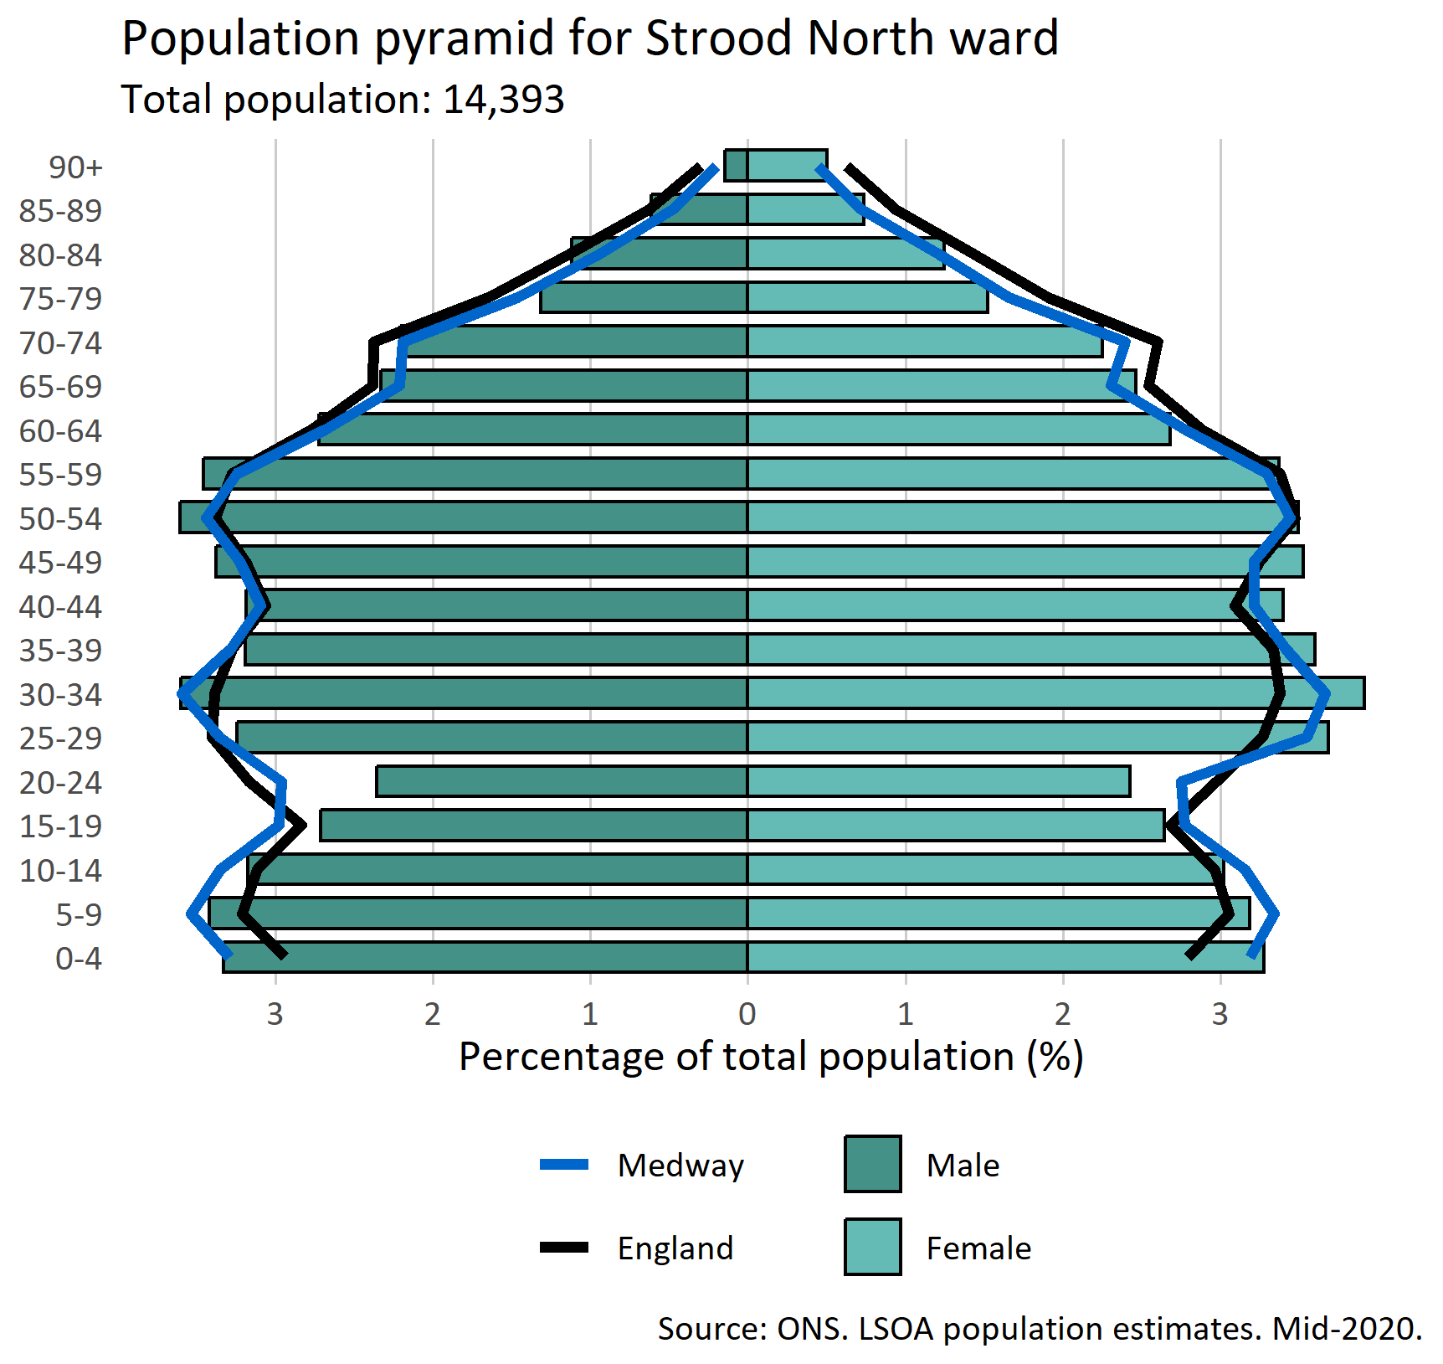
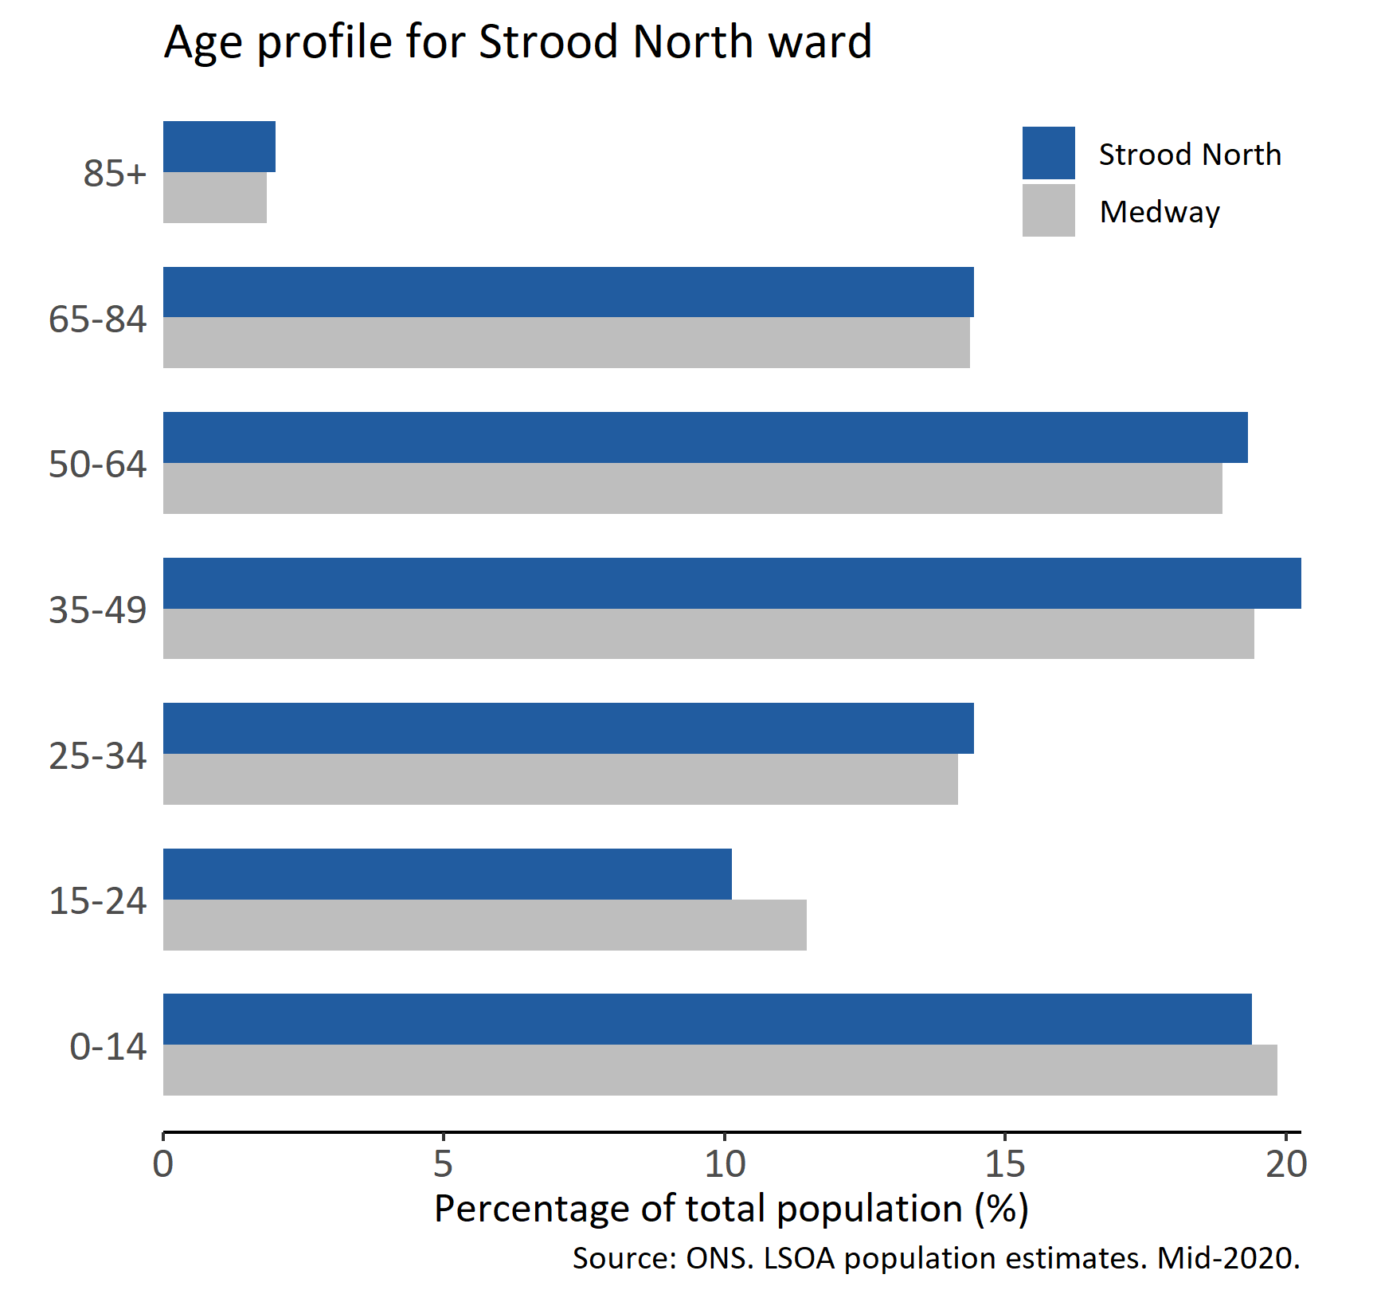
Population
Version 1.1 © Medway Council, Public Health Intelligence Team, 22/03/2023

Slide 15
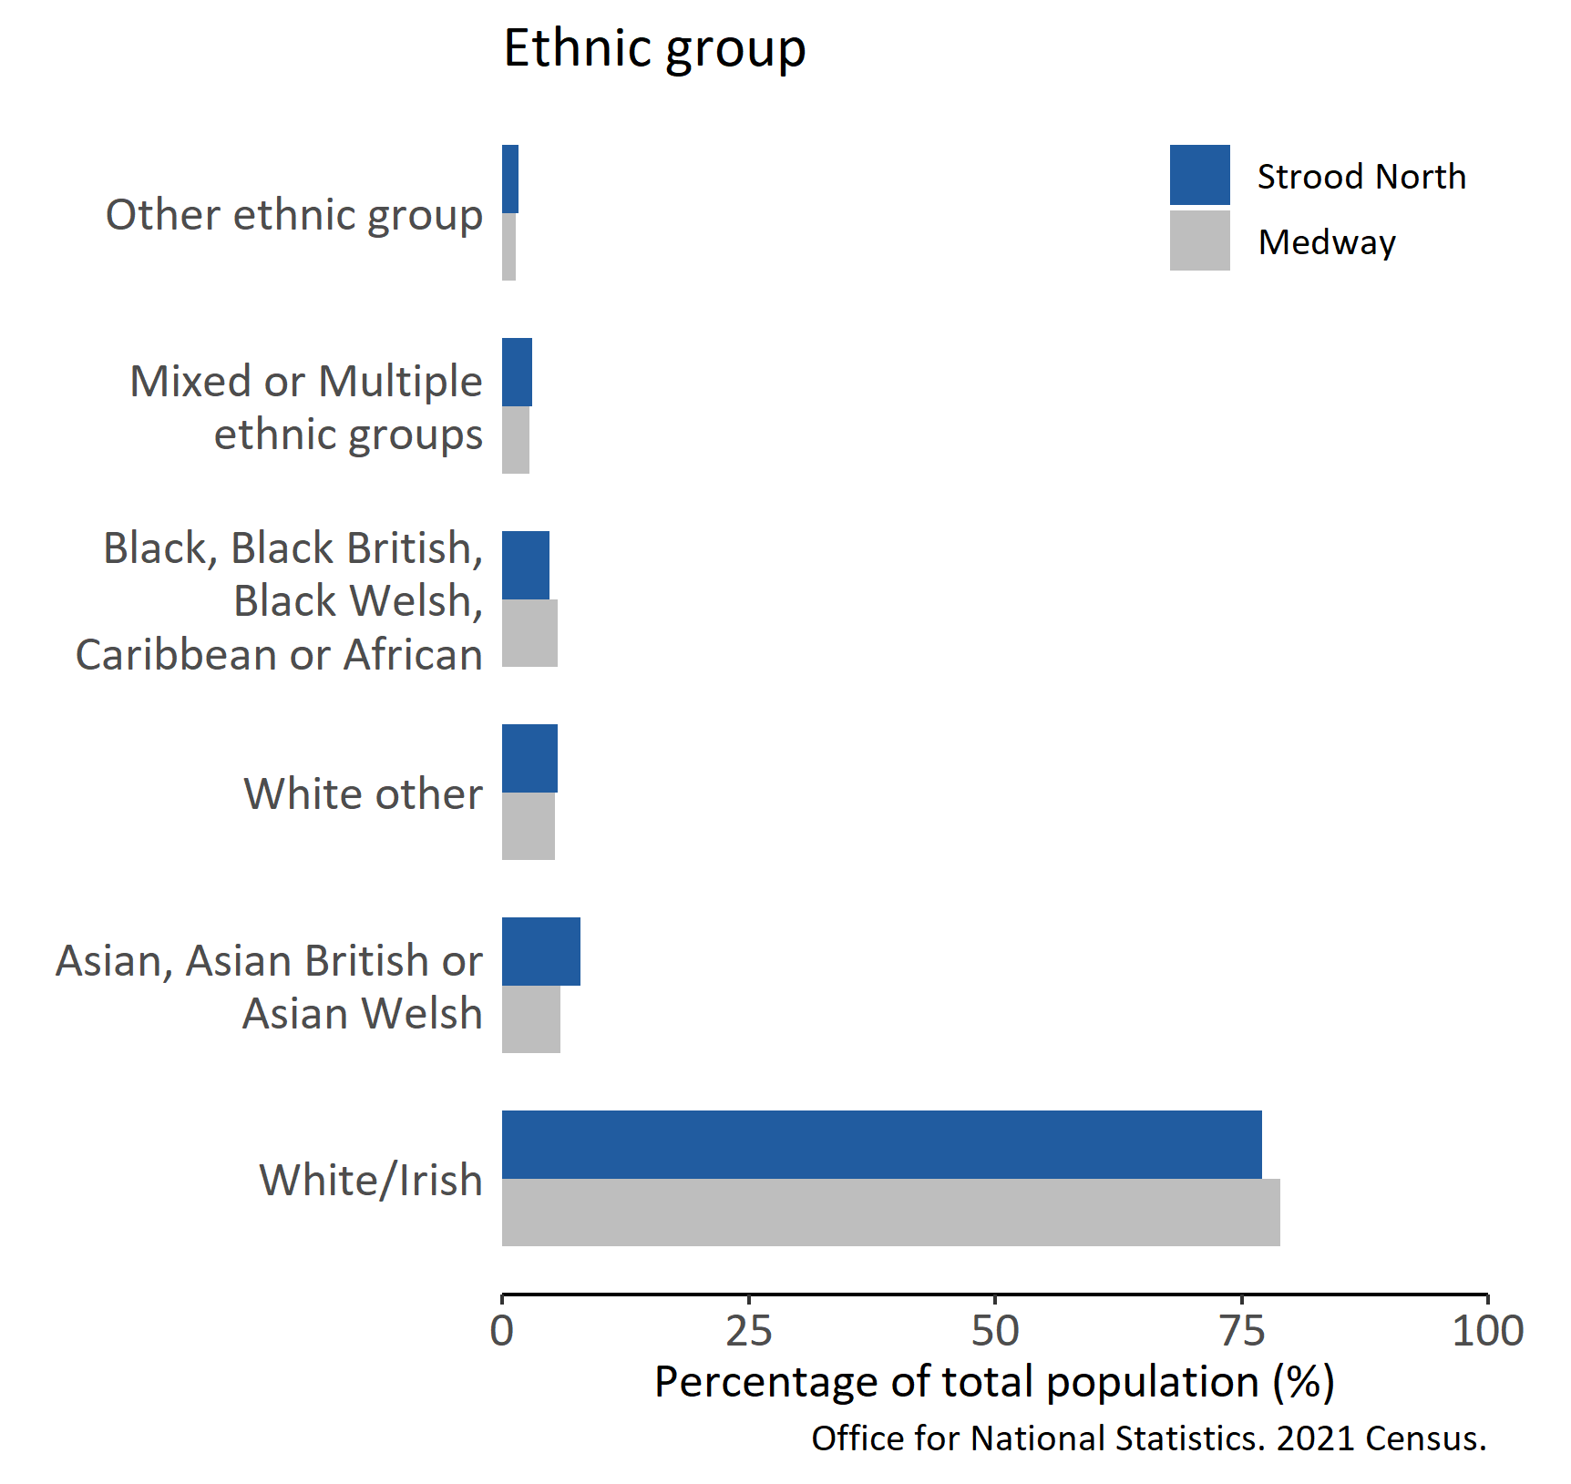
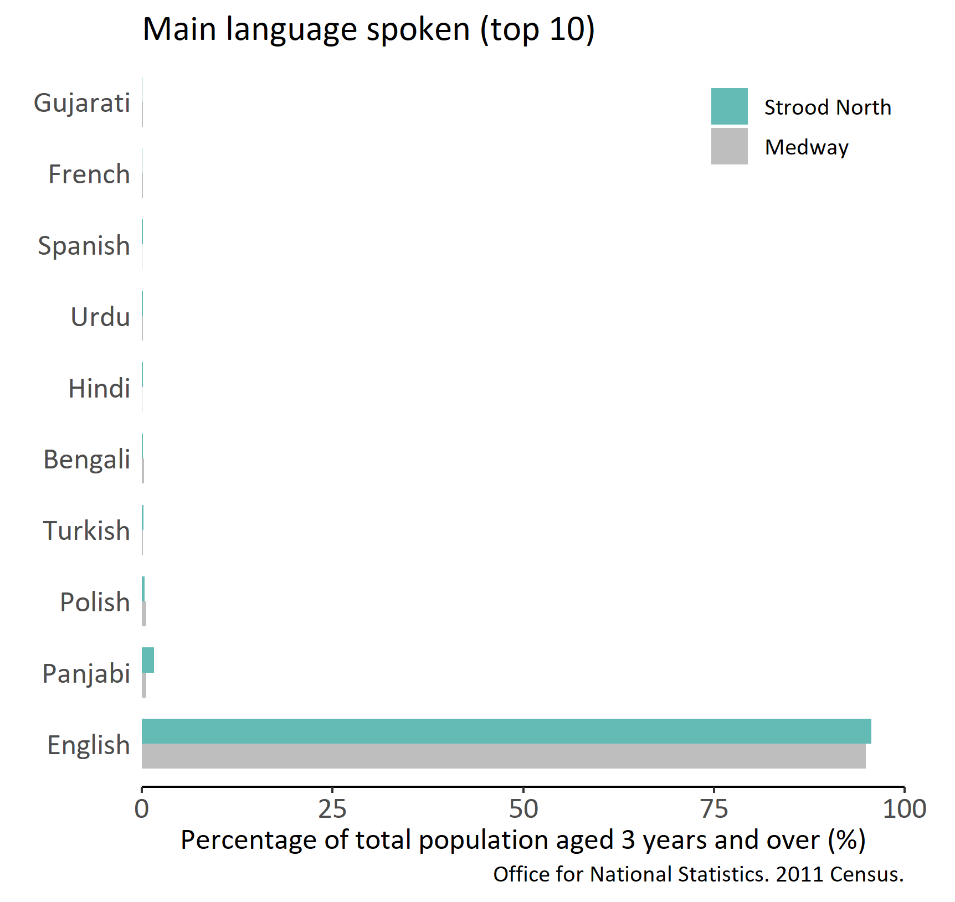
Ethnic group and main language
Version 1.1 © Medway Council, Public Health Intelligence Team, 22/03/2023

Slide 16
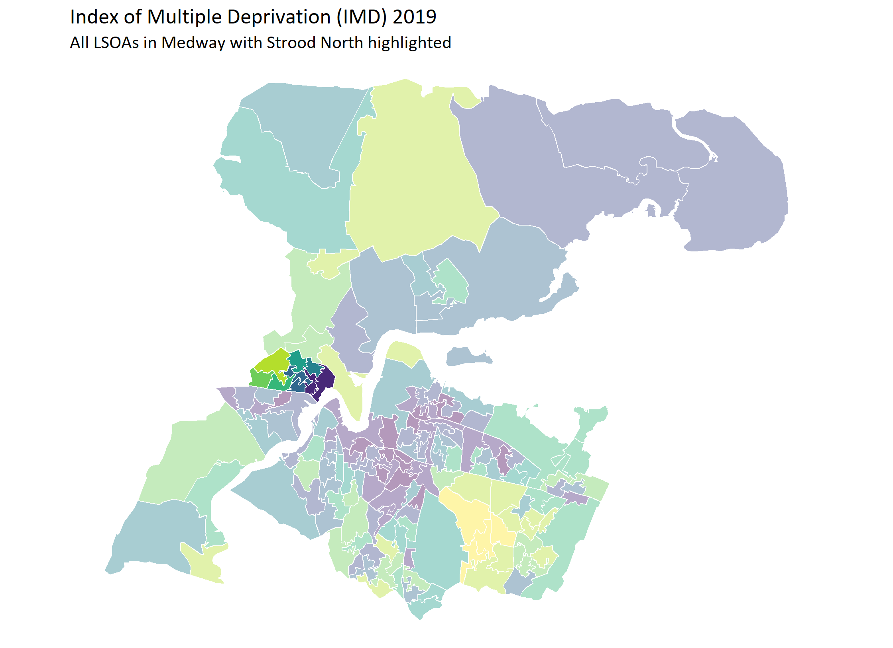
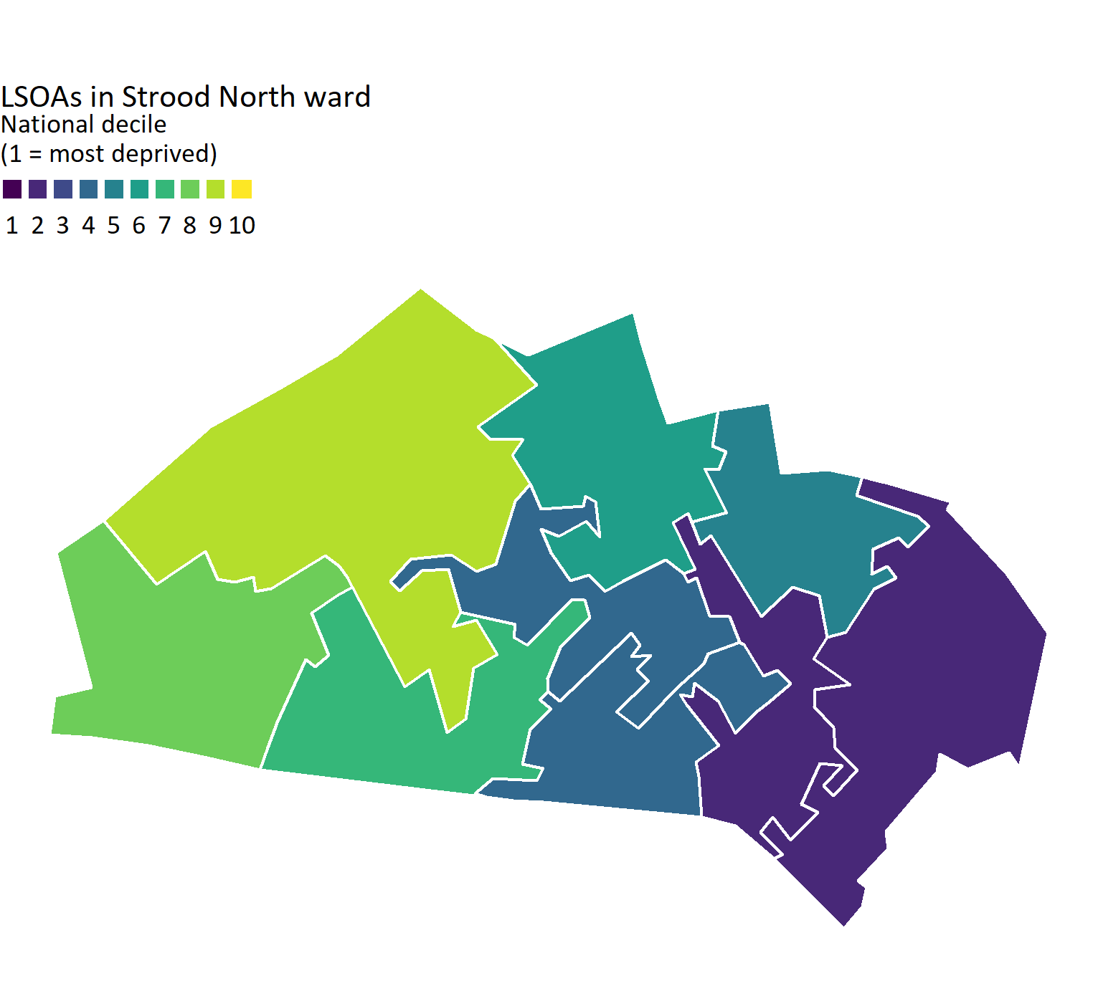
Deprivation
Version 1.1 © Medway Council, Public Health Intelligence Team, 22/03/2023
Contains National Statistics data © Crown copyright and database right 2019
Contains OS data © Crown copyright and database right 2019
Medway Public Health Intelligence Team, Medway Council 2023-03-22

Slide 17
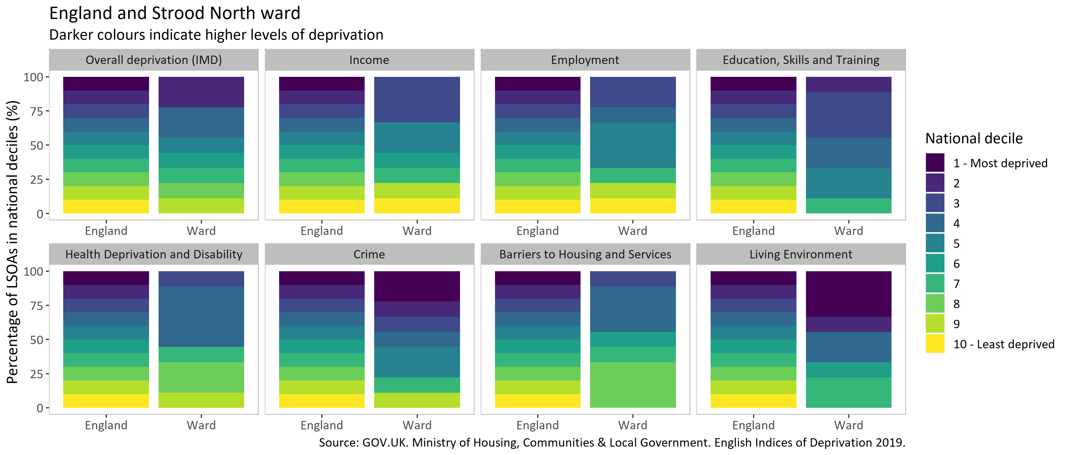
Domains of deprivation
Version 1.1 © Medway Council, Public Health Intelligence Team, 22/03/2023

Slide 18
Best start in life

Slide 19
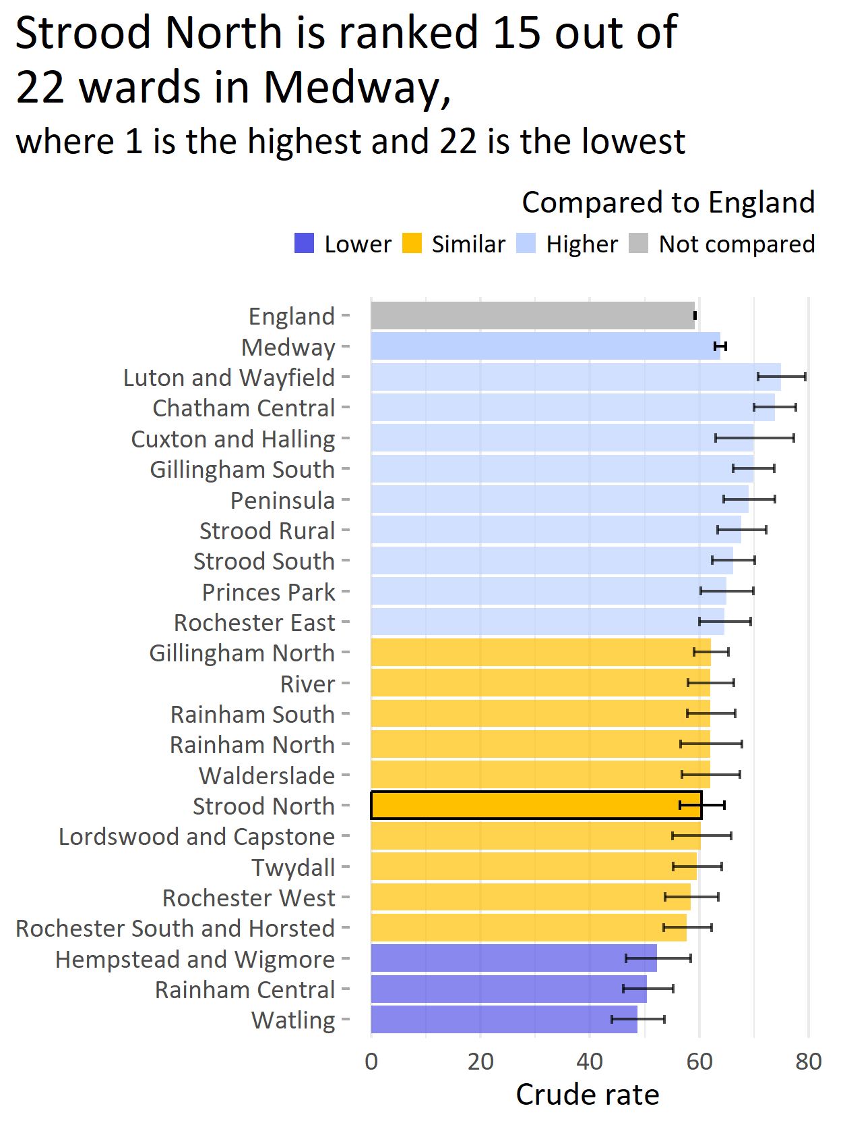
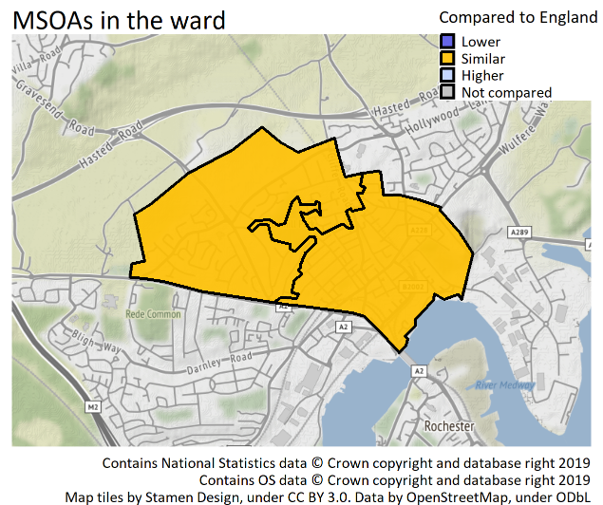
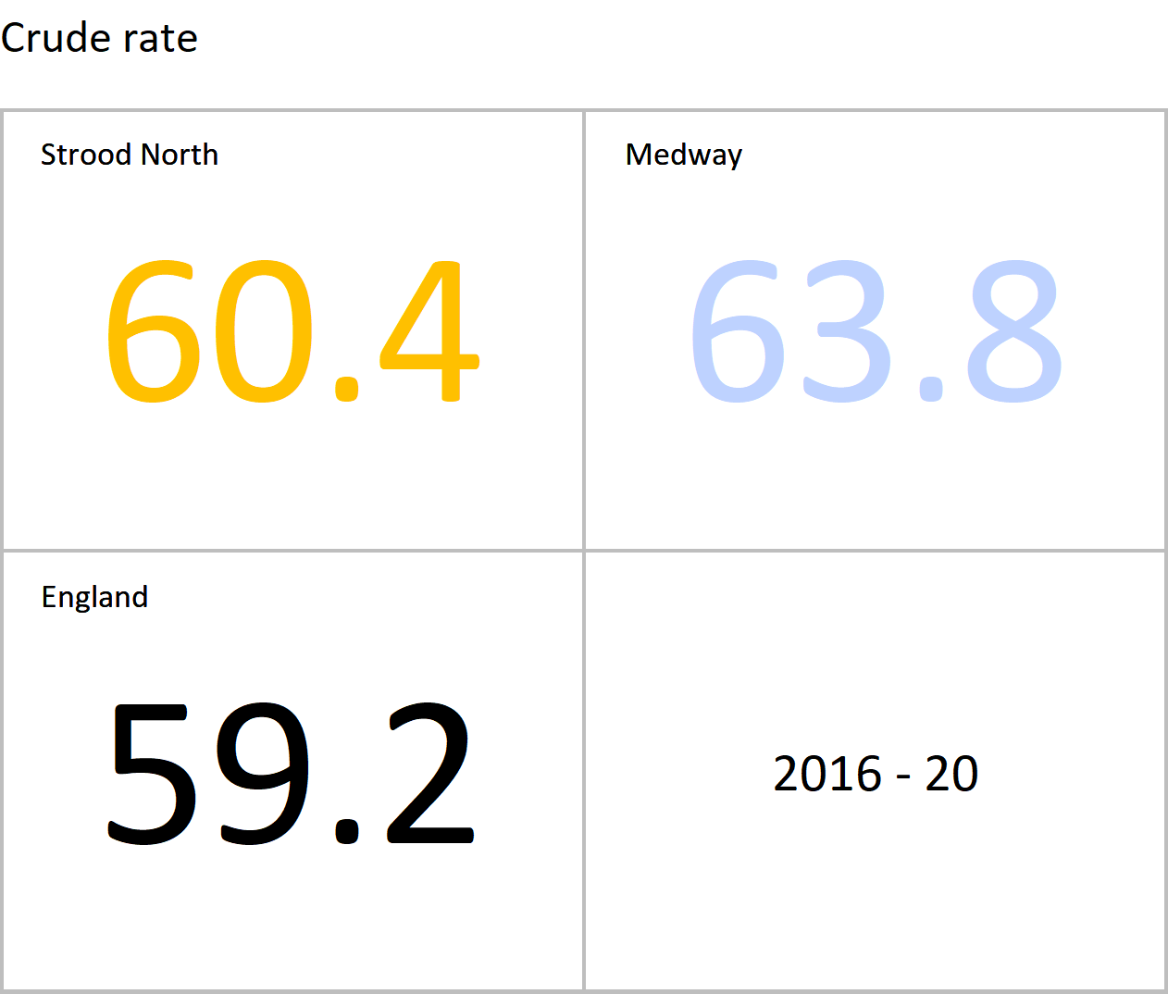
General fertility rate: live births per 1,000 women aged 15-44 years
Version 1.1 © Medway Council, Public Health Intelligence Team, 22/03/2023
The latest value for Strood North is similar to England.
Value type: Crude rate.
Original geography: Ward or MSOA.
Benchmarking method: Byar's CI method (95%).
Source: Office for Health Improvement and Disparities. Fingertips. Indicator ID: 93089.
Copyright: Crown Copyright. Original data source: Office for National Statistics.
No trend data available.

Slide 20
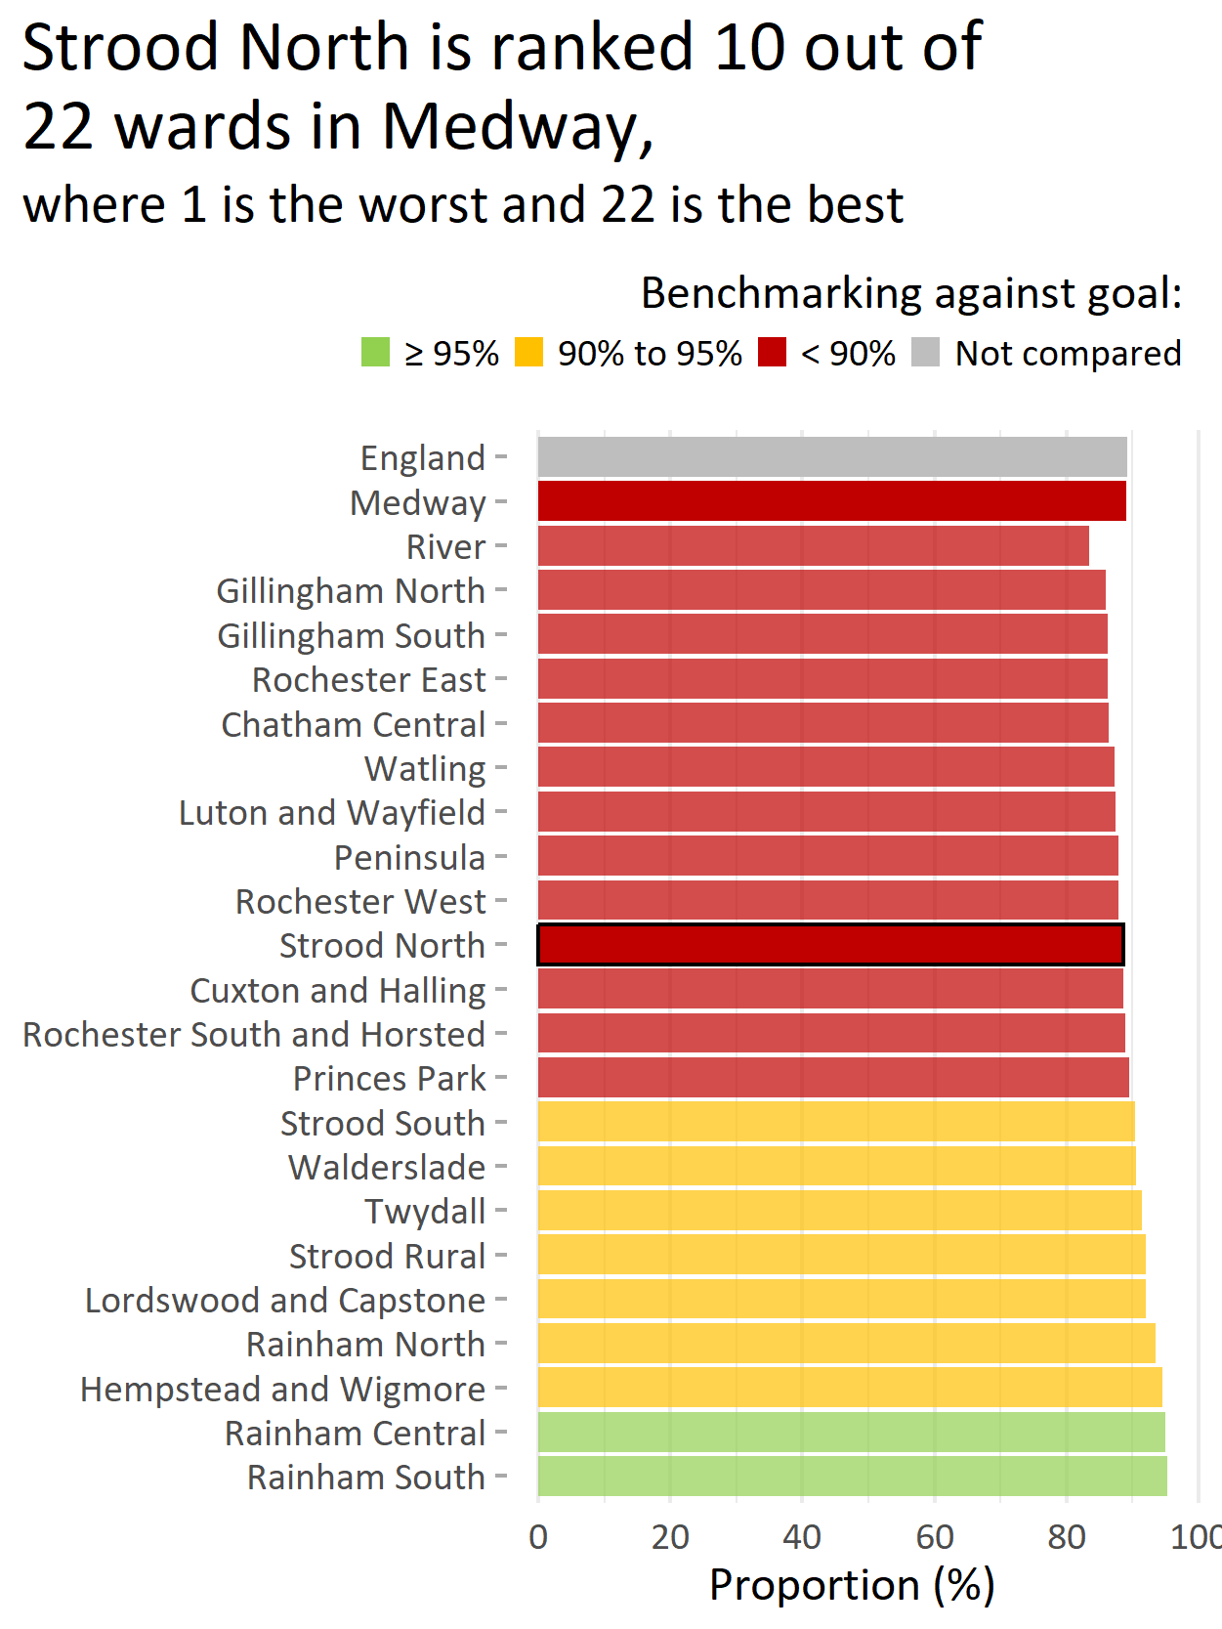
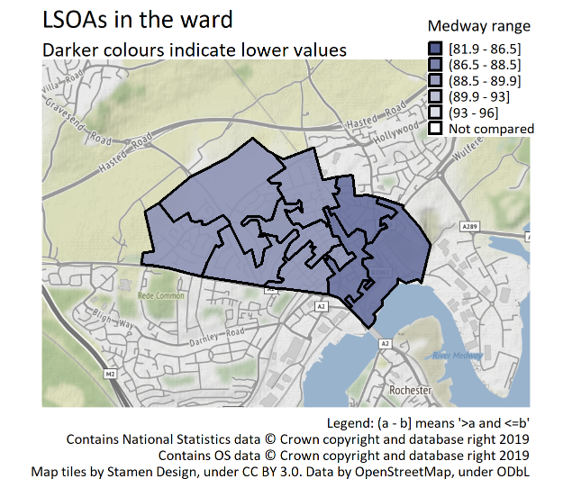
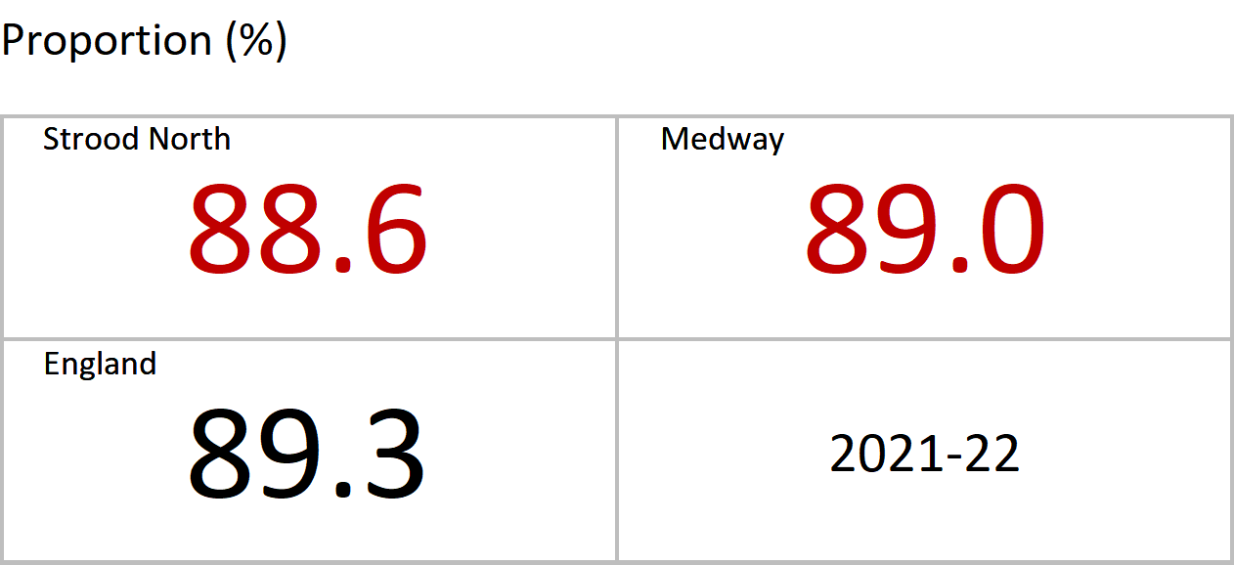
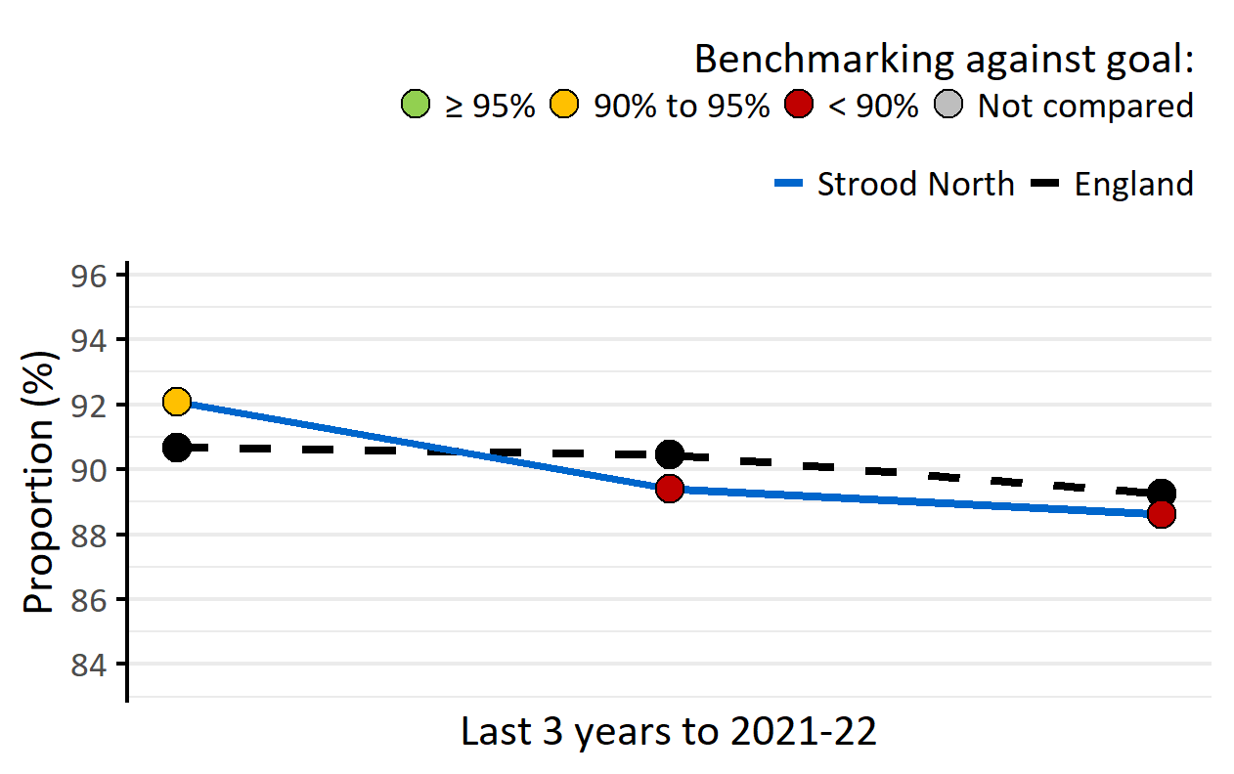
MMR vaccination for one dose (2 years)
Version 1.1 © Medway Council, Public Health Intelligence Team, 22/03/2023
The latest value for Strood North is worse than the goal (95%).
MMR is the combined vaccine that protects against measles, mumps and rubella.
The World Health Organization (WHO) recommends that at least 95% of children should be immunised against vaccine-preventable diseases.
Value type: Proportion (%).
Original geography: Practice.
Benchmarking method: Benchmarking against goal: 95%.
Source: UK Health Security Agency. Cover of Vaccination Evaluated Rapidly (COVER) programme: annual data.

Slide 21
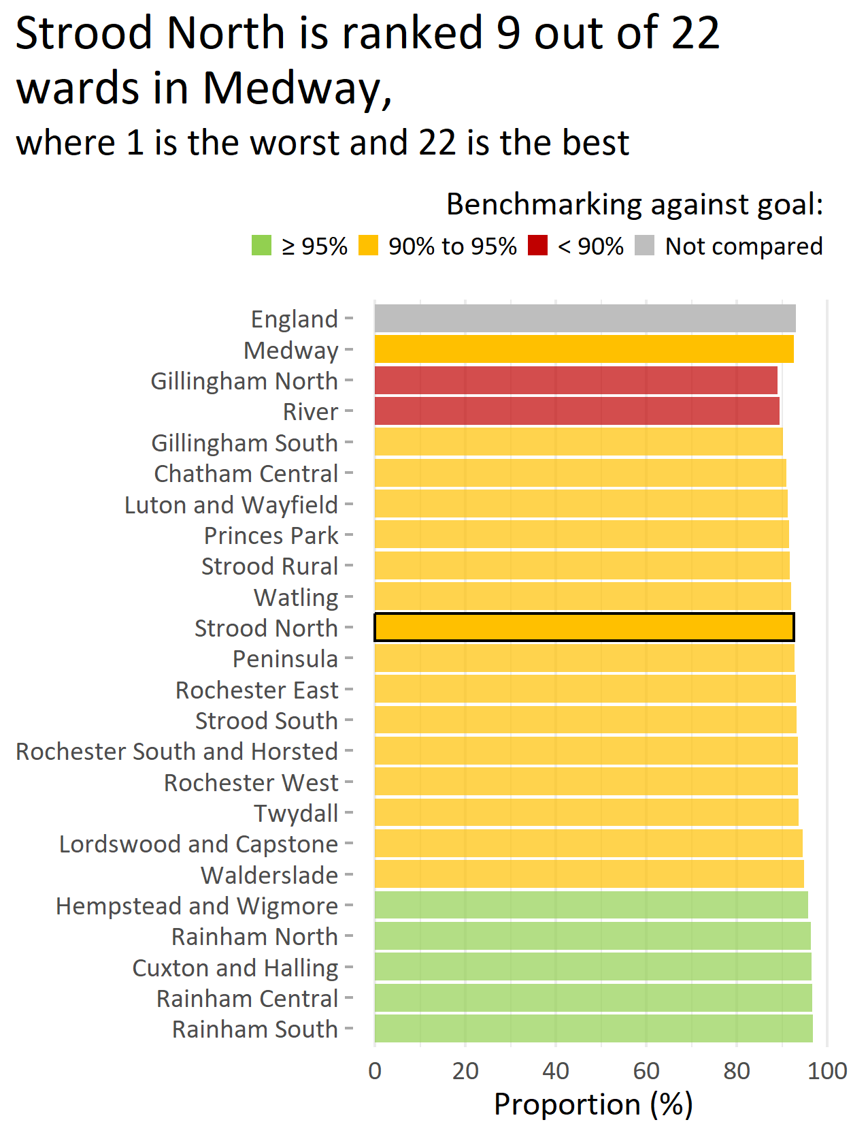
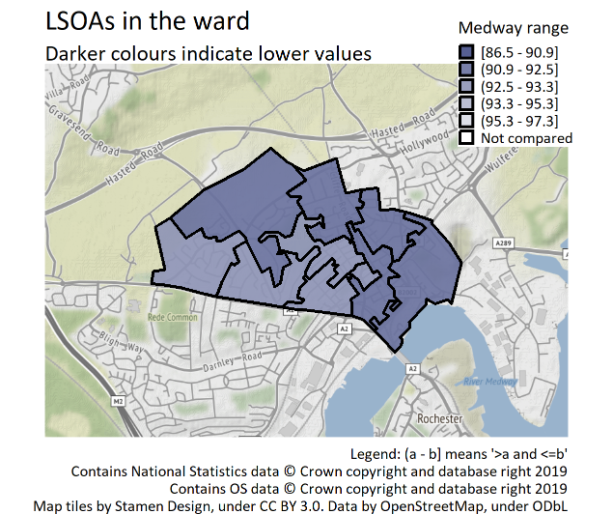
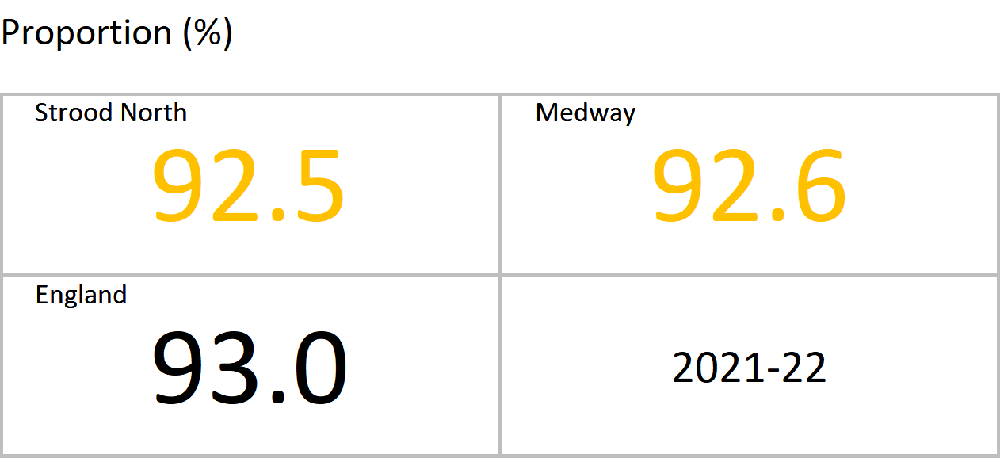
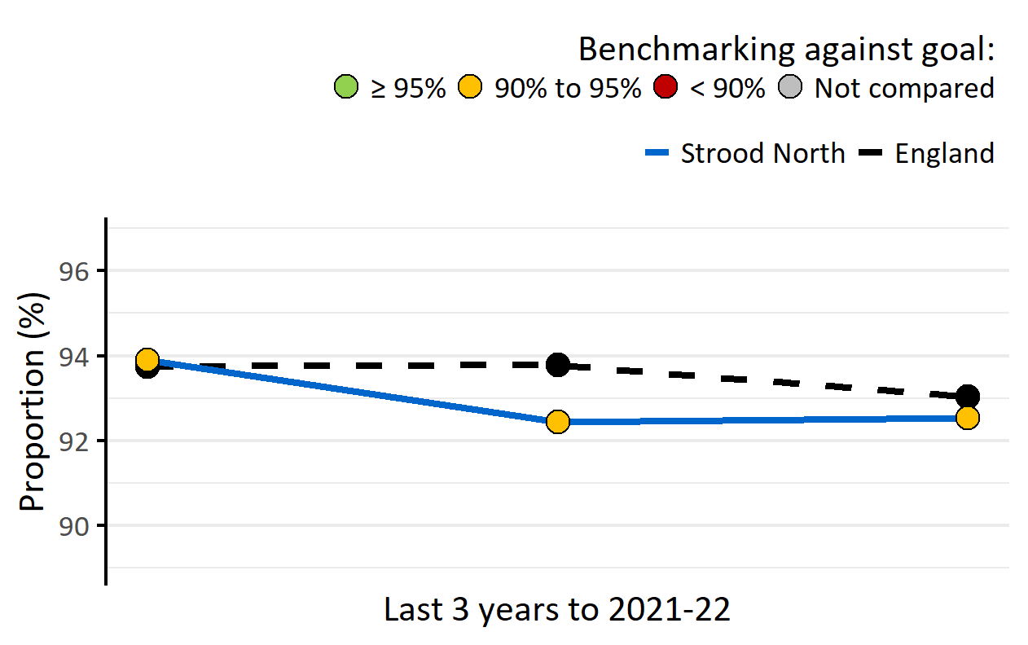
DTaP/IPV/Hib/HepB vaccination (2 years)
Version 1.1 © Medway Council, Public Health Intelligence Team, 22/03/2023
The latest value for Strood North is similar to the goal (95%).
The 6-in-1 vaccine helps protect children against diphtheria, tetanus, pertussis (whooping cough), polio, Haemophilus influenzae type b (cause of childhood meningitis and pneumonia), and hepatitis B. The World Health Organization (WHO) recommends that at least 95% of children should be immunised against vaccine-preventable diseases.
Value type: Proportion (%).
Original geography: Practice.
Benchmarking method: Benchmarking against goal: 95%.
Source: UK Health Security Agency. Cover of Vaccination Evaluated Rapidly (COVER) programme: annual data.

Slide 22
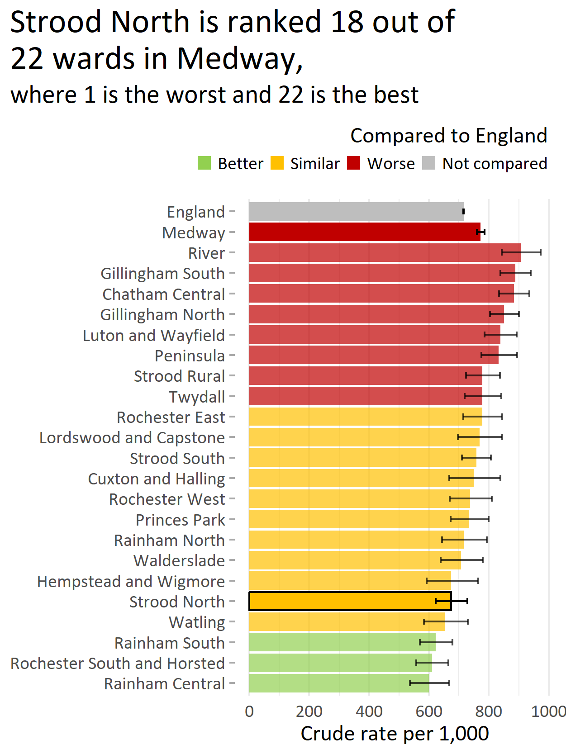
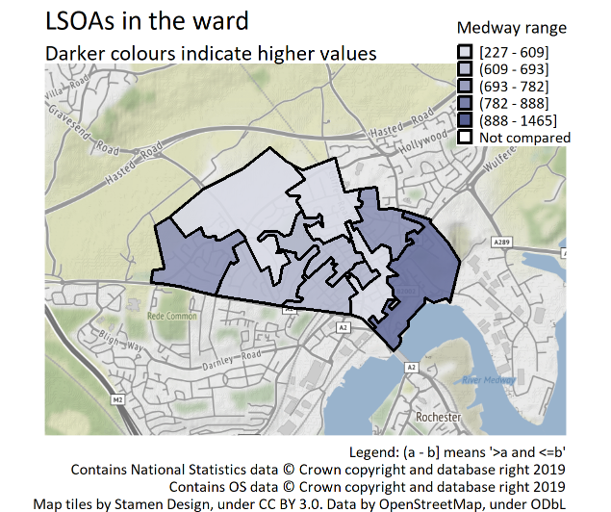
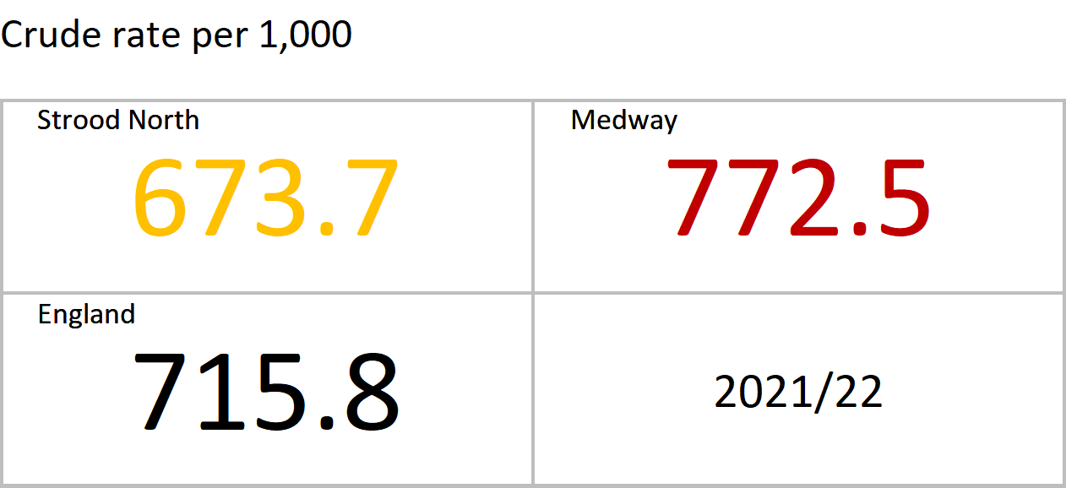
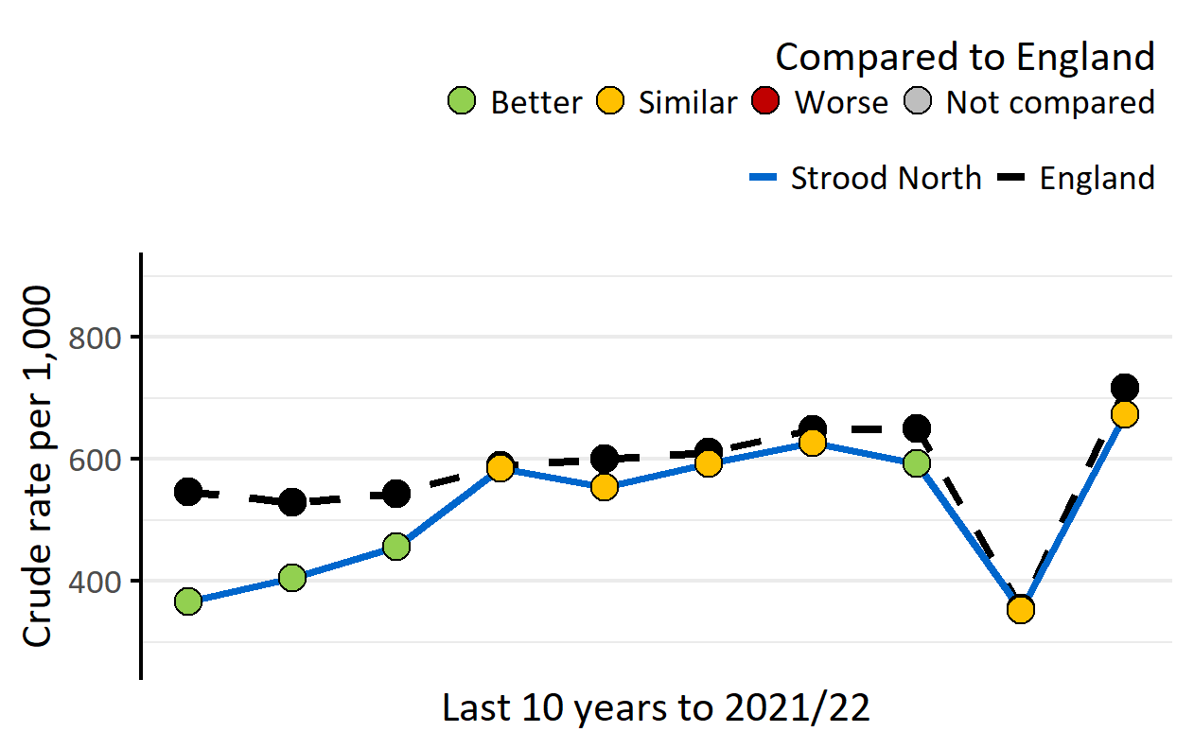
A&E attendances, persons, 0-4 yrs
Version 1.1 © Medway Council, Public Health Intelligence Team, 22/03/2023
The latest value for Strood North is similar to England.
Value type: Crude rate per 1,000.
Original geography: LSOA.
Benchmarking method: Byar's CI method (95%).
Source: NHS Digital, Hospital Episode Statistics (HES).
Notes: COVID-19 had a large impact on hospital activity. A&E attendances decreased significantly across the country in 2020/21.

Slide 23
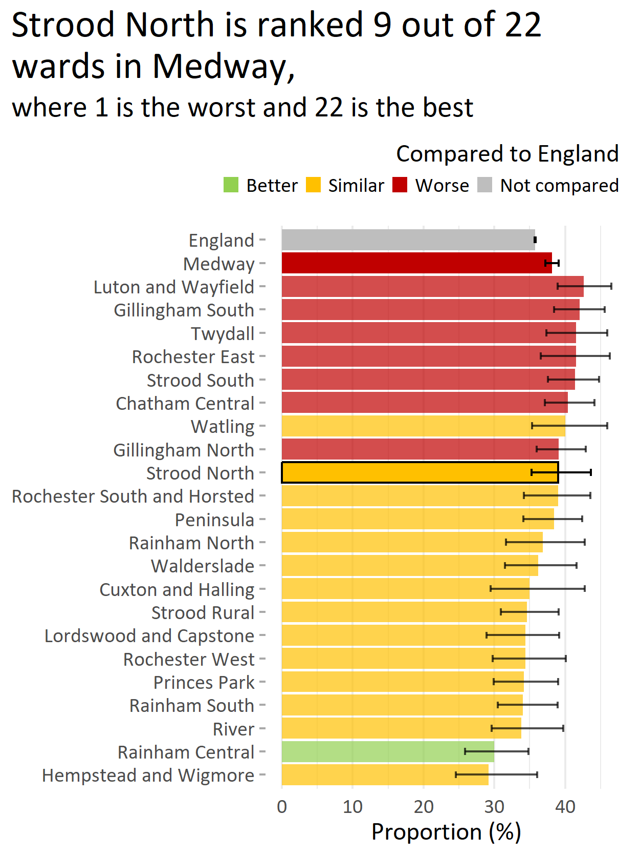
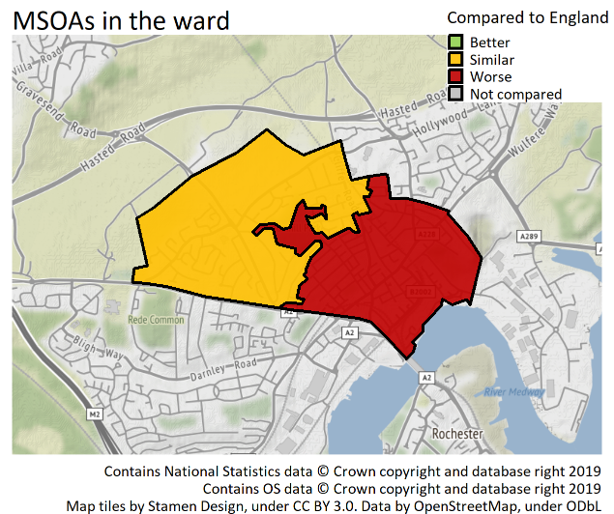
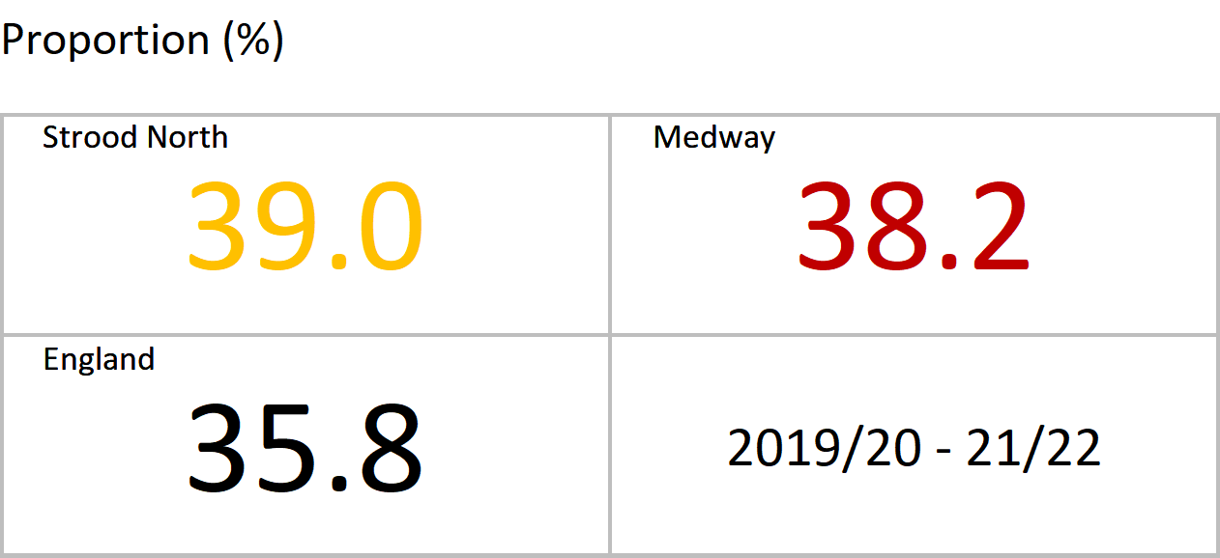
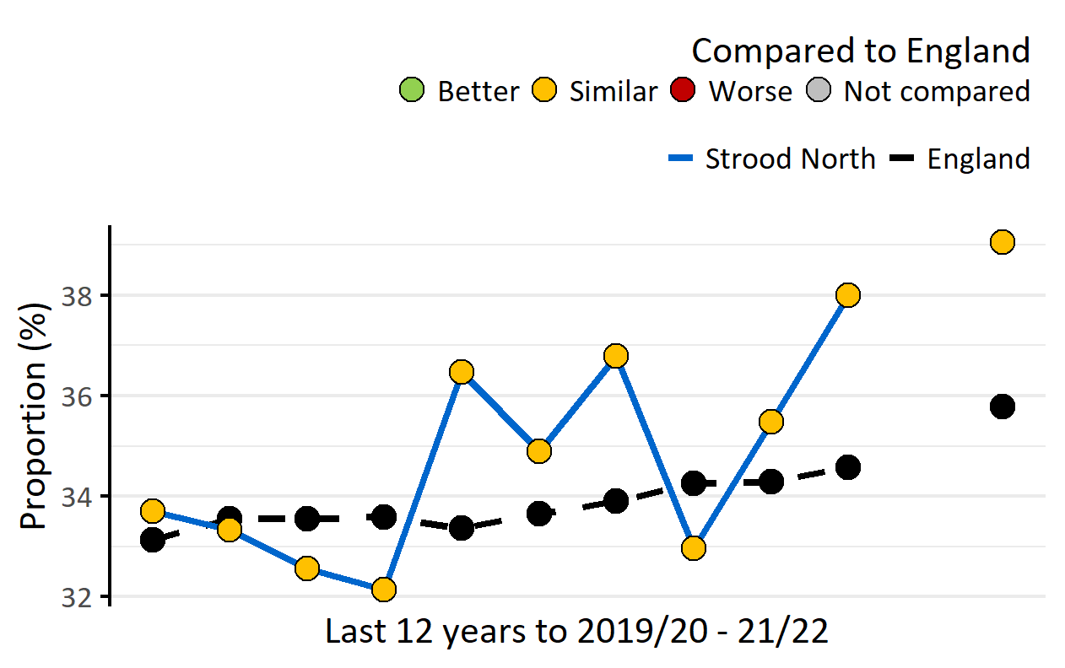
Year 6: Prevalence of excess weight, persons, 10-11 yrs
Version 1.1 © Medway Council, Public Health Intelligence Team, 22/03/2023
The latest value for Strood North is similar to England.
Excess weight: Overweight or obese.
Value type: Proportion (%).
Original geography: Ward or MSOA.
Benchmarking method: Wilson Score CI method (95%).
Source: Office for Health Improvement and Disparities. Fingertips. Indicator ID: 93108. Copyright: NHS Digital..
Notes: Due to the impact of COVID-19 on the NCMP data collection, data was not published for the 2018/19-20/21 time period.

Slide 24
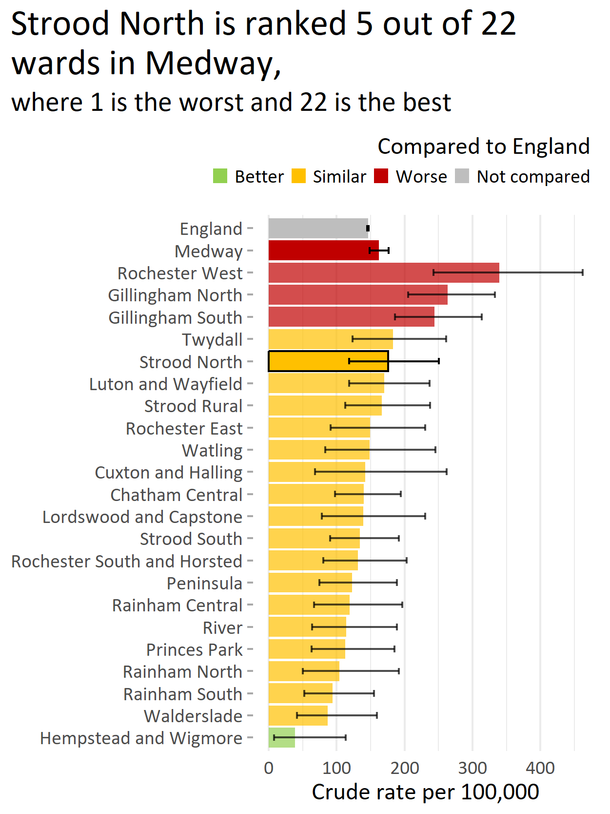
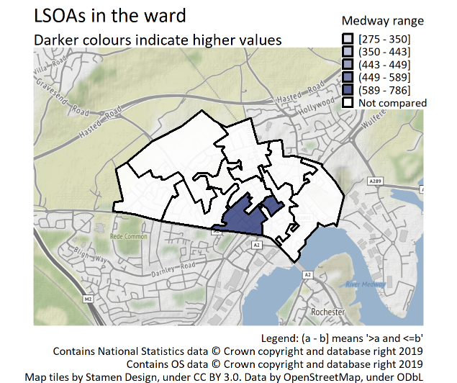
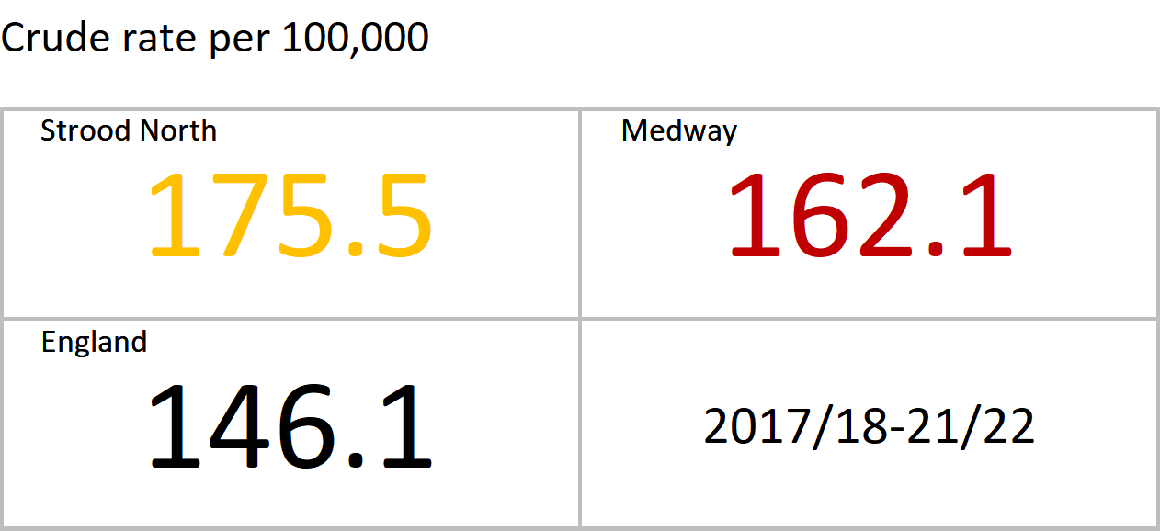
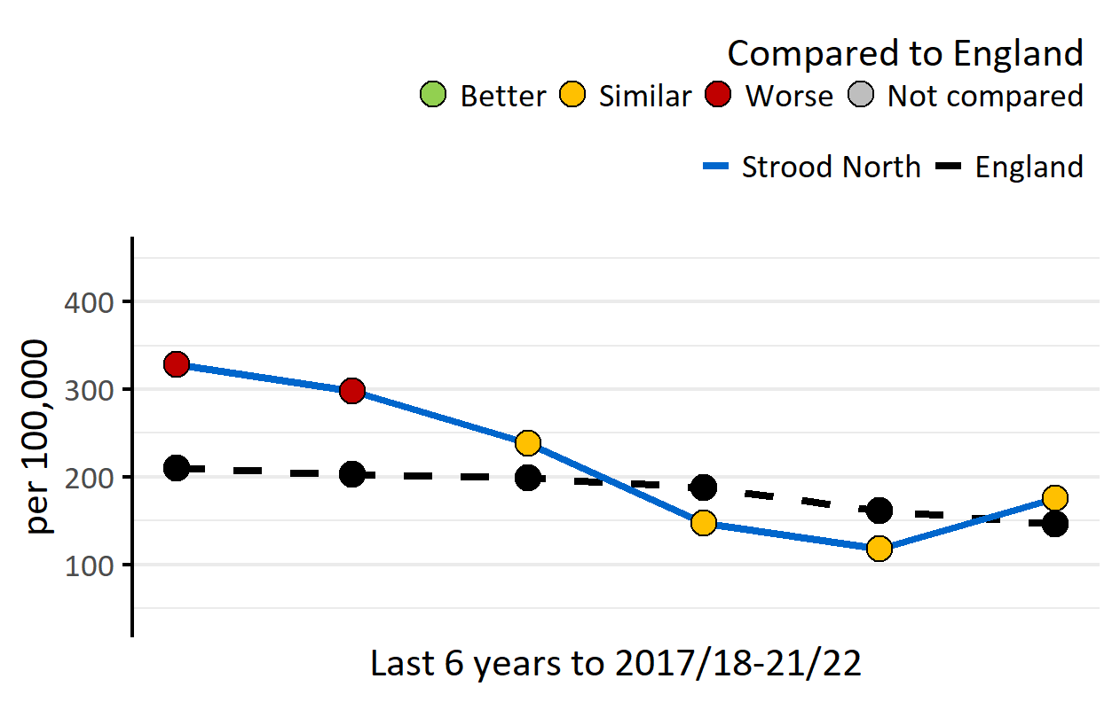
Hospital admissions for asthma, persons, 0-18 yrs
Version 1.1 © Medway Council, Public Health Intelligence Team, 22/03/2023
The latest value for Strood North is similar to England.
Value type: Crude rate per 100,000.
Original geography: LSOA.
Benchmarking method: Byar's CI method (95%).
Source: NHS Digital, Hospital Episode Statistics (HES).

Slide 25
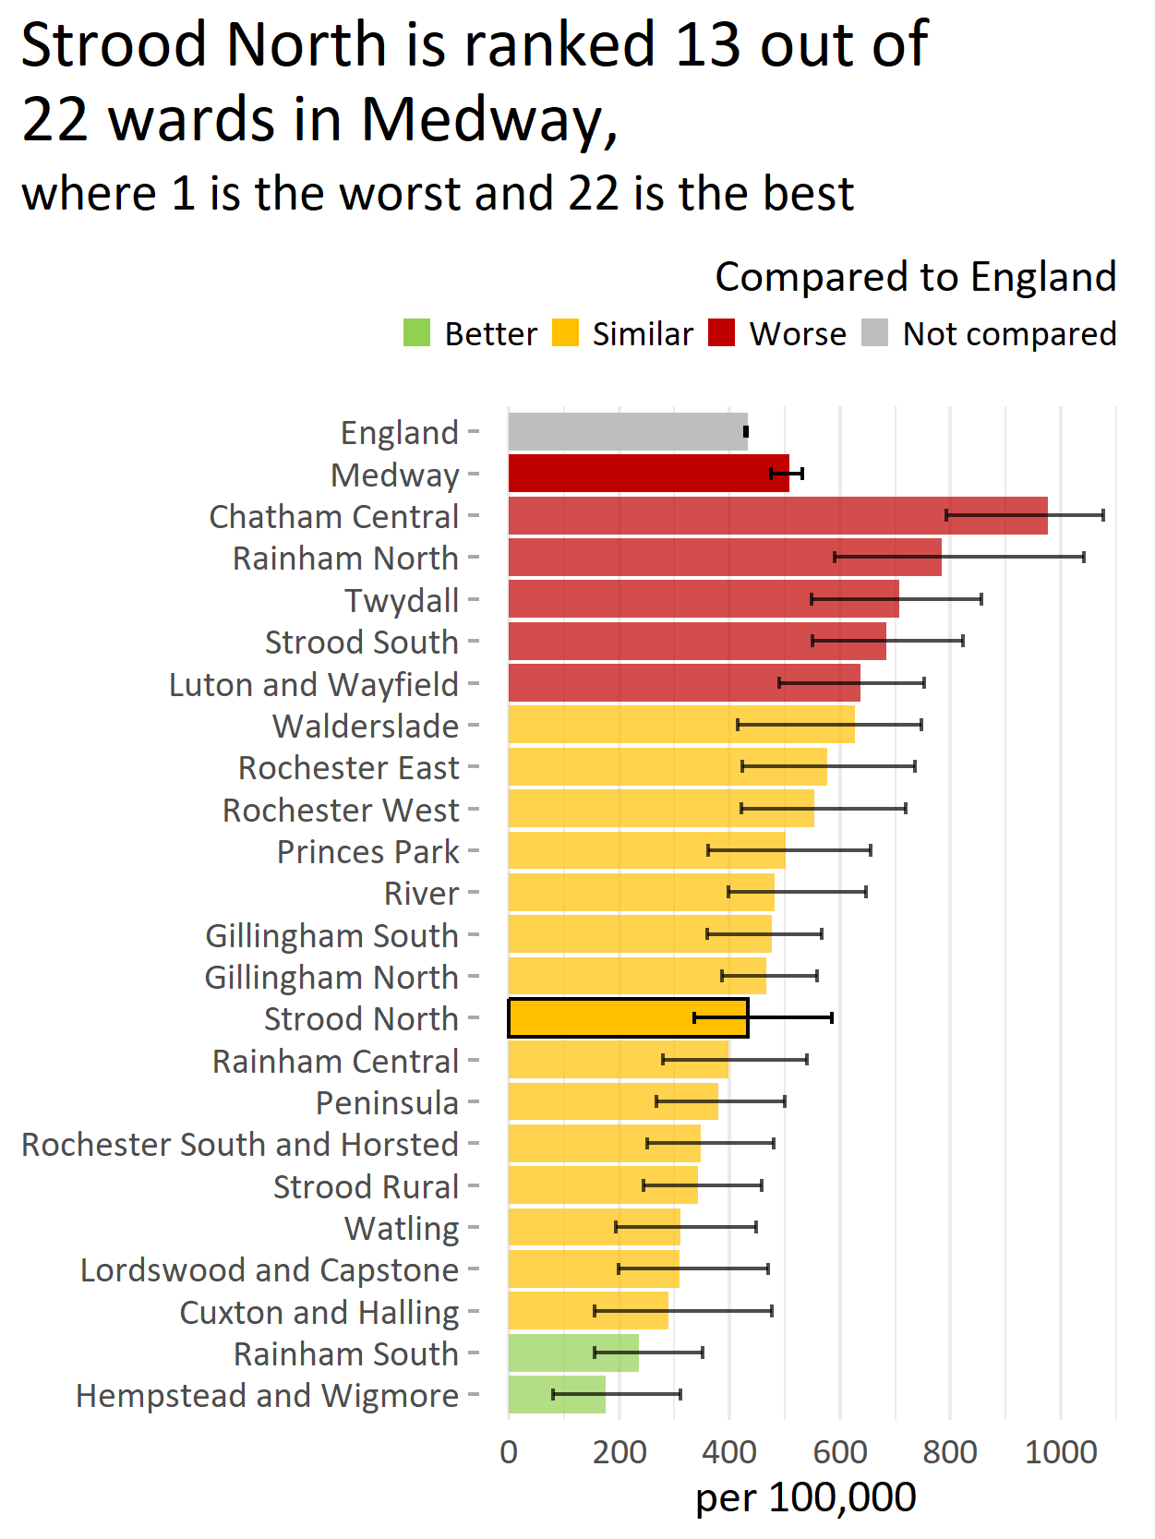
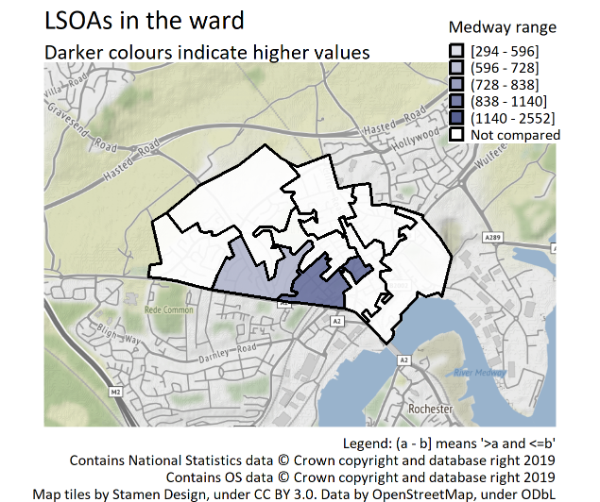
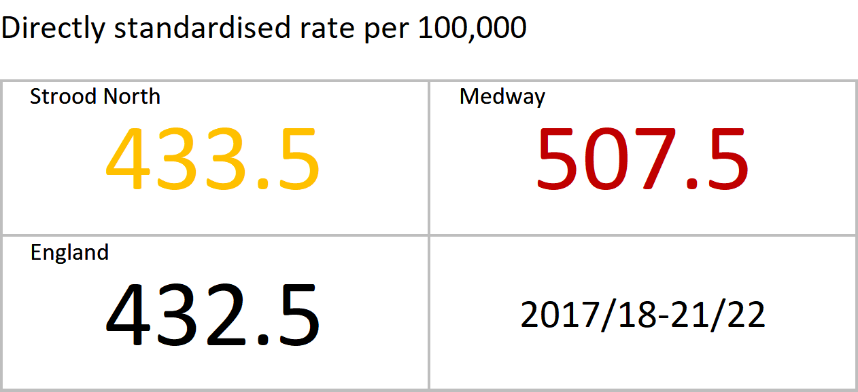
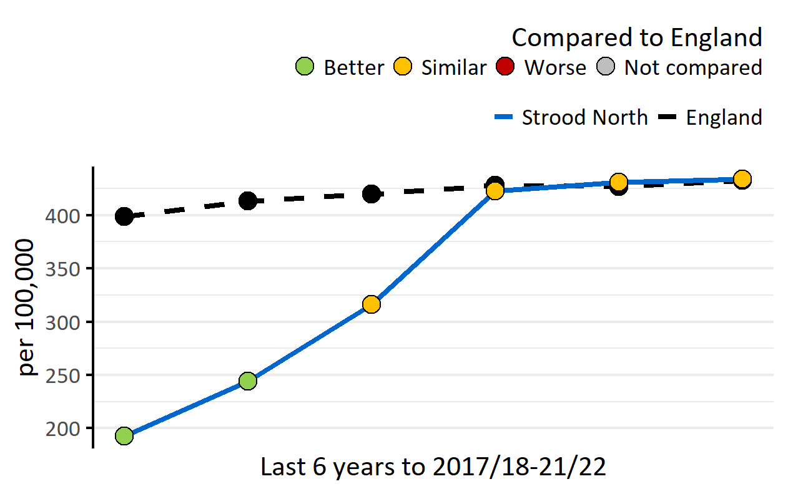
Hospital admissions as a result of self-harm, persons, 10-24 yrs
Version 1.1 © Medway Council, Public Health Intelligence Team, 22/03/2023
The latest value for Strood North is similar to England.
Value type: Directly standardised rate per 100,000.
Original geography: LSOA.
Benchmarking method: Dobson & Byar’s CI method (95%).
Source: NHS Digital, Hospital Episode Statistics (HES).

Slide 26
Improving health and wellbeing

Slide 27
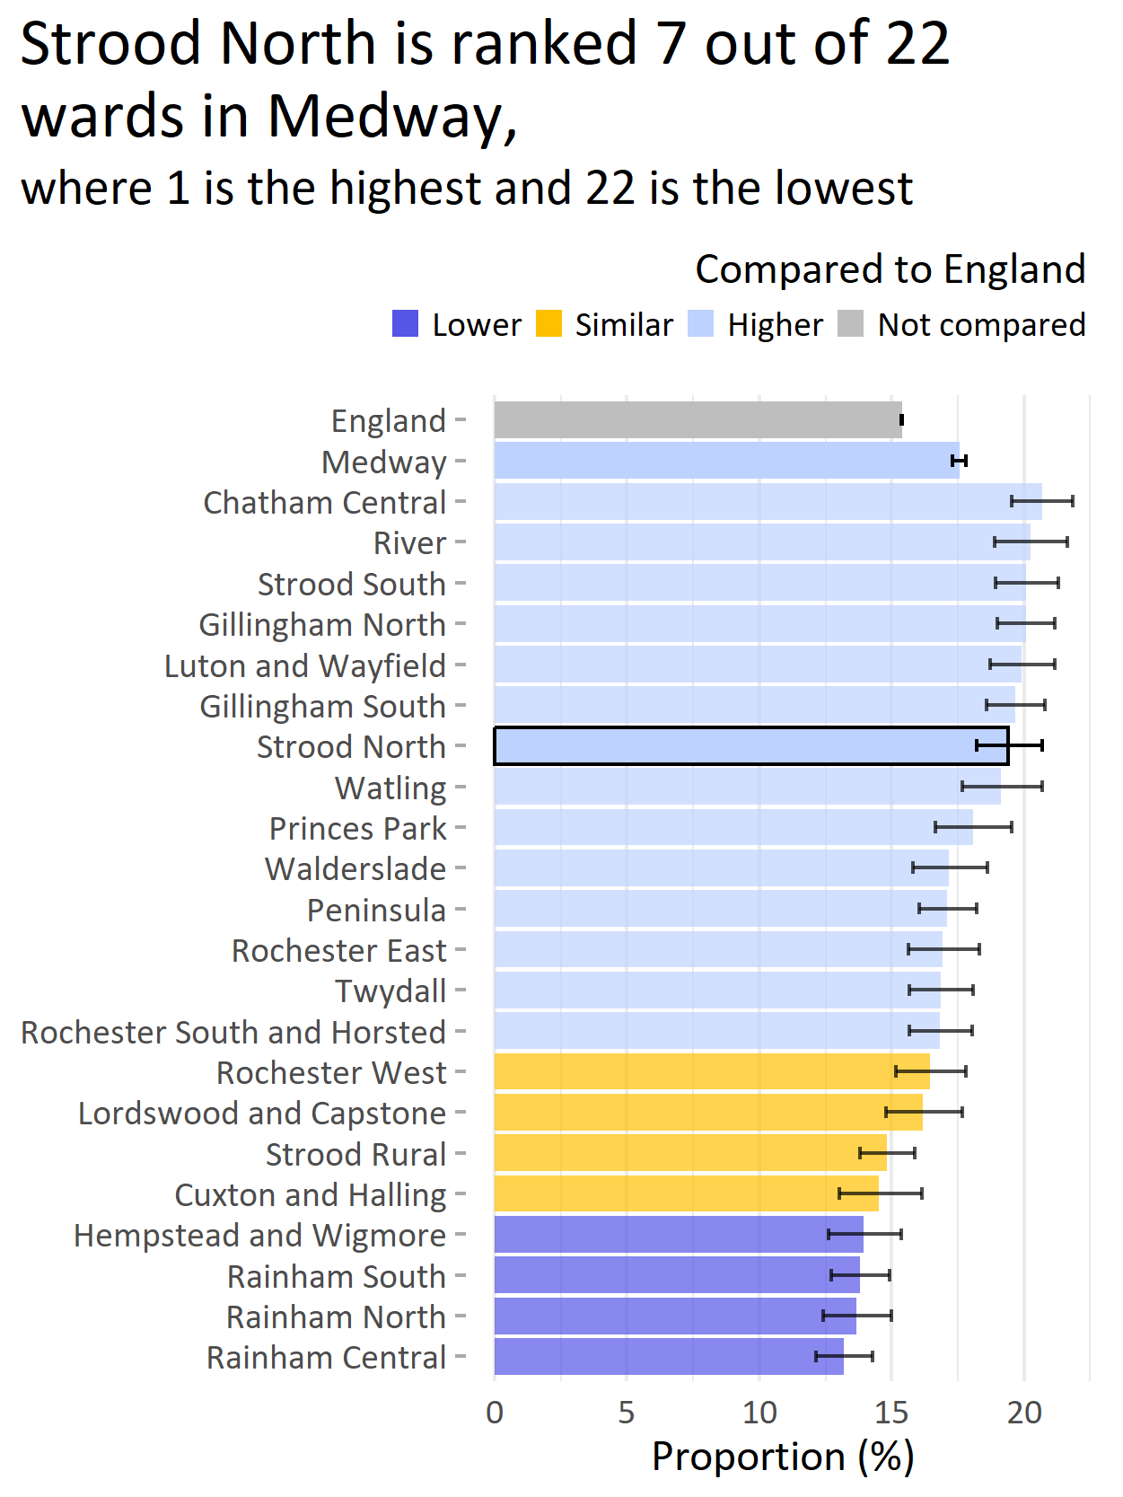
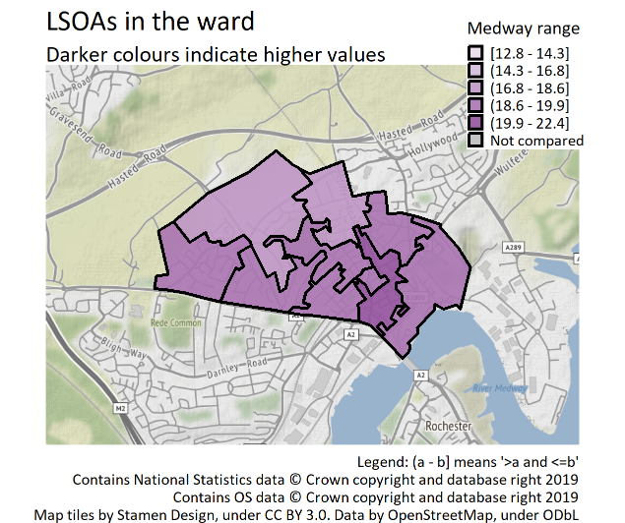
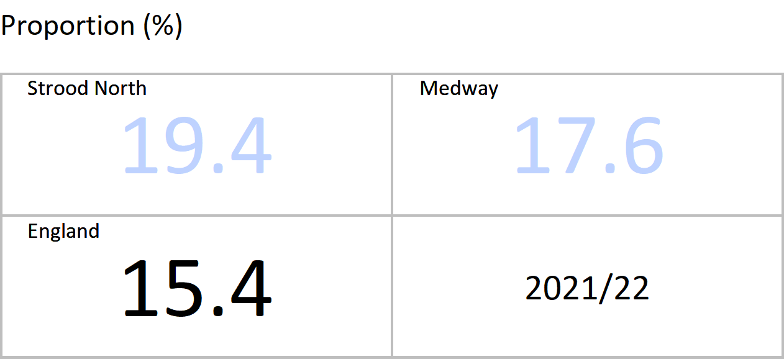
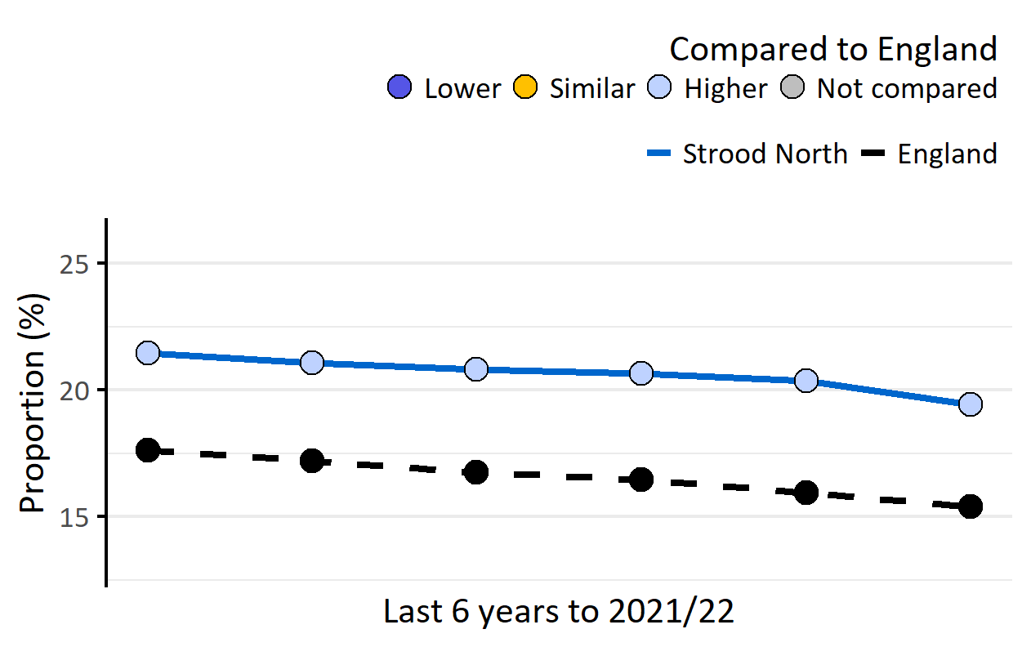
Smoking: Recorded prevalence, persons, 15+ yrs
Version 1.1 © Medway Council, Public Health Intelligence Team, 22/03/2023
The latest value for Strood North is higher than England.
Value type: Proportion of registered GP patients.
Original geography: Practice.
Benchmarking method: Byar's CI method (99.8%).
Source: NHS Digital, Quality and Outcomes Framework (QOF).
Caveats: This indicator measures recorded prevalence, not actual prevalence. QOF recorded smoking prevalence is thought to underestimate actual smoking prevalence. QOF data may be inaccurate for 2020/21 due to the impact of COVID-19.

Slide 28
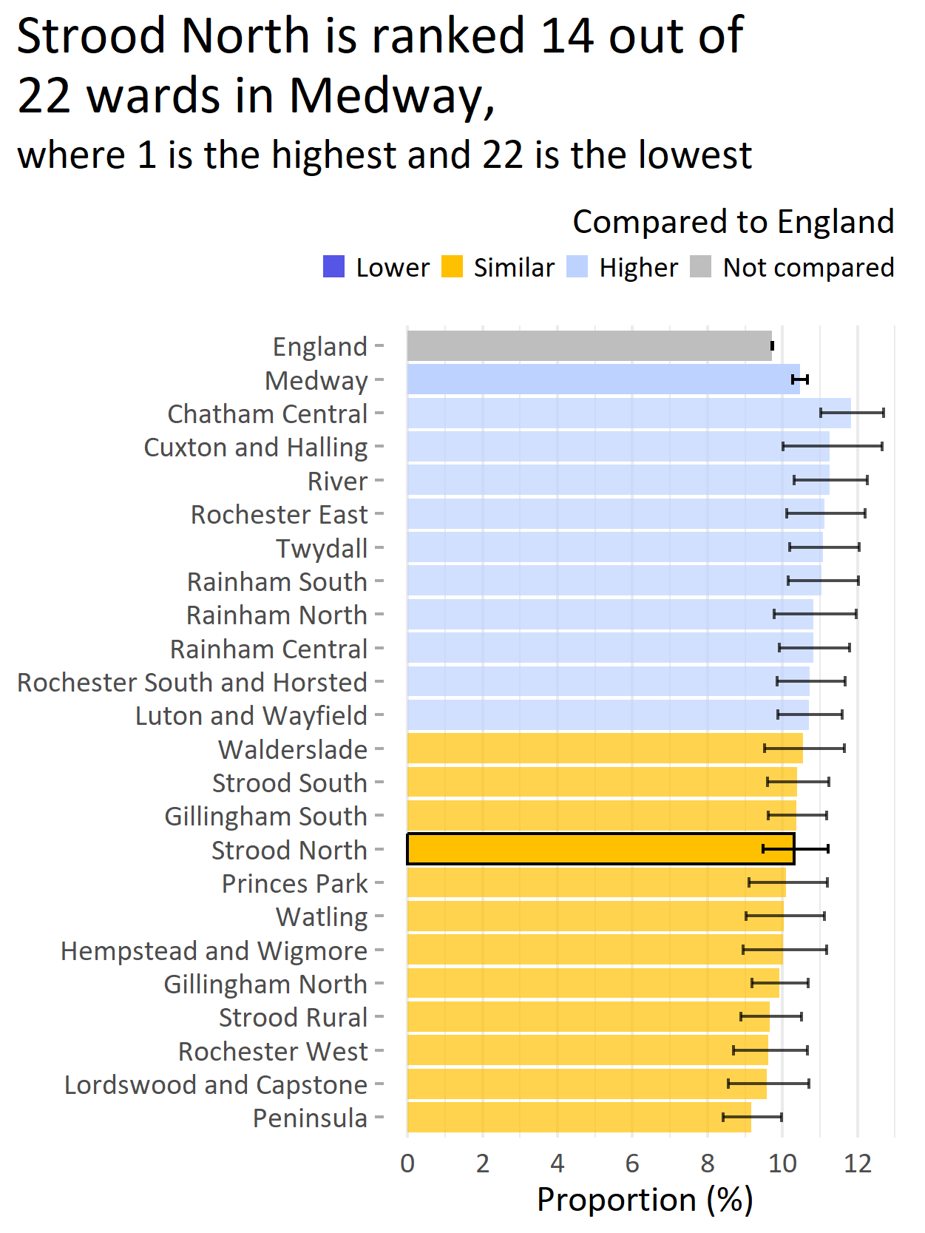
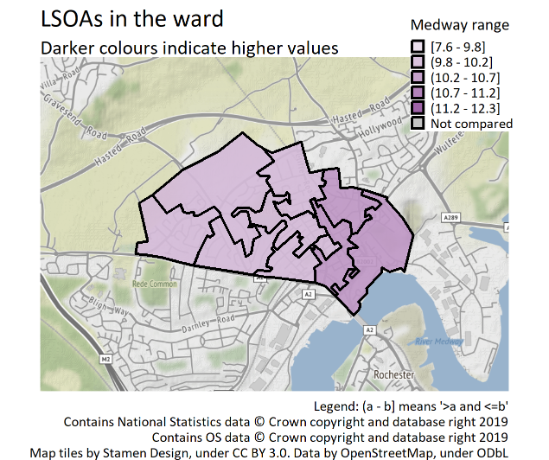
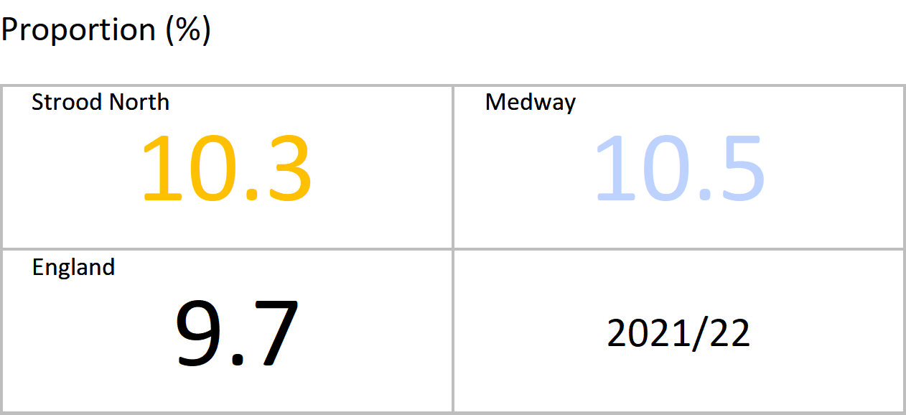
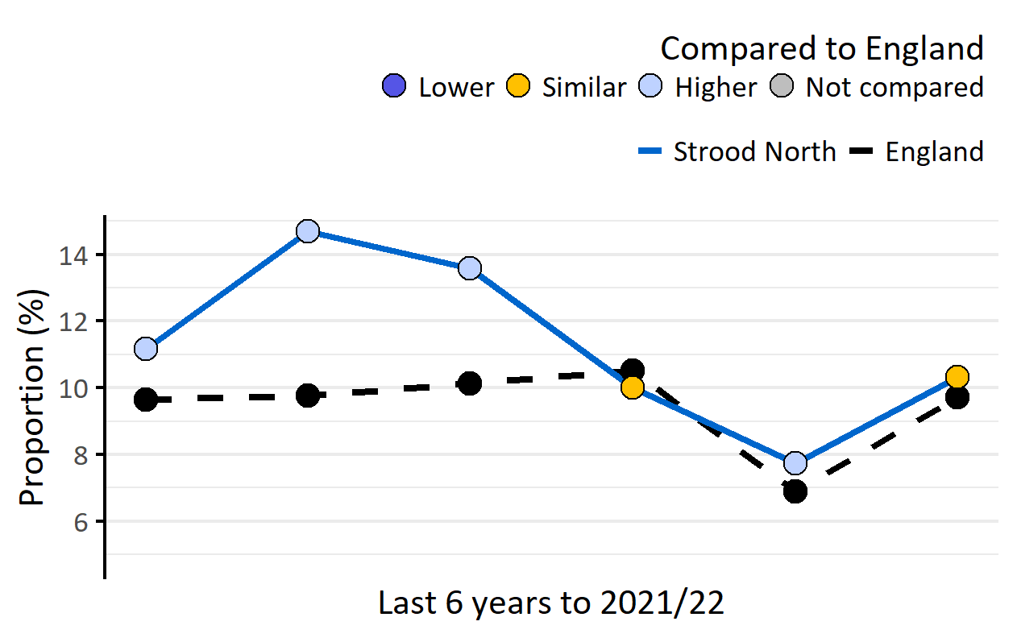
Obesity: Recorded prevalence, persons, 18+ yrs
Version 1.1 © Medway Council, Public Health Intelligence Team, 22/03/2023
The latest value for Strood North is similar to England.
Value type: Proportion of registered GP patients.
Original geography: Practice.
Benchmarking method: Wilson Score CI method (99.8%).
Source: NHS Digital, Quality and Outcomes Framework (QOF).
Caveats: This indicator measures recorded prevalence, not actual prevalence. QOF recorded obesity prevalence is thought to underestimate actual obesity prevalence. Changes in QOF during the COVID-19 pandemic mean that the 2020/21 data may be inaccurate and misleading.

Slide 29
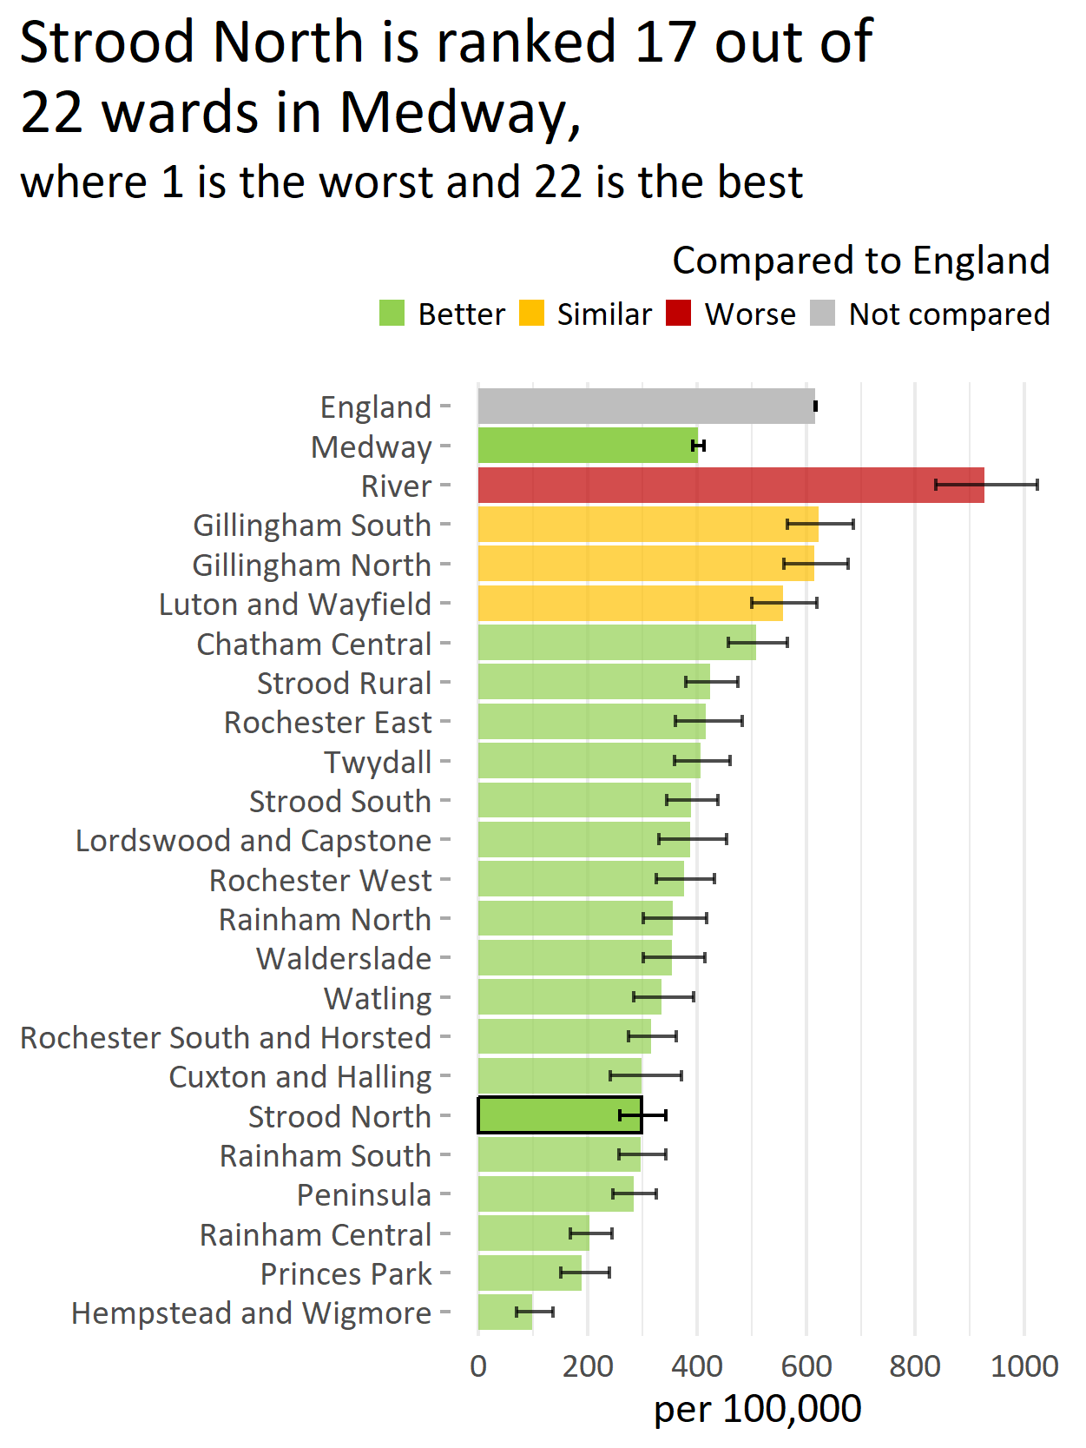
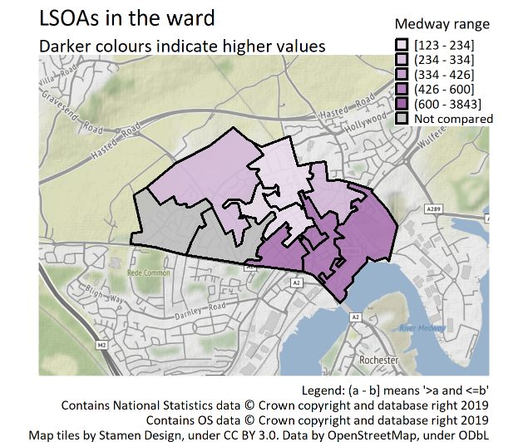
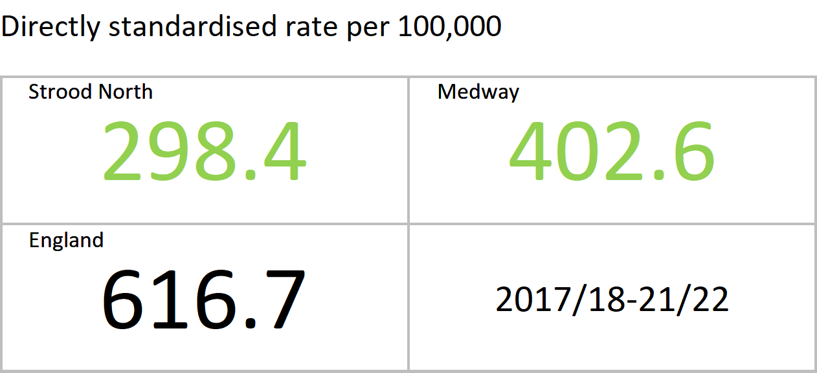

Admission episodes for alcohol-specific conditions, persons, all ages
Version 1.1 © Medway Council, Public Health Intelligence Team, 22/03/2023
The latest value for Strood North is better than England.
Value type: Directly standardised rate per 100,000.
Original geography: LSOA.
Benchmarking method: Dobson & Byar’s CI method (95%).
Source: NHS Digital, Hospital Episode Statistics (HES).

Slide 30




Depression: Recorded prevalence, persons, 18+ yrs
Version 1.1 © Medway Council, Public Health Intelligence Team, 22/03/2023
The latest value for Strood North is higher than England.
Value type: Proportion of registered GP patients.
Original geography: Practice.
Benchmarking method: Wilson Score CI method (99.8%).
Source: NHS Digital, Quality and Outcomes Framework (QOF).
Caveats: This indicator measures recorded prevalence, not actual prevalence. QOF data may be inaccurate for 2020/21 due to the impact of COVID-19.

Slide 31




Severe mental illness: Recorded prevalence, persons, all ages
Version 1.1 © Medway Council, Public Health Intelligence Team, 22/03/2023
The latest value for Strood North is similar to England.
Severe mental illness: Patients with schizophrenia, bipolar affective disorder and other psychoses.
Value type: Proportion of registered GP patients.
Original geography: Practice.
Benchmarking method: Wilson Score CI method (99.8%).
Source: NHS Digital, Quality and Outcomes Framework (QOF).
Caveats: This indicator measures recorded prevalence, not actual prevalence. QOF data may be inaccurate for 2020/21 due to the impact of COVID-19.

Slide 32
Increasing years of healthy life

Slide 33
Cancer
Version 1.1 © Medway Council, Public Health Intelligence Team, 22/03/2023

Slide 34




Cervical screening, persons, 25-49 yrs
Version 1.1 © Medway Council, Public Health Intelligence Team, 22/03/2023
The latest value for Strood North is similar to England.
The number of persons aged 25 to 49 years attending cervical screening in last 42 months (3.5 year coverage).
Value type: Proportion (%).
Original geography: Practice.
Benchmarking method: Wilson Score CI method (99.8%).
Source: Office for Health Improvement and Disparities. Fingertips. Indicator ID: 93725.

Slide 35




Breast cancer screening, persons, 50-70 yrs
Version 1.1 © Medway Council, Public Health Intelligence Team, 22/03/2023
The latest value for Strood North is lower than England.
The number of persons aged 50 to 70 years screened for breast cancer in last 36 months (3 year coverage).
Value type: Proportion (%).
Original geography: Practice.
Benchmarking method: Wilson Score CI method (99.8%).
Source: Office for Health Improvement and Disparities. Fingertips. Indicator ID: 91339.

Slide 36




Bowel cancer screening, persons, 60-74 yrs
Version 1.1 © Medway Council, Public Health Intelligence Team, 22/03/2023
The latest value for Strood North is lower than England.
The number of persons aged 25 to 49 years screened for bowel cancer in last 30 months (2.5 year coverage).
Value type: Proportion (%).
Original geography: Practice.
Benchmarking method: Wilson Score CI method (99.8%).
Source: Office for Health Improvement and Disparities. Fingertips. Indicator ID: 92600.

Slide 37




Cancer: Recorded prevalence, persons, all ages
Version 1.1 © Medway Council, Public Health Intelligence Team, 22/03/2023
The latest value for Strood North is lower than England.
Value type: Proportion of registered GP patients.
Original geography: Practice.
Benchmarking method: Wilson Score CI method (99.8%).
Source: NHS Digital, Quality and Outcomes Framework (QOF).
Caveats: This indicator measures recorded prevalence, not actual prevalence. This is a crude rate (non age-adjusted). Rates may be higher in areas with older populations for age-related conditions. QOF data may be inaccurate for 2020/21 due to the impact of COVID-19.

Slide 38



Deaths from all cancer, persons, all ages
Version 1.1 © Medway Council, Public Health Intelligence Team, 22/03/2023
The latest value for Strood North is similar to England.
Value type: Standardised mortality ratio.
Original geography: Ward or MSOA.
Benchmarking method: Byar's CI method (95%).
Source: Office for Health Improvement and Disparities. Fingertips. Indicator ID: 93253.
Copyright: Crown Copyright. Original data source: Office for National Statistics.
No trend data available.

Slide 39
Cardiovascular disease
Version 1.1 © Medway Council, Public Health Intelligence Team, 22/03/2023

Slide 40




Hypertension: Recorded prevalence, persons, all ages
Version 1.1 © Medway Council, Public Health Intelligence Team, 22/03/2023
The latest value for Strood North is similar to England.
Value type: Proportion of registered GP patients.
Original geography: Practice.
Benchmarking method: Wilson Score CI method (99.8%).
Source: NHS Digital, Quality and Outcomes Framework (QOF).
Caveats: This indicator measures recorded prevalence, not actual prevalence. This is a crude rate (non age-adjusted). Rates may be higher in areas with older populations for age-related conditions. QOF data may be inaccurate for 2020/21 due to the impact of COVID-19.

Slide 41




Coronary heart disease: Recorded prevalence, persons, all ages
Version 1.1 © Medway Council, Public Health Intelligence Team, 22/03/2023
The latest value for Strood North is lower than England.
Value type: Proportion of registered GP patients.
Original geography: Practice.
Benchmarking method: Wilson Score CI method (99.8%).
Source: NHS Digital, Quality and Outcomes Framework (QOF).
Caveats: This indicator measures recorded prevalence, not actual prevalence. This is a crude rate (non age-adjusted). Rates may be higher in areas with older populations for age-related conditions. QOF data may be inaccurate for 2020/21 due to the impact of COVID-19.

Slide 42


Deaths from coronary heart disease, persons, all ages
Version 1.1 © Medway Council, Public Health Intelligence Team, 22/03/2023
The latest value for Strood North is similar to England.
Value type: Standardised mortality ratio.
Original geography: Ward or MSOA.
Benchmarking method: Byar's CI method (95%).
Source: Office for Health Improvement and Disparities. Fingertips. Indicator ID: 93257.
Copyright: Crown Copyright. Original data source: Office for National Statistics.
No trend data available.

Slide 43




Stroke: Recorded prevalence, persons, all ages
Version 1.1 © Medway Council, Public Health Intelligence Team, 22/03/2023
The latest value for Strood North is lower than England.
Value type: Proportion of registered GP patients.
Original geography: Practice.
Benchmarking method: Wilson Score CI method (99.8%).
Source: NHS Digital, Quality and Outcomes Framework (QOF).
Caveats: This indicator measures recorded prevalence, not actual prevalence. This is a crude rate (non age-adjusted). Rates may be higher in areas with older populations for age-related conditions. QOF data may be inaccurate for 2020/21 due to the impact of COVID-19.

Slide 44



Deaths from stroke, persons, all ages
Version 1.1 © Medway Council, Public Health Intelligence Team, 22/03/2023
The latest value for Strood North is better than England.
Value type: Standardised mortality ratio.
Original geography: Ward or MSOA.
Benchmarking method: Byar's CI method (95%).
Source: Office for Health Improvement and Disparities. Fingertips. Indicator ID: 93259.
Copyright: Crown Copyright. Original data source: Office for National Statistics.
No trend data available.

Slide 45




Heart failure: Recorded prevalence, persons, all ages
Version 1.1 © Medway Council, Public Health Intelligence Team, 22/03/2023
The latest value for Strood North is similar to England.
Value type: Proportion of registered GP patients.
Original geography: Practice.
Benchmarking method: Wilson Score CI method (99.8%).
Source: NHS Digital, Quality and Outcomes Framework (QOF).
Caveats: This indicator measures recorded prevalence, not actual prevalence. This is a crude rate (non age-adjusted). Rates may be higher in areas with older populations for age-related conditions. QOF data may be inaccurate for 2020/21 due to the impact of COVID-19.

Slide 46




Atrial fibrillation: Recorded prevalence, persons, all ages
Version 1.1 © Medway Council, Public Health Intelligence Team, 22/03/2023
The latest value for Strood North is lower than England.
Value type: Proportion of registered GP patients.
Original geography: Practice.
Benchmarking method: Wilson Score CI method (99.8%).
Source: NHS Digital, Quality and Outcomes Framework (QOF).
Caveats: This indicator measures recorded prevalence, not actual prevalence. This is a crude rate (non age-adjusted). Rates may be higher in areas with older populations for age-related conditions. QOF data may be inaccurate for 2020/21 due to the impact of COVID-19.

Slide 47


Deaths from circulatory disease, persons, all ages
Version 1.1 © Medway Council, Public Health Intelligence Team, 22/03/2023
The latest value for Strood North is similar to England.
Value type: Standardised mortality ratio.
Original geography: Ward or MSOA.
Benchmarking method: Byar's CI method (95%).
Source: Office for Health Improvement and Disparities. Fingertips. Indicator ID: 93255.
Copyright: Crown Copyright. Original data source: Office for National Statistics.
No trend data available.

Slide 48
Diabetes
Version 1.1 © Medway Council, Public Health Intelligence Team, 22/03/2023

Slide 49




Diabetes: Recorded prevalence, persons, 17+ yrs
Version 1.1 © Medway Council, Public Health Intelligence Team, 22/03/2023
The latest value for Strood North is similar to England.
Value type: Proportion of registered GP patients.
Original geography: Practice.
Benchmarking method: Wilson Score CI method (99.8%).
Source: NHS Digital, Quality and Outcomes Framework (QOF).
Caveats: This indicator measures recorded prevalence, not actual prevalence. This is a crude rate (non age-adjusted). Rates may be higher in areas with older populations for age-related conditions. QOF data may be inaccurate for 2020/21 due to the impact of COVID-19.

Slide 50
Kidney disease
Version 1.1 © Medway Council, Public Health Intelligence Team, 22/03/2023

Slide 51




Chronic kidney disease: Recorded prevalence, persons, 18+ yrs
Version 1.1 © Medway Council, Public Health Intelligence Team, 22/03/2023
The latest value for Strood North is similar to England.
Value type: Proportion of registered GP patients.
Original geography: Practice.
Benchmarking method: Wilson Score CI method (99.8%).
Source: NHS Digital, Quality and Outcomes Framework (QOF).
Caveats: This indicator measures recorded prevalence, not actual prevalence. This is a crude rate (non age-adjusted). Rates may be higher in areas with older populations for age-related conditions. QOF data may be inaccurate for 2020/21 due to the impact of COVID-19.

Slide 52
Respiratory disease
Version 1.1 © Medway Council, Public Health Intelligence Team, 22/03/2023

Slide 53




Asthma: Recorded prevalence, persons, 6+ yrs
Version 1.1 © Medway Council, Public Health Intelligence Team, 22/03/2023
The latest value for Strood North is lower than England.
Value type: Proportion of registered GP patients.
Original geography: Practice.
Benchmarking method: Wilson Score CI method (99.8%).
Source: NHS Digital, Quality and Outcomes Framework (QOF).
Caveats: This indicator measures recorded prevalence, not actual prevalence. QOF data may be inaccurate for 2020/21 due to the impact of COVID-19.

Slide 54




COPD: Recorded prevalence, persons, all ages
Version 1.1 © Medway Council, Public Health Intelligence Team, 22/03/2023
The latest value for Strood North is similar to England.
COPD: Chronic Obstructive Pulmonary Disease
Value type: Proportion of registered GP patients.
Original geography: Practice.
Benchmarking method: Wilson Score CI method (99.8%).
Source: NHS Digital, Quality and Outcomes Framework (QOF).
Caveats: This indicator measures recorded prevalence, not actual prevalence. This is a crude rate (non age-adjusted). Rates may be higher in areas with older populations for age-related conditions. QOF data may be inaccurate for 2020/21 due to the impact of COVID-19.

Slide 55


Deaths from respiratory diseases, persons, all ages
Version 1.1 © Medway Council, Public Health Intelligence Team, 22/03/2023
The latest value for Strood North is similar to England.
Value type: Standardised mortality ratio.
Original geography: Ward or MSOA.
Benchmarking method: Byar's CI method (95%).
Source: Office for Health Improvement and Disparities. Fingertips. Indicator ID: 93260.
Copyright: Crown Copyright. Original data source: Office for National Statistics.
No trend data available.

Slide 56
Other conditions
Version 1.1 © Medway Council, Public Health Intelligence Team, 22/03/2023

Slide 57




Epilepsy: Recorded prevalence, persons, 18+ yrs
Version 1.1 © Medway Council, Public Health Intelligence Team, 22/03/2023
The latest value for Strood North is similar to England.
Value type: Proportion of registered GP patients.
Original geography: Practice.
Benchmarking method: Wilson Score CI method (99.8%).
Source: NHS Digital, Quality and Outcomes Framework (QOF).
Caveats: This indicator measures recorded prevalence, not actual prevalence. QOF data may be inaccurate for 2020/21 due to the impact of COVID-19.

Slide 58




Unplanned hospitalisation for chronic ACSC, persons, all ages
Version 1.1 © Medway Council, Public Health Intelligence Team, 22/03/2023
The latest value for Strood North is similar to England.
ACSC: Ambulatory care sensitive conditions.
ACSCs are conditions where effective community care and case management can help prevent the need for hospital admission. These conditions include, for example, diabetes, epilepsy and high blood pressure.
Value type: Directly standardised rate per 100,000.
Original geography: LSOA.
Benchmarking method: Dobson & Byar’s CI method (95%).
Source: NHS Digital, Hospital Episode Statistics (HES).

Slide 59
Other mortality
Version 1.1 © Medway Council, Public Health Intelligence Team, 22/03/2023

Slide 60



Deaths from all causes, persons, all ages
Version 1.1 © Medway Council, Public Health Intelligence Team, 22/03/2023
The latest value for Strood North is worse than England.
Value type: Standardised mortality ratio.
Original geography: Ward or MSOA.
Benchmarking method: Byar's CI method (95%).
Source: Office for Health Improvement and Disparities. Fingertips. Indicator ID: 93250.
Copyright: Crown Copyright. Original data source: Office for National Statistics.
No trend data available.

Slide 61


Deaths from causes considered preventable, persons, <75 yrs
Version 1.1 © Medway Council, Public Health Intelligence Team, 22/03/2023
The latest value for Strood North is similar to England.
Value type: Standardised mortality ratio.
Original geography: Ward or MSOA.
Benchmarking method: Byar's CI method (95%).
Source: Office for Health Improvement and Disparities. Fingertips. Indicator ID: 93480.
Copyright: Crown Copyright. Original data source: Office for National Statistics.
Preventable mortality: Causes of death that could potentially be avoided by public health and primary prevention interventions.

Slide 62
Ageing well

Slide 63




Dementia: Recorded prevalence, persons, all ages
Version 1.1 © Medway Council, Public Health Intelligence Team, 22/03/2023
The latest value for Strood North is similar to England.
Value type: Proportion of registered GP patients.
Original geography: Practice.
Benchmarking method: Wilson Score CI method (99.8%).
Source: NHS Digital, Quality and Outcomes Framework (QOF).
Caveats: This indicator measures recorded prevalence, not actual prevalence. This is a crude rate (non age-adjusted). Rates may be higher in areas with older populations for age-related conditions. QOF data may be inaccurate for 2020/21 due to the impact of COVID-19.

Slide 64




Emergency hospital admissions due to falls, persons, 65+ yrs
Version 1.1 © Medway Council, Public Health Intelligence Team, 22/03/2023
The latest value for Strood North is similar to England.
Value type: Directly standardised rate per 100,000.
Original geography: LSOA.
Benchmarking method: Dobson & Byar’s CI method (95%).
Source: NHS Digital, Hospital Episode Statistics (HES).

Slide 65




Emergency hospital admissions for hip fractures, persons, 65+ yrs
Version 1.1 © Medway Council, Public Health Intelligence Team, 22/03/2023
The latest value for Strood North is similar to England.
Value type: Directly standardised rate per 100,000.
Original geography: LSOA.
Benchmarking method: Dobson & Byar’s CI method (95%).
Source: NHS Digital, Hospital Episode Statistics (HES).

Slide 66
Reducing health inequalities

Slide 67


Life expectancy at birth, male, all ages
Version 1.1 © Medway Council, Public Health Intelligence Team, 22/03/2023
The latest value for Strood North is similar to England.
Value type: Years.
Original geography: Ward or MSOA.
Benchmarking method: See Fingertips website.
Source: Office for Health Improvement and Disparities. Fingertips. Indicator ID: 93283.
Copyright: Crown Copyright. Original data source: Office for National Statistics.
No trend data available.

Slide 68


Life expectancy at birth, female, all ages
Version 1.1 © Medway Council, Public Health Intelligence Team, 22/03/2023
The latest value for Strood North is similar to England.
Value type: Years.
Original geography: Ward or MSOA.
Benchmarking method: See Fingertips website.
Source: Office for Health Improvement and Disparities. Fingertips. Indicator ID: 93283.
Copyright: Crown Copyright. Original data source: Office for National Statistics.
No trend data available.

Slide 69
Wider determinants of health
Version 1.1 © Medway Council, Public Health Intelligence Team, 22/03/2023

Slide 70



Households in fuel poverty
Version 1.1 © Medway Council, Public Health Intelligence Team, 22/03/2023
The latest value for Strood North is lower than England.
Value type: Proportion.
Original geography: Ward or MSOA.
Benchmarking method: England plus/minus 5%.
Source: Office for Health Improvement and Disparities. Fingertips. Indicator ID: 93280.
Copyright: Department for Business, Energy & Industrial Strategy.
Crown Copyright. Original data source: Office for National Statistics.
A household is considered to be fuel poor if they are living in a property with a fuel poverty energy efficiency rating of band D or below and their disposable income (after housing and fuel costs) is below the poverty line.

Slide 71


Unemployment (claiming out of work benefit), persons, 16-64 yrs
Version 1.1 © Medway Council, Public Health Intelligence Team, 22/03/2023
The latest value for Strood North is similar to England.
Value type: Proportion.
Original geography: Ward or MSOA.
Benchmarking method: Wilson Score CI method (95%).
Source: Office for Health Improvement and Disparities. Fingertips. Indicator ID: 93097.
Copyright: NOMIS Labour Market Statistics. ONS Crown Copyright Reserved.
Unemployment: People claiming Jobseeker's Allowance plus those who claim Universal Credit and are required to seek work and be available for work.

Slide 72



Access to hospital within 45 minutes by public transport or walking
Version 1.1 © Medway Council, Public Health Intelligence Team, 22/03/2023
The latest value for Strood North is better than England.
Definition: Service users able to access a hospital within 45-minutes by public transport or walking.
Value type: Percentage.
Original geography: LSOA.
Benchmarking method: England plus/minus 5%.
Source: Department for Transport. Journey time statistics.
No trend data available.

Slide 73



Access to secondary school within 30 minutes by public transport or walking
Version 1.1 © Medway Council, Public Health Intelligence Team, 22/03/2023
The latest value for Strood North is better than England.
Definition: Service users able to access a secondary school within 30-minutes by public transport or walking.
Value type: Percentage.
Original geography: LSOA.
Benchmarking method: England plus/minus 5%.
Source: Department for Transport. Journey time statistics.
No trend data available.

Slide 74



Access to garden space
Version 1.1 © Medway Council, Public Health Intelligence Team, 22/03/2023
The latest value for Strood North is better than England.
Definition: Addresses with a private outdoor space or shared garden.
Value type: Percentage.
Original geography: MSOA.
Benchmarking method: England plus/minus 5%.
Source: Office for National Statistics (ONS). Access to gardens and public green space in Great Britain.
No trend data available.

Slide 75



Access to public green space (within a five-minute walk)
Version 1.1 © Medway Council, Public Health Intelligence Team, 22/03/2023
The latest value for Strood North is better than England.
Definition: Built up area postcodes within a five-minute walk (300m as the crow flies) of a park, public garden, or playing field.
Value type: Proportion.
Original geography: LSOA.
Benchmarking method: England plus/minus 5%.
Source: Office for National Statistics (ONS). Access to gardens and public green space in Great Britain.
Caveat: Public greenspace access analysis is restricted to built up areas such as towns and cities.
No trend data available.

