Slide 1
Medway Health and Wellbeing Survey
PCN Analysis
Medway Council
Public Health Intelligence Team
07/08/2023

Slide 2
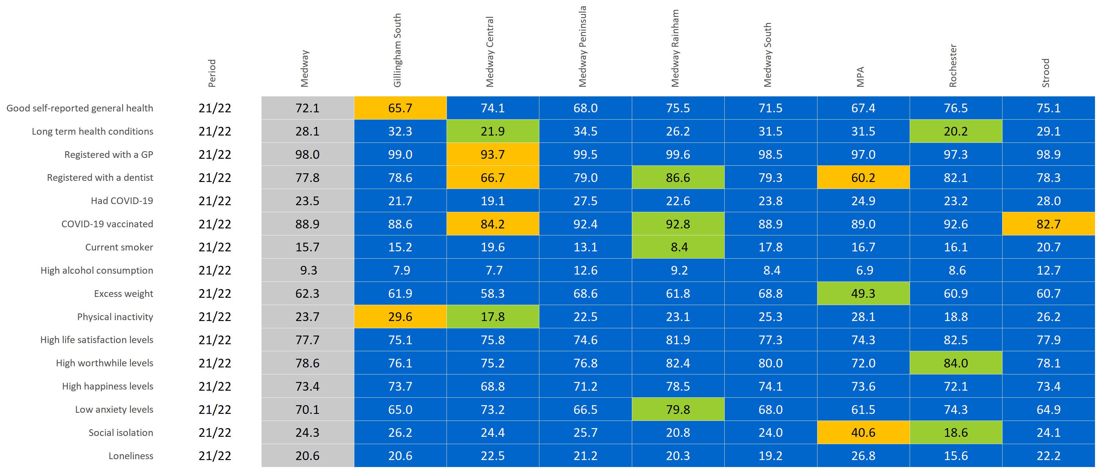
PCN summary
© Medway Council, Public Health Intelligence Team, Version 3.0, 07/08/2023
Estimated proportions for PCNs compared to Medway.

Slide 3
Contact details
© Medway Council, Public Health Intelligence Team, Version 3.0, 07/08/2023
If you have any questions or would like further information about the Medway Health and Wellbeing Survey, please contact:
Dr Natalie Goldring
Senior Public Health Intelligence Manager
Public Health
Medway Council
natalie.goldring@medway.gov.uk
01634 337271

Slide 4
Introduction
© Medway Council, Public Health Intelligence Team, Version 3.0, 07/08/2023
The aim of the Medway Health and Wellbeing Survey was to provide within Medway estimates (ward and Primary Care Network (PCN) level) of key health states and risk factors.
The survey was carried out in 2021/22.
Participants were asked a number of questions about their health and wellbeing, which were grouped into 6 key topic areas:

Slide 5
Sample
© Medway Council, Public Health Intelligence Team, Version 3.0, 07/08/2023
The Medway Health and Wellbeing Survey selected a random sample of the Medway population.
From this sample, characteristics of the entire Medway population were estimated.
The random sample was created from a list of all 119,369 residential properties in Medway.
Medway is split into smaller areas called Lower Layer Super Output Areas (LSOAs) and there are 163 LSOAs in Medway.
Using the residential property list, a survey was sent out to 6.77% of the residential properties within each LSOA (a range of 6.58% to 6.78% across the 163 LSOAs).
In total, 7,998 residential properties were sent a survey.
One adult was asked to complete the survey for each residential property.
We asked the person whose birthday was next to complete the survey.
In total, there were around 3,600 responses.

Slide 6
Weighting
© Medway Council, Public Health Intelligence Team, Version 3.0, 07/08/2023
Weights were calculated to make the survey data more representative of the population it is designed to represent, i.e. Medway as a whole.
Weighting assigns a value to each survey response to indicate how much it should be represented in the analysis.
The weights for the Medway Health and Wellbeing Survey are currently based on the number of adults within each household and the known population distributions by Middle Layer Super Output Areas (MSOA), broad age band (18-64 and 65+) and sex.
This methodology is being developed and may be updated in the future.

Slide 7
Estimating proportions
© Medway Council, Public Health Intelligence Team, Version 3.0, 07/08/2023
The survey results are presented as proportions.
  Frequentist approach
The majority of the survey analysis used a frequentist approach to estimate proportions.
For each survey question, the number of responses per category were divided by the total number of survey responses. This method is based solely on the answers given in the survey.
  Bayesian approach
In some cases, however, the sample size was too small to use the frequentist approach. For example, for ward level estimates. In this instance, a Bayesian approach was used to calculate the proportion.
This involves using prior knowledge to estimate a proportion and then update this value based on the answers given in the survey.
Current Bayesian model: Simple logistic regression model
Bayesian model in development: Hierarchical logistic regression including multiple levels and predictor variables. Will also incorporate survey weights and age-standardisation.

Slide 8
Confidence intervals
© Medway Council, Public Health Intelligence Team, Version 3.0, 07/08/2023
When samples are used, the values are usually accompanied by a measure of uncertainty.
Uncertainty relates to how an estimate might differ from the 'true value'.
Confidence intervals are used to show uncertainty in the Medway Health and Wellbeing Survey proportion estimates.
Confidence intervals provide a range in which we think the true proportion is likely to lie.
The confidence intervals are shown as lines in the middle of the bar graphs.
The wider the confidence interval, the greater the level of uncertainty in the estimate. This could be due to a small sample size or high variability.
A narrow confidence interval suggests that the estimate is more precise.
The 'logit' method has been used to calculate confidence intervals for the majority of the analysis.
However, when a Bayesian approach has been used to estimate the proportion, credible intervals are presented instead.

Slide 9
Validation
© Medway Council, Public Health Intelligence Team, Version 3.0, 07/08/2023
The objective of validation is to check the quality of the data collected from the Medway Health and Wellbeing survey.
Where possible, the survey estimates have been compared to values from national surveys, such as the Census and the Annual Population Survey, covering similar time periods.
Survey estimates have been considered acceptable if the value falls within the range (confidence interval) of the national survey.

Slide 10
Demographics

Slide 11
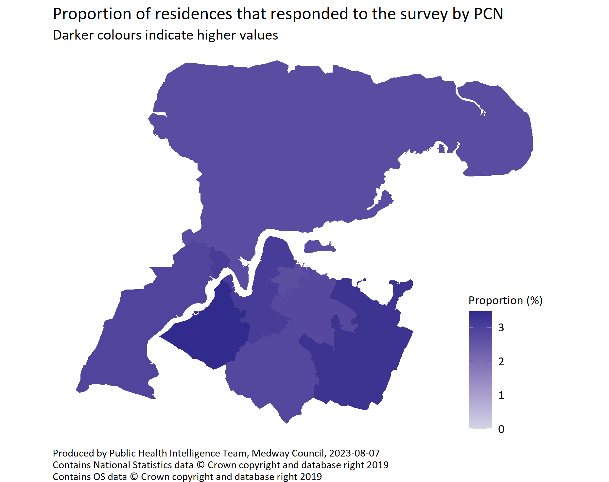
PCN
© Medway Council, Public Health Intelligence Team, Version 3.0, 07/08/2023
PCN | Number of responses | Number of residences | % residences responded
Gillingham South | 488 | 17,341 | 2.81%
Medway Central | 562 | 18,254 | 3.08%
Medway Peninsula | 360 | 13,244 | 2.72%
Medway Rainham | 635 | 19,482 | 3.26%
Medway South | 499 | 17,678 | 2.82%
MPA | 178 | 6,605 | 2.69%
Rochester | 467 | 13,468 | 3.47%
Strood | 385 | 13,297 | 2.90%
Total | 3,574 | 119,369 | 2.99%
  Target coverage: 3%
  PCN coverage range: 2.69% to 3.47%

Slide 12
Wider determinants

Slide 13
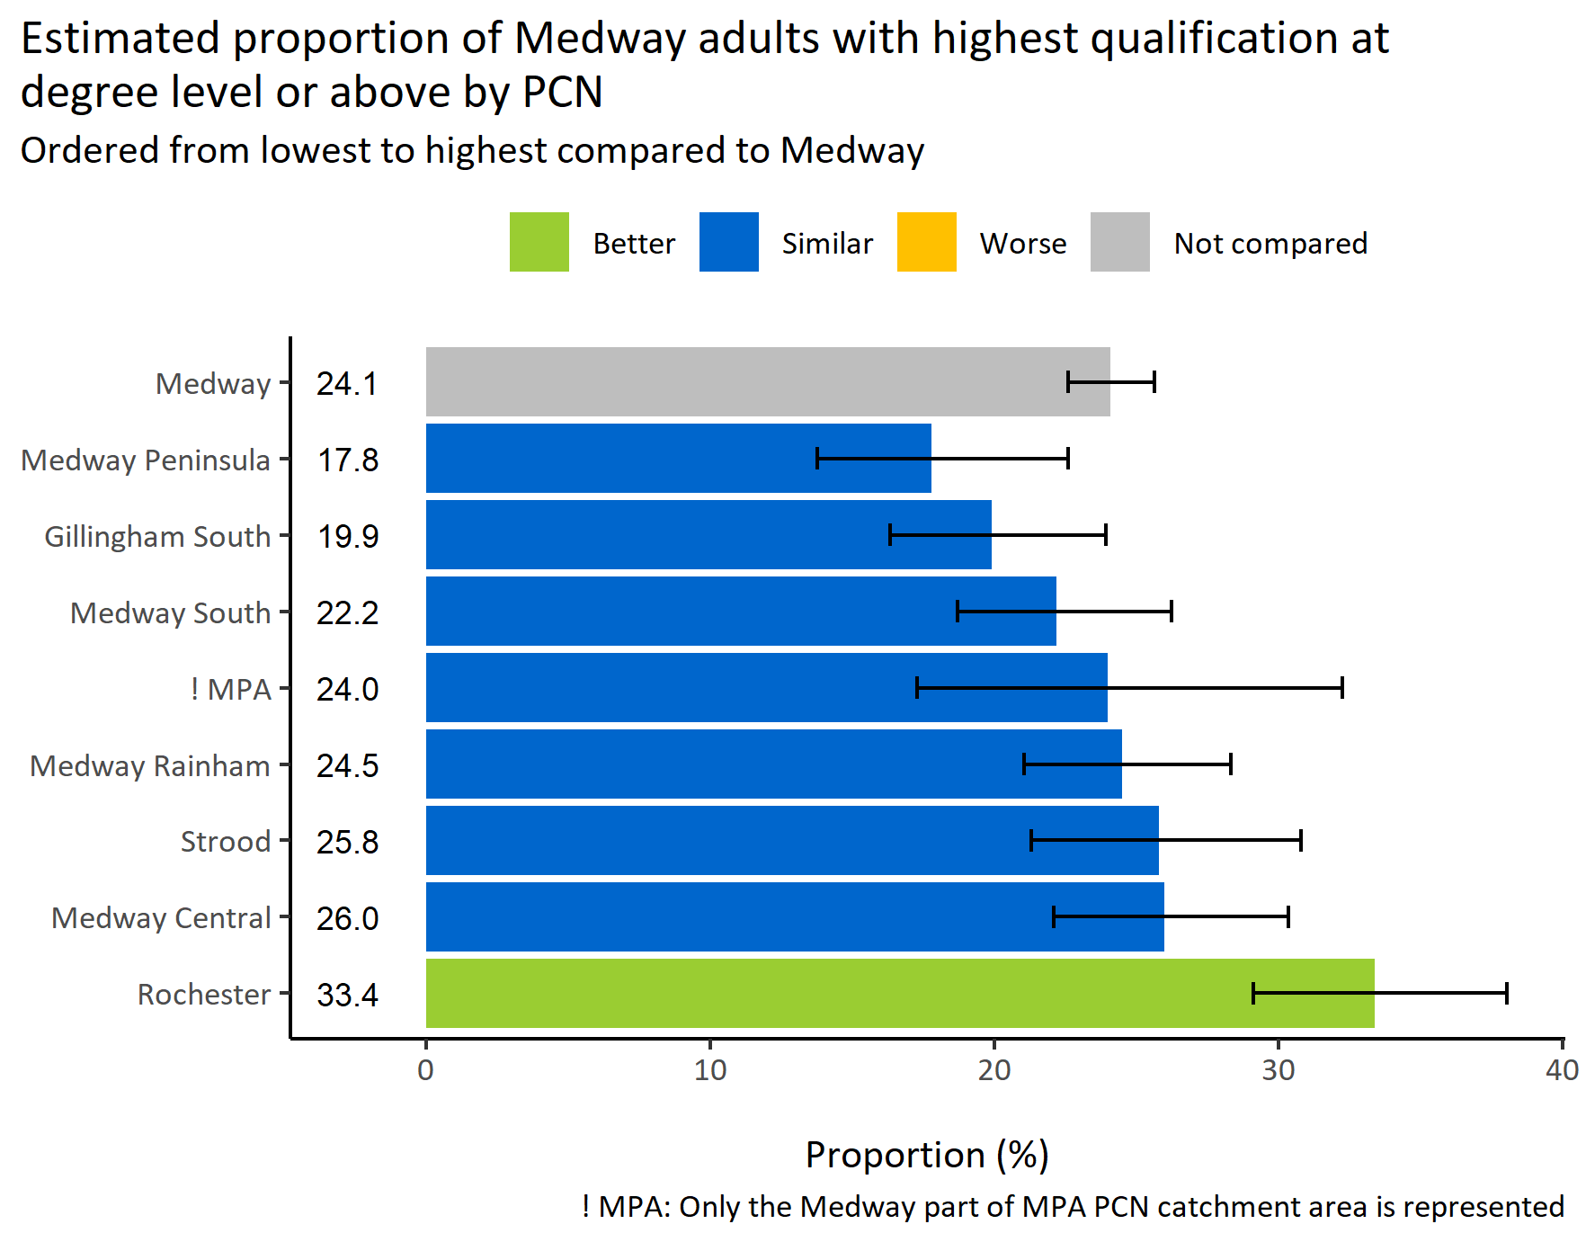
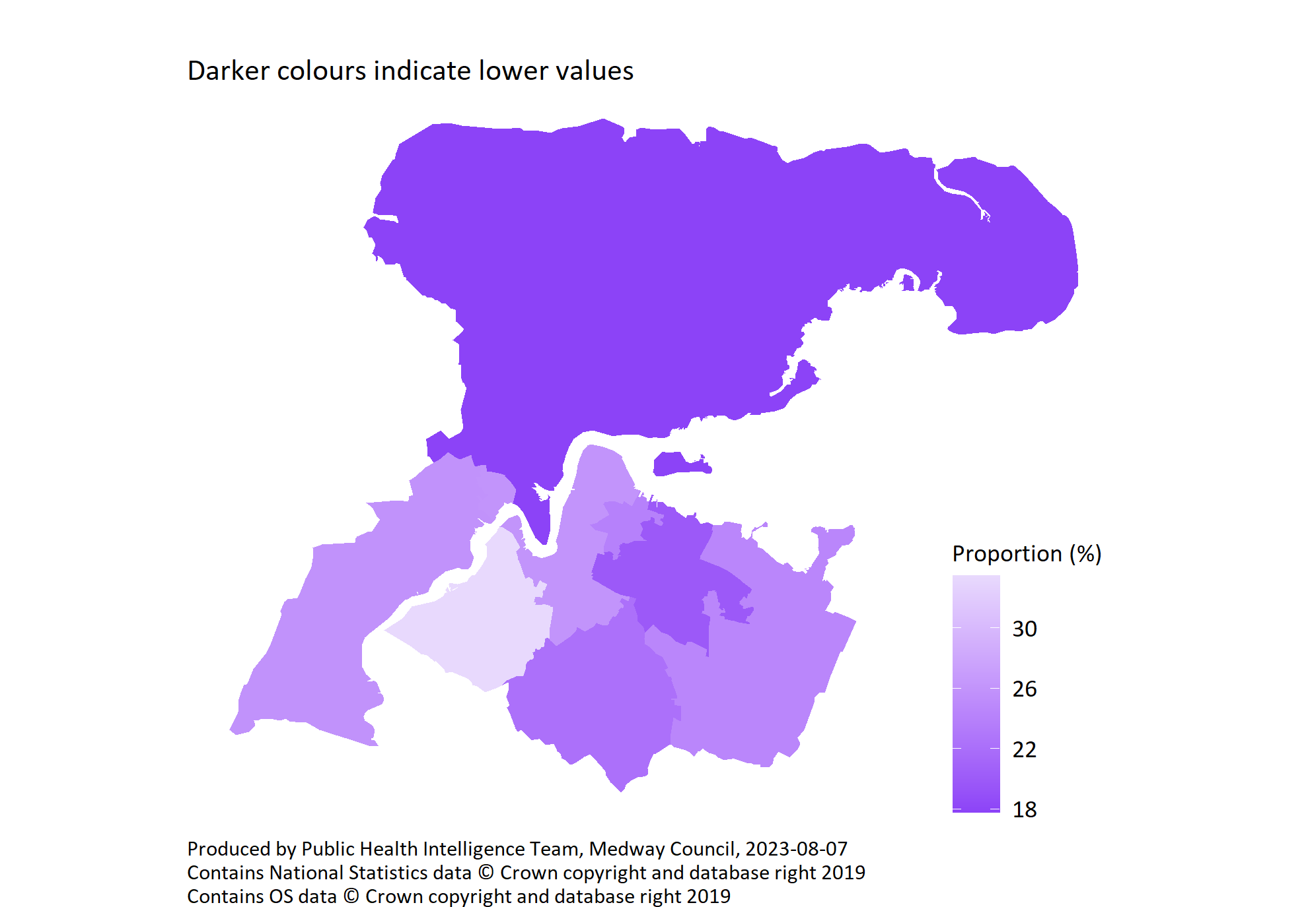
Highest qualification at degree level or above by PCN
© Medway Council, Public Health Intelligence Team, Version 3.0, 07/08/2023
Survey question: Can you tell me the highest educational or school qualification you have obtained?
Possible answers: O-Levels or equivalent, GCSE/Vocational GCSE or equivalent, AS-Level/Vocational AS-Level or equivalent, A-Level/Vocational A Level or equivalent, International Baccalaureate, School leavers certificate, Higher qualification below degree level, Undergraduate degree or equivalent, Postgraduate degree or equivalent, Other professional qualification, Don't know/don't want to say.
Category selected: Degree level or above: Undergraduate degree or equivalent, Postgraduate degree or equivalent.

Slide 14
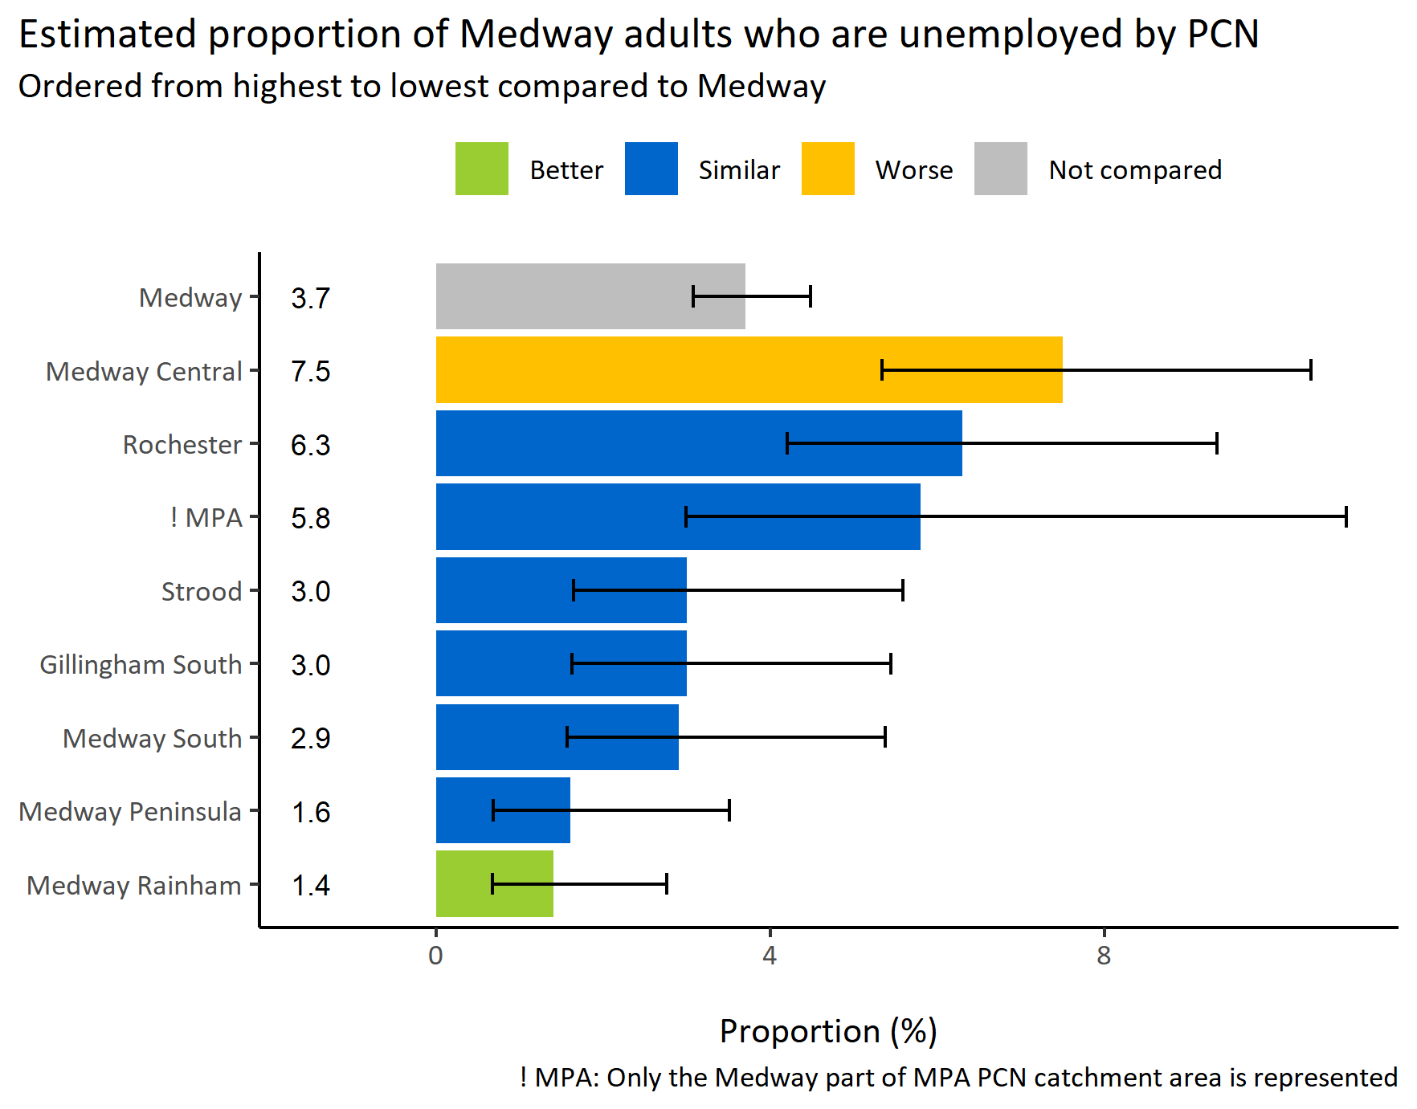
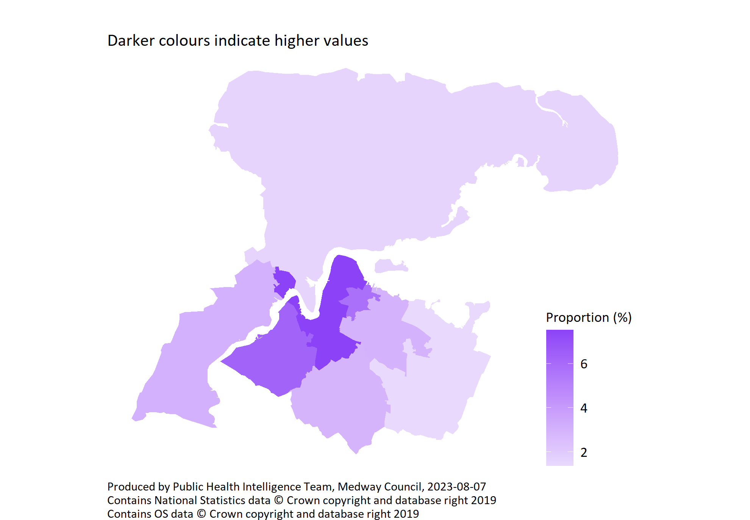
Unemployed by PCN
© Medway Council, Public Health Intelligence Team, Version 3.0, 07/08/2023
Survey question: Are you...?
Possible answers: Employed, Self-employed or freelance, Looking for work/unemployed, Student, Retired, Looking after home or family, Long term sick or disabled, Other, Don't know/don't want to say.
Category selected: Unemployed: Looking for work/unemployed.

Slide 15
General health

Slide 16
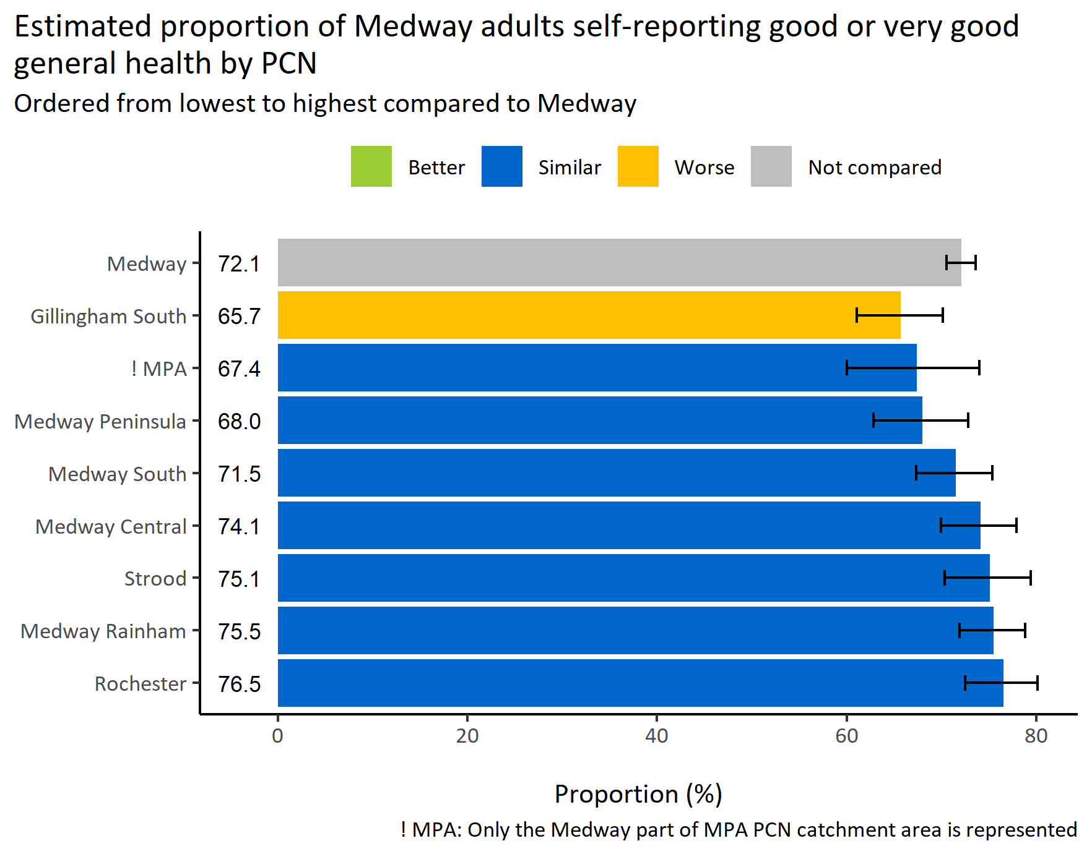
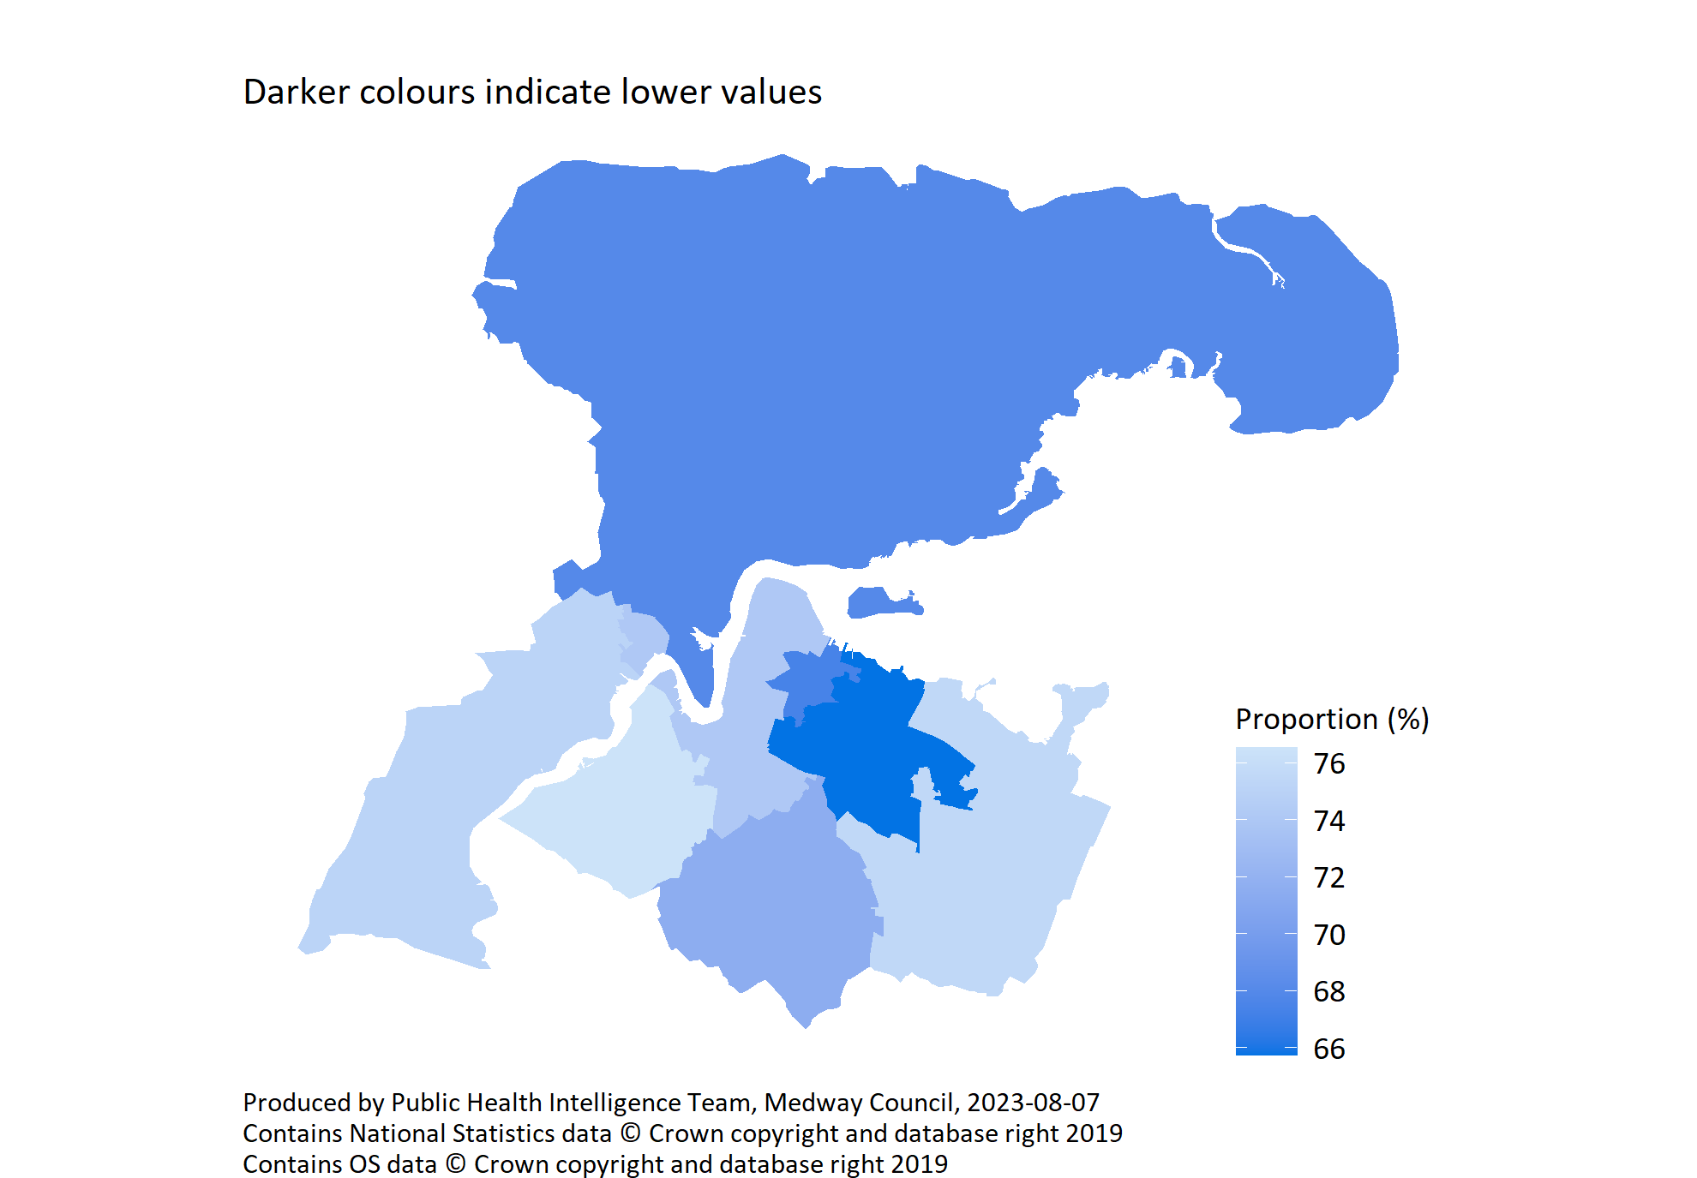
Self-reported general health by PCN
© Medway Council, Public Health Intelligence Team, Version 3.0, 07/08/2023
Survey question: How is your health in general?
Possible answers: Very good, Good, Fair, Bad, Very bad, Don't know/don't want to say.
Categories selected: Good or very good.

Slide 17
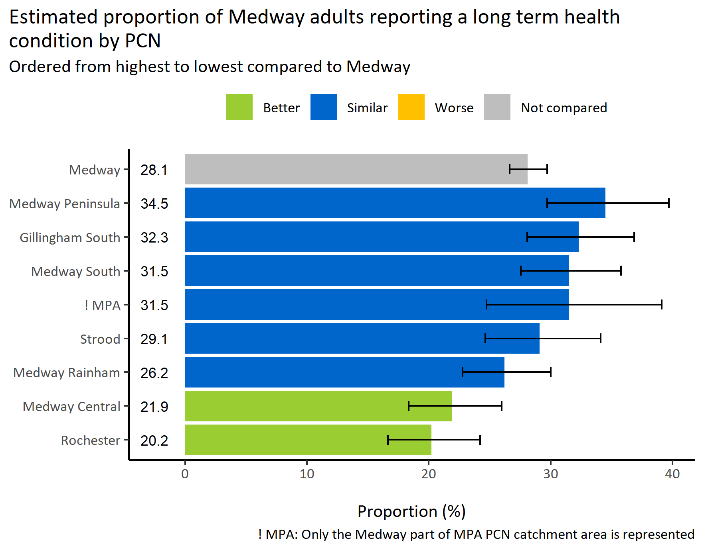
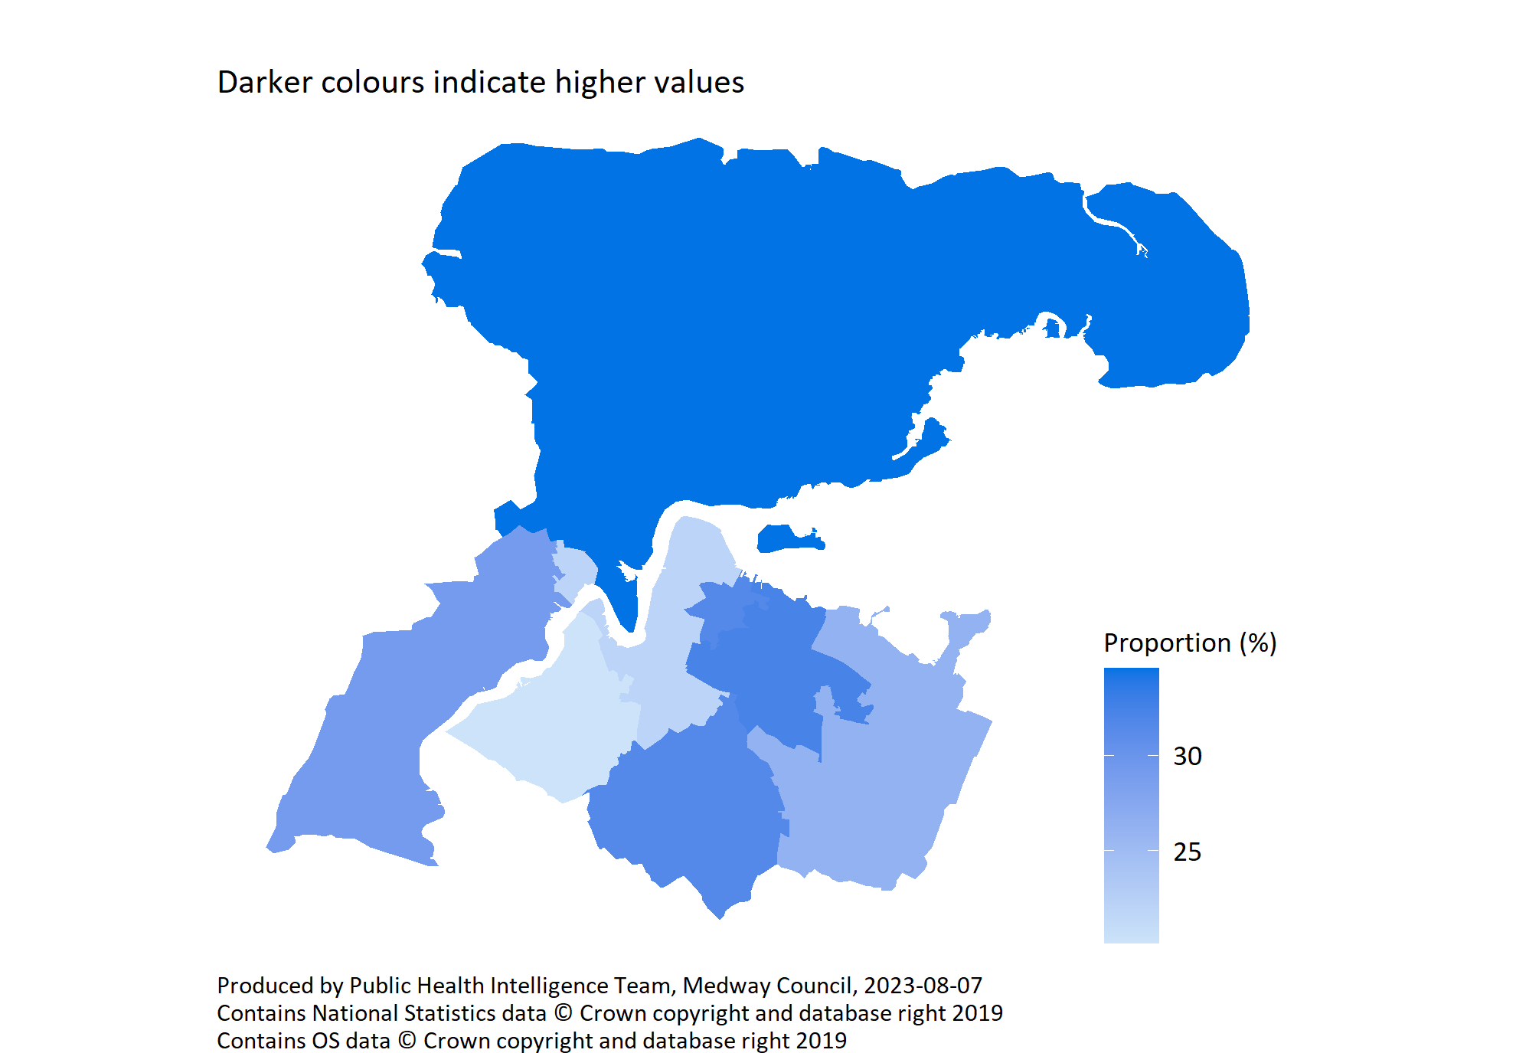
Long term health conditions by PCN
© Medway Council, Public Health Intelligence Team, Version 3.0, 07/08/2023
Survey question: Do you have any physical or mental health conditions or illnesses lasting or expecting to last 12 months or more?
Possible answers: Yes, No, Don't know/don't want to say.
Category selected: Yes.

Slide 18
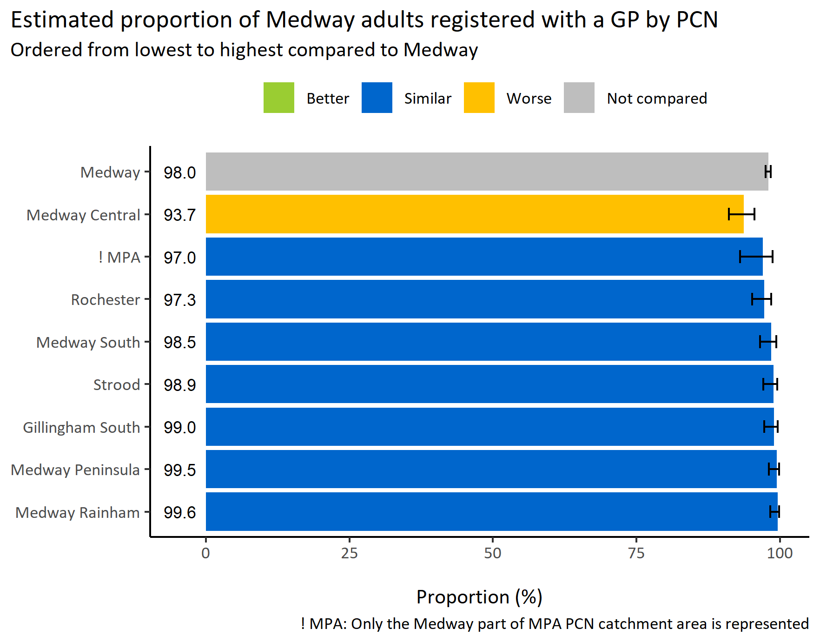
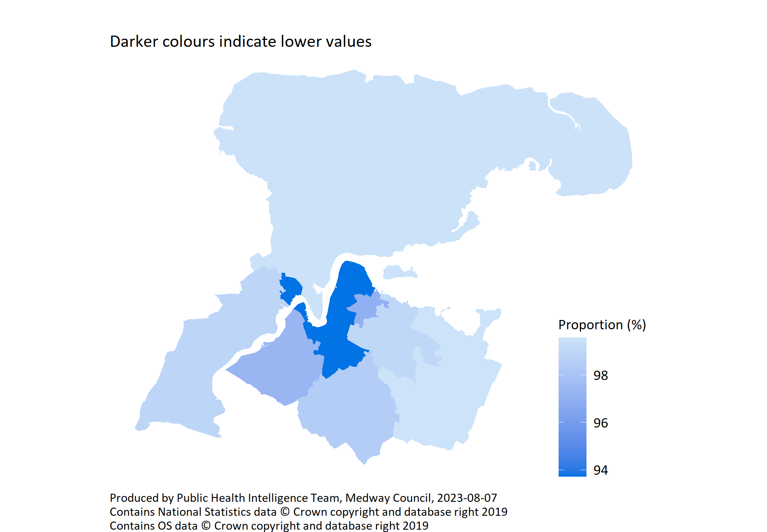
Registered with a GP by PCN
© Medway Council, Public Health Intelligence Team, Version 3.0, 07/08/2023
Survey question: Are you registered with a GP or a family doctor?
Possible answers: Yes, No, Don't know/don't want to say.
Category selected: Yes.

Slide 19
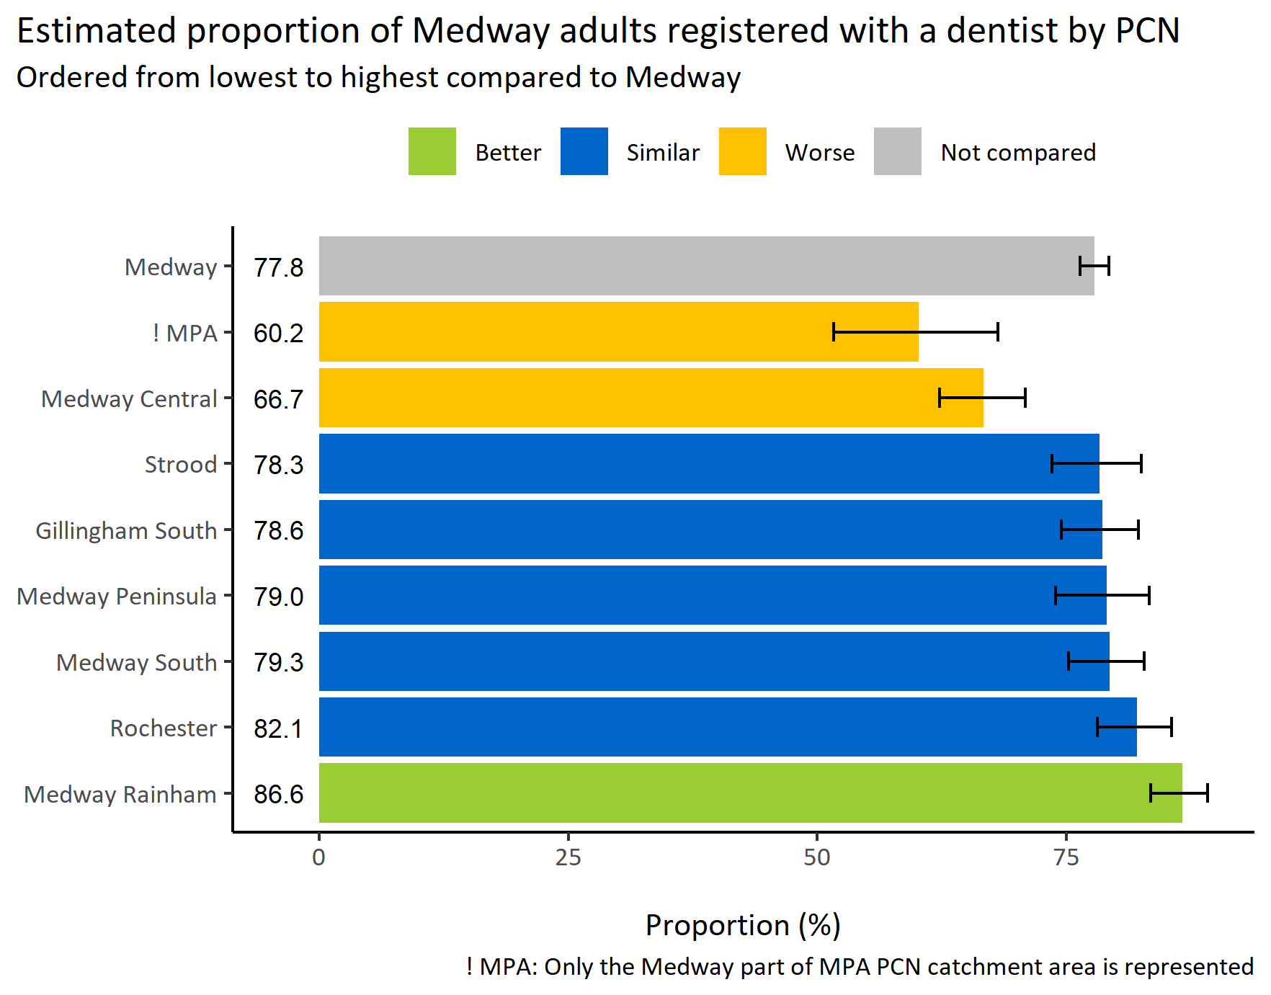
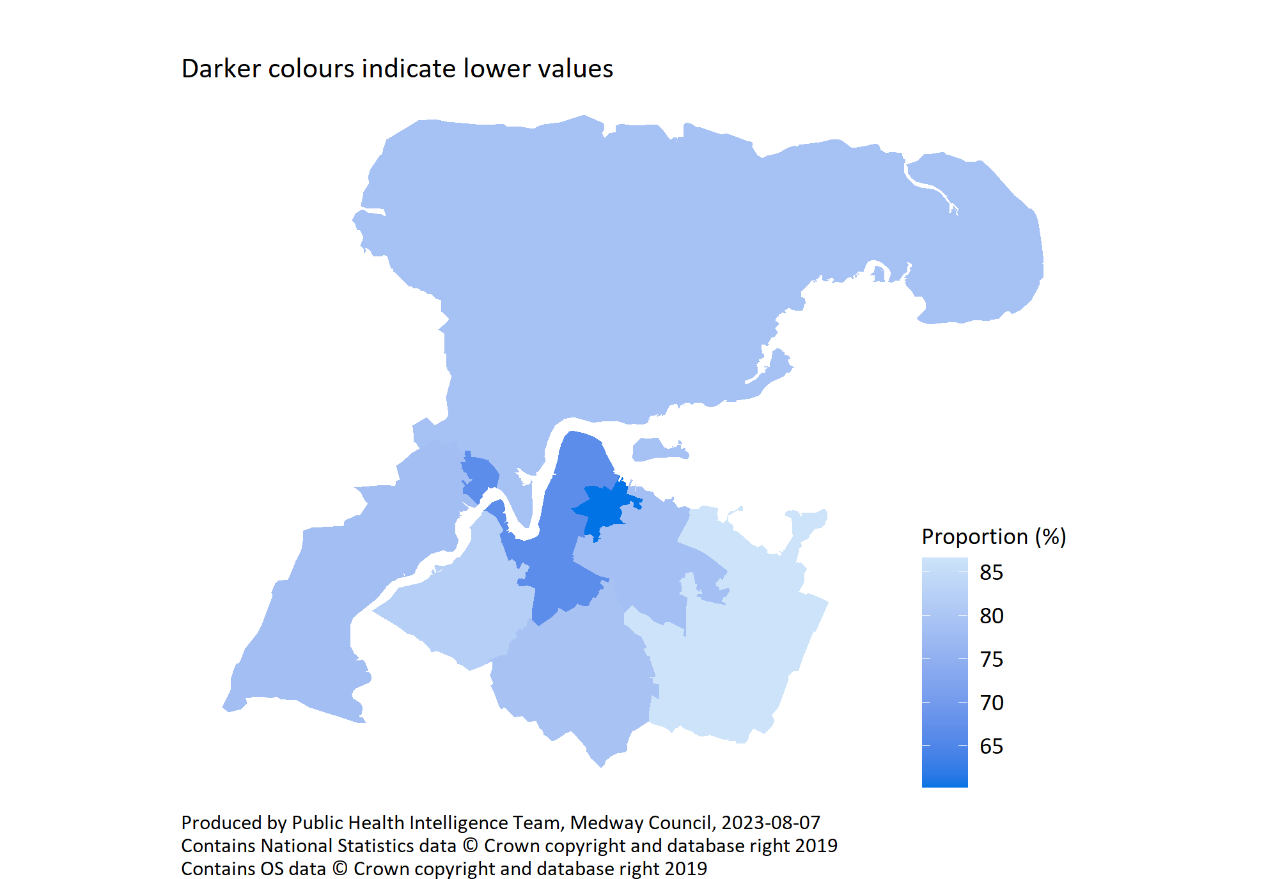
Registered with a dentist by PCN
© Medway Council, Public Health Intelligence Team, Version 3.0, 07/08/2023
Survey question: Are you registered with a dentist?
Possible answers: Yes, No, Don't know/don't want to say.
Category selected: Yes.

Slide 20
COVID-19

Slide 21
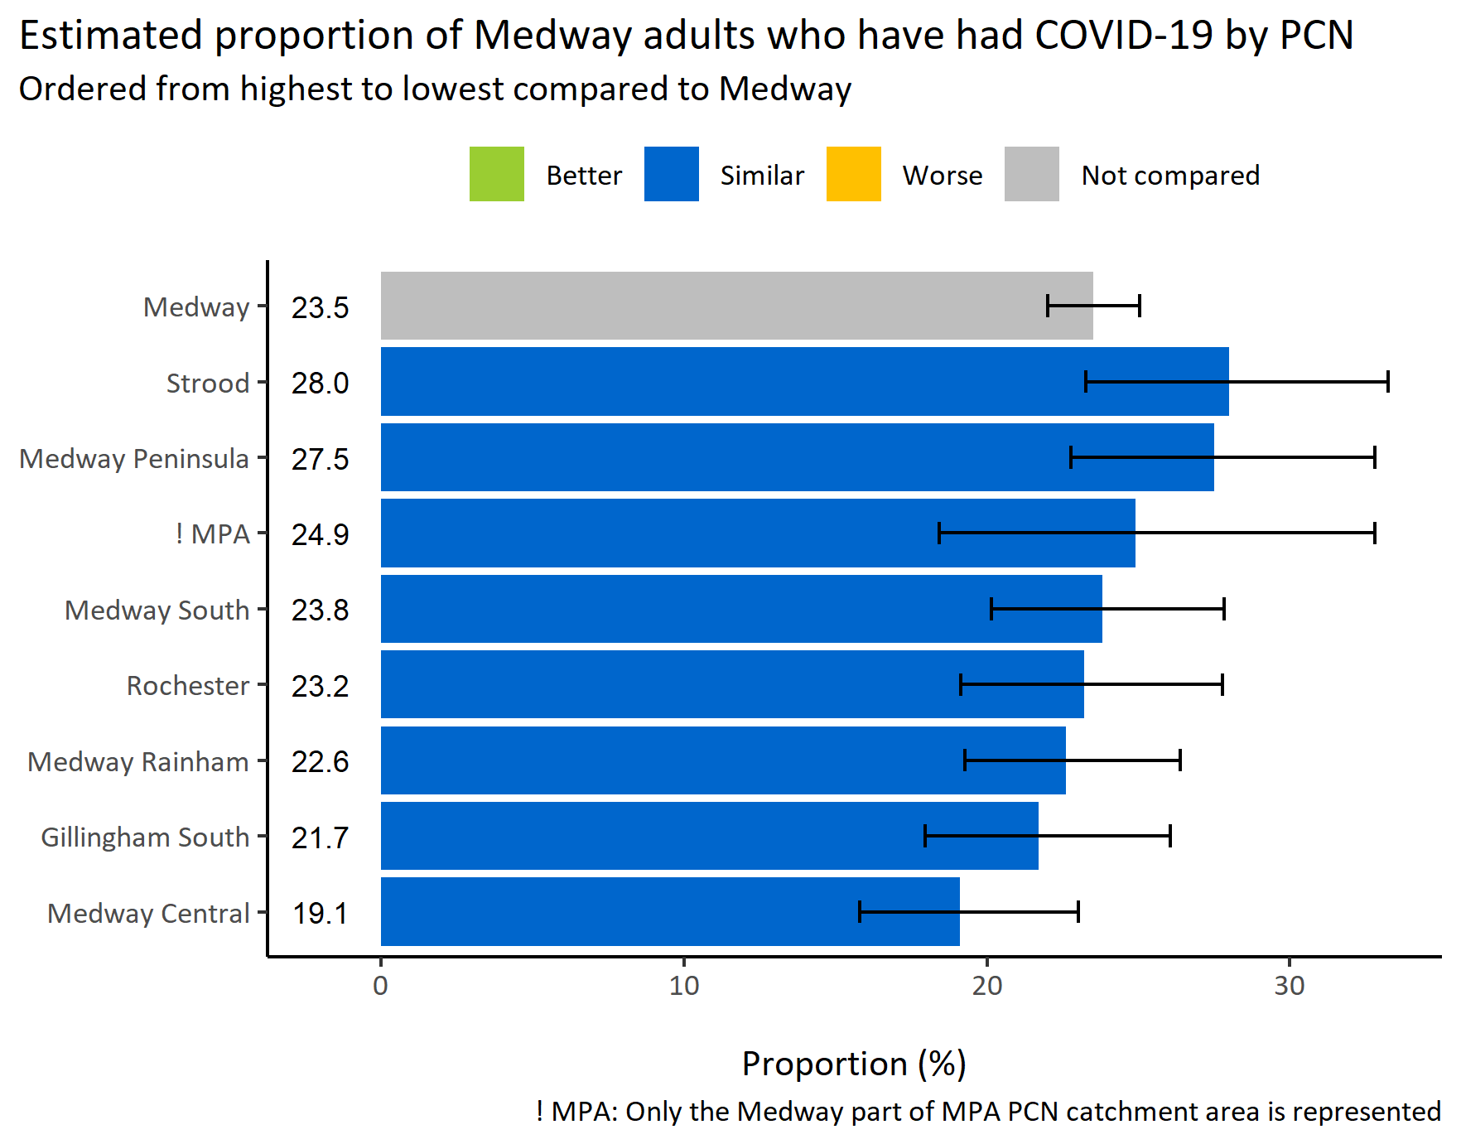
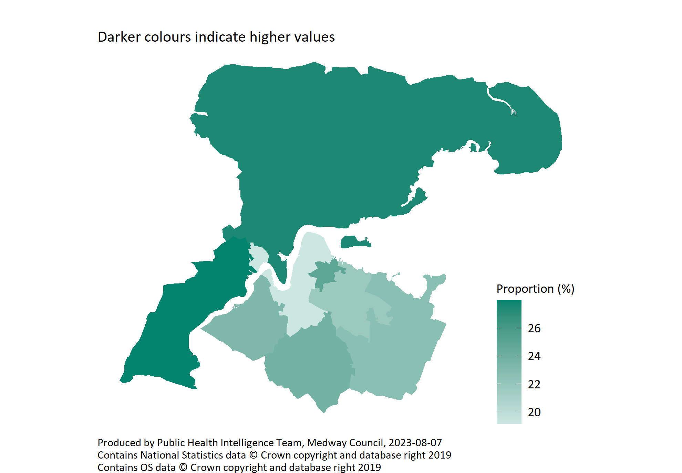
Had COVID-19 by PCN
© Medway Council, Public Health Intelligence Team, Version 3.0, 07/08/2023
Survey question: Have you had COVID-19?
Possible answers: Yes - diagnosed, Not diagnosed but suspected, Not that I know of/No, Don't want to say.
Category selected: Yes - diagnosed.

Slide 22
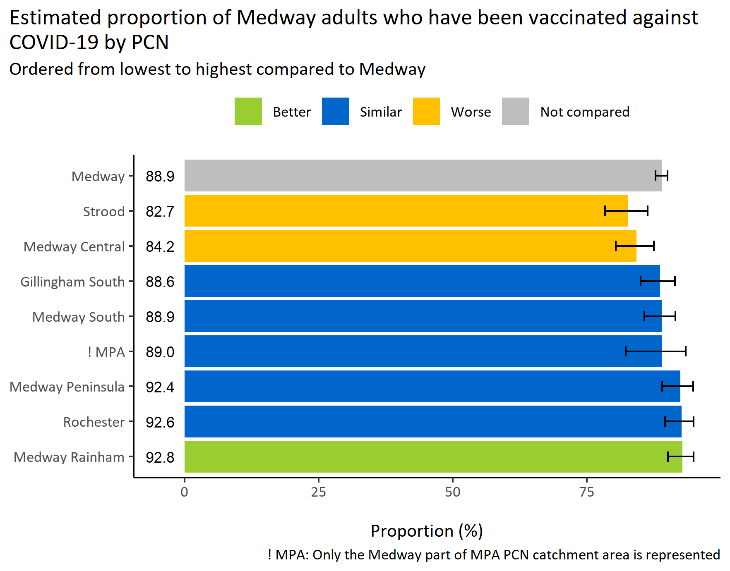
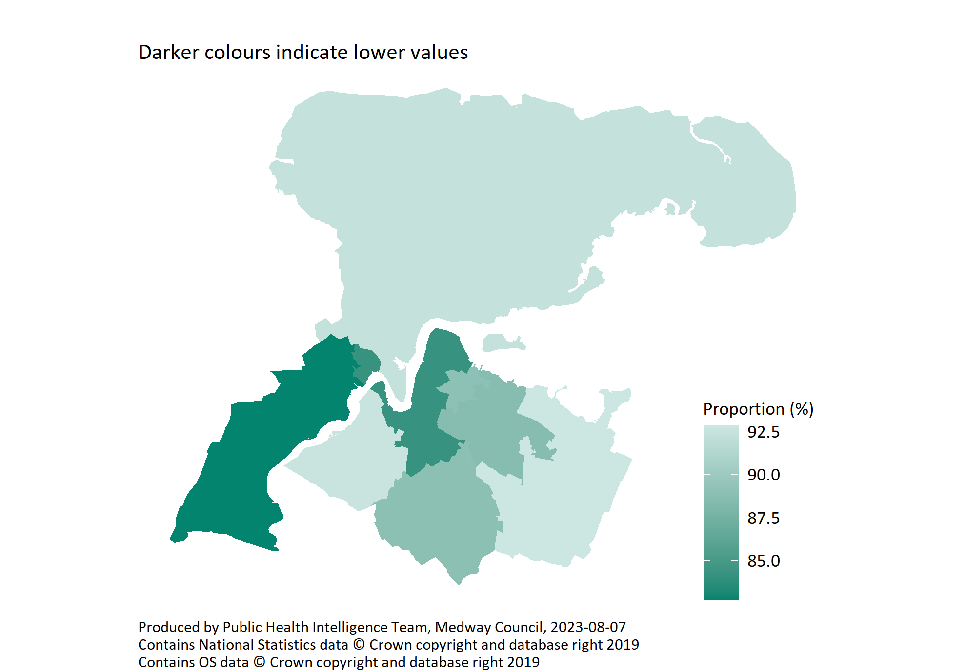
COVID-19 vaccinated by PCN
© Medway Council, Public Health Intelligence Team, Version 3.0, 07/08/2023
Survey question: Are you fully vaccinated against COVID-19 (have taken up all eligible doses excluding the booster)?
Possible answers: Yes, No, Don't know/don't want to say.
Category selected: Yes.

Slide 23
Risk factors

Slide 24
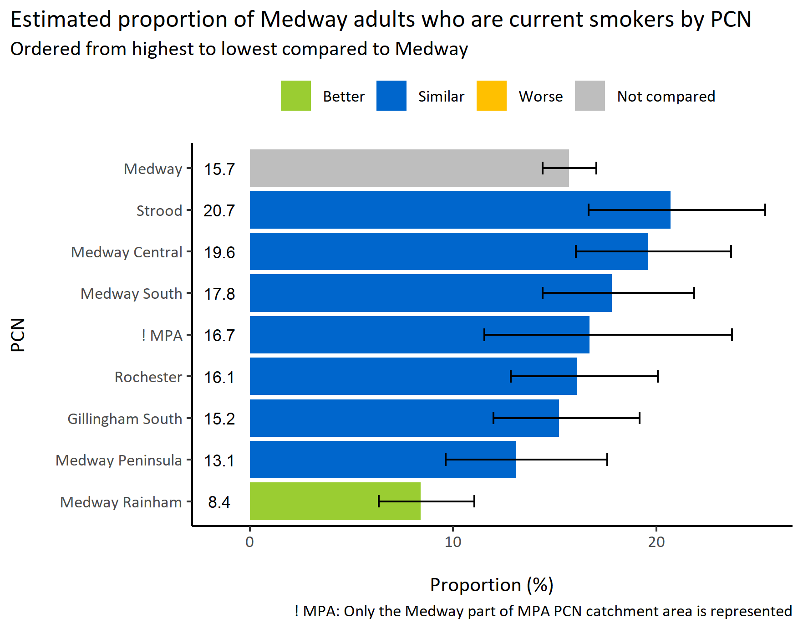
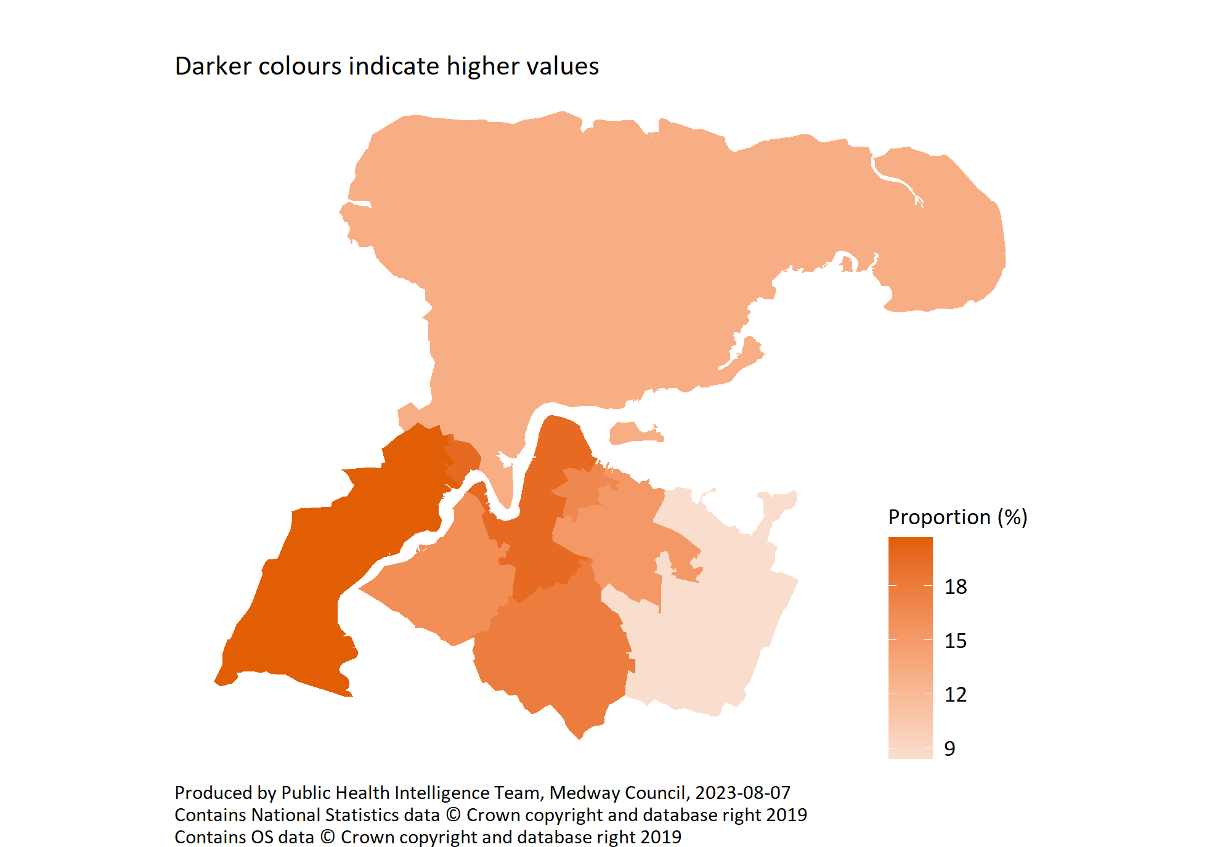
Current smokers by PCN
© Medway Council, Public Health Intelligence Team, Version 3.0, 07/08/2023
Survey questions
1) Have you ever smoked a cigarette, a cigar or a pipe? Possible answers: Yes, No
2) Do you smoke any tobacco containing products nowadays? Possible answers: Yes, No.
Categories: Ex-smoker: 1) Yes, 2) No. Never smoked: 1) No, 2) No. Smoker: 1) Yes, 2) Yes.
Category selected: Smoker

Slide 25
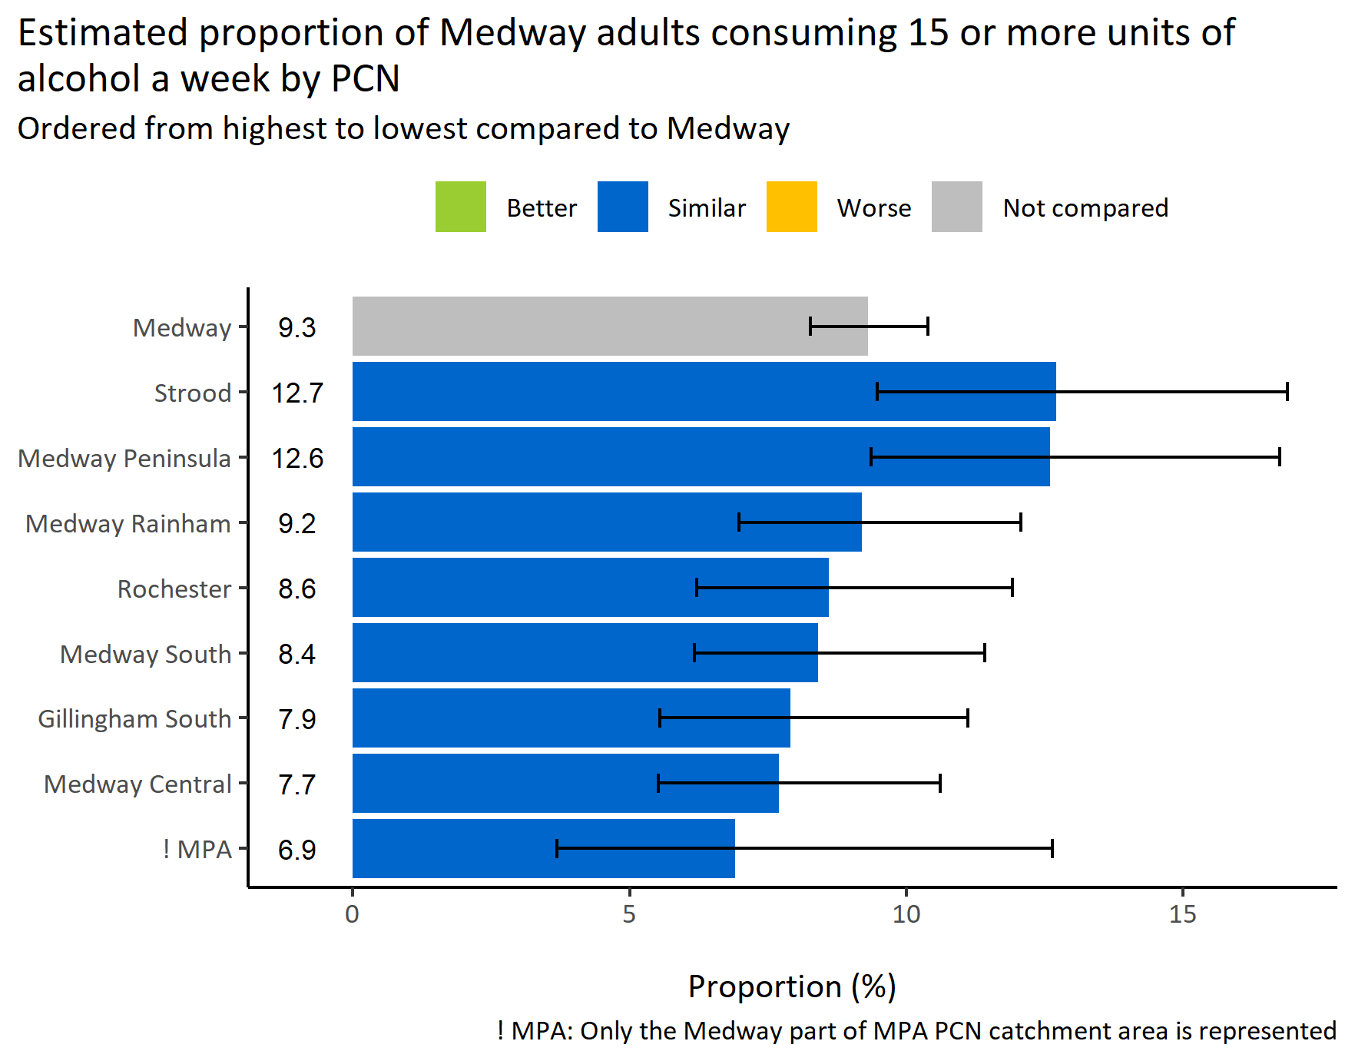
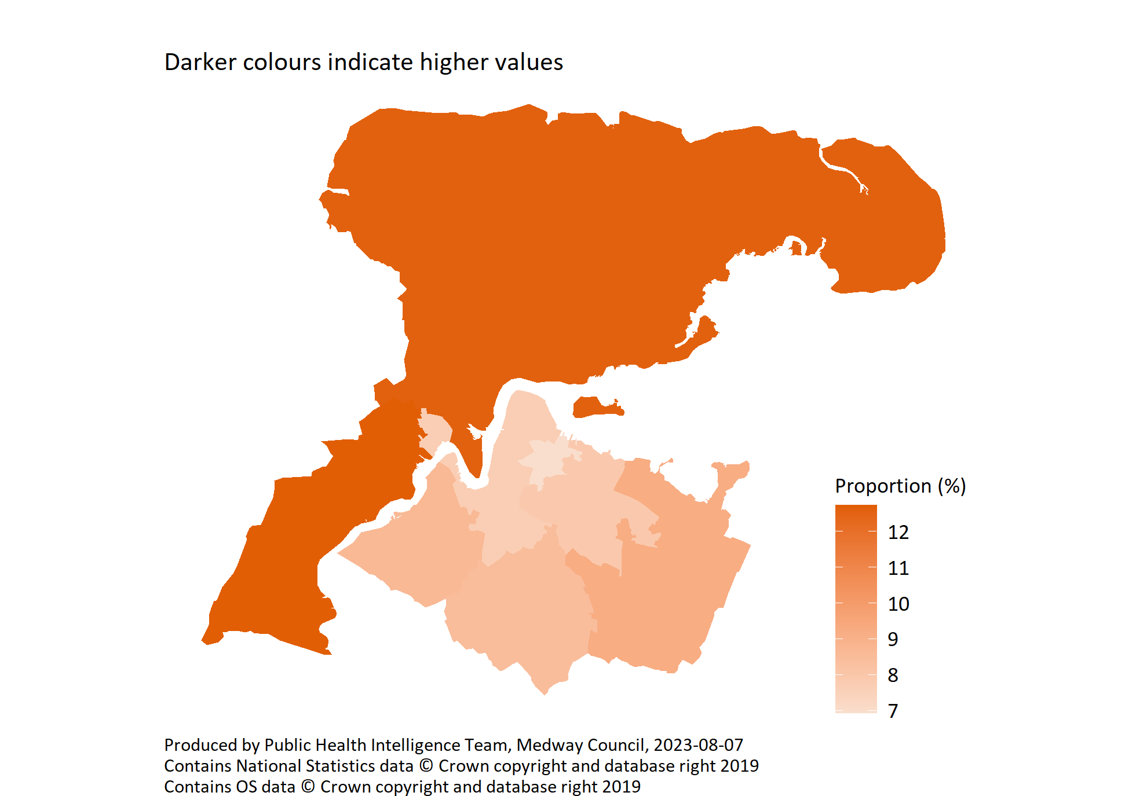
High alcohol consumption by PCN
© Medway Council, Public Health Intelligence Team, Version 3.0, 07/08/2023
Survey question: How many units of alcohol do you drink in a typical week? If unsure, please estimate.
Possible answers: 14 units or less, 15 - 35 units, More than 35 units, I don't drink alcohol, Don't know/don't want to say.
Category selected: High alcohol consumption: More than 15 units

Slide 26
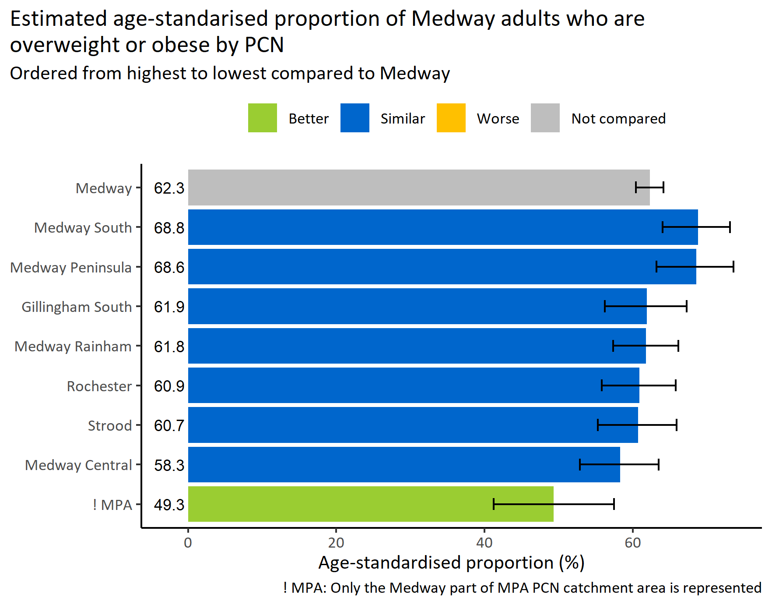
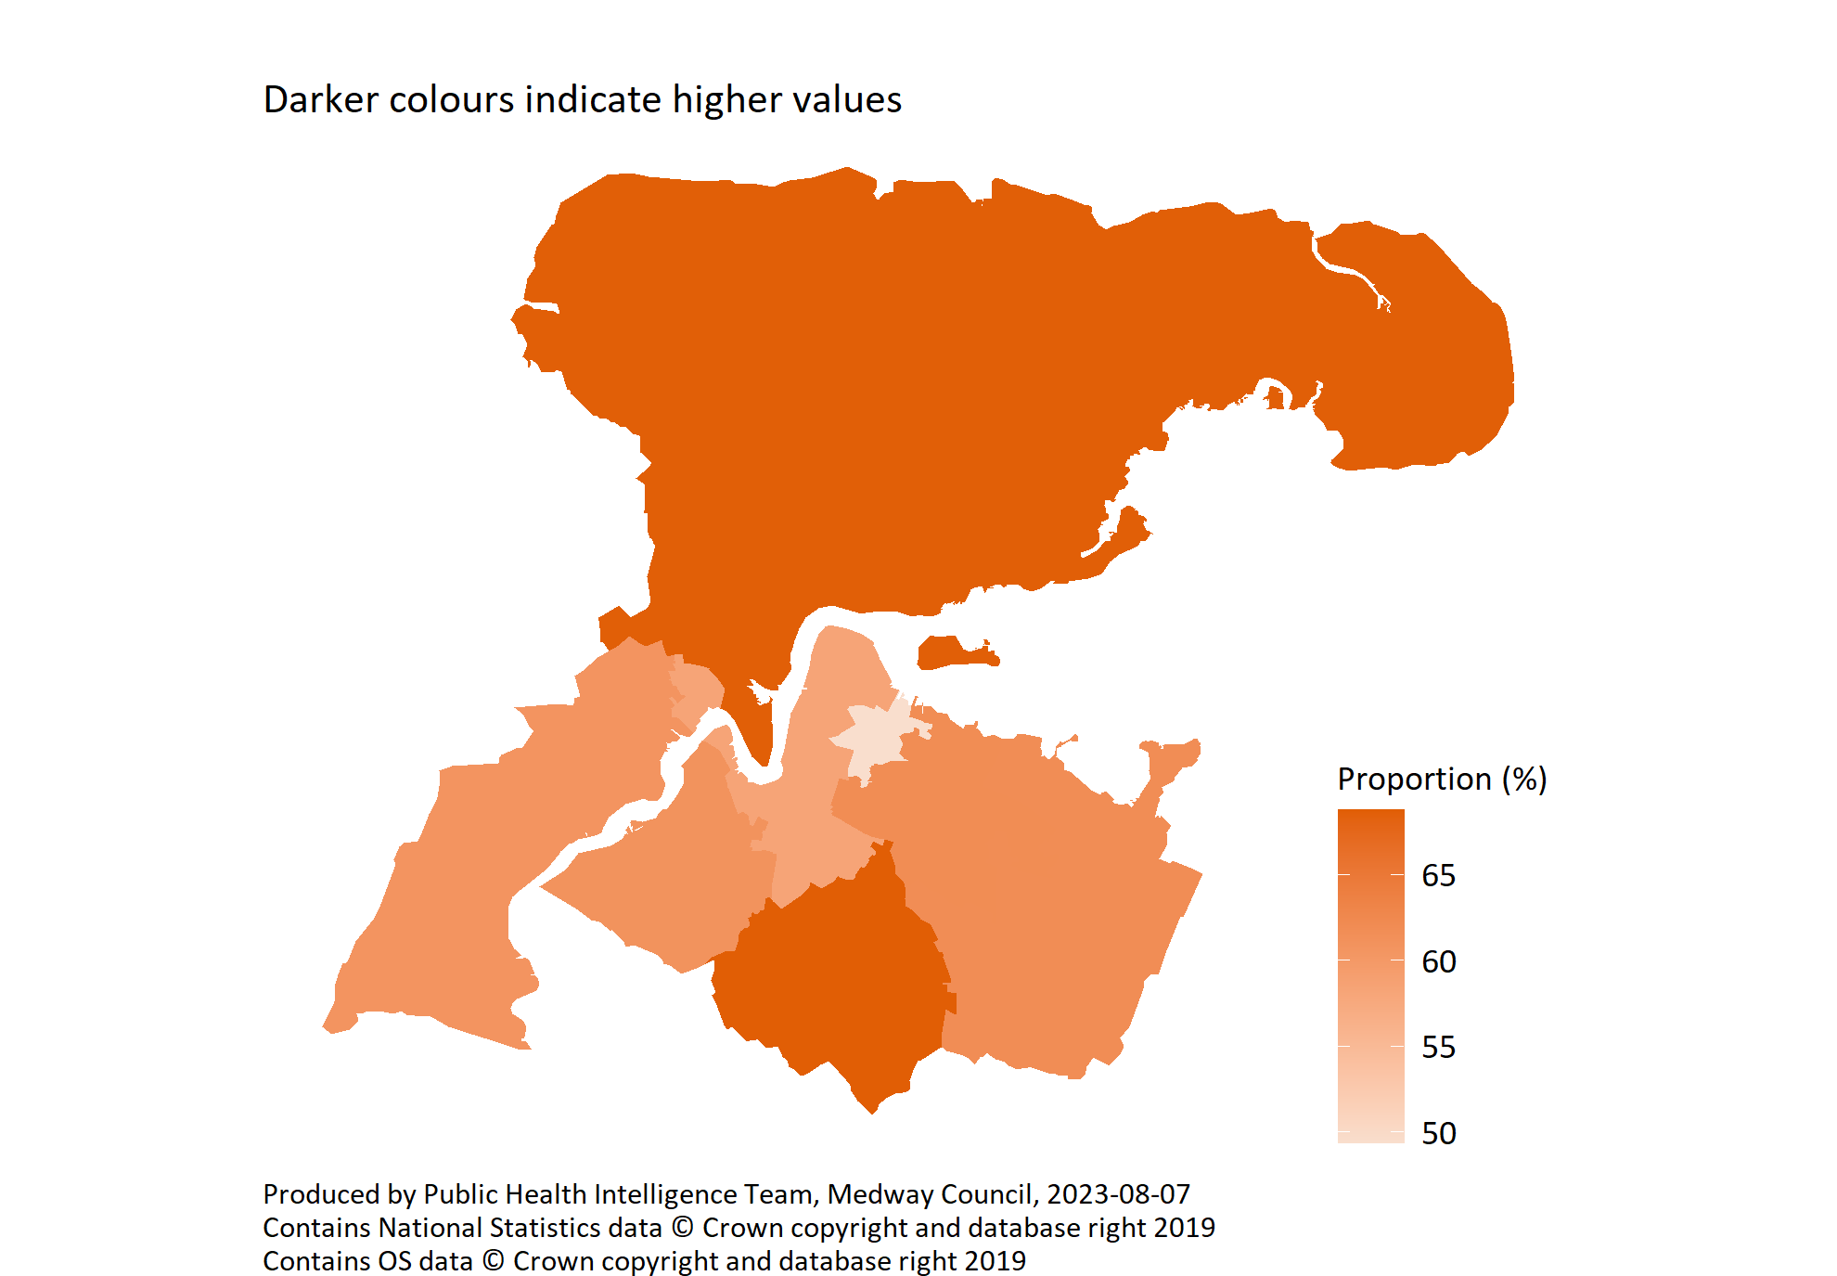
Excess weight prevalence by PCN
© Medway Council, Public Health Intelligence Team, Version 3.0, 07/08/2023
Survey questions
1) How tall are you without shoes?
2) What is your current weight?
BMI calculation: weight / height^2
Categories selected: Overweight or obese (BMI >= 25); Obese (BMI >= 30)

Slide 27
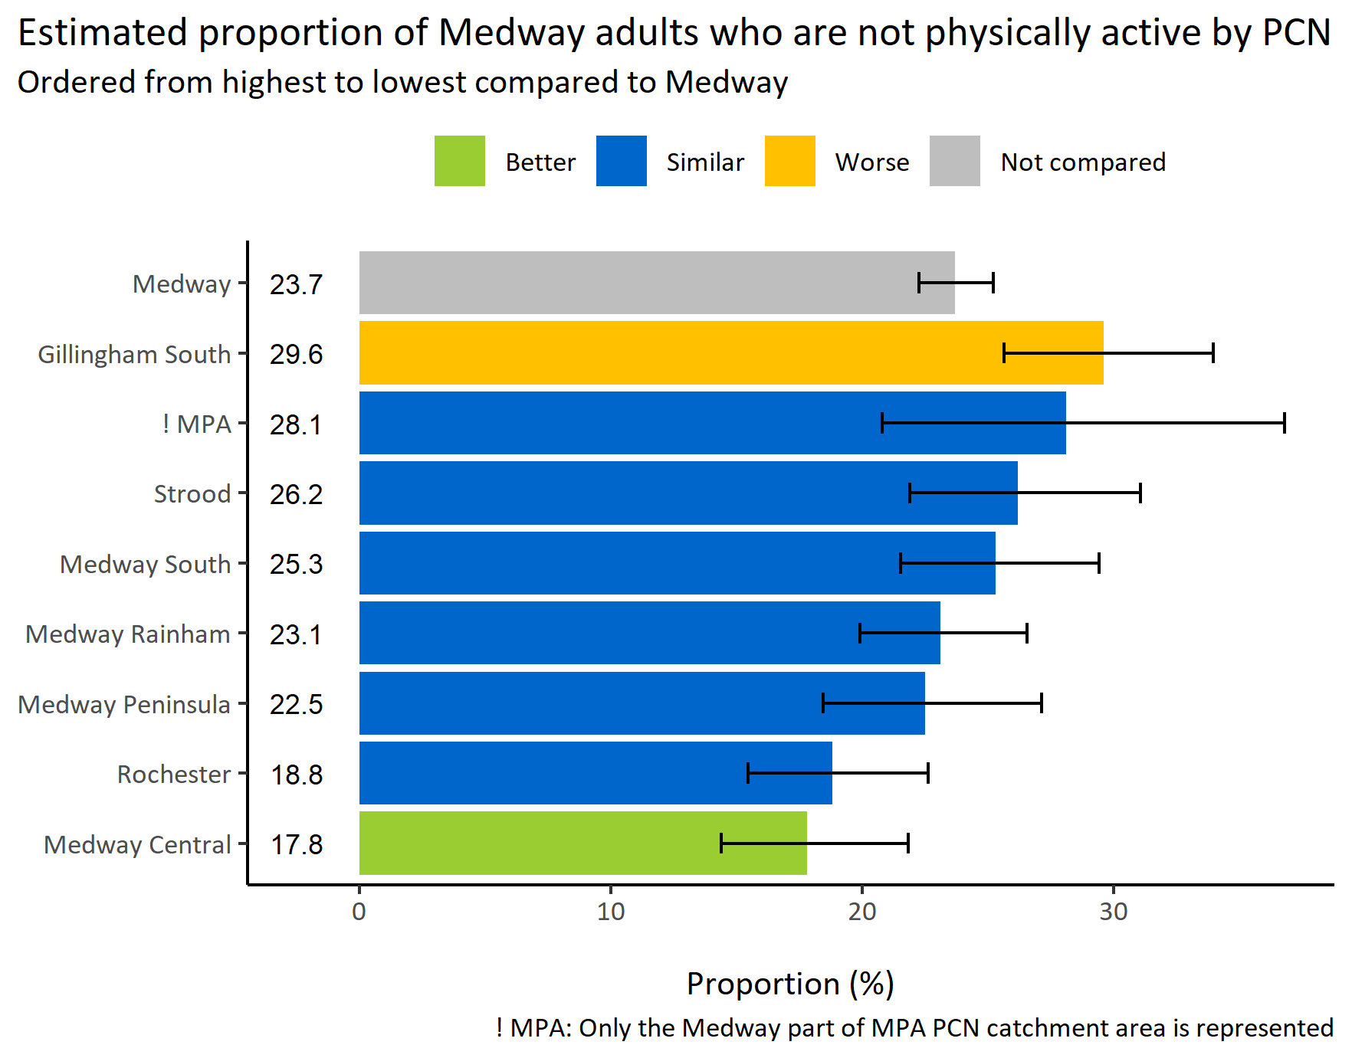
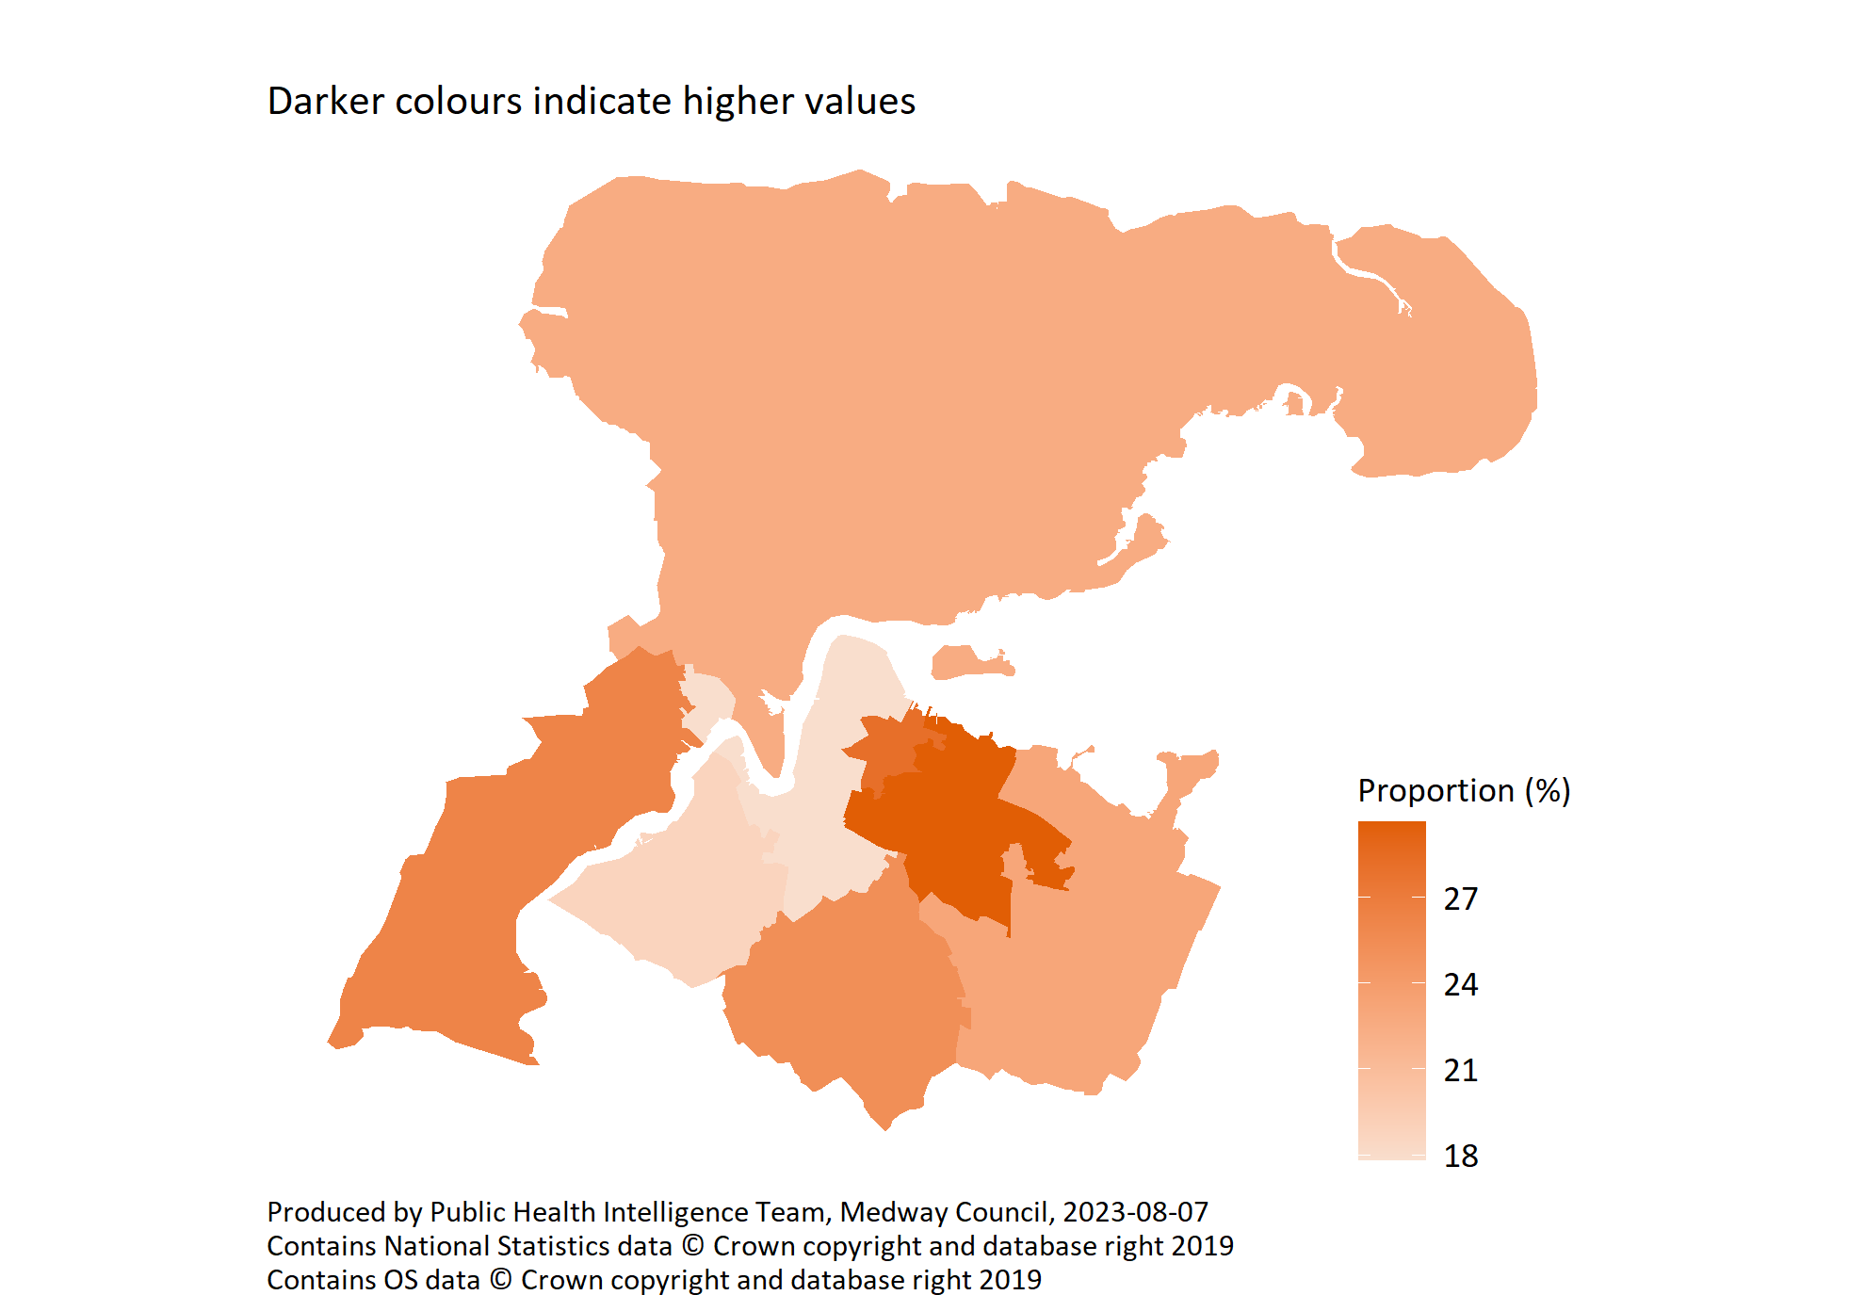
Physical inactivity by PCN
© Medway Council, Public Health Intelligence Team, Version 3.0, 07/08/2023
Survey question: Please think about your physical activity over the last 7 days. On average, how many days have you done a total of 30 minutes or more of physical activity?
Possible answers: 0, 1, 2, 3, 4, 5, 6, 7, Don't know/don't want to say.
Category selected: Physical inactivity: 0 days

Slide 28
Mental health and wellbeing

Slide 29
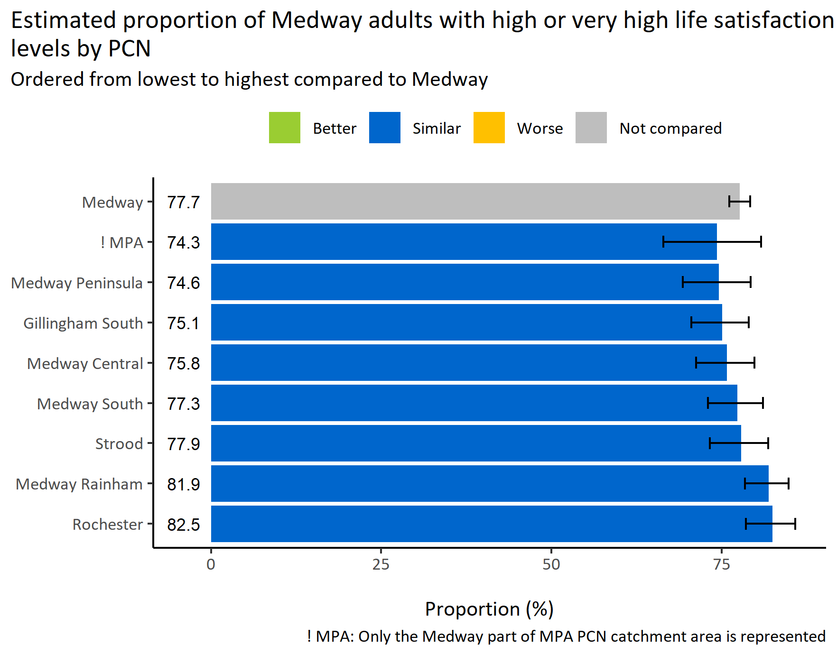
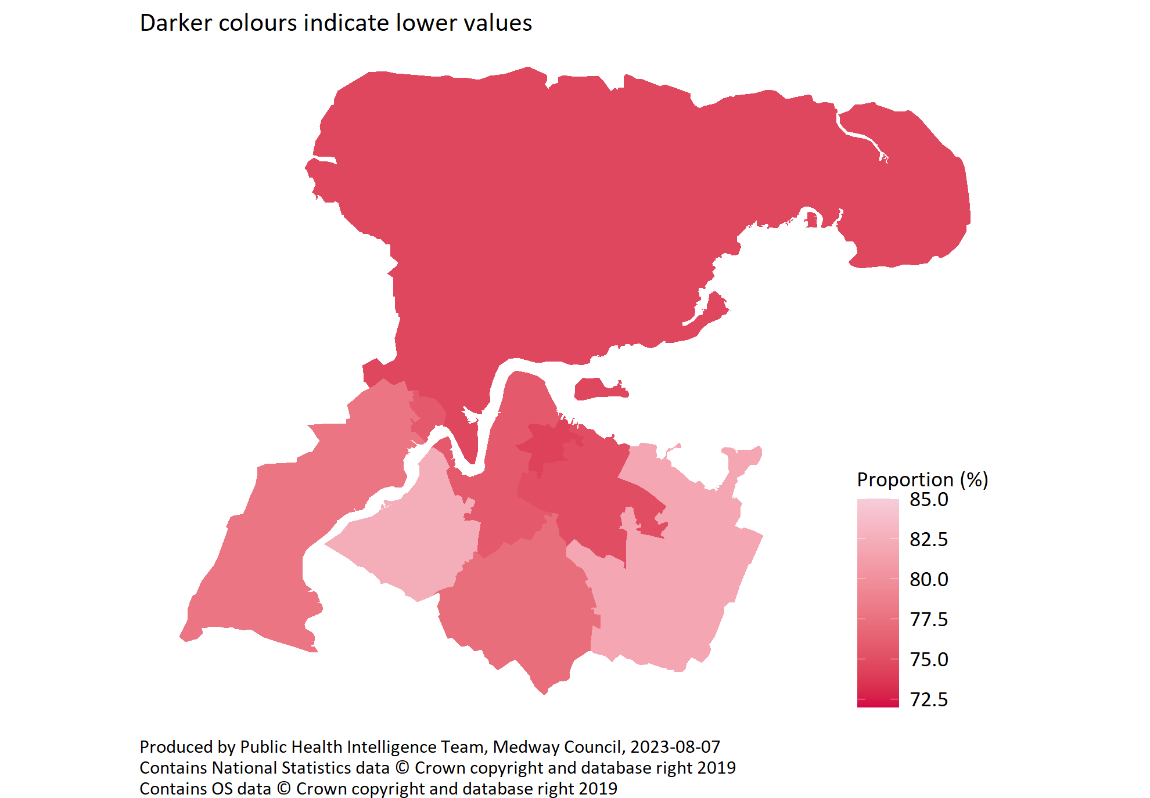
High or very high life satisfaction by PCN
© Medway Council, Public Health Intelligence Team, Version 3.0, 07/08/2023
Survey question: I’d like you to give an answer on a scale of 0 to 10 where 0 is 'not at all' and 10 is 'completely': Overall, how satisfied are you with your life nowadays?
Possible answers: Scale 0-10
Categories: Low (0-4), Medium (5-6), High (7-8), Very High (9-10)

Slide 30
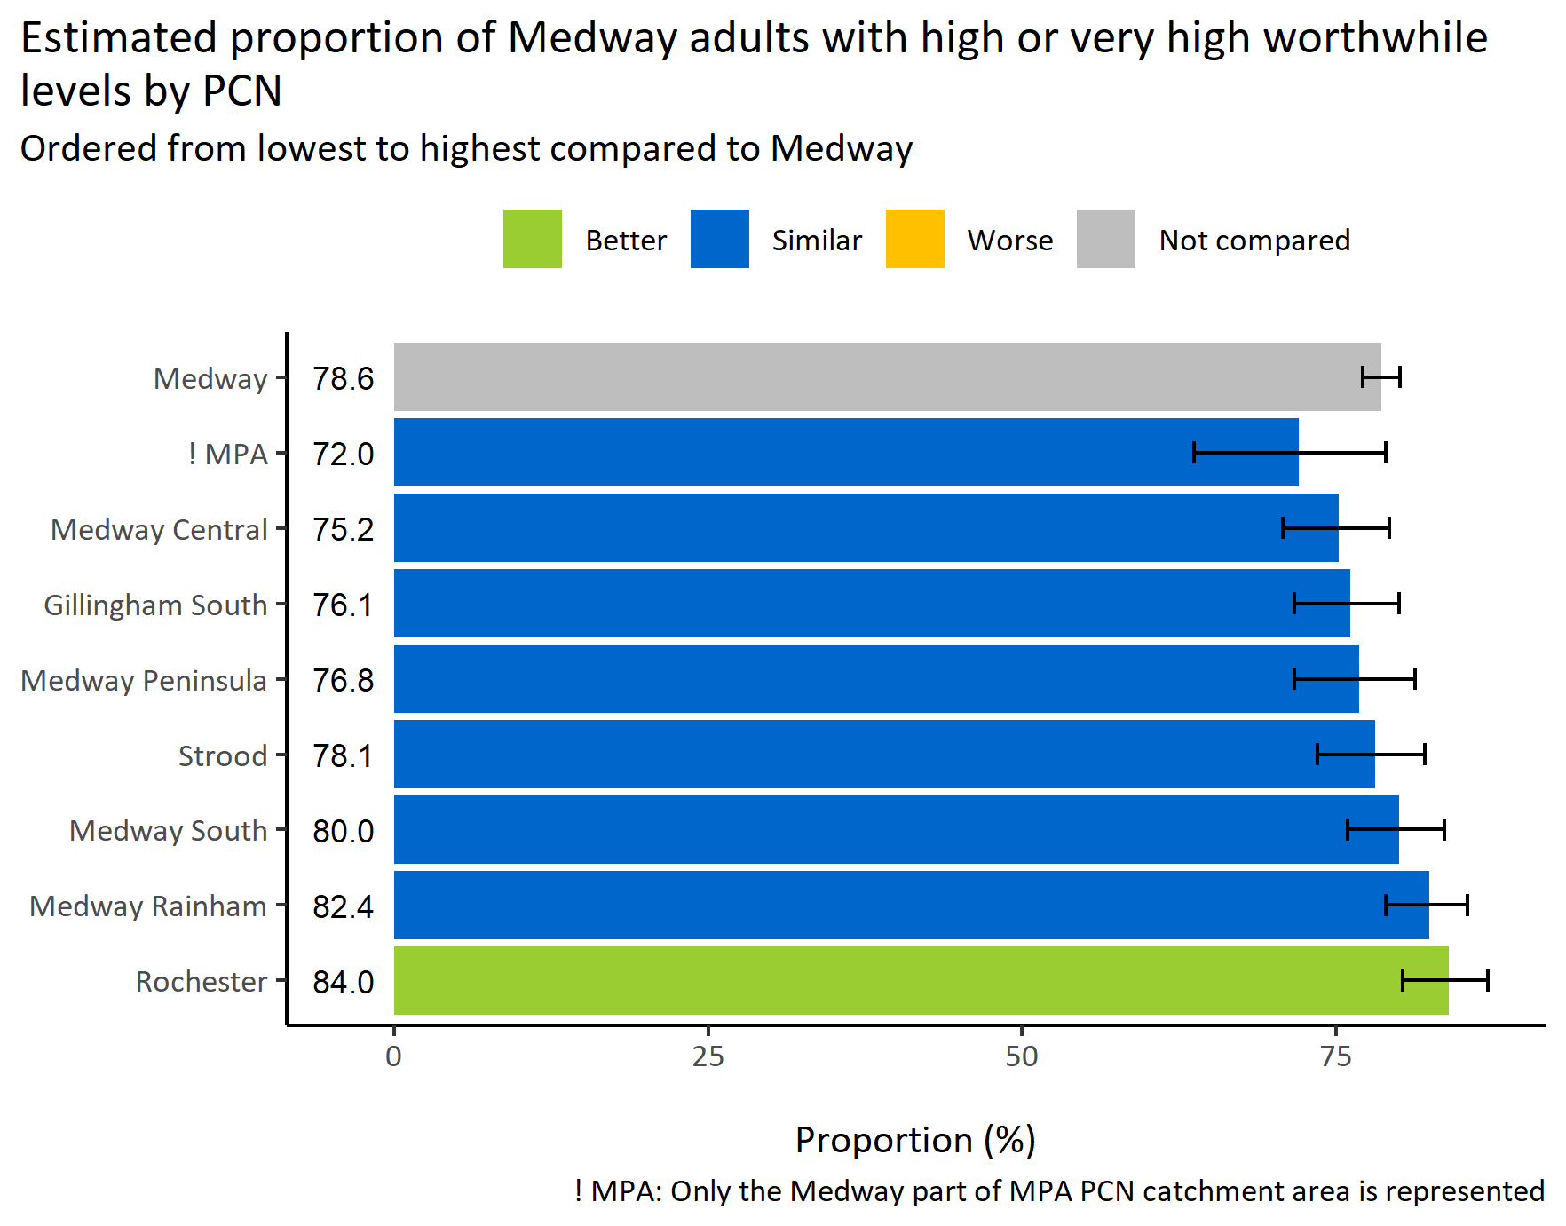
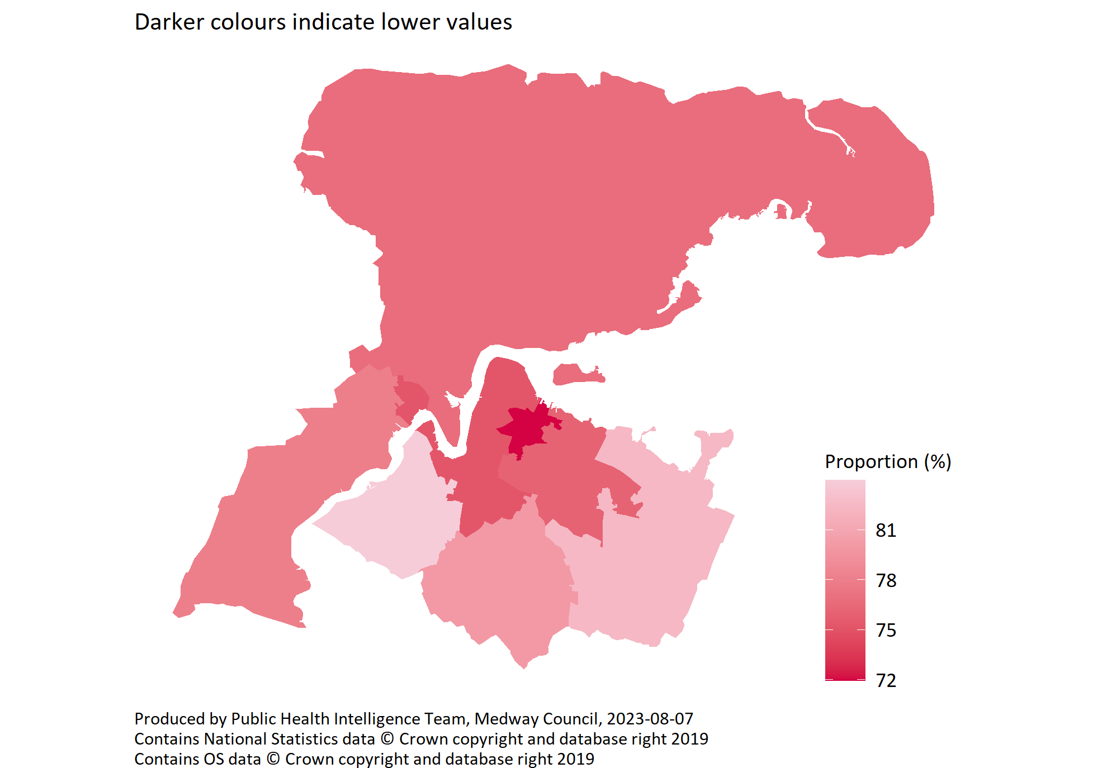
High or very high worthwhile by PCN
© Medway Council, Public Health Intelligence Team, Version 3.0, 07/08/2023
Survey question: I’d like you to give an answer on a scale of 0 to 10 where 0 is 'not at all' and 10 is 'completely': Overall, to what extent do you feel that the things you do in your life are worthwhile?
Possible answers: Scale 0-10
Categories: Low (0-4), Medium (5-6), High (7-8), Very High (9-10)

Slide 31
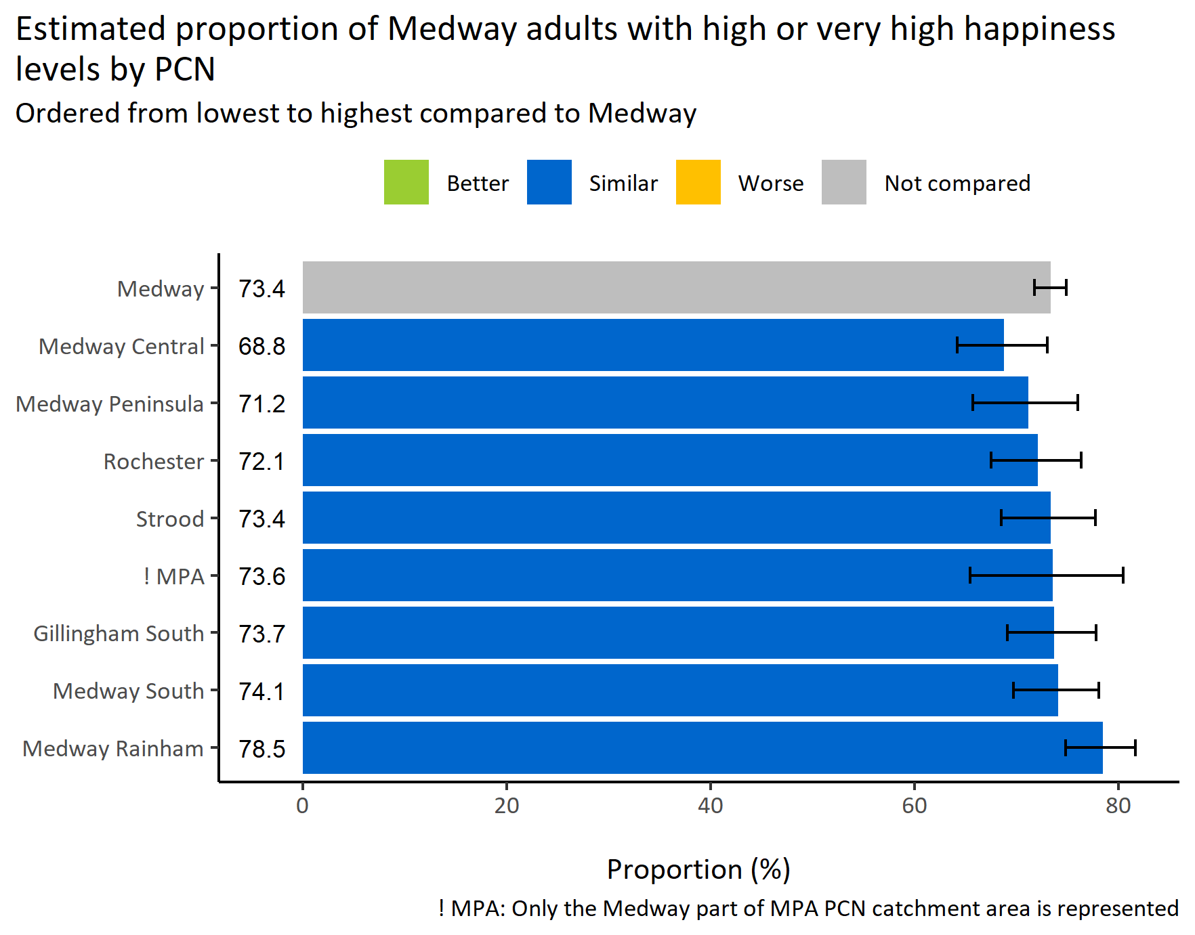
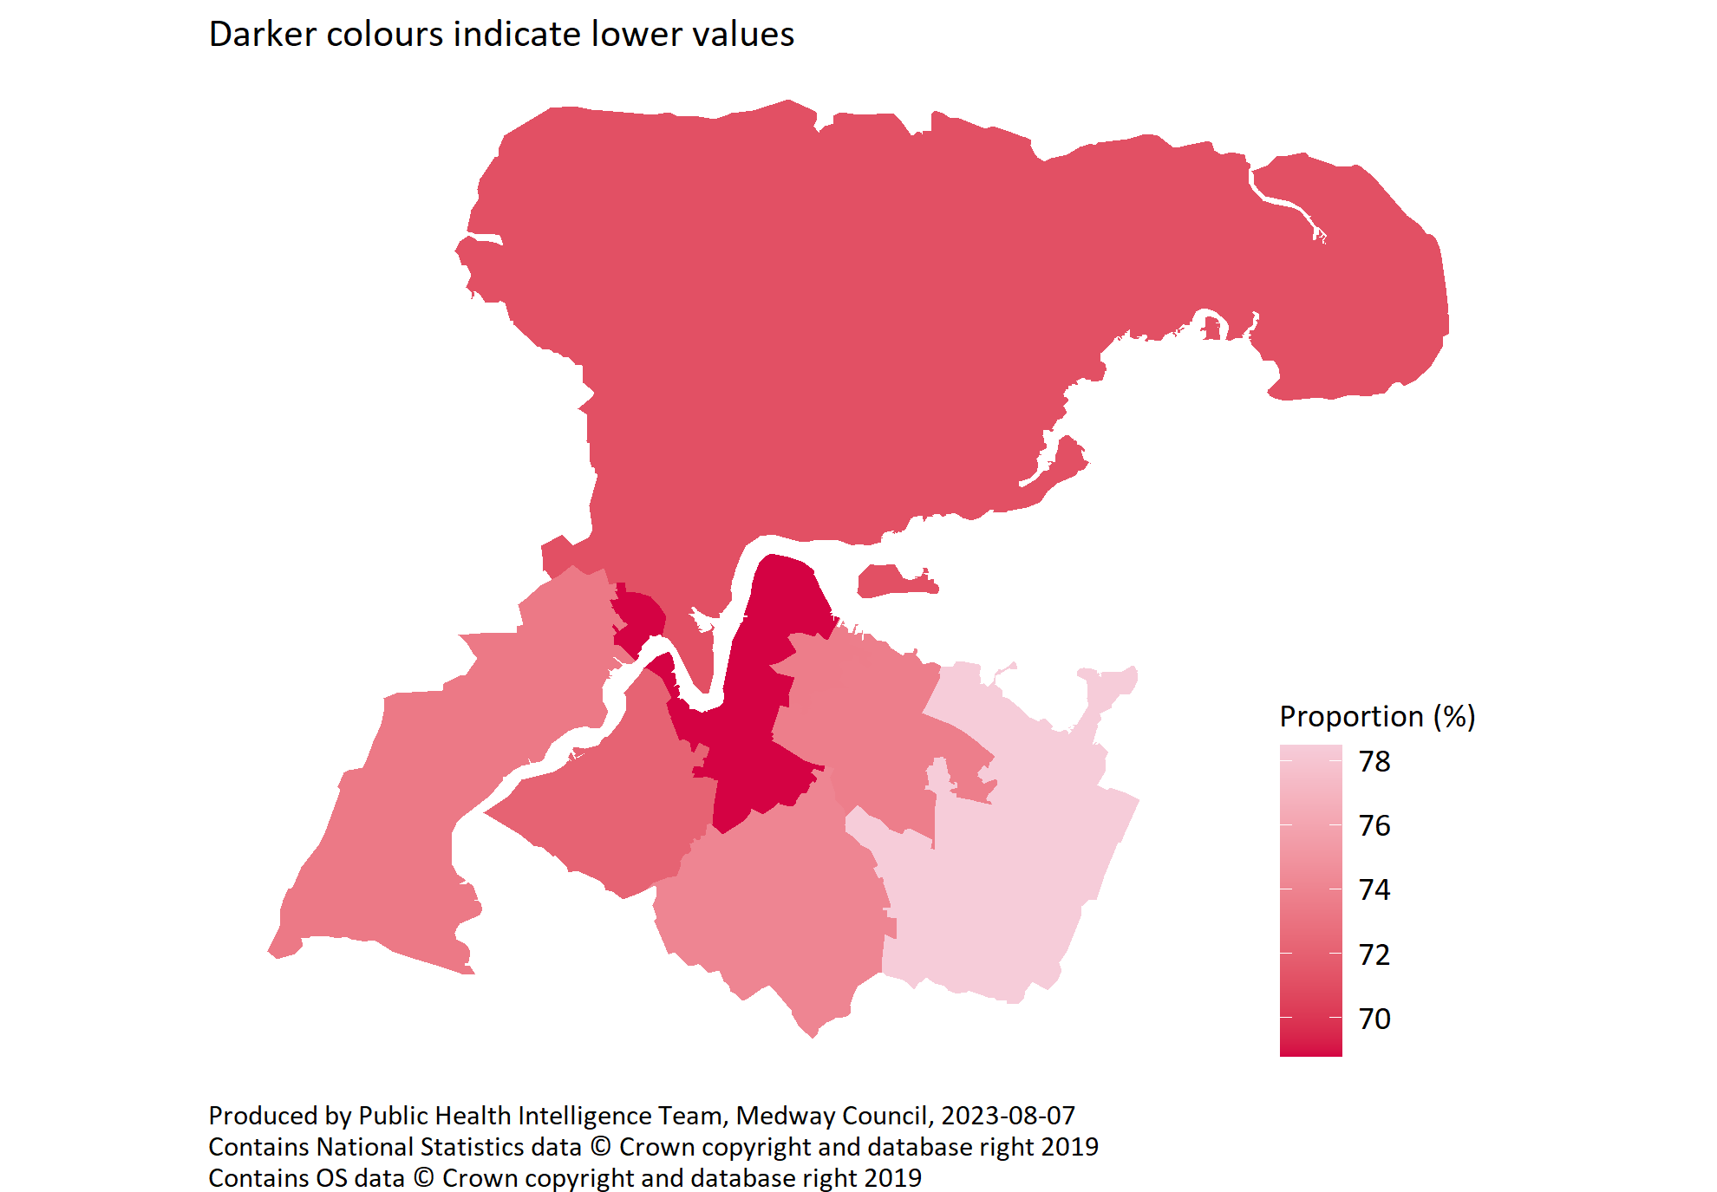
High or very high happiness by PCN
© Medway Council, Public Health Intelligence Team, Version 3.0, 07/08/2023
Survey question: I’d like you to give an answer on a scale of 0 to 10 where 0 is 'not at all' and 10 is 'completely': Overall, how happy did you feel yesterday?
Possible answers: Scale 0-10
Categories: Low (0-4), Medium (5-6), High (7-8), Very High (9-10)

Slide 32
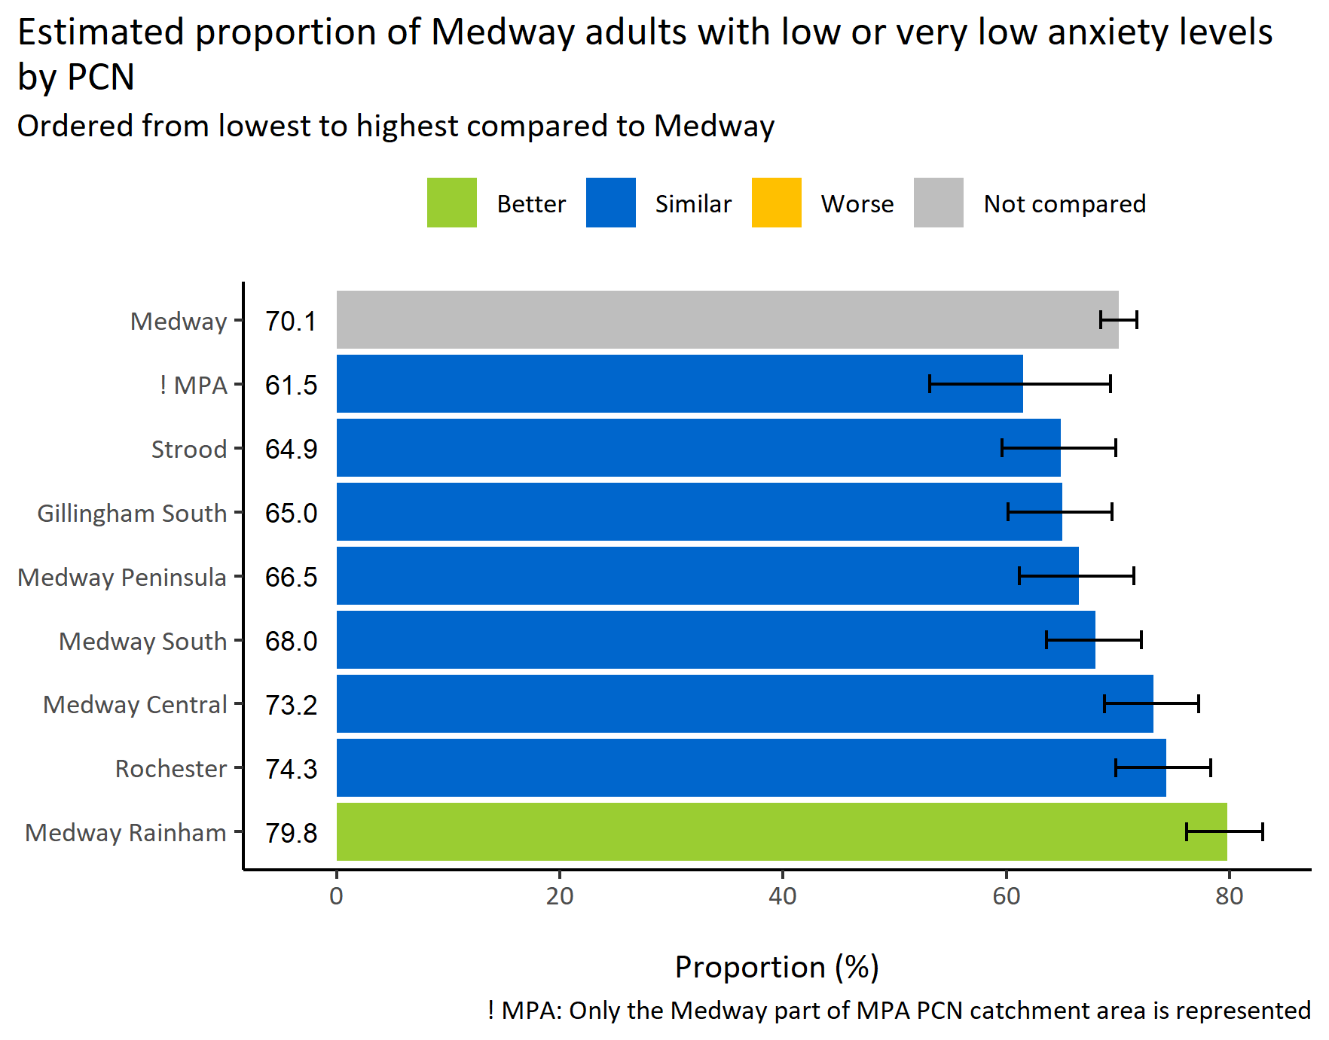
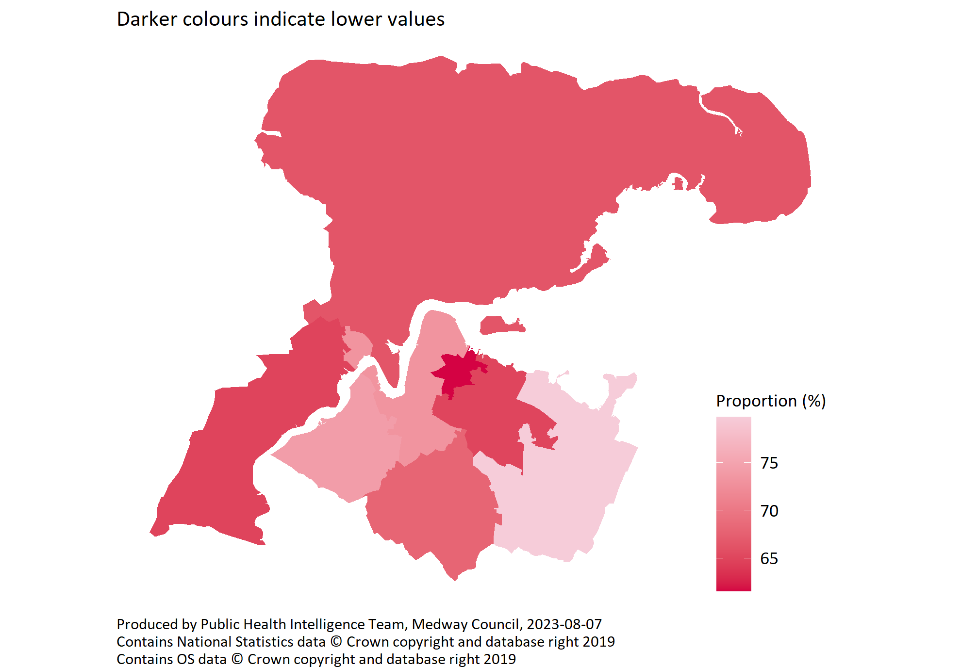
Low or very low anxiety by PCN
© Medway Council, Public Health Intelligence Team, Version 3.0, 07/08/2023
Survey question: I’d like you to give an answer on a scale of 0 to 10 where 0 is 'not at all' and 10 is 'completely': Overall, how anxious did you feel yesterday?
Possible answers: Scale 0-10
Categories: Very low (0-1), Low (2-3), Medium (4-5), High (6-10)

Slide 33
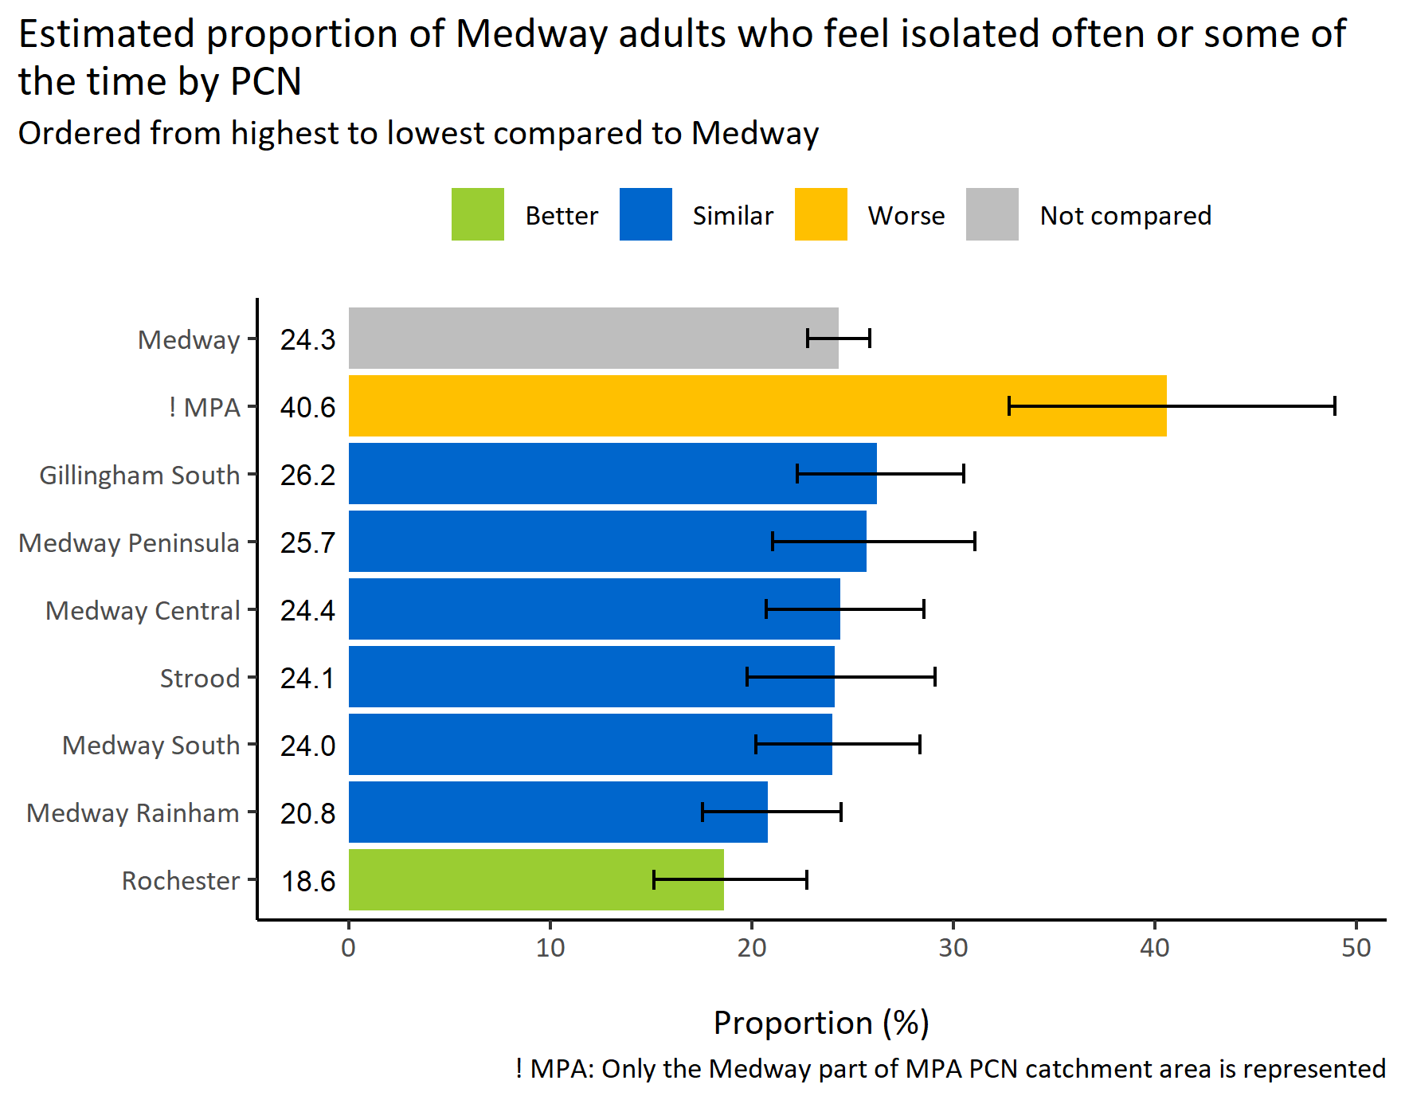
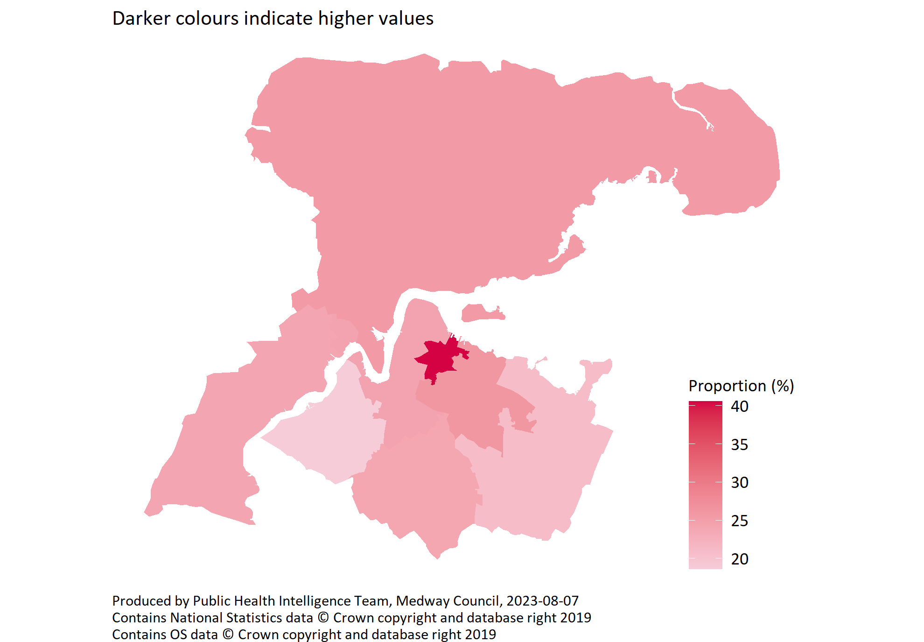
Social isolation by PCN
© Medway Council, Public Health Intelligence Team, Version 3.0, 07/08/2023
Survey question: How often do you feel isolated from others?
Possible answers: Often, Some of the time, Hardly ever or never, Don't want to say.
Category selected: Socially isolated: Often; Some of the time.

Slide 34
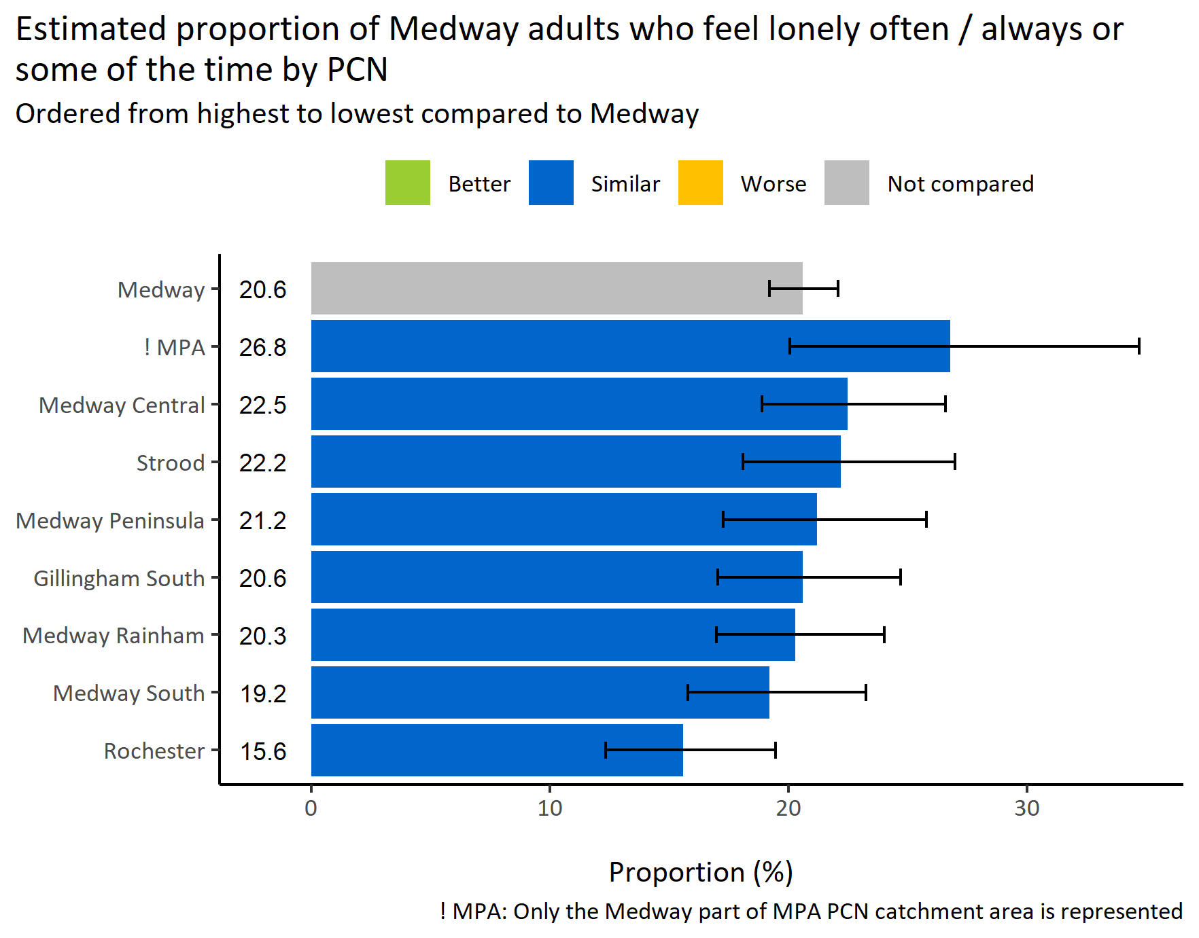
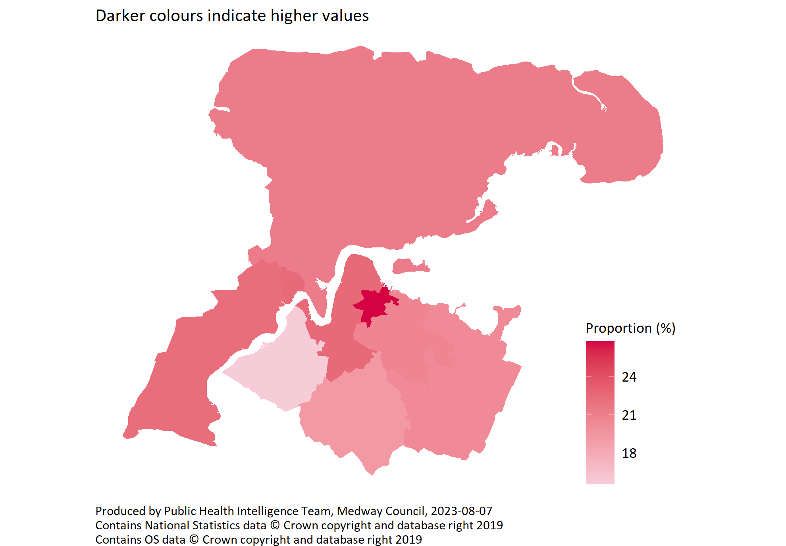
Loneliness by PCN
© Medway Council, Public Health Intelligence Team, Version 3.0, 07/08/2023
Survey question: How often do you feel lonely?
Possible answers: Often/always, Some of the time, Occasionally, Hardly ever, Never, Don't want to say.
Category selected: Lonely: Often/always or some of the time.

