Slide 1
Health and Wellbeing
Ward Profile
Hoo St Werburgh & High Halstow
Medway Council
Public Health Intelligence Team
28/01/2025

Slide 2
Purpose and rationale
Version 3.0 © Medway Council, Public Health Intelligence Team, 28/01/2025
Profiles have been created for each of the 24 wards in Medway Unitary Authority.
The aim of the ward profiles is to identify the health and wellbeing needs of the ward.
The people and place section provides contextual information about the population characteristics.
The indicators are then grouped into the five main themes of the Medway Joint Health and Wellbeing Strategy (JHWS) 2018 to 2023.
You can find a detailed methodology and resources section at the end of this presentation.
Medway Joint Health and Wellbeing Strategy (JHWS) 2018-2023

Slide 3
Summary: Hoo St Werburgh & High Halstow ward
Version 3.0 © Medway Council, Public Health Intelligence Team, 28/01/2025
Indicator | Compared | Slide
General fertility rate | Higher | 12
MMR one dose (2 yrs) | Similar | 13
DTaP/IPV/Hib/HepB vaccine (2 yrs) | Better | 14
A&E attendances (0-4 yrs) | Worse | 15
Year 6: Prevalence of excess weight | Similar | 16
Admissions for asthma (<19 yrs) | Similar | 17
Admissions for self-harm (10-24 yrs) | Similar | 18
Smoking prevalence | Higher | 20
Obesity prevalence | Similar | 21
Alcohol admissions | Better | 22
Depression prevalence | Higher | 23
Severe mental illness prevalence | Lower | 24
Cervical screening | Higher | 27
Breast cancer screening | Similar | 28
Bowel cancer screening | Similar | 29
Cancer prevalence | Similar | 30
Deaths from cancer | Similar | 31
Hypertension prevalence | Higher | 33
Coronary heart disease prevalence | Similar | 34
Deaths from coronary heart disease | Similar | 35
Indicator | Compared | Slide
Stroke prevalence | Lower | 36
Deaths from stroke | Similar | 37
Heart failure prevalence | Similar | 38
Atrial fibrillation prevalence | Similar | 39
Deaths from circulatory disease | Similar | 40
Diabetes prevalence | Higher | 42
Chronic kidney disease prevalence | Similar | 44
Asthma prevalence | Similar | 46
COPD prevalence | Similar | 47
Deaths from respiratory diseases | Similar | 48
Epilepsy prevalence | Similar | 50
ACSC admissions | Worse | 51
Deaths from all causes | Similar | 53
Dementia prevalence | Similar | 55
Emergency admissions for falls | Similar | 56
Emergency admissions for hip fractures | Similar | 57
Life expectancy (male) | Similar | 59
Life expectancy (female) | Similar | 60
Unemployment | Better | 62
Access to hospital | Worse | 63
Indicator | Compared | Slide
Access to secondary school | Better | 64
Access to garden space | Better | 65
Access to public green space | Better | 66

Slide 4
Indicator slides explained
Version 3.0 © Medway Council, Public Health Intelligence Team, 28/01/2025

Slide 5
Contact details
Version 3.0 © Medway Council, Public Health Intelligence Team, 28/01/2025
If you have any questions or would like further information about these profiles, please contact:
Dr Eluned Broom
Senior Public Health Intelligence Manager
Public Health
Medway Council
eluned.broom@medway.gov.uk
01634 334111
For general enquiries, please contact the Medway Public Health Intelligence Team Inbox: phit@medway.gov.uk

Slide 6
People and place

Slide 7
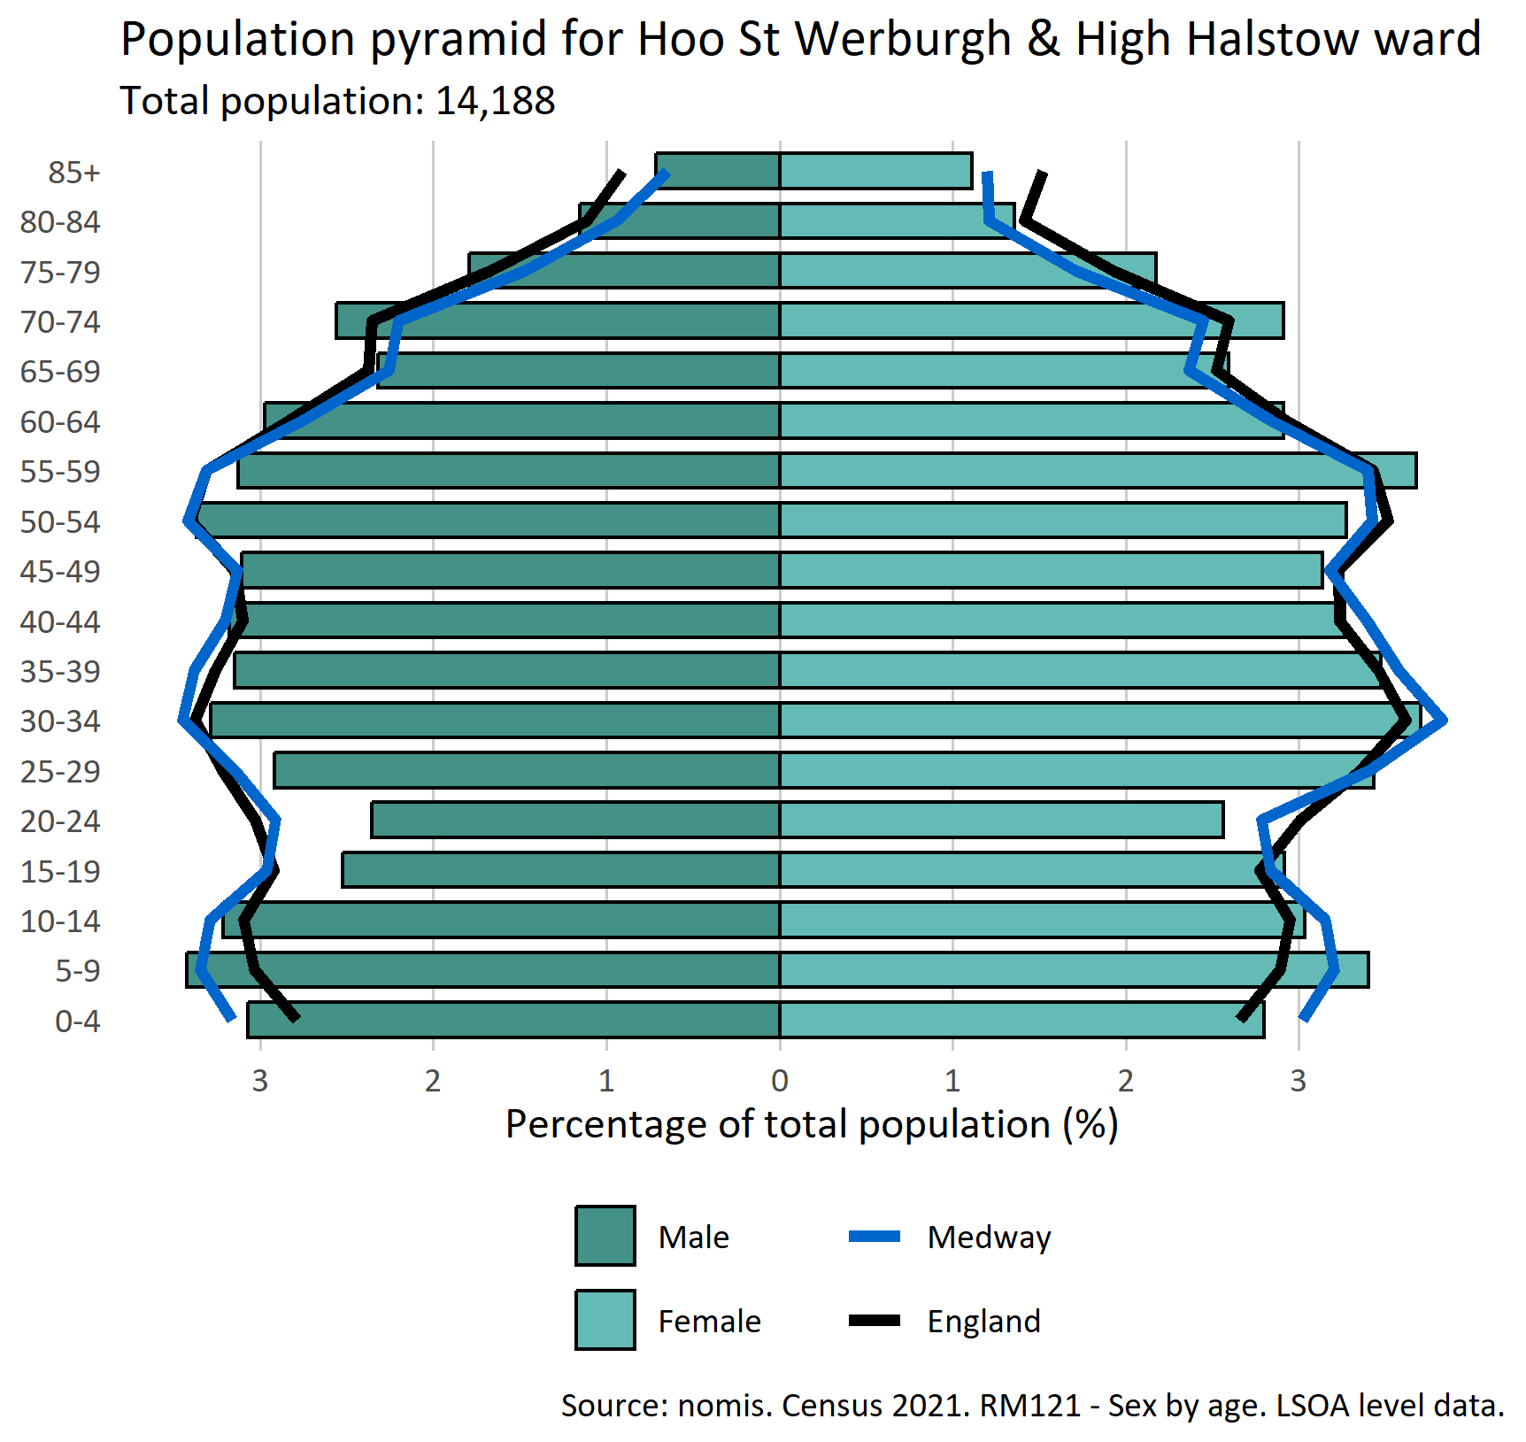
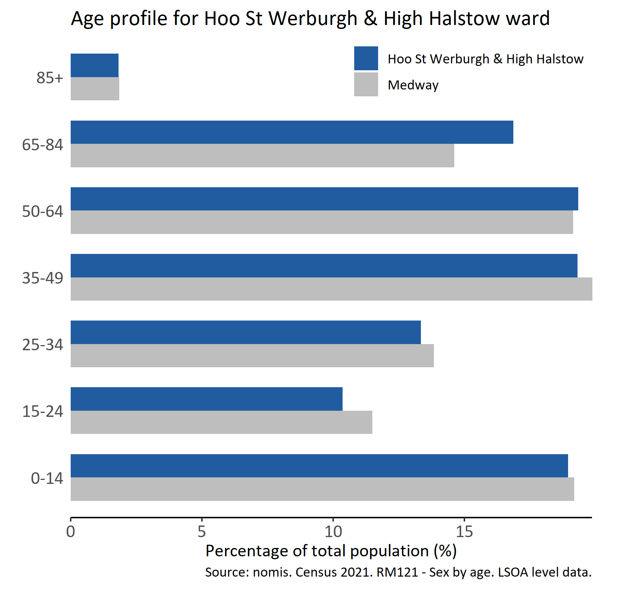
Population
Version 3.0 © Medway Council, Public Health Intelligence Team, 28/01/2025

Slide 8
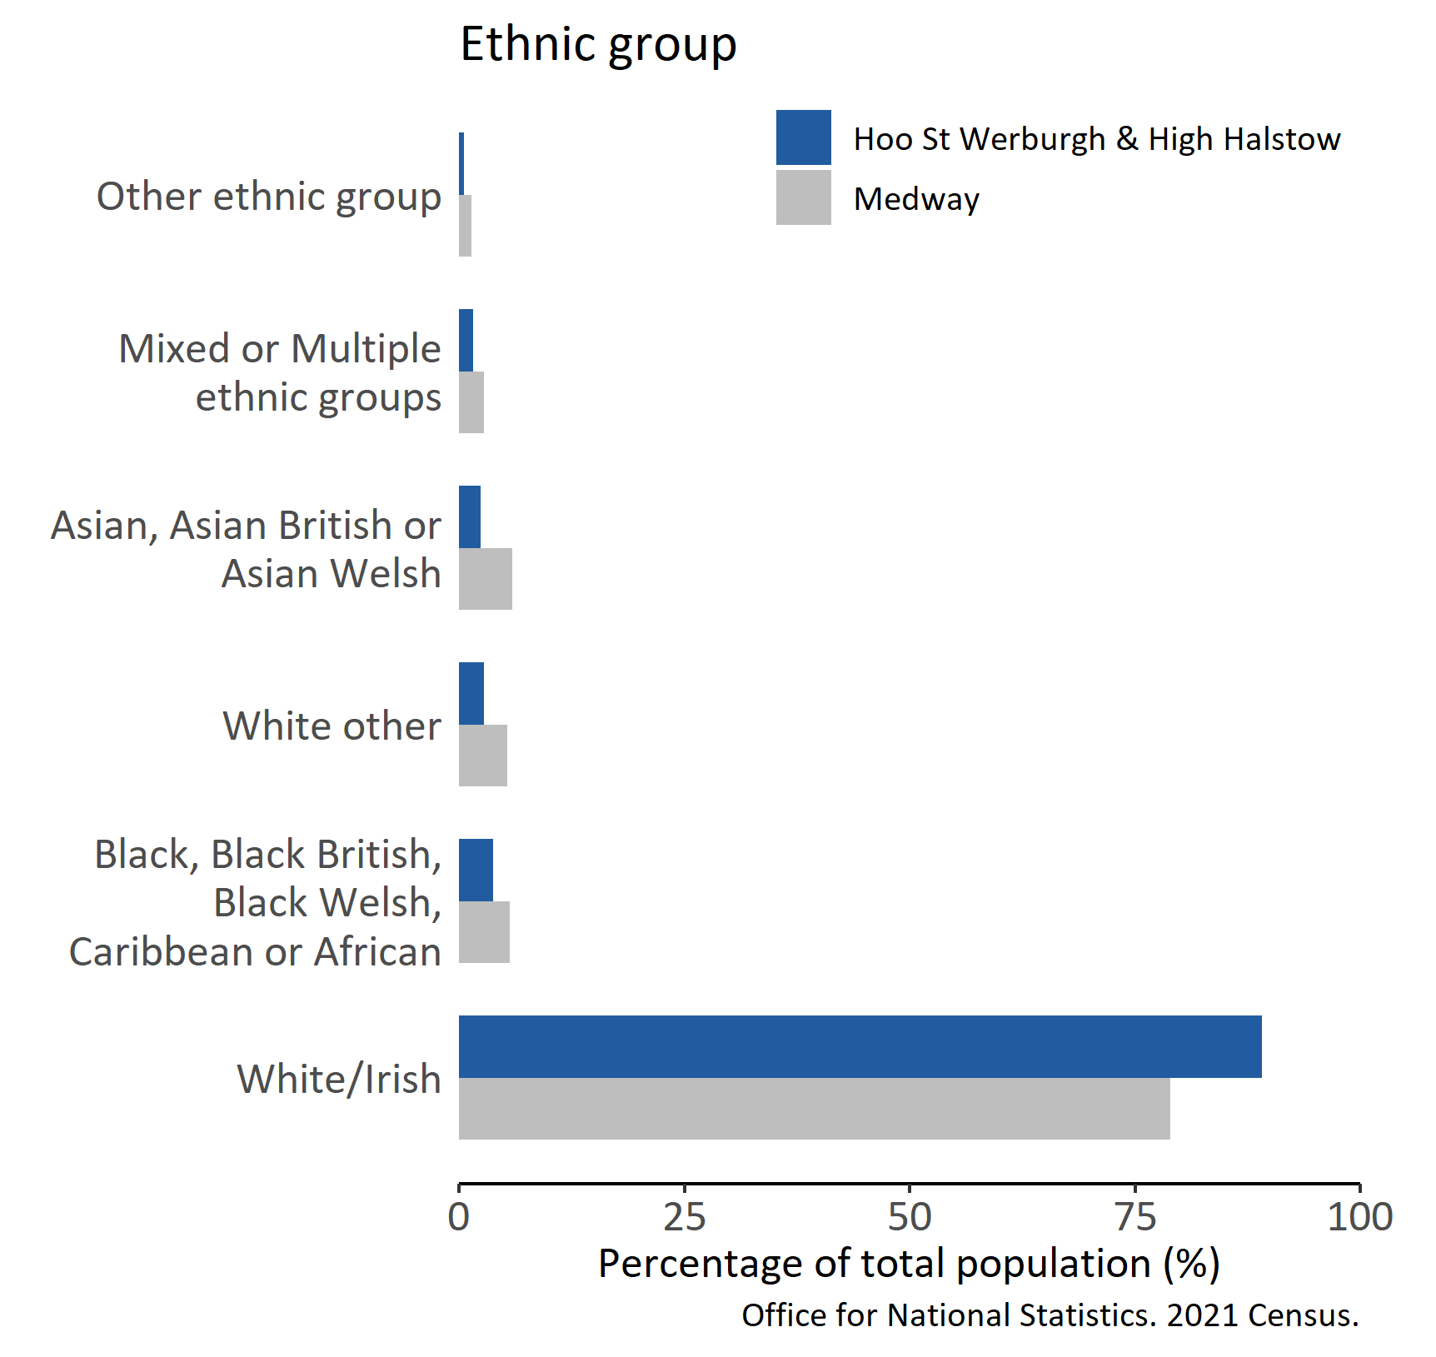
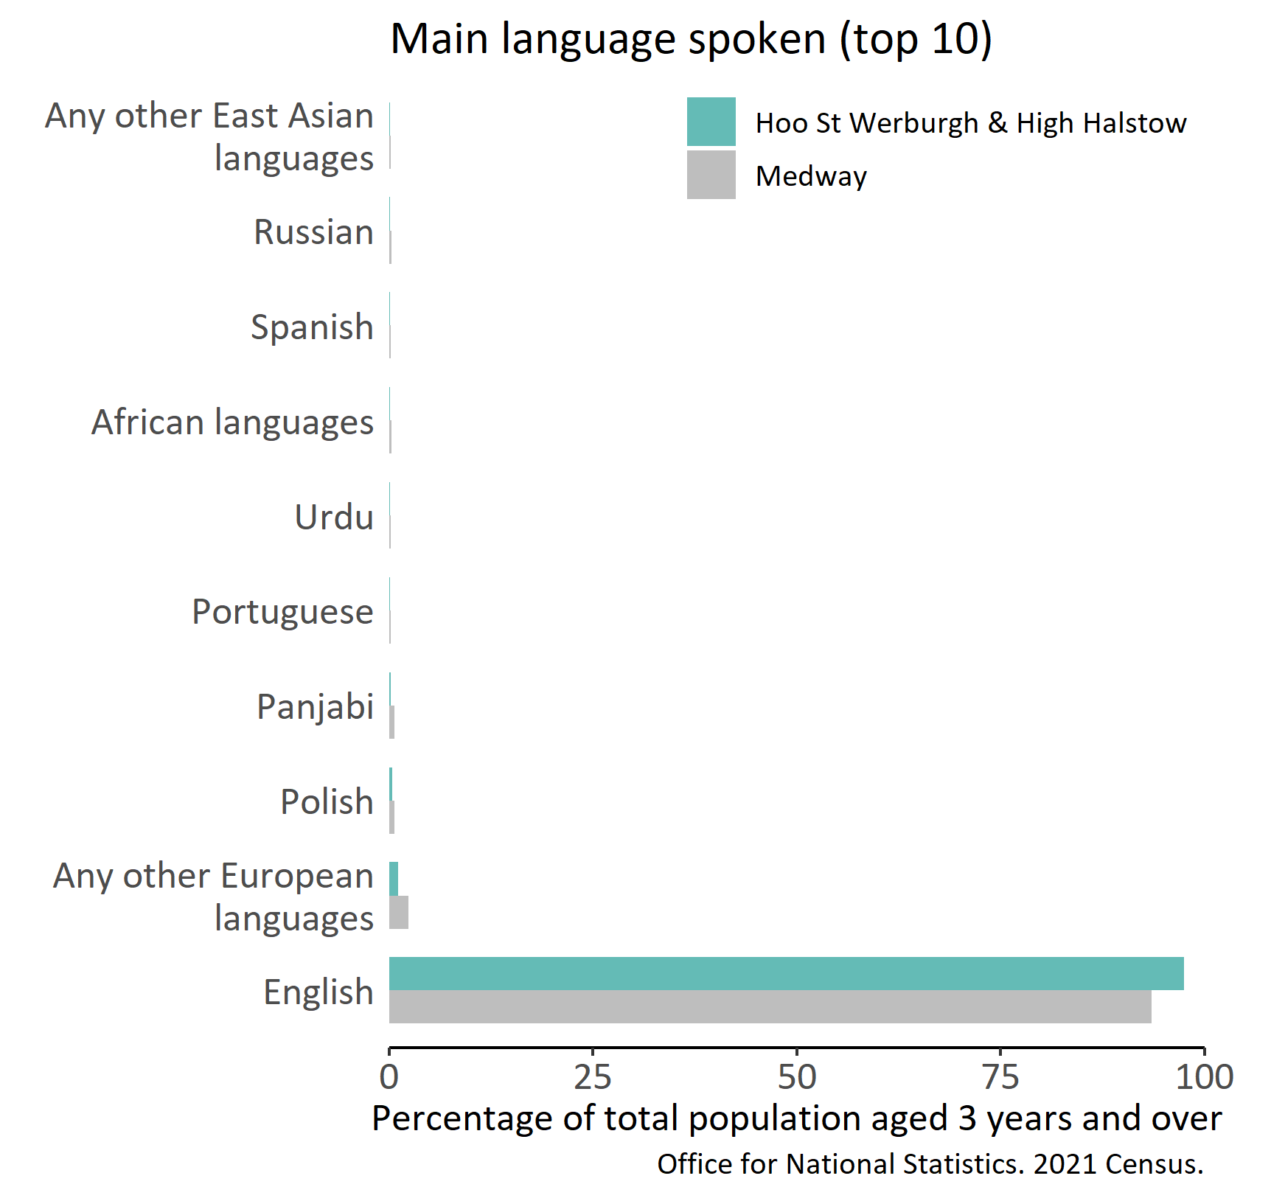
Ethnic group and main language
Version 3.0 © Medway Council, Public Health Intelligence Team, 28/01/2025

Slide 9
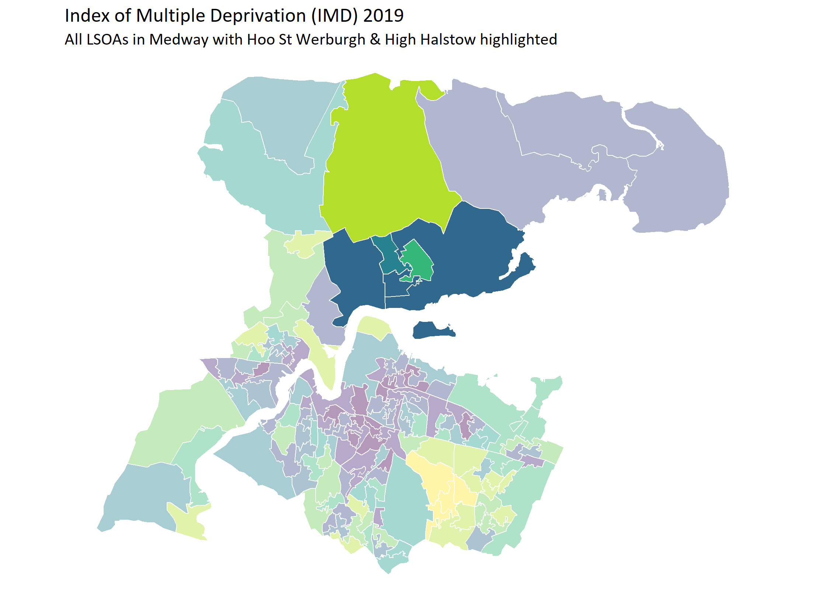
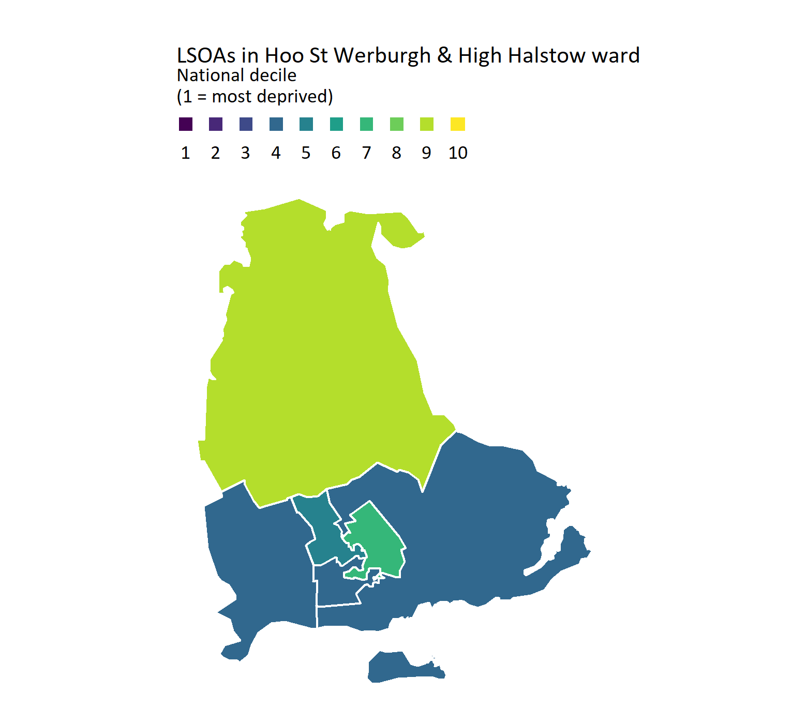
Deprivation
Version 3.0 © Medway Council, Public Health Intelligence Team, 28/01/2025
Contains National Statistics data © Crown copyright and database right 2025
Contains OS data © Crown copyright and database right 2025
Medway Public Health Intelligence Team, Medway Council 2025-01-28

Slide 10
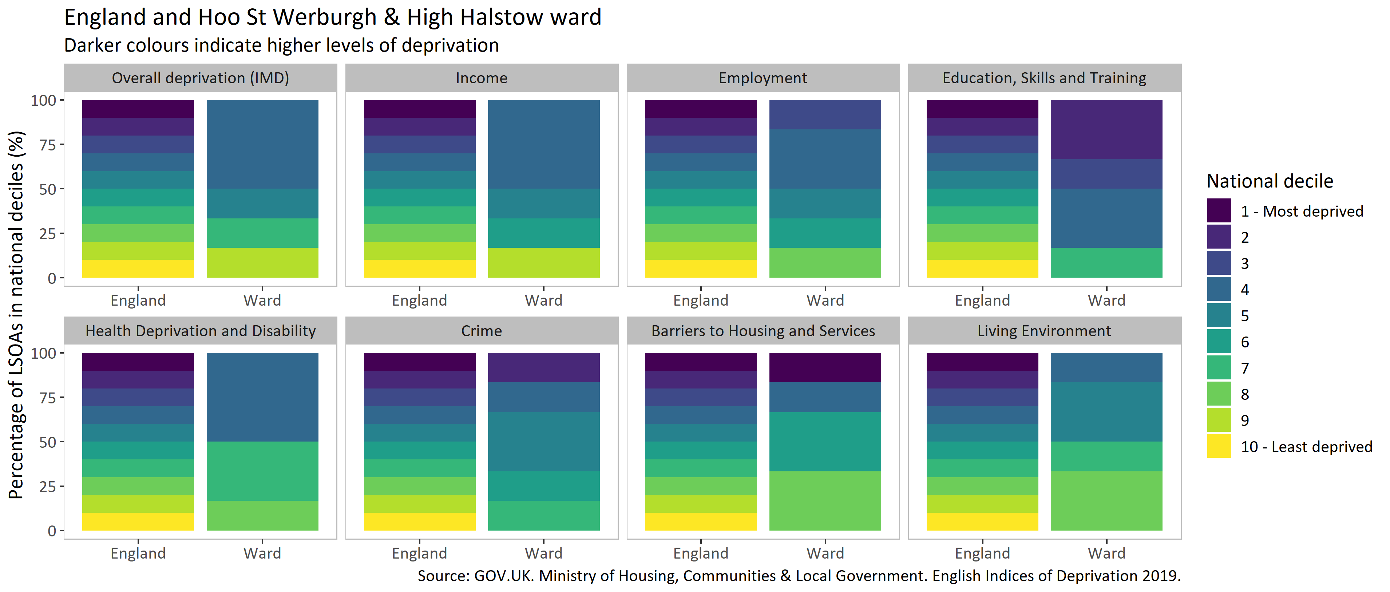
Domains of deprivation
Version 3.0 © Medway Council, Public Health Intelligence Team, 28/01/2025

Slide 11
Best start in life

Slide 12
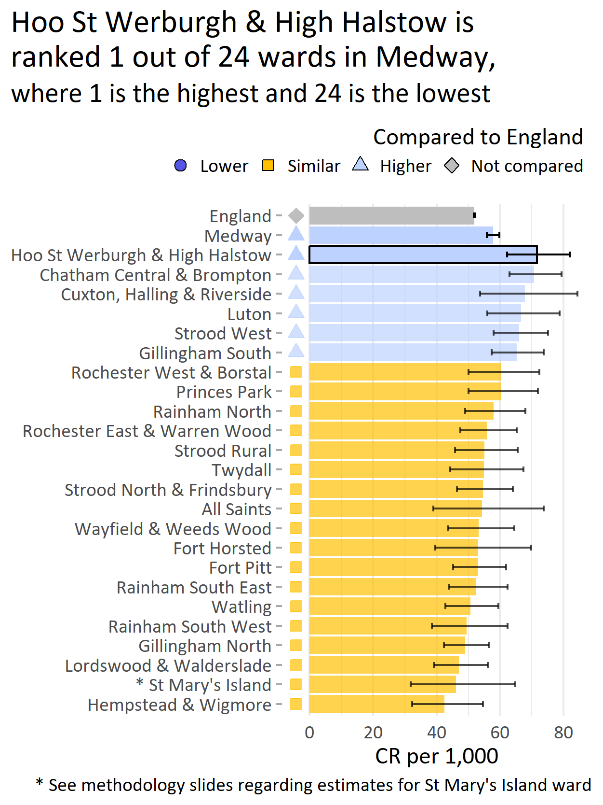
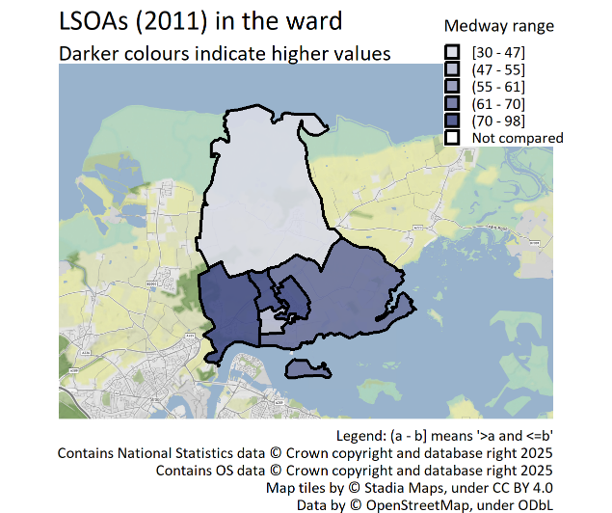
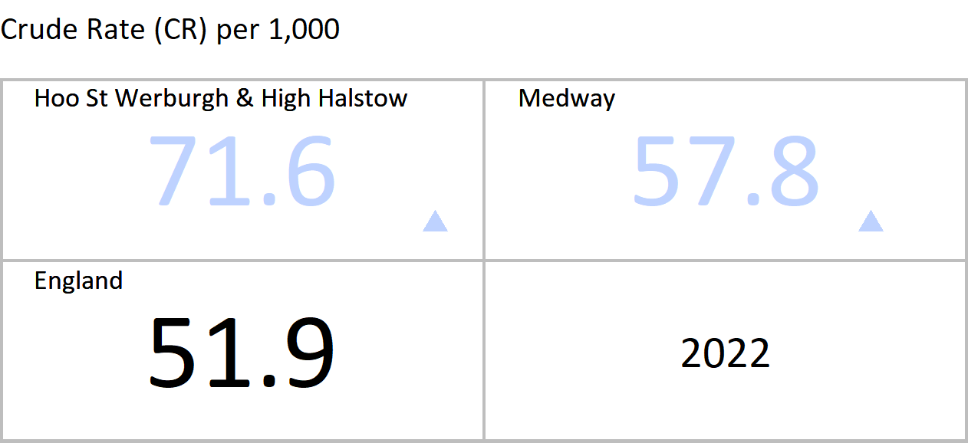
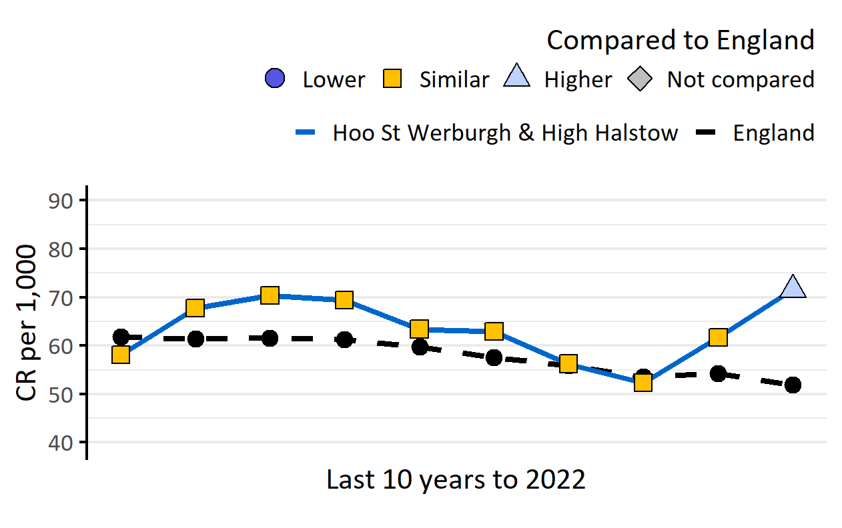
General fertility rate: live births per 1,000 women aged 15-44 years
Version 3.0 © Medway Council, Public Health Intelligence Team, 28/01/2025
The latest value for Hoo St Werburgh and High Halstow is higher than England.
Value type: Crude Rate (CR) per 1,000.
Original geography: LSOA.
Benchmarking method: Byar's CI method (95%).
Source: Office for National Statistics Births Statistics; ONS Mid-Year Population Estimates.
Copyright: Crown Copyright. Original data source: Office for National Statistics.
This indicator may vary slightly from published figures due to data quality issues between 2020 and 2022.

Slide 13
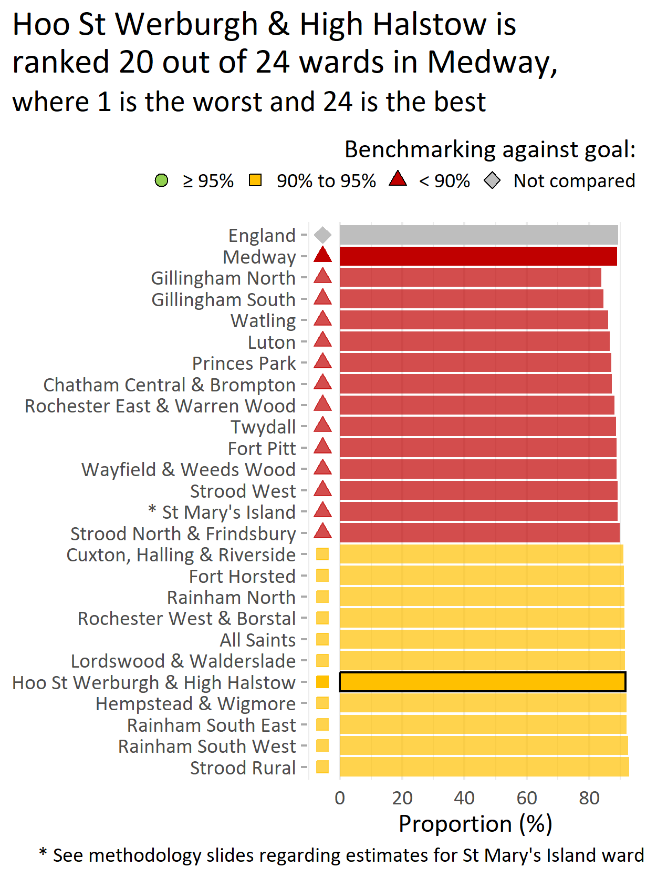
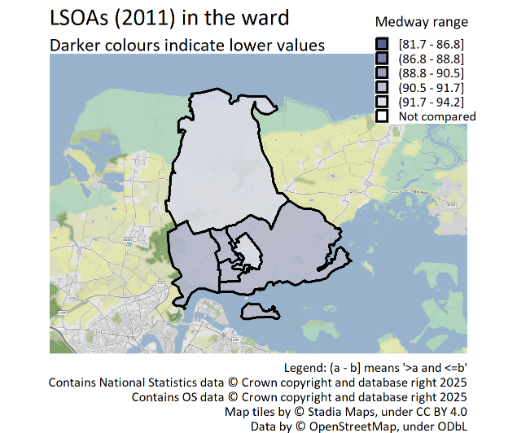
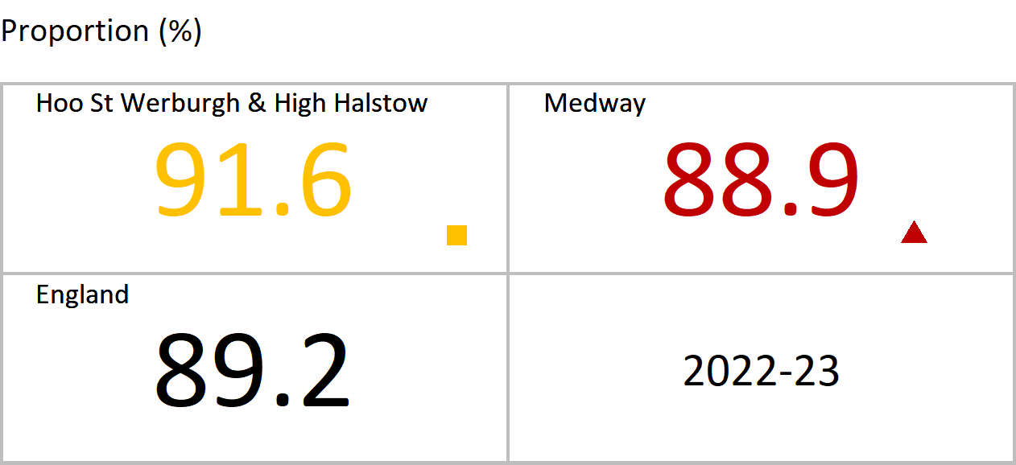
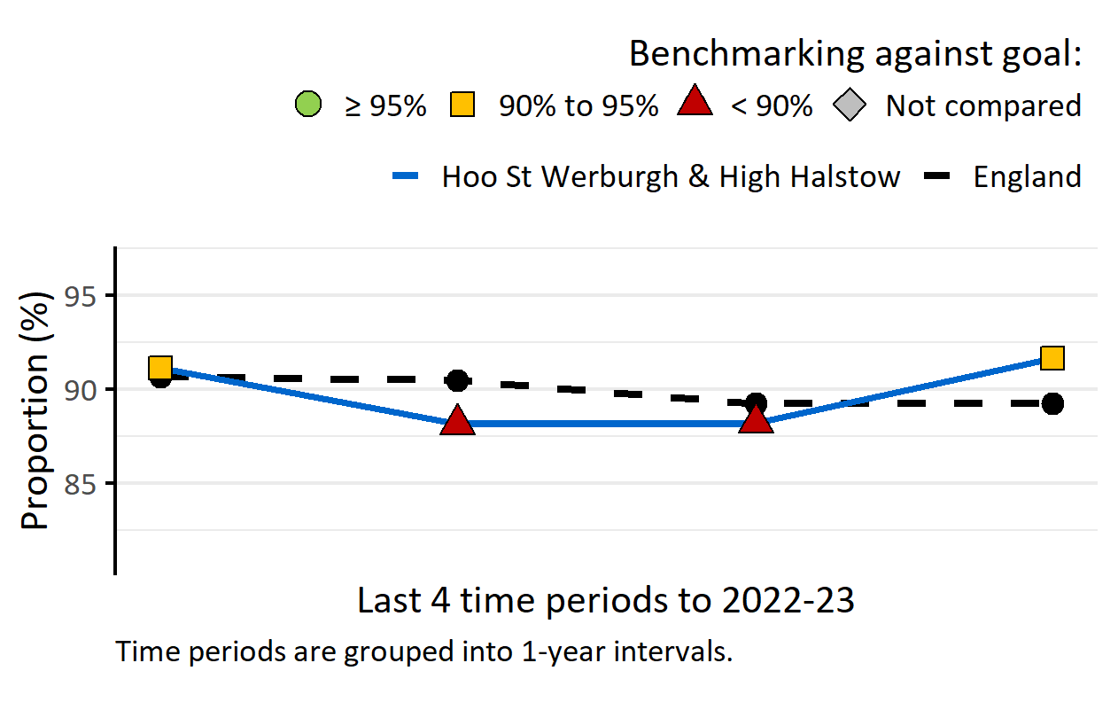
MMR vaccination for one dose (2 years)
Version 3.0 © Medway Council, Public Health Intelligence Team, 28/01/2025
The latest value for Hoo St Werburgh and High Halstow is similar to the goal (95%).
MMR is the vaccine that protects against measles, mumps and rubella.
The World Health Organization (WHO) recommends that at least 95% of children should be immunised against vaccine-preventable diseases.
Value type: Proportion (%).
Original geography: Practice.
Benchmarking method: Benchmarking against goal: 95%.
Source: UK Health Security Agency. Cover of Vaccination Evaluated Rapidly (COVER) programme: annual data.

Slide 14
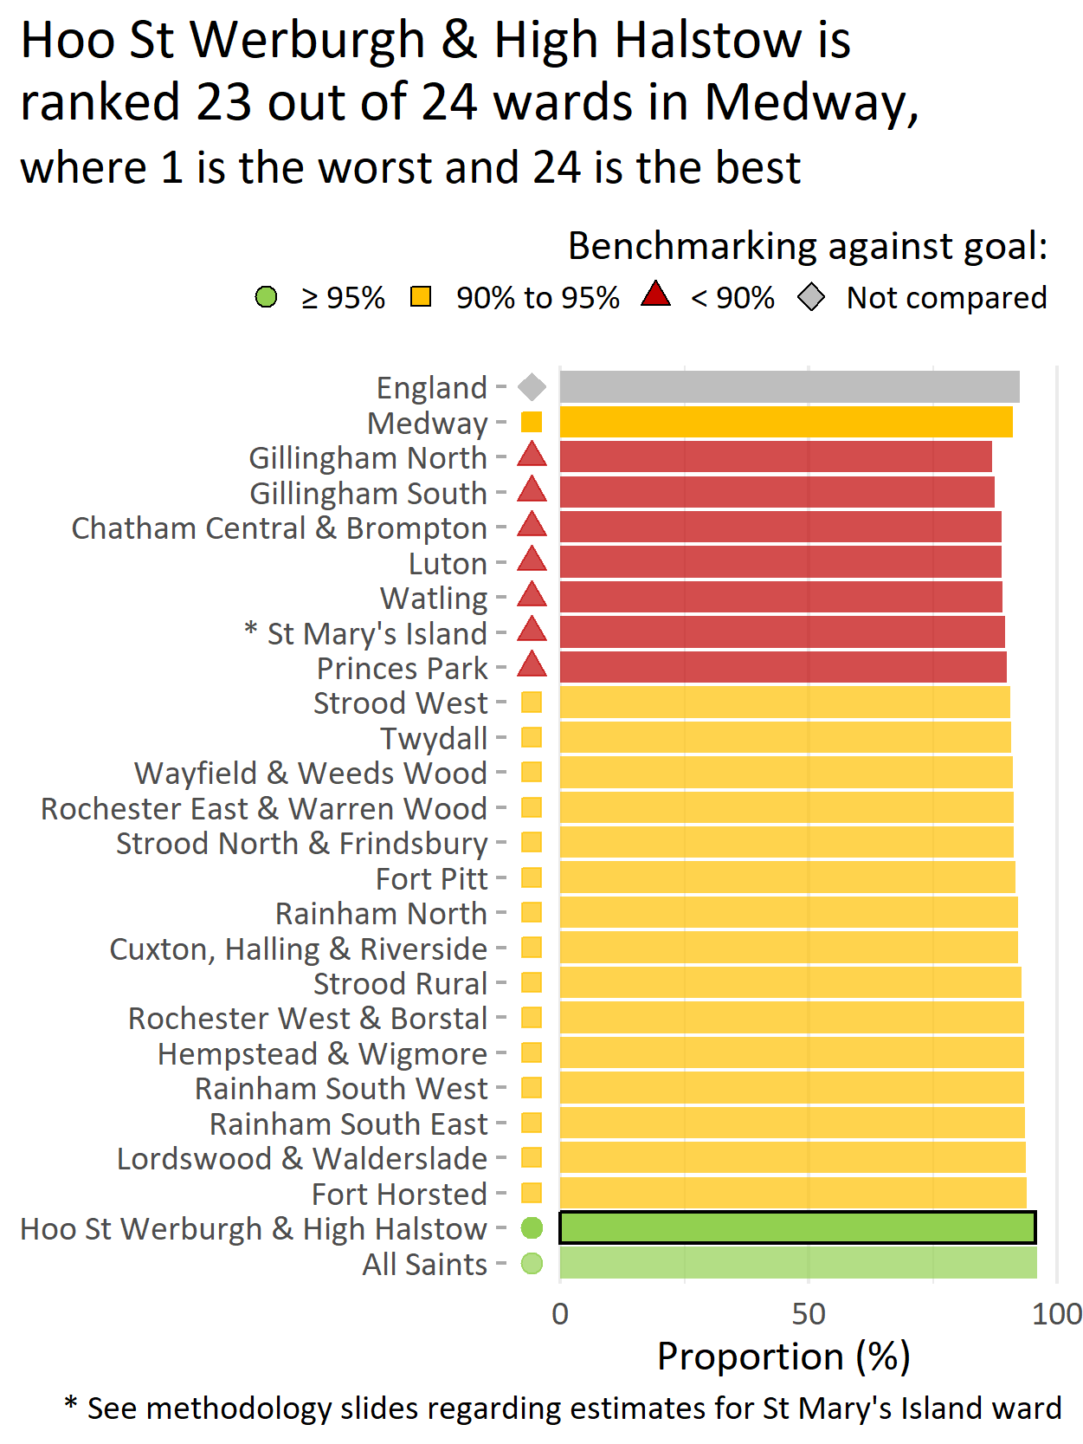
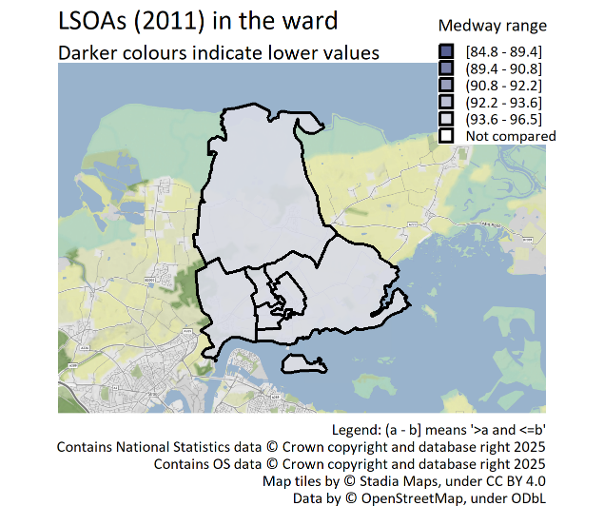
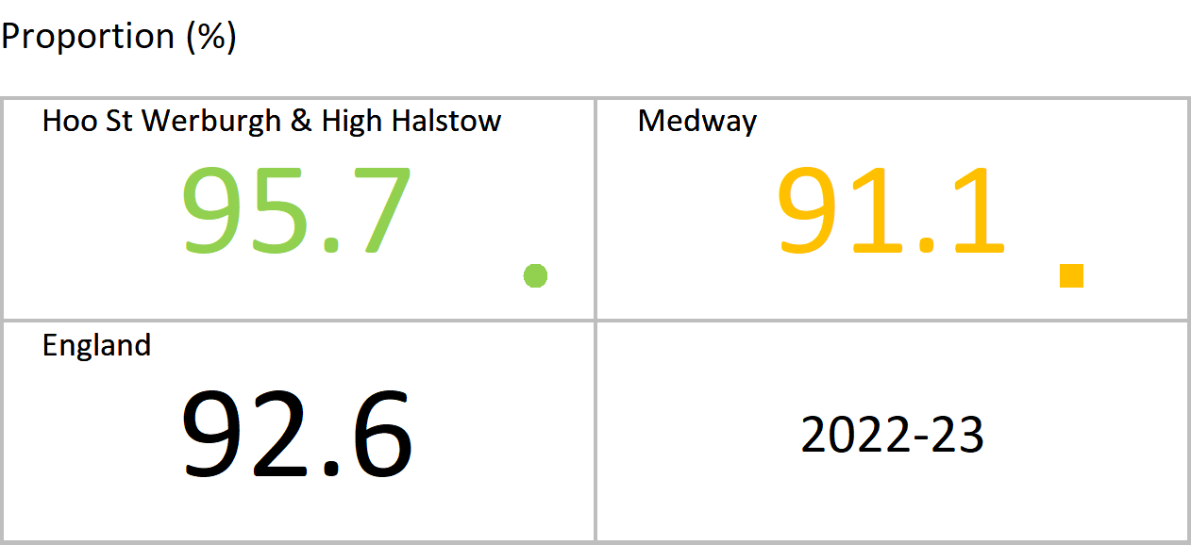
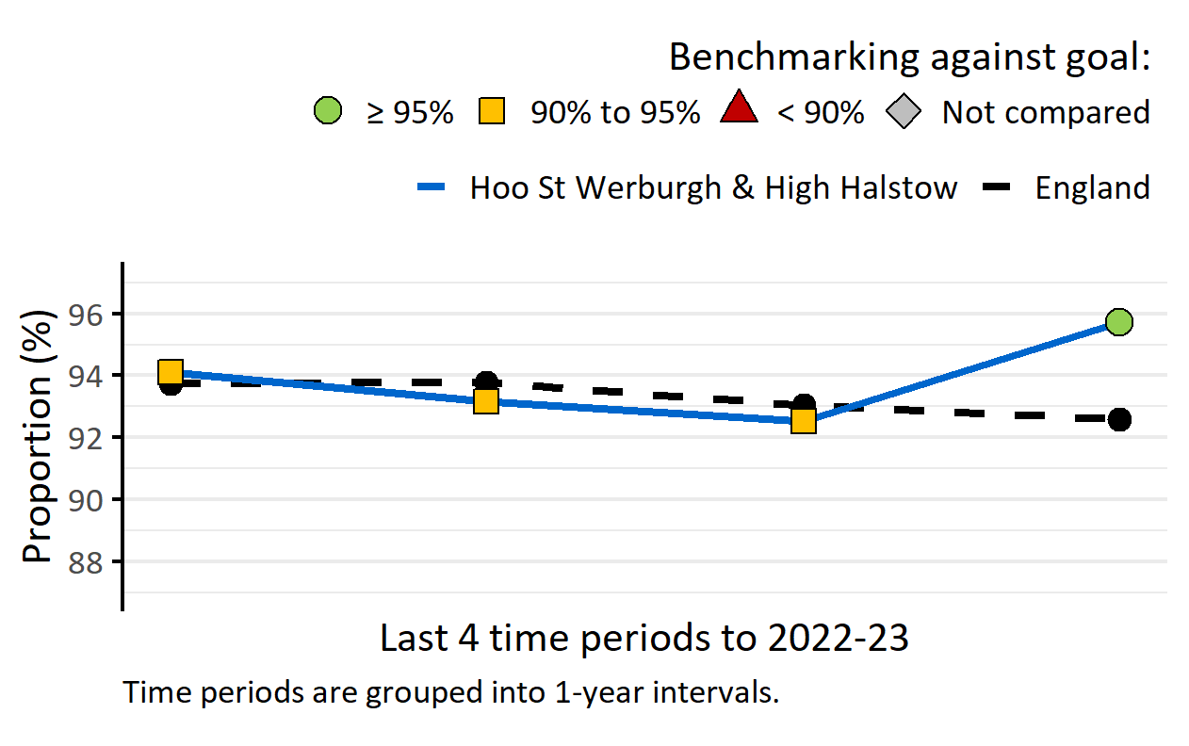
DTaP/IPV/Hib/HepB vaccination (2 years)
Version 3.0 © Medway Council, Public Health Intelligence Team, 28/01/2025
The latest value for Hoo St Werburgh and High Halstow is better than the goal (95%).
The 6-in-1 vaccine helps protect children against diphtheria, tetanus, pertussis (whooping cough), polio, Haemophilus influenzae type b (cause of childhood meningitis and pneumonia), and hepatitis B. The World Health Organization (WHO) recommends that at least 95% of children should be immunised against vaccine-preventable diseases.
Value type: Proportion (%).
Original geography: Practice.
Benchmarking method: Benchmarking against goal: 95%.
Source: UK Health Security Agency. Cover of Vaccination Evaluated Rapidly (COVER) programme: annual data.

Slide 15
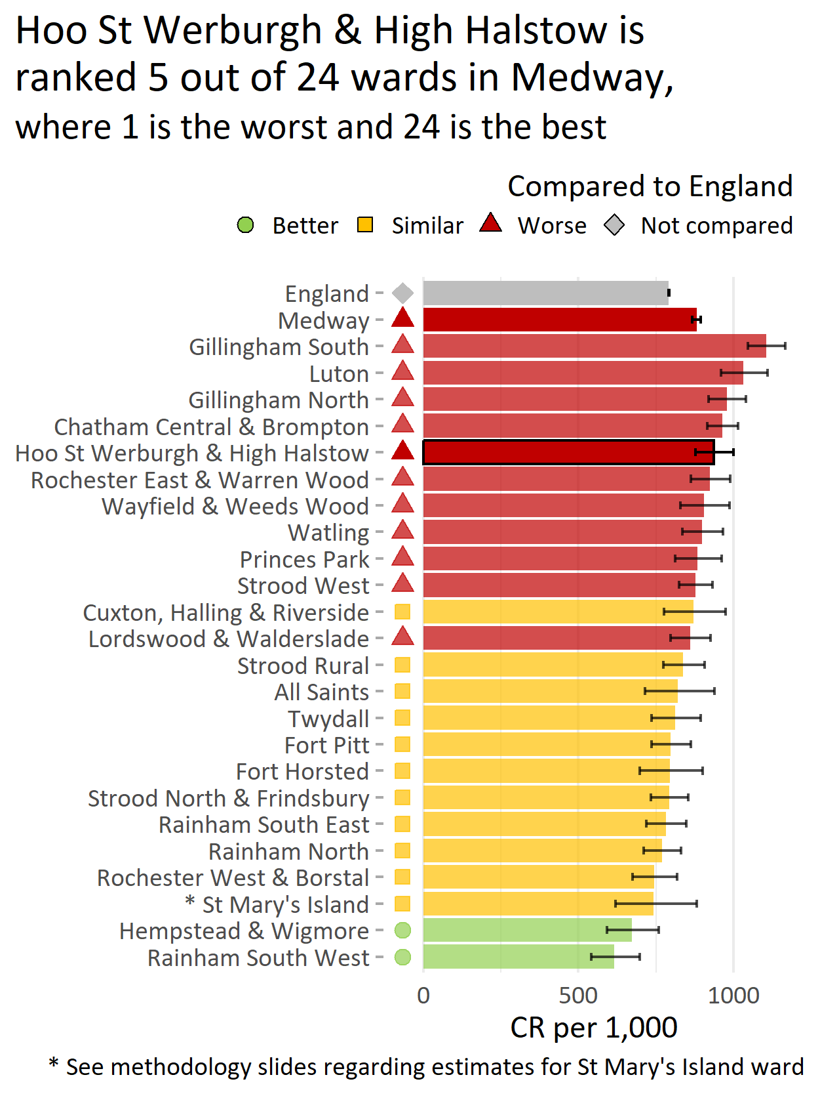
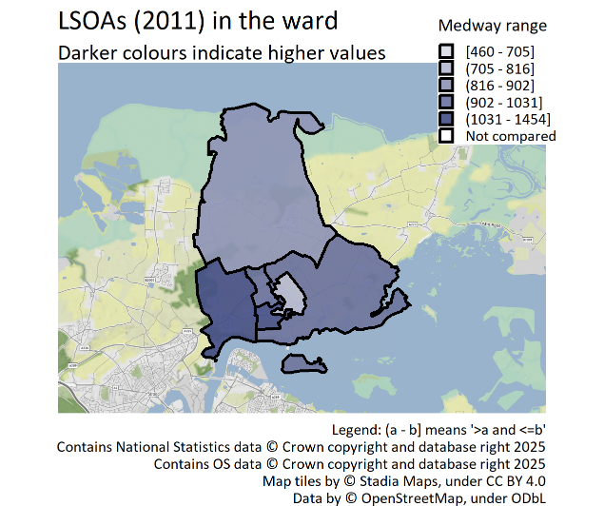
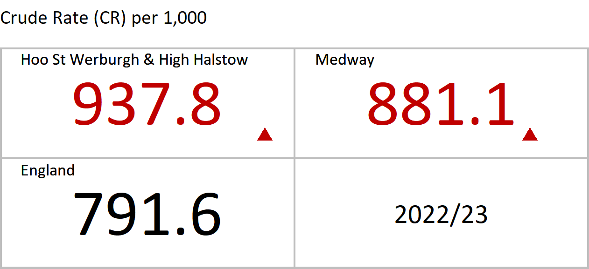
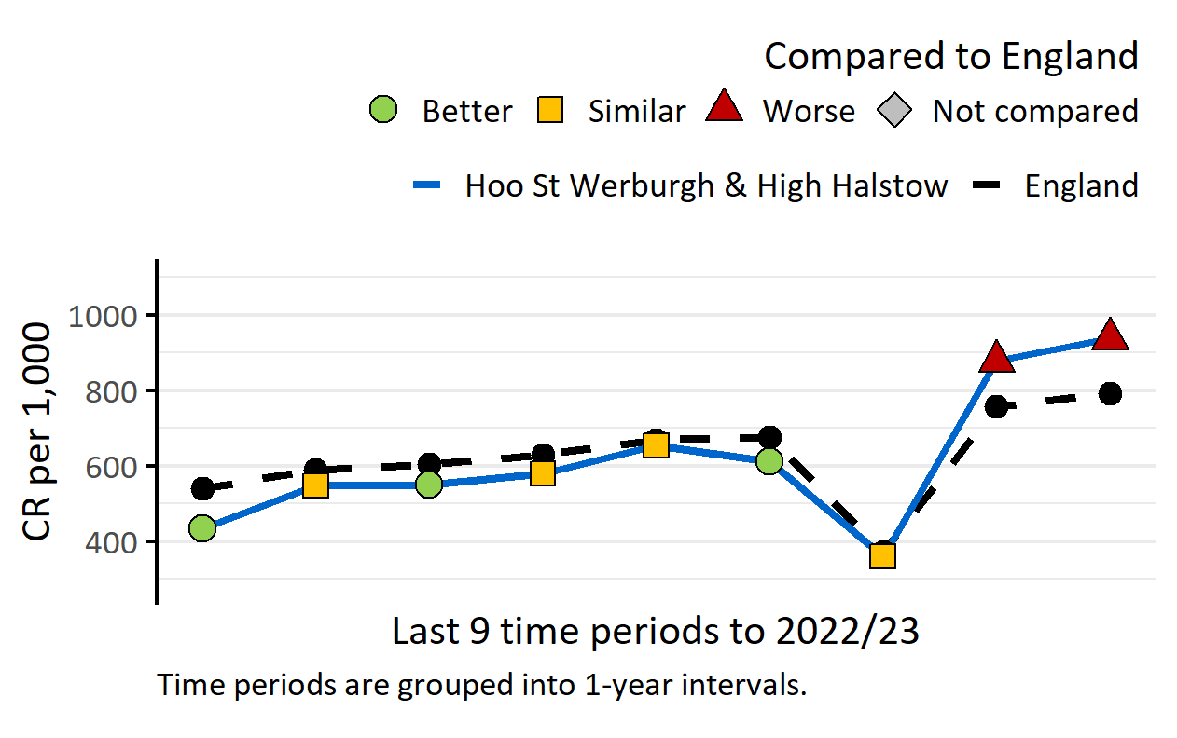
A&E attendances, persons, 0-4 yrs
Version 3.0 © Medway Council, Public Health Intelligence Team, 28/01/2025
The latest value for Hoo St Werburgh and High Halstow is worse than England.
Value type: Crude Rate (CR) per 1,000.
Original geography: LSOA.
Benchmarking method: Byar's CI method (95%).
Source: NHS Digital, Hospital Episode Statistics (HES).
Notes: COVID-19 had a large impact on hospital activity. A&E attendances decreased significantly across the country in 2020/21.

Slide 16
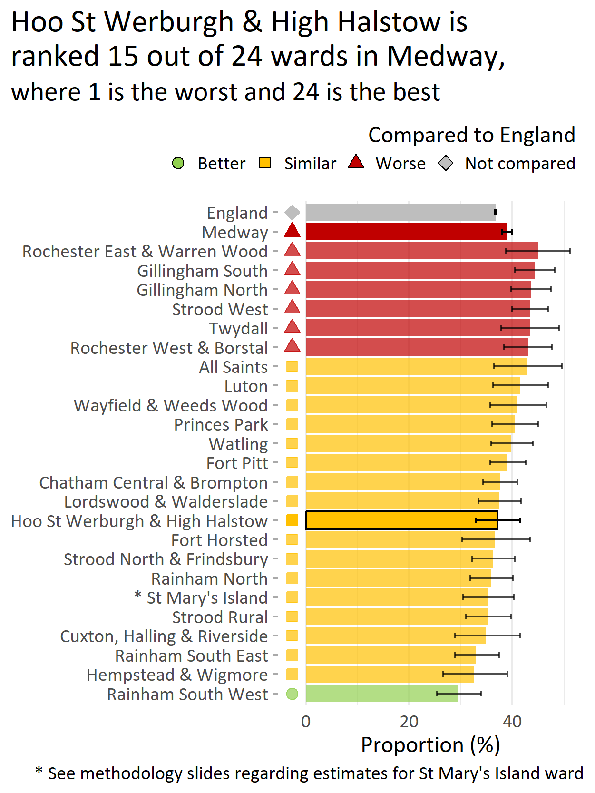
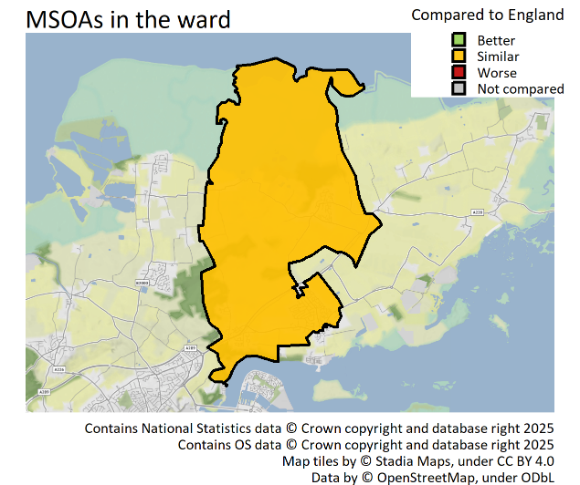
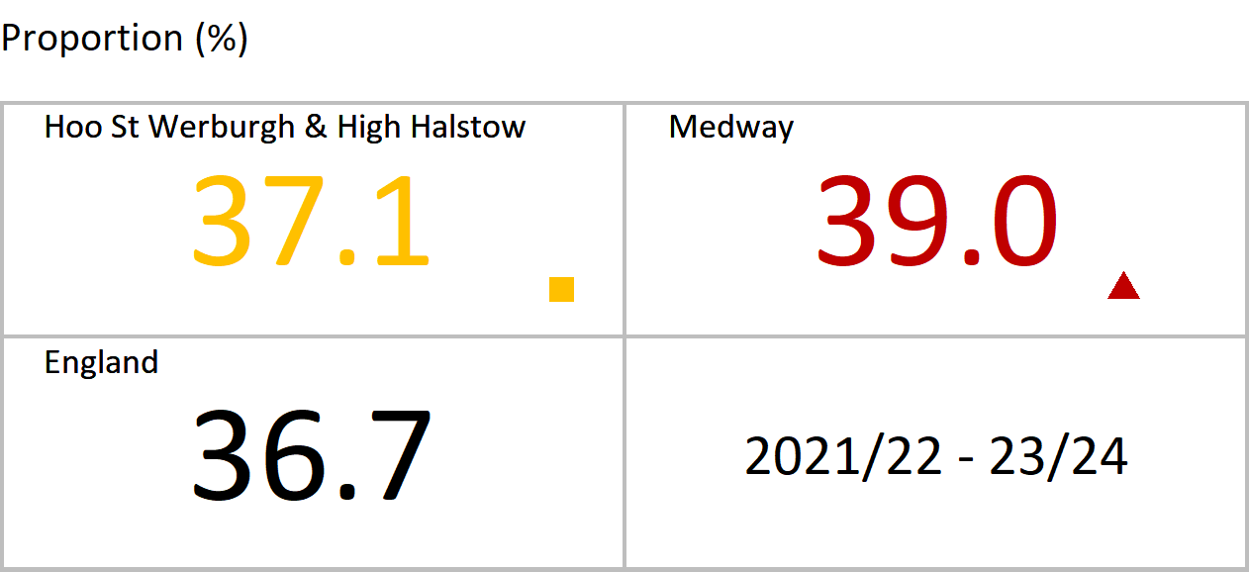
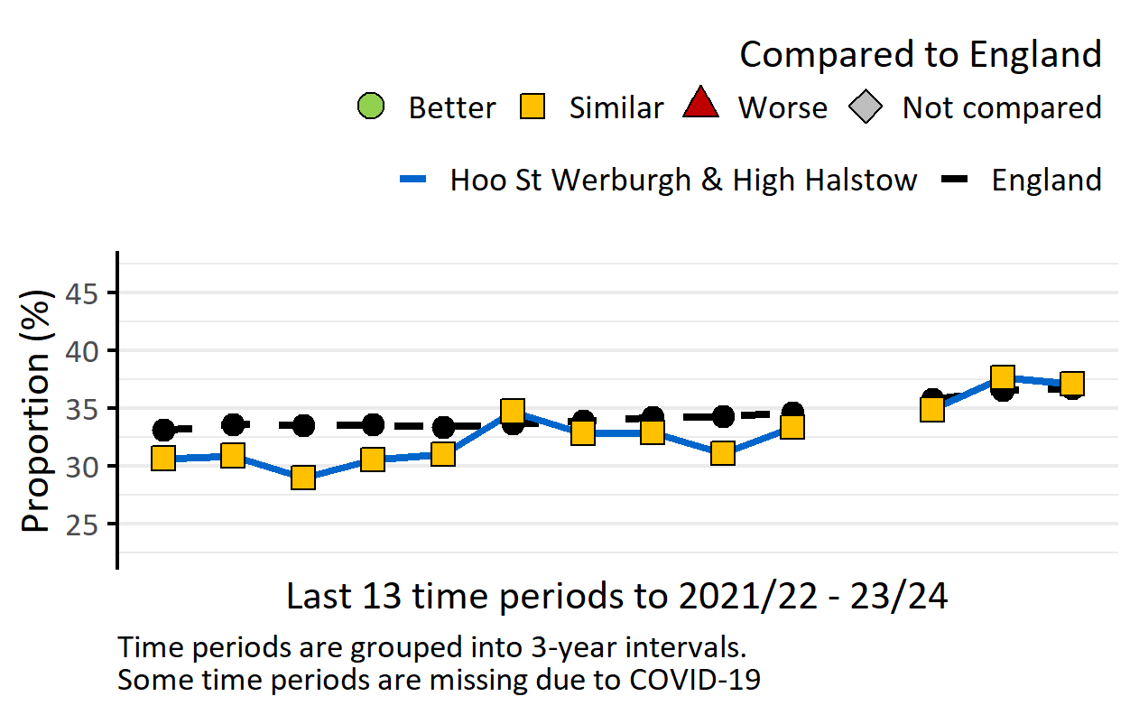
Year 6: Prevalence of excess weight, persons, 10-11 yrs
Version 3.0 © Medway Council, Public Health Intelligence Team, 28/01/2025
The latest value for Hoo St Werburgh and High Halstow is similar to England.
Excess weight: Overweight or obese.
Value type: Proportion (%).
Original geography: MSOA.
Benchmarking method: Wilson Score CI method (95%).
Source: Office for Health Improvement and Disparities. Fingertips. Indicator ID: 93108. Copyright: NHS Digital..
Notes: Due to the impact of COVID-19 on the NCMP data collection, data was not published for the 2018/19-20/21 time period.

Slide 17
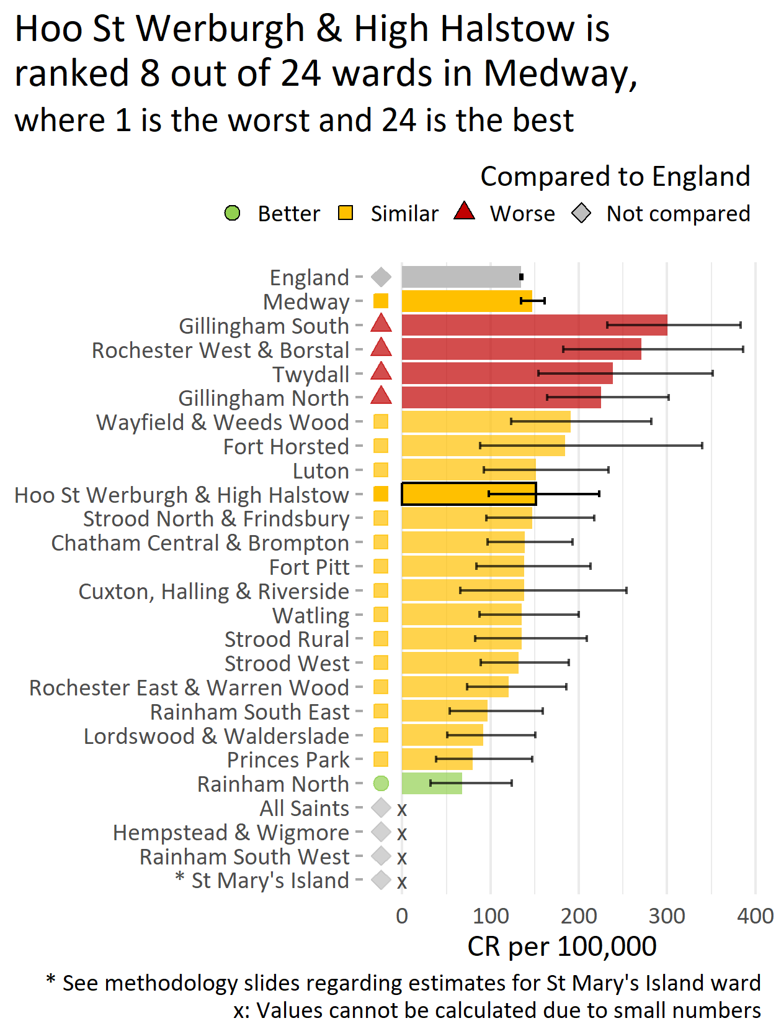
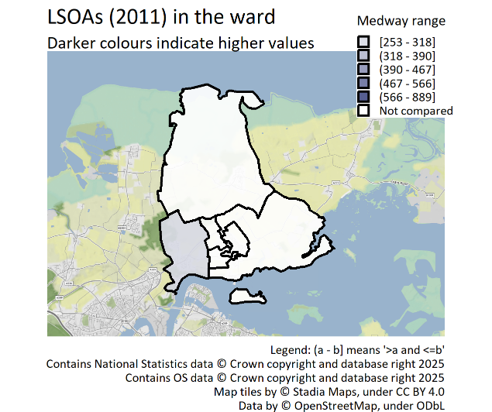
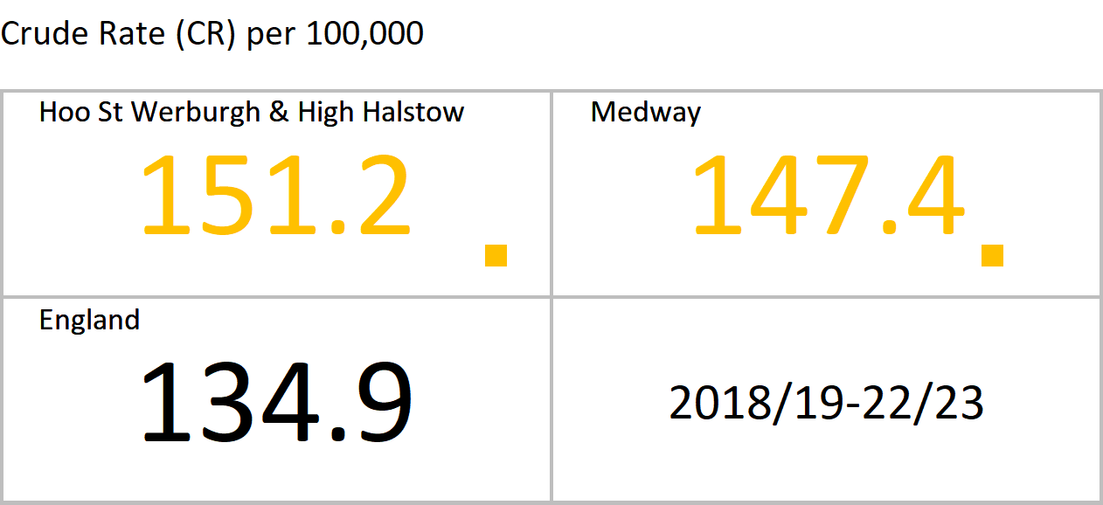
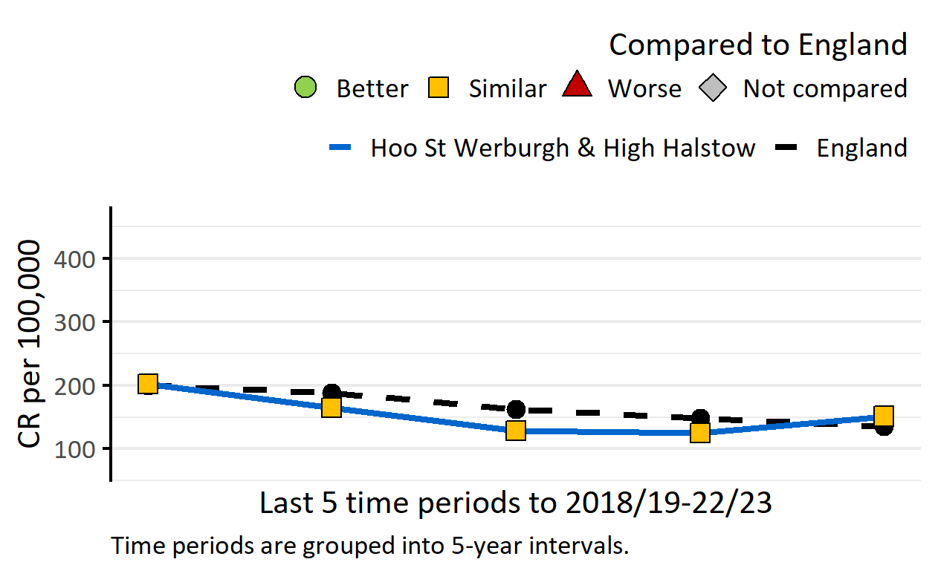
Hospital admissions for asthma, persons, 0-18 yrs
Version 3.0 © Medway Council, Public Health Intelligence Team, 28/01/2025
The latest value for Hoo St Werburgh and High Halstow is similar to England.
Value type: Crude Rate (CR) per 100,000.
Original geography: LSOA.
Benchmarking method: Byar's CI method (95%).
Source: NHS Digital, Hospital Episode Statistics (HES).

Slide 18
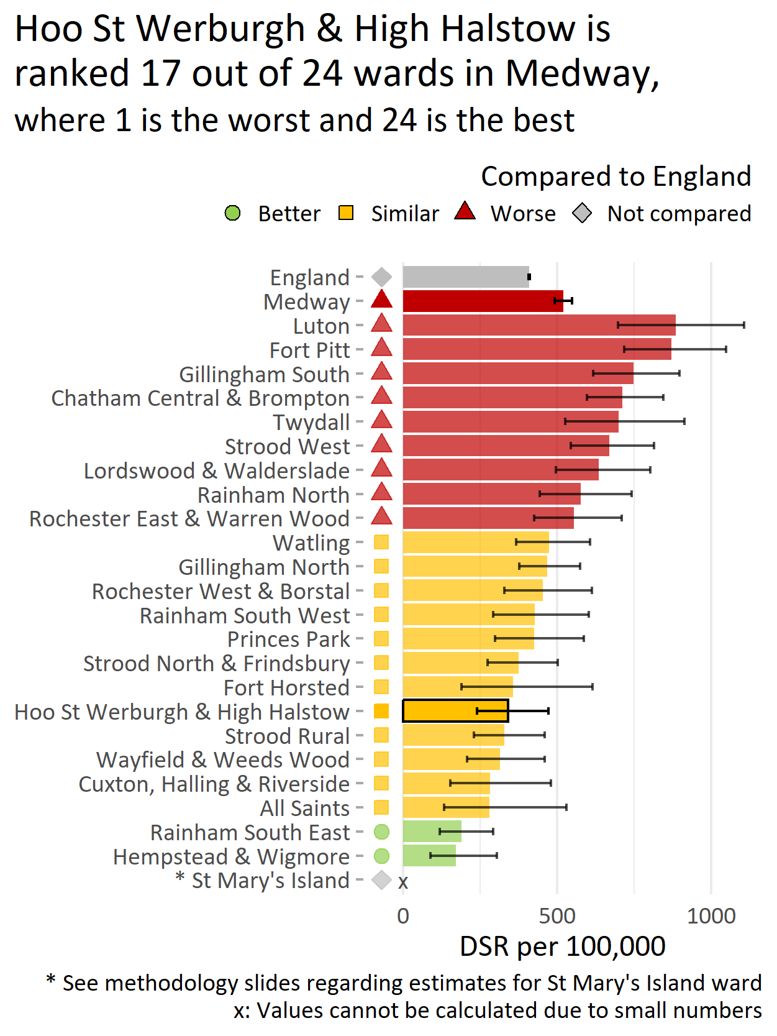
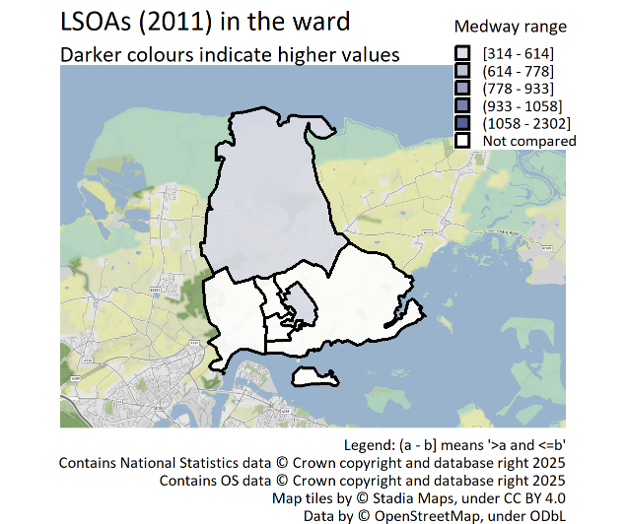
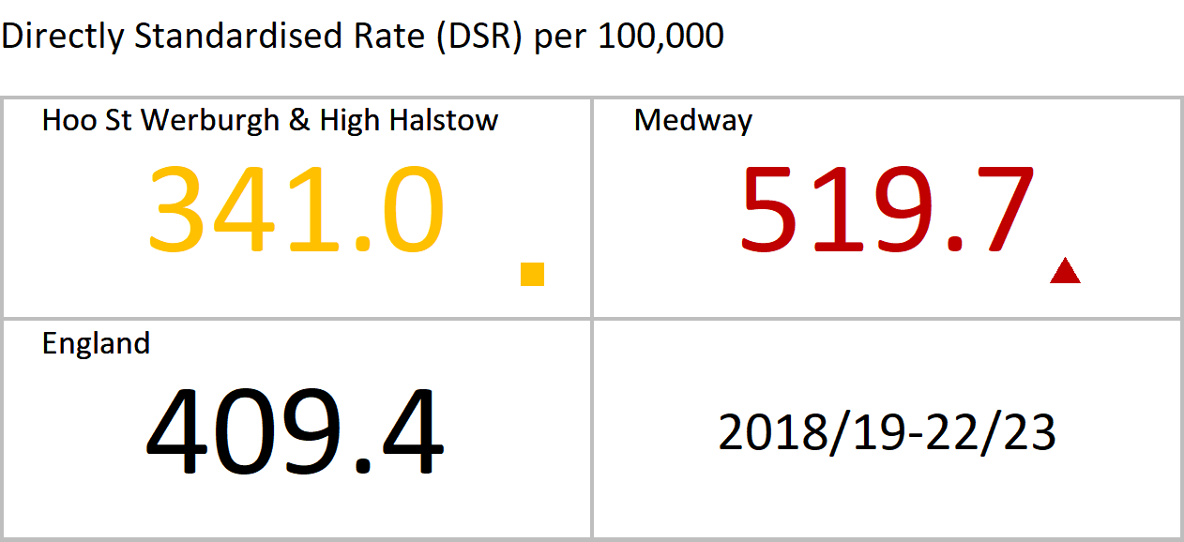
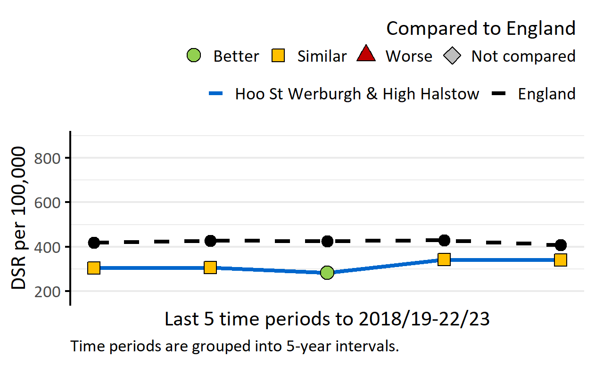
Hospital admissions as a result of self-harm, persons, 10-24 yrs
Version 3.0 © Medway Council, Public Health Intelligence Team, 28/01/2025
The latest value for Hoo St Werburgh and High Halstow is similar to England.
Value type: Directly Standardised Rate (DSR) per 100,000.
Original geography: LSOA.
Benchmarking method: Exact CI method (95%).
Source: NHS Digital, Hospital Episode Statistics (HES).

Slide 19
Improving health and wellbeing

Slide 20
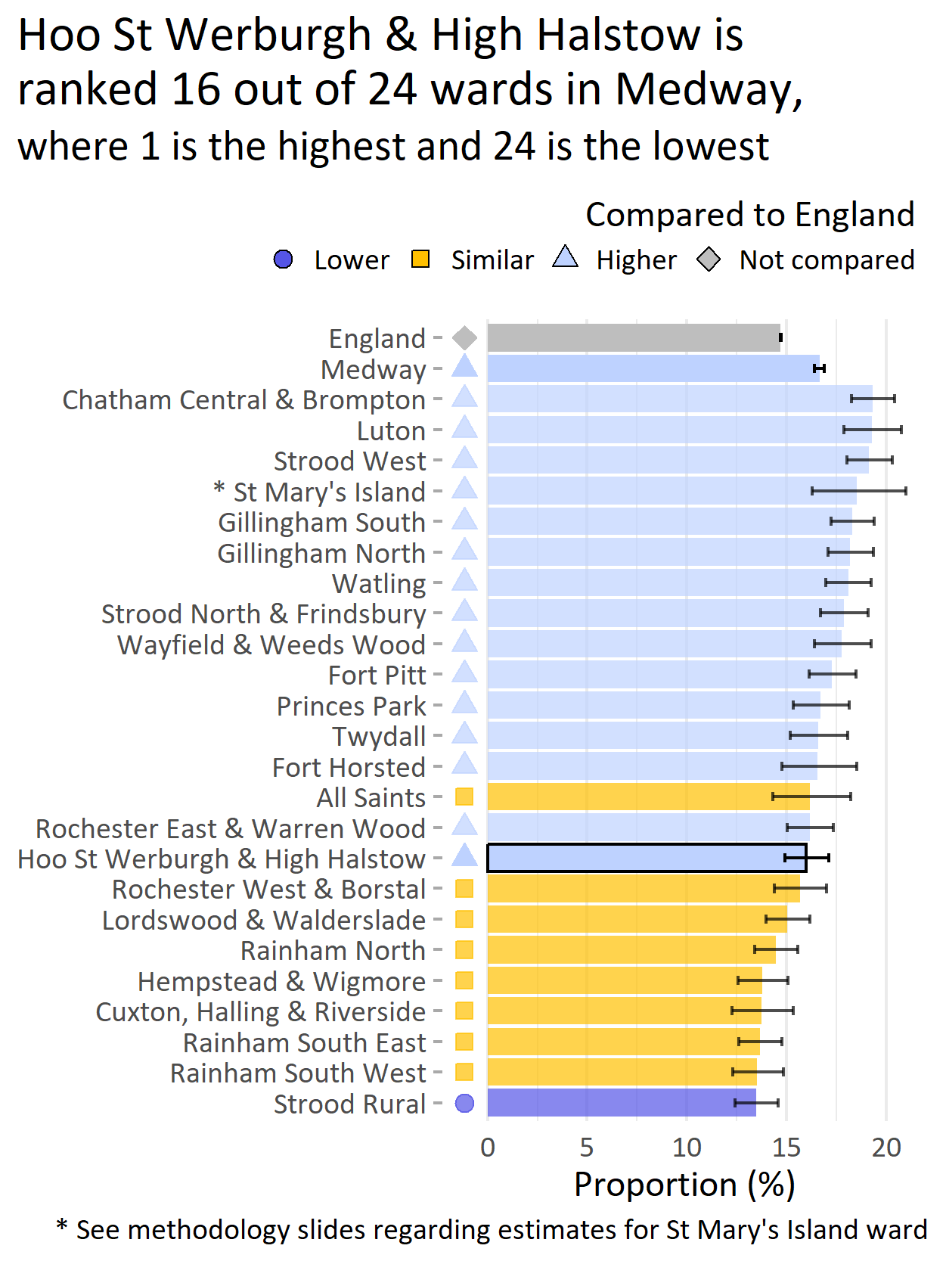
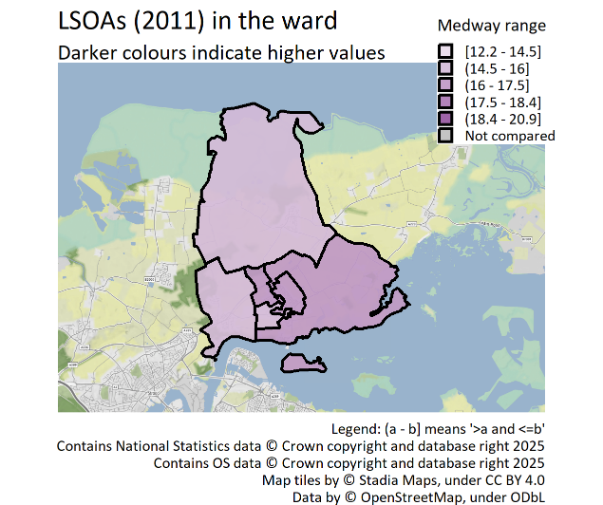
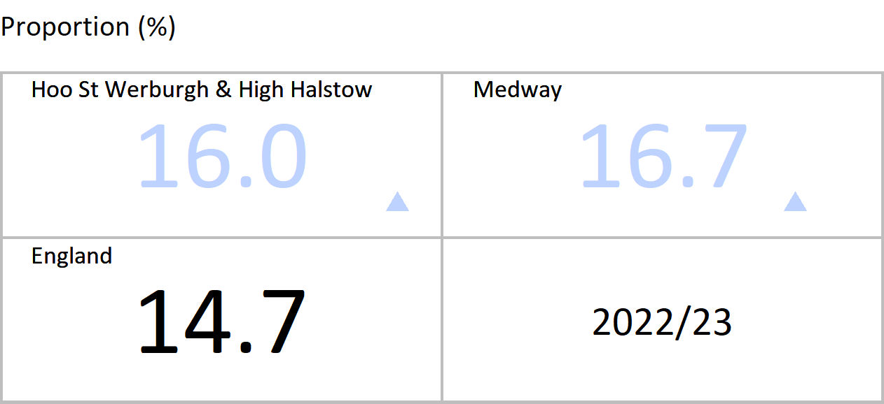
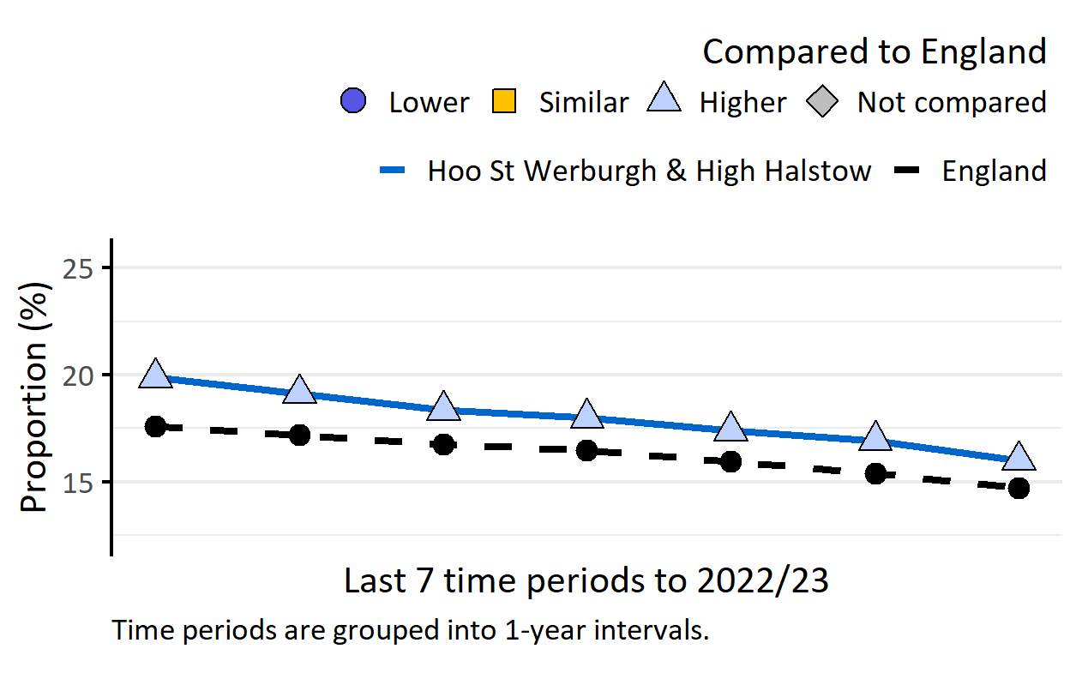
Smoking: Recorded prevalence, persons, 15+ yrs
Version 3.0 © Medway Council, Public Health Intelligence Team, 28/01/2025
The latest value for Hoo St Werburgh and High Halstow is higher than England.
Value type: Proportion of registered GP patients.
Original geography: Practice.
Benchmarking method: Byar's CI method (99.8%).
Source: NHS Digital, Quality and Outcomes Framework (QOF).
Caveats: This indicator measures recorded prevalence, not actual prevalence. QOF recorded smoking prevalence is thought to underestimate actual smoking prevalence. QOF data may be inaccurate for 2020/21 due to the impact of COVID-19.

Slide 21
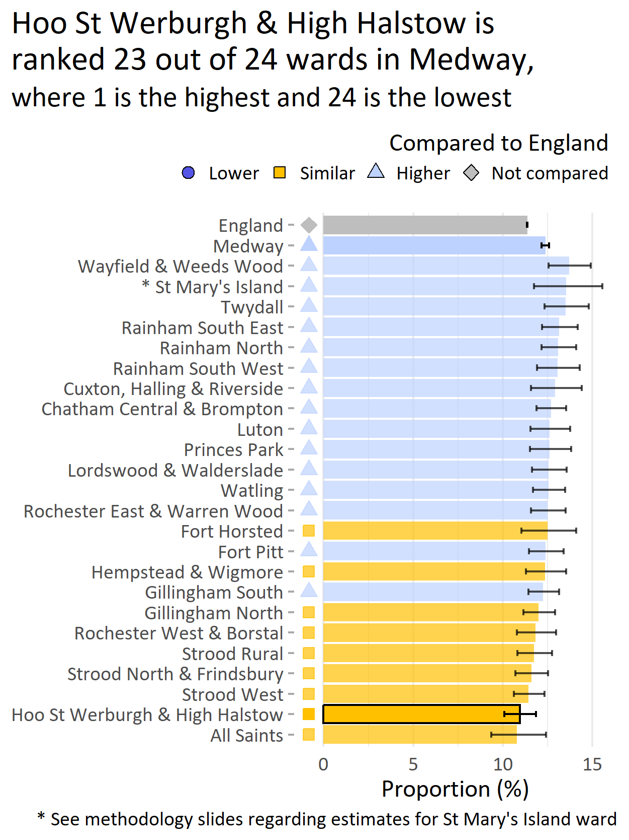
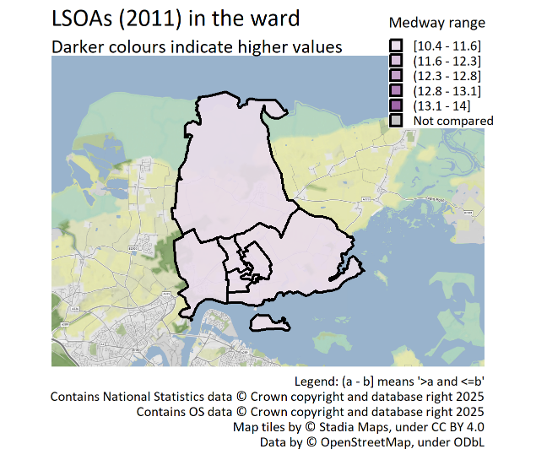
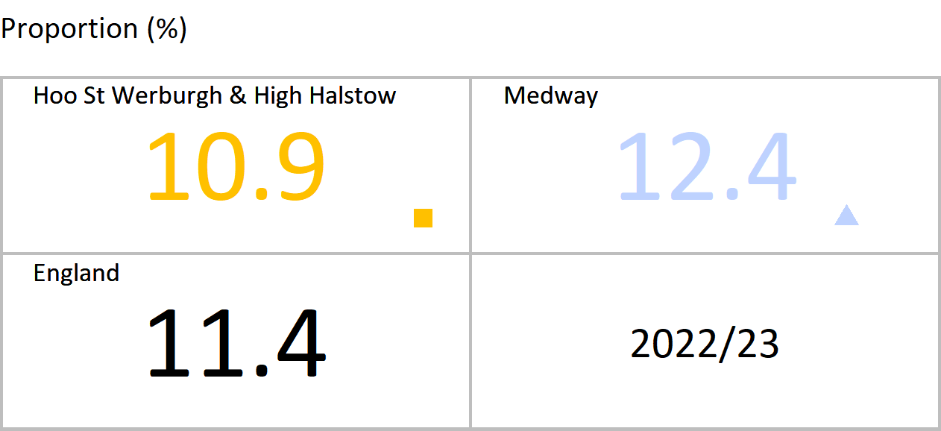
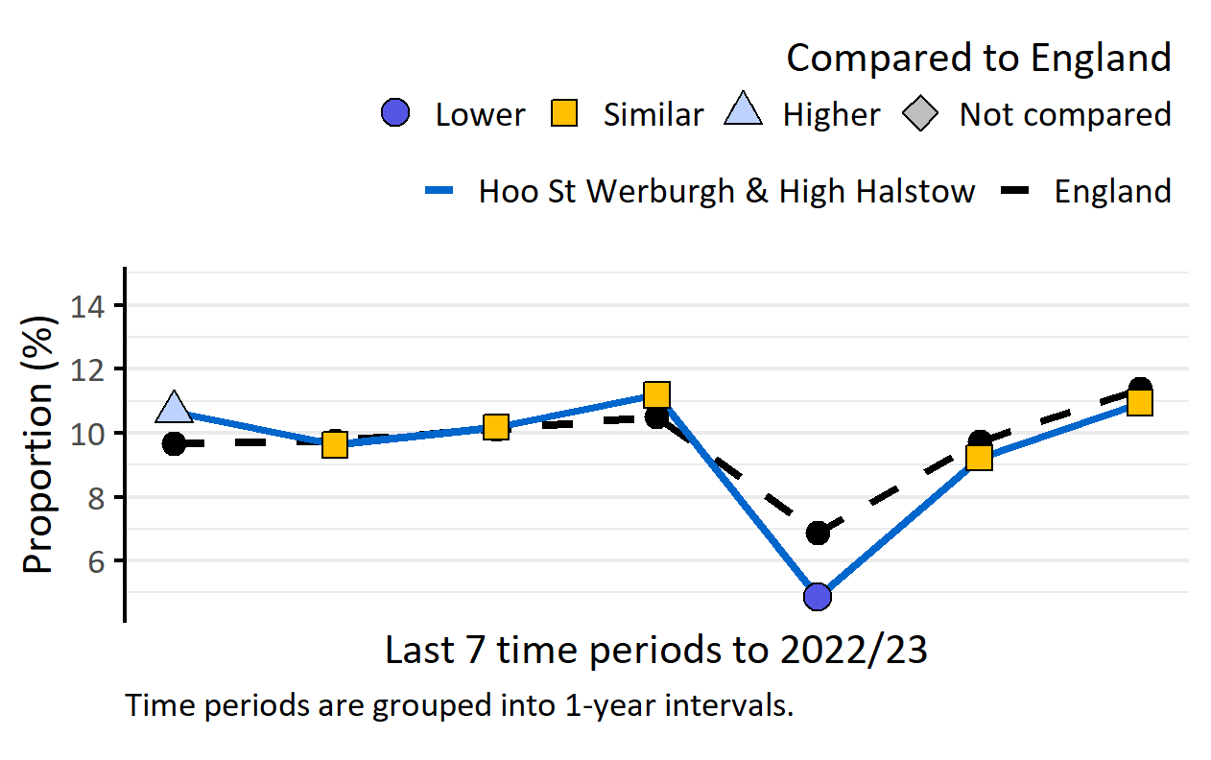
Obesity: Recorded prevalence, persons, 18+ yrs
Version 3.0 © Medway Council, Public Health Intelligence Team, 28/01/2025
The latest value for Hoo St Werburgh and High Halstow is similar to England.
Value type: Proportion of registered GP patients.
Original geography: Practice.
Benchmarking method: Wilson Score CI method (99.8%).
Source: NHS Digital, Quality and Outcomes Framework (QOF).
Caveats: This indicator measures recorded prevalence, not actual prevalence. QOF recorded obesity prevalence is thought to underestimate actual obesity prevalence. Changes in QOF during the COVID-19 pandemic mean that the 2020/21 data may be inaccurate and misleading.

Slide 22
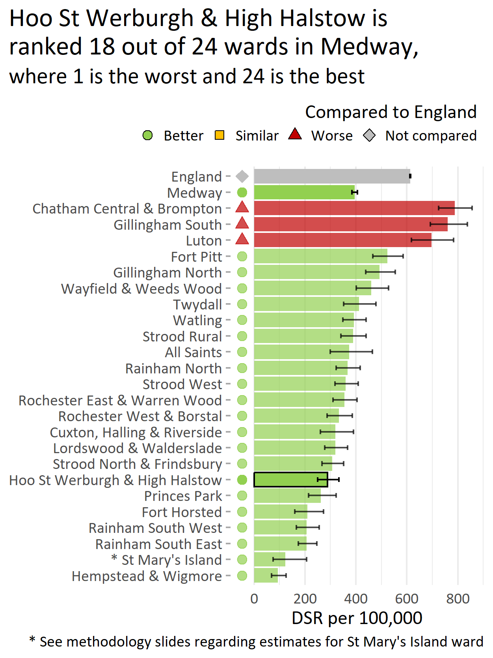
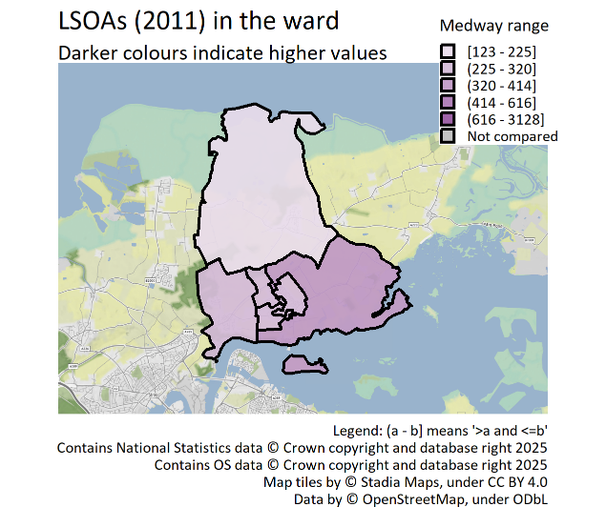
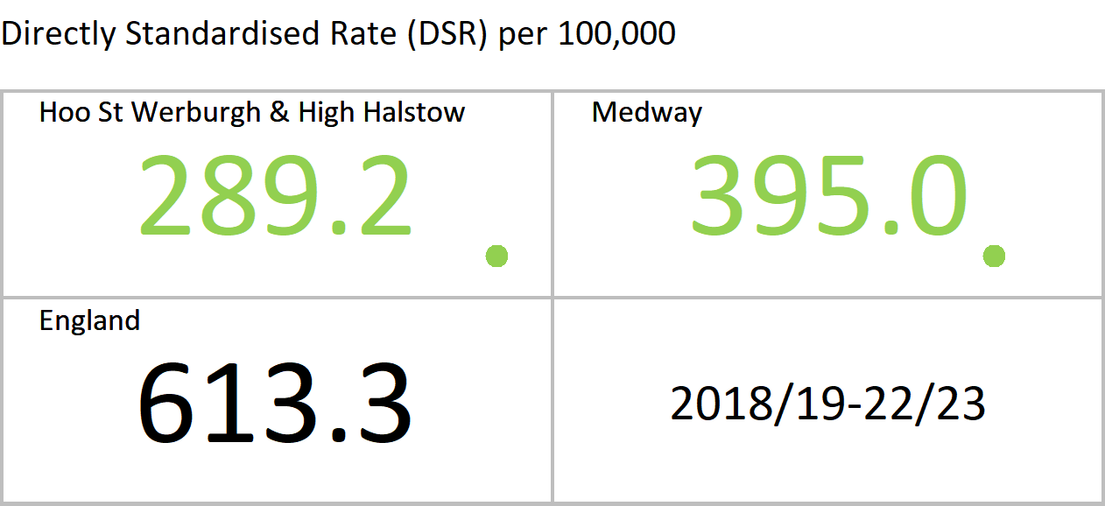
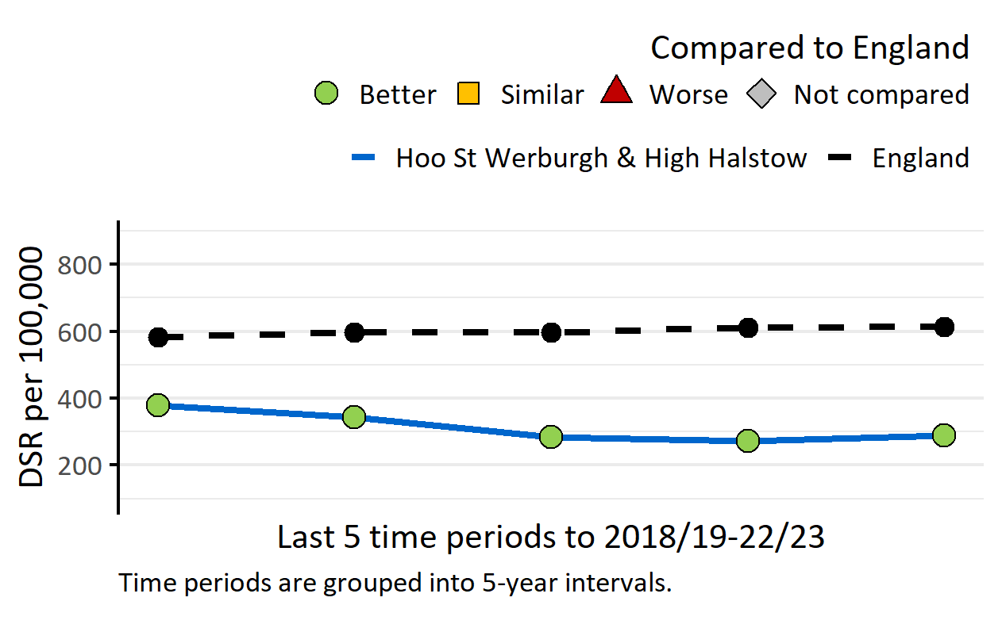
Admission episodes for alcohol-specific conditions, persons, all ages
Version 3.0 © Medway Council, Public Health Intelligence Team, 28/01/2025
The latest value for Hoo St Werburgh and High Halstow is better than England.
Value type: Directly Standardised Rate (DSR) per 100,000.
Original geography: LSOA.
Benchmarking method: Exact CI method (95%).
Source: NHS Digital, Hospital Episode Statistics (HES).

Slide 23
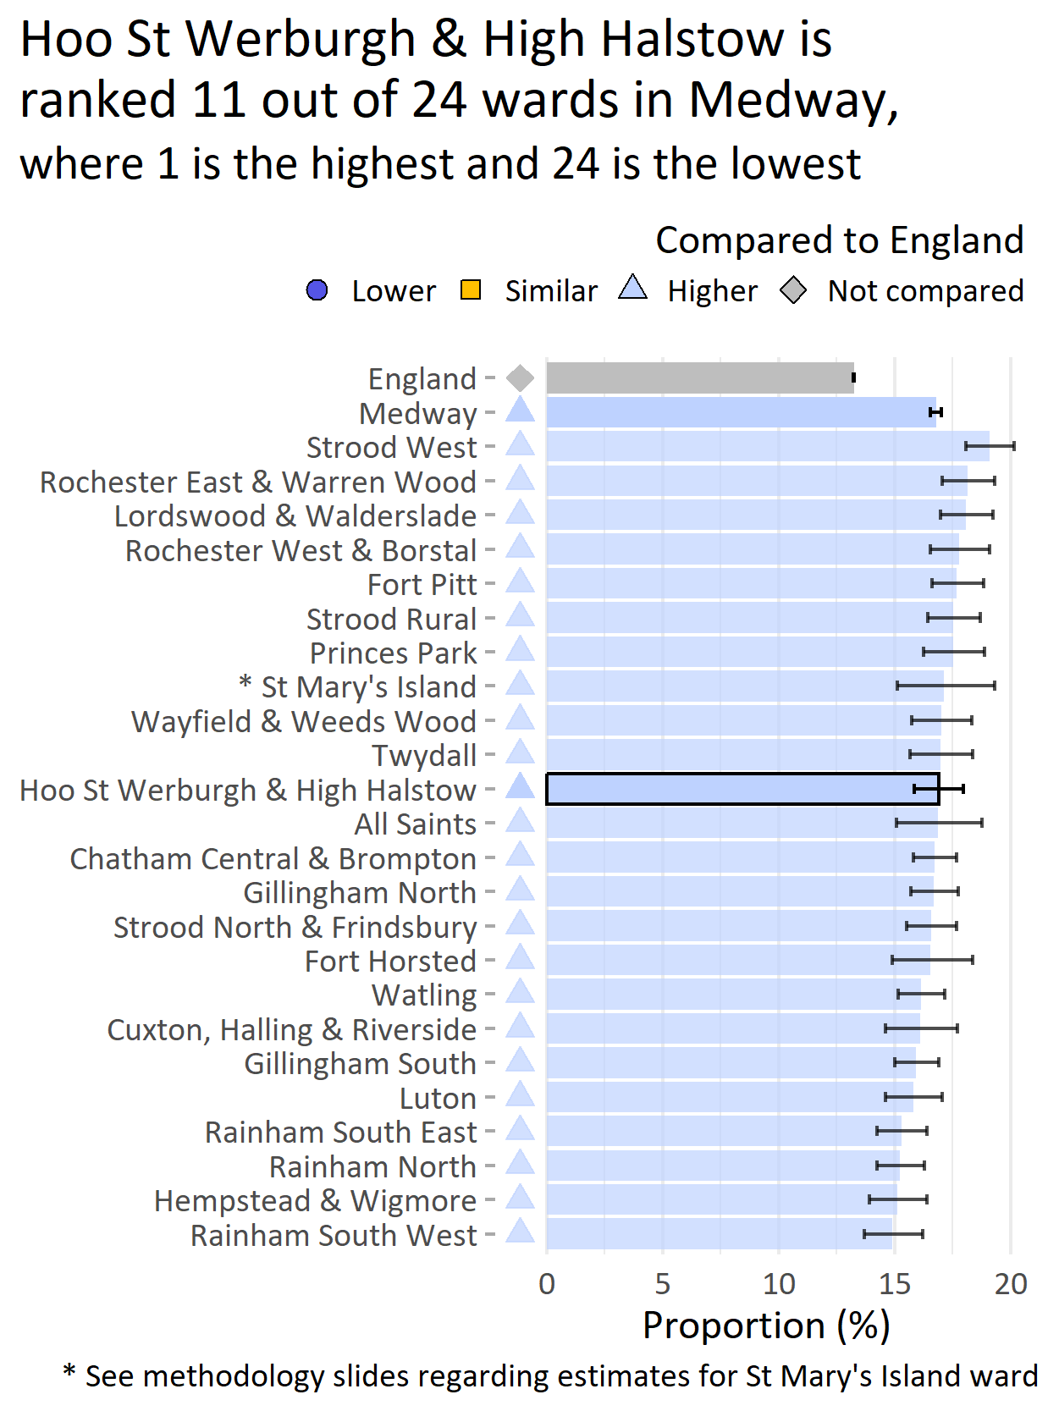
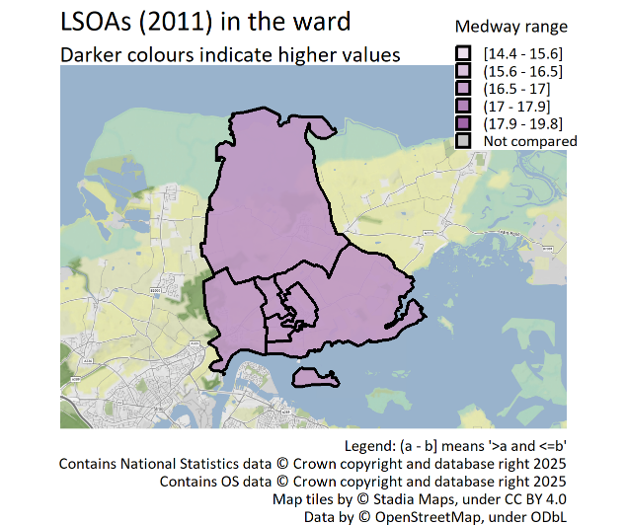
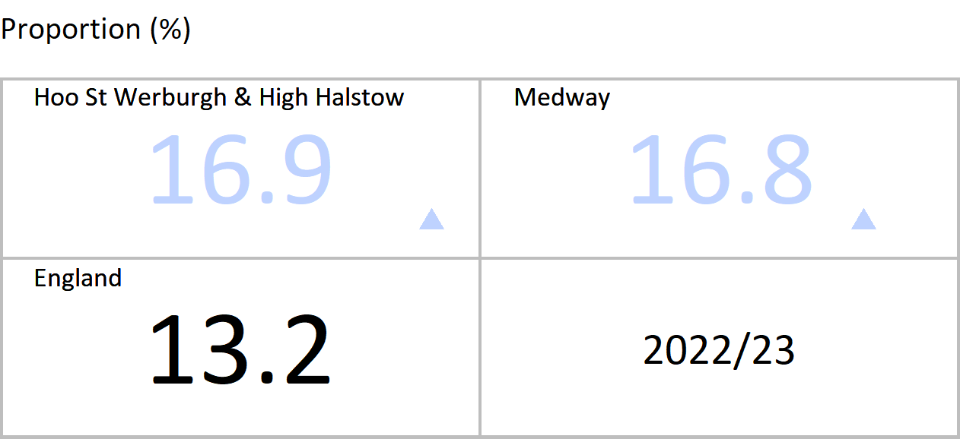

Depression: Recorded prevalence, persons, 18+ yrs
Version 3.0 © Medway Council, Public Health Intelligence Team, 28/01/2025
The latest value for Hoo St Werburgh and High Halstow is higher than England.
Value type: Proportion of registered GP patients.
Original geography: Practice.
Benchmarking method: Wilson Score CI method (99.8%).
Source: NHS Digital, Quality and Outcomes Framework (QOF).
Caveats: This indicator measures recorded prevalence, not actual prevalence. QOF data may be inaccurate for 2020/21 due to the impact of COVID-19.

Slide 24




Severe mental illness: Recorded prevalence, persons, all ages
Version 3.0 © Medway Council, Public Health Intelligence Team, 28/01/2025
The latest value for Hoo St Werburgh and High Halstow is lower than England.
Severe mental illness: Patients with schizophrenia, bipolar affective disorder and other psychoses.
Value type: Proportion of registered GP patients.
Original geography: Practice.
Benchmarking method: Wilson Score CI method (99.8%).
Source: NHS Digital, Quality and Outcomes Framework (QOF).
Caveats: This indicator measures recorded prevalence, not actual prevalence. QOF data may be inaccurate for 2020/21 due to the impact of COVID-19.

Slide 25
Increasing years of healthy life

Slide 26
Cancer
Version 3.0 © Medway Council, Public Health Intelligence Team, 28/01/2025

Slide 27




Cervical screening, female, 25-49 yrs
Version 3.0 © Medway Council, Public Health Intelligence Team, 28/01/2025
The latest value for Hoo St Werburgh and High Halstow is higher than England.
The number of persons aged 25 to 49 years attending cervical screening in last 42 months (3.5 year coverage).
Value type: Proportion (%).
Original geography: Practice.
Benchmarking method: Wilson Score CI method (99.8%).
Source: Office for Health Improvement and Disparities. Fingertips. Indicator ID: 93725.

Slide 28




Breast cancer screening, female, 50-70 yrs
Version 3.0 © Medway Council, Public Health Intelligence Team, 28/01/2025
The latest value for Hoo St Werburgh and High Halstow is similar to England.
The number of persons aged 50 to 70 years screened for breast cancer in last 36 months (3 year coverage).Please note that this indicator has now been retired from 2021/22 and will not be updated.
Value type: Proportion (%).
Original geography: Practice.
Benchmarking method: Wilson Score CI method (99.8%).
Source: Office for Health Improvement and Disparities. Fingertips. Indicator ID: 91339.

Slide 29




Bowel cancer screening, persons, 60-74 yrs
Version 3.0 © Medway Council, Public Health Intelligence Team, 28/01/2025
The latest value for Hoo St Werburgh and High Halstow is similar to England.
The number of persons aged 25 to 49 years screened for bowel cancer in last 30 months (2.5 year coverage).
Value type: Proportion (%).
Original geography: Practice.
Benchmarking method: Wilson Score CI method (99.8%).
Source: Office for Health Improvement and Disparities. Fingertips. Indicator ID: 92600.

Slide 30




Cancer: Recorded prevalence, persons, all ages
Version 3.0 © Medway Council, Public Health Intelligence Team, 28/01/2025
The latest value for Hoo St Werburgh and High Halstow is similar to England.
Value type: Proportion of registered GP patients.
Original geography: Practice.
Benchmarking method: Wilson Score CI method (99.8%).
Source: NHS Digital, Quality and Outcomes Framework (QOF).
Caveats: This indicator measures recorded prevalence, not actual prevalence. This is a crude rate (non age-adjusted). Rates may be higher in areas with older populations for age-related conditions. QOF data may be inaccurate for 2020/21 due to the impact of COVID-19.

Slide 31



Deaths from cancer, persons, all ages
Version 3.0 © Medway Council, Public Health Intelligence Team, 28/01/2025
The latest value for Hoo St Werburgh and High Halstow is similar to England.
Value type: Directly Standardised Rate (DSR) per 100,000.
Original geography: LSOA.
Benchmarking method: Exact CI method (95%).
Source: Medway deaths: NHS Digital. Primary Care Mortality Database (PCMD). England deaths: Nomis. Mortality statistics - underlying cause, sex and age.

Slide 32
Cardiovascular disease
Version 3.0 © Medway Council, Public Health Intelligence Team, 28/01/2025

Slide 33




Hypertension: Recorded prevalence, persons, all ages
Version 3.0 © Medway Council, Public Health Intelligence Team, 28/01/2025
The latest value for Hoo St Werburgh and High Halstow is higher than England.
Value type: Proportion of registered GP patients.
Original geography: Practice.
Benchmarking method: Wilson Score CI method (99.8%).
Source: NHS Digital, Quality and Outcomes Framework (QOF).
Caveats: This indicator measures recorded prevalence, not actual prevalence. This is a crude rate (non age-adjusted). Rates may be higher in areas with older populations for age-related conditions. QOF data may be inaccurate for 2020/21 due to the impact of COVID-19.

Slide 34




Coronary heart disease: Recorded prevalence, persons, all ages
Version 3.0 © Medway Council, Public Health Intelligence Team, 28/01/2025
The latest value for Hoo St Werburgh and High Halstow is similar to England.
Value type: Proportion of registered GP patients.
Original geography: Practice.
Benchmarking method: Wilson Score CI method (99.8%).
Source: NHS Digital, Quality and Outcomes Framework (QOF).
Caveats: This indicator measures recorded prevalence, not actual prevalence. This is a crude rate (non age-adjusted). Rates may be higher in areas with older populations for age-related conditions. QOF data may be inaccurate for 2020/21 due to the impact of COVID-19.

Slide 35



Deaths from coronary heart disease, persons, all ages
Version 3.0 © Medway Council, Public Health Intelligence Team, 28/01/2025
The latest value for Hoo St Werburgh and High Halstow is similar to England.
Value type: Directly Standardised Rate (DSR) per 100,000.
Original geography: LSOA.
Benchmarking method: Exact CI method (95%).
Source: Medway deaths: NHS Digital. Primary Care Mortality Database (PCMD). England deaths: Nomis. Mortality statistics - underlying cause, sex and age.

Slide 36




Stroke: Recorded prevalence, persons, all ages
Version 3.0 © Medway Council, Public Health Intelligence Team, 28/01/2025
The latest value for Hoo St Werburgh and High Halstow is lower than England.
Value type: Proportion of registered GP patients.
Original geography: Practice.
Benchmarking method: Wilson Score CI method (99.8%).
Source: NHS Digital, Quality and Outcomes Framework (QOF).
Caveats: This indicator measures recorded prevalence, not actual prevalence. This is a crude rate (non age-adjusted). Rates may be higher in areas with older populations for age-related conditions. QOF data may be inaccurate for 2020/21 due to the impact of COVID-19.

Slide 37



Deaths from stroke, persons, all ages
Version 3.0 © Medway Council, Public Health Intelligence Team, 28/01/2025
The latest value for Hoo St Werburgh and High Halstow is similar to England.
Value type: Directly Standardised Rate (DSR) per 100,000.
Original geography: LSOA.
Benchmarking method: Exact CI method (95%).
Source: Medway deaths: NHS Digital. Primary Care Mortality Database (PCMD). England deaths: Nomis. Mortality statistics - underlying cause, sex and age.

Slide 38




Heart failure: Recorded prevalence, persons, all ages
Version 3.0 © Medway Council, Public Health Intelligence Team, 28/01/2025
The latest value for Hoo St Werburgh and High Halstow is similar to England.
Value type: Proportion of registered GP patients.
Original geography: Practice.
Benchmarking method: Wilson Score CI method (99.8%).
Source: NHS Digital, Quality and Outcomes Framework (QOF).
Caveats: This indicator measures recorded prevalence, not actual prevalence. This is a crude rate (non age-adjusted). Rates may be higher in areas with older populations for age-related conditions. QOF data may be inaccurate for 2020/21 due to the impact of COVID-19.

Slide 39




Atrial fibrillation: Recorded prevalence, persons, all ages
Version 3.0 © Medway Council, Public Health Intelligence Team, 28/01/2025
The latest value for Hoo St Werburgh and High Halstow is similar to England.
Value type: Proportion of registered GP patients.
Original geography: Practice.
Benchmarking method: Wilson Score CI method (99.8%).
Source: NHS Digital, Quality and Outcomes Framework (QOF).
Caveats: This indicator measures recorded prevalence, not actual prevalence. This is a crude rate (non age-adjusted). Rates may be higher in areas with older populations for age-related conditions. QOF data may be inaccurate for 2020/21 due to the impact of COVID-19.

Slide 40



Deaths from circulatory disease, persons, all ages
Version 3.0 © Medway Council, Public Health Intelligence Team, 28/01/2025
The latest value for Hoo St Werburgh and High Halstow is similar to England.
Value type: Directly Standardised Rate (DSR) per 100,000.
Original geography: LSOA.
Benchmarking method: Exact CI method (95%).
Source: Medway deaths: NHS Digital. Primary Care Mortality Database (PCMD). England deaths: Nomis. Mortality statistics - underlying cause, sex and age.

Slide 41
Diabetes
Version 3.0 © Medway Council, Public Health Intelligence Team, 28/01/2025

Slide 42




Diabetes: Recorded prevalence, persons, 17+ yrs
Version 3.0 © Medway Council, Public Health Intelligence Team, 28/01/2025
The latest value for Hoo St Werburgh and High Halstow is higher than England.
Value type: Proportion of registered GP patients.
Original geography: Practice.
Benchmarking method: Wilson Score CI method (99.8%).
Source: NHS Digital, Quality and Outcomes Framework (QOF).
Caveats: This indicator measures recorded prevalence, not actual prevalence. This is a crude rate (non age-adjusted). Rates may be higher in areas with older populations for age-related conditions. QOF data may be inaccurate for 2020/21 due to the impact of COVID-19.

Slide 43
Kidney disease
Version 3.0 © Medway Council, Public Health Intelligence Team, 28/01/2025

Slide 44




Chronic kidney disease: Recorded prevalence, persons, 18+ yrs
Version 3.0 © Medway Council, Public Health Intelligence Team, 28/01/2025
The latest value for Hoo St Werburgh and High Halstow is similar to England.
Value type: Proportion of registered GP patients.
Original geography: Practice.
Benchmarking method: Wilson Score CI method (99.8%).
Source: NHS Digital, Quality and Outcomes Framework (QOF).
Caveats: This indicator measures recorded prevalence, not actual prevalence. This is a crude rate (non age-adjusted). Rates may be higher in areas with older populations for age-related conditions. QOF data may be inaccurate for 2020/21 due to the impact of COVID-19.

Slide 45
Respiratory disease
Version 3.0 © Medway Council, Public Health Intelligence Team, 28/01/2025

Slide 46




Asthma: Recorded prevalence, persons, 6+ yrs
Version 3.0 © Medway Council, Public Health Intelligence Team, 28/01/2025
The latest value for Hoo St Werburgh and High Halstow is similar to England.
Value type: Proportion of registered GP patients.
Original geography: Practice.
Benchmarking method: Wilson Score CI method (99.8%).
Source: NHS Digital, Quality and Outcomes Framework (QOF).
Caveats: This indicator measures recorded prevalence, not actual prevalence. QOF data may be inaccurate for 2020/21 due to the impact of COVID-19.

Slide 47




COPD: Recorded prevalence, persons, all ages
Version 3.0 © Medway Council, Public Health Intelligence Team, 28/01/2025
The latest value for Hoo St Werburgh and High Halstow is similar to England.
COPD: Chronic Obstructive Pulmonary Disease
Value type: Proportion of registered GP patients.
Original geography: Practice.
Benchmarking method: Wilson Score CI method (99.8%).
Source: NHS Digital, Quality and Outcomes Framework (QOF).
Caveats: This indicator measures recorded prevalence, not actual prevalence. This is a crude rate (non age-adjusted). Rates may be higher in areas with older populations for age-related conditions. QOF data may be inaccurate for 2020/21 due to the impact of COVID-19.

Slide 48



Deaths from respiratory diseases, persons, all ages
Version 3.0 © Medway Council, Public Health Intelligence Team, 28/01/2025
The latest value for Hoo St Werburgh and High Halstow is similar to England.
Value type: Directly Standardised Rate (DSR) per 100,000.
Original geography: LSOA.
Benchmarking method: Exact CI method (95%).
Source: Medway deaths: NHS Digital. Primary Care Mortality Database (PCMD). England deaths: Nomis. Mortality statistics - underlying cause, sex and age.

Slide 49
Other conditions
Version 3.0 © Medway Council, Public Health Intelligence Team, 28/01/2025

Slide 50




Epilepsy: Recorded prevalence, persons, 18+ yrs
Version 3.0 © Medway Council, Public Health Intelligence Team, 28/01/2025
The latest value for Hoo St Werburgh and High Halstow is similar to England.
Value type: Proportion of registered GP patients.
Original geography: Practice.
Benchmarking method: Wilson Score CI method (99.8%).
Source: NHS Digital, Quality and Outcomes Framework (QOF).
Caveats: This indicator measures recorded prevalence, not actual prevalence. QOF data may be inaccurate for 2020/21 due to the impact of COVID-19.

Slide 51




Unplanned hospitalisation for chronic ACSC, persons, all ages
Version 3.0 © Medway Council, Public Health Intelligence Team, 28/01/2025
The latest value for Hoo St Werburgh and High Halstow is worse than England.
ACSC: Ambulatory care sensitive conditions.
ACSCs are conditions where effective community care and case management can help prevent the need for hospital admission. These conditions include, for example, diabetes, epilepsy and high blood pressure.
Value type: Directly Standardised Rate (DSR) per 100,000.
Original geography: LSOA.
Benchmarking method: Exact CI method (95%).
Source: NHS Digital, Hospital Episode Statistics (HES).

Slide 52
Other mortality
Version 3.0 © Medway Council, Public Health Intelligence Team, 28/01/2025

Slide 53



Deaths from all causes, persons, all ages
Version 3.0 © Medway Council, Public Health Intelligence Team, 28/01/2025
The latest value for Hoo St Werburgh and High Halstow is similar to England.
Value type: Directly Standardised Rate (DSR) per 100,000.
Original geography: LSOA.
Benchmarking method: Exact CI method (95%).
Source: Medway deaths: NHS Digital. Primary Care Mortality Database (PCMD). England deaths: Nomis. Mortality statistics - underlying cause, sex and age.

Slide 54
Ageing well

Slide 55




Dementia: Recorded prevalence, persons, all ages
Version 3.0 © Medway Council, Public Health Intelligence Team, 28/01/2025
The latest value for Hoo St Werburgh and High Halstow is similar to England.
Value type: Proportion of registered GP patients.
Original geography: Practice.
Benchmarking method: Wilson Score CI method (99.8%).
Source: NHS Digital, Quality and Outcomes Framework (QOF).
Caveats: This indicator measures recorded prevalence, not actual prevalence. This is a crude rate (non age-adjusted). Rates may be higher in areas with older populations for age-related conditions. QOF data may be inaccurate for 2020/21 due to the impact of COVID-19.

Slide 56




Emergency hospital admissions due to falls, persons, 65+ yrs
Version 3.0 © Medway Council, Public Health Intelligence Team, 28/01/2025
The latest value for Hoo St Werburgh and High Halstow is similar to England.
Value type: Directly Standardised Rate (DSR) per 100,000.
Original geography: LSOA.
Benchmarking method: Exact CI method (95%).
Source: NHS Digital, Hospital Episode Statistics (HES).

Slide 57




Emergency hospital admissions for hip fractures, persons, 65+ yrs
Version 3.0 © Medway Council, Public Health Intelligence Team, 28/01/2025
The latest value for Hoo St Werburgh and High Halstow is similar to England.
Value type: Directly Standardised Rate (DSR) per 100,000.
Original geography: LSOA.
Benchmarking method: Exact CI method (95%).
Source: NHS Digital, Hospital Episode Statistics (HES).

Slide 58
Reducing health inequalities

Slide 59



Life expectancy at birth, male, all ages
Version 3.0 © Medway Council, Public Health Intelligence Team, 28/01/2025
The latest value for Hoo St Werburgh and High Halstow is similar to England.
Value type: Years.
Original geography: LSOA.
Benchmarking method: 95% confidence interval.
Source: Medway deaths: NHS Digital. Primary Care Mortality Database (PCMD). England deaths: Nomis. Mortality statistics - underlying cause, sex and age.

Slide 60



Life expectancy at birth, female, all ages
Version 3.0 © Medway Council, Public Health Intelligence Team, 28/01/2025
The latest value for Hoo St Werburgh and High Halstow is similar to England.
Value type: Years.
Original geography: LSOA.
Benchmarking method: 95% confidence interval.
Source: Medway deaths: NHS Digital. Primary Care Mortality Database (PCMD). England deaths: Nomis. Mortality statistics - underlying cause, sex and age.

Slide 61
Wider determinants of health
Version 3.0 © Medway Council, Public Health Intelligence Team, 28/01/2025

Slide 62




Unemployment (claiming out of work benefit), persons, 16-64 yrs
Version 3.0 © Medway Council, Public Health Intelligence Team, 28/01/2025
The latest value for Hoo St Werburgh and High Halstow is better than England.
Value type: Proportion.
Original geography: MSOA.
Benchmarking method: Wilson Score CI method (95%).
Source: Numerator: Nomis - Claimant Count by age and sex; Denominator - Office for National Statistics Mid Year Population Estimates.
Copyright: NOMIS Labour Market Statistics. ONS Crown Copyright Reserved.

Slide 63



Access to hospital within 45 minutes by public transport or walking
Version 3.0 © Medway Council, Public Health Intelligence Team, 28/01/2025
The latest value for Hoo St Werburgh and High Halstow is worse than England.
Definition: Service users able to access a hospital within 45-minutes by public transport or walking.
Value type: Percentage.
Original geography: LSOA.
Benchmarking method: England plus/minus 5%.
Source: Department for Transport. Journey time statistics.
No trend data available.

Slide 64



Access to secondary school within 30 minutes by public transport or walking
Version 3.0 © Medway Council, Public Health Intelligence Team, 28/01/2025
The latest value for Hoo St Werburgh and High Halstow is better than England.
Definition: Service users able to access a secondary school within 30-minutes by public transport or walking.
Value type: Percentage.
Original geography: LSOA.
Benchmarking method: England plus/minus 5%.
Source: Department for Transport. Journey time statistics.
No trend data available.

Slide 65



Access to garden space
Version 3.0 © Medway Council, Public Health Intelligence Team, 28/01/2025
The latest value for Hoo St Werburgh and High Halstow is better than England.
Definition: Addresses with a private outdoor space or shared garden.
Value type: Percentage.
Original geography: MSOA.
Benchmarking method: England plus/minus 5%.
Source: Office for National Statistics (ONS). Access to gardens and public green space in Great Britain.
No trend data available.

Slide 66



Access to public green space (within a five-minute walk)
Version 3.0 © Medway Council, Public Health Intelligence Team, 28/01/2025
The latest value for Hoo St Werburgh and High Halstow is better than England.
Definition: Built up area postcodes within a five-minute walk (300m as the crow flies) of a park, public garden, or playing field.
Value type: Proportion.
Original geography: LSOA.
Benchmarking method: England plus/minus 5%.
Source: Office for National Statistics (ONS). Access to gardens and public green space in Great Britain.
Caveat: Public greenspace access analysis is restricted to built up areas such as towns and cities.
No trend data available.

Slide 67
Methodology and Resources

Slide 68
Measures
Version 3.0 © Medway Council, Public Health Intelligence Team, 28/01/2025
The profiles use a range of Public Health measures to best present the data for each indicator:
    Proportion/Percentage (%): The number of events (e.g. admissions) divided by the total population of interest, multiplied by 100. This is expressed as a number between 0 and 100.
    Crude Rate (CR): A CR is a measure of the total number of events divided by the total population in each area of interest. CRs are not adjusted or standardised for variables such as age that might influence the estimate between groups.
    Directly Standardised Rate (DSR): A DSR is a measure of occurrence or frequency that has been adjusted to account for differences in the age structure of different population groups. It involves applying the age-specific rates of a standard population to the age distribution of the population of interest. This provides a fair comparison between groups that have different age structures. Without using an age-adjusted rate, it would be difficult to determine whether there are true differences in the risk of the event between groups.
Rates are presented as the number of events within a multiple of ten. For example, the rate per 1,000 people.

Slide 69
LSOA and MSOA data
Version 3.0 © Medway Council, Public Health Intelligence Team, 28/01/2025
Data at several small area levels have been used as building blocks to calculate the ward values: 2011 and 2021 Lower layer Super Output Areas (LSOAs), 2011 Middle layer Super Output Area (MSOA), and GP practice (GP).
  LSOA
    LSOAs have an average population of 1,500 people or 650 households.
    There are 163 LSOAs within Medway and 6 LSOAs in Hoo St Werburgh & High Halstow ward (based on 2011 LSOAs). There are 169 LSOAs within Medway and 7 LSOAs in Hoo St Werburgh & High Halstow (based on 2021 LSOAs). Currently, this profile only maps data at 2011 LSOA level as a number of data sources have not been released at 2021 LSOA level.
  MSOA
    MSOAs have an average population of 7,500 residents or 4,000 households.
    There are 38 MSOAs within Medway and 1 MSOA in Hoo St Werburgh & High Halstow ward (based on 2011 and 2021 MSOAs).
  LSOA/MSOA to ward
    To calculate values for each ward, data for several LSOAs or MSOAs are combined.
    LSOAs and MSOAs do not fit exactly into ward boundaries.
    LSOAs and MSOAs are assigned to wards based on best-fit lookups.

Slide 70
Ward boundary changes
Version 3.0 © Medway Council, Public Health Intelligence Team, 28/01/2025
    Changes to the ward boundaries in 2023 have had a significant impact on the provision of statistics for each of the Medway wards.
    Existing data published pre-May 2023, and new data published post-May 2023, will be restricted to statistical geographies associated with the 2003 ward boundaries.
    Unfortunately, these geographies do not fit exactly to the 2023 ward boundaries.
    As a result, ward level data published by the Council will use a best-fit approach to estimate ward level statistics.
    The LSOAs/MSOAs assigned to each ward may cover a slightly larger or smaller area than the actual ward boundary.
    This difference can affect the accuracy of the ward level estimates, but this is best data available.

Slide 71



Ward boundaries
Version 3.0 © Medway Council, Public Health Intelligence Team, 28/01/2025

Slide 72
GP practice data
Version 3.0 © Medway Council, Public Health Intelligence Team, 28/01/2025
GP practice level data has been used to create modelled estimates of health condition prevalence for LSOAs and larger geographies, such as wards.
    In short: for each GP practice, health condition prevalence numbers are allocated to LSOAs based on the percentage of that practice's patients living in each LSOA.
    The LSOA level estimates are then aggregated to other geographies, such as ward.
    This methodology has also been used for immunisation and screening indicators.
  Caveats
    It's important to reiterate that these are modelled estimates of local health condition prevalence.
    It's not possible to say for sure how many people in a given LSOA or ward have certain health conditions.
    Some differences in prevalence estimates between areas may reflect variation in the way that GP practices operate, or how they record and measure data, rather than genuine differences in prevalence.

Slide 73
St Mary's Island ward: Health condition estimates
Version 3.0 © Medway Council, Public Health Intelligence Team, 28/01/2025
    Creating precise modelled estimates for health condition, immunisation, and screening indicators for the population of St Mary's Island ward is difficult.
    The challenge arises from the complexities associated with published GP practice data.
    As of July 2023, the GP practices located on St Mary's Island are branch practices. Instead of submitting and publishing data separately for each practice, the data is consolidated and attributed to the parent practice, which is Maritime Health Partnership. This parent practice covers multiple areas across Medway.
    Therefore, estimating values for St Mary's Island ward becomes challenging as the published GP data covers a wider region rather than this specific ward.

Slide 74
Benchmarking
Version 3.0 © Medway Council, Public Health Intelligence Team, 28/01/2025
    A RAG rating (red, amber, green) has been applied to the indicators to show how well an area is performing compared to a benchmark (England).
    The RAG rating is assigned by comparing an area's value to a reference range, which was created using either confidence intervals (CIs) or a range around the England average (usually 5%).
    Shapes are used alongside benchmarking colours to make plots accessible.
    Green corresponds to a value that is better than England, red to a value that is worse, and amber indicates that there is no difference.
    Where it is inappropriate to label high or low values as 'better' or 'worse', for example osteoporosis prevalence, the terms 'higher' and 'lower' have been used with neutral colouring: shades of blue from light to dark. Such labelling does not imply that high values of these indicators, for example, are 'worse'.
    An indicator is shaded grey where it is inappropriate to apply a RAG rating due to the methods used in the calculation or the count is less than 10.
    The indicators related to immunisations have been benchmarked against a goal (95%), as the World Health Organization (WHO) recommends that at least 95% of children should be immunised against vaccine-preventable diseases.

Slide 75
Accessibility
Version 3.0 © Medway Council, Public Health Intelligence Team, 28/01/2025
    All plots contain alternative text (alt text), which describes the plot and, where possible, includes values.
    To access the alt text: Right-click an image, and then select View Alt Text. This will open the Alt Text pane.
    Shapes have been used to communicate meaning when the colour palette may not be accessible. For instance, a RAG rating (red, amber, green) is used for most indicators to show how well the value compares to a benchmark, such as the England average. Green represents better performance, amber represents similarity, and red signifies worse performance. Shapes are also used to communicate this information, where a circle signifies better performance, a square represents similarity, a triangle indicates worse, and a diamond signifies there has been no comparison.

Slide 76
References
Version 3.0 © Medway Council, Public Health Intelligence Team, 28/01/2025
    The methodology for each indicator is based on published data and existing measures.
    Sources of methodology include Fingertips (Office for Health Improvement and Disparities), Office for National Statistics, and NHS Digital.
    Some indicator values may be different from published figures. This may be due to slight differences in numbers extracted or data being grouped into different year intervals.
    Map tiles by © Stadia Maps, under CC BY 4.0. Data by © OpenStreetMap, under ODbL.

Slide 77
Resources
Version 3.0 © Medway Council, Public Health Intelligence Team, 28/01/2025
There are other resources available to explore the health and wellbeing needs of Medway's residents:
Medway's Joint Strategic Needs Assessment (JSNA): Contains over 30 topic specific chapters as well as other supporting information, such as an overview of people and place.
Infographics: Summarise key data and information from some of the main JSNA chapters.
Ward Profiles: Provide a more detailed overview of the health and wellbeing needs of each ward in Medway.
Medway Health and Wellbeing Survey: Medway Council’s Public Health team conducted a health and wellbeing survey in 2021 to 2022. Provides estimates of key health states and risk factors at Medway ward and Primary Care Network (PCN) level.
Annual Public Health Reports: Every year the Director of Public Health for Medway Council produces an Annual Public Health Report. These reports take an in depth look at an issue that is having, or has the potential to have, a significant impact on the health of local people.

