Slide 1
Medway Health and Wellbeing Survey
Alcohol Analysis
Medway Council
Public Health Intelligence Team
15/08/2023

Slide 2
Contact details
© Medway Council, Public Health Intelligence Team, Version 1.0, 15/08/2023
If you have any questions or would like further information about the Medway Health and Wellbeing Survey, please contact:
Dr Natalie Goldring
Senior Public Health Intelligence Manager
Public Health
Medway Council
natalie.goldring@medway.gov.uk
01634 337271

Slide 3
Introduction
© Medway Council, Public Health Intelligence Team, Version 1.0, 15/08/2023
The aim of the Medway Health and Wellbeing Survey was to provide within Medway estimates (ward and Primary Care Network (PCN) level) of key health states and risk factors.
The survey was carried out in 2021/22.
Participants were asked a number of questions about their health and wellbeing, which were grouped into 6 key topic areas:

Slide 4
Sample
© Medway Council, Public Health Intelligence Team, Version 1.0, 15/08/2023
The Medway Health and Wellbeing Survey selected a random sample of the Medway population.
From this sample, characteristics of the entire Medway population were estimated.
The random sample was created from a list of all 119,369 residential properties in Medway.
Medway is split into smaller areas called Lower Layer Super Output Areas (LSOAs) and there are 163 LSOAs in Medway.
Using the residential property list, a survey was sent out to 6.77% of the residential properties within each LSOA (a range of 6.58% to 6.78% across the 163 LSOAs).
In total, 7,998 residential properties were sent a survey.
One adult was asked to complete the survey for each residential property.
We asked the person whose birthday was next to complete the survey.
In total, there were around 3,600 responses.

Slide 5
Weighting
© Medway Council, Public Health Intelligence Team, Version 1.0, 15/08/2023
Weights were calculated to make the survey data more representative of the population it is designed to represent, i.e. Medway as a whole.
Weighting assigns a value to each survey response to indicate how much it should be represented in the analysis.
The weights for the Medway Health and Wellbeing Survey are currently based on the number of adults within each household and the known population distributions by Middle Layer Super Output Areas (MSOA), broad age band (18-64 and 65+) and sex.
This methodology is being developed and may be updated in the future.

Slide 6
Estimating proportions
© Medway Council, Public Health Intelligence Team, Version 1.0, 15/08/2023
The survey results are presented as proportions.
  Frequentist approach
The majority of the survey analysis used a frequentist approach to estimate proportions.
For each survey question, the number of responses per category were divided by the total number of survey responses. This method is based solely on the answers given in the survey.
  Bayesian approach
In some cases, however, the sample size was too small to use the frequentist approach. For example, for ward level estimates and CIP areas. In this instance, a Bayesian approach was used to calculate the proportion.
This involves using prior knowledge to estimate a proportion and then update this value based on the answers given in the survey.
Current Bayesian model: Simple logistic regression model
Bayesian model in development: Hierarchical logistic regression including multiple levels and predictor variables. Will also incorporate survey weights and age-standardisation.

Slide 7
Confidence intervals
© Medway Council, Public Health Intelligence Team, Version 1.0, 15/08/2023
When samples are used, the values are usually accompanied by a measure of uncertainty.
Uncertainty relates to how an estimate might differ from the 'true value'.
Confidence intervals are used to show uncertainty in the Medway Health and Wellbeing Survey proportion estimates.
Confidence intervals provide a range in which we think the true proportion is likely to lie.
The confidence intervals are shown as lines in the middle of the bar graphs.
The wider the confidence interval, the greater the level of uncertainty in the estimate. This could be due to a small sample size or high variability.
A narrow confidence interval suggests that the estimate is more precise.
The 'logit' method has been used to calculate confidence intervals for the majority of the analysis.
However, when a Bayesian approach has been used to estimate the proportion, credible intervals are presented instead.

Slide 8
Validation
© Medway Council, Public Health Intelligence Team, Version 1.0, 15/08/2023
The objective of validation is to check the quality of the data collected from the Medway Health and Wellbeing survey.
Where possible, the survey estimates have been compared to values from national surveys, such as the Census and the Annual Population Survey, covering similar time periods.
Survey estimates have been considered acceptable if the value falls within the range (confidence interval) of the national survey.

Slide 9
Inequalities and wider determinants
© Medway Council, Public Health Intelligence Team, Version 1.0, 15/08/2023
Survey estimates have also been calculated for inequalities and the wider determinants of health to explore the characteristics that may influence health states or risk factors.
  Inequalities
    Gender
    Age group
    Ethnic group
    Deprivation
  Wider determinants
    Highest level of qualification
    Economic activity
    Housing tenure

Slide 10
Alcohol consumption

Slide 11
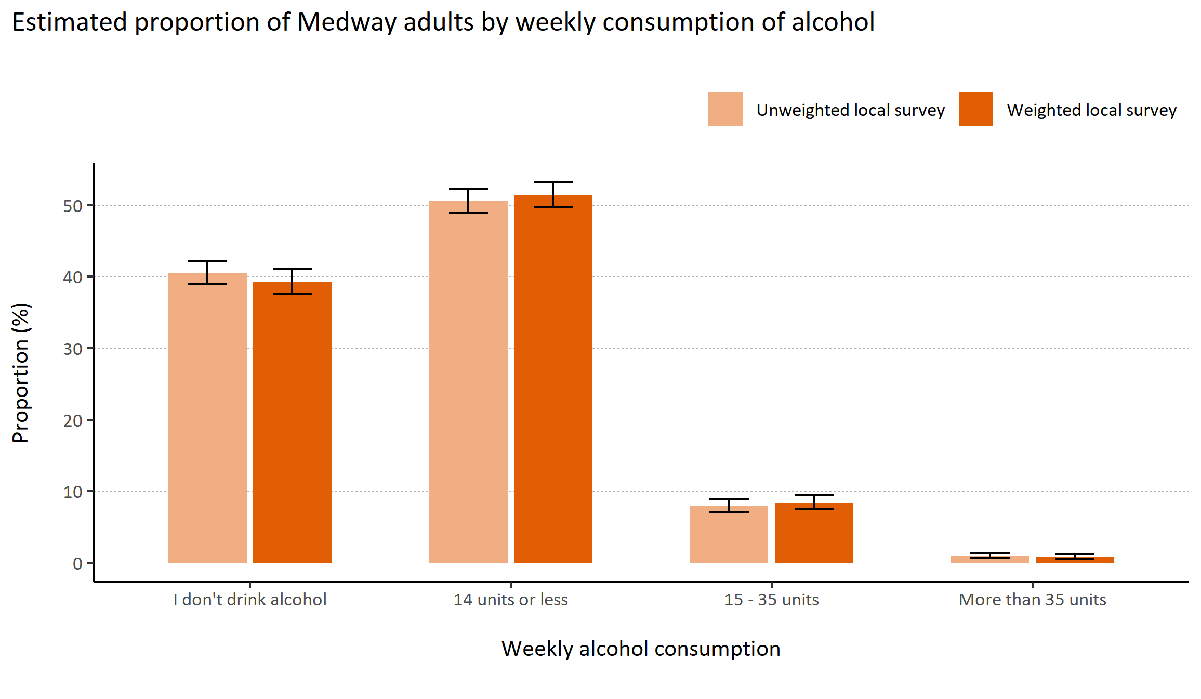
Alcohol consumption
© Medway Council, Public Health Intelligence Team, Version 1.0, 15/08/2023
Plot description
  National Medway estimate not available for comparison for this indicator.
  The weighted survey results estimate that 51.4% of Medway adults consume 14 units of alcohol or less a week, 8.4% consume 15 - 35 units, 0.8% consume more than 35 units, and 39.3% do not drink alcohol.
  87 out of 3,594 survey respondents did not answer this question.
Survey question: How many units of alcohol do you drink in a typical week? If unsure, please estimate.
Possible answers: 14 units or less, 15 - 35 units, More than 35 units, I don't drink alcohol, Don't know/don't want to say.

Slide 12
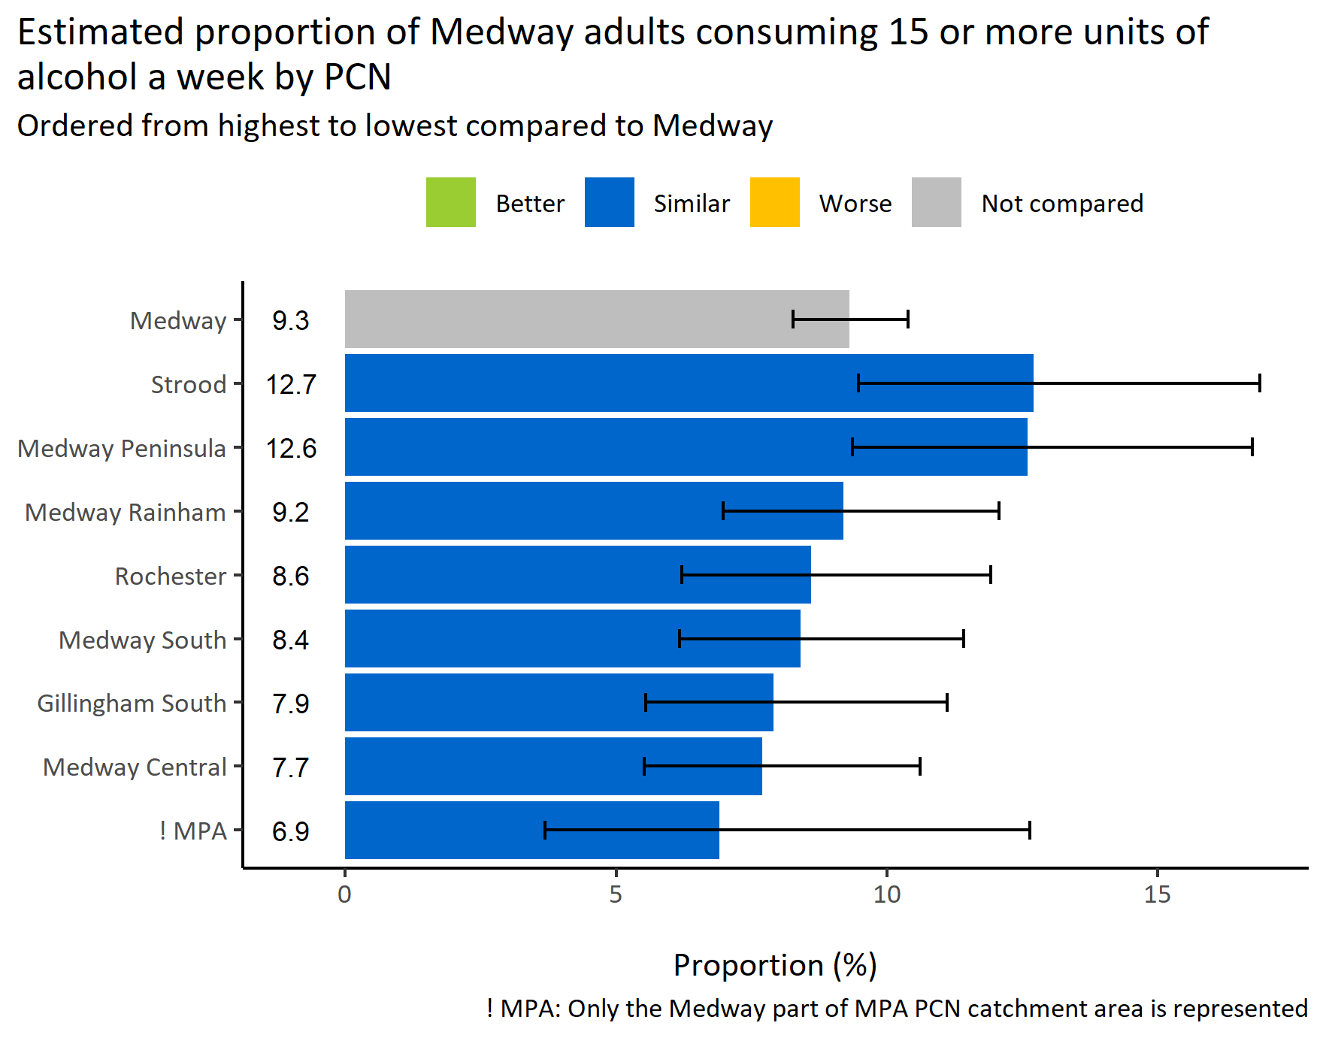
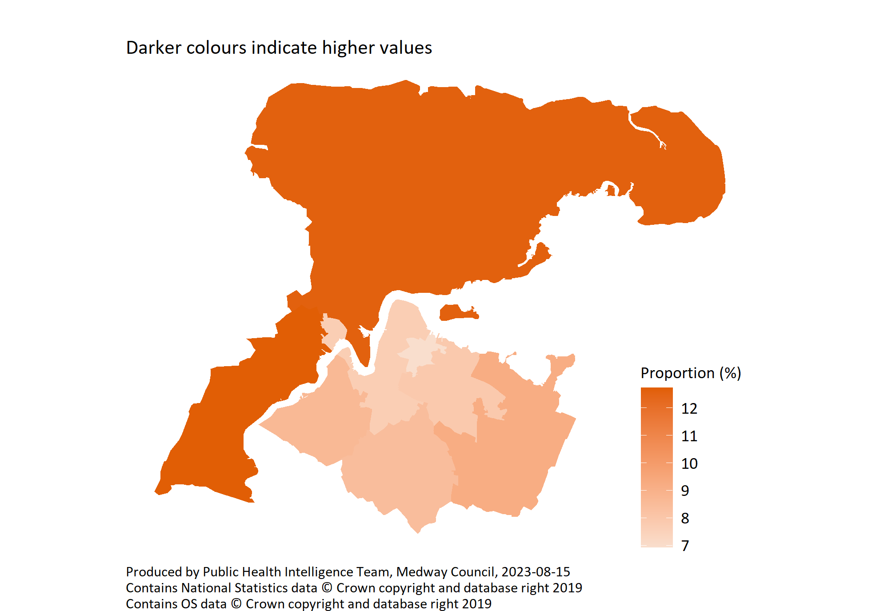
High alcohol consumption by PCN
© Medway Council, Public Health Intelligence Team, Version 1.0, 15/08/2023
Survey question: How many units of alcohol do you drink in a typical week? If unsure, please estimate.
Possible answers: 14 units or less, 15 - 35 units, More than 35 units, I don't drink alcohol, Don't know/don't want to say.
Category selected: High alcohol consumption: More than 15 units

Slide 13
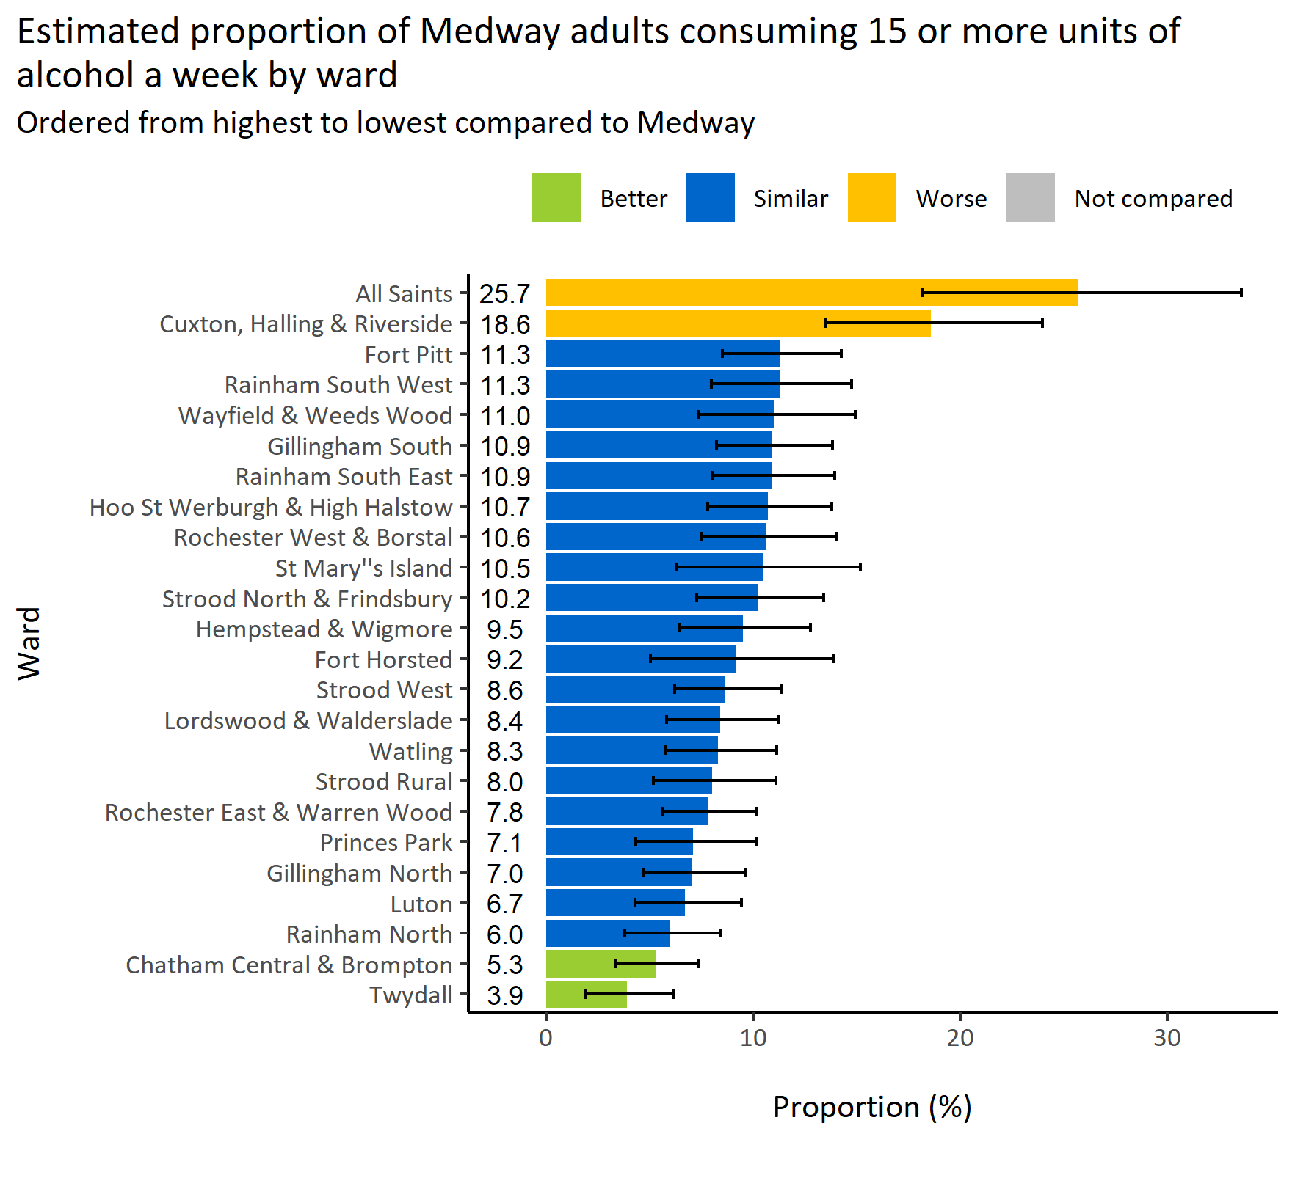
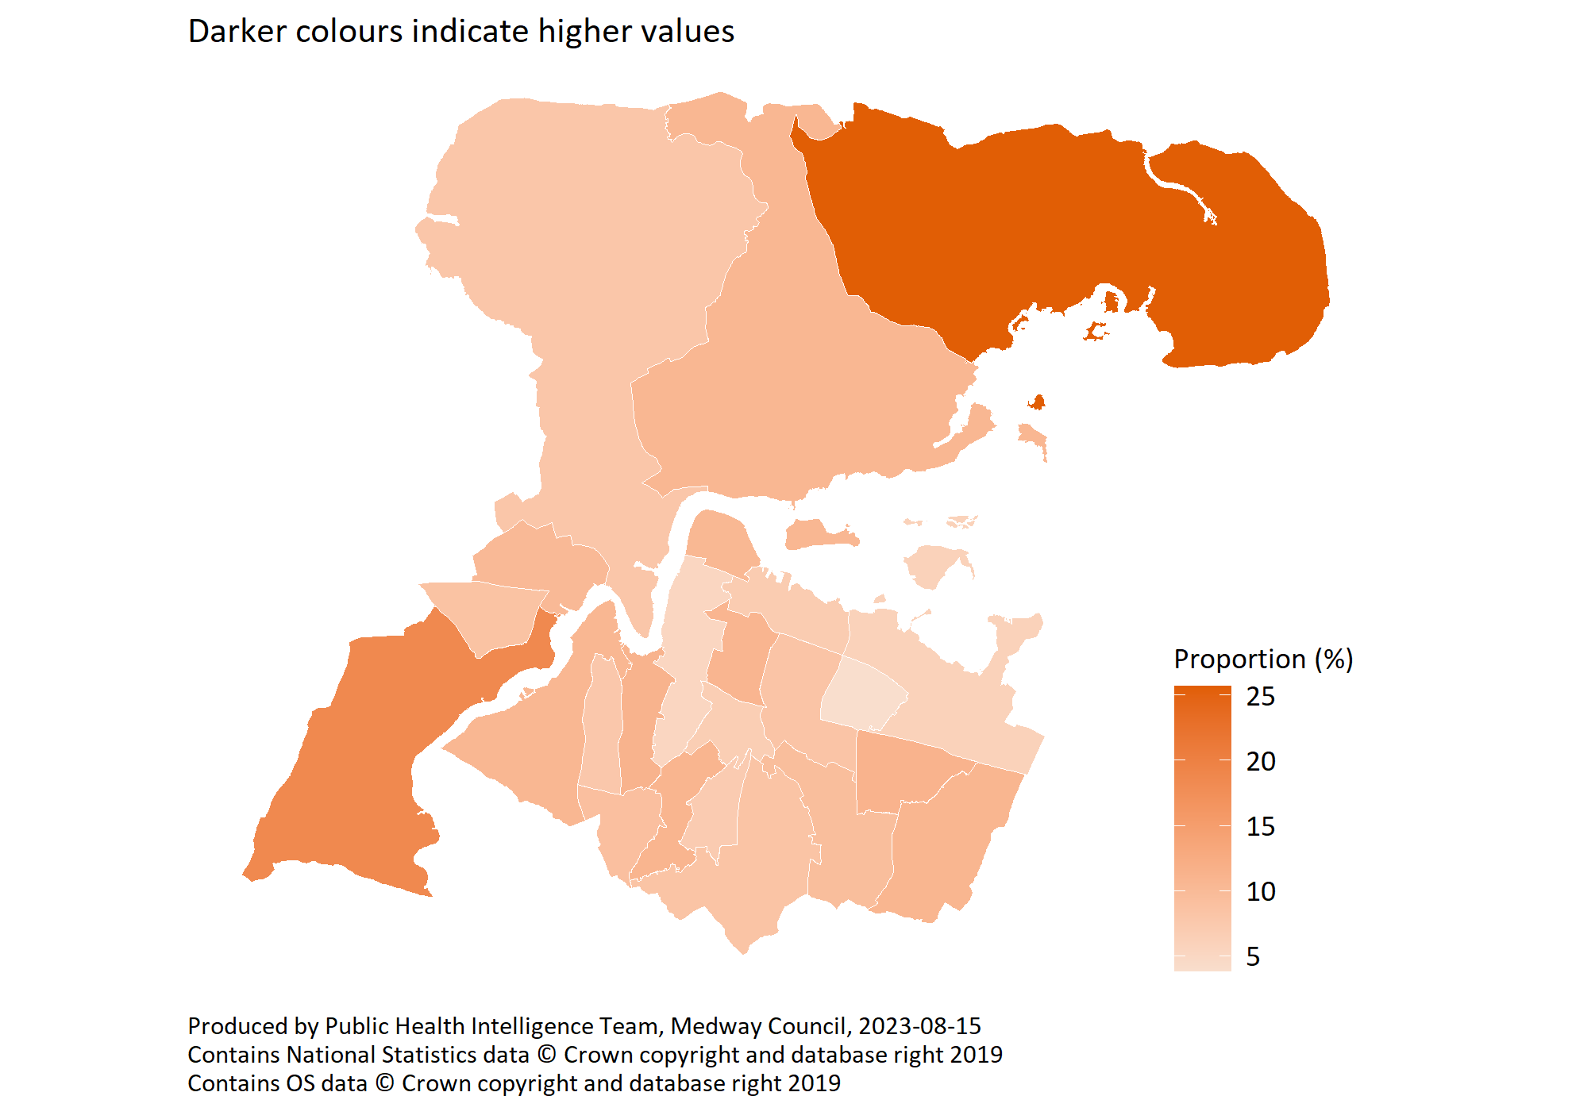
High alcohol consumption by ward
© Medway Council, Public Health Intelligence Team, Version 1.0, 15/08/2023
Survey question: How many units of alcohol do you drink in a typical week? If unsure, please estimate.
Category selected: More than 15 units of alcohol a week
Estimates are calculated using Bayesian methods. These do not take into
account survey weighting but will be updated in the future to do so.

Slide 14
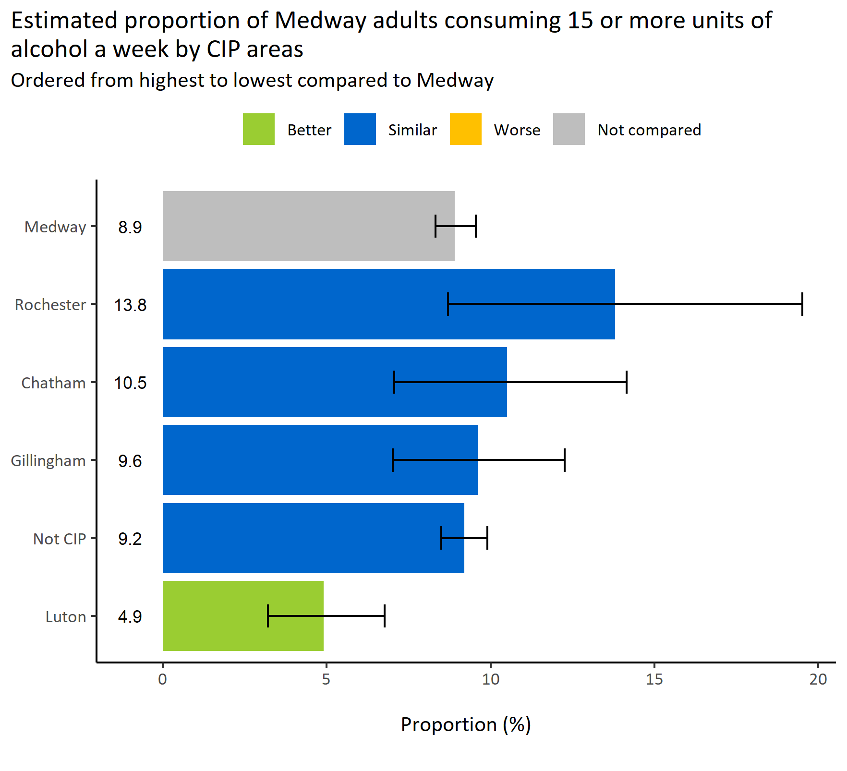
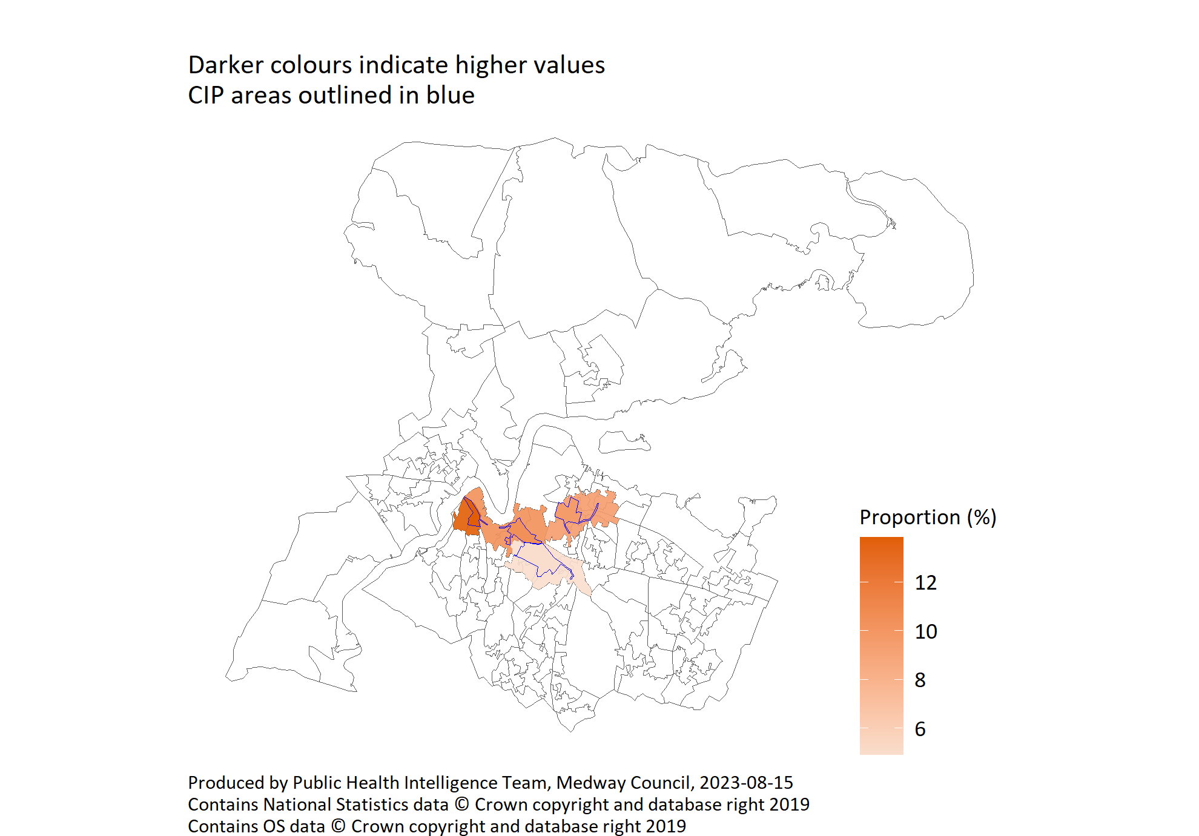
High alcohol consumption by CIP areas
© Medway Council, Public Health Intelligence Team, Version 1.0, 15/08/2023
Survey question: How many units of alcohol do you drink in a typical week? If unsure, please estimate.
Category selected: High alcohol consumption: More than 15 units
CIP area: Cumulative Impact Policy area
Estimates are calculated using Bayesian methods. These do not take into
account survey weighting but will be updated in the future to do so.

Slide 15
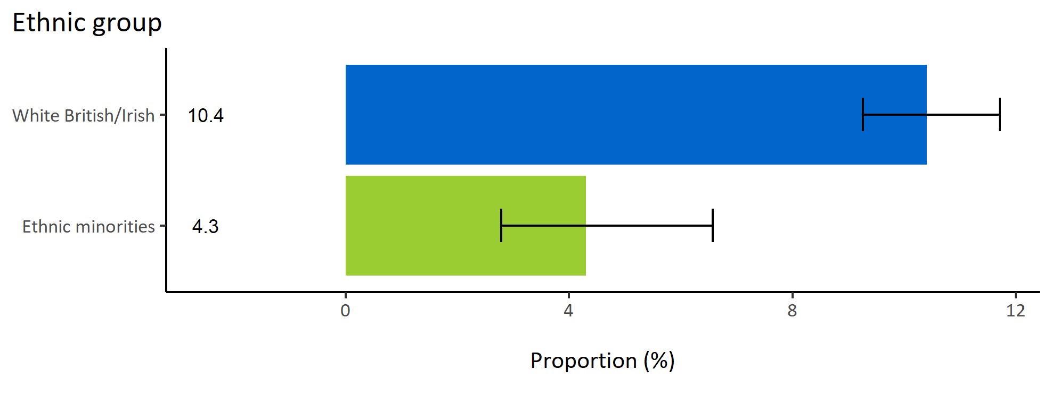
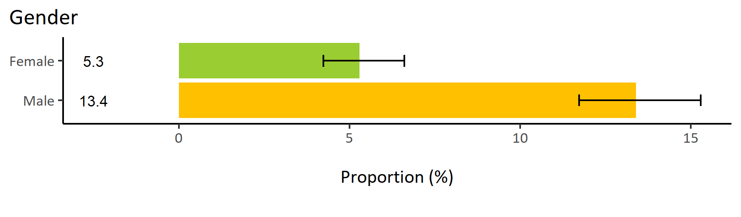
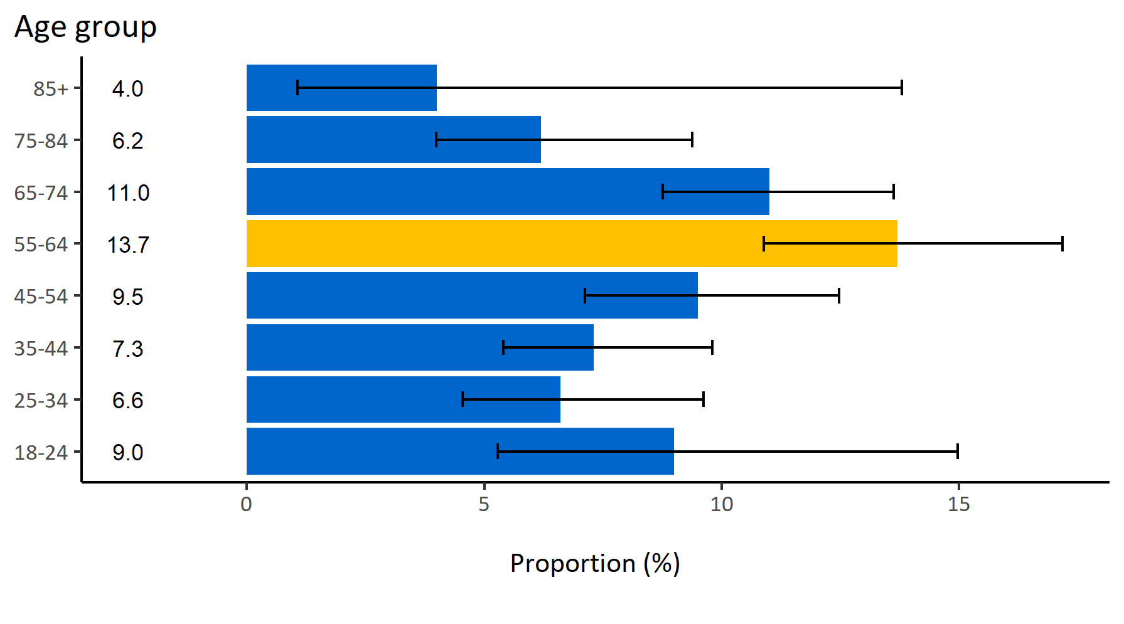
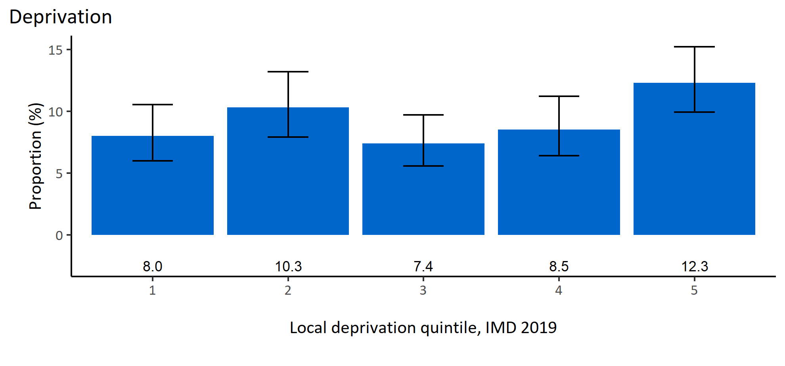
High alcohol consumption by inequalities
© Medway Council, Public Health Intelligence Team, Version 1.0, 15/08/2023
Estimated proportion of Medway adults consuming 15 or more units of alcohol a week by inequalities

Slide 16
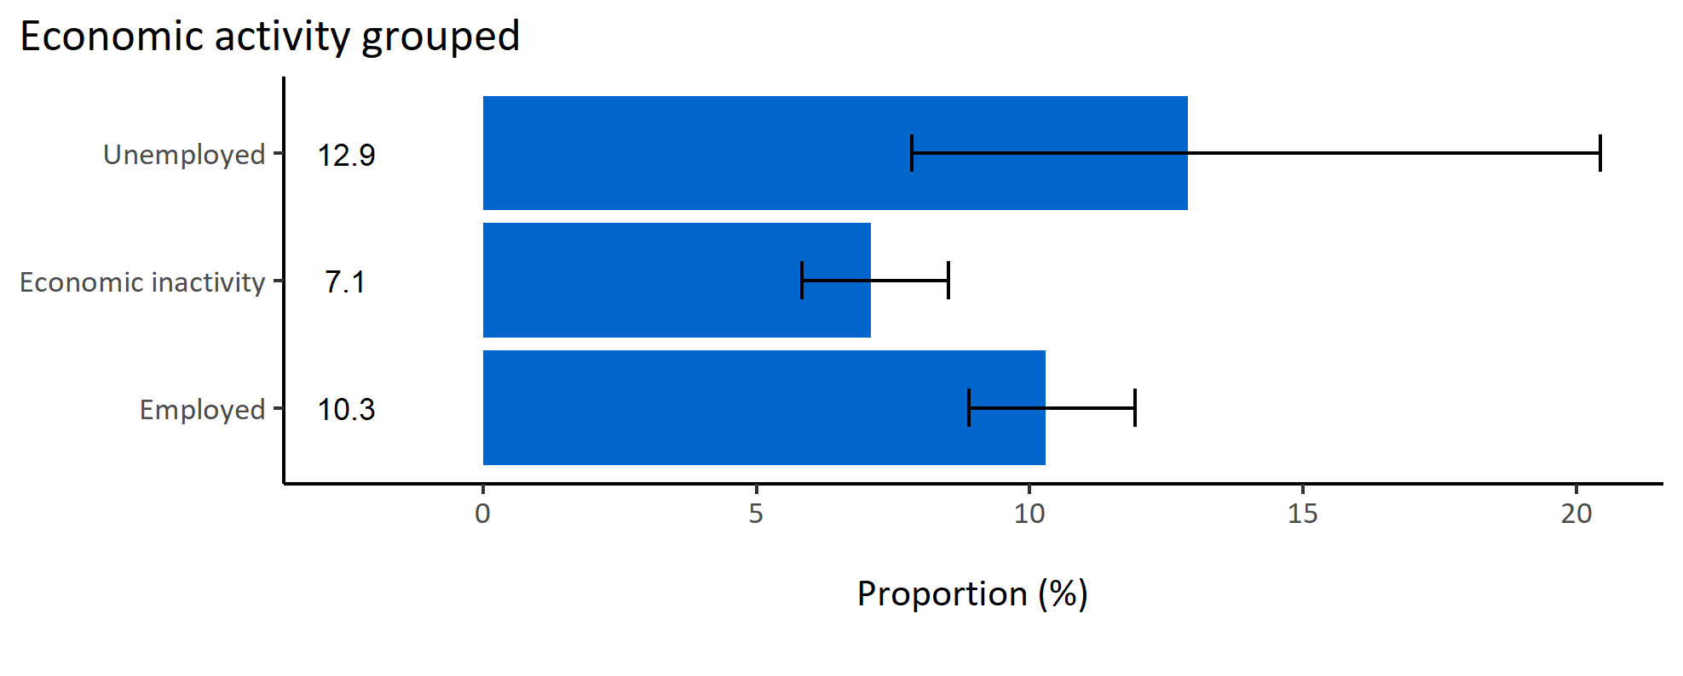
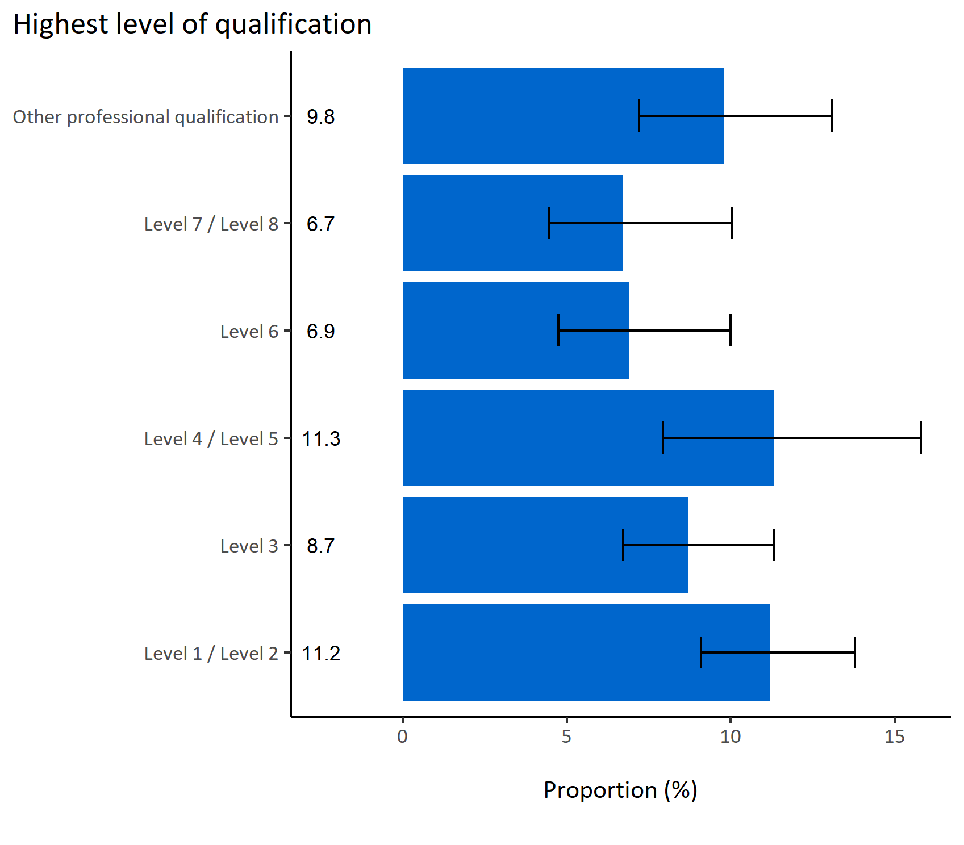
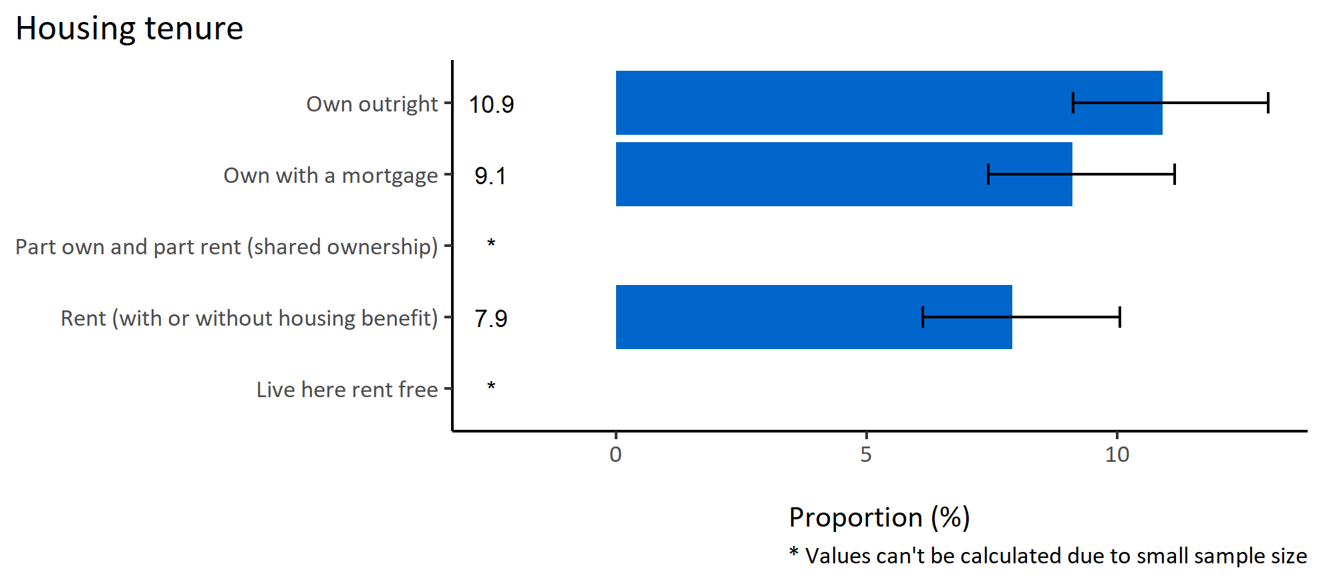
High alcohol consumption by wider determinants
© Medway Council, Public Health Intelligence Team, Version 1.0, 15/08/2023
Estimated proportion of Medway adults consuming 15 or more units of alcohol a week by wider determinants

Slide 17
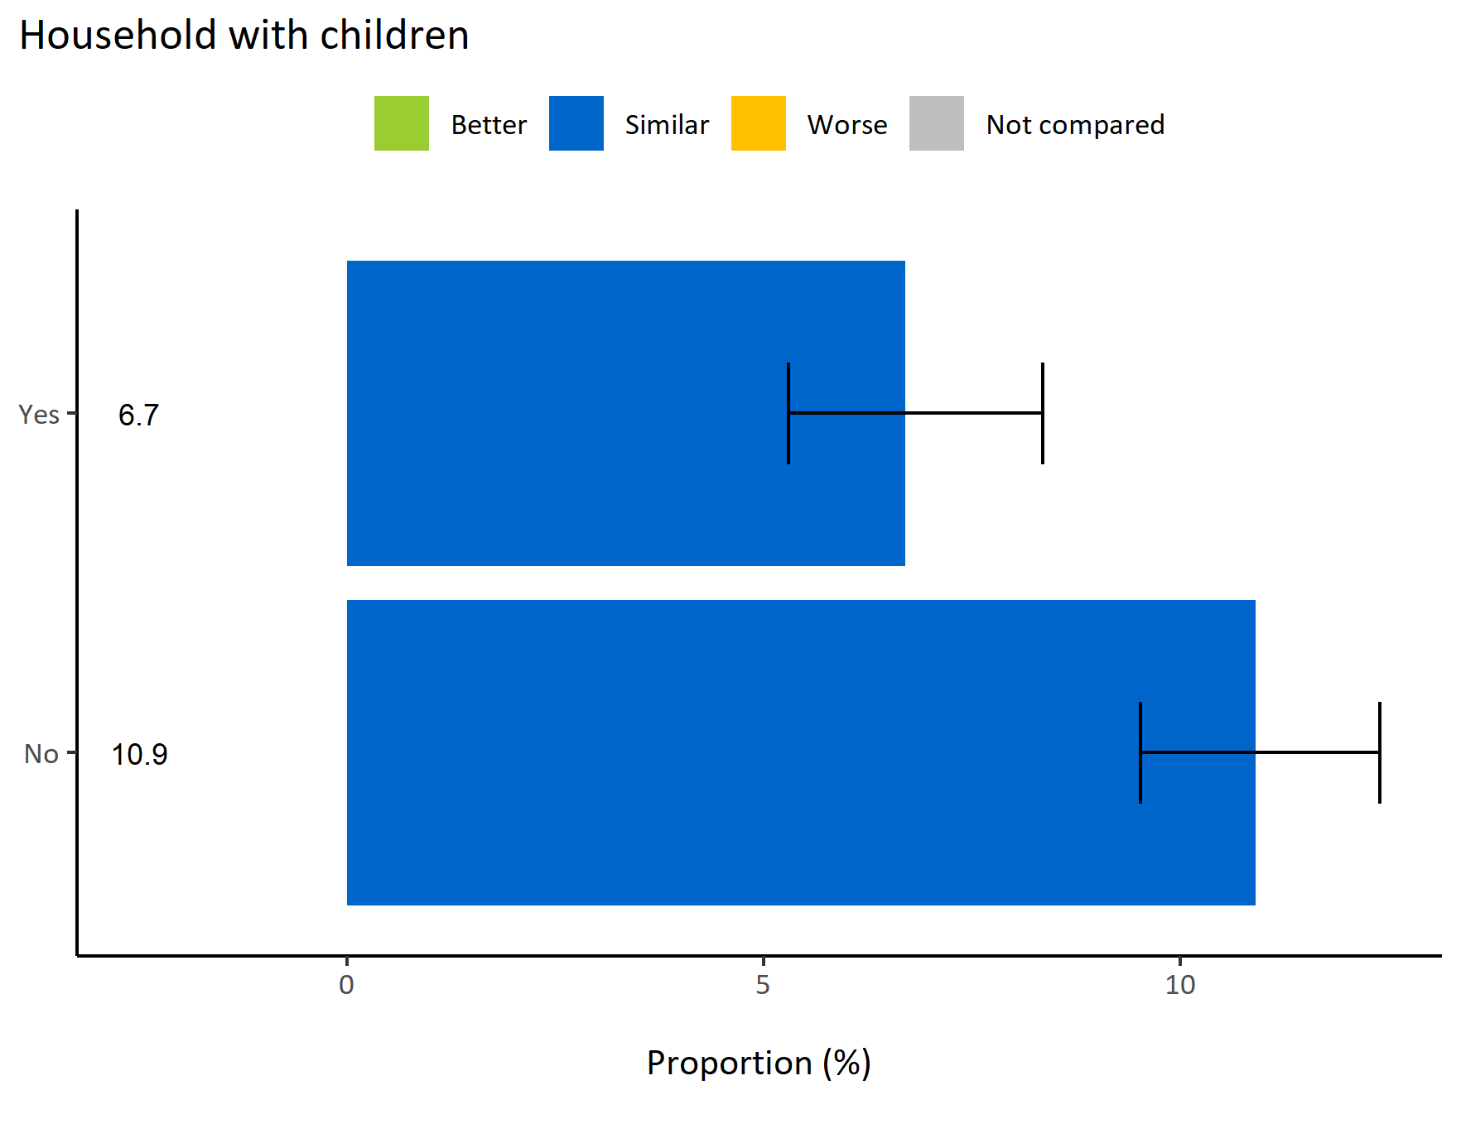
High alcohol consumption by households with children
© Medway Council, Public Health Intelligence Team, Version 1.0, 15/08/2023
  The weighted survey results estimate that 6.7% of Medway adults living with children consume 15 or more units of alcohol per week.
  In contrast, the percentage is significantly higher at 10.9% among Medway adults without children in their households.
  Both estimates are similar to the value for the whole of Medway.
Survey question: How many units of alcohol do you drink in a typical week? If unsure, please estimate.
Possible answers: 14 units or less, 15 - 35 units, More than 35 units, I don't drink alcohol, Don't know/don't want to say.
Category selected: High alcohol consumption: More than 15 units

Slide 18
Summary: High alcohol consumption
© Medway Council, Public Health Intelligence Team, Version 1.0, 15/08/2023
The weighted survey results estimate that 9.3% of Medway adults consume 15 or more units of alcohol a week.
Certain groups in Medway are more likely to have higher levels of alcohol consumption. These groups include:
  Adults in wards All Saints and Cuxton, Halling & Riverside
  Males
  Adults aged 55 to 64 years old.

Slide 19
Alcohol-related household issue

Slide 20
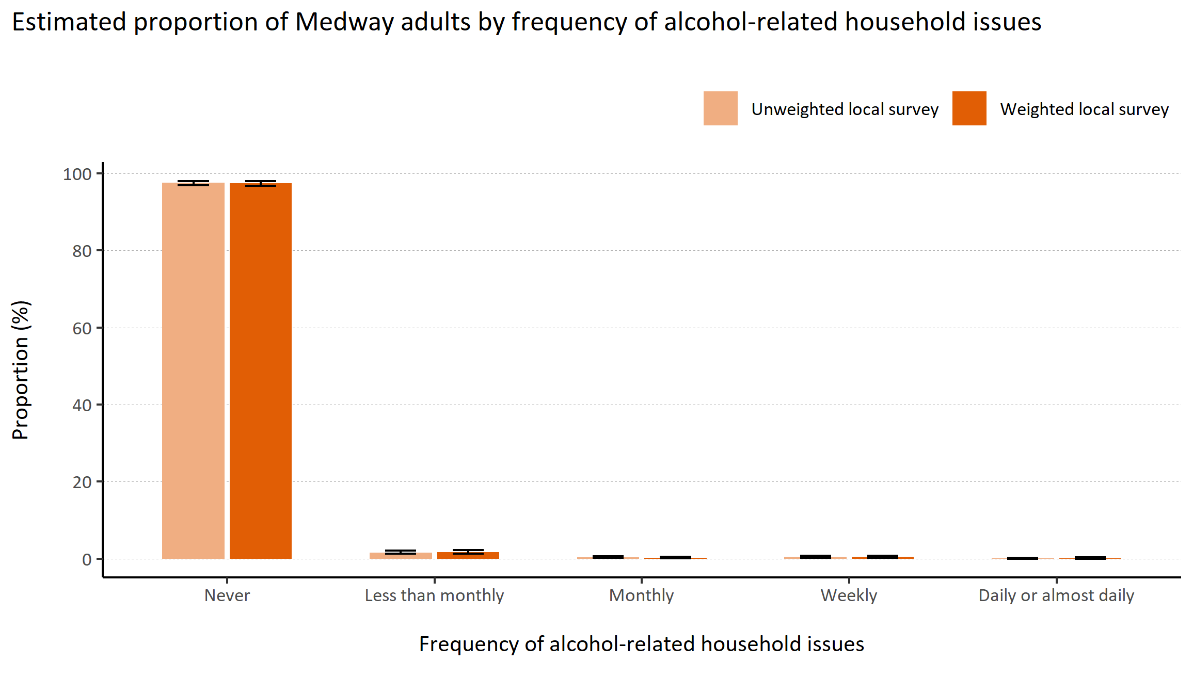
Alcohol-related household issues
© Medway Council, Public Health Intelligence Team, Version 1.0, 15/08/2023
Plot description
  National Medway estimate not available for comparison for this indicator.
  The weighted survey results estimate that 97.4% of Medway adults never experience alcohol-related household issues, 1.7% experience issues less than monthly, 0.3% monthly, 0.4% weekly, and 0.1% experience daily alcohol-related household issues.
  71 out of 3,594 survey respondents did not answer this question.
Survey question: Alcohol can sometimes lead to increased tensions in the home or cause people to be unreliable. How often does the alcohol drinking of someone in your household cause problems?
Possible answers: Daily or almost daily, Weekly, Monthly, Less than monthly, Never, Don't know/don't want to say, Not applicable.

Slide 21
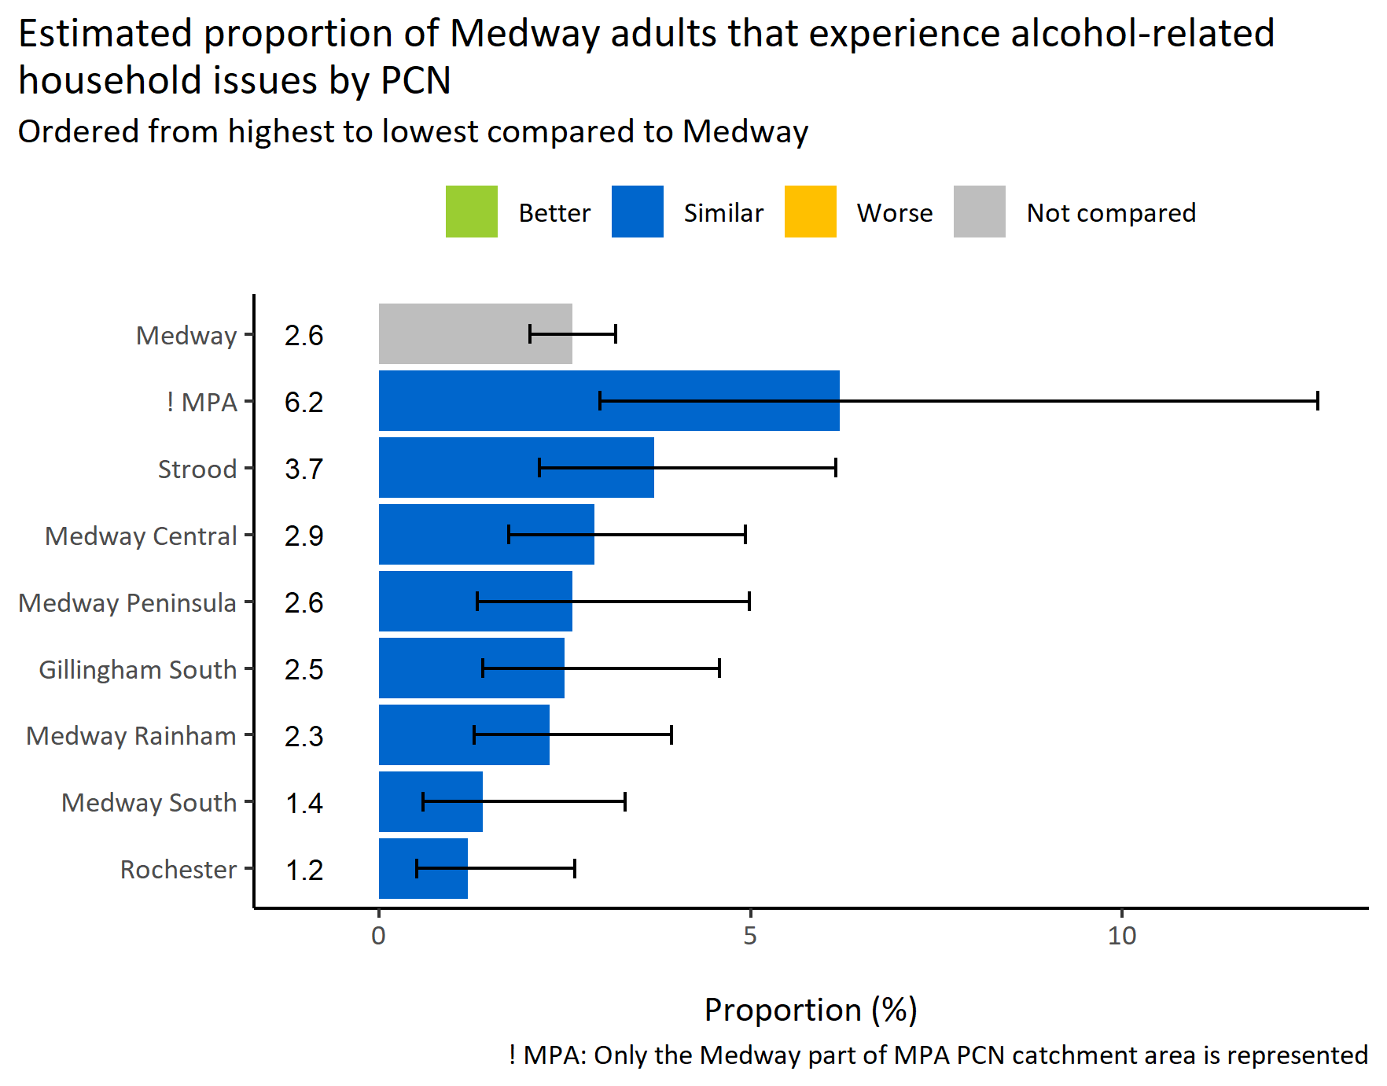
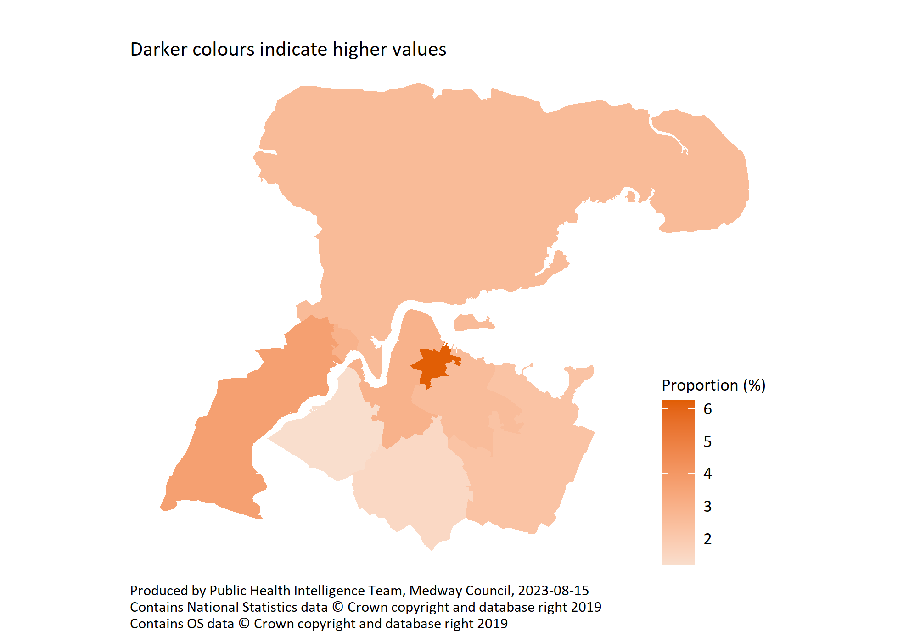
Alcohol-related household issues by PCN
© Medway Council, Public Health Intelligence Team, Version 1.0, 15/08/2023
Survey question: Alcohol can sometimes lead to increased tensions in the home or cause people to be unreliable. How often does the alcohol drinking of someone in your household cause problems?
Possible answers: Daily or almost daily, Weekly, Monthly, Less than monthly, Never, Don't know/don't want to say, Not applicable.
Category selected: Experience alcohol-related household issues: Less than monthly; Monthly; Weekly; Daily or almost daily

Slide 22
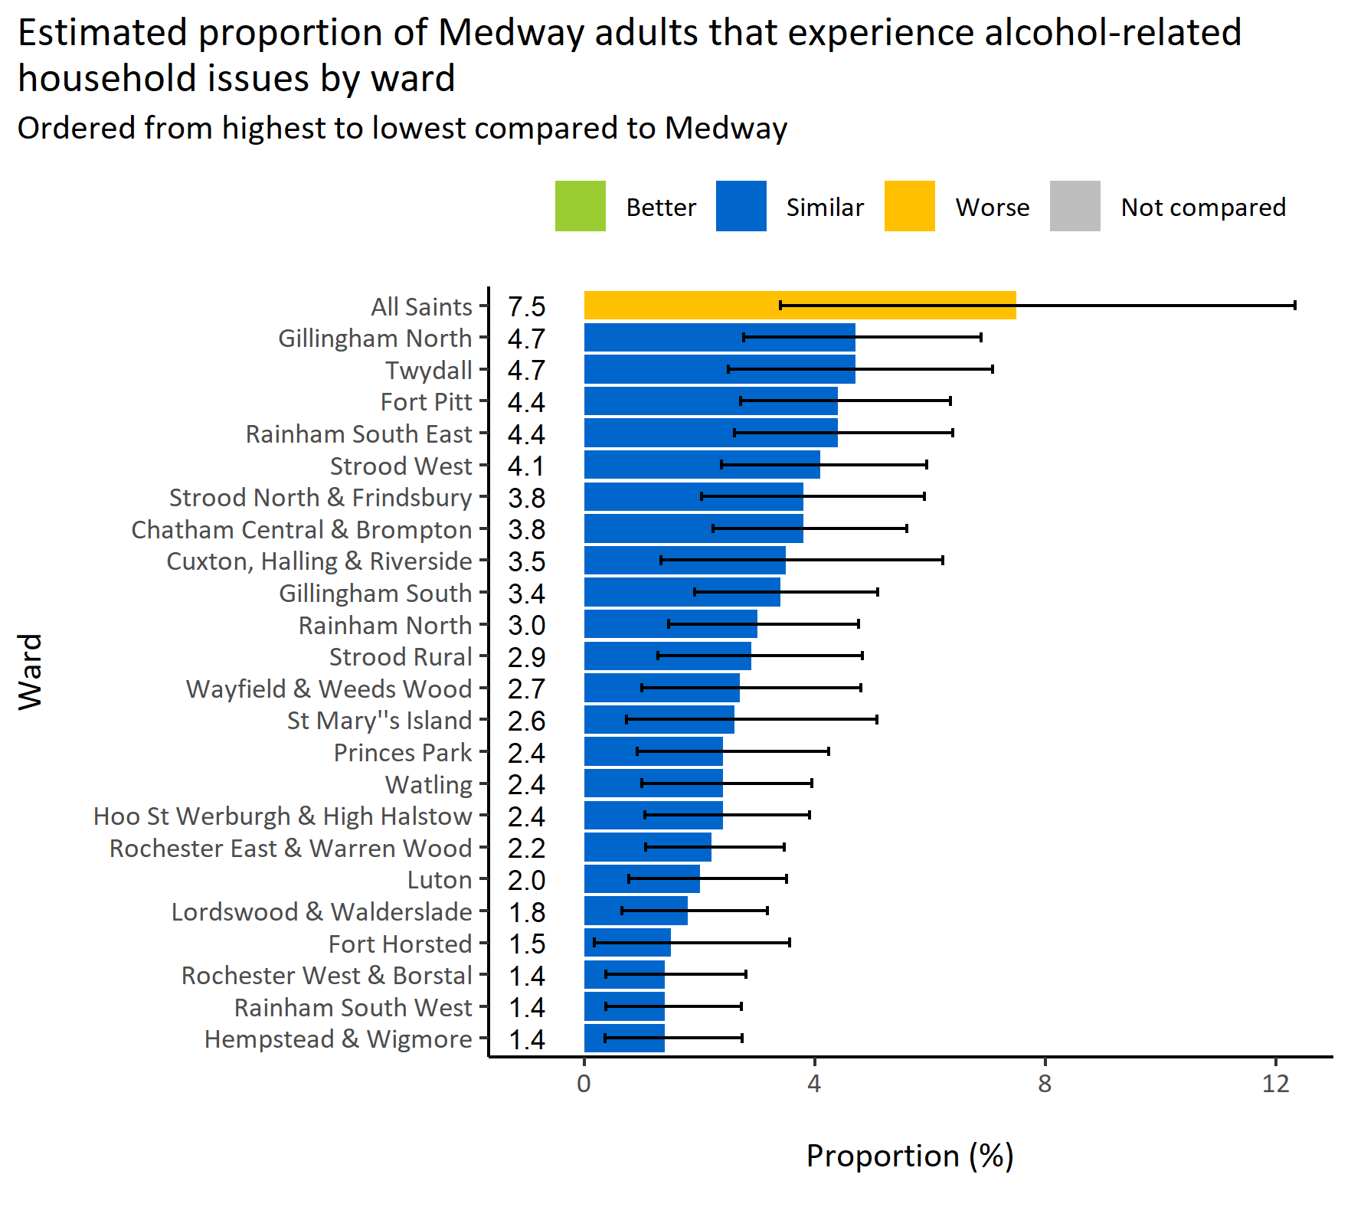
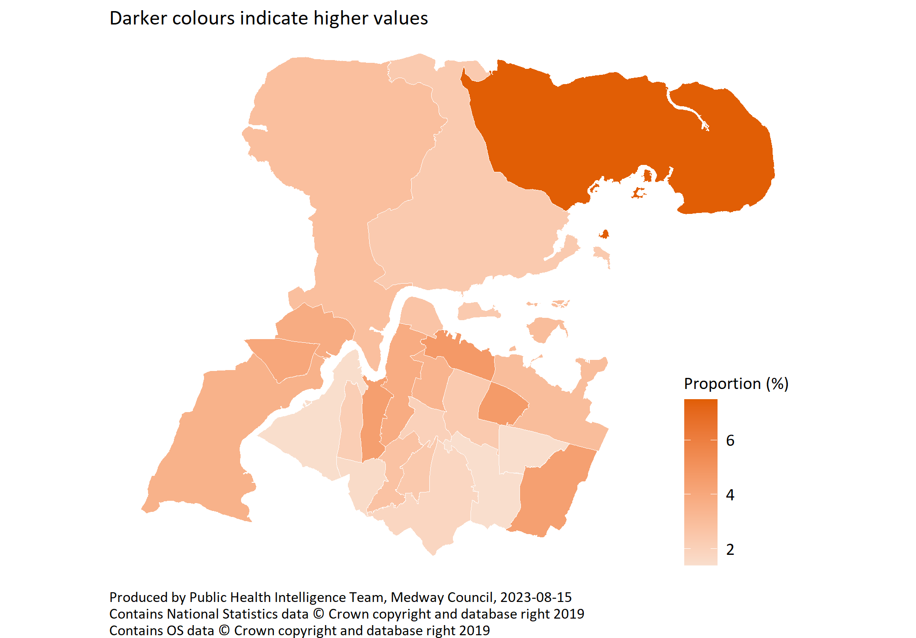
Alcohol-related household issues by ward
© Medway Council, Public Health Intelligence Team, Version 1.0, 15/08/2023
Survey question: Alcohol can sometimes lead to increased tensions in the home or cause people to be unreliable. How often does the alcohol drinking of someone in your household cause problems?
Category selected: Experience alcohol-related household issues: Less than monthly; Monthly; Weekly; Daily or almost daily
Estimates are calculated using Bayesian methods. These do not take into
account survey weighting but will be updated in the future to do so.

Slide 23
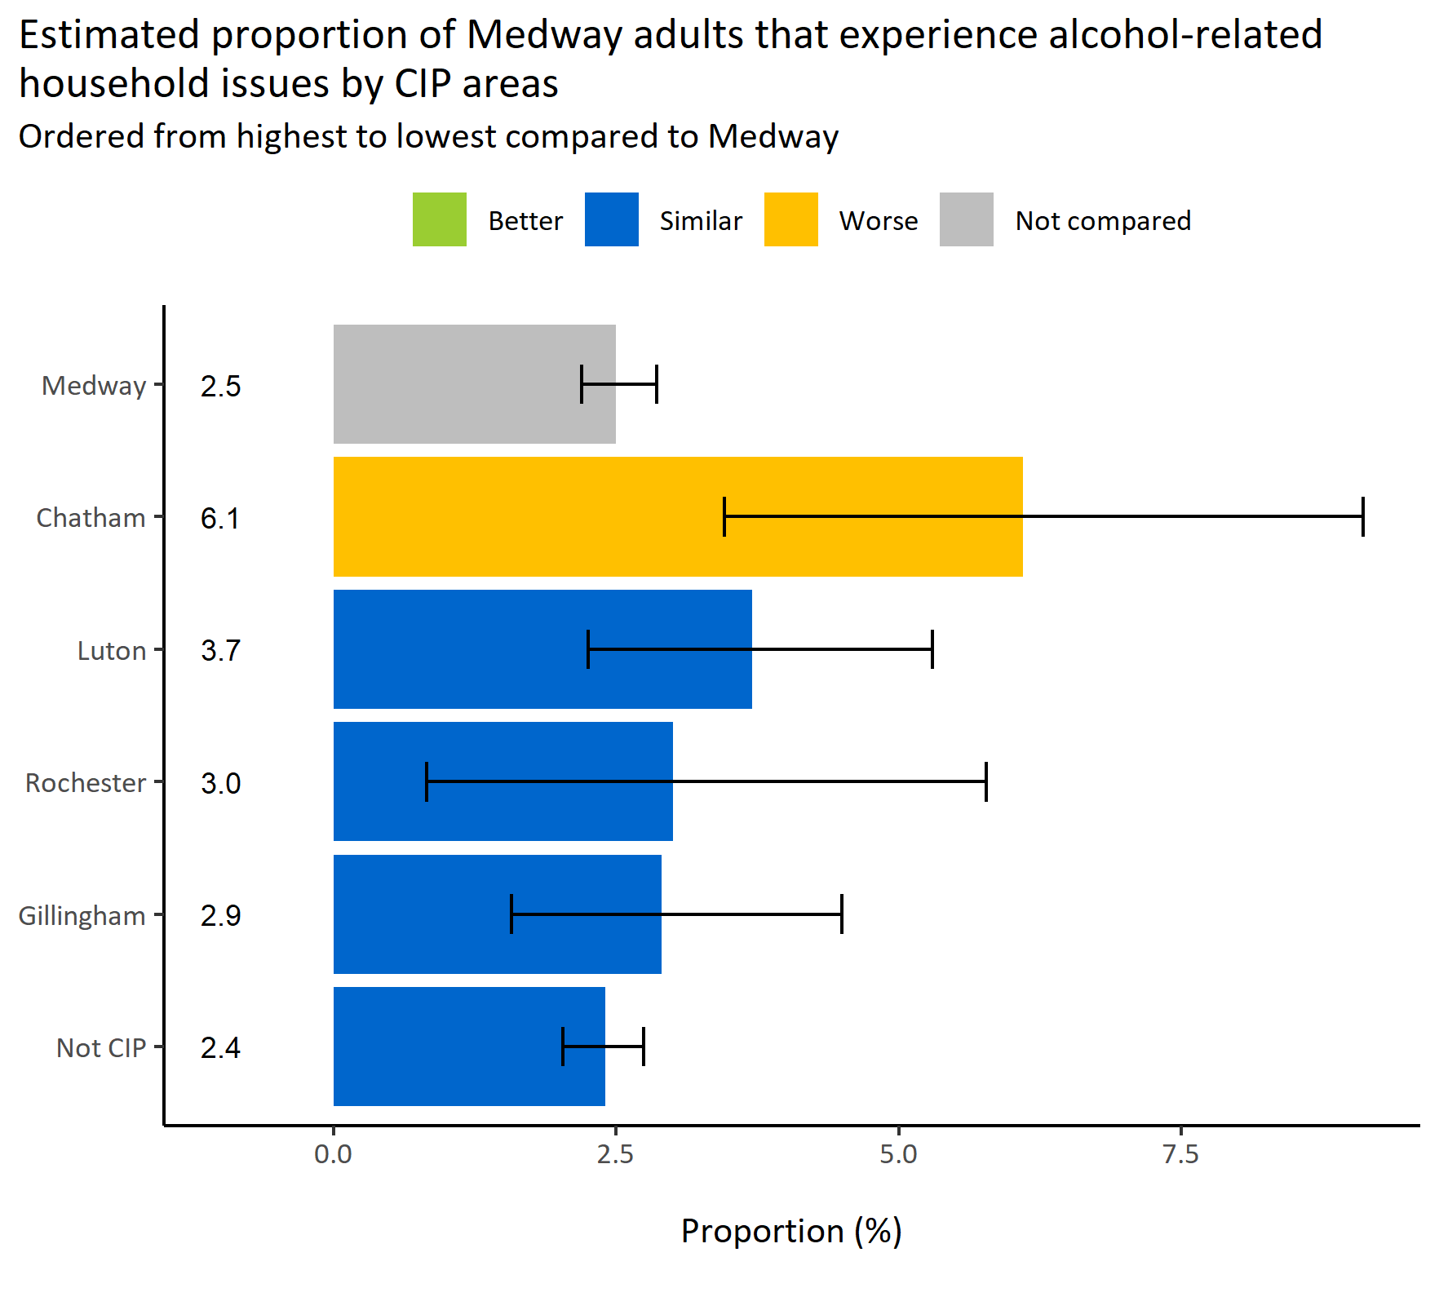

Alcohol-related household issues by CIP areas
© Medway Council, Public Health Intelligence Team, Version 1.0, 15/08/2023
Survey question: How often does the alcohol drinking of someone in your household cause problems?
Category selected: Experience alcohol-related household issues: Less than monthly; Monthly; Weekly; Daily or almost daily
CIP area: Cumulative Impact Policy area
Estimates are calculated using Bayesian methods. These do not take into
account survey weighting but will be updated in the future to do so.

Slide 24
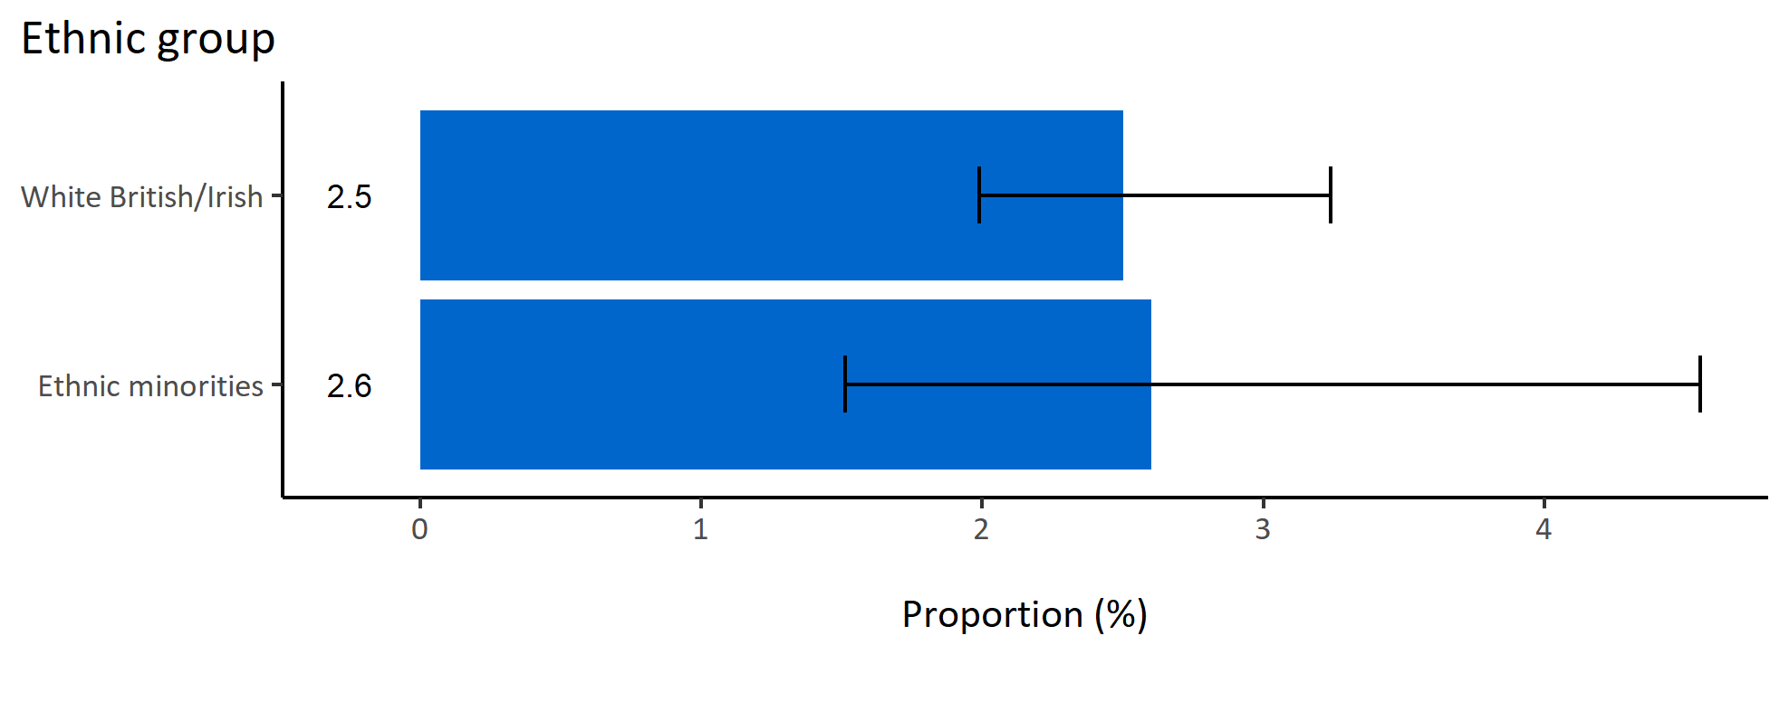
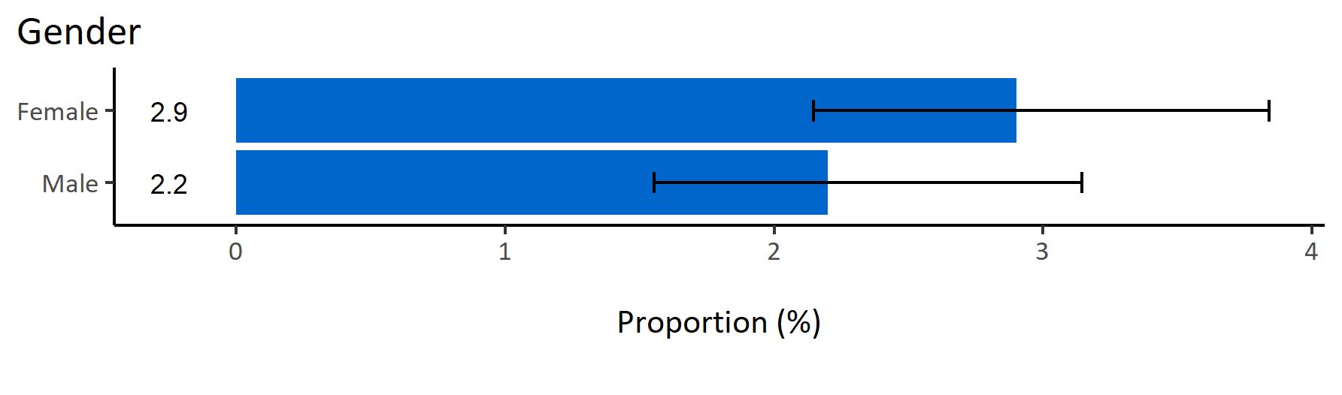
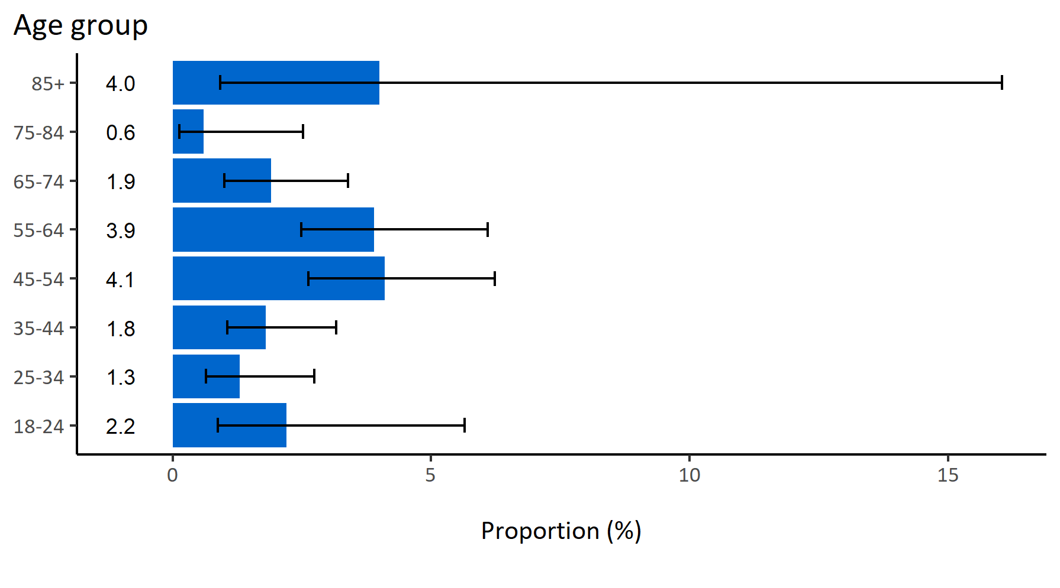
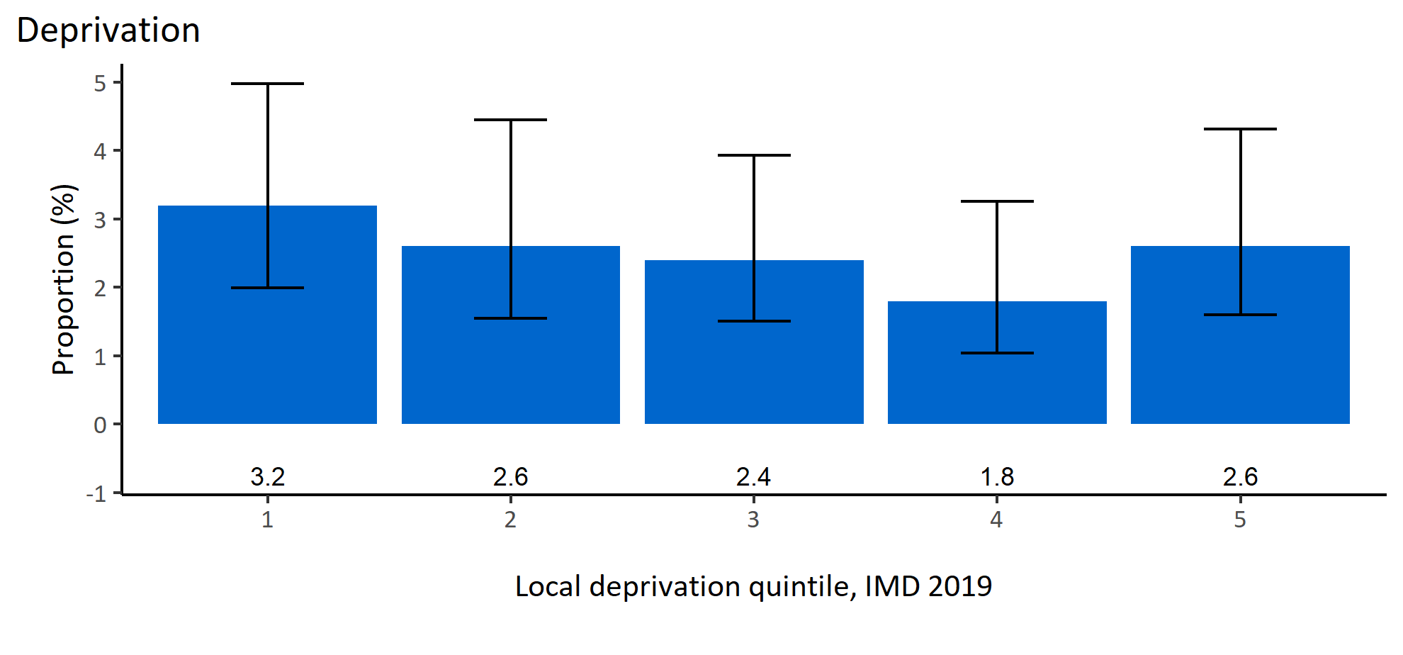
Alcohol-related household issues by inequalities
© Medway Council, Public Health Intelligence Team, Version 1.0, 15/08/2023
Estimated proportion of Medway adults that experience alcohol-related household issues by inequalities

Slide 25
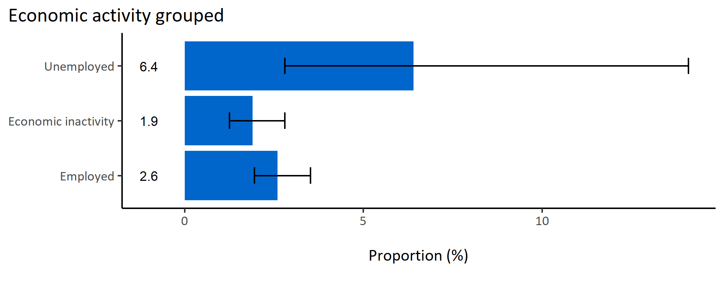
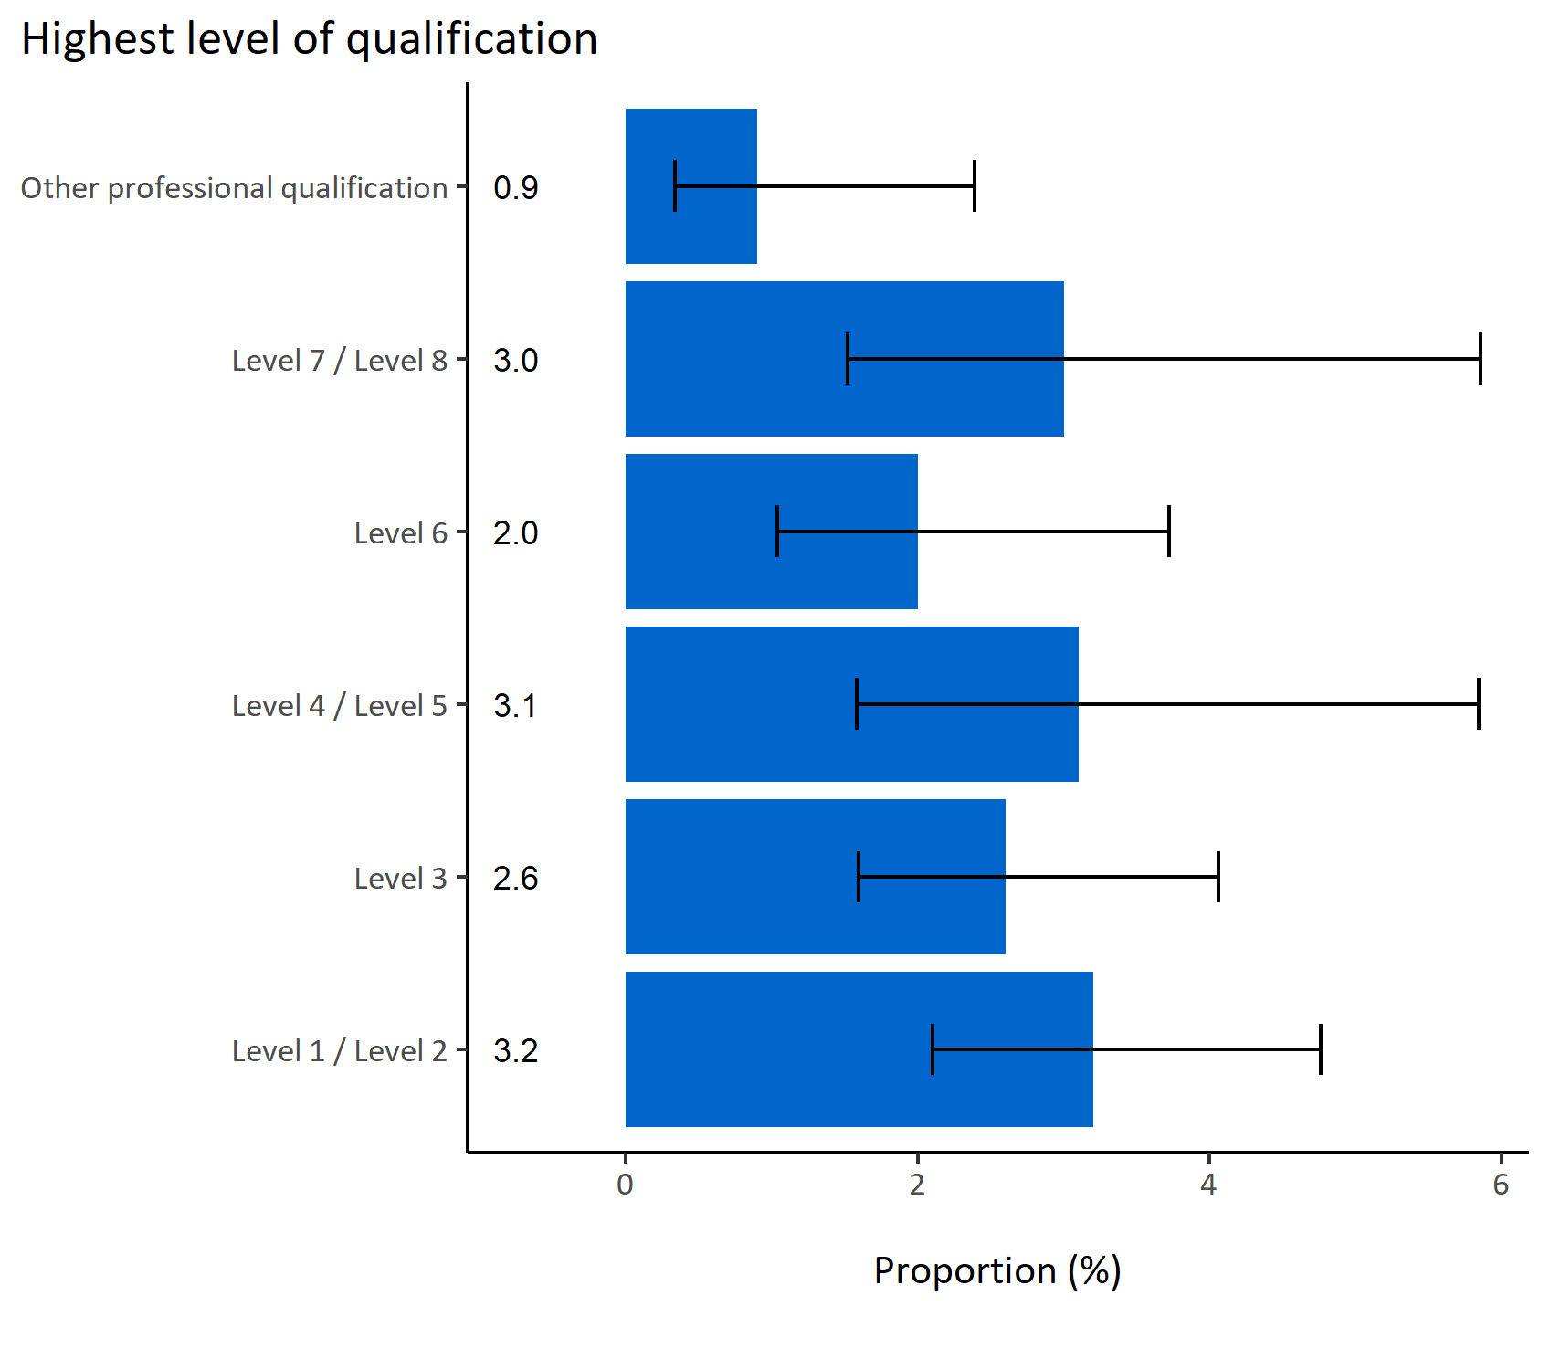
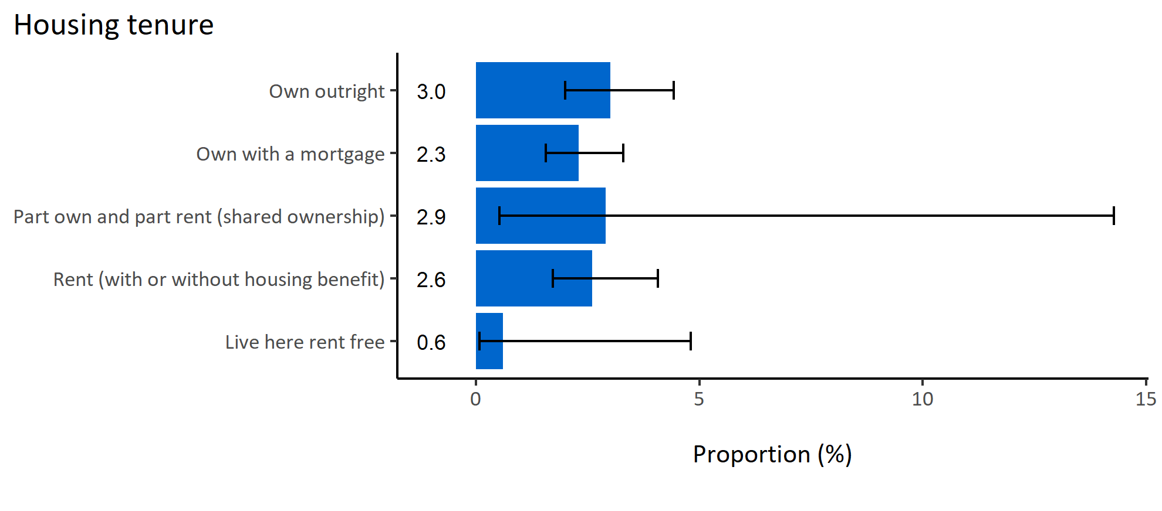
Alcohol-related household issues by wider determinants
© Medway Council, Public Health Intelligence Team, Version 1.0, 15/08/2023
Estimated proportion of Medway adults that experience alcohol-related household issues by wider determinants

Slide 26
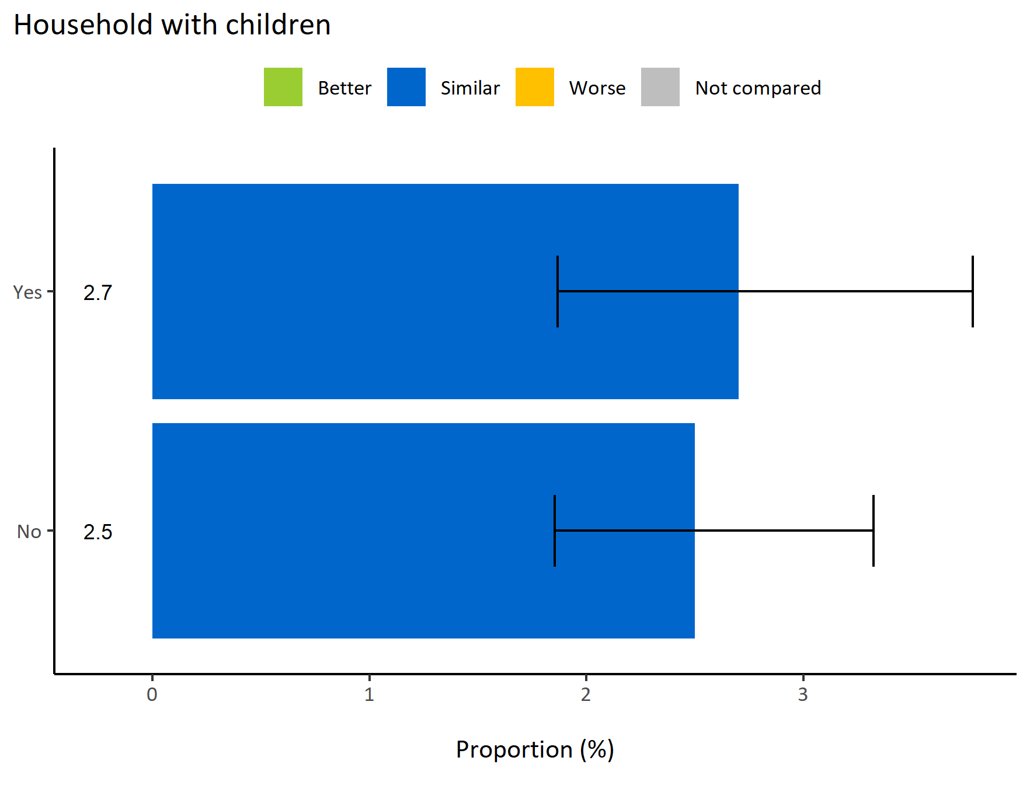
Alcohol-related household issues by households with children
© Medway Council, Public Health Intelligence Team, Version 1.0, 15/08/2023
  The weighted survey results estimate that 2.7% of Medway adults living with children experience alcohol-related household issues.
  The value is similar for Medway adults without children in their households (2.5%).
  Both estimates are similar to the value for the whole of Medway.
Survey question: Alcohol can sometimes lead to increased tensions in the home or cause people to be unreliable. How often does the alcohol drinking of someone in your household cause problems?
Possible answers: Daily or almost daily, Weekly, Monthly, Less than monthly, Never, Don't know/don't want to say, Not applicable.
Category selected: Experience alcohol-related household issues: Less than monthly; Monthly; Weekly; Daily or almost daily

Slide 27
Summary: Alcohol-related household issues
© Medway Council, Public Health Intelligence Team, Version 1.0, 15/08/2023
The weighted survey results estimate that 2.6% of Medway adults experience alcohol-related household issues.
Certain groups in Medway are more likely to experience alcohol-related household issues. These groups include:
  Adults in All Saints ward
  Adults living in the Chatham CIP area
It is important to note that the confidence intervals are wide in the inequalities and wider determinants analysis due to small sample sizes, making it difficult to identify clear differences between groups.

