Slide 1
Medway Health and Wellbeing Survey
Oral Health Analysis
Medway Council
Public Health Intelligence Team
15/08/2023

Slide 2
Contact details
© Medway Council, Public Health Intelligence Team, Version 1.0, 15/08/2023
If you have any questions or would like further information about the Medway Health and Wellbeing Survey, please contact:
Dr Natalie Goldring
Senior Public Health Intelligence Manager
Public Health
Medway Council
natalie.goldring@medway.gov.uk
01634 337271

Slide 3
Introduction
© Medway Council, Public Health Intelligence Team, Version 1.0, 15/08/2023
The aim of the Medway Health and Wellbeing Survey was to provide within Medway estimates (ward and Primary Care Network (PCN) level) of key health states and risk factors.
The survey was carried out in 2021/22.
Participants were asked a number of questions about their health and wellbeing, which were grouped into 6 key topic areas:

Slide 4
Sample
© Medway Council, Public Health Intelligence Team, Version 1.0, 15/08/2023
The Medway Health and Wellbeing Survey selected a random sample of the Medway population.
From this sample, characteristics of the entire Medway population were estimated.
The random sample was created from a list of all 119,369 residential properties in Medway.
Medway is split into smaller areas called Lower Layer Super Output Areas (LSOAs) and there are 163 LSOAs in Medway.
Using the residential property list, a survey was sent out to 6.77% of the residential properties within each LSOA (a range of 6.58% to 6.78% across the 163 LSOAs).
In total, 7,998 residential properties were sent a survey.
One adult was asked to complete the survey for each residential property.
We asked the person whose birthday was next to complete the survey.
In total, there were around 3,600 responses.

Slide 5
Weighting
© Medway Council, Public Health Intelligence Team, Version 1.0, 15/08/2023
Weights were calculated to make the survey data more representative of the population it is designed to represent, i.e. Medway as a whole.
Weighting assigns a value to each survey response to indicate how much it should be represented in the analysis.
The weights for the Medway Health and Wellbeing Survey are currently based on the number of adults within each household and the known population distributions by Middle Layer Super Output Areas (MSOA), broad age band (18-64 and 65+) and sex.
This methodology is being developed and may be updated in the future.

Slide 6
Estimating proportions
© Medway Council, Public Health Intelligence Team, Version 1.0, 15/08/2023
The survey results are presented as proportions.
  Frequentist approach
The majority of the survey analysis used a frequentist approach to estimate proportions.
For each survey question, the number of responses per category were divided by the total number of survey responses. This method is based solely on the answers given in the survey.
  Bayesian approach
In some cases, however, the sample size was too small to use the frequentist approach. For example, for ward level estimates and CIP areas. In this instance, a Bayesian approach was used to calculate the proportion.
This involves using prior knowledge to estimate a proportion and then update this value based on the answers given in the survey.
Current Bayesian model: Simple logistic regression model
Bayesian model in development: Hierarchical logistic regression including multiple levels and predictor variables. Will also incorporate survey weights and age-standardisation.

Slide 7
Confidence intervals
© Medway Council, Public Health Intelligence Team, Version 1.0, 15/08/2023
When samples are used, the values are usually accompanied by a measure of uncertainty.
Uncertainty relates to how an estimate might differ from the 'true value'.
Confidence intervals are used to show uncertainty in the Medway Health and Wellbeing Survey proportion estimates.
Confidence intervals provide a range in which we think the true proportion is likely to lie.
The confidence intervals are shown as lines in the middle of the bar graphs.
The wider the confidence interval, the greater the level of uncertainty in the estimate. This could be due to a small sample size or high variability.
A narrow confidence interval suggests that the estimate is more precise.
The 'logit' method has been used to calculate confidence intervals for the majority of the analysis.
However, when a Bayesian approach has been used to estimate the proportion, credible intervals are presented instead.

Slide 8
Validation
© Medway Council, Public Health Intelligence Team, Version 1.0, 15/08/2023
The objective of validation is to check the quality of the data collected from the Medway Health and Wellbeing survey.
Where possible, the survey estimates have been compared to values from national surveys, such as the Census and the Annual Population Survey, covering similar time periods.
Survey estimates have been considered acceptable if the value falls within the range (confidence interval) of the national survey.

Slide 9
Inequalities and wider determinants
© Medway Council, Public Health Intelligence Team, Version 1.0, 15/08/2023
Survey estimates have also been calculated for inequalities and the wider determinants of health to explore the characteristics that may influence health states or risk factors.
  Inequalities
    Gender
    Age group
    Ethnic group
    Deprivation
  Wider determinants
    Highest level of qualification
    Economic activity
    Housing tenure

Slide 10
Registered with a dentist

Slide 11
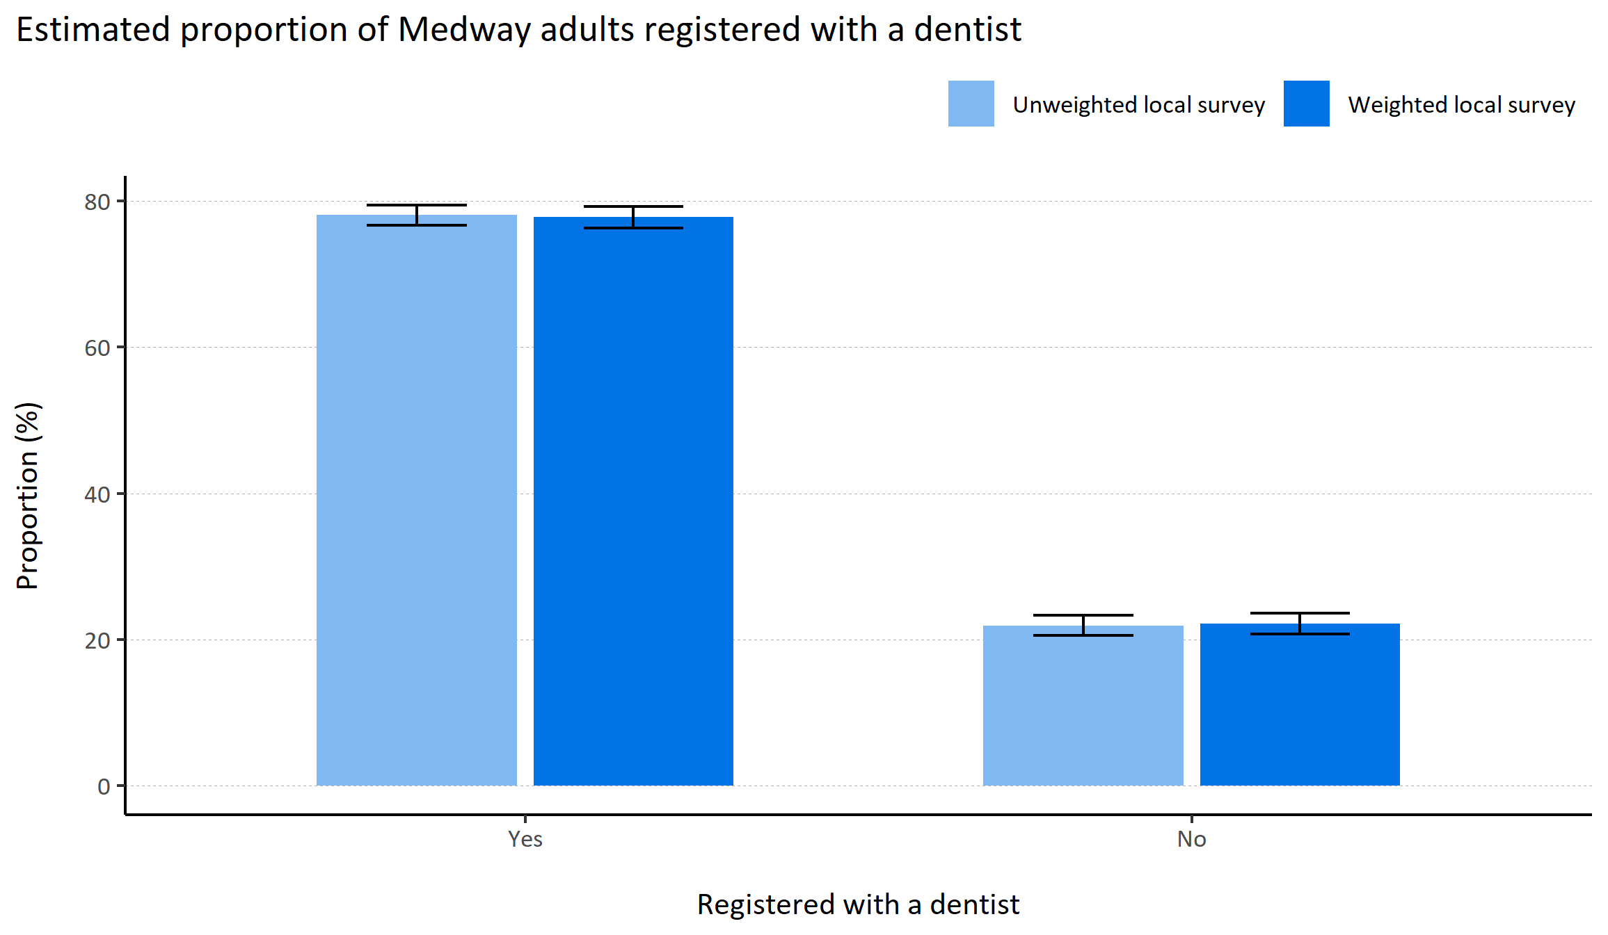
Registered with a dentist
© Medway Council, Public Health Intelligence Team, Version 1.0, 15/08/2023
Plot description
  National Medway estimate not available for comparison for this indicator.
  The weighted survey results estimate that 77.8% of Medway adults report being registered with a dentist.
  95 out of 3,594 survey respondents did not answer this question.
Survey question: Are you registered with a dentist?
Possible answers: Yes, No, Don't know/don't want to say.

Slide 12
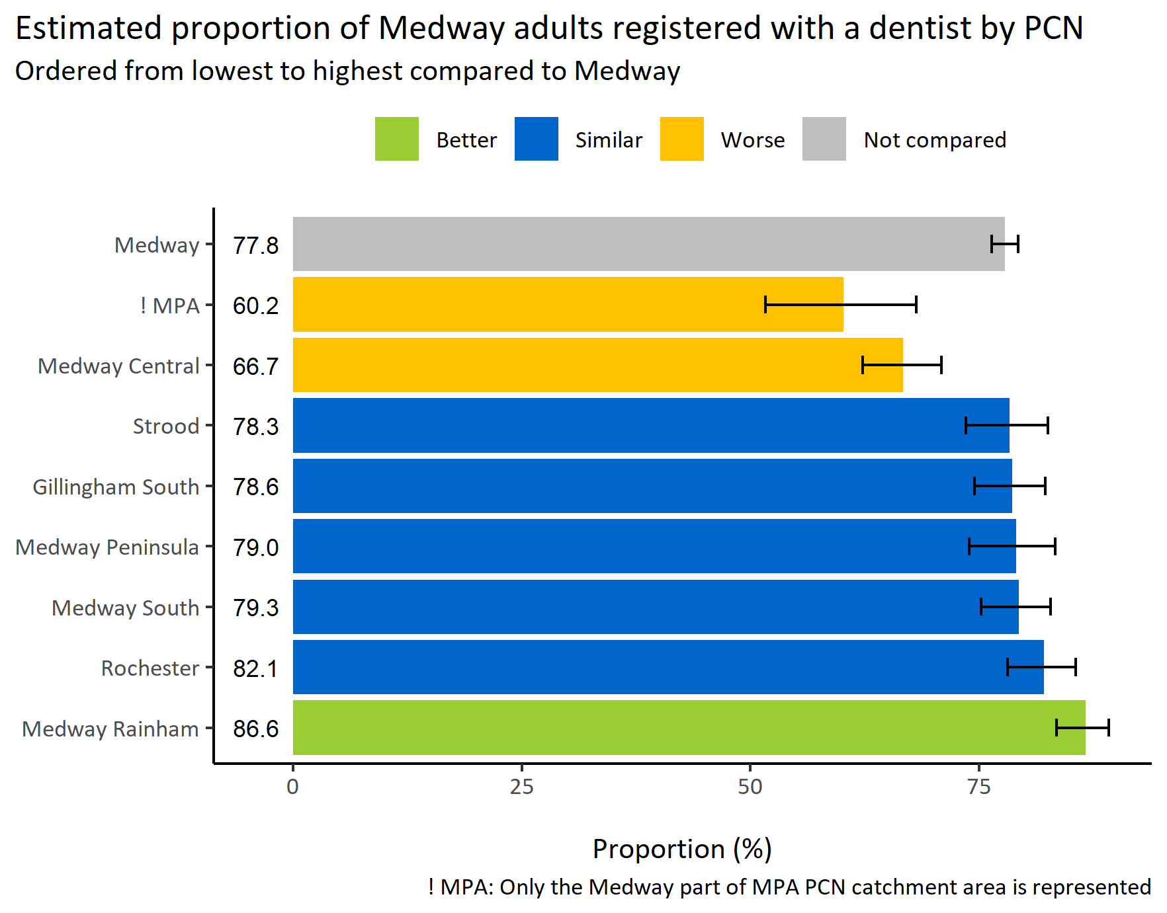
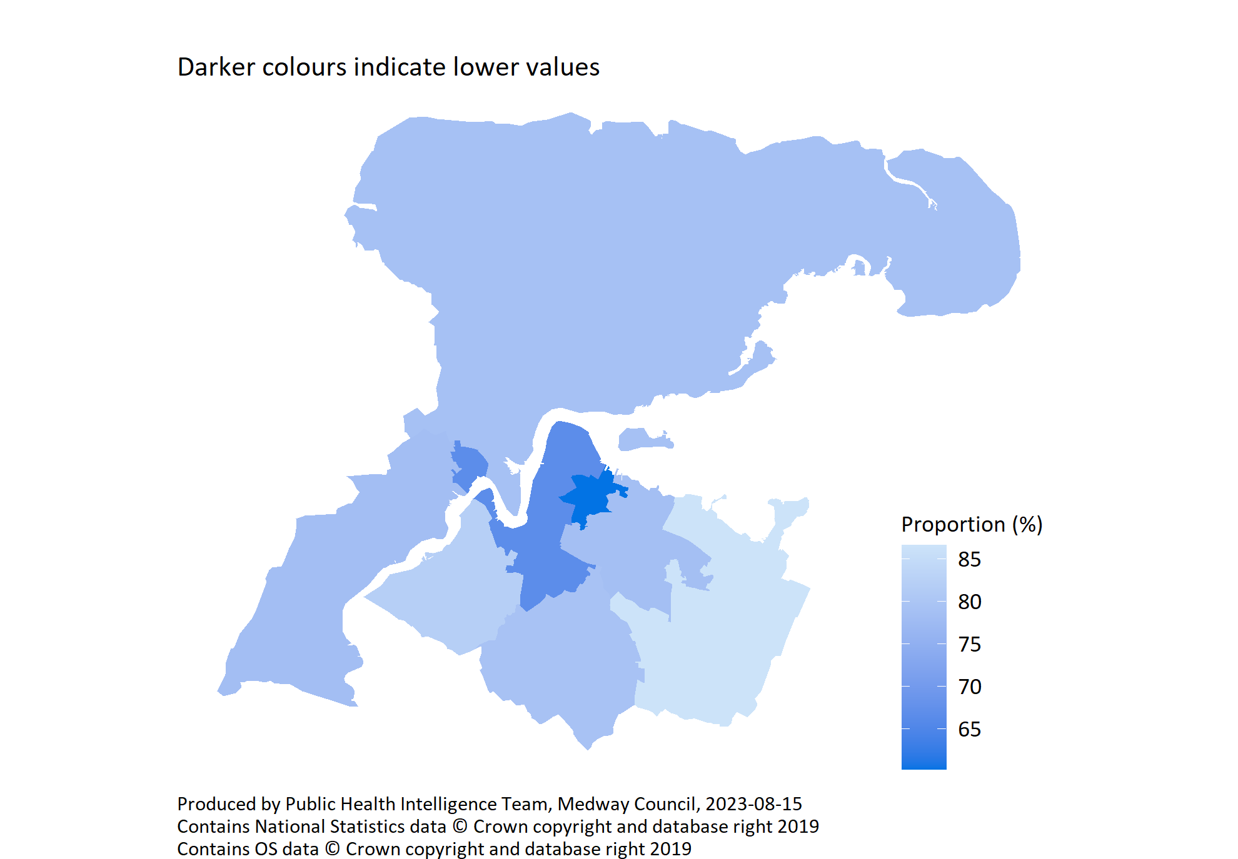
Registered with a dentist by PCN
© Medway Council, Public Health Intelligence Team, Version 1.0, 15/08/2023
Survey question: Are you registered with a dentist?
Possible answers: Yes, No, Don't know/don't want to say.
Category selected: Yes.

Slide 13
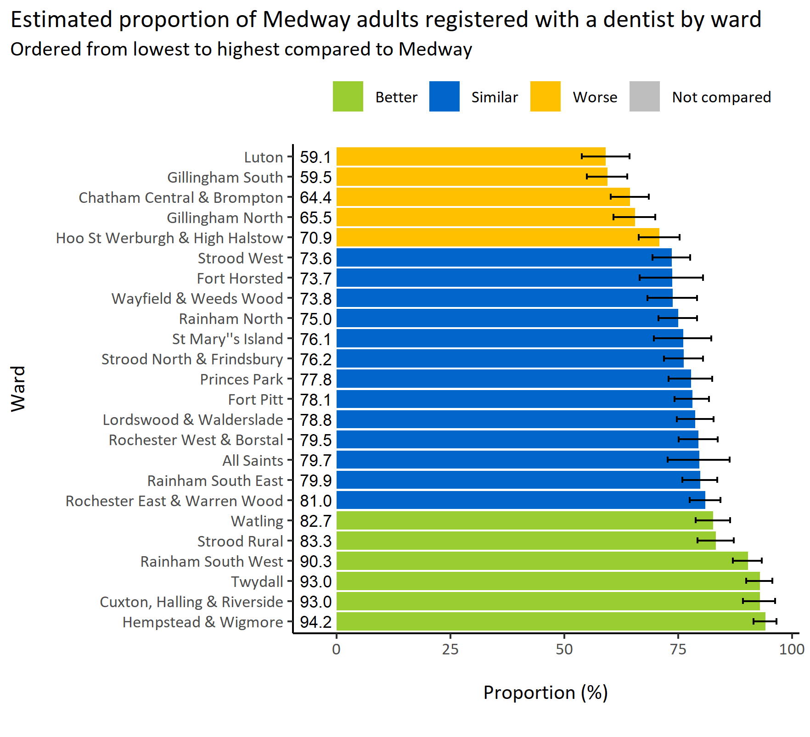
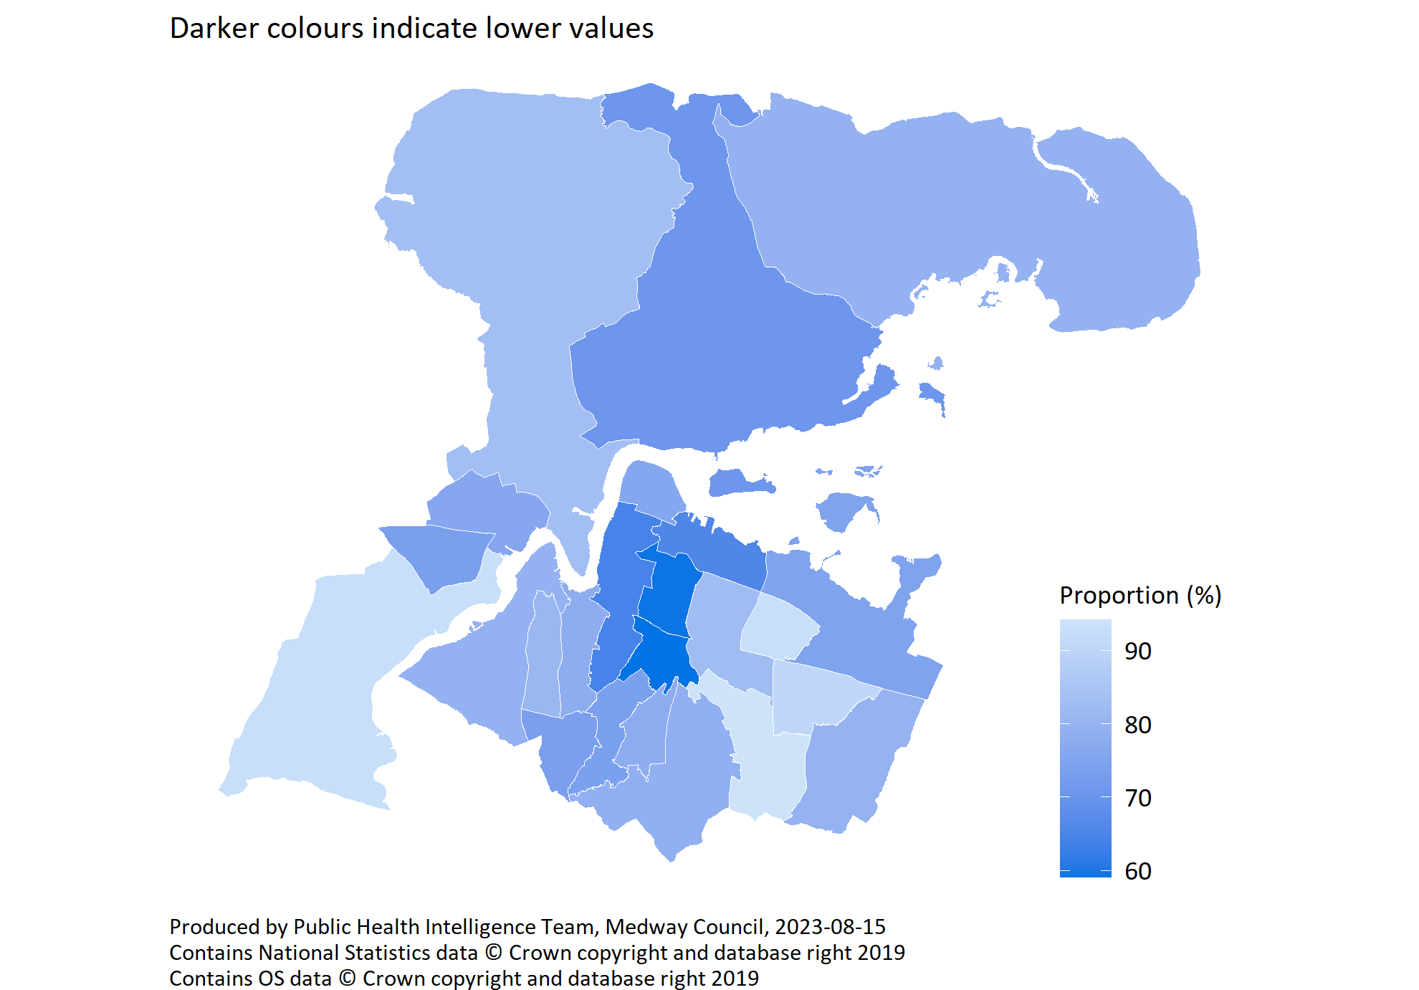
Registered with a dentist by ward
© Medway Council, Public Health Intelligence Team, Version 1.0, 15/08/2023
Survey question: Are you registered with a dentist?
Category selected: Answers include people who are registered with a dentist.
Estimates are calculated using Bayesian methods. These do not take into
account survey weighting but will be updated in the future to do so.

Slide 14
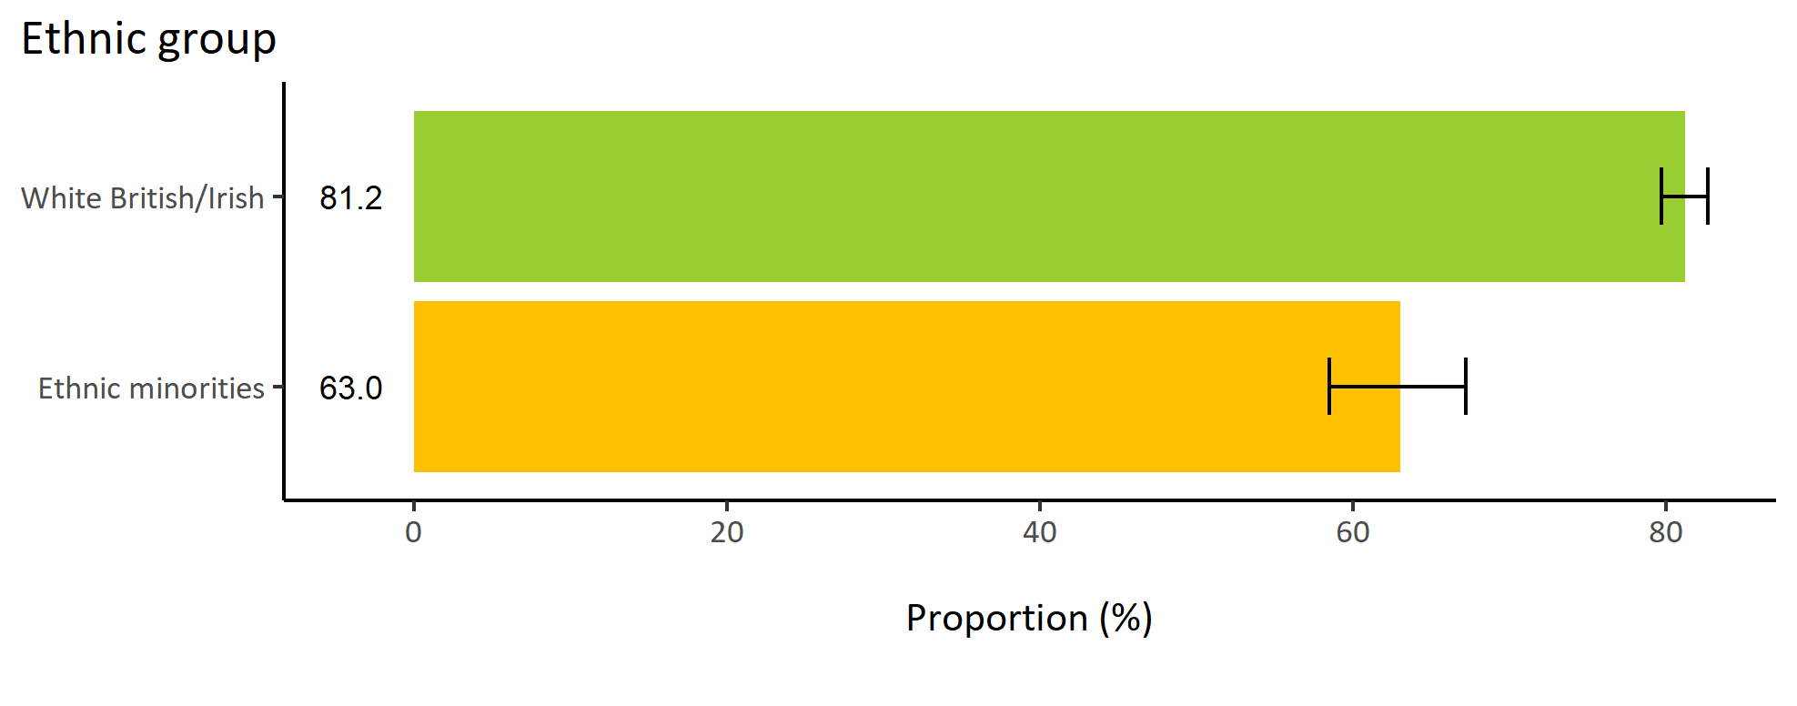
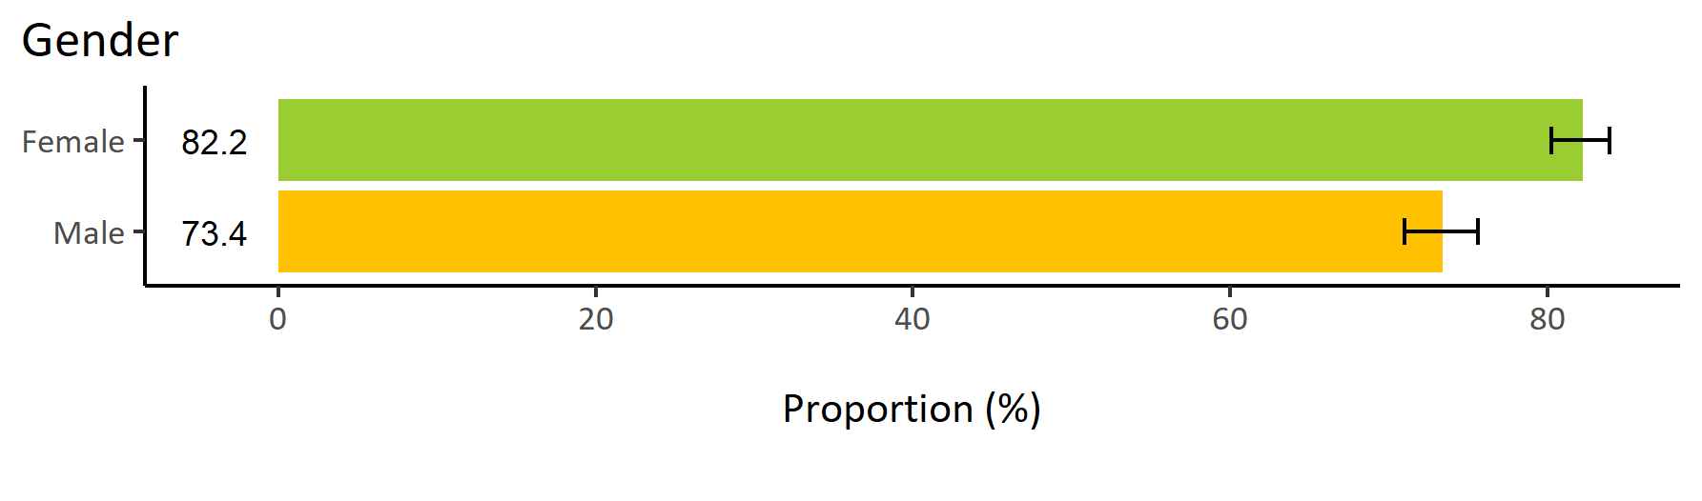
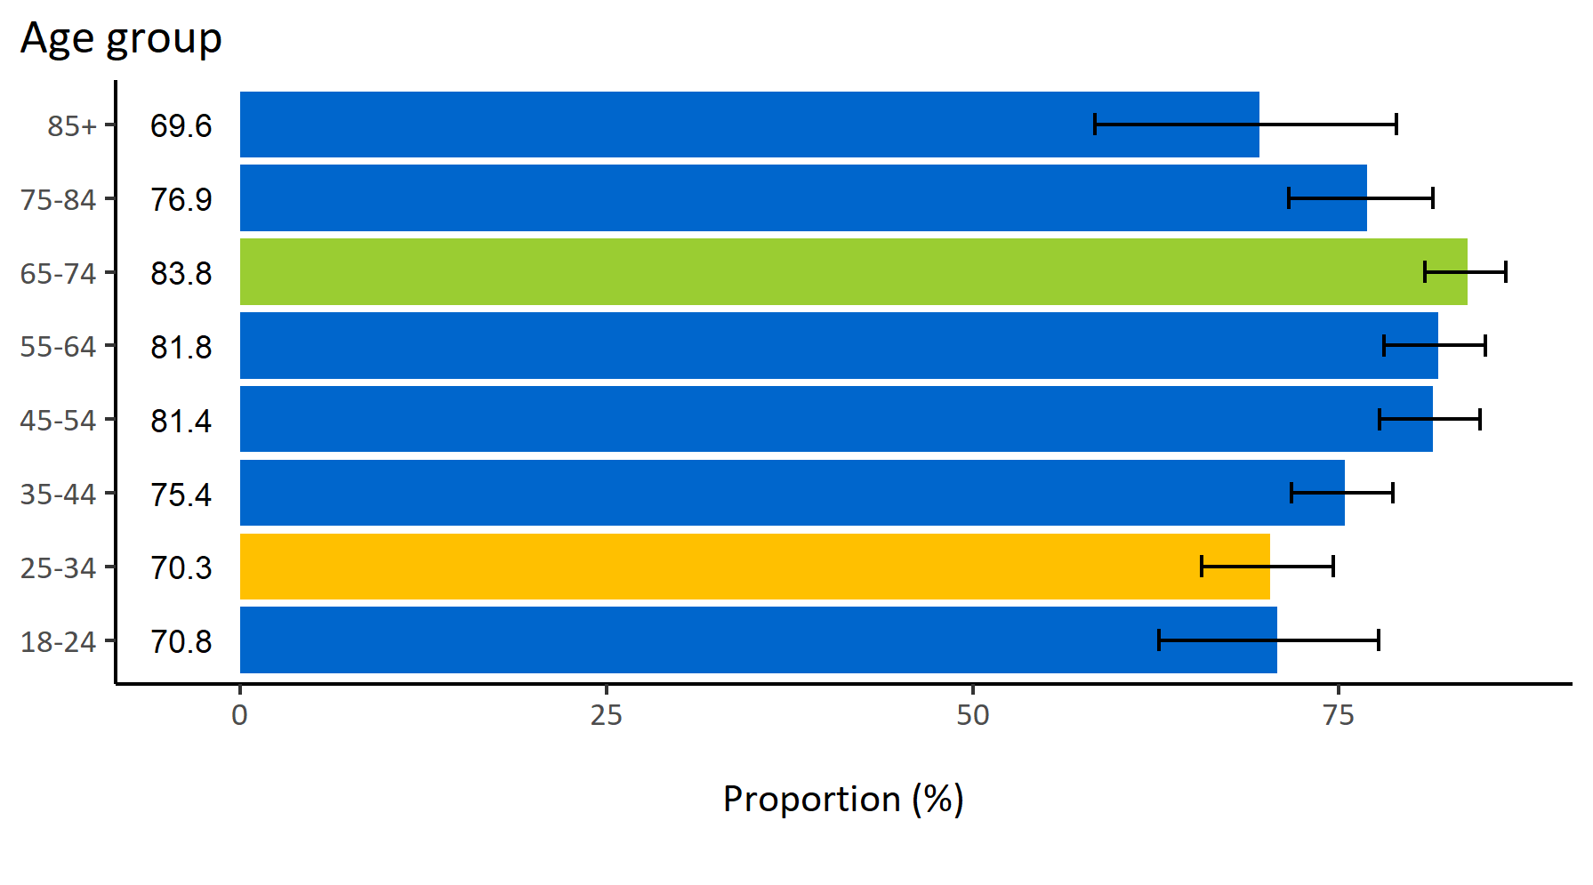
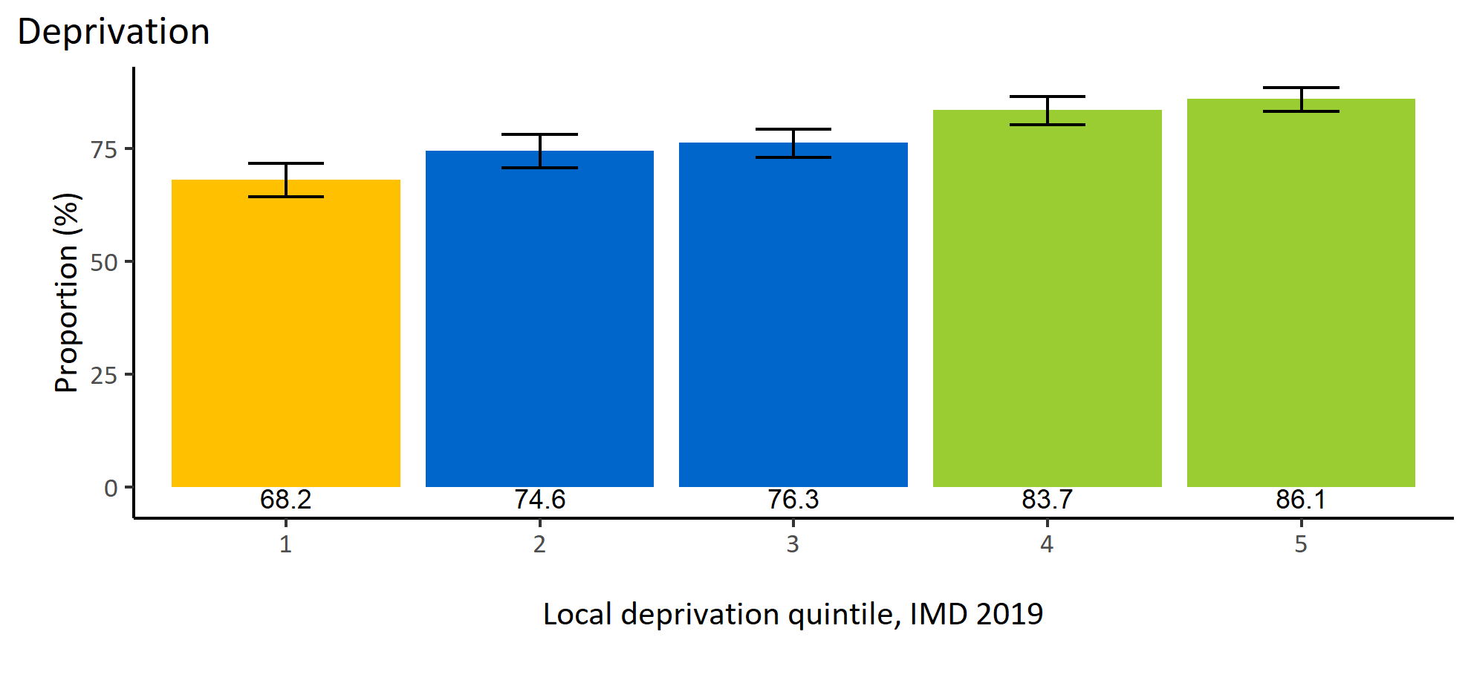
Registered with a dentist by inequalities
© Medway Council, Public Health Intelligence Team, Version 1.0, 15/08/2023
Estimated proportion of Medway adults registered with a dentist by inequalities

Slide 15
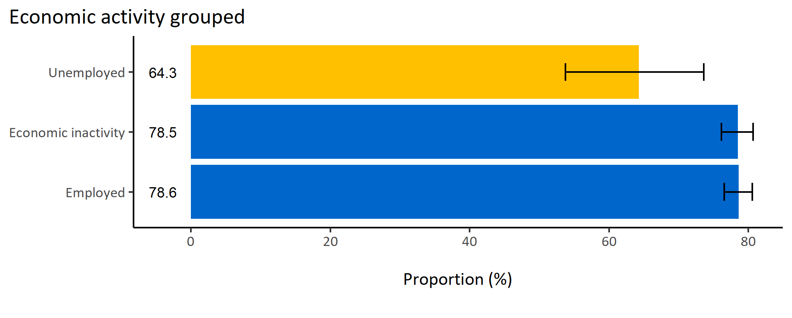
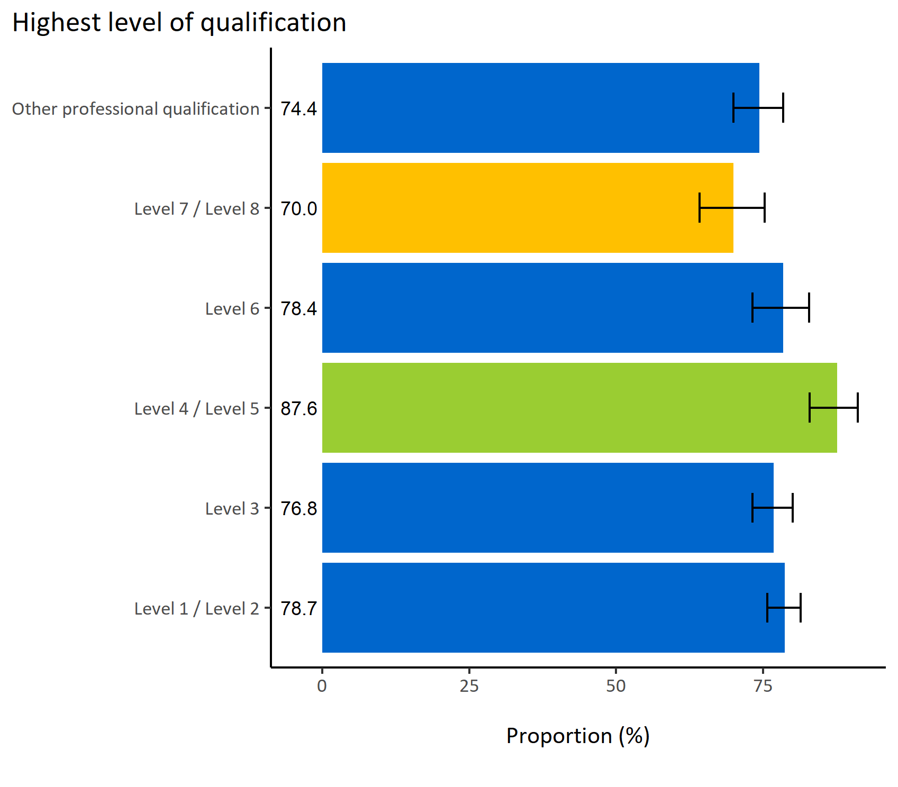
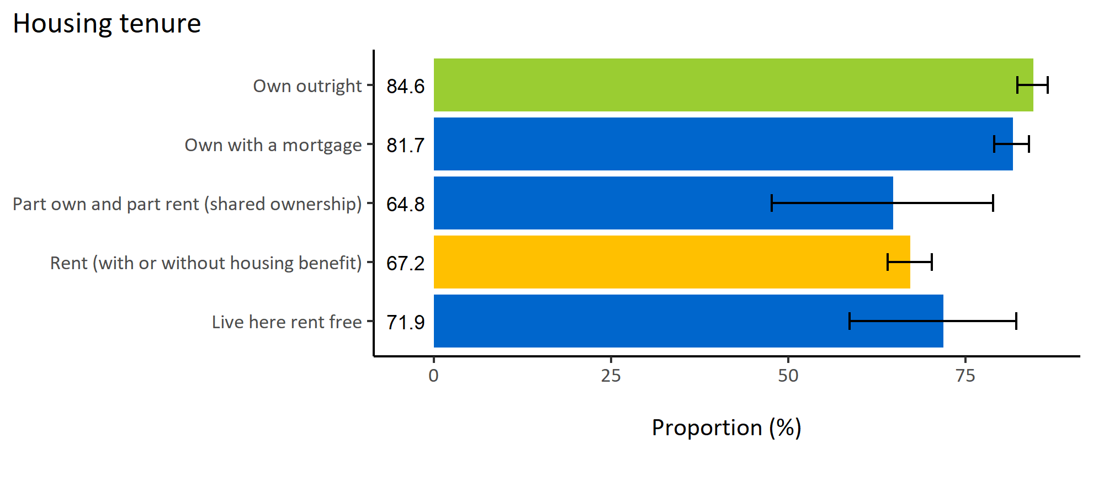
Registered with a dentist by wider determinants
© Medway Council, Public Health Intelligence Team, Version 1.0, 15/08/2023
Estimated proportion of Medway adults registered with a dentist by wider determinants

Slide 16
Summary: Registered with a dentist
© Medway Council, Public Health Intelligence Team, Version 1.0, 15/08/2023
The weighted survey results estimate that 77.8% of Medway adults report being registered with a dentist.
Certain groups in Medway are less likely to be registered with a dentist. These groups include:
  Adults in Medway Central PCN
  Adults in wards Luton, Chatham Central & Brompton, Gillingham North, Gillingham South, and Hoo St Werburgh & High Halstow
  Males
  Adults aged 25 to 34 years old
  Adults from minority ethnic backgrounds
  Adults living in areas of high deprivation (quintile 1)
  Adults whose highest qualification achieved is level 7 or 8
  Unemployed adults
  Adults who rent (with or without housing benefit).

Slide 17
Teeth or mouth pain

Slide 18
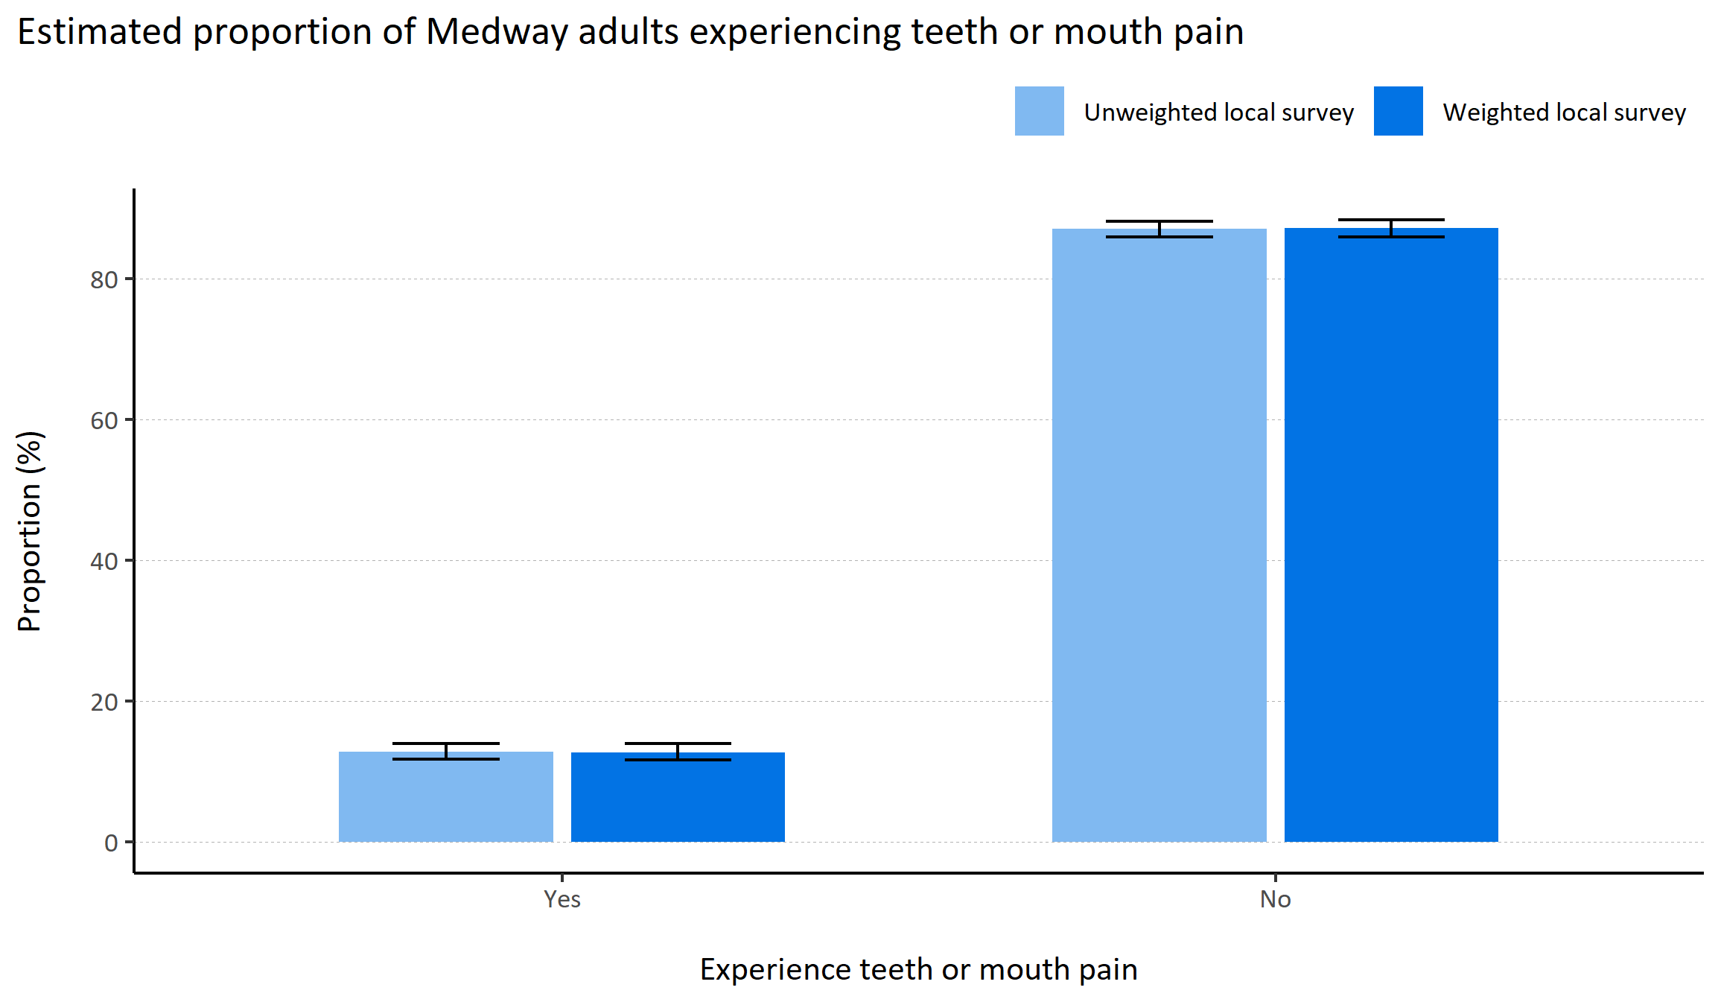
Teeth or mouth pain
© Medway Council, Public Health Intelligence Team, Version 1.0, 15/08/2023
Plot description
  National Medway estimate not available for comparison for this indicator.
  The weighted survey results estimate that 12.8% of Medway adults experience teeth or mouth pain or other problems which affects eating, sleeping or work.
  88 out of 3,594 survey respondents did not answer this question.
Survey question: In the last 12 months, did you experience pain or other problem with your teeth/mouth which affected eating, sleeping or work?
Possible answers: Yes, No, Don't know/don't want to say.

Slide 19
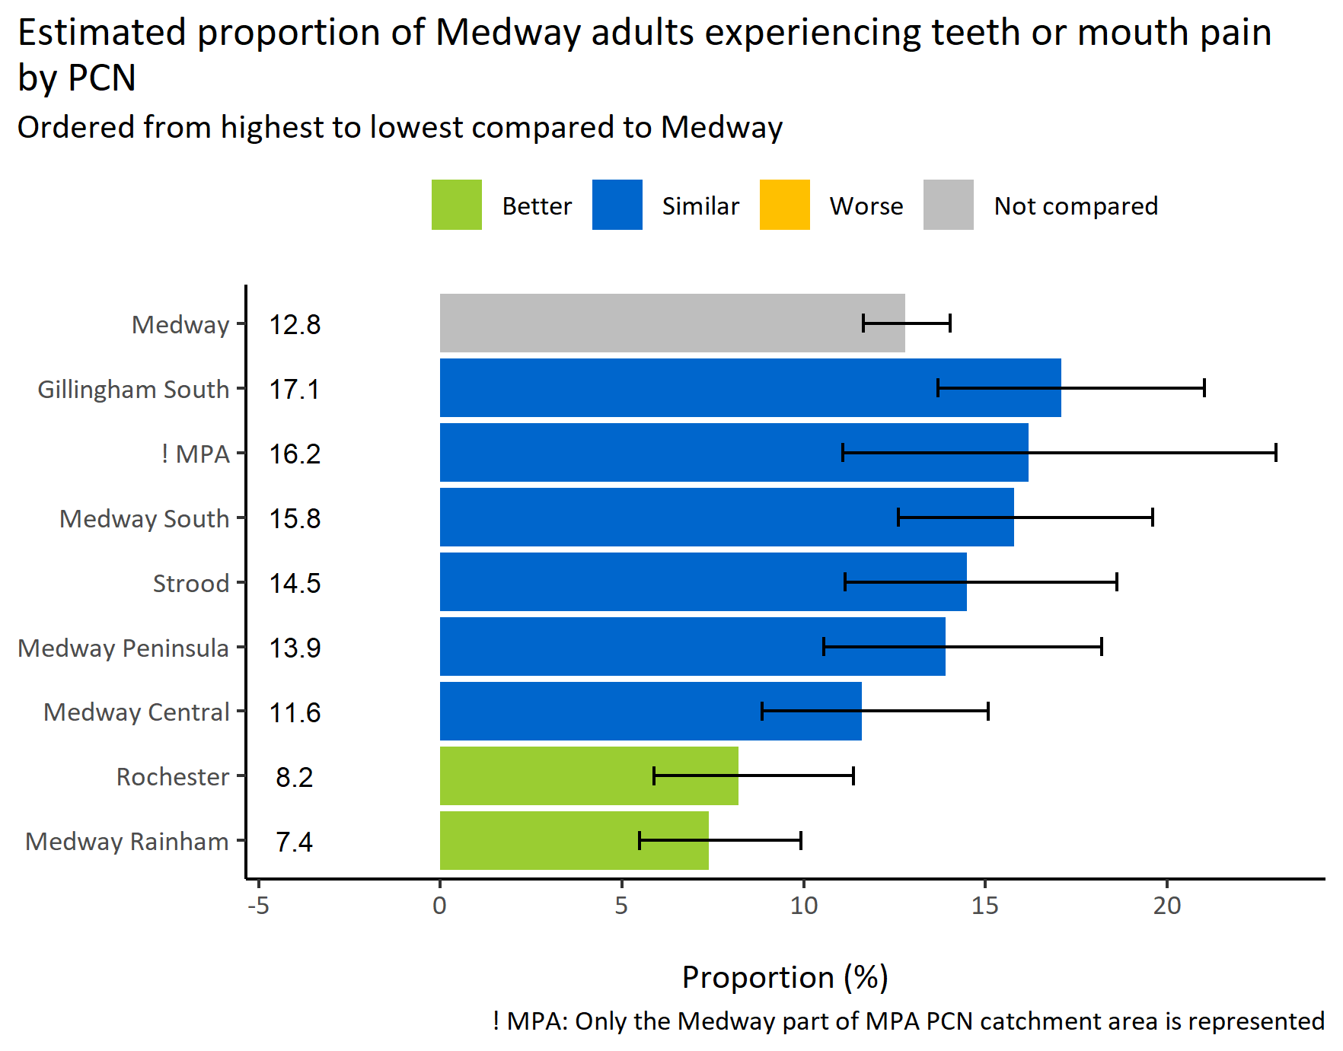
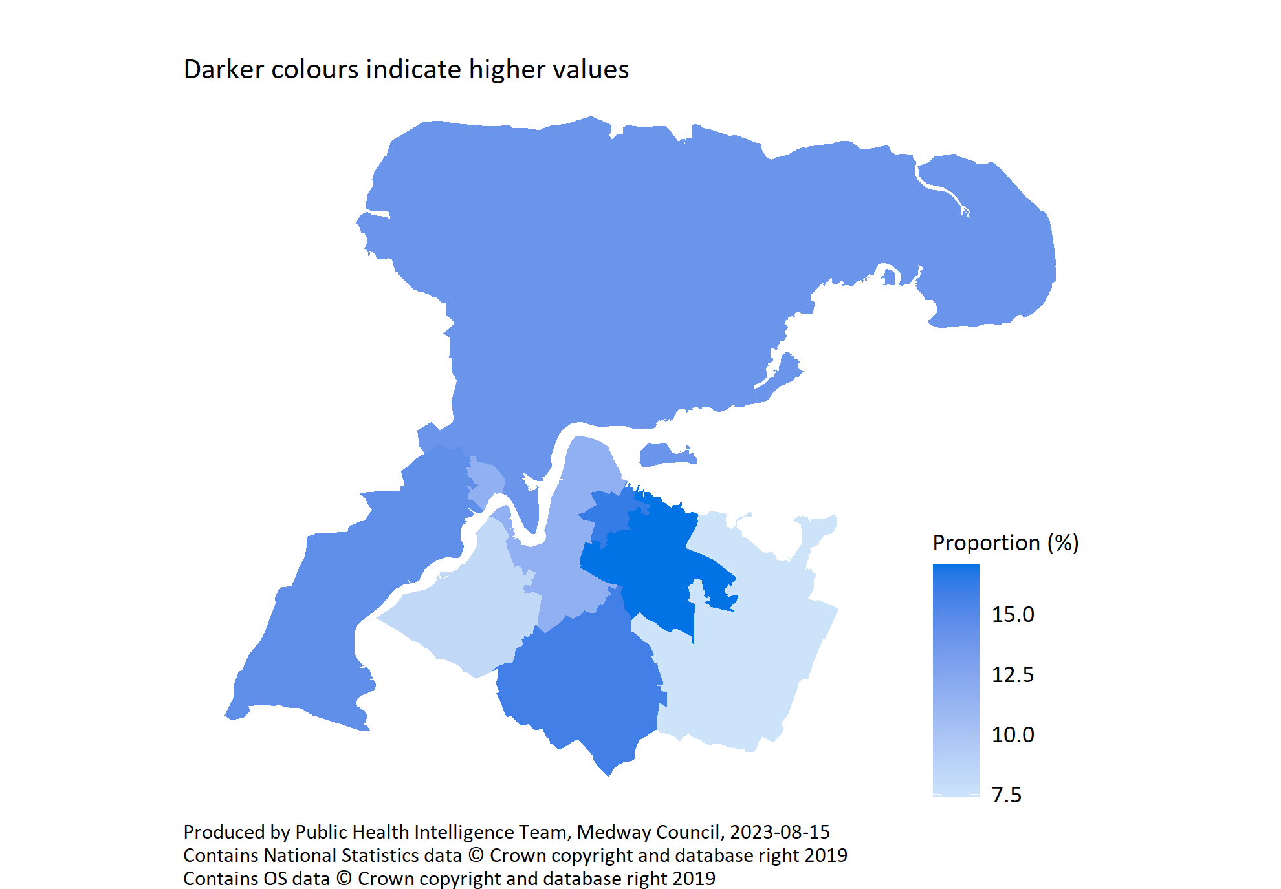
Teeth or mouth pain by PCN
© Medway Council, Public Health Intelligence Team, Version 1.0, 15/08/2023
Survey question: In the last 12 months, did you experience pain or other problem with your teeth/mouth which affected eating, sleeping or work?
Possible answers: Yes, No, Don't know/don't want to say.
Category selected: Yes.

Slide 20
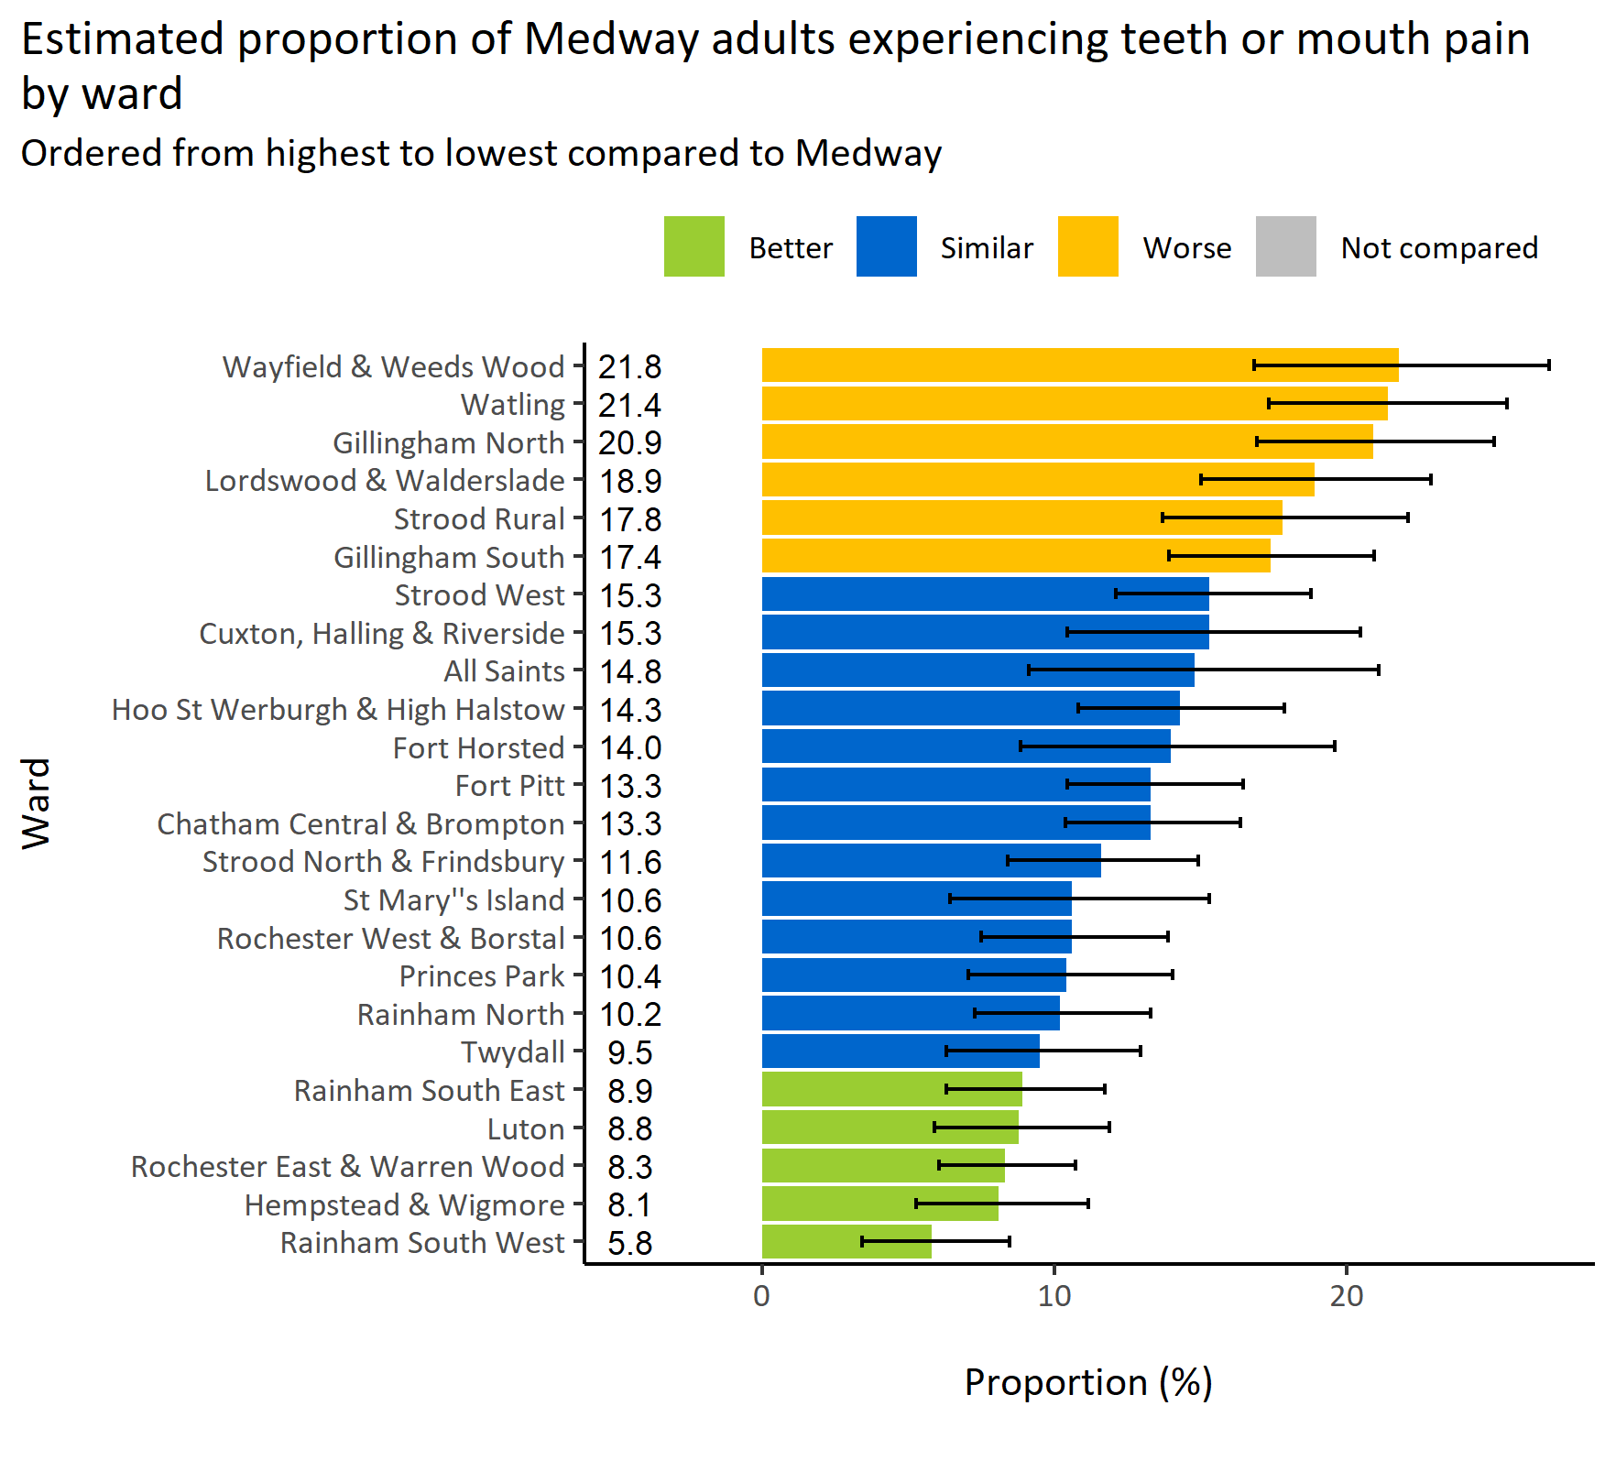
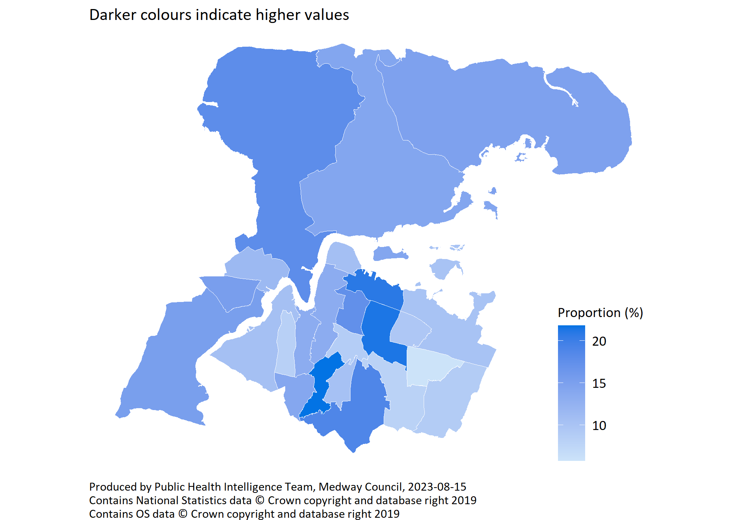
Teeth or mouth pain by ward
© Medway Council, Public Health Intelligence Team, Version 1.0, 15/08/2023
Survey question: In the last 12 months, did you experience pain or other problem with your teeth/mouth which affected eating, sleeping or work?
Category selected: Yes
Estimates are calculated using Bayesian methods. These do not take into
account survey weighting but will be updated in the future to do so.

Slide 21
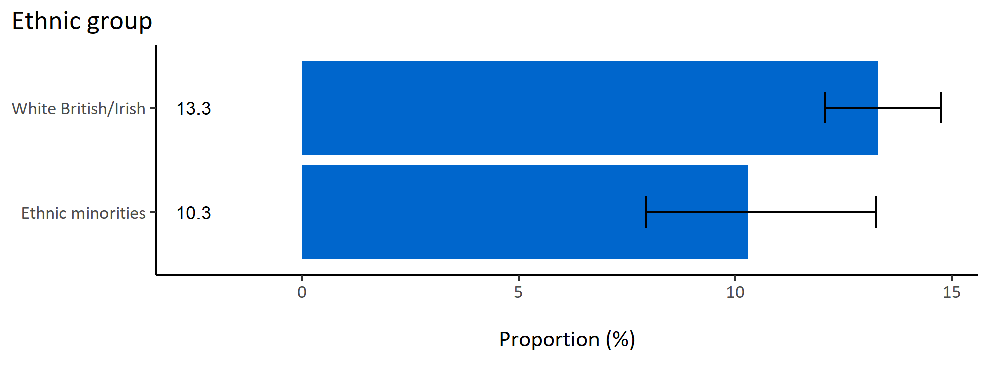
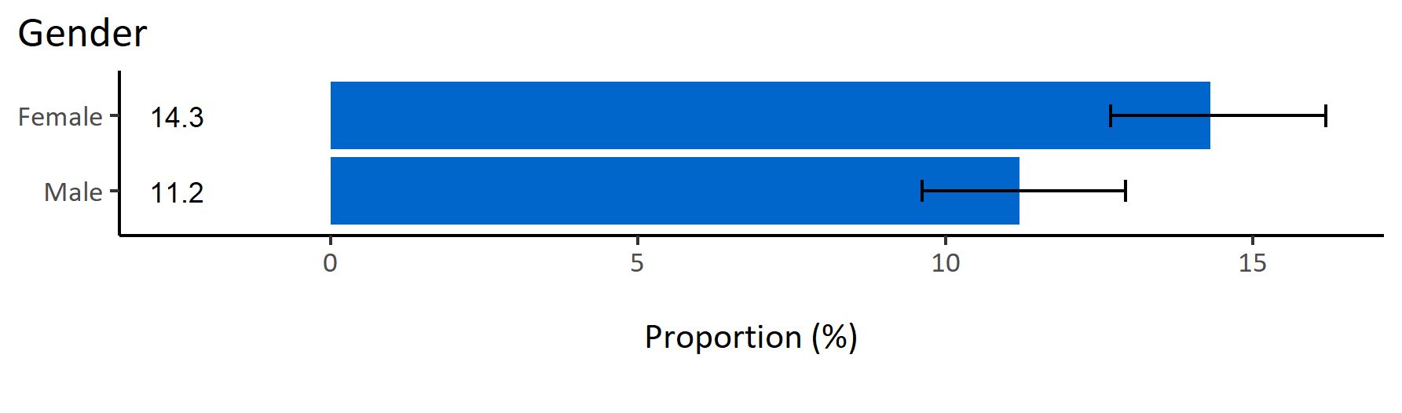
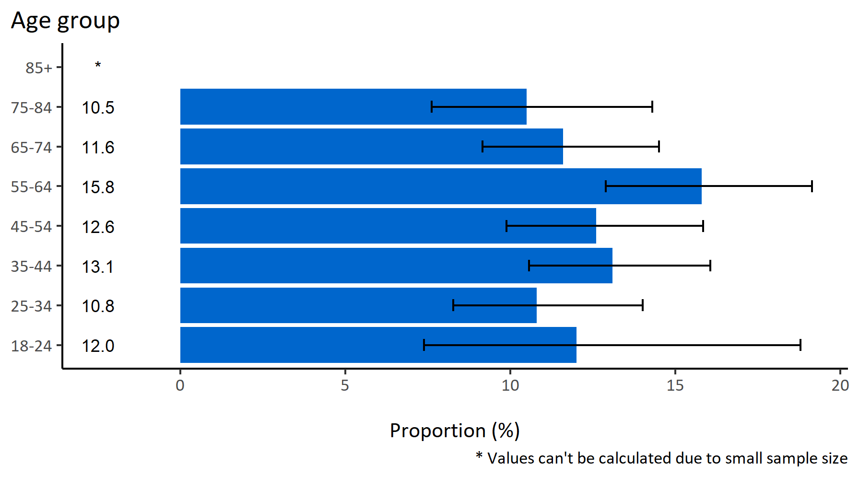
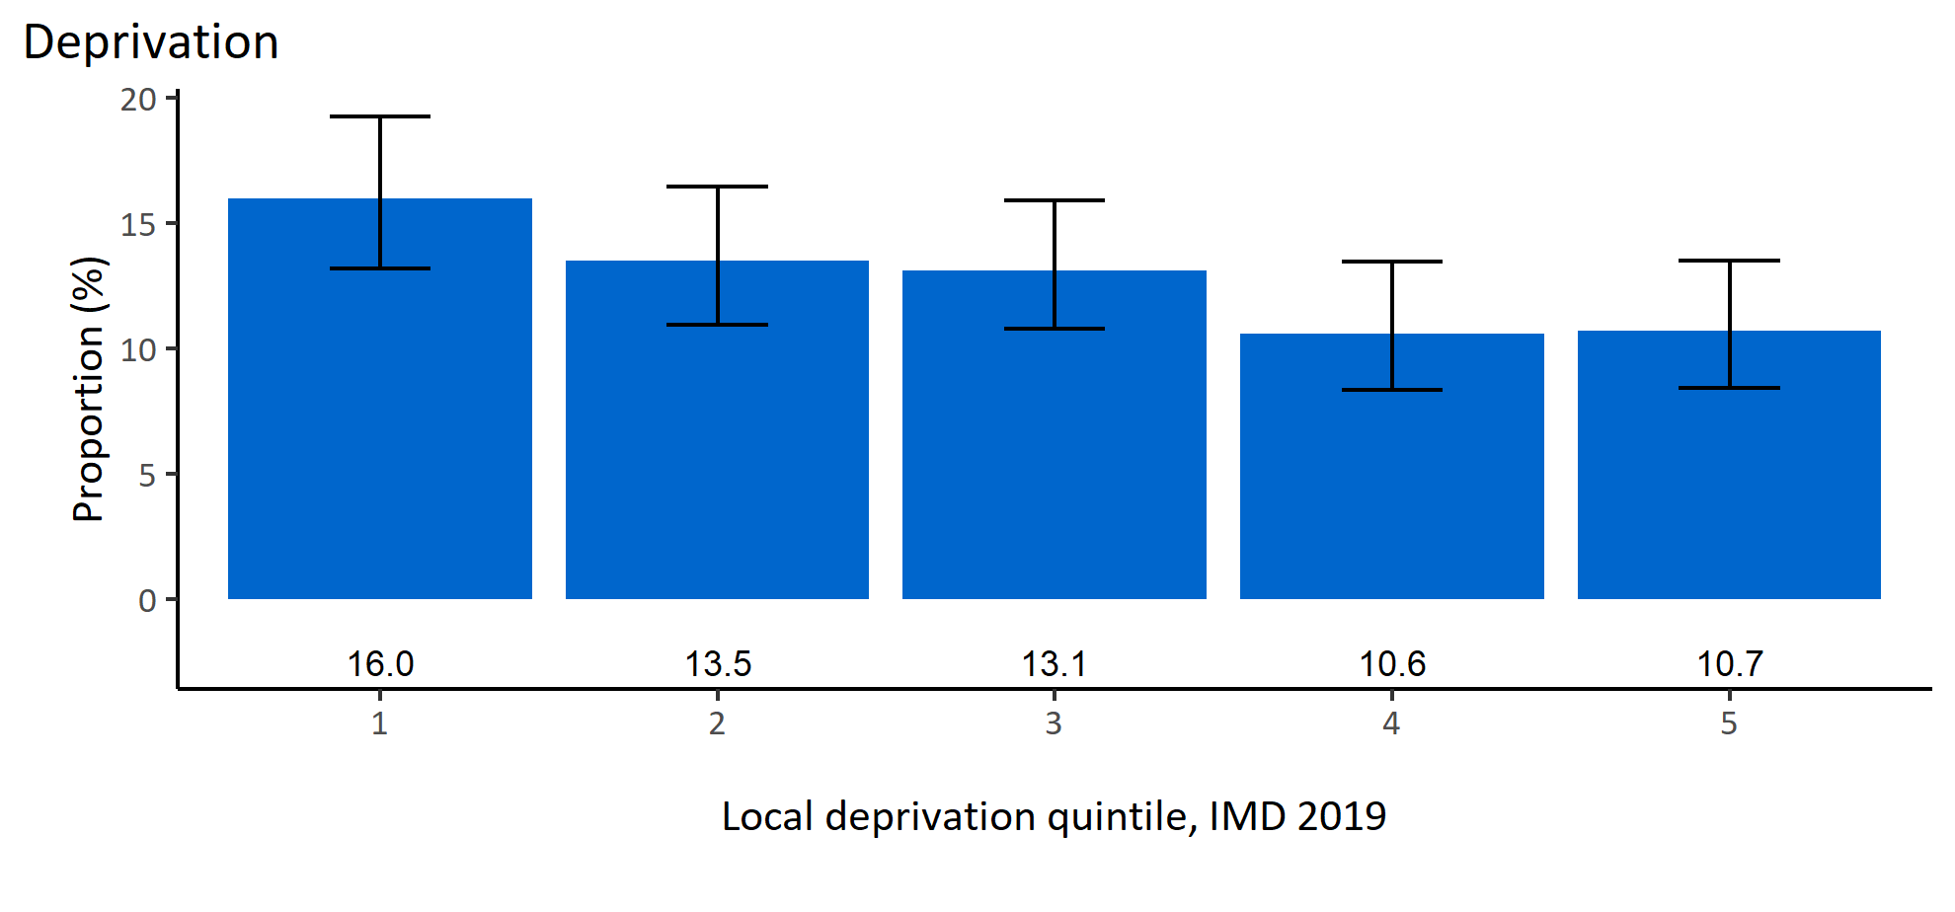
Teeth or mouth pain by inequalities
© Medway Council, Public Health Intelligence Team, Version 1.0, 15/08/2023
Estimated proportion of Medway adults experiencing teeth or mouth pain by inequalities

Slide 22
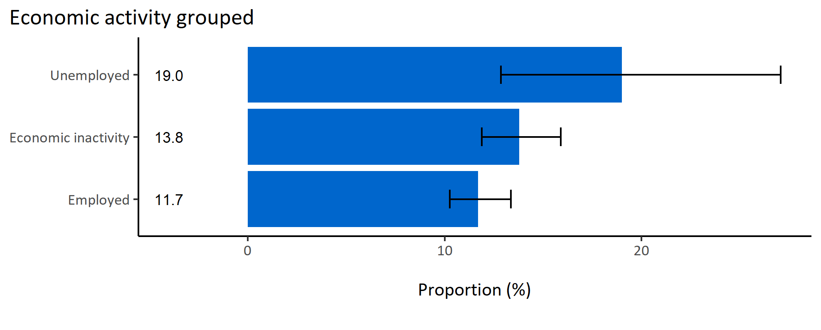
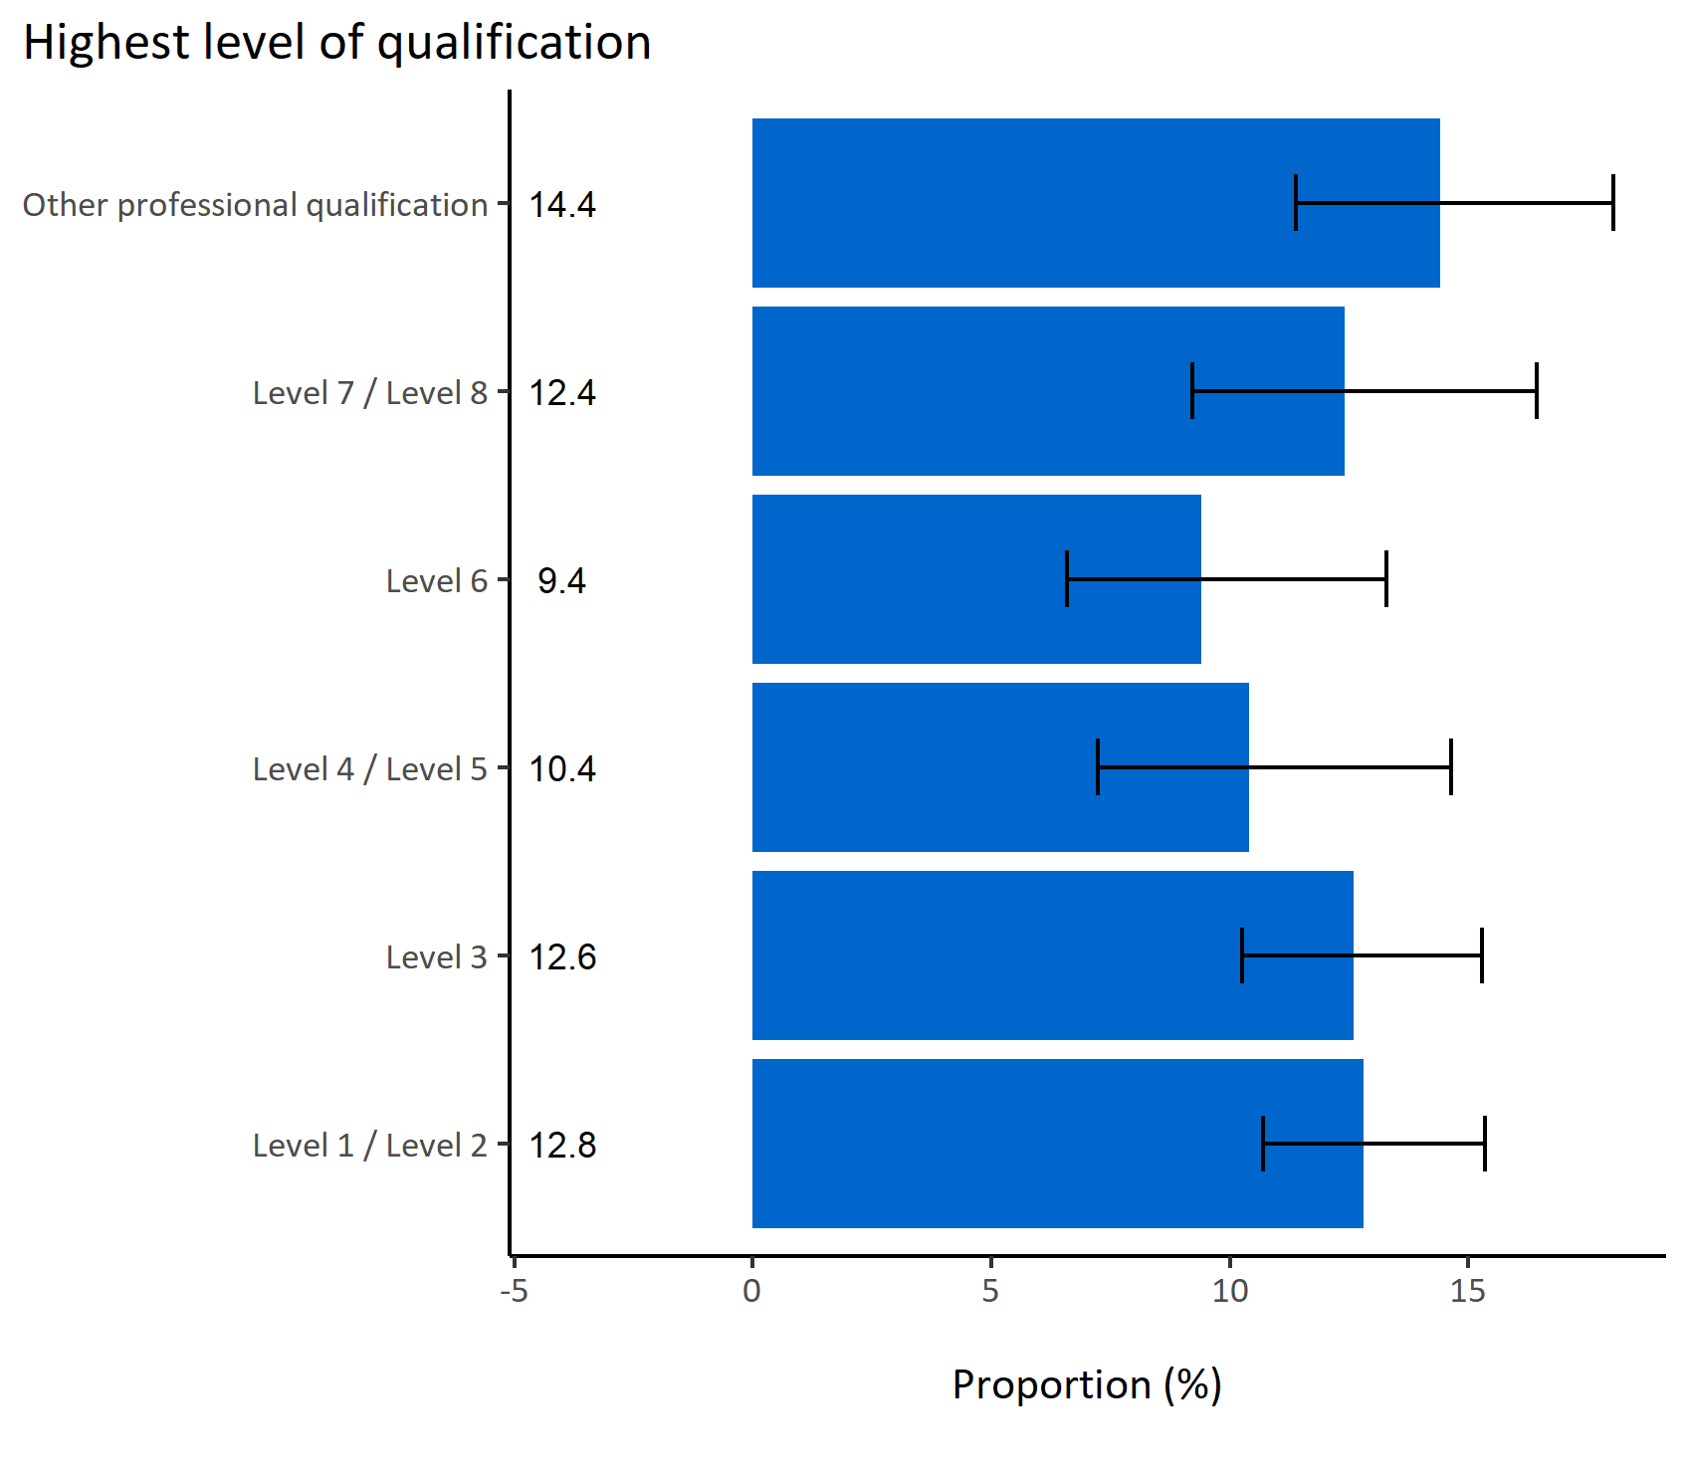
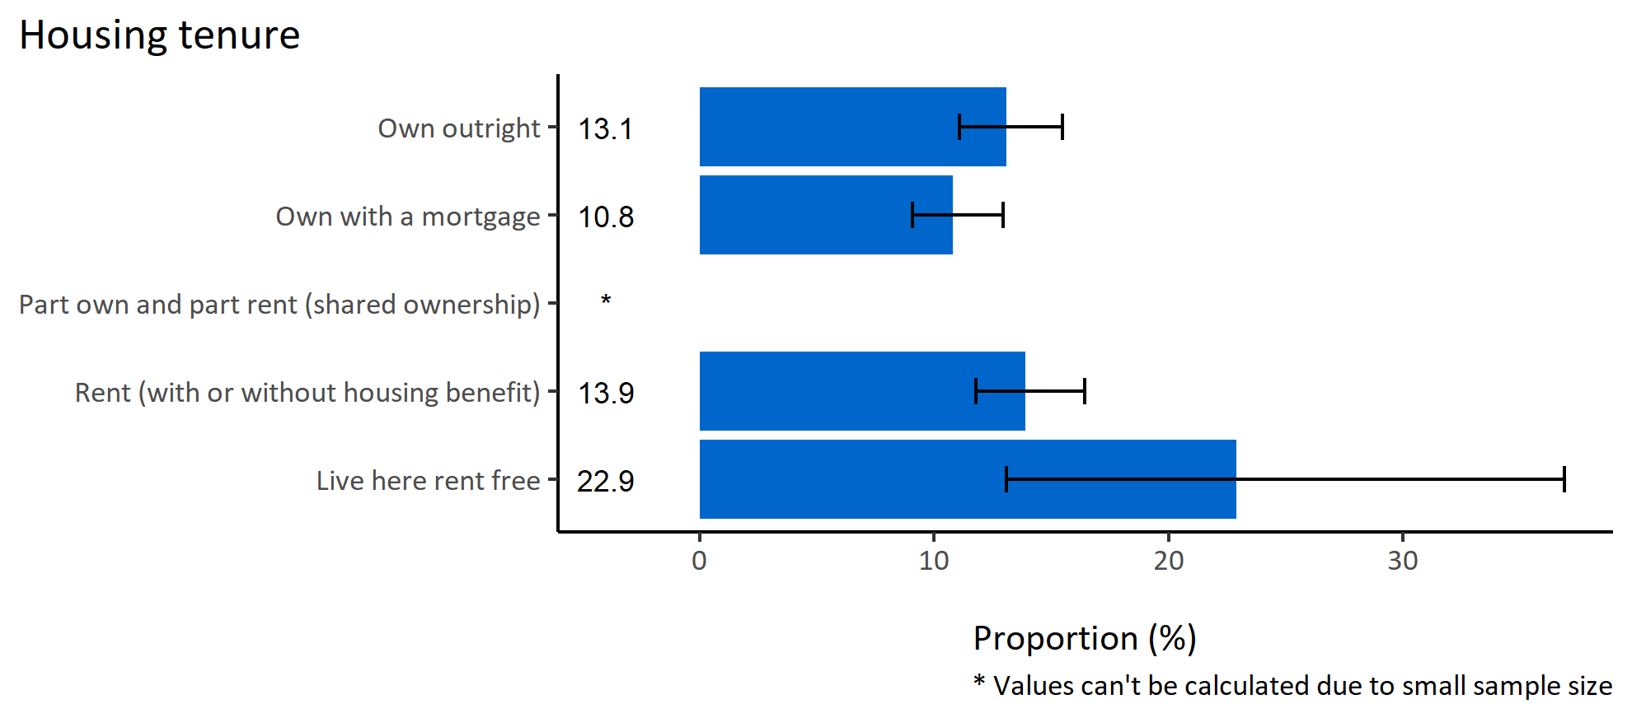
Teeth or mouth pain by wider determinants
© Medway Council, Public Health Intelligence Team, Version 1.0, 15/08/2023
Estimated proportion of Medway adults experiencing teeth or mouth pain by wider determinants

Slide 23
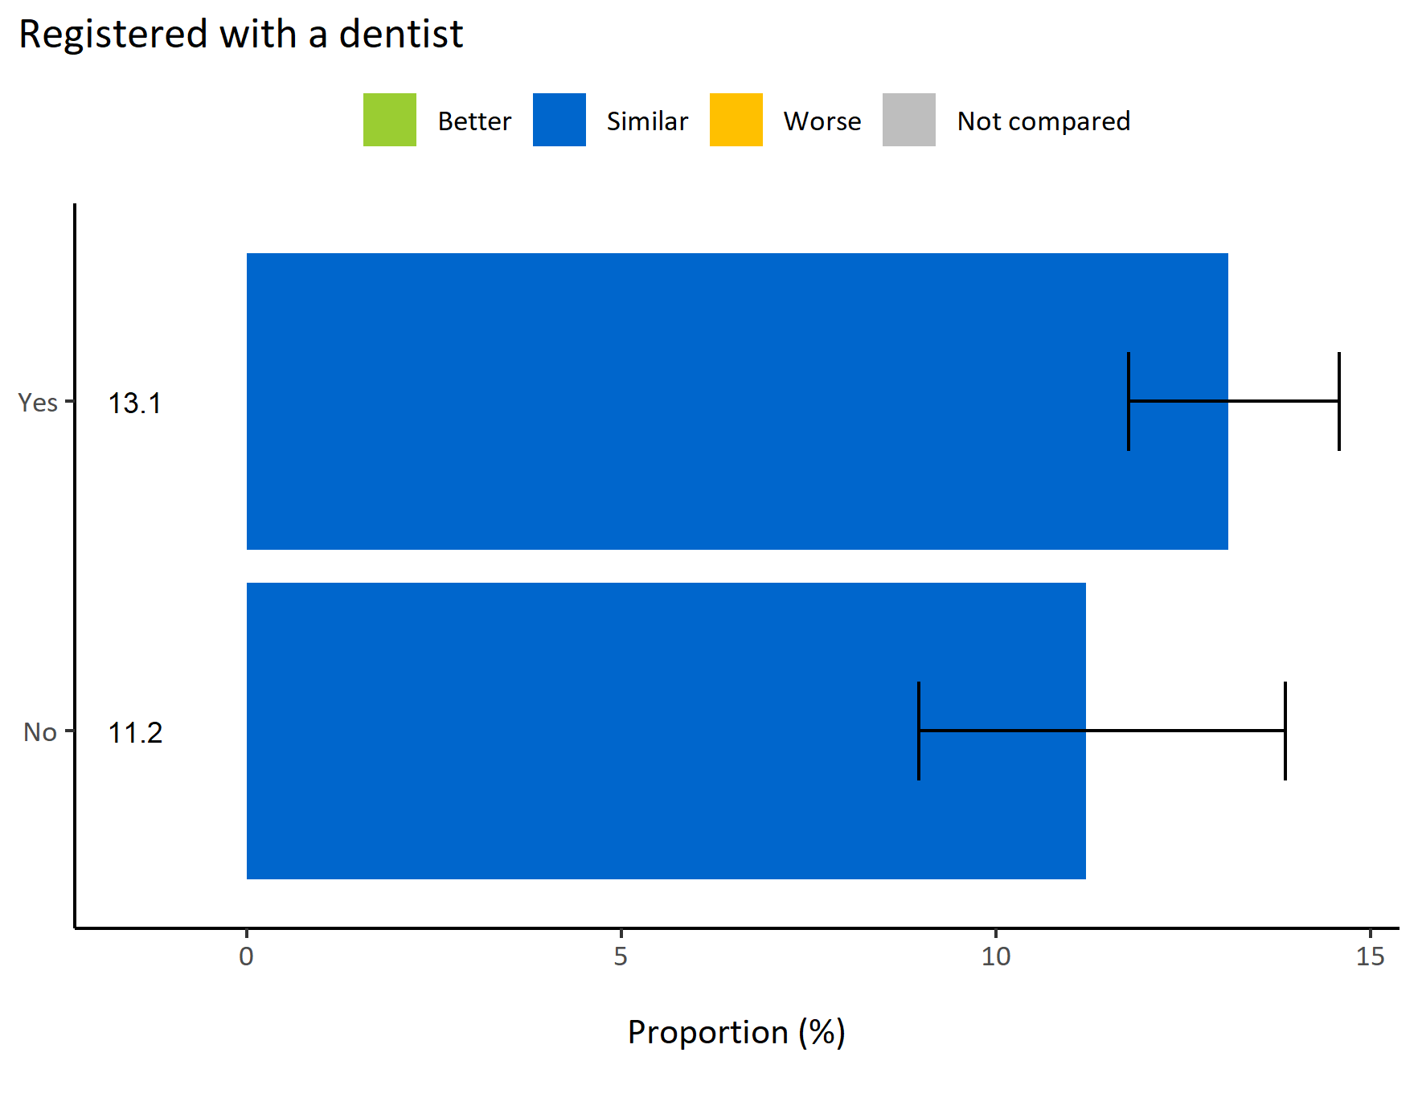
Teeth or mouth pain by registered with a dentist
© Medway Council, Public Health Intelligence Team, Version 1.0, 15/08/2023
  The weighted survey results estimate that 13.1% of Medway adults experiencing teeth or mouth pain are registered with a dentist, which is higher than those who are not registered with a dentist (11.2%).
  However, both estimates are similar to the value for the whole of Medway.
Survey question: In the last 12 months, did you experience pain or other problem with your teeth/mouth which affected eating, sleeping or work?
Possible answers: Yes, No, Don't know/don't want to say.

Slide 24
Summary: Teeth or mouth pain
© Medway Council, Public Health Intelligence Team, Version 1.0, 15/08/2023
The weighted survey results estimate that 12.8% of Medway adults report experiencing teeth or mouth pain.
Certain groups in Medway are more likely to report experiencing teeth or mouth pain. These groups include:
  Adults in wards Lordswood & Walderslade, Strood Rural, Watling, Wayfield & Weeds Wood, Gillingham North, and Gillingham South

