Slide 1
Medway Health and Wellbeing Survey
Food Analysis
Medway Council
Public Health Intelligence Team
15/08/2023

Slide 2
Contact details
© Medway Council, Public Health Intelligence Team, Version 1.0, 15/08/2023
If you have any questions or would like further information about the Medway Health and Wellbeing Survey, please contact:
Dr Natalie Goldring
Senior Public Health Intelligence Manager
Public Health
Medway Council
natalie.goldring@medway.gov.uk
01634 337271

Slide 3
Introduction
© Medway Council, Public Health Intelligence Team, Version 1.0, 15/08/2023
The aim of the Medway Health and Wellbeing Survey was to provide within Medway estimates (ward and Primary Care Network (PCN) level) of key health states and risk factors.
The survey was carried out in 2021/22.
Participants were asked a number of questions about their health and wellbeing, which were grouped into 6 key topic areas:

Slide 4
Sample
© Medway Council, Public Health Intelligence Team, Version 1.0, 15/08/2023
The Medway Health and Wellbeing Survey selected a random sample of the Medway population.
From this sample, characteristics of the entire Medway population were estimated.
The random sample was created from a list of all 119,369 residential properties in Medway.
Medway is split into smaller areas called Lower Layer Super Output Areas (LSOAs) and there are 163 LSOAs in Medway.
Using the residential property list, a survey was sent out to 6.77% of the residential properties within each LSOA (a range of 6.58% to 6.78% across the 163 LSOAs).
In total, 7,998 residential properties were sent a survey.
One adult was asked to complete the survey for each residential property.
We asked the person whose birthday was next to complete the survey.
In total, there were around 3,600 responses.

Slide 5
Weighting
© Medway Council, Public Health Intelligence Team, Version 1.0, 15/08/2023
Weights were calculated to make the survey data more representative of the population it is designed to represent, i.e. Medway as a whole.
Weighting assigns a value to each survey response to indicate how much it should be represented in the analysis.
The weights for the Medway Health and Wellbeing Survey are currently based on the number of adults within each household and the known population distributions by Middle Layer Super Output Areas (MSOA), broad age band (18-64 and 65+) and sex.
This methodology is being developed and may be updated in the future.

Slide 6
Estimating proportions
© Medway Council, Public Health Intelligence Team, Version 1.0, 15/08/2023
The survey results are presented as proportions.
  Frequentist approach
The majority of the survey analysis used a frequentist approach to estimate proportions.
For each survey question, the number of responses per category were divided by the total number of survey responses. This method is based solely on the answers given in the survey.
  Bayesian approach
In some cases, however, the sample size was too small to use the frequentist approach. For example, for ward level estimates and CIP areas. In this instance, a Bayesian approach was used to calculate the proportion.
This involves using prior knowledge to estimate a proportion and then update this value based on the answers given in the survey.
Current Bayesian model: Simple logistic regression model
Bayesian model in development: Hierarchical logistic regression including multiple levels and predictor variables. Will also incorporate survey weights and age-standardisation.

Slide 7
Confidence intervals
© Medway Council, Public Health Intelligence Team, Version 1.0, 15/08/2023
When samples are used, the values are usually accompanied by a measure of uncertainty.
Uncertainty relates to how an estimate might differ from the 'true value'.
Confidence intervals are used to show uncertainty in the Medway Health and Wellbeing Survey proportion estimates.
Confidence intervals provide a range in which we think the true proportion is likely to lie.
The confidence intervals are shown as lines in the middle of the bar graphs.
The wider the confidence interval, the greater the level of uncertainty in the estimate. This could be due to a small sample size or high variability.
A narrow confidence interval suggests that the estimate is more precise.
The 'logit' method has been used to calculate confidence intervals for the majority of the analysis.
However, when a Bayesian approach has been used to estimate the proportion, credible intervals are presented instead.

Slide 8
Validation
© Medway Council, Public Health Intelligence Team, Version 1.0, 15/08/2023
The objective of validation is to check the quality of the data collected from the Medway Health and Wellbeing survey.
Where possible, the survey estimates have been compared to values from national surveys, such as the Census and the Annual Population Survey, covering similar time periods.
Survey estimates have been considered acceptable if the value falls within the range (confidence interval) of the national survey.

Slide 9
Inequalities and wider determinants
© Medway Council, Public Health Intelligence Team, Version 1.0, 15/08/2023
Survey estimates have also been calculated for inequalities and the wider determinants of health to explore the characteristics that may influence health states or risk factors.
  Inequalities
    Gender
    Age group
    Ethnic group
    Deprivation
  Wider determinants
    Highest level of qualification
    Economic activity
    Housing tenure

Slide 10
Fruit and vegetable portions per day

Slide 11
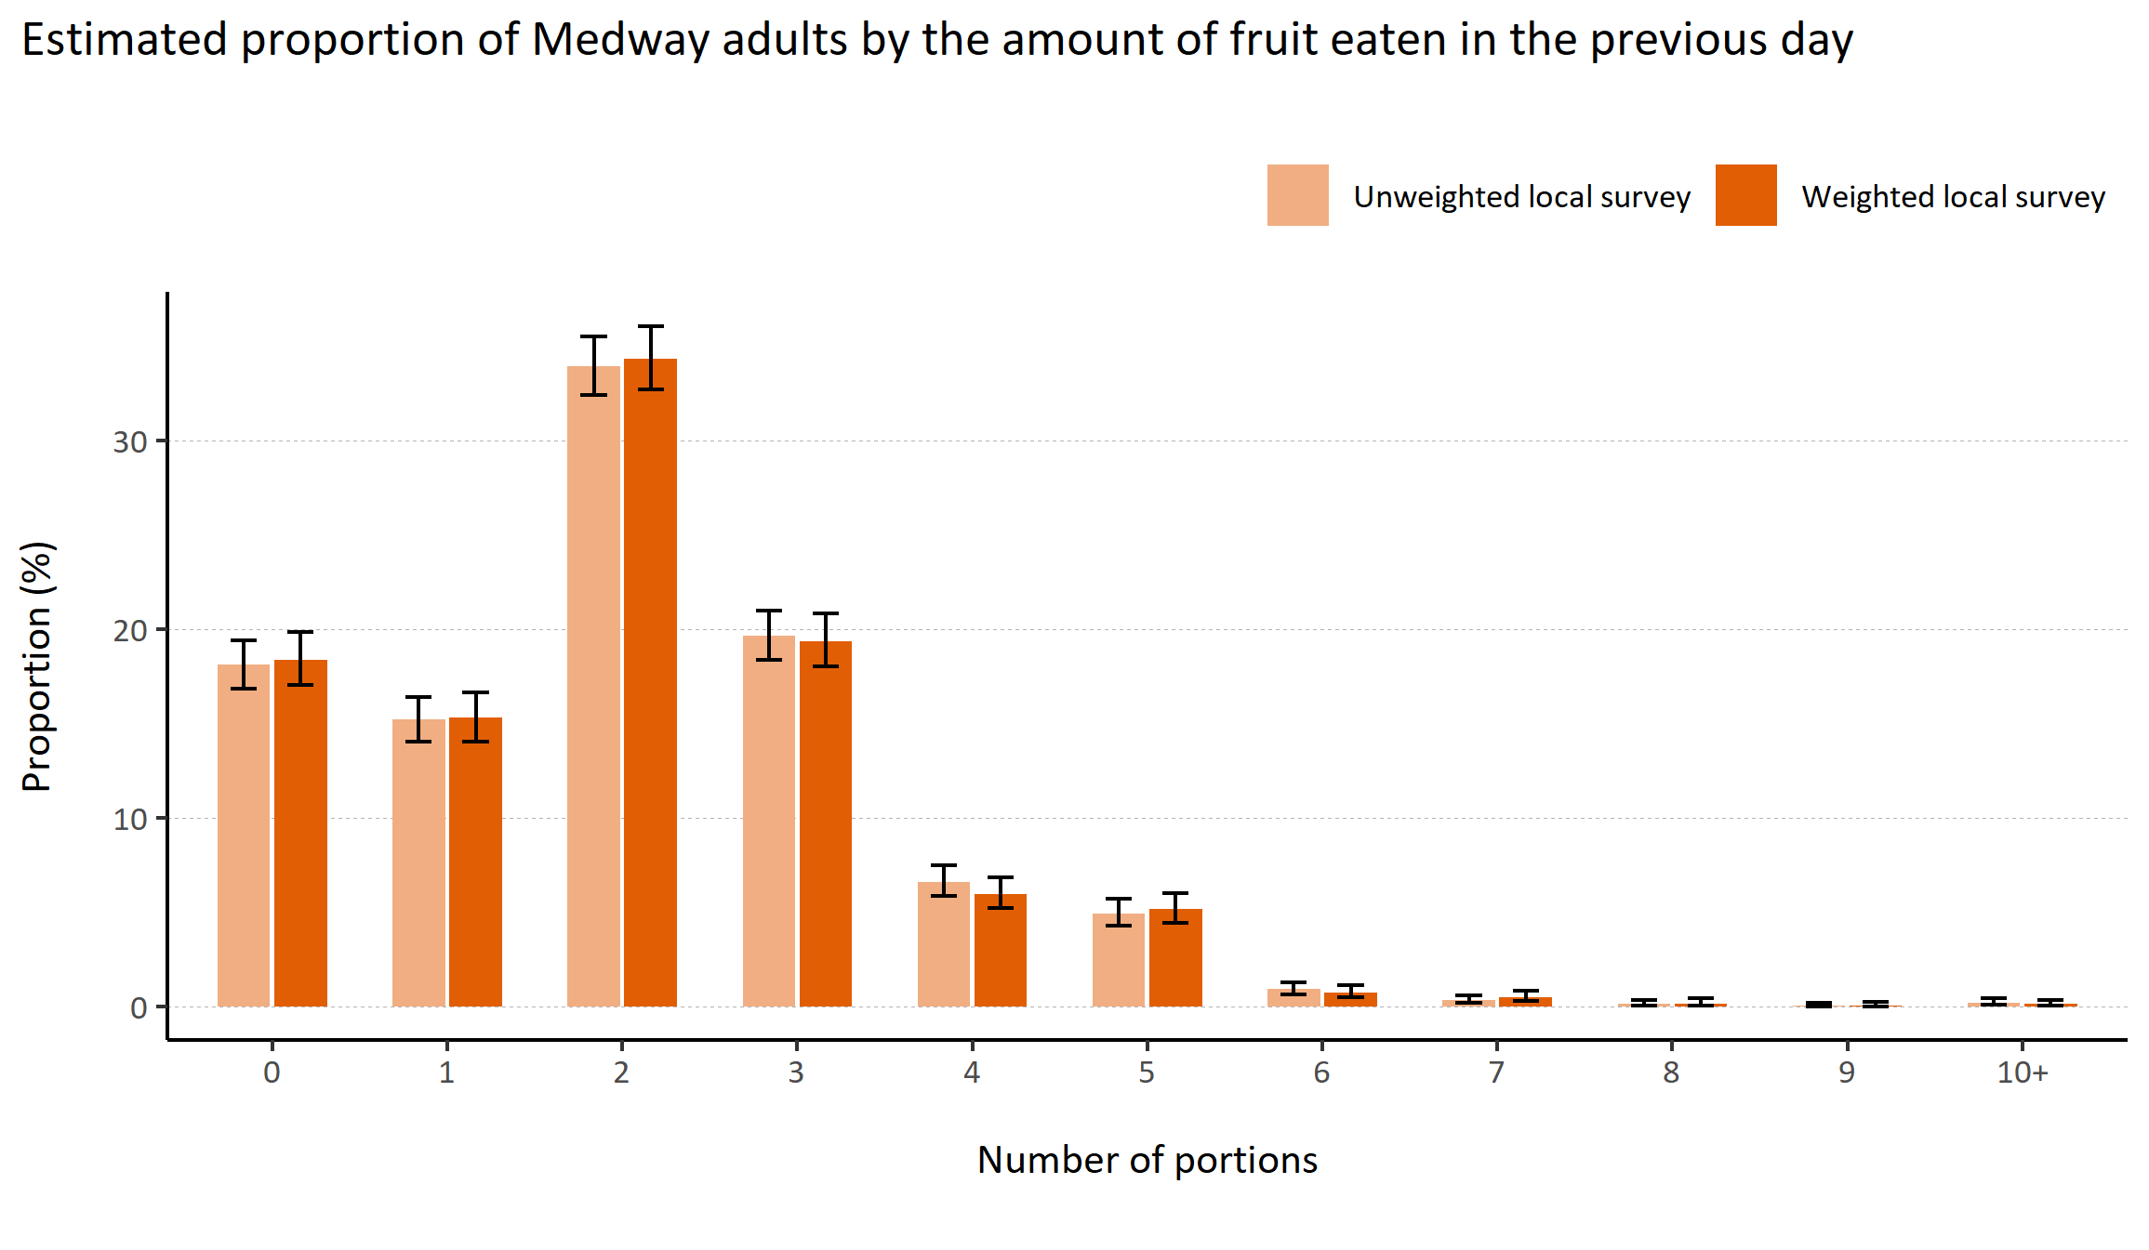
Fruit consumption
© Medway Council, Public Health Intelligence Team, Version 1.0, 15/08/2023
Plot description
  National Medway estimate not available for comparison for this indicator.
  The weighted survey results estimate that 18.4% of Medway adults did not eat any fruit in the previous day.
  84 out of 3,594 survey respondents did not answer this question.
Survey question: How many portions of fruit did you eat yesterday?

Slide 12
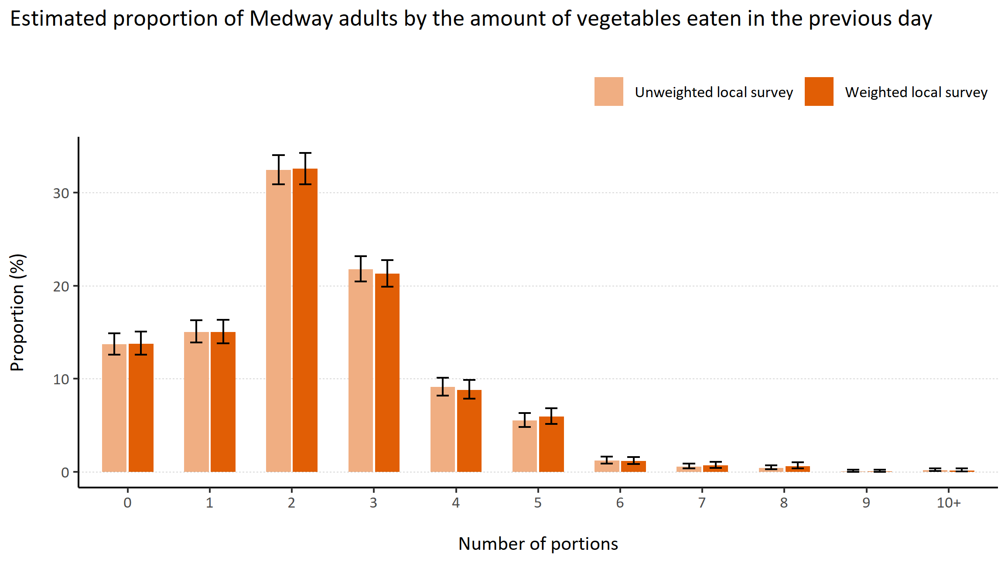
Vegetable consumption
© Medway Council, Public Health Intelligence Team, Version 1.0, 15/08/2023
Plot description
  National Medway estimate not available for comparison for this indicator.
  The weighted survey results estimate that 13.8% of Medway adults did not eat any vegetables in the previous day.
  84 out of 3,594 survey respondents did not answer this question.
Survey question: How many portions of vegetables did you eat yesterday?

Slide 13
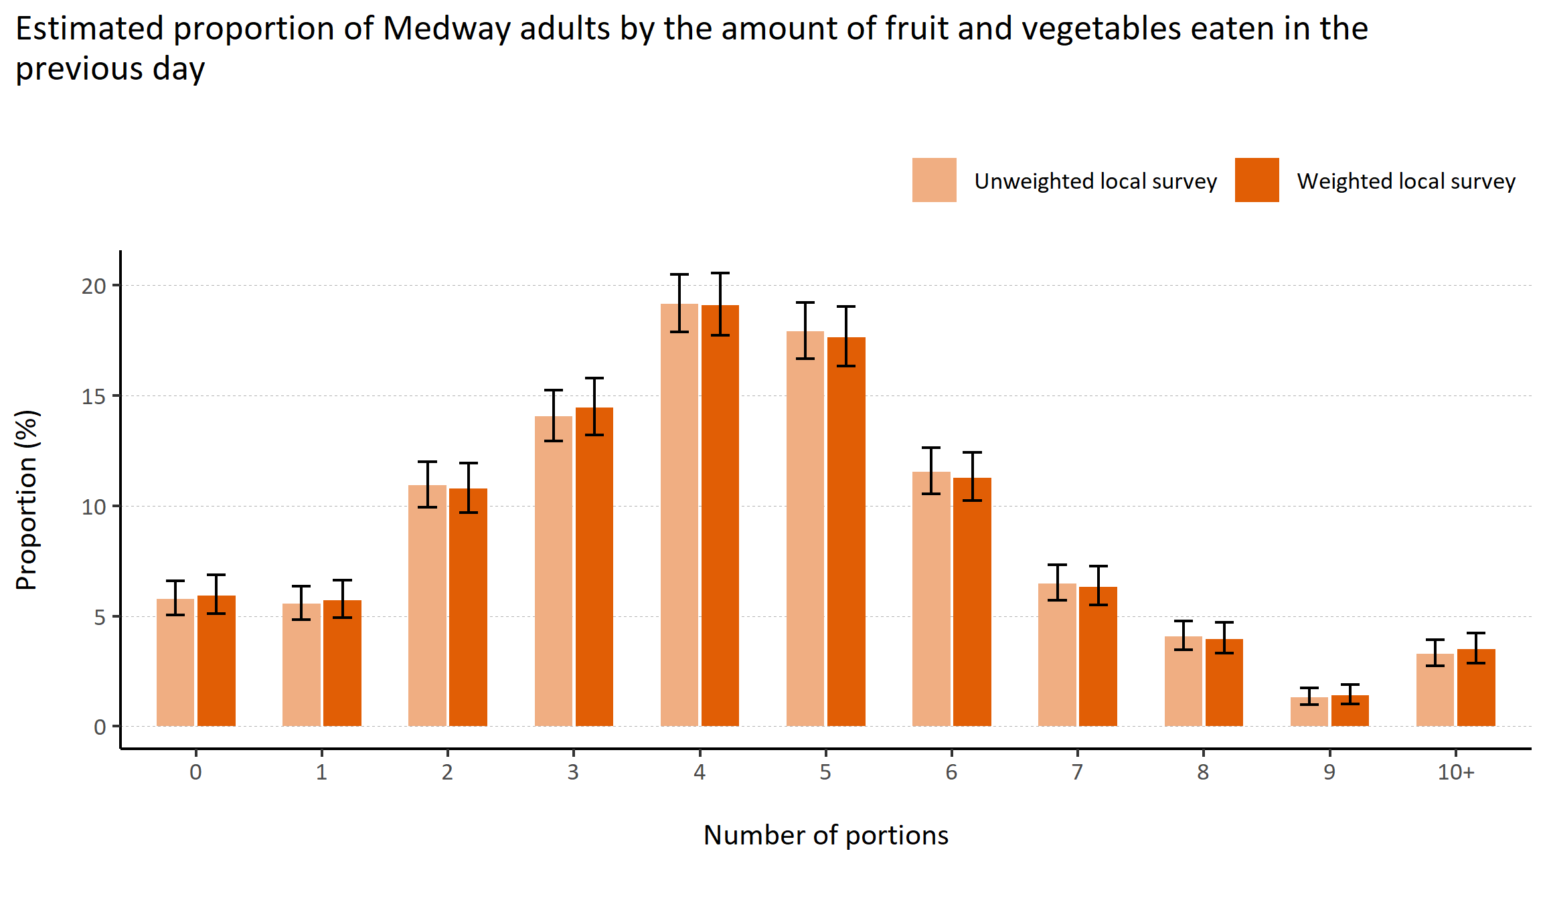
Fruit and vegetable consumption
© Medway Council, Public Health Intelligence Team, Version 1.0, 15/08/2023
Plot description
  National Medway estimate not available for comparison for this indicator.
  The weighted survey results estimate that 5.9% of Medway adults did not eat any fruit or vegetables in the previous day.
  84 out of 3,594 survey respondents did not answer this question.
Survey question: How many portions of fruit did you eat yesterday?
Survey question: How many portions of vegetables did you eat yesterday?

Slide 14
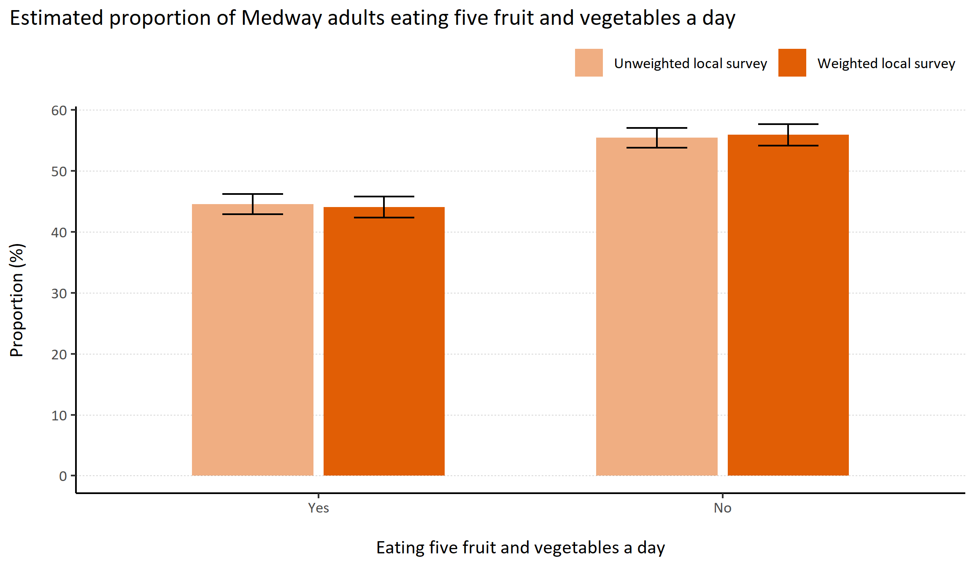
Eating five fruit and vegetables a day
© Medway Council, Public Health Intelligence Team, Version 1.0, 15/08/2023
Plot description
  National Medway estimate not available for comparison for this indicator.
  The weighted survey results estimate that 44.1% of Medway adults report eating five portions of fruit and vegetables a day, while 55.9% do not meet this guideline.
  84 out of 3,594 survey respondents did not answer this question.
Survey question: How many portions of fruit did you eat yesterday?
Survey question: How many portions of vegetables did you eat yesterday?

Slide 15
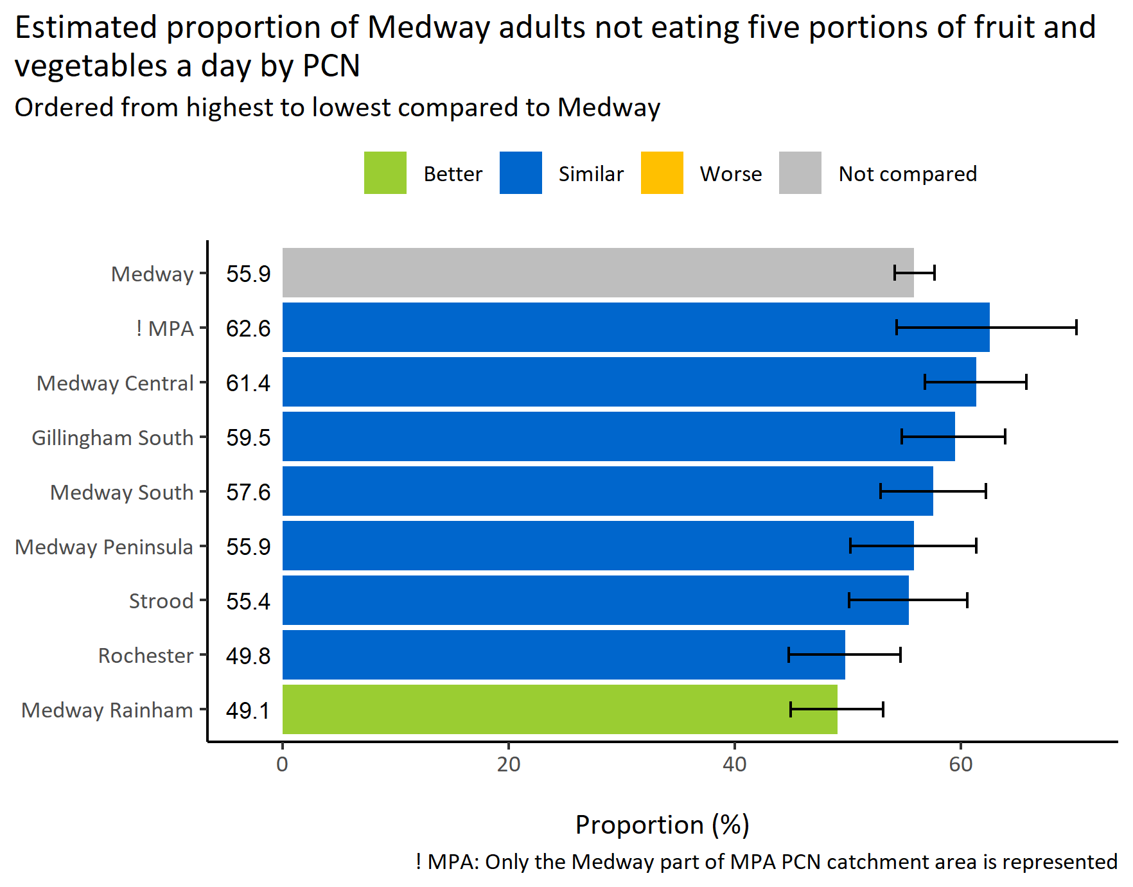
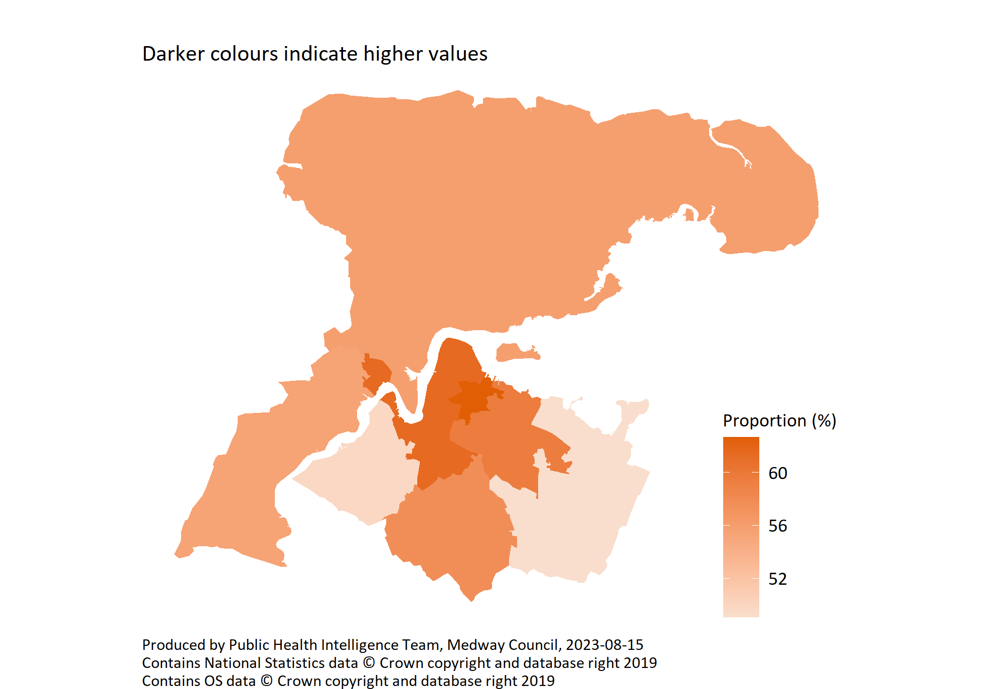
Not eating five a day by PCN
© Medway Council, Public Health Intelligence Team, Version 1.0, 15/08/2023
Survey question: How many portions of fruit did you eat yesterday?
Survey question: How many portions of vegetables did you eat yesterday?

Slide 16
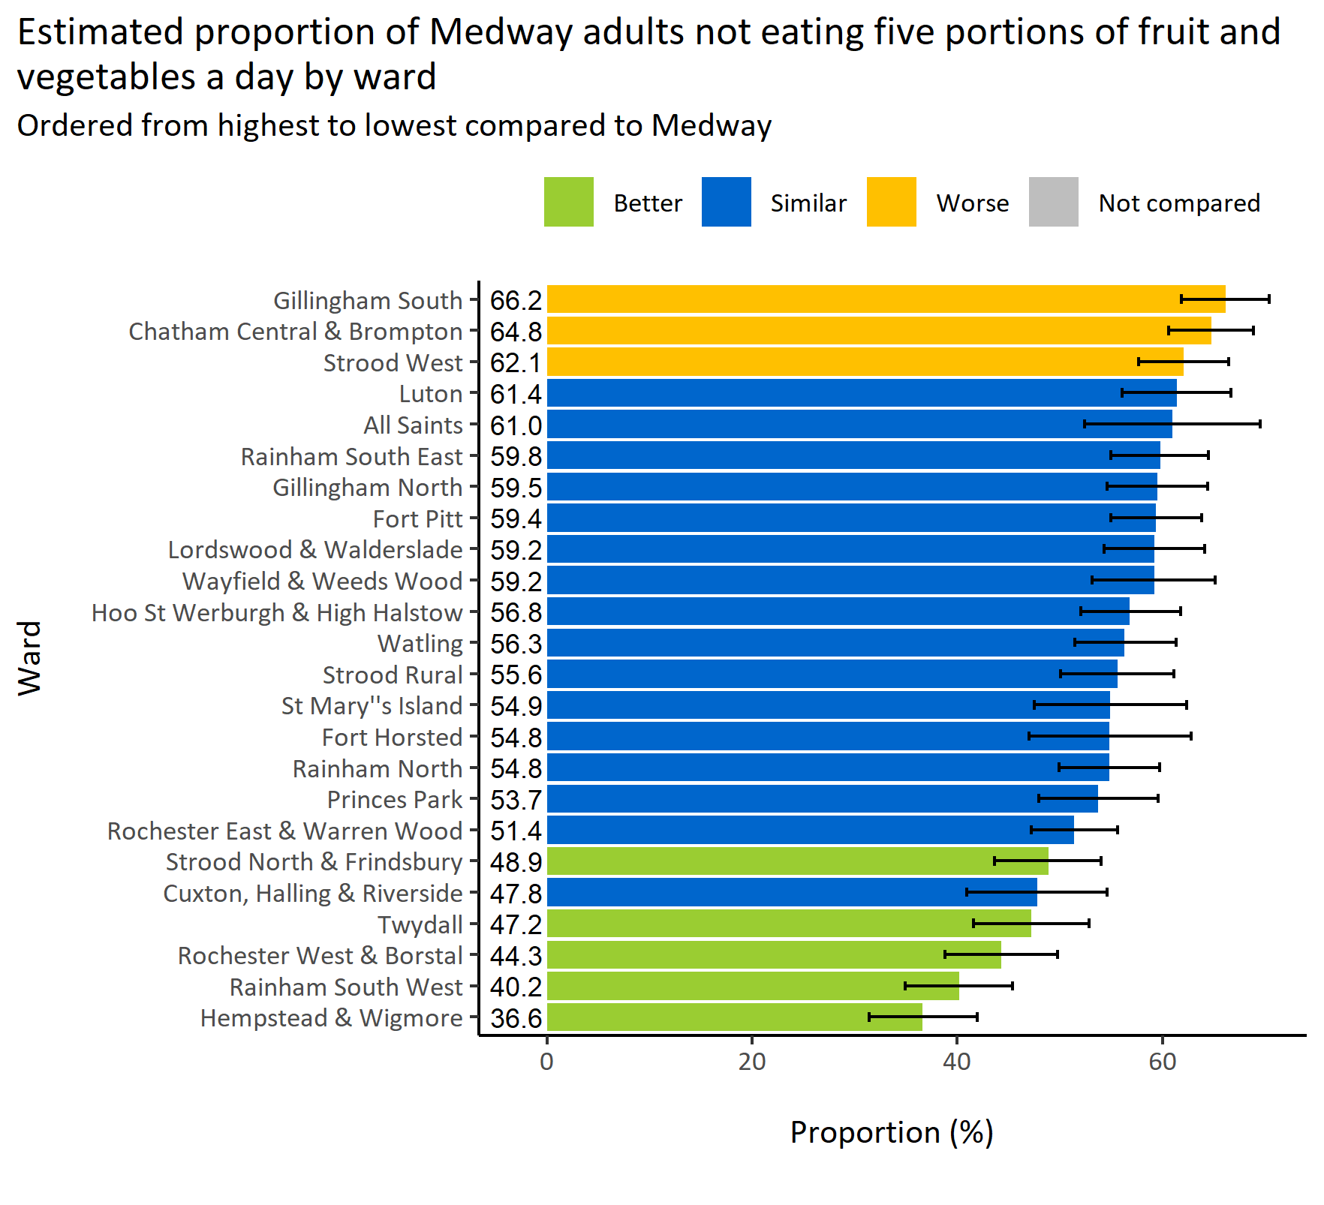
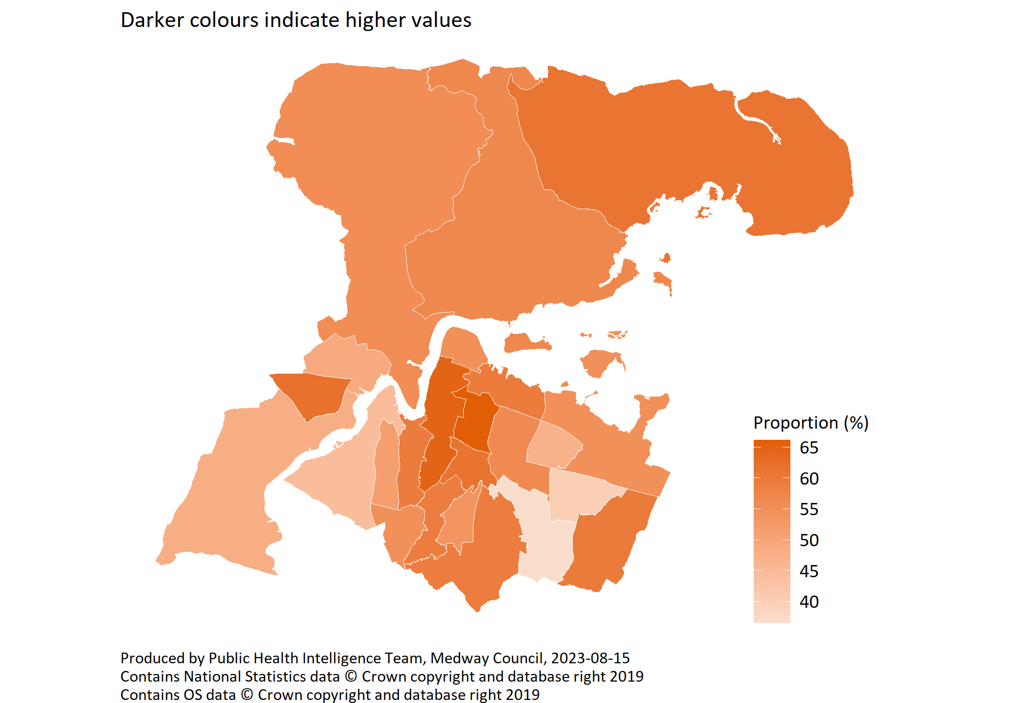
Not eating five a day by ward
© Medway Council, Public Health Intelligence Team, Version 1.0, 15/08/2023
Survey question: How many portions of fruit did you eat yesterday?
Survey question: How many portions of vegetables did you eat yesterday?
Estimates are calculated using Bayesian methods. These do not take into
account survey weighting but will be updated in the future to do so.

Slide 17
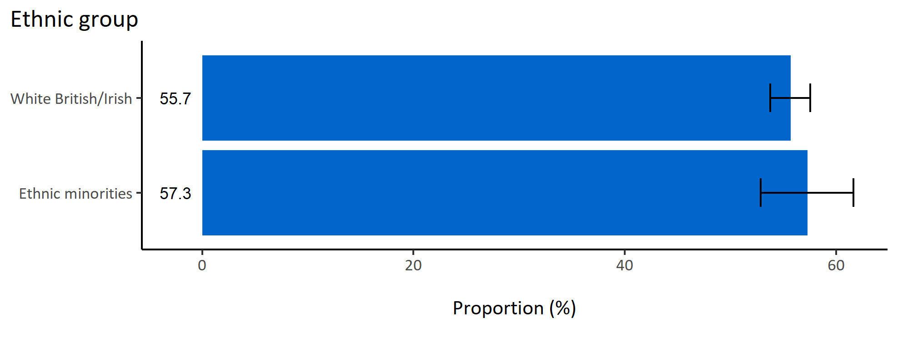
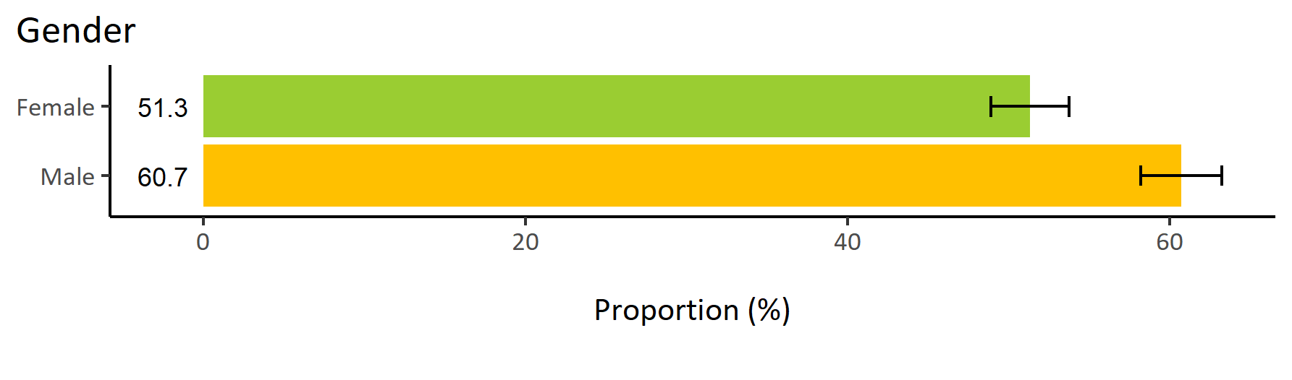
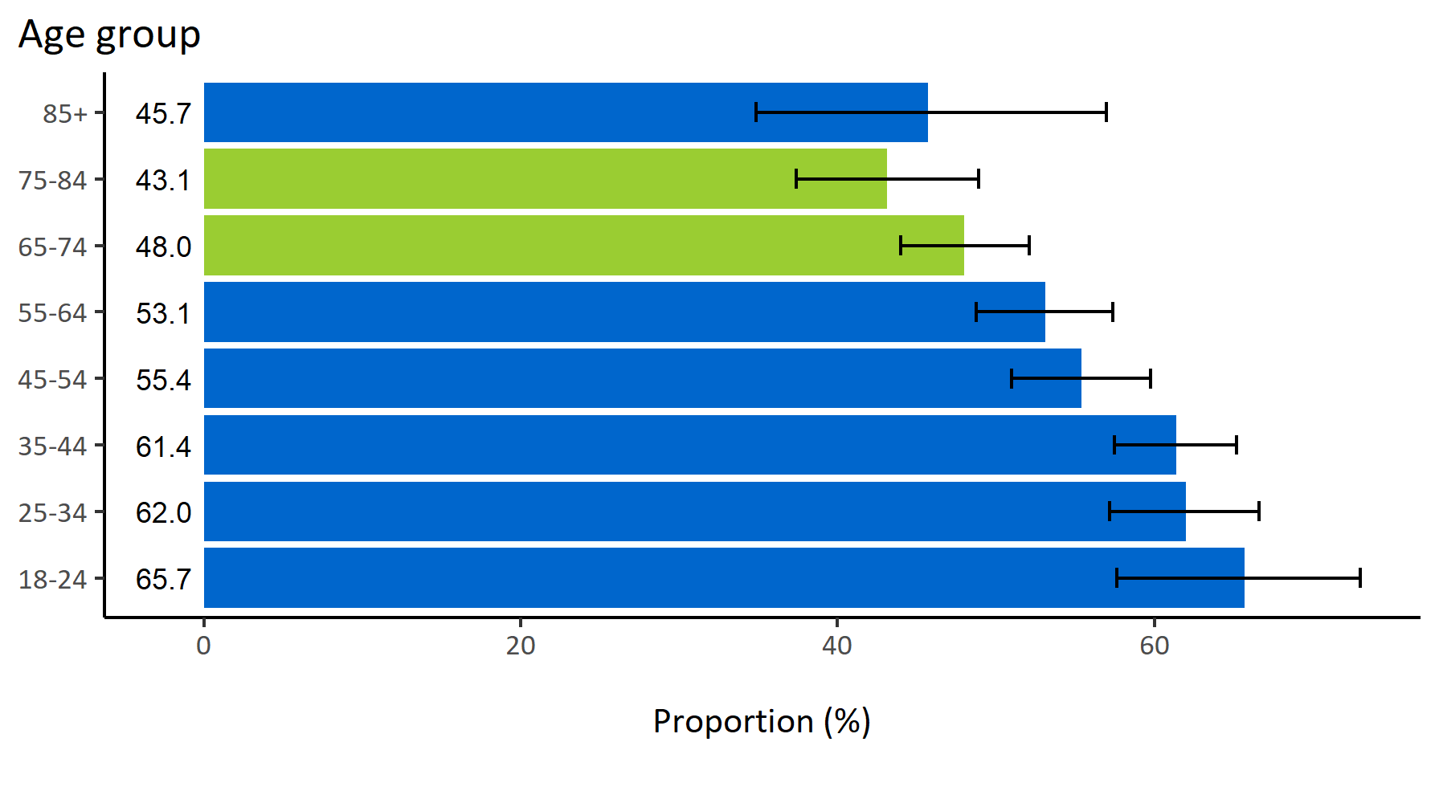
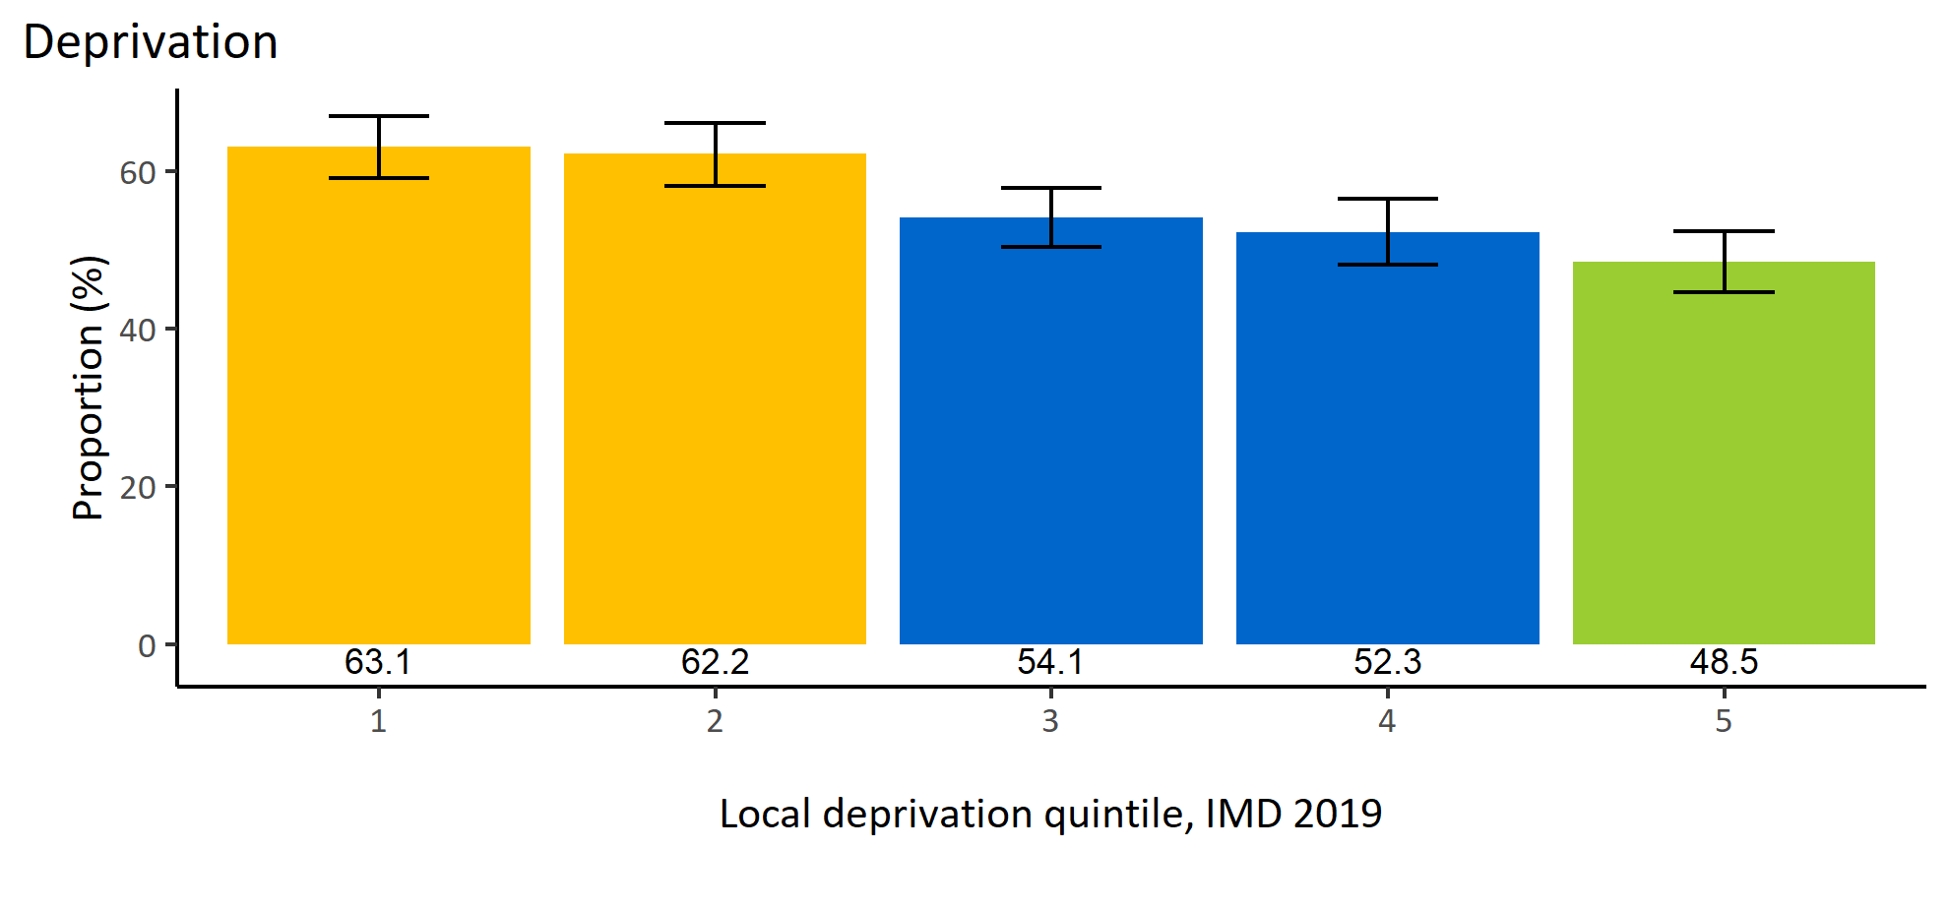
Not eating five a day by inequalities
© Medway Council, Public Health Intelligence Team, Version 1.0, 15/08/2023
Estimated proportion of Medway adults not eating five portions of fruit and vegetables a day by inequalities

Slide 18
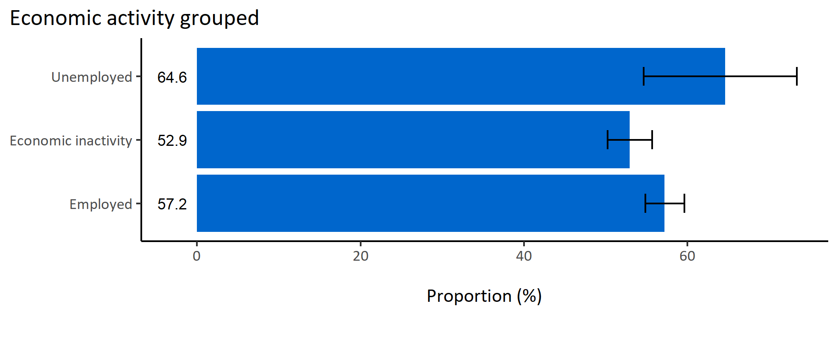
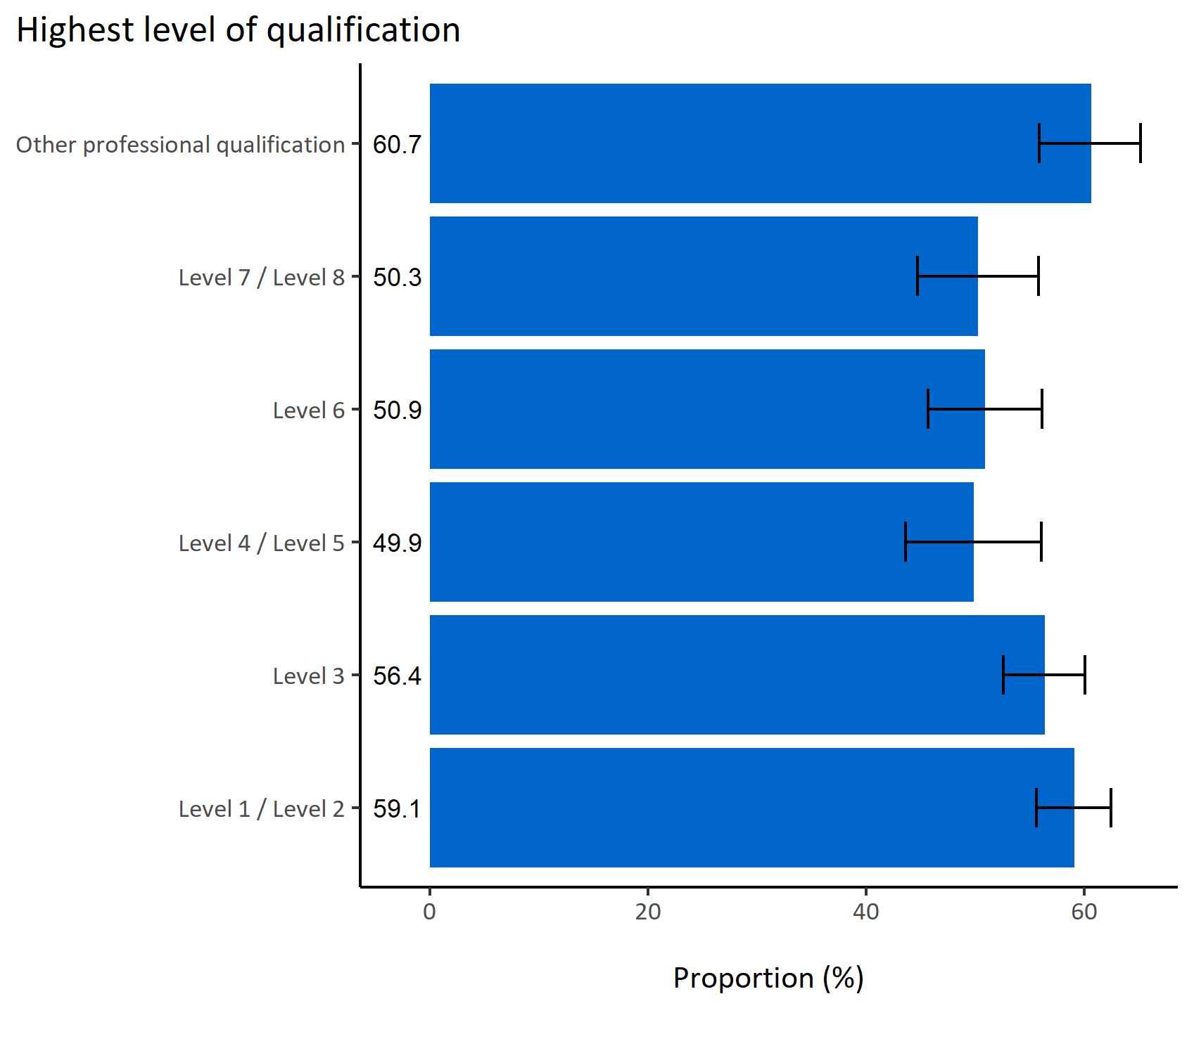
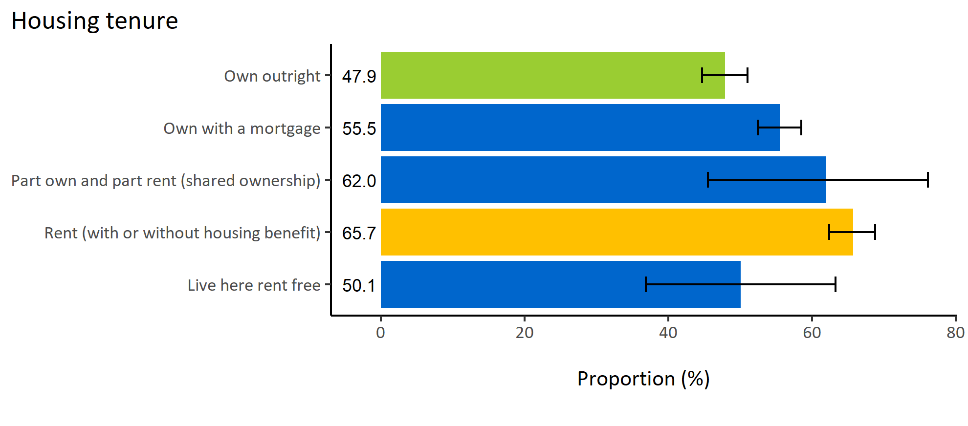
Not eating five a day by wider determinants
© Medway Council, Public Health Intelligence Team, Version 1.0, 15/08/2023
Estimated proportion of Medway adults not eating five portions of fruit and vegetables a day by wider determinants

Slide 19
Summary: Not eating five a day
© Medway Council, Public Health Intelligence Team, Version 1.0, 15/08/2023
The weighted survey results estimate that 55.9% of Medway adults do not eat five portions of fruit and vegetables a day.
Certain groups in Medway are less likely to eat five portions of fruit and vegetables a day. These groups include:
  Adults in wards Chatham Central & Brompton, Strood West, and Gillingham South
  Males
  Adults living in areas of high deprivation (quintiles 1 and 2)
  Adults who rent (with or without housing benefit).

Slide 20
Not enough food due to finances

Slide 21
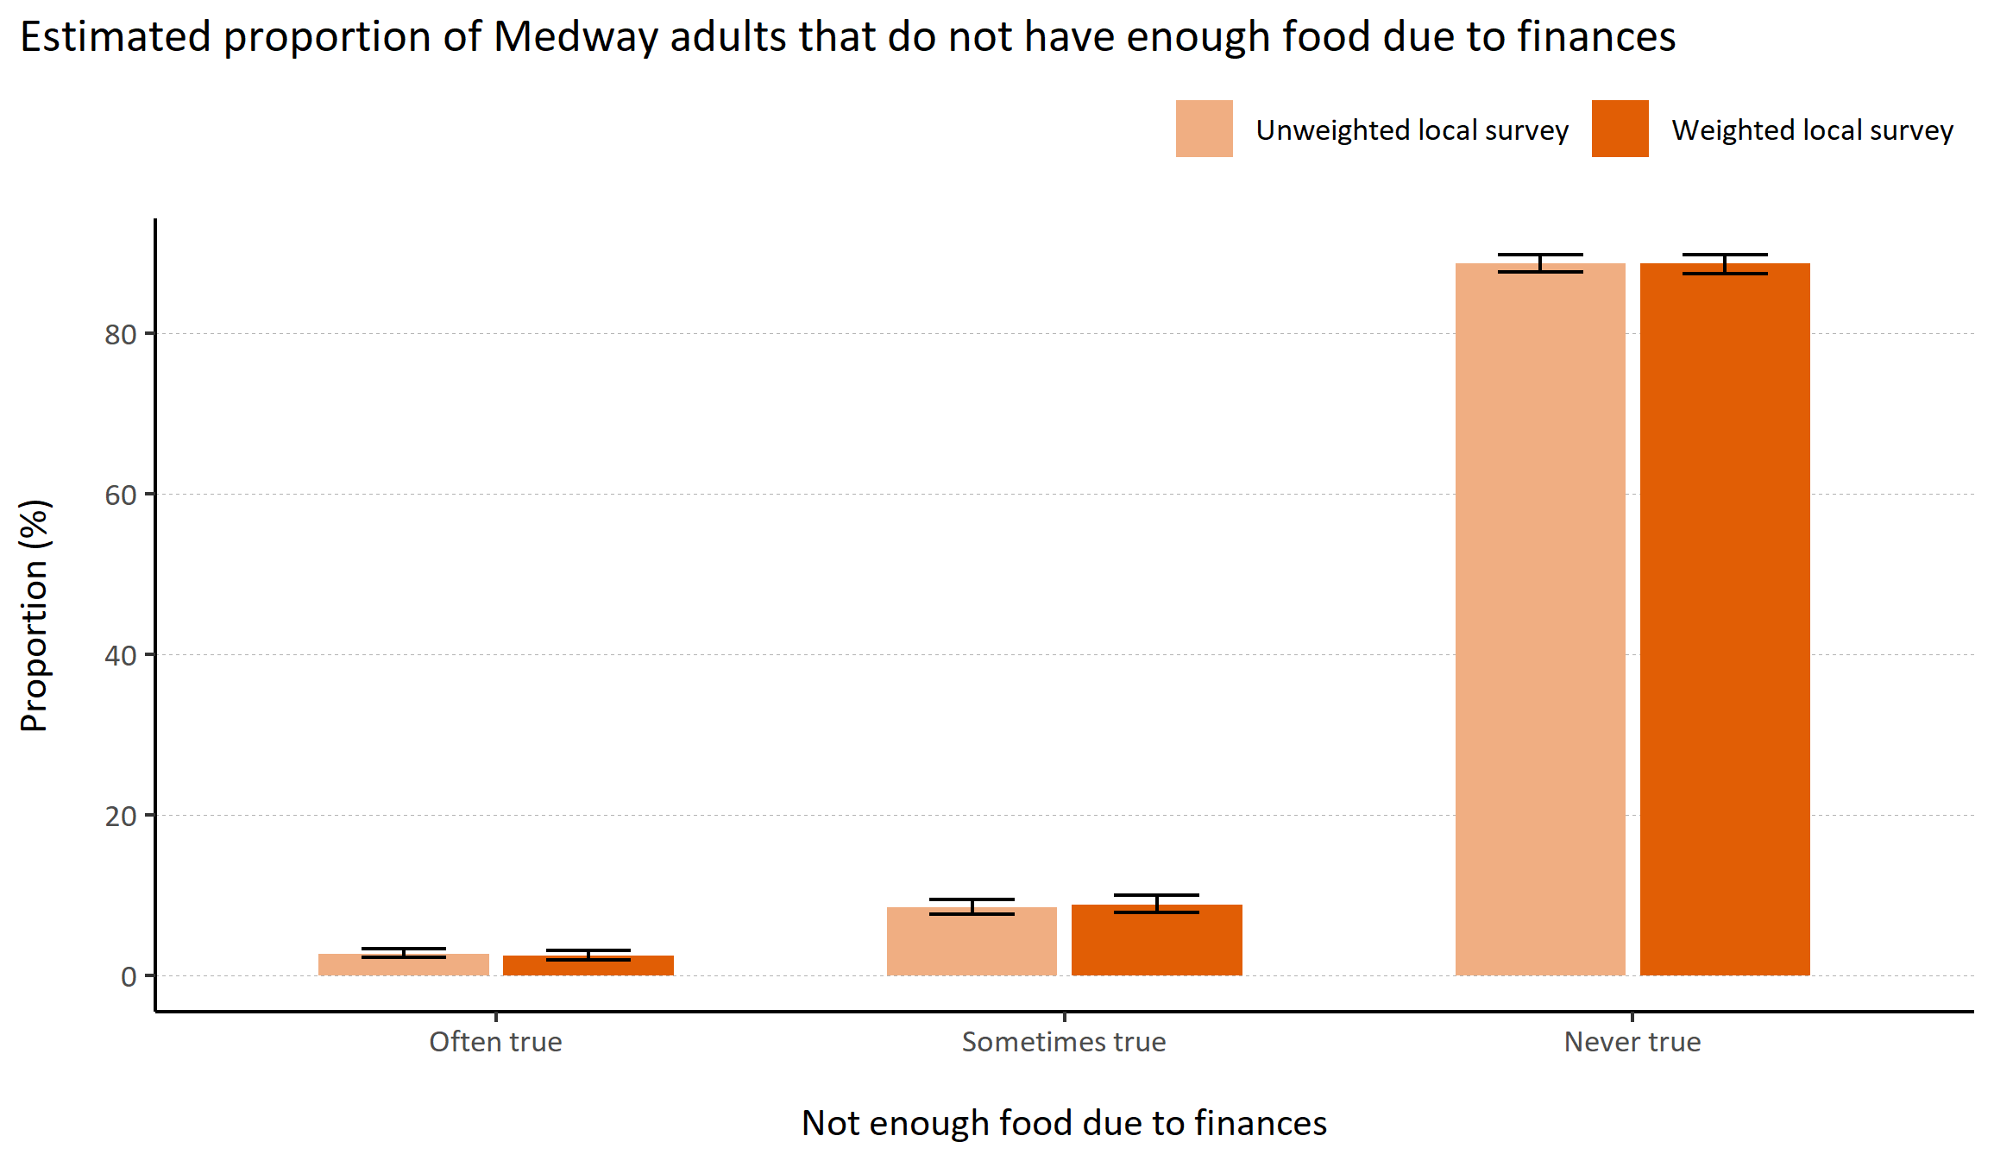
Not enough food due to finances
© Medway Council, Public Health Intelligence Team, Version 1.0, 15/08/2023
Plot description
  National Medway estimate not available for comparison for this indicator.
  The weighted survey results estimate that 88.6% of Medway adults always have enough food, 8.9% sometimes don't have enough food due to financial reasons, and 2.5% often expereince food shortage due to finances.
  121 out of 3,594 survey respondents did not answer this question.
Survey question: In the last 12 months, The food that I/we bought just didn’t last, and I/we didn’t have money to get more
Possible answers: Often true, Sometimes true, Never true, Don't know/don't want to say.

Slide 22
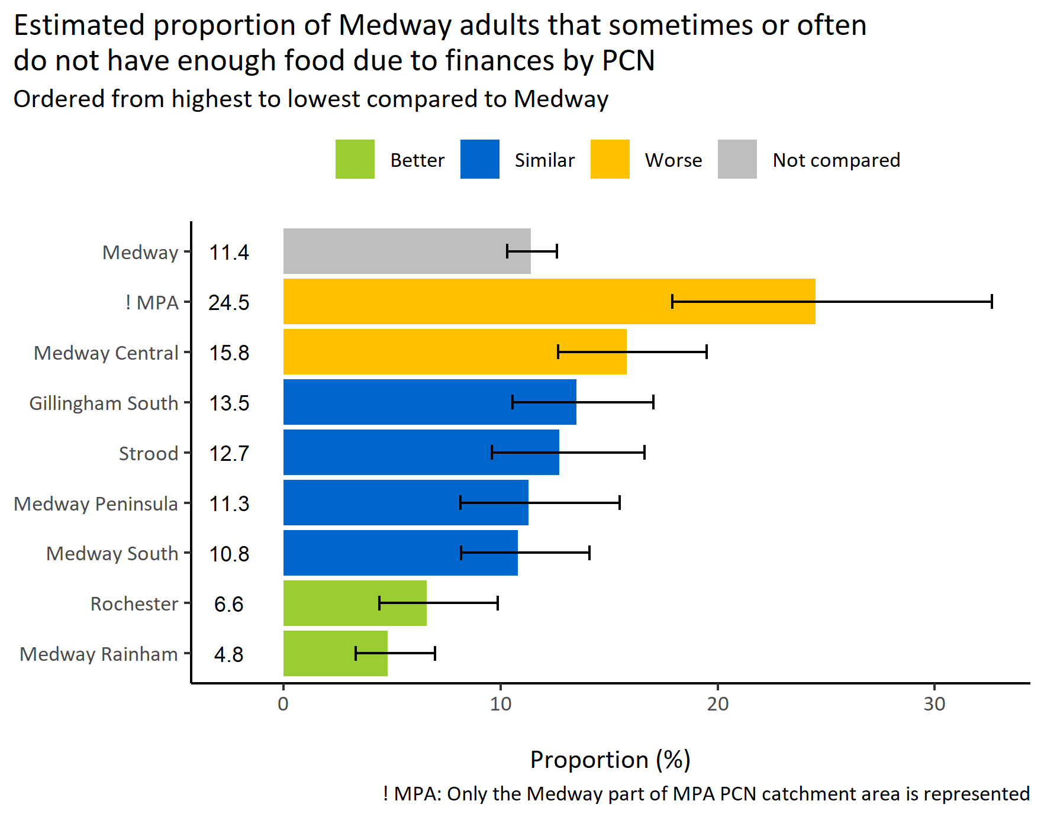
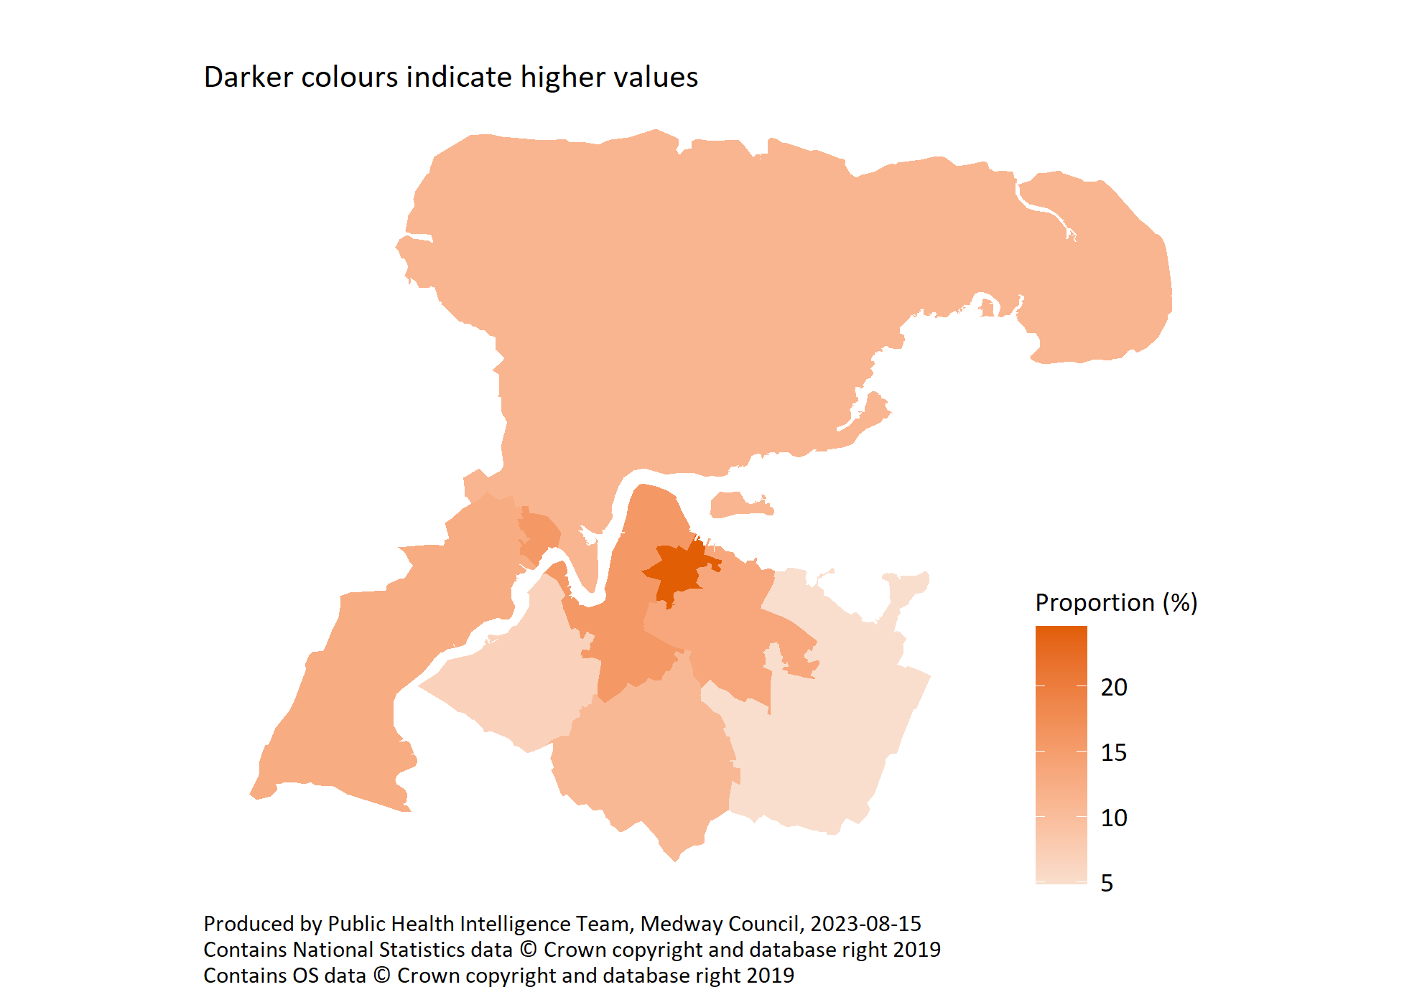
Not enough food due to finances by PCN
© Medway Council, Public Health Intelligence Team, Version 1.0, 15/08/2023
Survey question: In the last 12 months, The food that I/we bought just didn’t last, and I/we didn’t have money to get more
Possible answers: Often true, Sometimes true, Never true, Don't know/don't want to say.
Categories selected: Often true or sometimes true

Slide 23
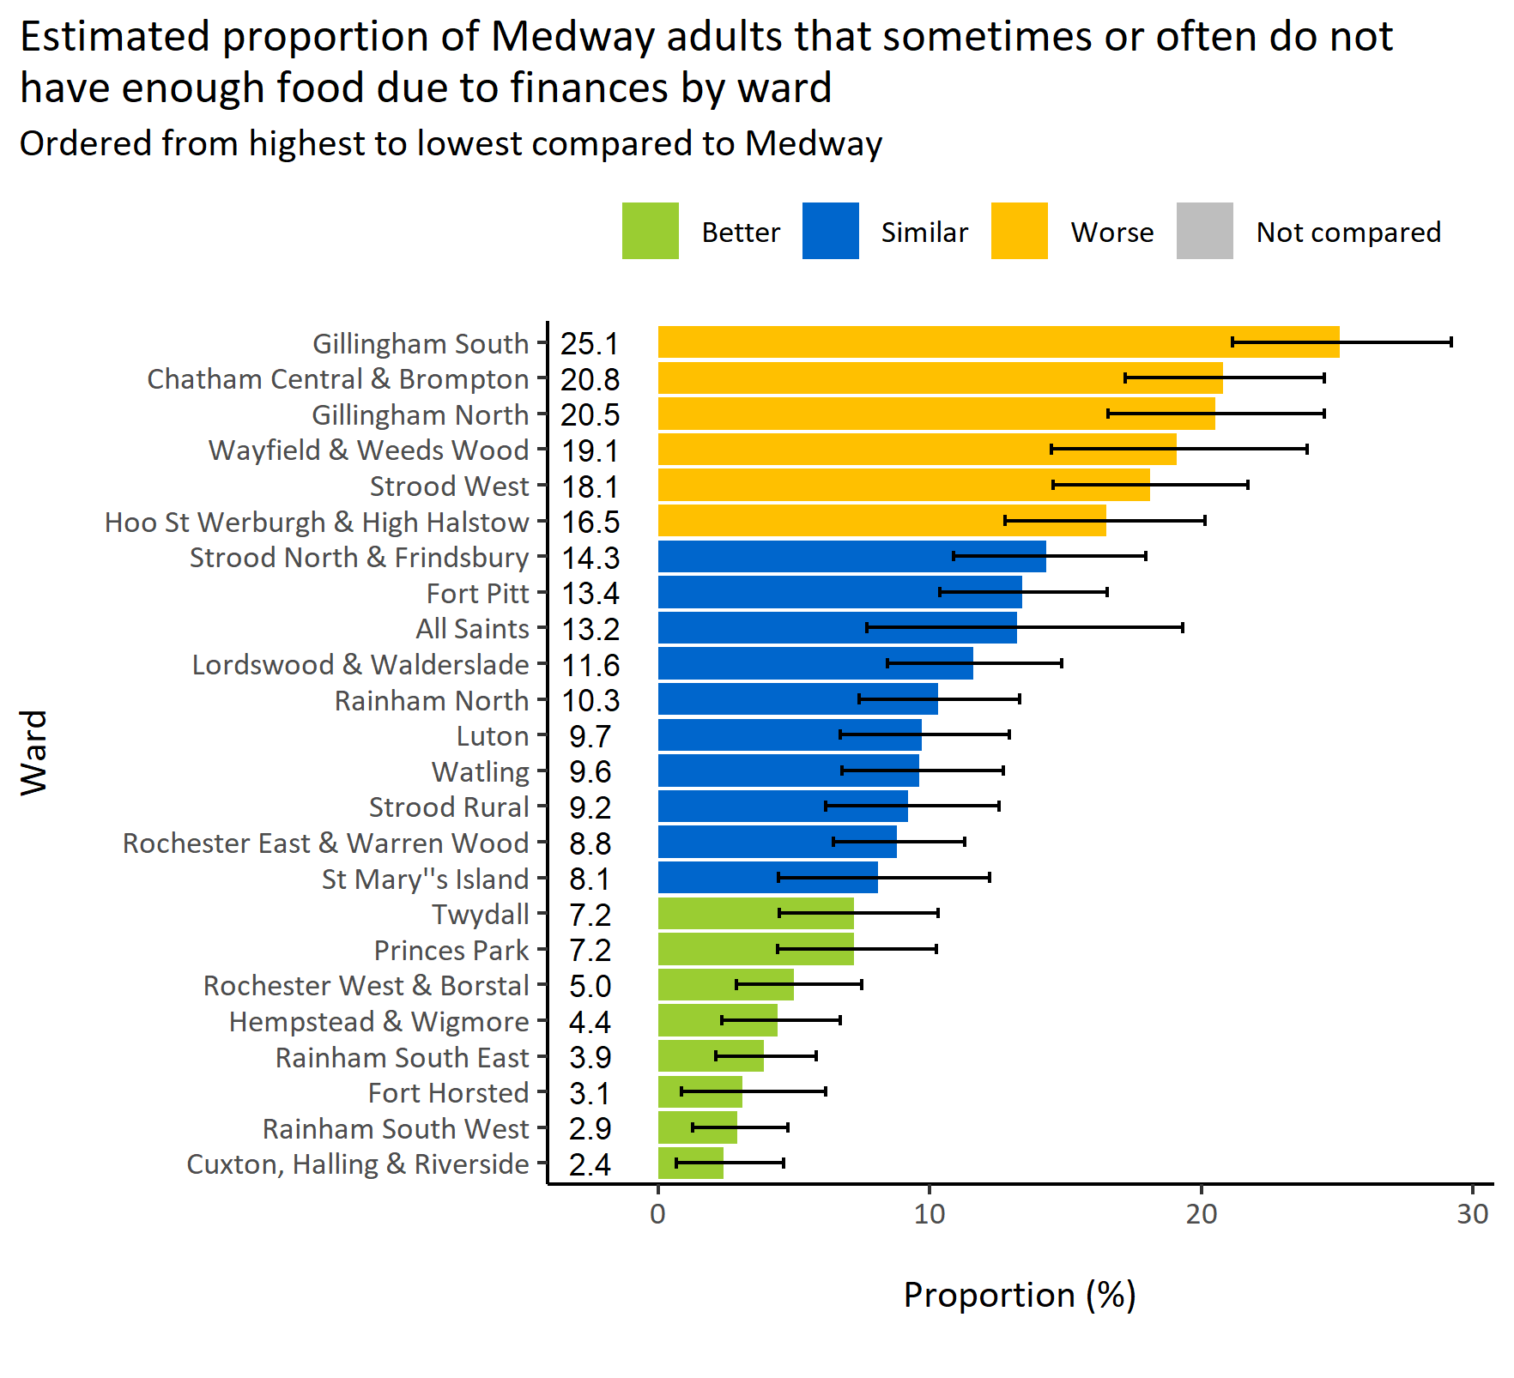
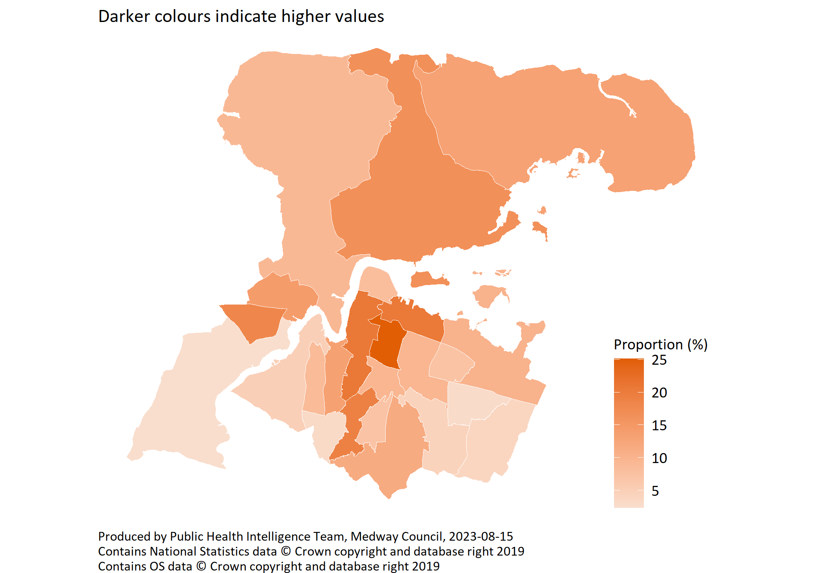
Not enough food due to finances by ward
© Medway Council, Public Health Intelligence Team, Version 1.0, 15/08/2023
Survey question: In the last 12 months, The food that I/we bought just didn’t last, and I/we didn’t have money to get more
Possible answers: Often true, Sometimes true, Never true, Don't know/don't want to say.
Categories selected: Often true or sometimes true
Estimates are calculated using Bayesian methods. These do not take into
account survey weighting but will be updated in the future to do so.

Slide 24
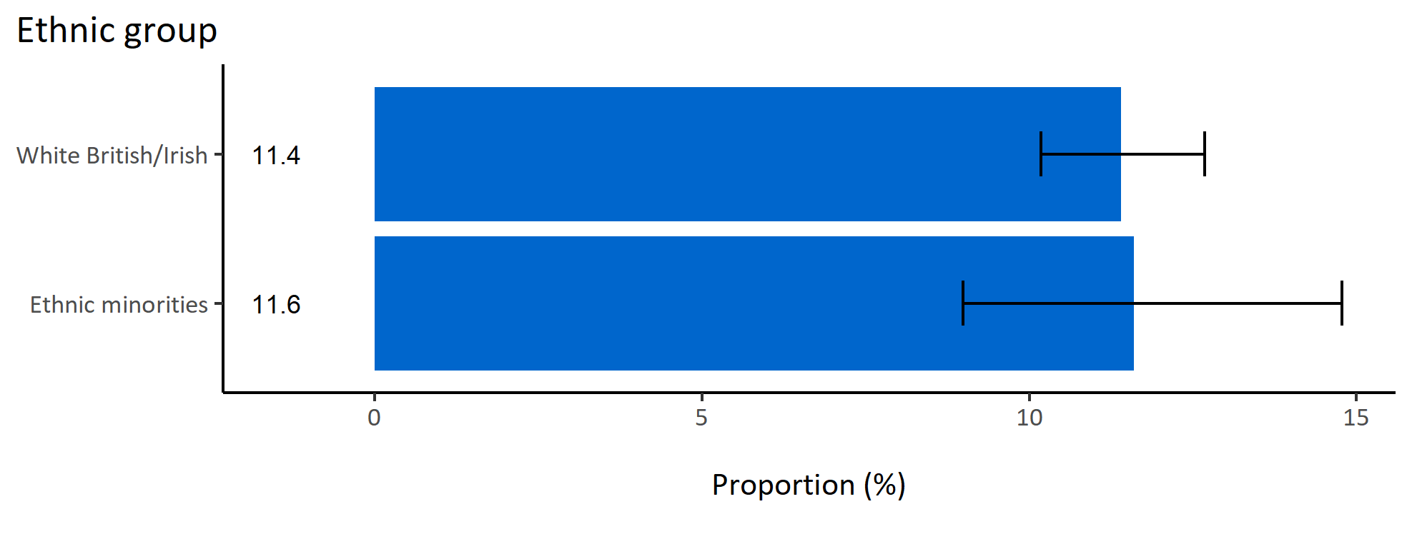
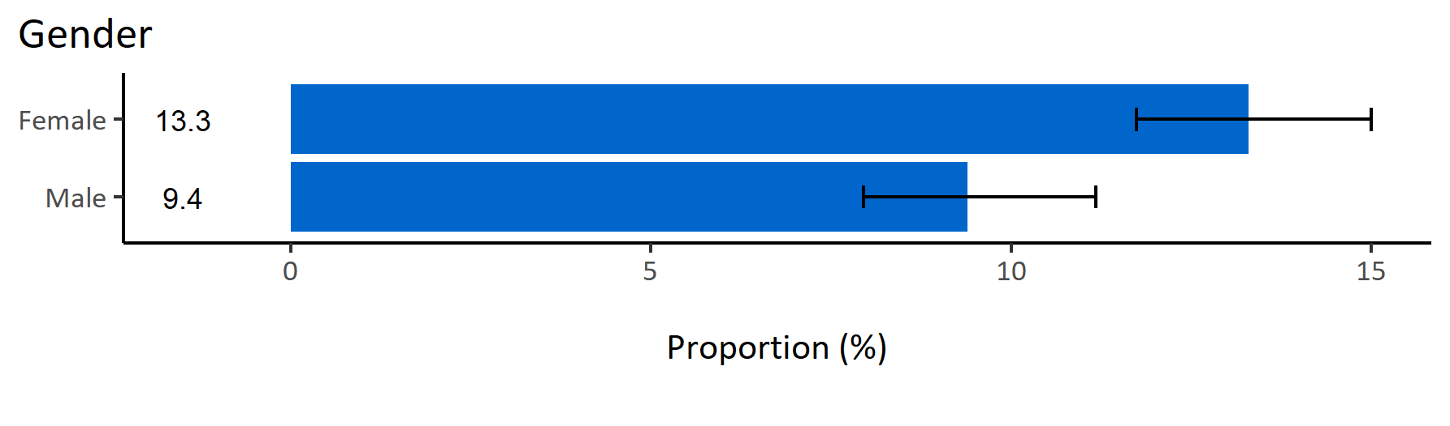
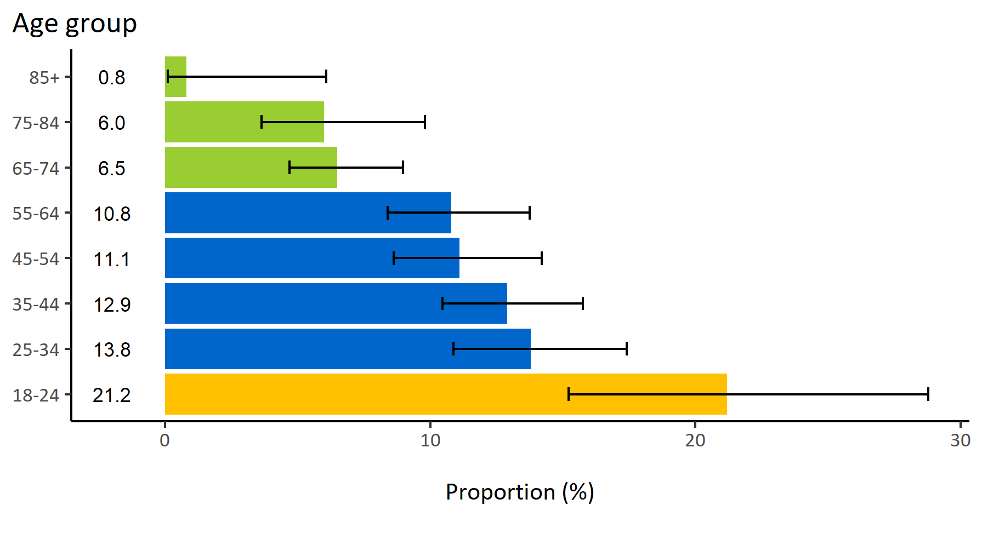
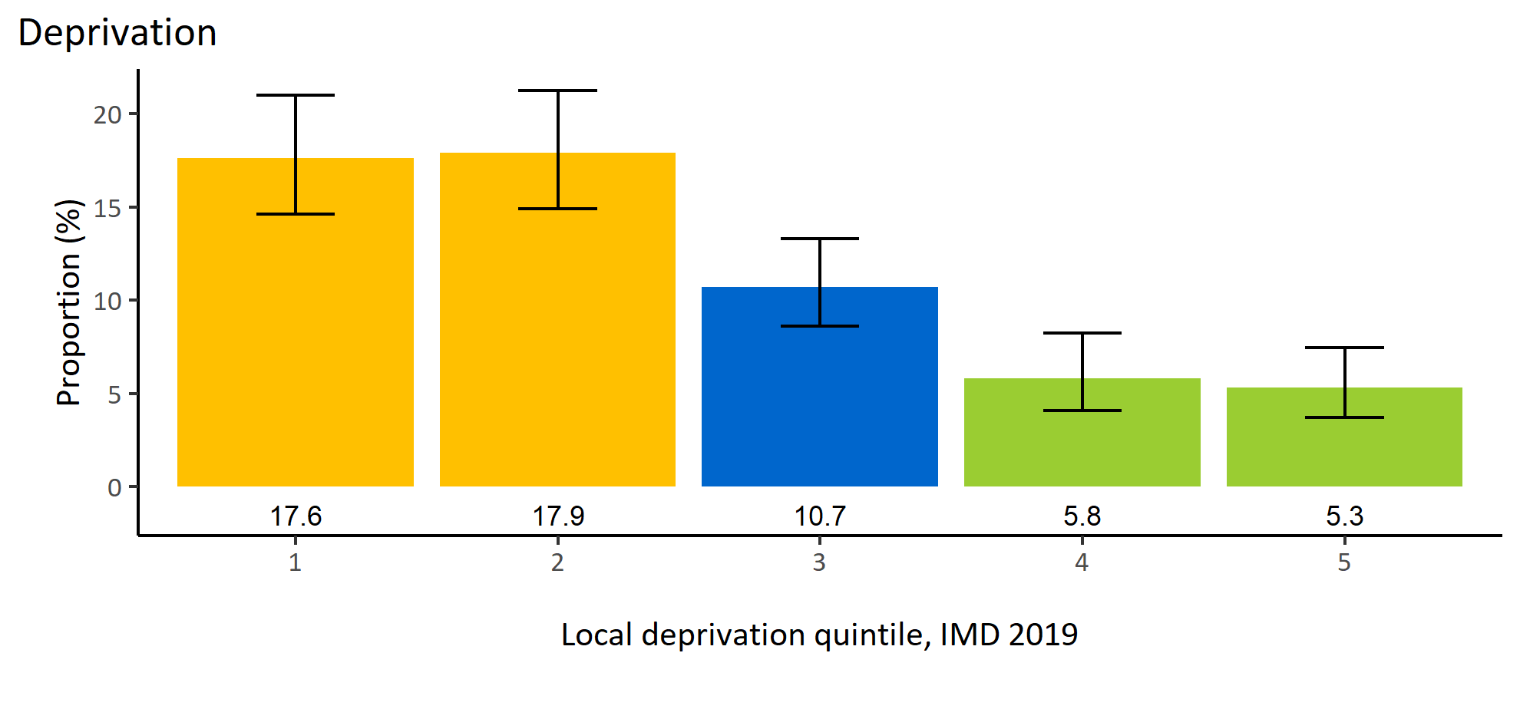
Not enough food due to finances by inequalities
© Medway Council, Public Health Intelligence Team, Version 1.0, 15/08/2023
Estimated proportion of Medway adults that sometimes or often do not have enough food due to finances by inequalities

Slide 25
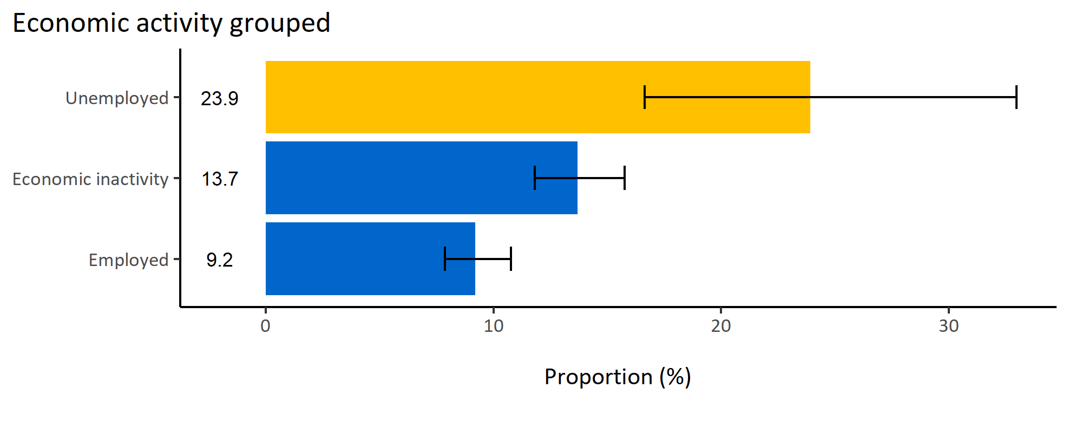
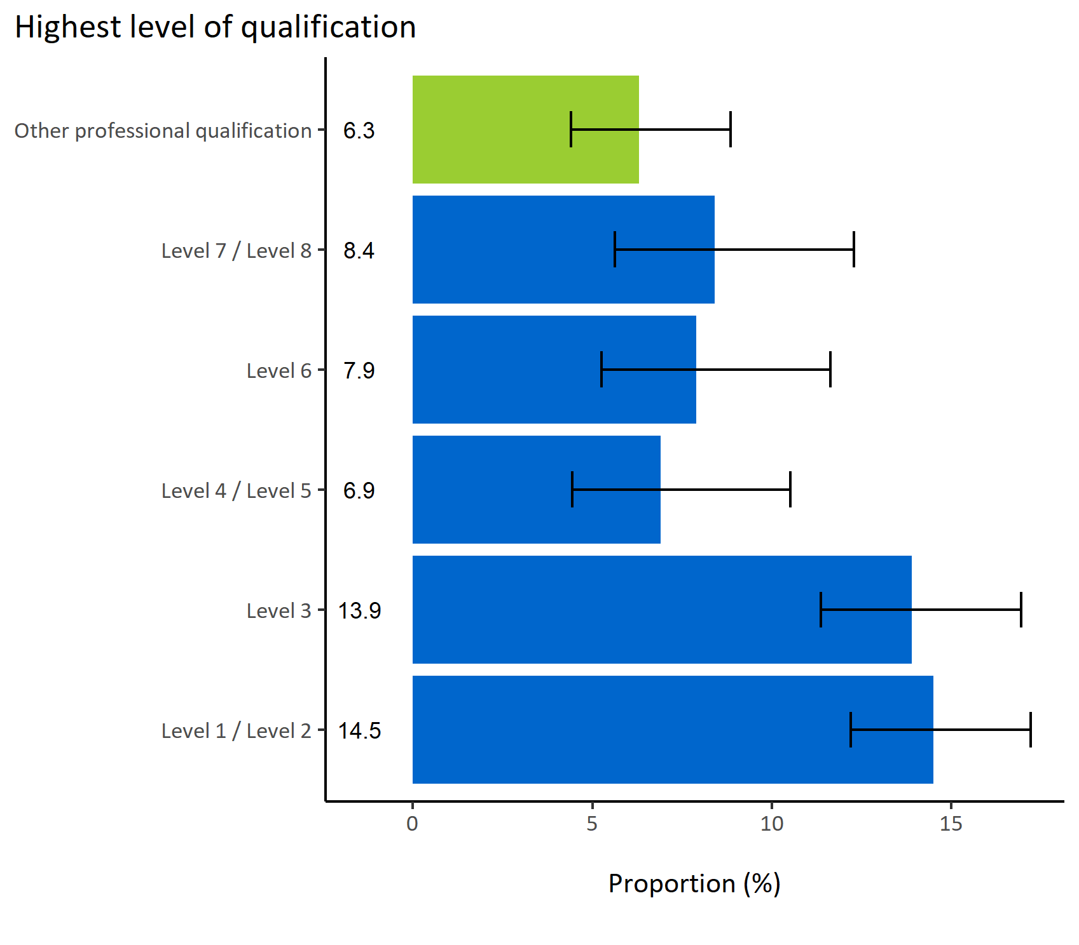
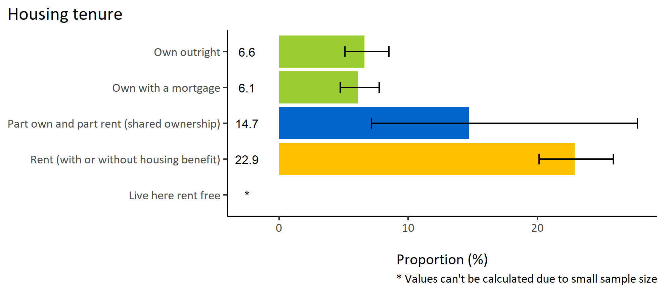
Not enough food due to finances by wider determinants
© Medway Council, Public Health Intelligence Team, Version 1.0, 15/08/2023
Estimated proportion of Medway adults that sometimes or often do not have enough food due to finances by wider determinants

Slide 26
Summary: Not enough food due to finances
© Medway Council, Public Health Intelligence Team, Version 1.0, 15/08/2023
The weighted survey results estimate that 11.4% of Medway adults sometimes or often do not have enough food due to finances.
Certain groups in Medway are more likely to not have enough food due to finances. These groups include:
  Adults in MPA PCN and Medway Central PCN
  Adults in wards Chatham Central & Brompton, Strood West, Wayfield & Weeds Wood, Gillingham North, Gillingham South, and Hoo St Werburgh & High Halstow
  Adults aged 18 to 34 years old
  Adults living in areas of high deprivation (quintiles 1 and 2)
  Unemployed adults
  Adults who rent (with or without housing benefit).

Slide 27
Reduced meals due to finances

Slide 28
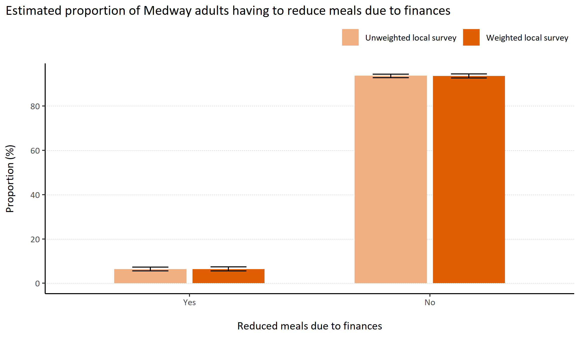
Reduced meals due to finances
© Medway Council, Public Health Intelligence Team, Version 1.0, 15/08/2023
Plot description
  National Medway estimate not available for comparison for this indicator.
  The weighted survey results estimate that 93.6% of Medway adults do not have to reduce the size of meals or skip meals due to finances, but 6.4% do.
  106 out of 3,594 survey respondents did not answer this question.
Survey question: In the last 12 months, did you (you or other adults in your household) ever cut the size of your meals or skip meals because there wasn't enough money for food?
Possible answers: Yes, No, Don't know/don't want to say.

Slide 29
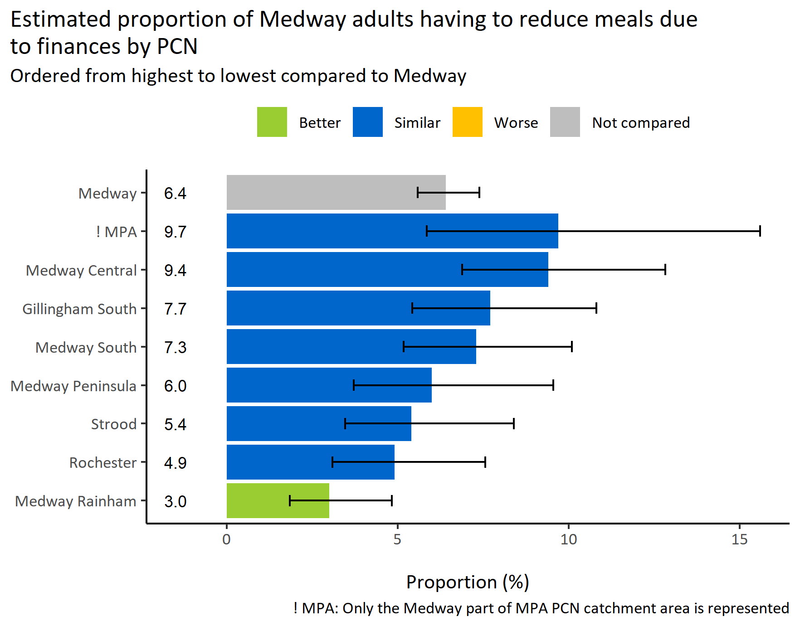
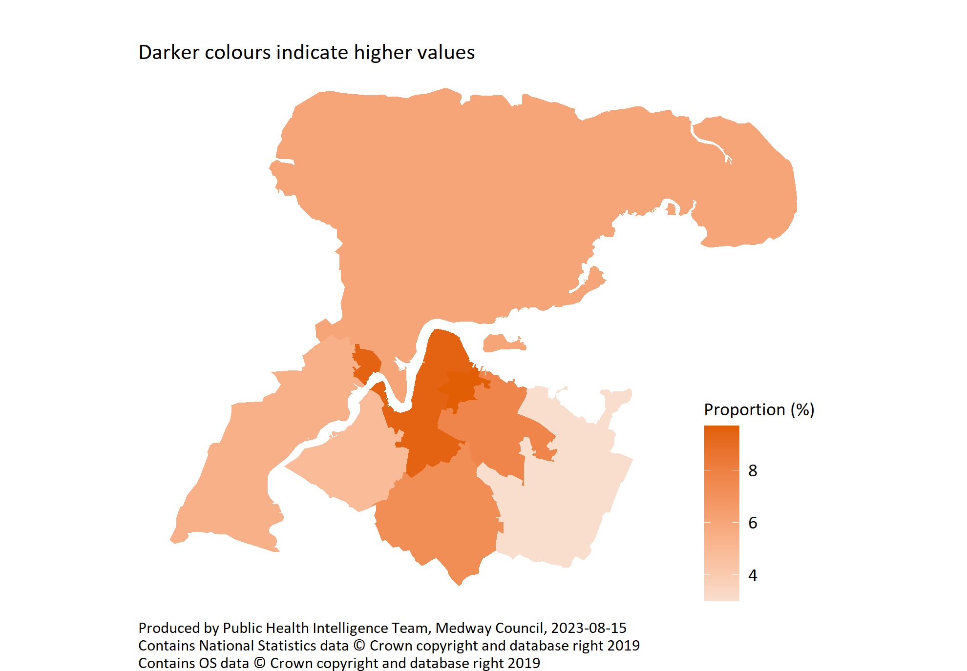
Reduced meals due to finances by PCN
© Medway Council, Public Health Intelligence Team, Version 1.0, 15/08/2023
Survey question: In the last 12 months, The food that I/we bought just didn’t last, and I/we didn’t have money to get more
Possible answers: Often true, Sometimes true, Never true, Don't know/don't want to say.
Categories selected: Often true or sometimes true

Slide 30
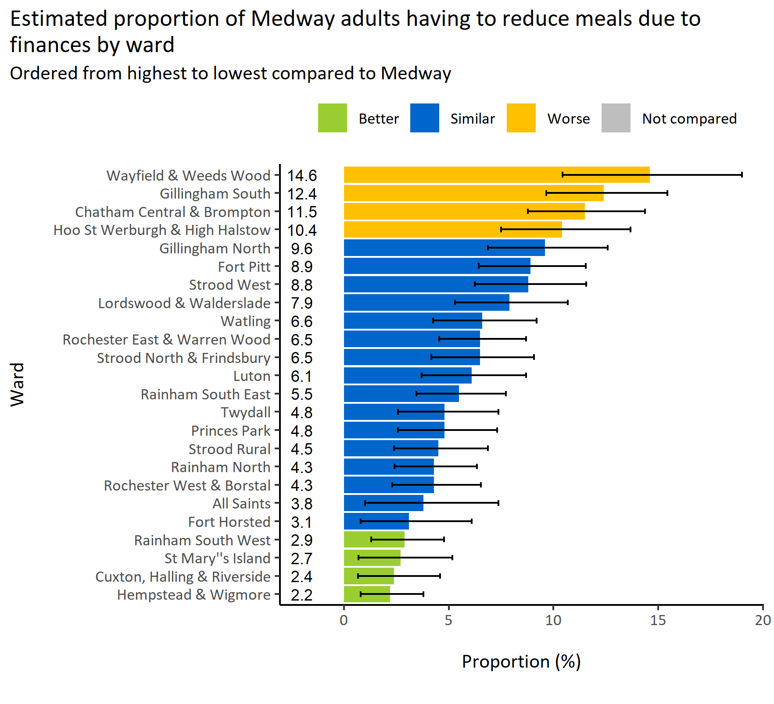
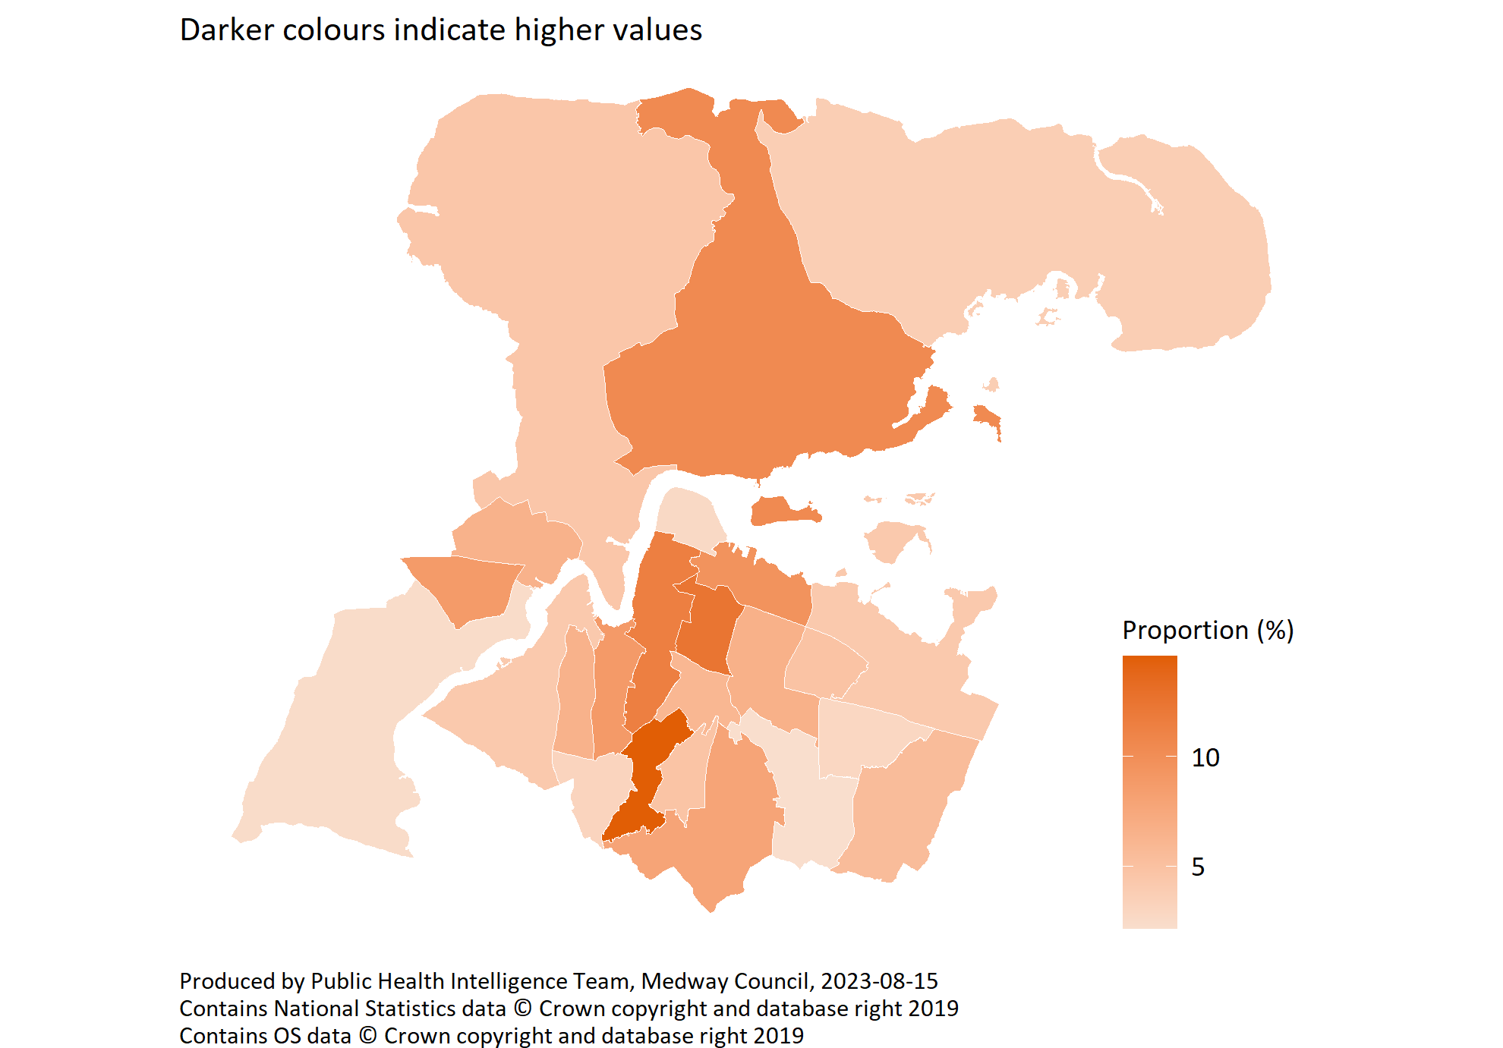
Reduced meals due to finances by ward
© Medway Council, Public Health Intelligence Team, Version 1.0, 15/08/2023
Survey question: In the last 12 months, The food that I/we bought just didn’t last, and I/we didn’t have money to get more
Possible answers: Often true, Sometimes true, Never true, Don't know/don't want to say.
Categories selected: Often true or sometimes true
Estimates are calculated using Bayesian methods. These do not take into
account survey weighting but will be updated in the future to do so.

Slide 31
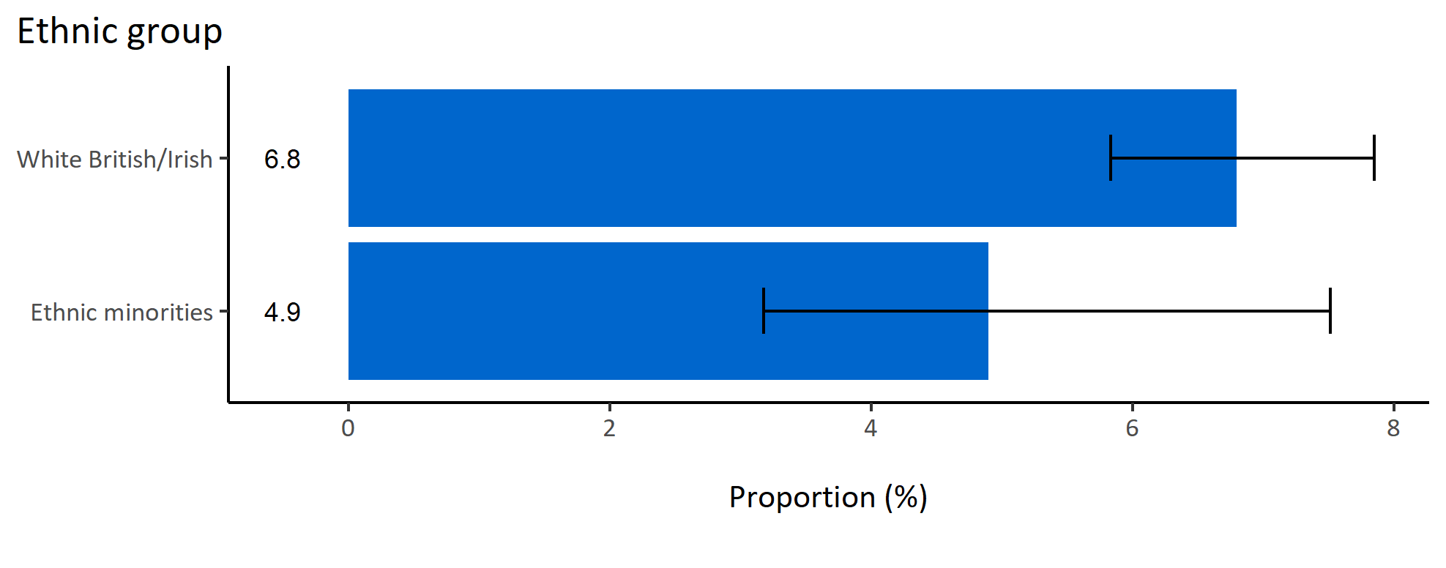
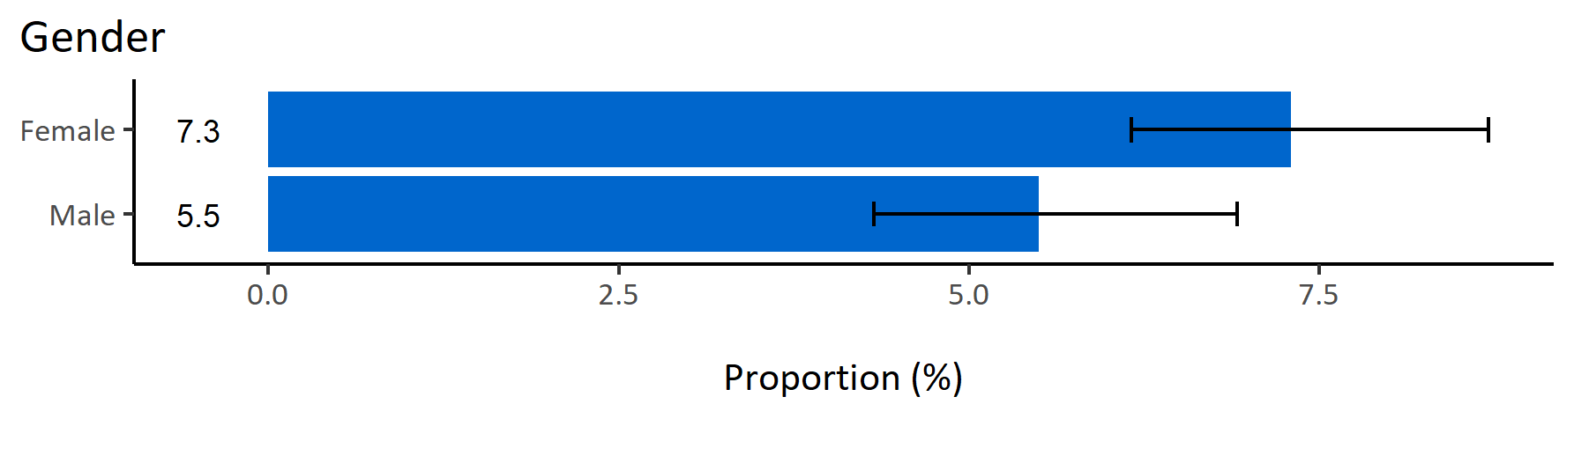
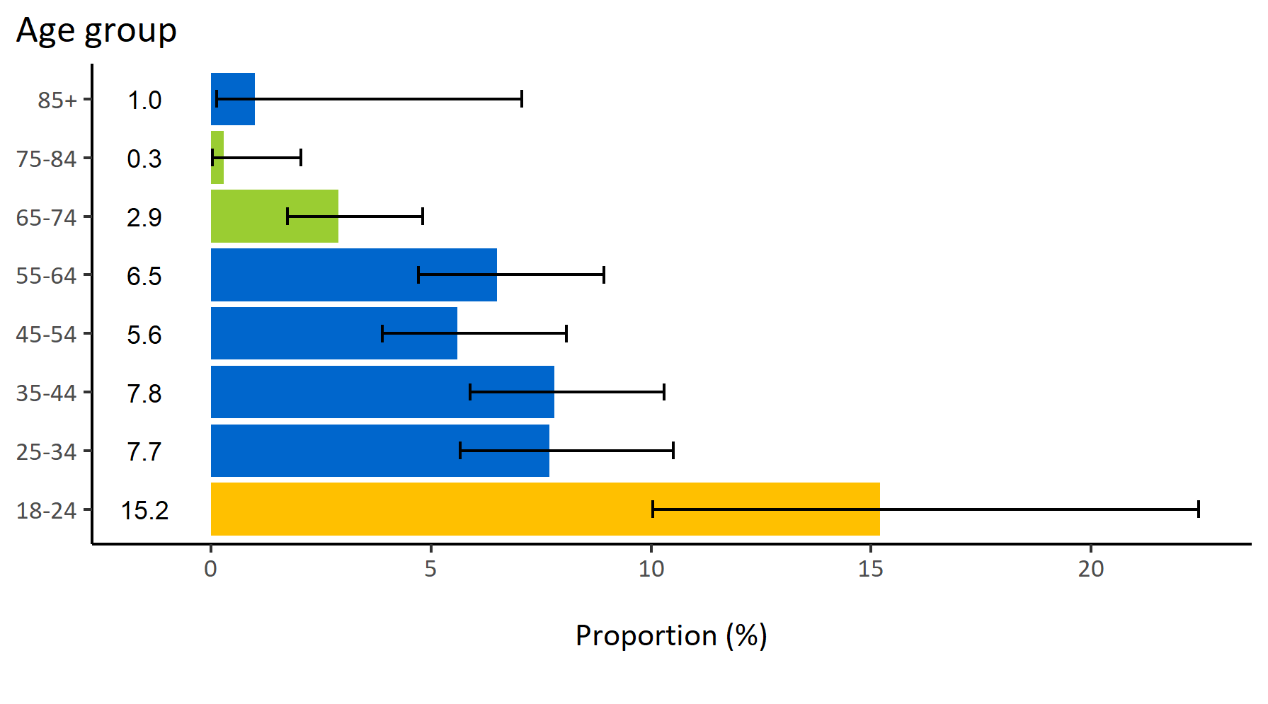
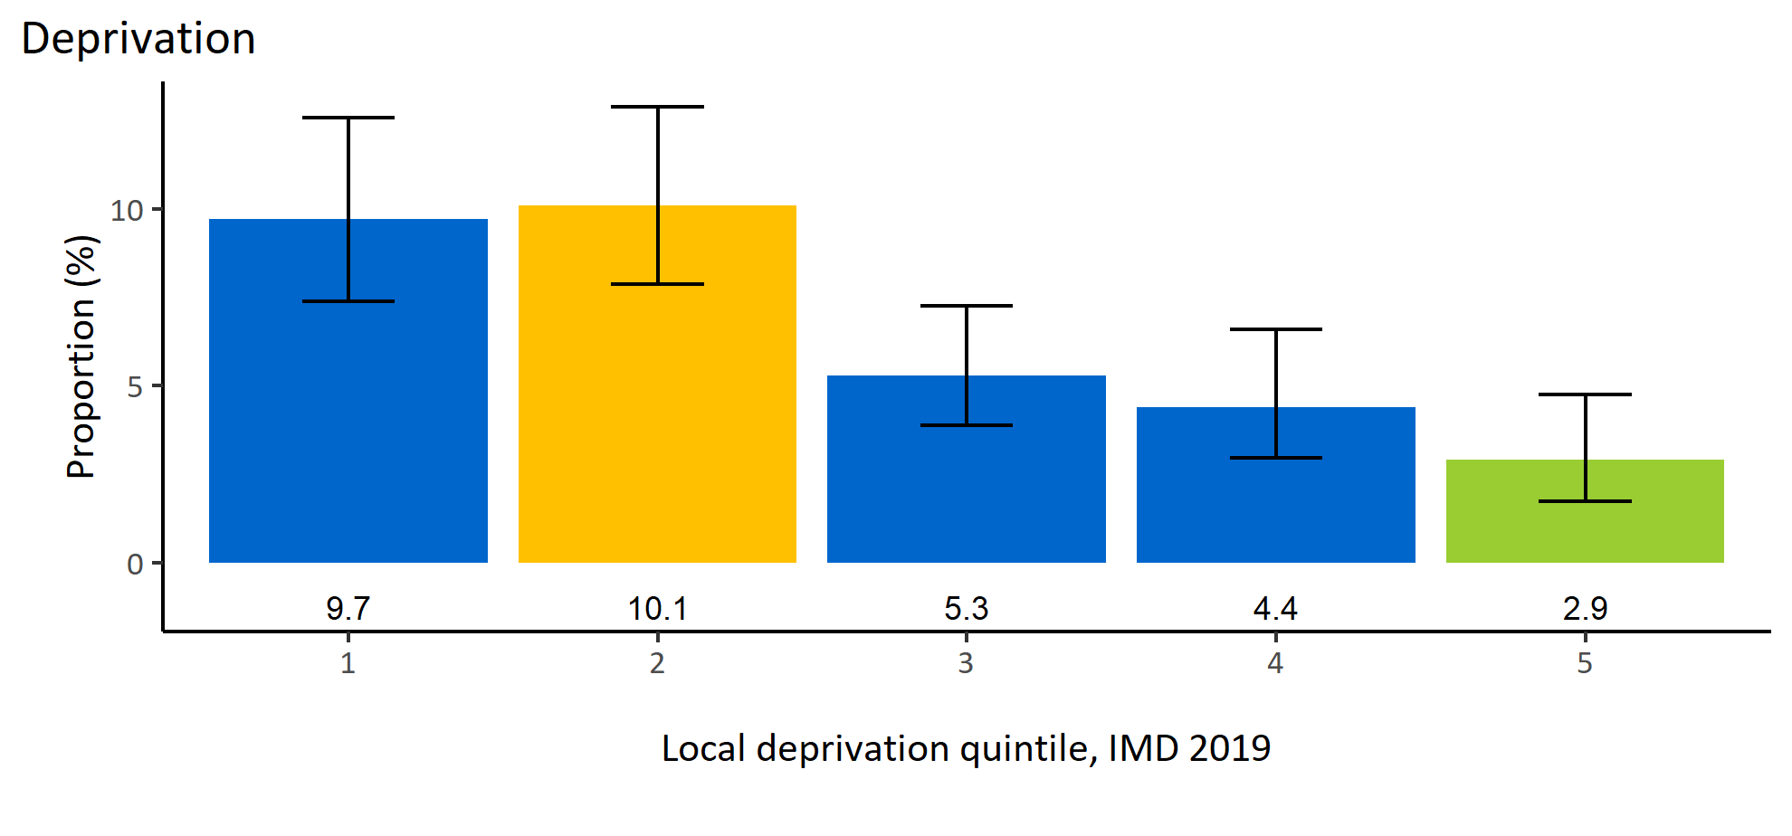
Reduced meals due to finances by inequalities
© Medway Council, Public Health Intelligence Team, Version 1.0, 15/08/2023
Estimated proportion of Medway adults having to reduce meals due to finances by inequalities

Slide 32
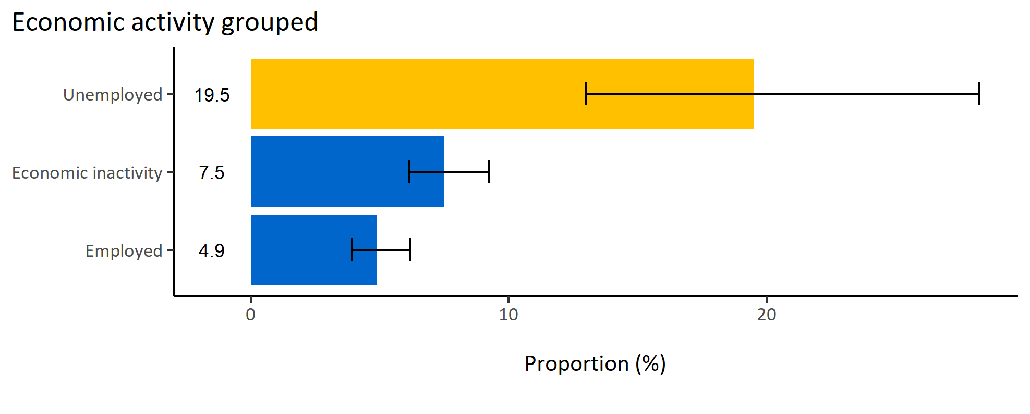
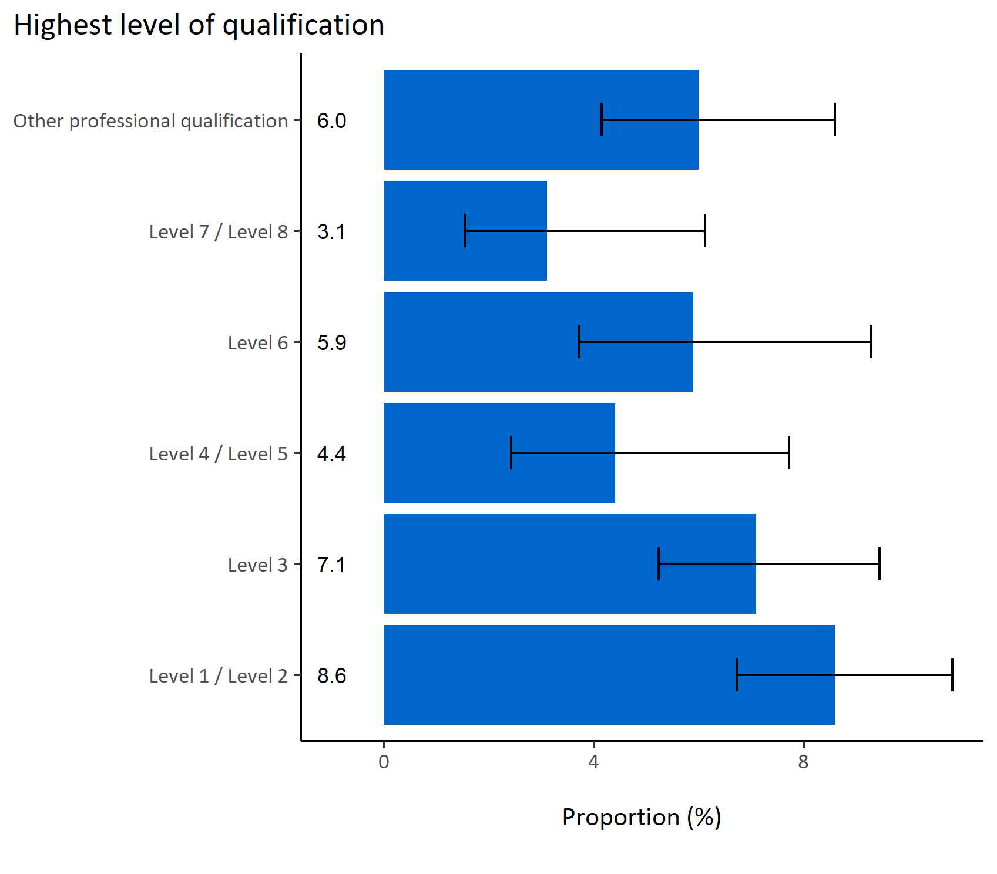
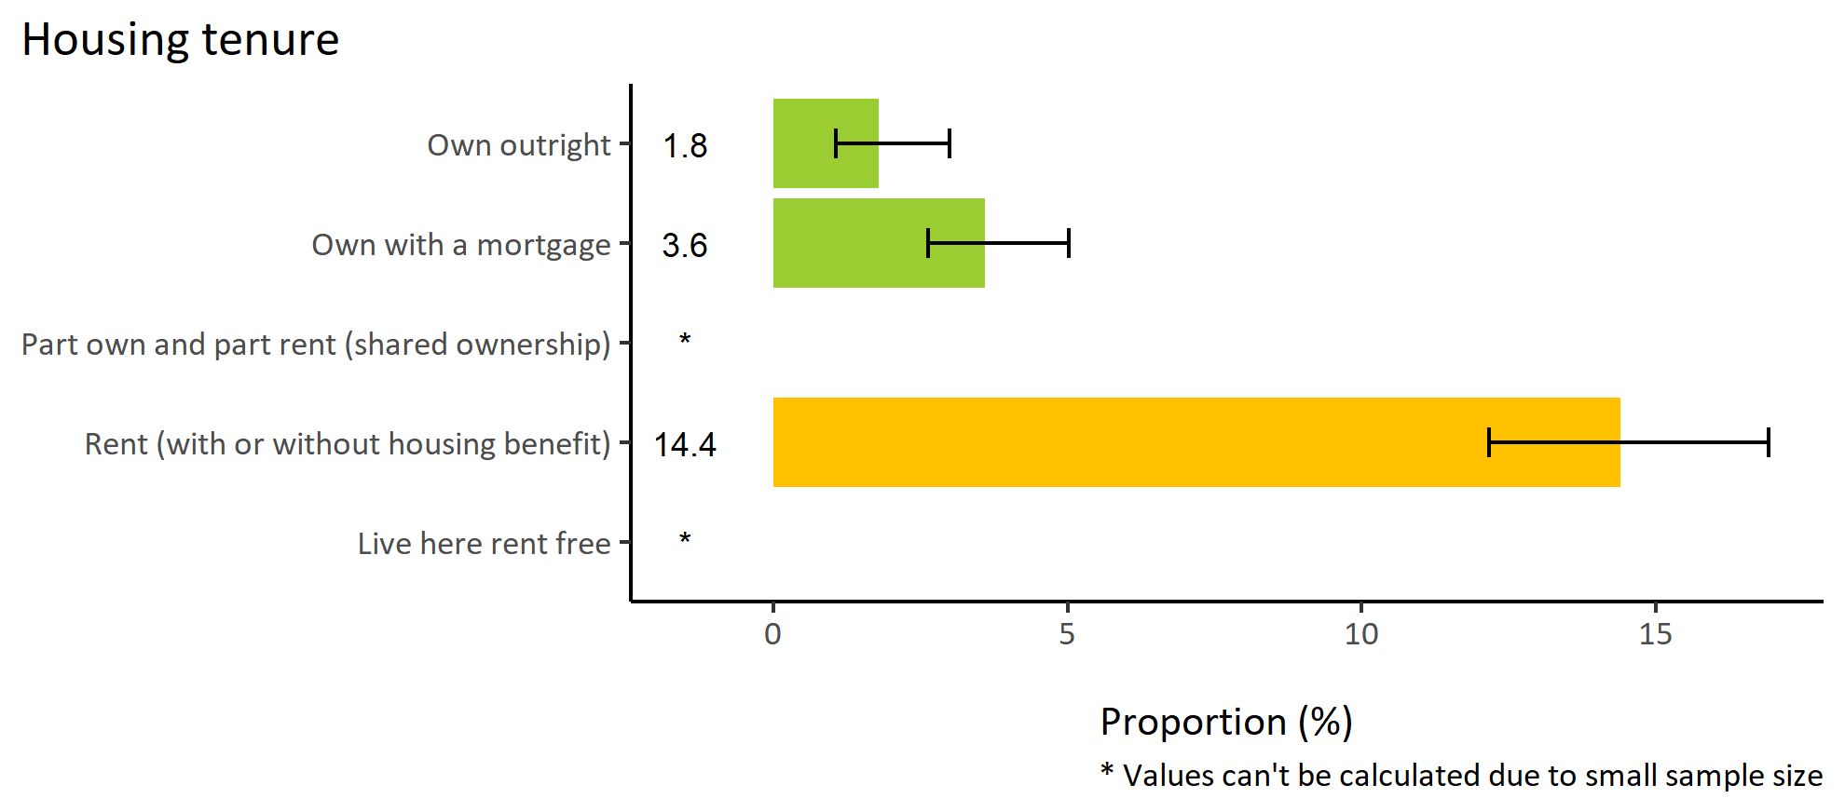
Reduced meals due to finances by wider determinants
© Medway Council, Public Health Intelligence Team, Version 1.0, 15/08/2023
Estimated proportion of Medway adults having to reduce meals due to finances by wider determinants

Slide 33
Summary: Reduced meals due to finances
© Medway Council, Public Health Intelligence Team, Version 1.0, 15/08/2023
The weighted survey results estimate that 6.4% of Medway have reduced the size of meals or skipped meals due to finances.
Certain groups in Medway are more likely to reduce meals due to finances. These groups include:
  Adults in wards Chatham Central & Brompton, Wayfield & Weeds Wood, Gillingham South, and Hoo St Werburgh & High Halstow
  Adults aged 18 to 34 years old
  Adults living in areas of higher deprivation (quintile 2)
  Unemployed adults
  Adults who rent (with or without housing benefit).

