Slide 1
Health Inequalities Profile
Kent and Medway
Medway Council
Public Health Intelligence Team
11/03/2024

Slide 2
Purpose and rationale
Version 1.2 © Medway Council, Public Health Intelligence Team, 11/03/2024
The purpose of the Kent and Medway ICS health inequalities report is to examine disparities in health outcomes among different population groups.
Indicators have been selected that are relevant to the NHS England Core20PLUS5 clinical areas of focus for children and young people, and adults.
The Core20PLUS5 is a national NHS England initiative aimed at addressing healthcare inequalities. It targets the most deprived 20% of the population (Core20) and additional vulnerable groups (PLUS), focusing on clinical areas for accelerated improvement.
You can find a detailed methodology section at the end of this presentation.
NHS England. Core20PLUS5. Children and Young People.
NHS England. Core20PLUS5. Adults.

Slide 3
Summary
Version 1.2 © Medway Council, Public Health Intelligence Team, 11/03/2024
Indicator | Latest value | Inequality (worse outcomes) | Slide
Admissions for asthma (<19 yrs) | Better | More deprived | 11
Admissions for diabetes (<19 yrs) | Worse | More deprived | 12
Admissions for epilepsy (<19 yrs) | Similar | More deprived | 13
Admissions for mental health (<18 yrs) | Similar | No inequality | 14
Admissions for self-harm (10-24 yrs) | Similar | More deprived | 15
Adms for tooth extraction (<20 yrs) | Better | More deprived | 16
Infant mortality | Similar | More deprived | 18
Low birth weight | Better | More deprived | 19
Admissions of babies <14 days | Similar | No inequality | 20
Admissions for SMI | Worse | More deprived | 22
Deaths from suicide | Worse | More deprived | 23
Admissions for respiratory disease | Better | More deprived | 25
Indicator | Latest value | Inequality (worse outcomes) | Slide
Deaths from respiratory disease | Similar | More deprived | 26
Admissions for COPD (35+ yrs) | Better | More deprived | 27
Deaths from COPD | Worse | More deprived | 28
Admissions for all cancer | Better | More deprived | 30
Deaths from all cancer | Similar | More deprived | 31
Admissions for lung cancer | Better | More deprived | 32
Deaths from lung cancer | Similar | More deprived | 33
Admissions for cardiovascular disease | Better | More deprived | 35
Deaths from cardiovascular diseases | Similar | More deprived | 36
Admissions for hypertensive disease | Worse | More deprived | 37
Deaths from hypertensive diseases | Similar | More deprived | 38

Slide 4
Indicator slides explained
Version 1.2 © Medway Council, Public Health Intelligence Team, 11/03/2024

Slide 5
Contact details
Version 1.2 © Medway Council, Public Health Intelligence Team, 11/03/2024
If you have any questions or would like further information about these profiles, please contact:
Dr Eluned Broom
Senior Public Health Intelligence Manager
Public Health
Medway Council
eluned.broom@medway.gov.uk
01634 334111

Slide 6
Overarching Indicators

Slide 7
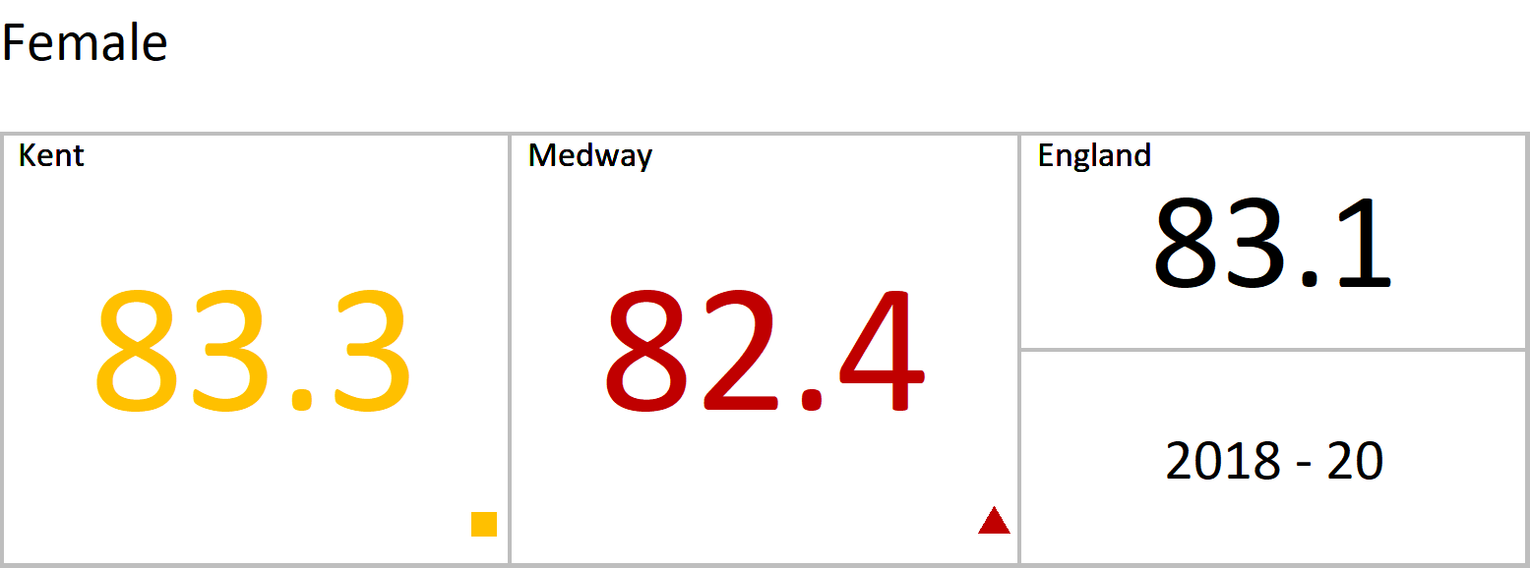
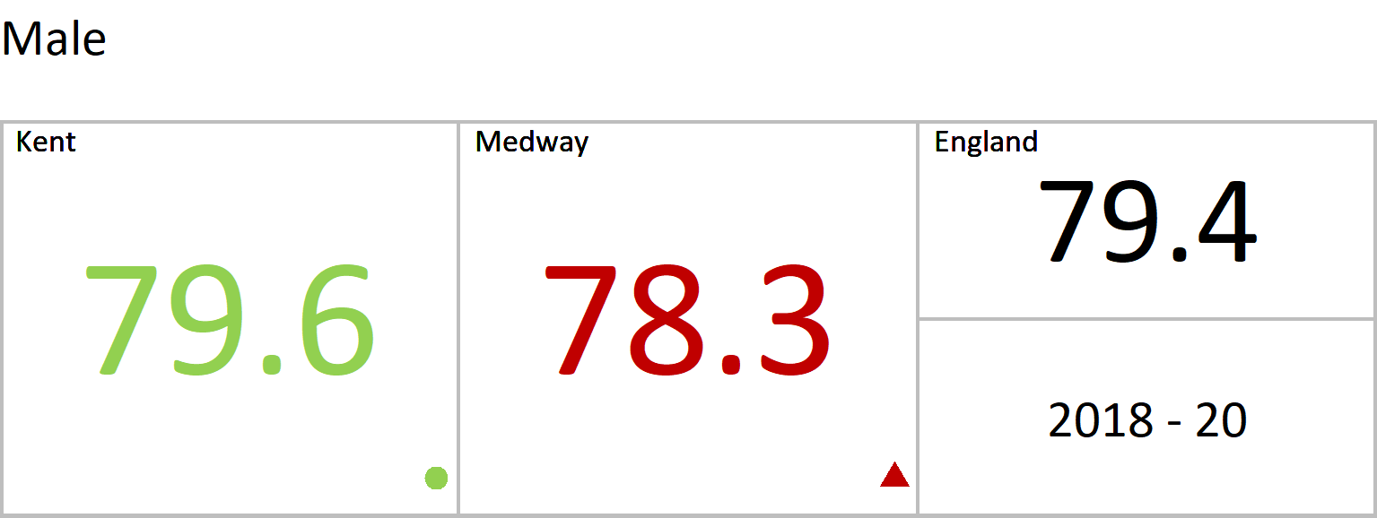
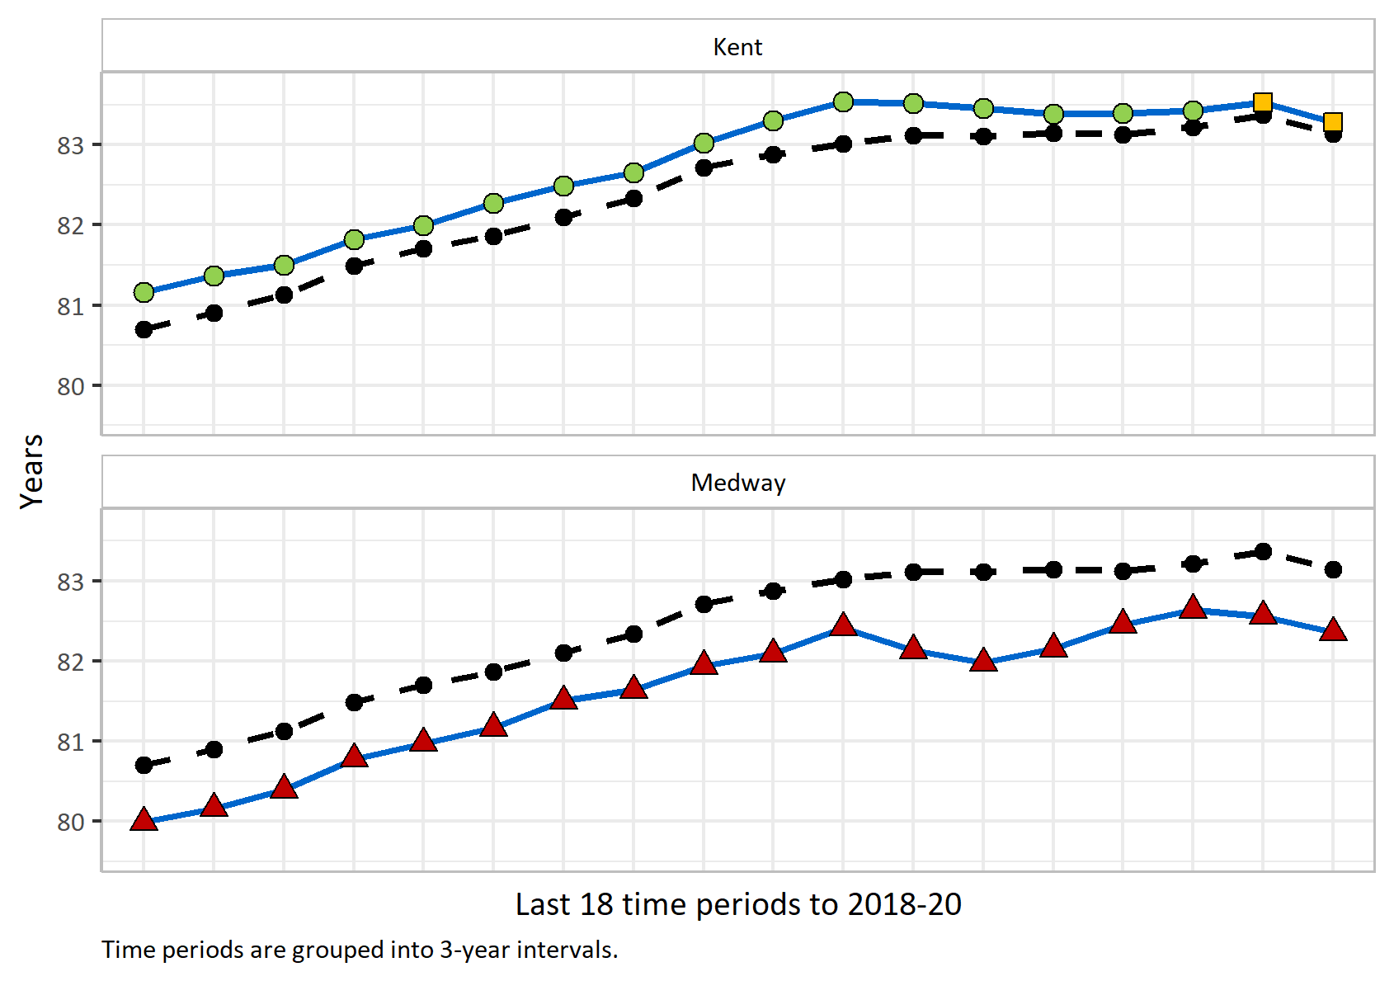
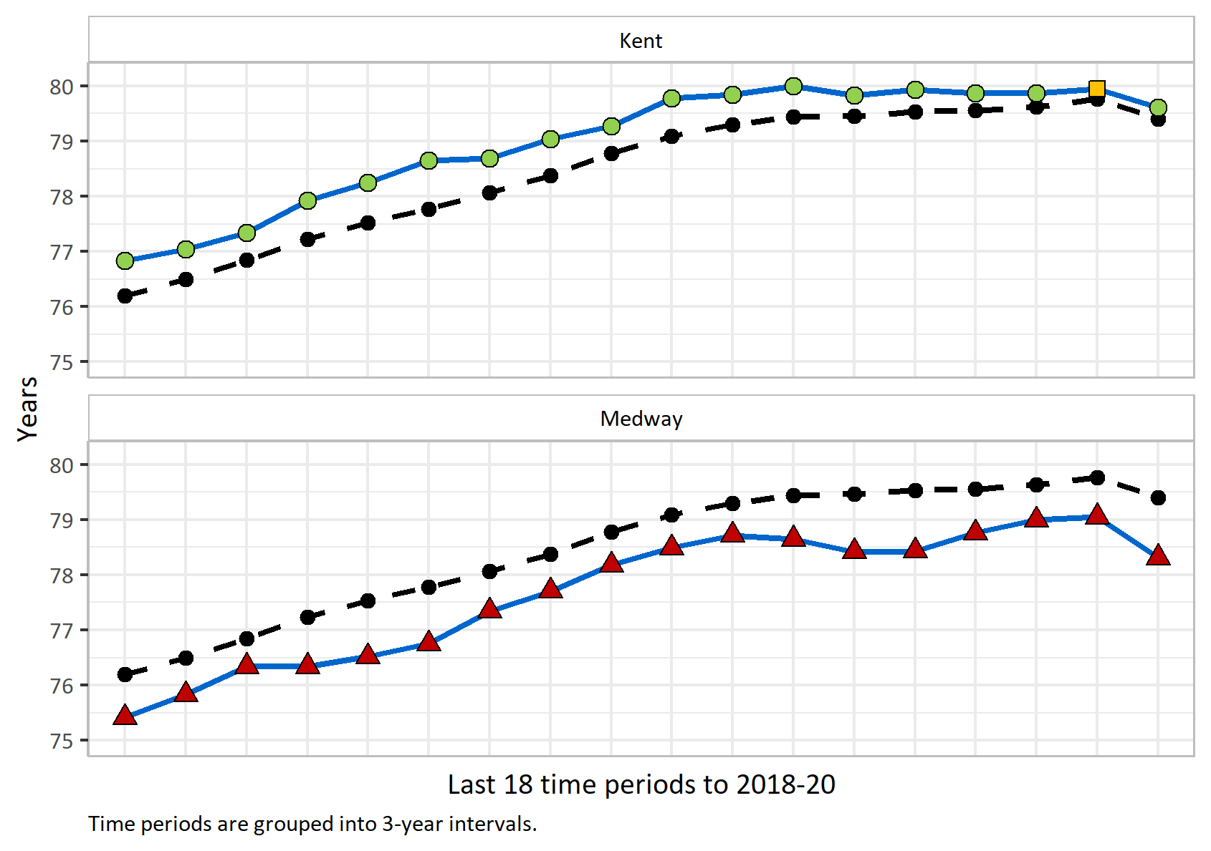
Life expectancy at birth
Version 1.2 © Medway Council, Public Health Intelligence Team, 11/03/2024
Life expectancy: the average number of years that an individual is expected to live (based on current mortality rates)
Value type: Years.
Original geography: Counties and Unitary Authorities .
Benchmarking method: Chiang II method.
Source: Office to Health Improvement and Disparities. Fingertips. Indicator ID: 90366.
Copyright: ©Crown copyright.

Slide 8
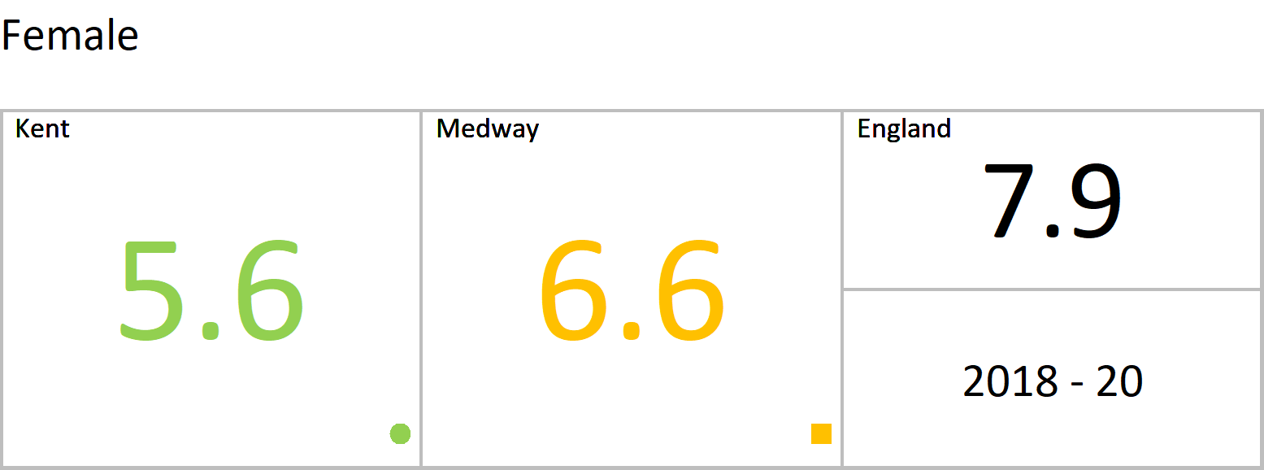
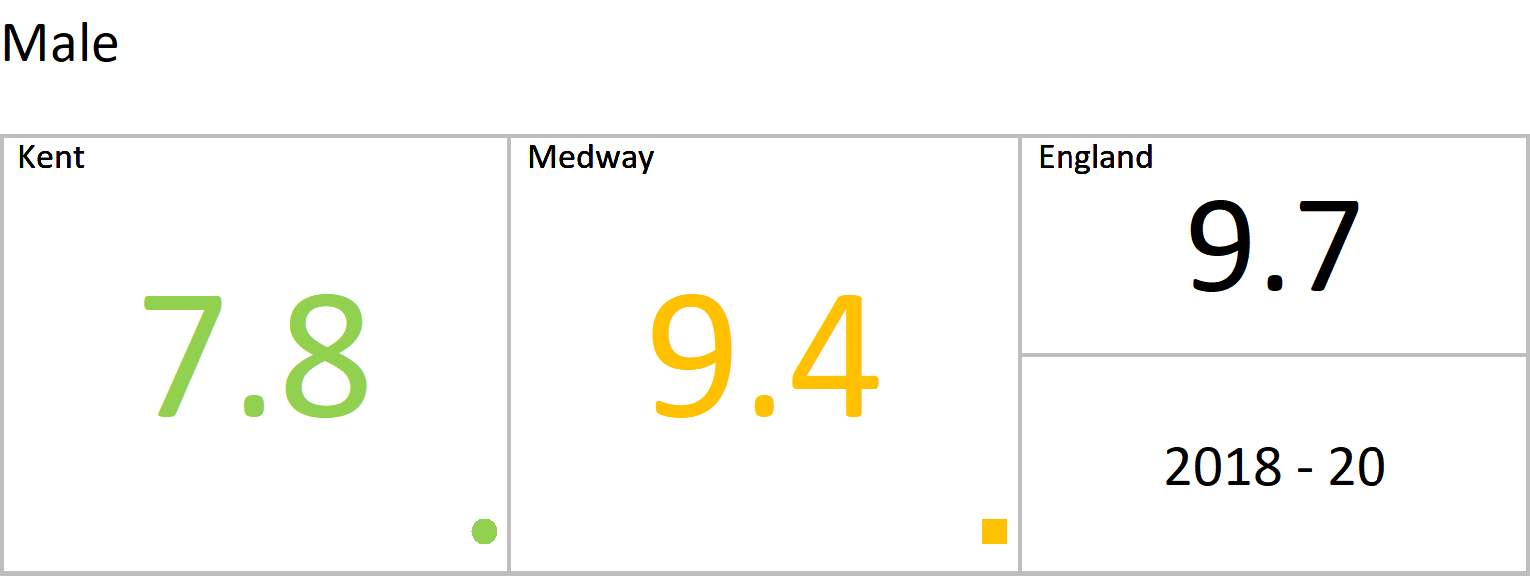
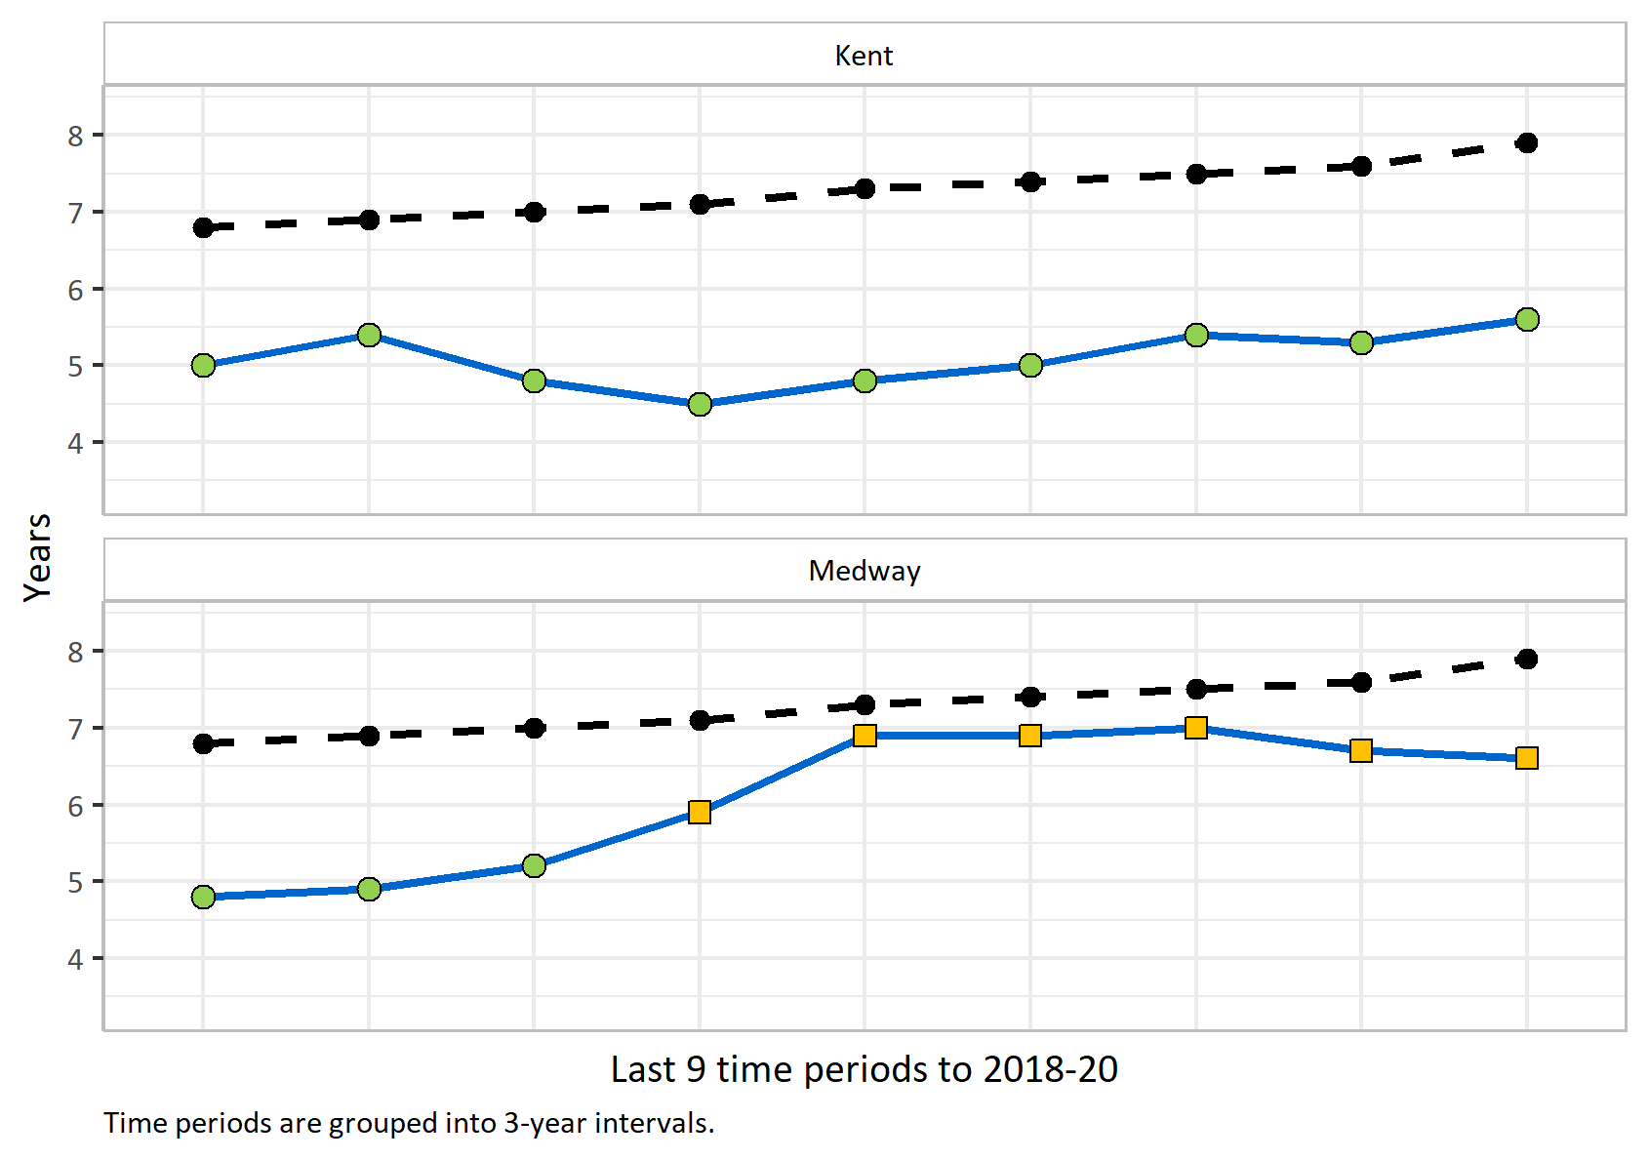
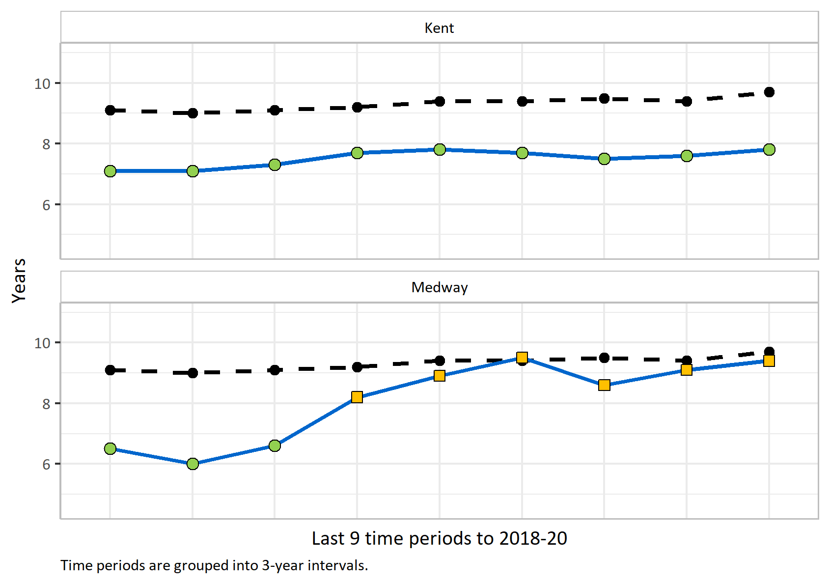
Inequality in life expectancy at birth
Version 1.2 © Medway Council, Public Health Intelligence Team, 11/03/2024
Inequality in life expectancy: A measure of how much life expectancy varies with deprivation. Quantifies the range in years of life expectancy across the social gradient from the most to the least deprived areas.
Value type: Years.
Original geography: Counties and Unitary Authorities .
Benchmarking method: Simulation .
Source: Office to Health Improvement and Disparities. Fingertips. Indicator ID: 92901.
Copyright: ©Crown copyright.

Slide 9
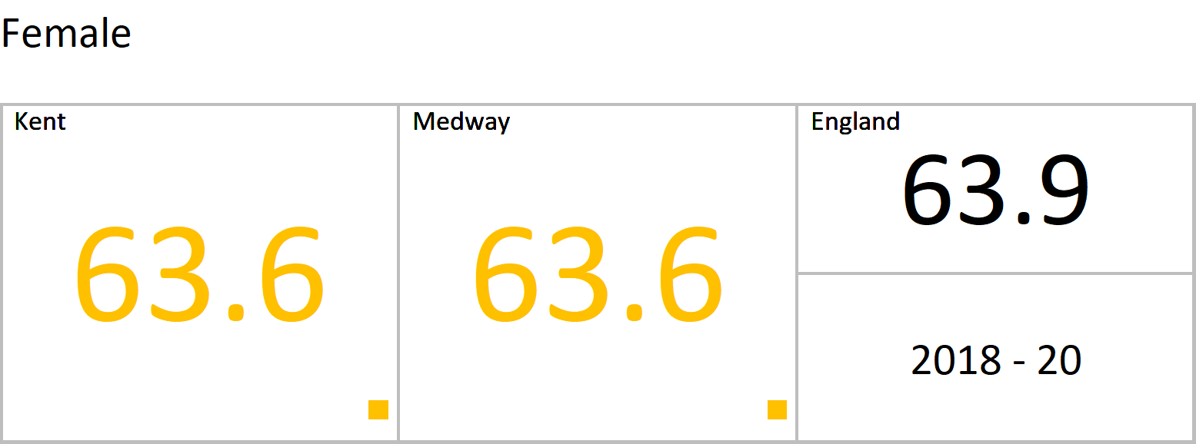
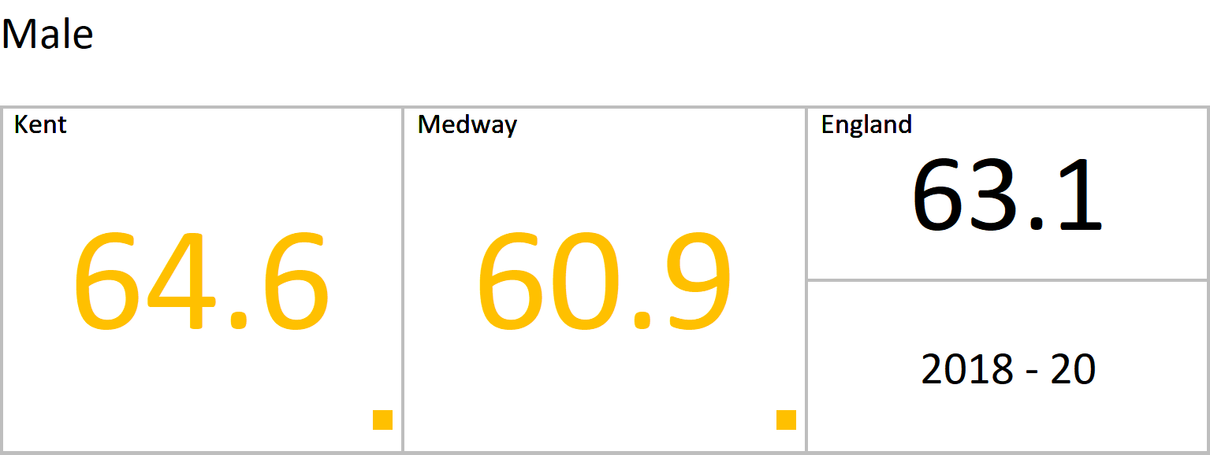
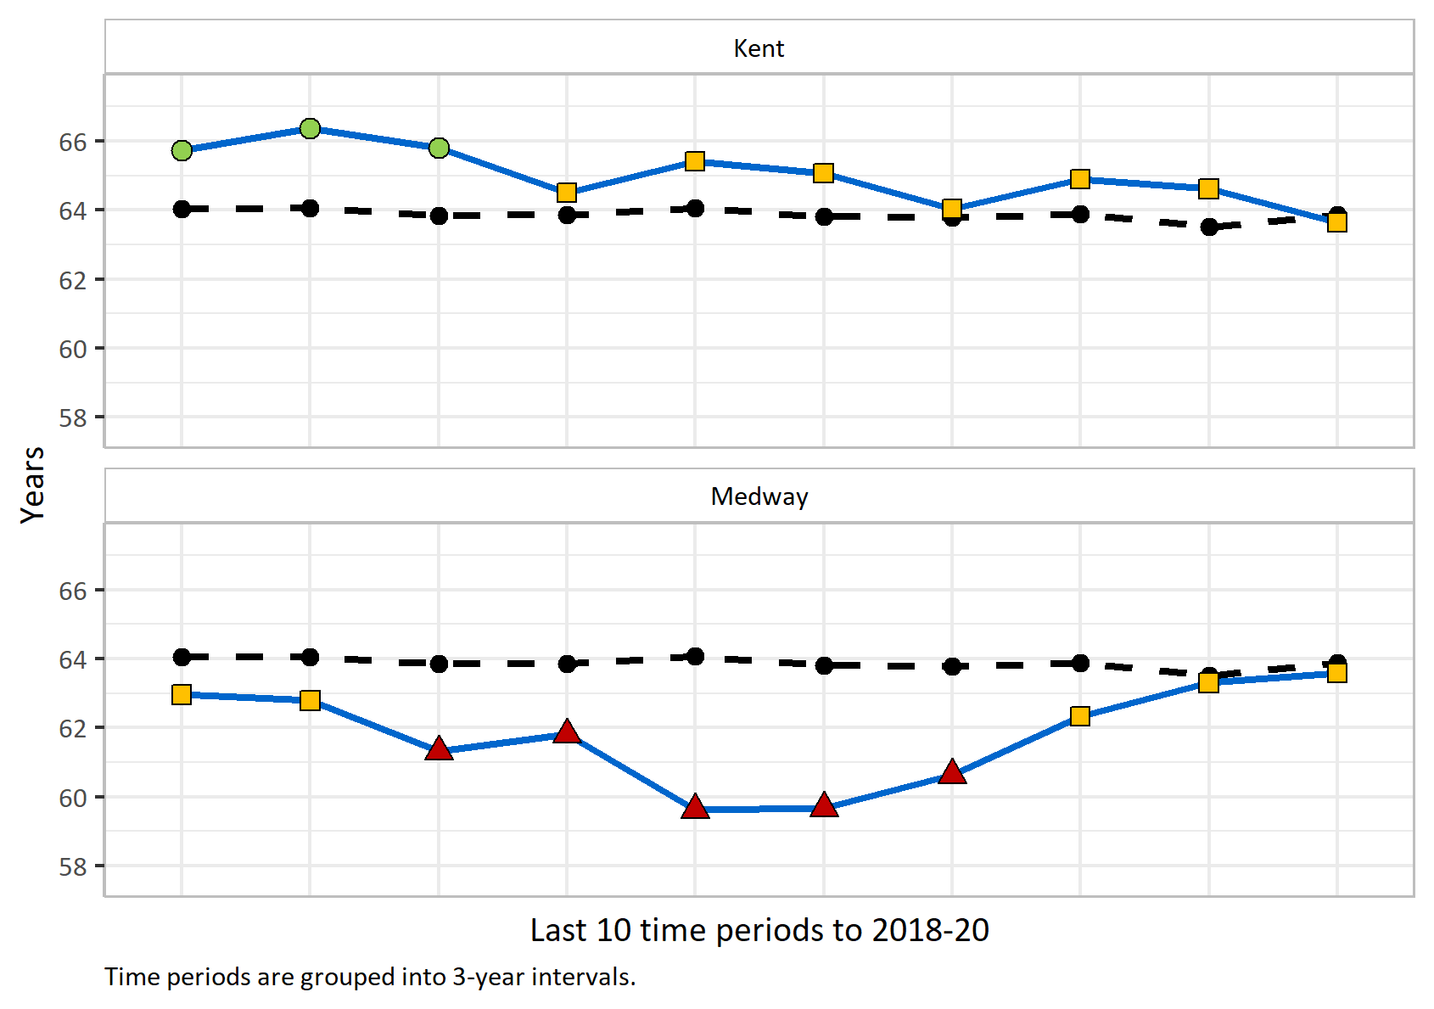
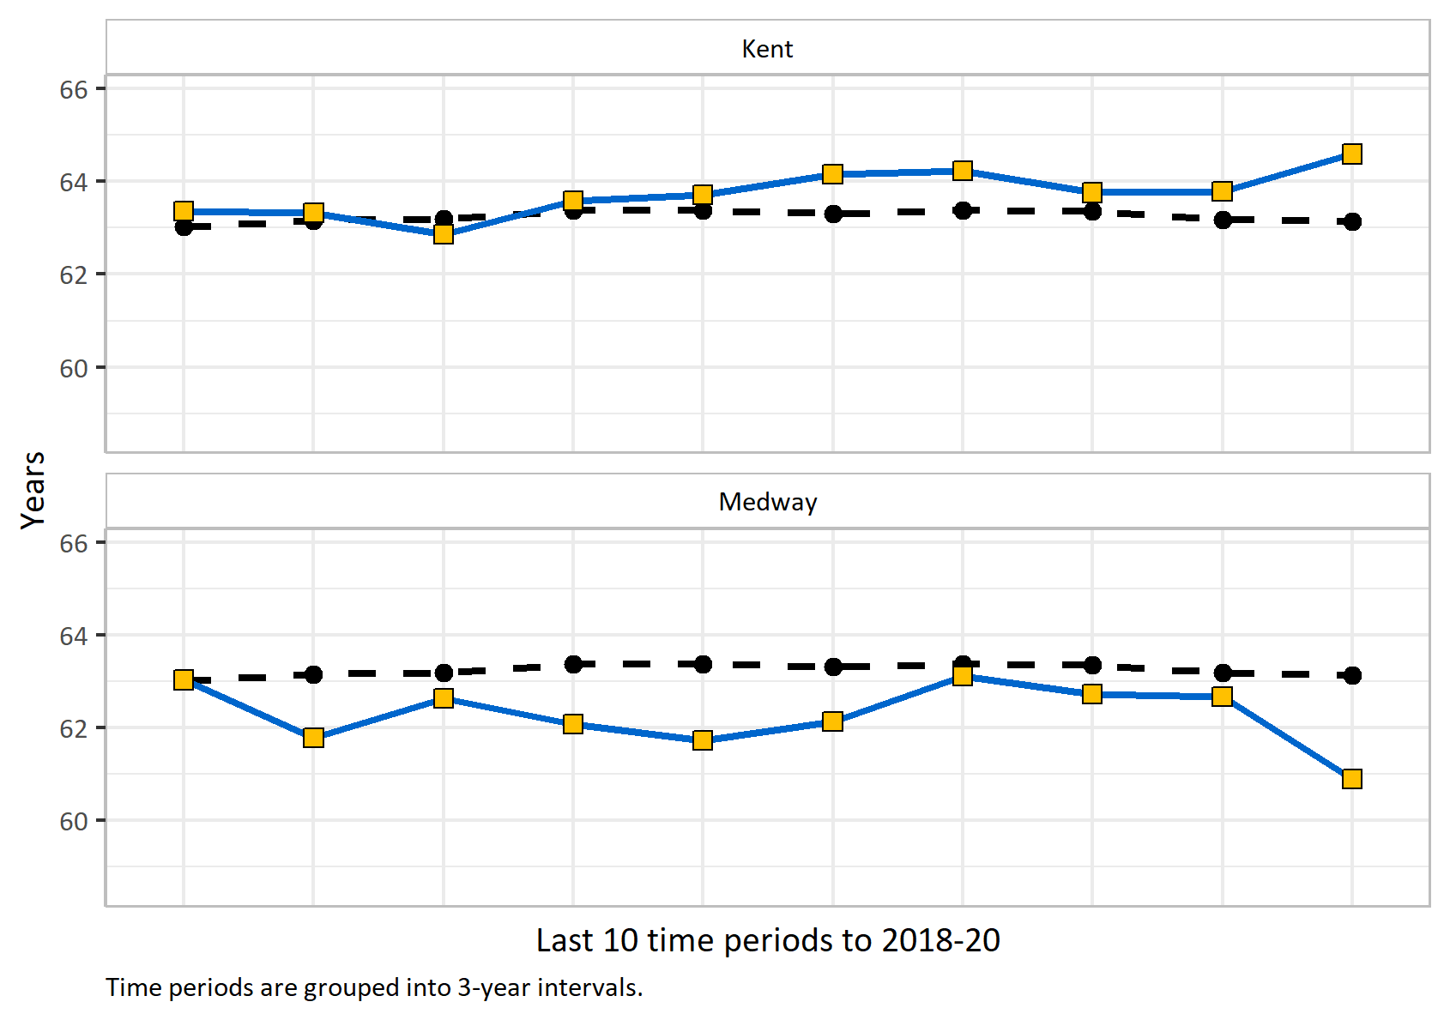
Healthy life expectancy at birth
Version 1.2 © Medway Council, Public Health Intelligence Team, 11/03/2024
Healthy life expectancy: the average number of years that an individual is expected to live in a state of self-assessed good or very good health (based on current mortality rates and prevalence of good or very good health).
Value type: Years.
Original geography: Counties and Unitary Authorities .
Benchmarking method: As stated in "Health Expectancy Calculations by the Sullivan Method".
Source: Office to Health Improvement and Disparities. Fingertips. Indicator ID: 90362.
Copyright: ©Crown copyright.

Slide 10
Children and Young People

Slide 11
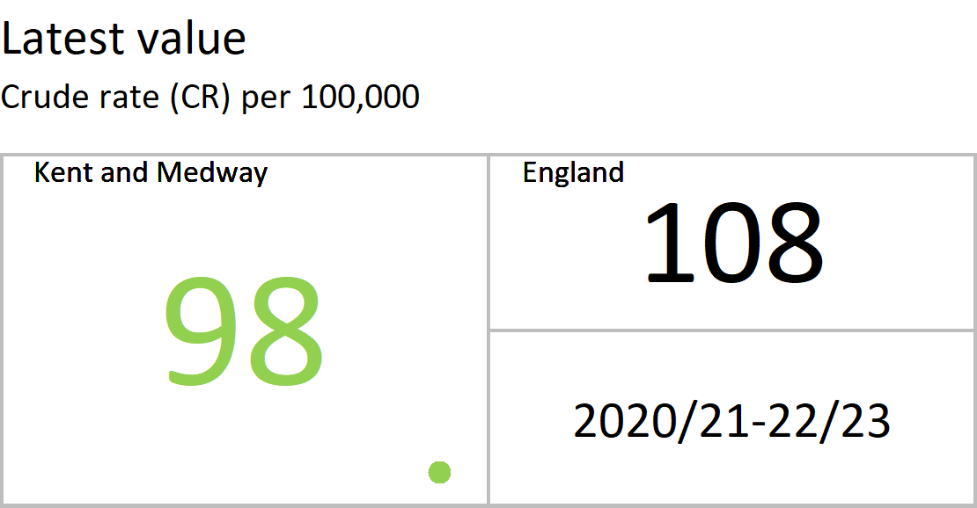
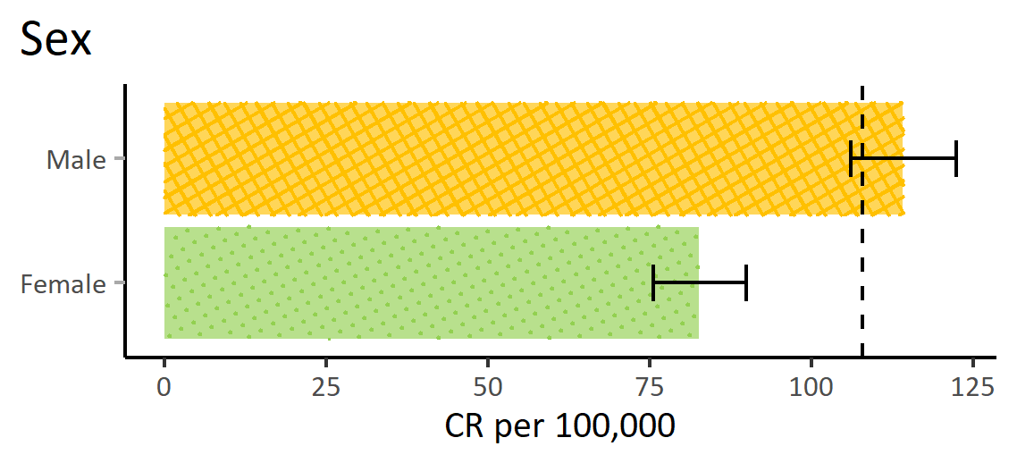
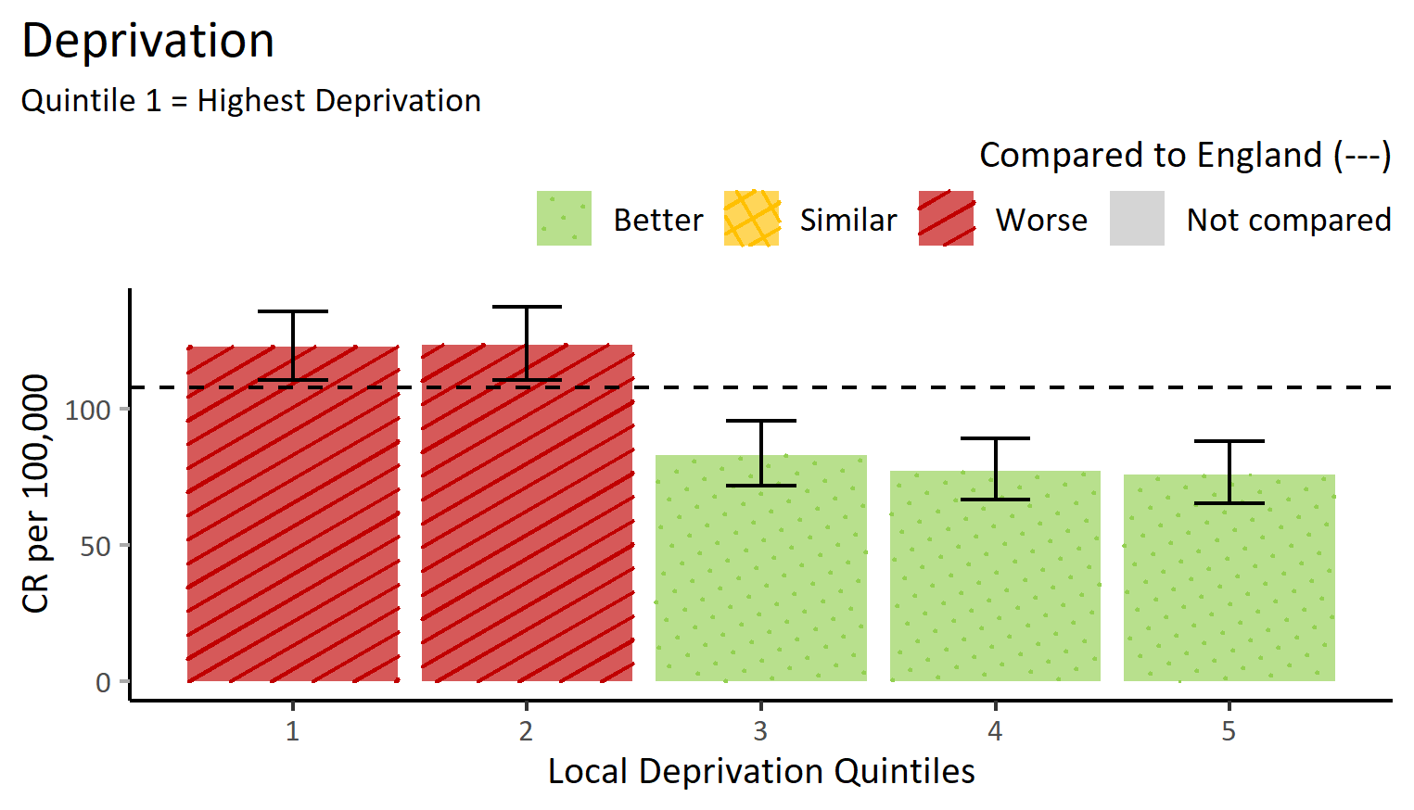
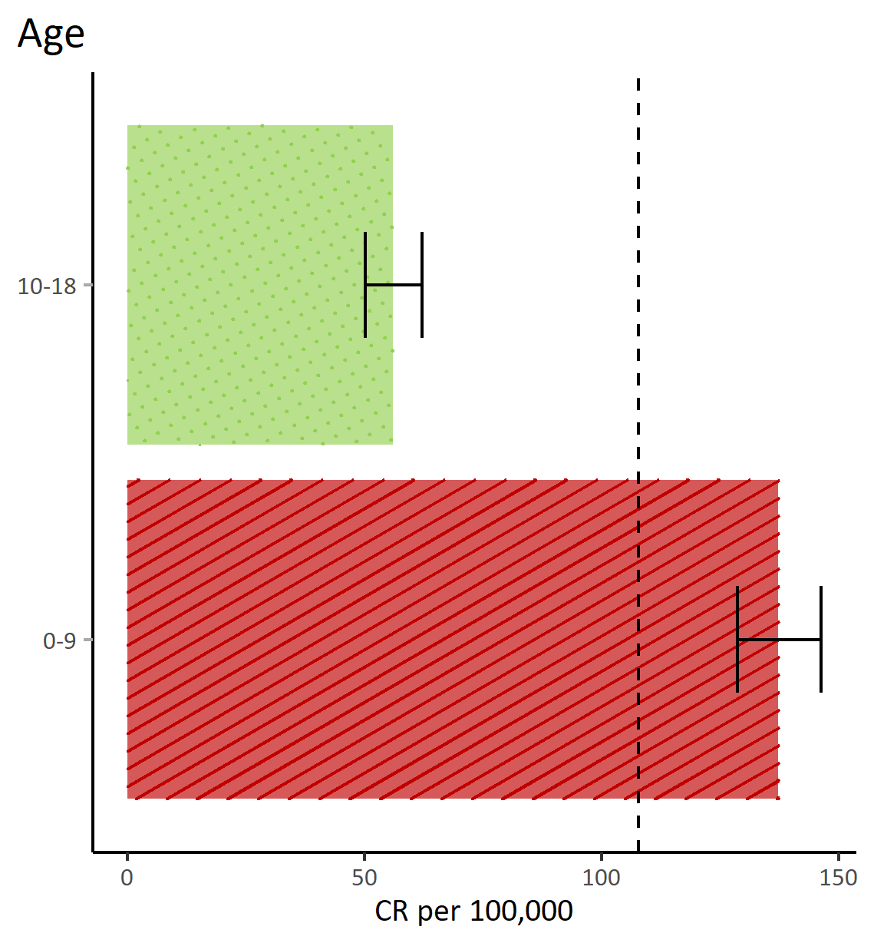
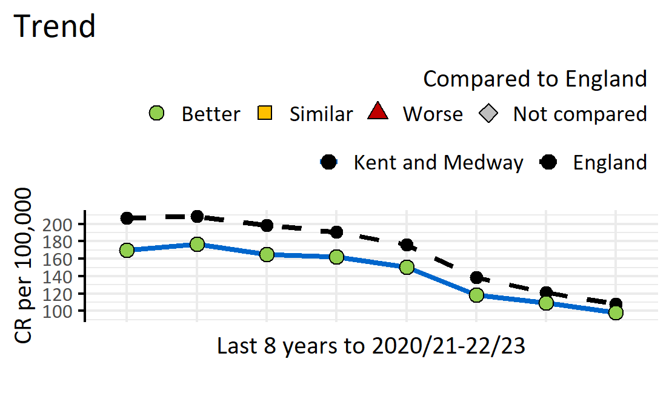
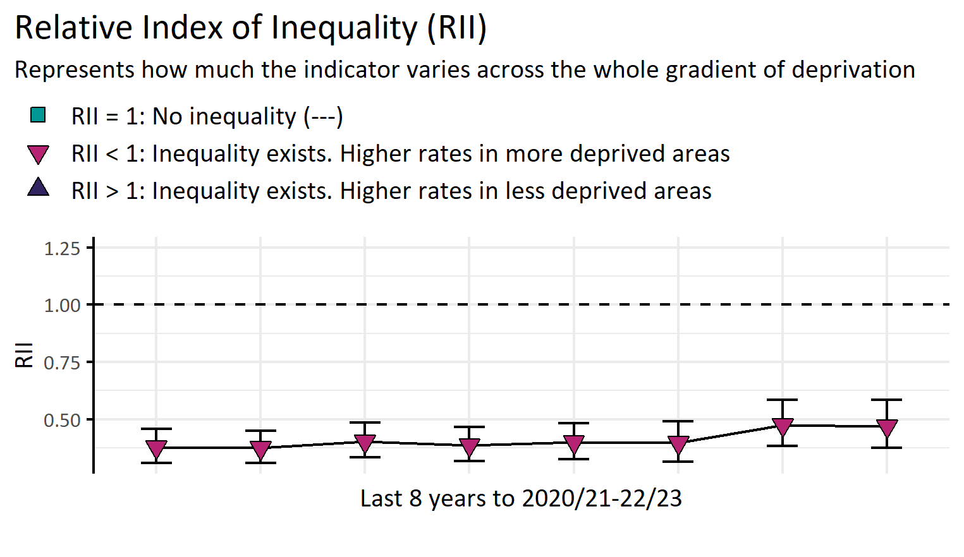
Emergency admissions for asthma (under 19 years)
Version 1.2 © Medway Council, Public Health Intelligence Team, 11/03/2024
ICD-10 codes as a primary diagnosis: J45-J46.
Completed first episode emergency admissions discounting regular attendees.
Value type: Crude rate (CR) per 100,000.
Original geography: Lower Super Output Area (LSOA).
Benchmarking method: Byar's method (95%).
Source: NHS Digital, Hospital Episode Statistics (HES).

Slide 12
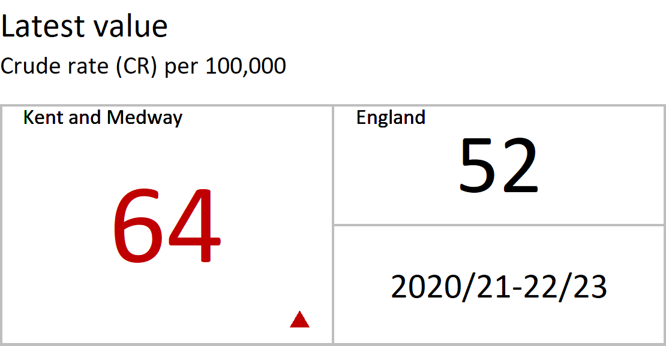
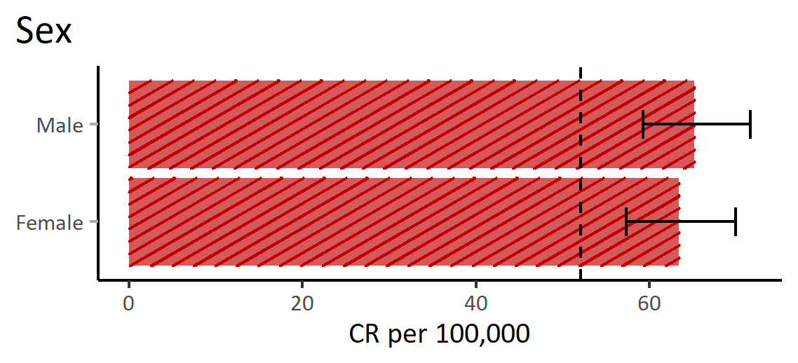
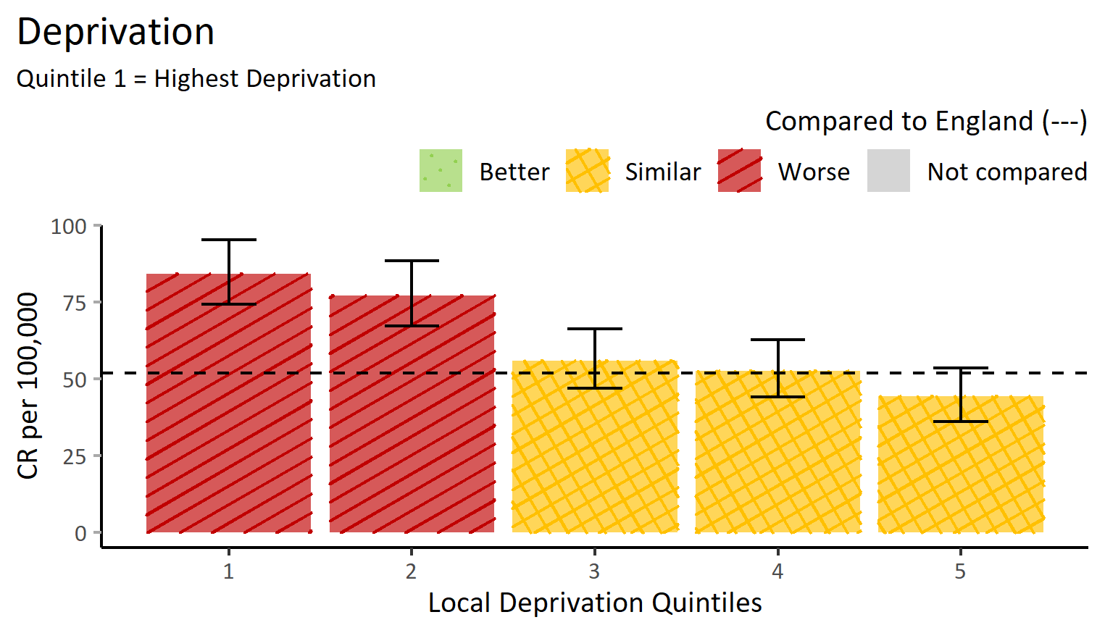
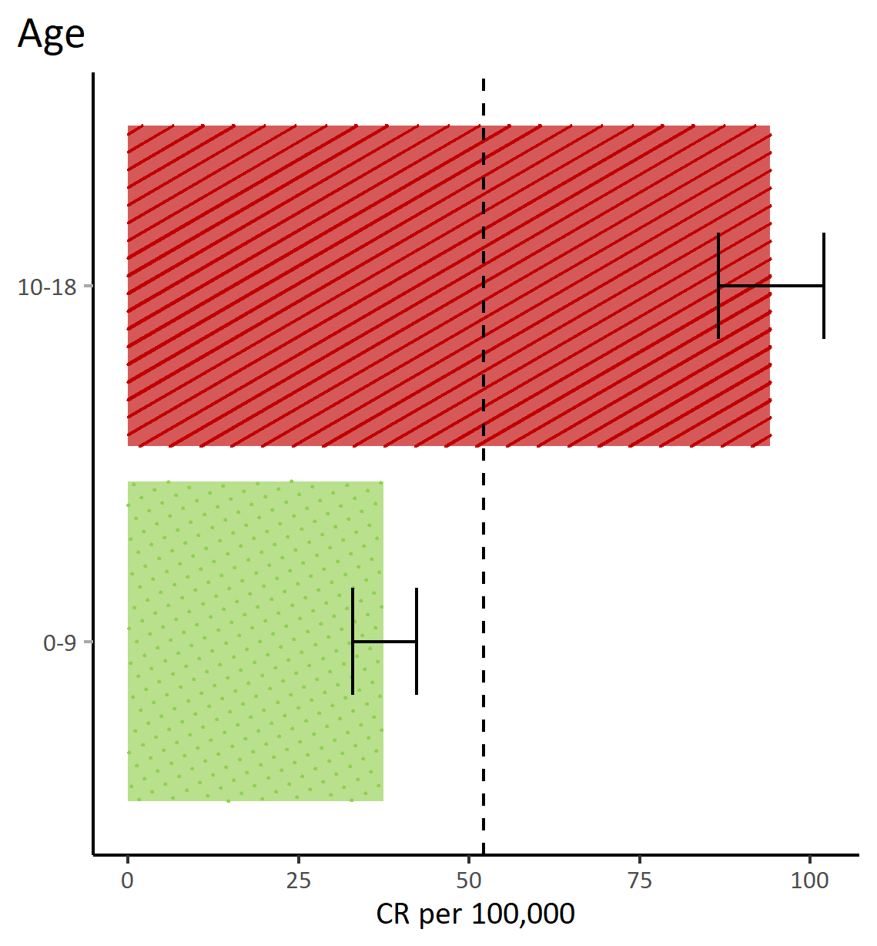
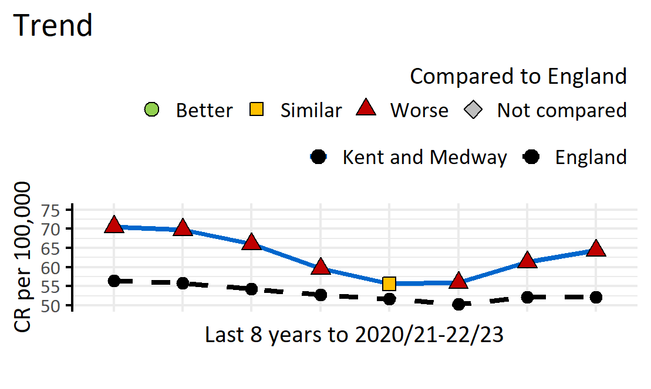
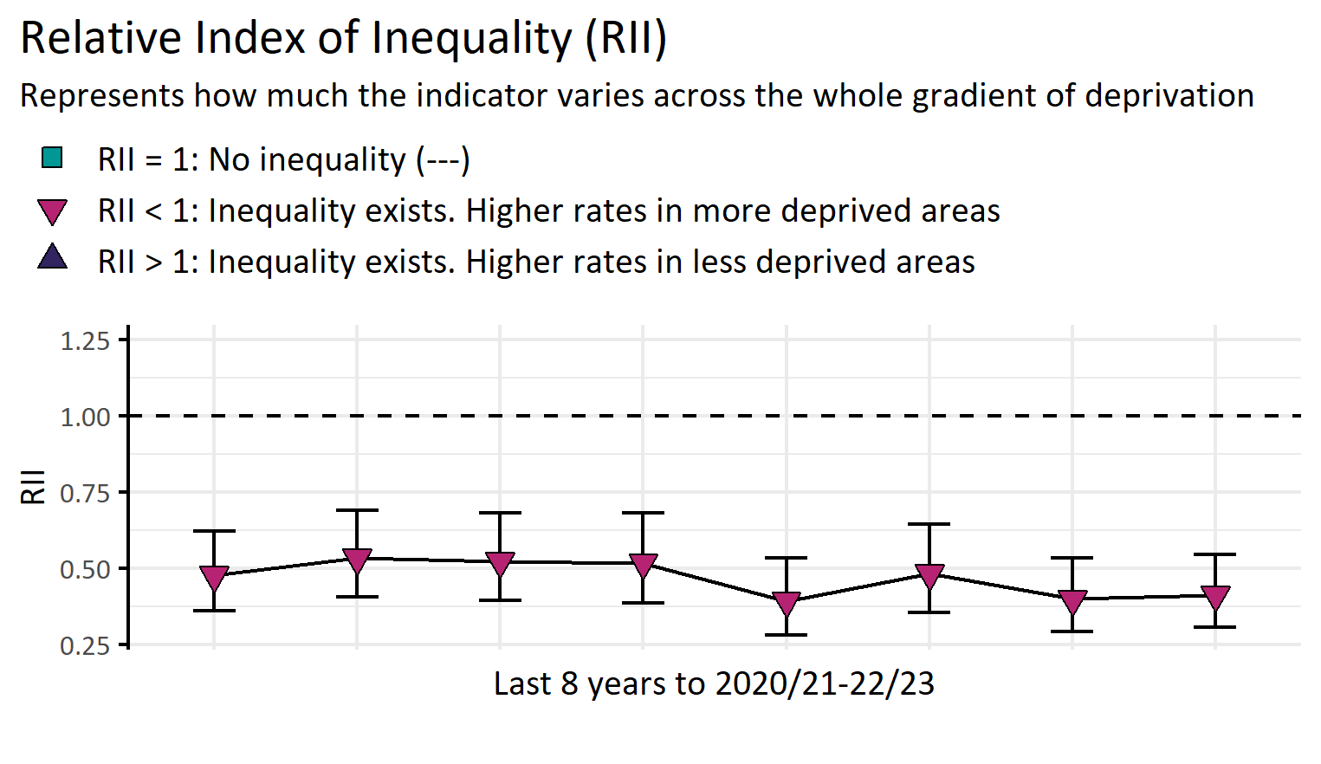
Emergency admissions for diabetes (under 19 years)
Version 1.2 © Medway Council, Public Health Intelligence Team, 11/03/2024
ICD-10 codes as a primary diagnosis: E10.
Completed first episode emergency admissions discounting regular attendees.
Value type: Crude rate (CR) per 100,000.
Original geography: Lower Super Output Area (LSOA).
Benchmarking method: Byar's method (95%).
Source: NHS Digital, Hospital Episode Statistics (HES).

Slide 13
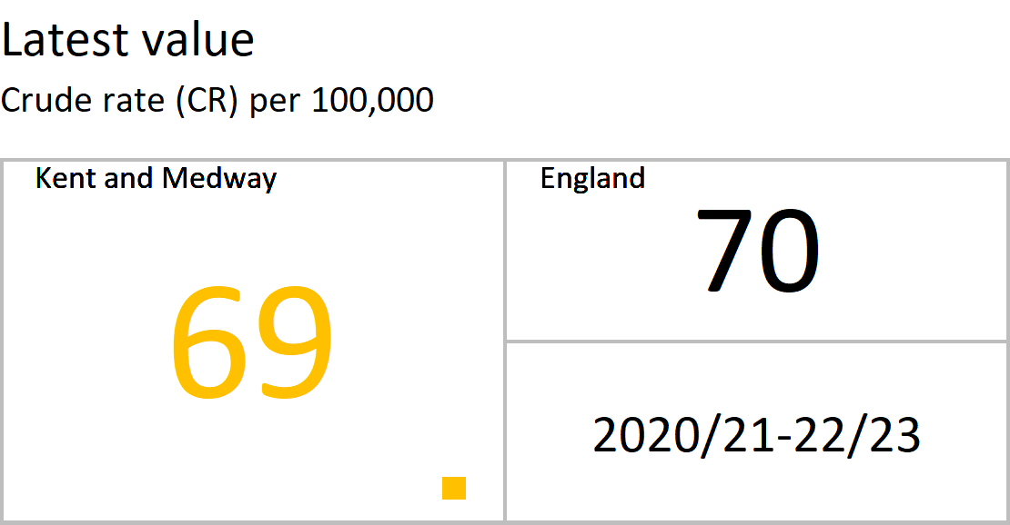
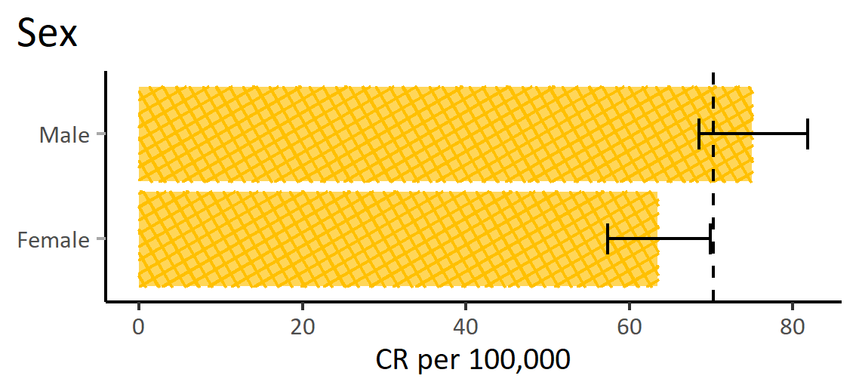
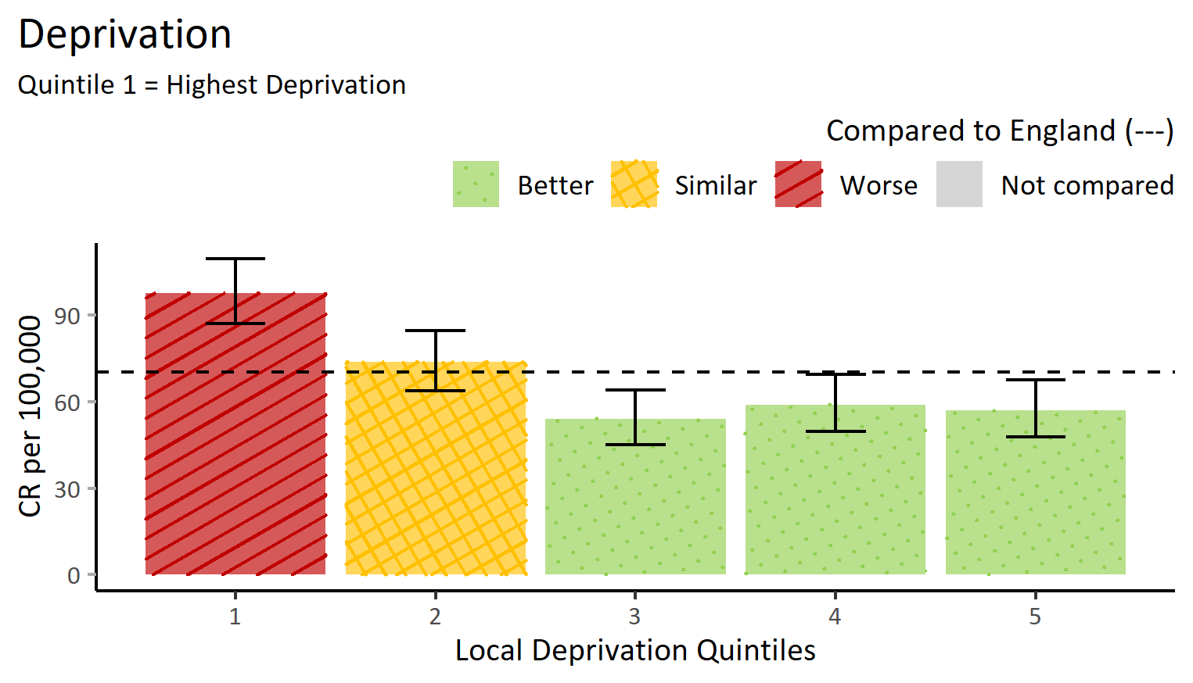
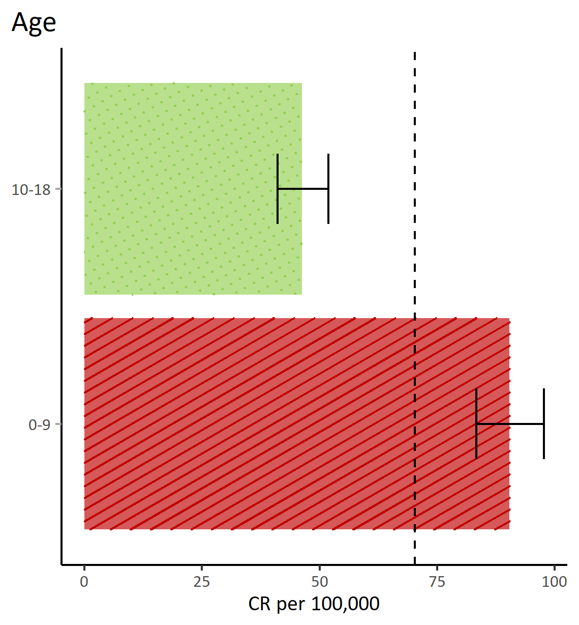
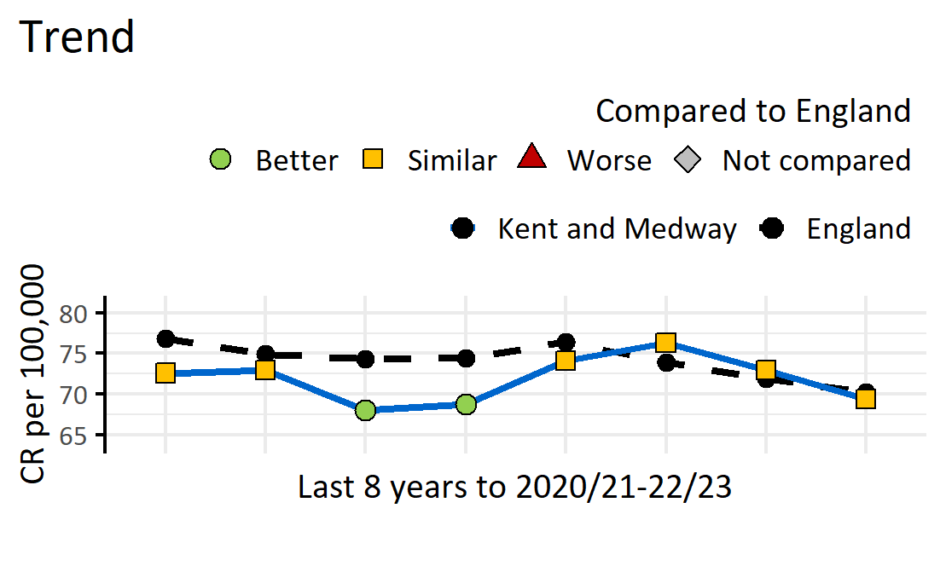
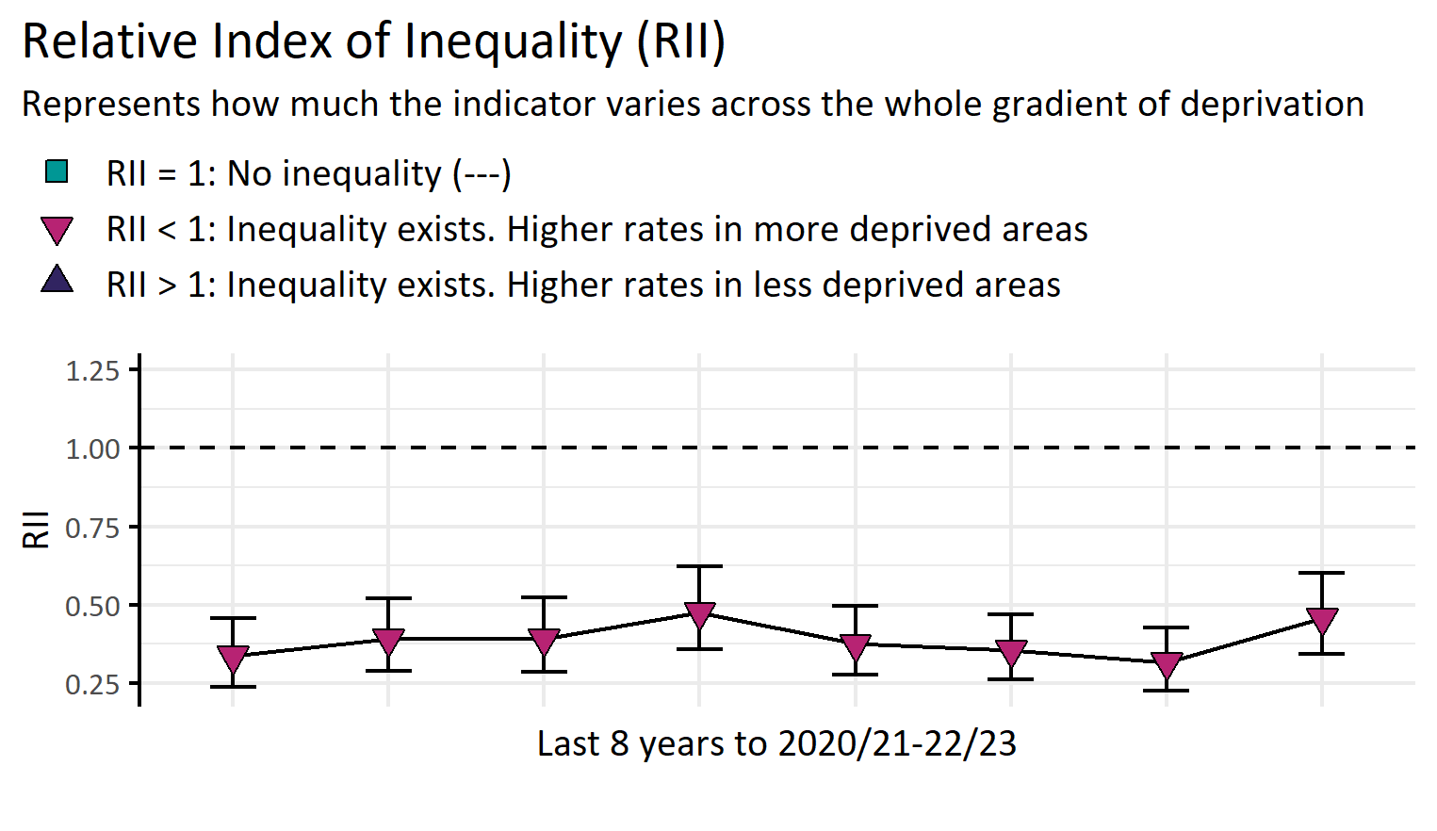
Emergency admissions for epilepsy (under 19 years)
Version 1.2 © Medway Council, Public Health Intelligence Team, 11/03/2024
ICD-10 codes as a primary diagnosis: G40-G41.
Completed first episode emergency admissions discounting regular attendees.
Value type: Crude rate (CR) per 100,000.
Original geography: Lower Super Output Area (LSOA).
Benchmarking method: Byar's method (95%).
Source: NHS Digital, Hospital Episode Statistics (HES).

Slide 14
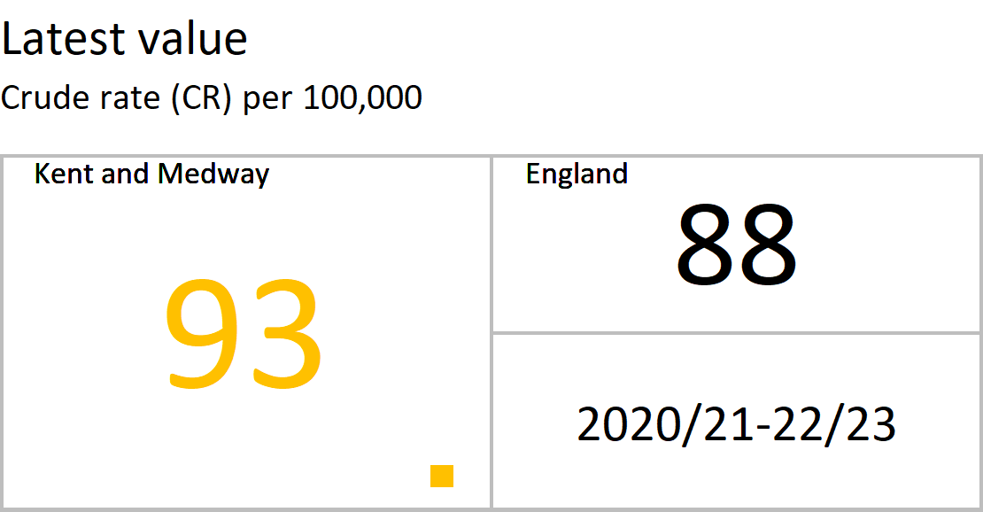
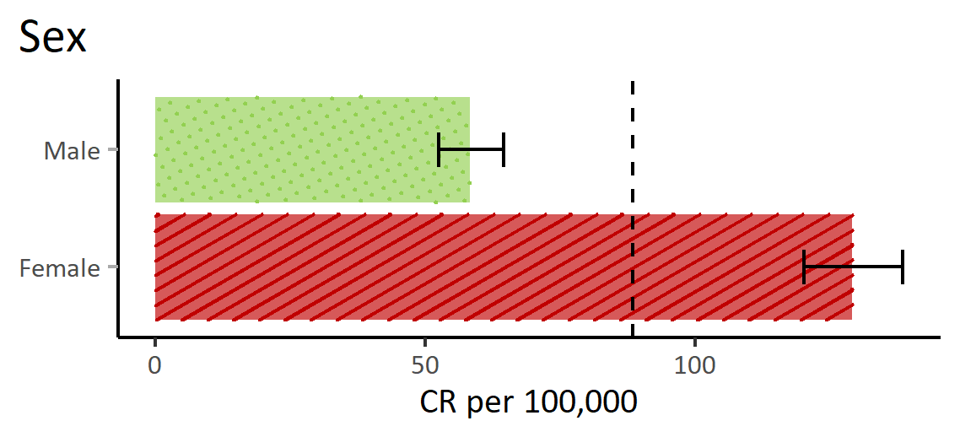
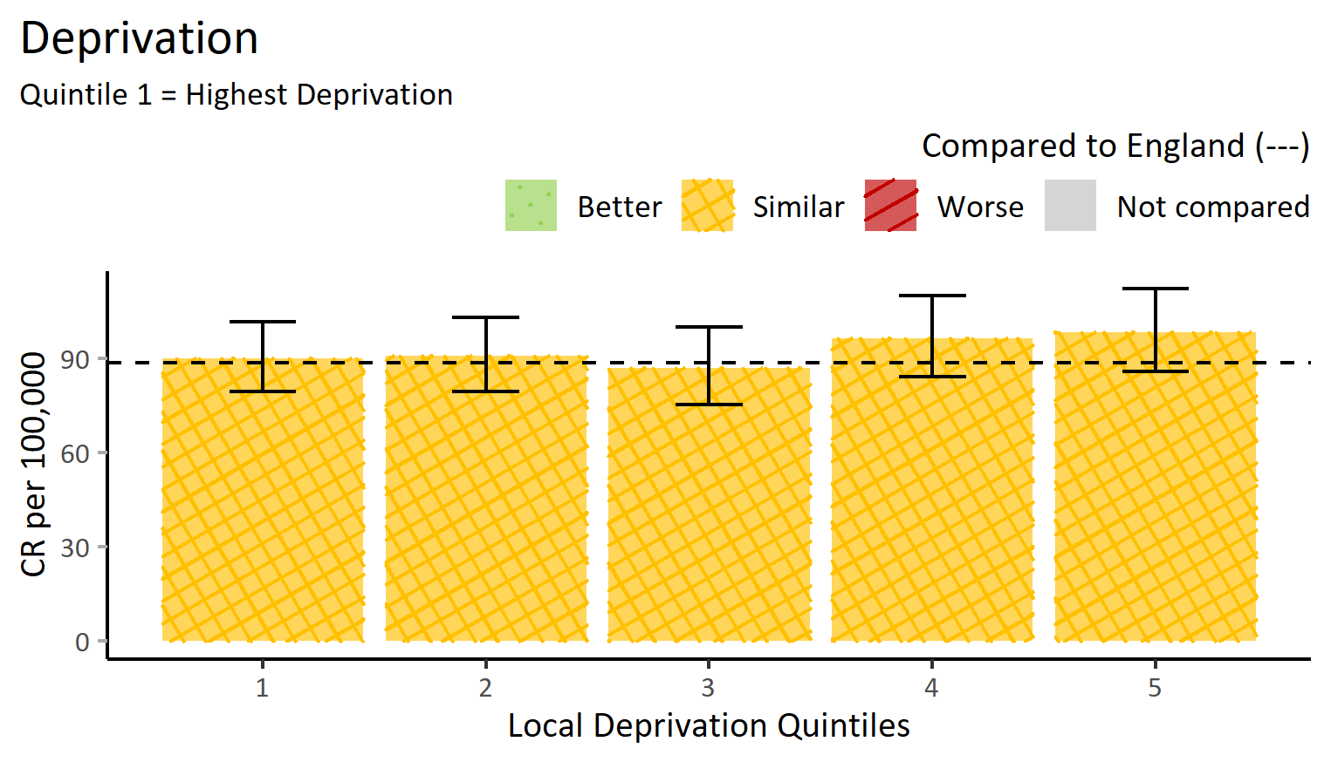
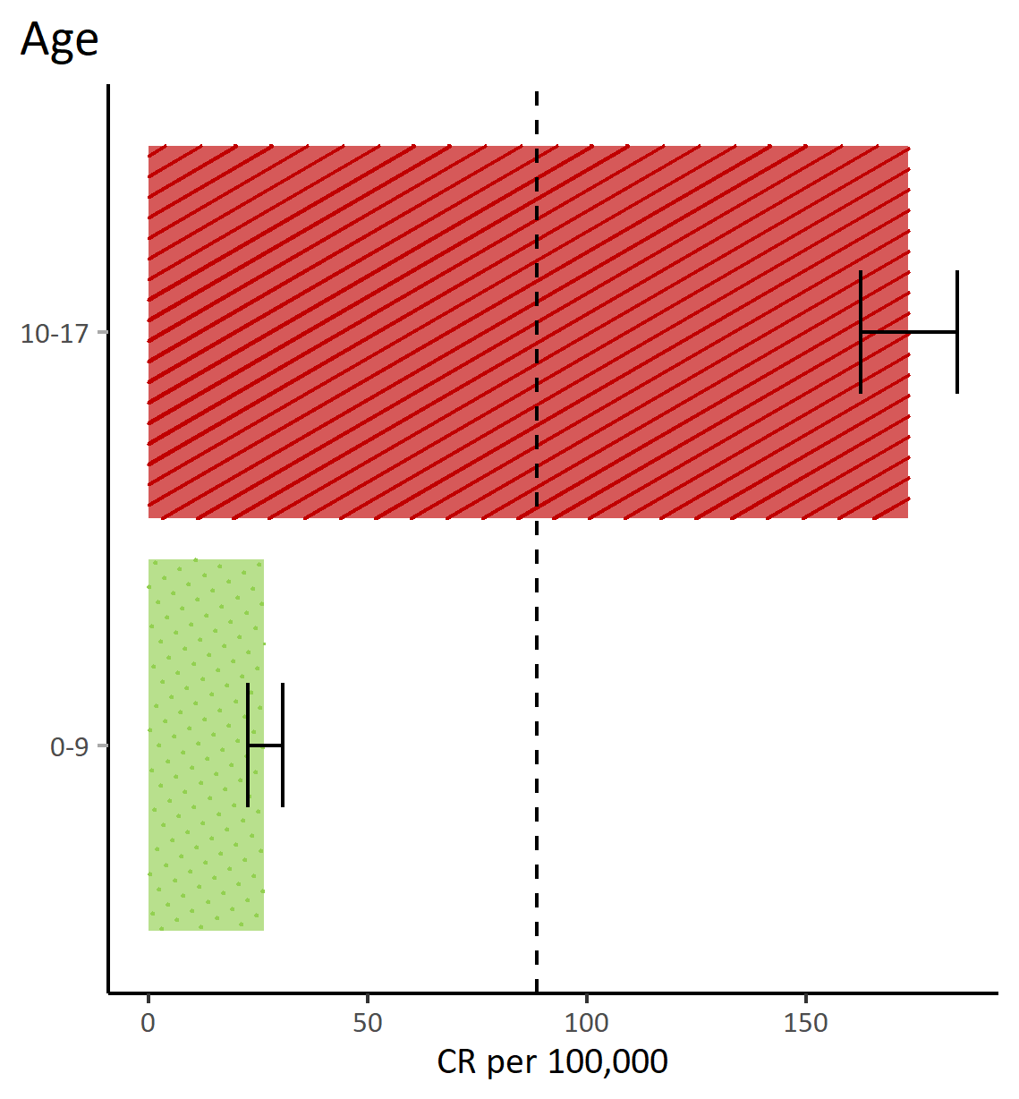
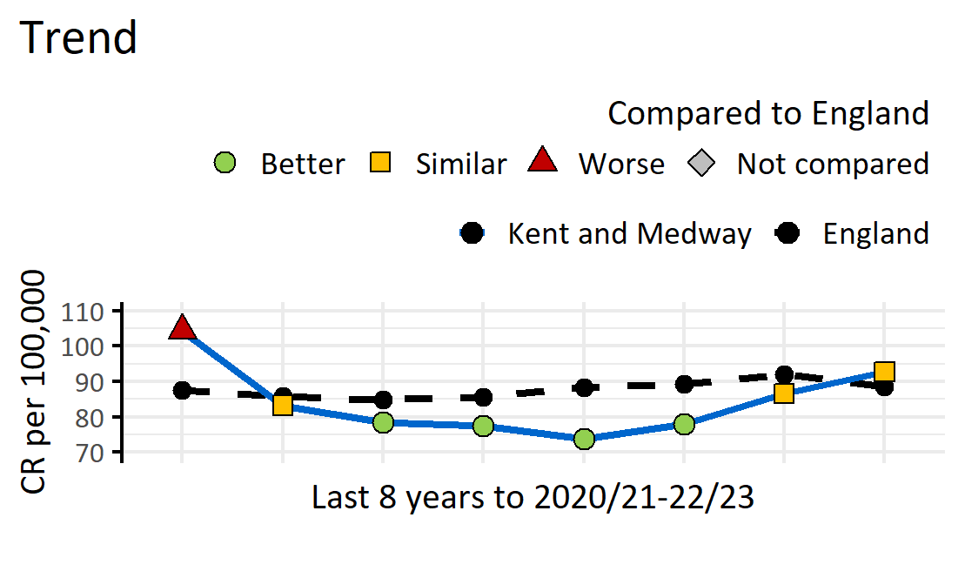
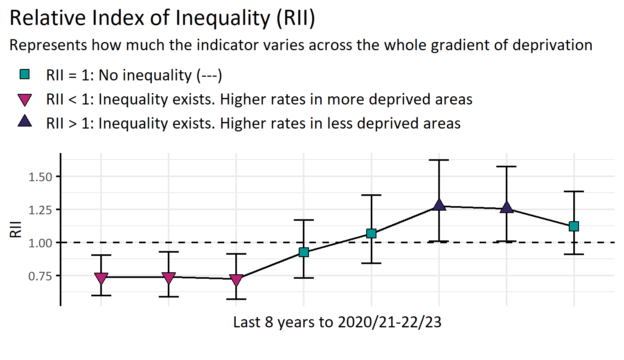
Hospital admissions for mental health conditions (under 18 years)
Version 1.2 © Medway Council, Public Health Intelligence Team, 11/03/2024
ICD-10 codes as a primary diagnosis: F00-F99.
Completed first episode admissions discounting regular attendees.
Value type: Crude rate (CR) per 100,000.
Original geography: Lower Super Output Area (LSOA).
Benchmarking method: Byar's method (95%).
Source: NHS Digital, Hospital Episode Statistics (HES).

Slide 15
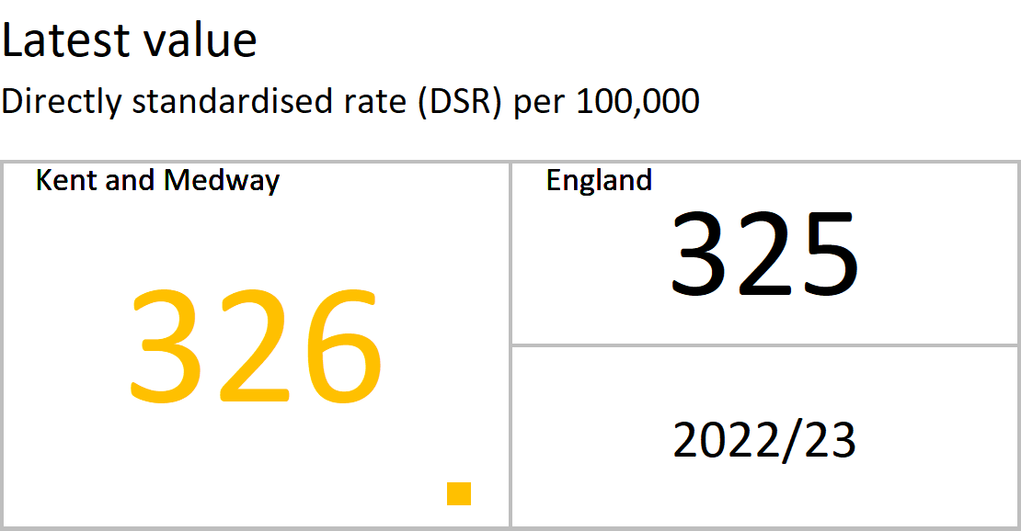
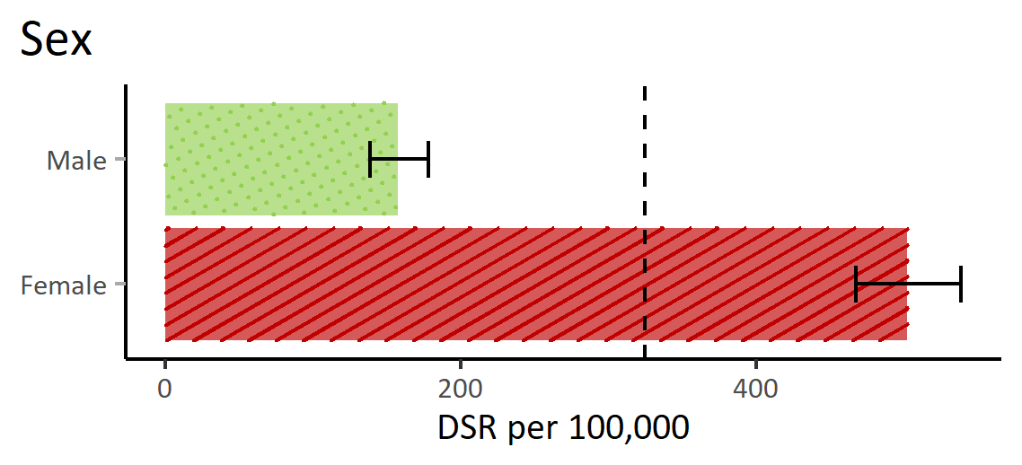
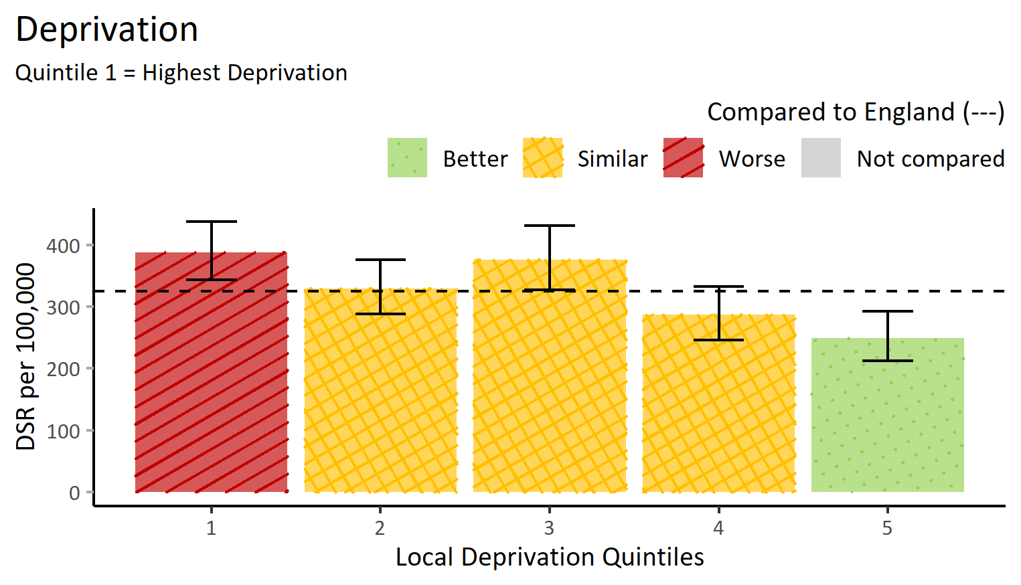
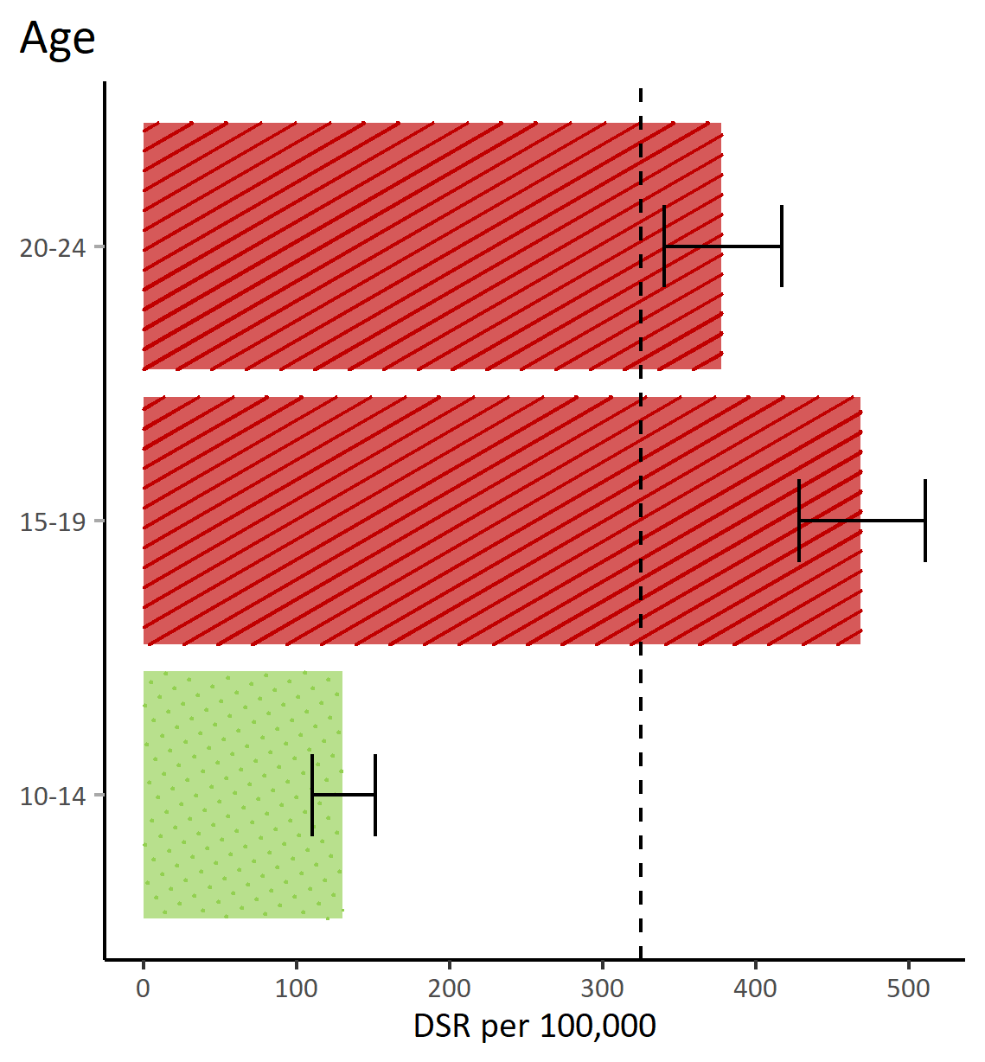
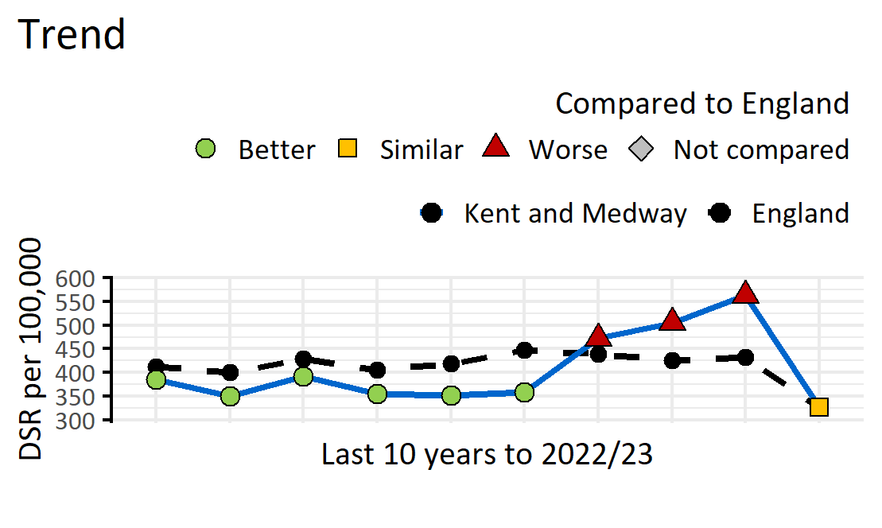
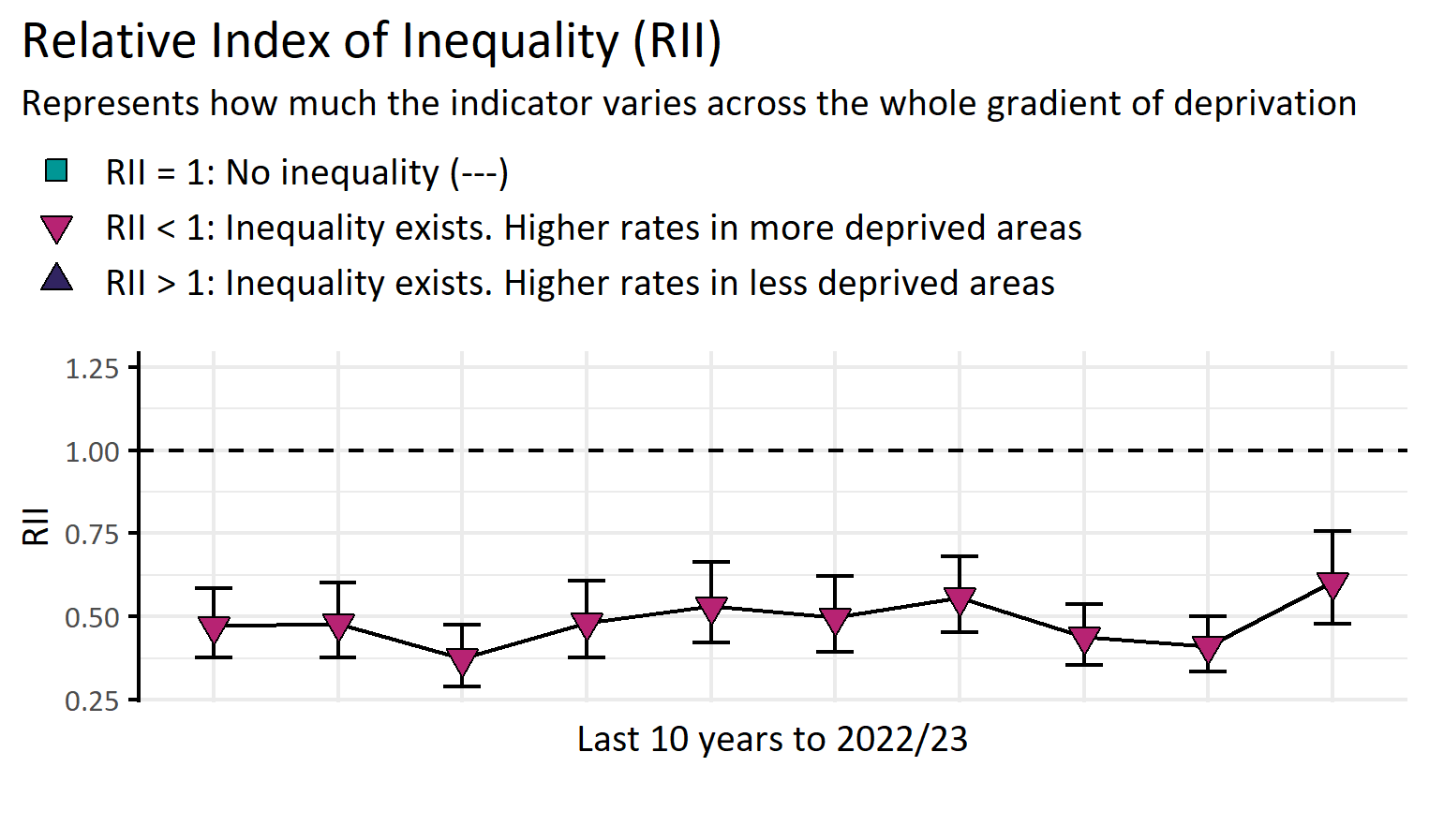
Hospital admissions as a result of self-harm (10-24 years)
Version 1.2 © Medway Council, Public Health Intelligence Team, 11/03/2024
ICD-10 codes: X60-X84.
Completed first episode admissions discounting regular attendees.
Value type: Directly standardised rate (DSR) per 100,000.
Original geography: Lower Super Output Area (LSOA).
Benchmarking method: Exact CI method (95%).
Source: NHS Digital, Hospital Episode Statistics (HES).

Slide 16
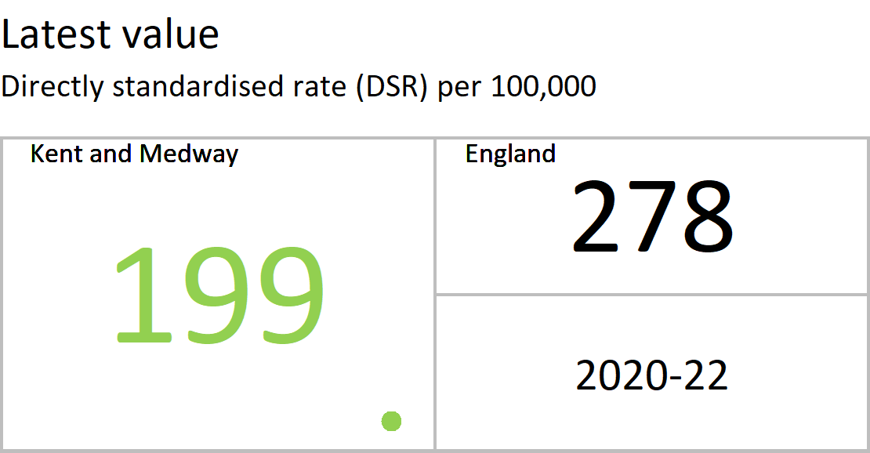
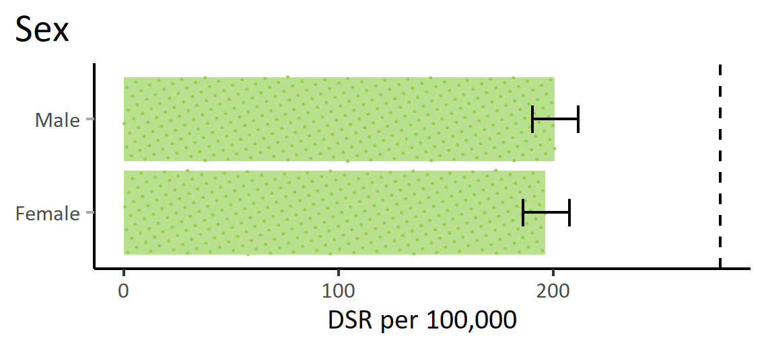
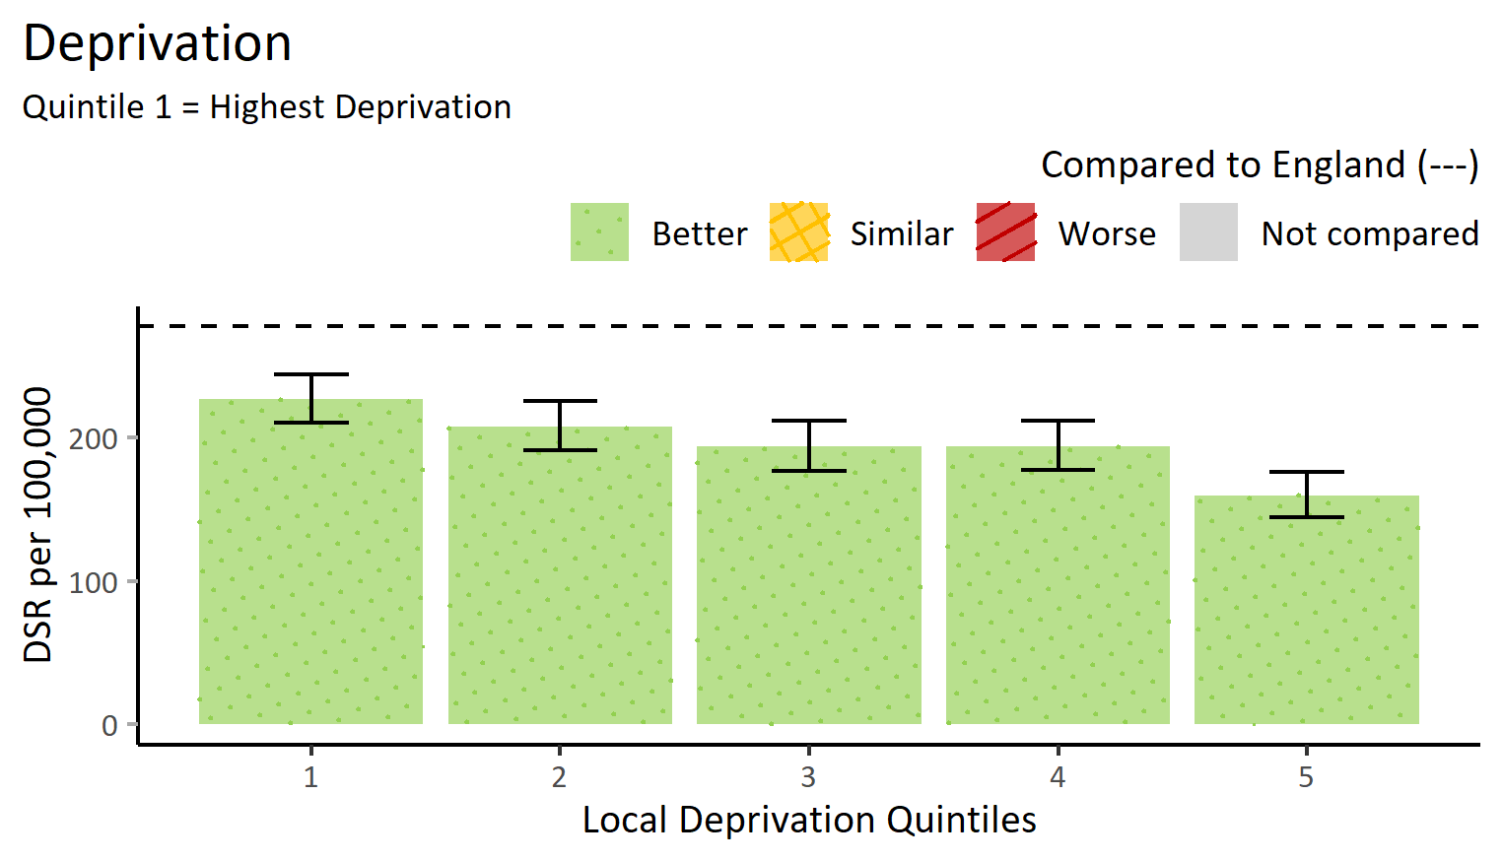
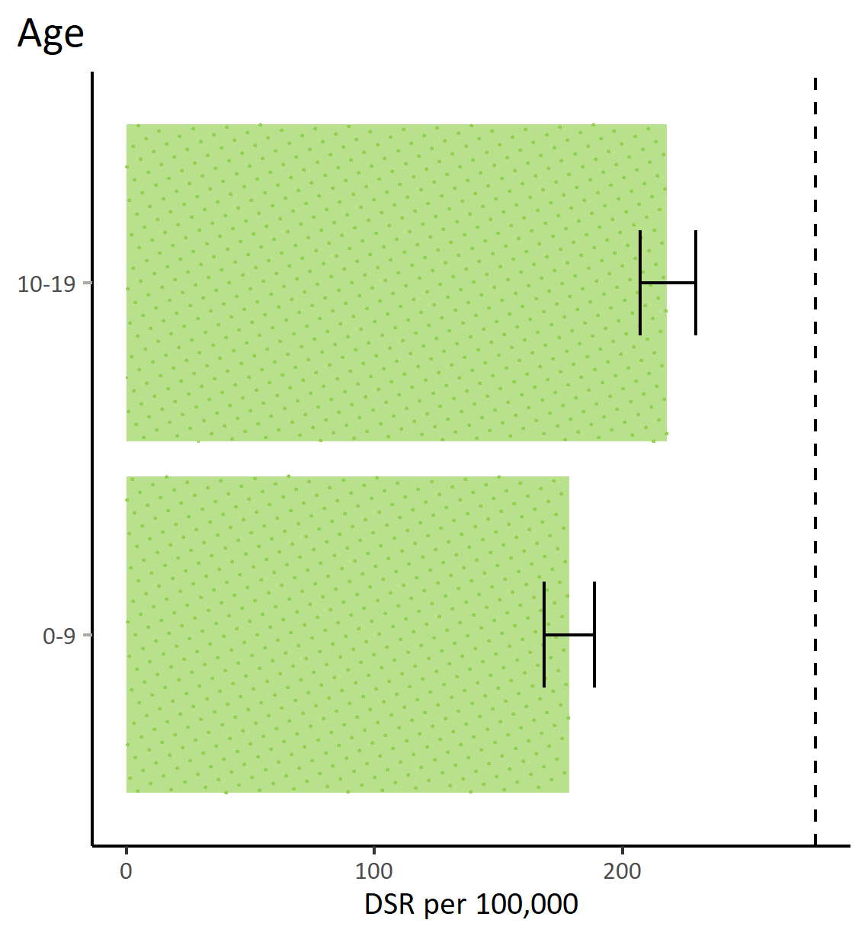
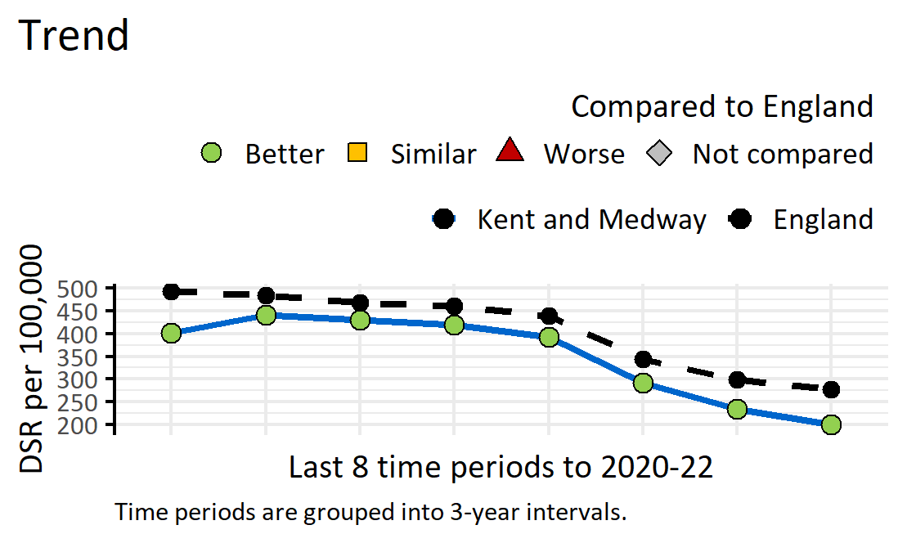
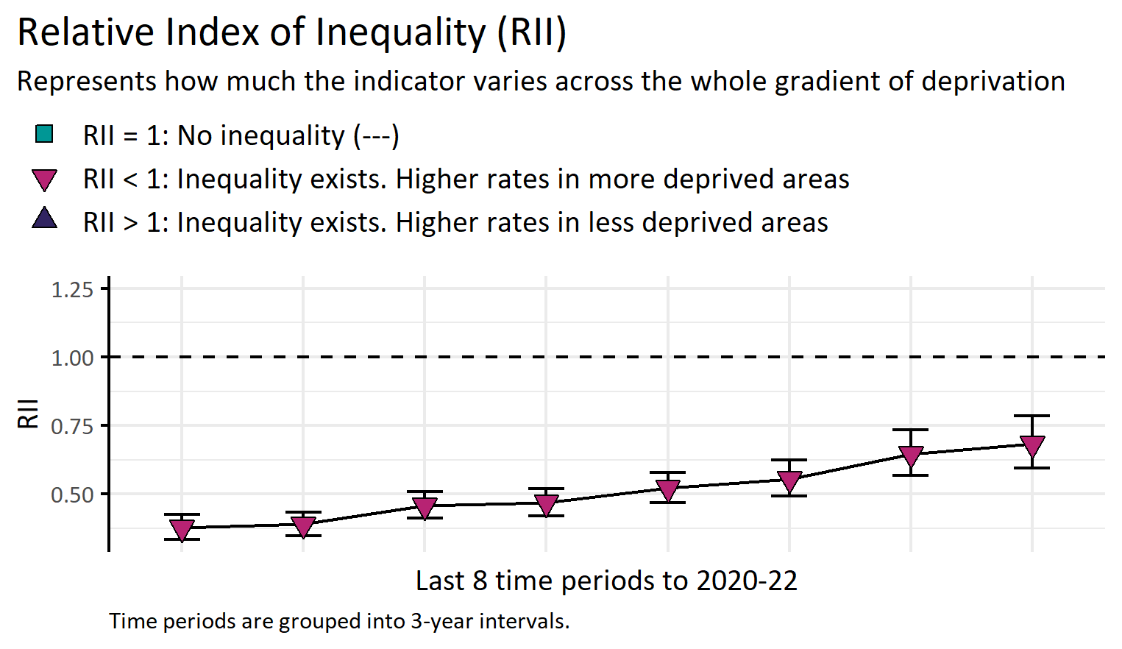
Hospital admissions where a tooth extraction was performed (<20 years)
Version 1.2 © Medway Council, Public Health Intelligence Team, 11/03/2024
Procedure codes: F09-F10.
Finished consultant episodes for ordinary admissions or day cases. Includes caries and non caries related tooth extractions
Value type: Directly standardised rate (DSR) per 100,000.
Original geography: Lower Super Output Area (LSOA).
Benchmarking method: Exact CI method (95%).
Source: NHS Digital, Hospital Episode Statistics (HES)
Caveat: Admissions figures may be underestimated as extractions in community dental services are not always included in data.

Slide 17
Maternity

Slide 18
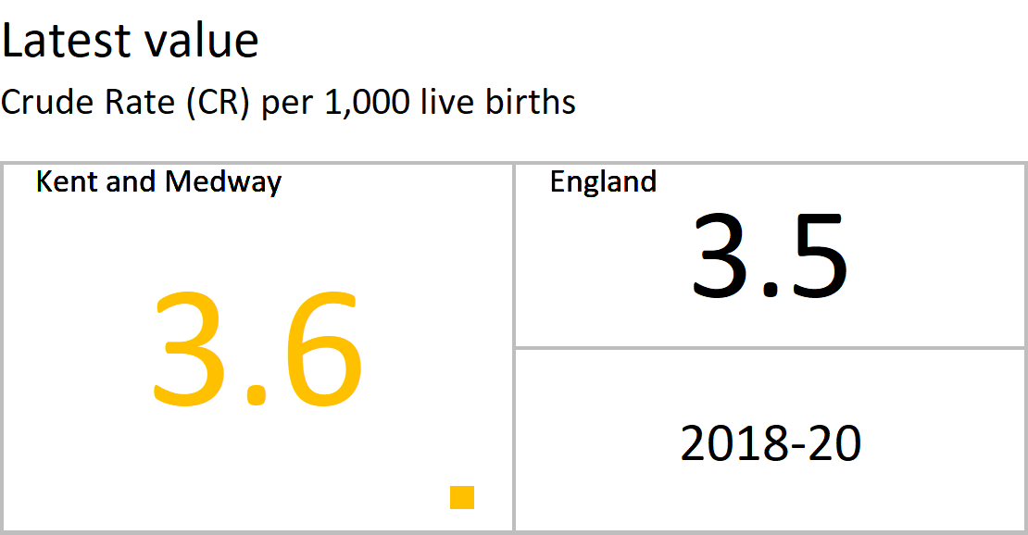
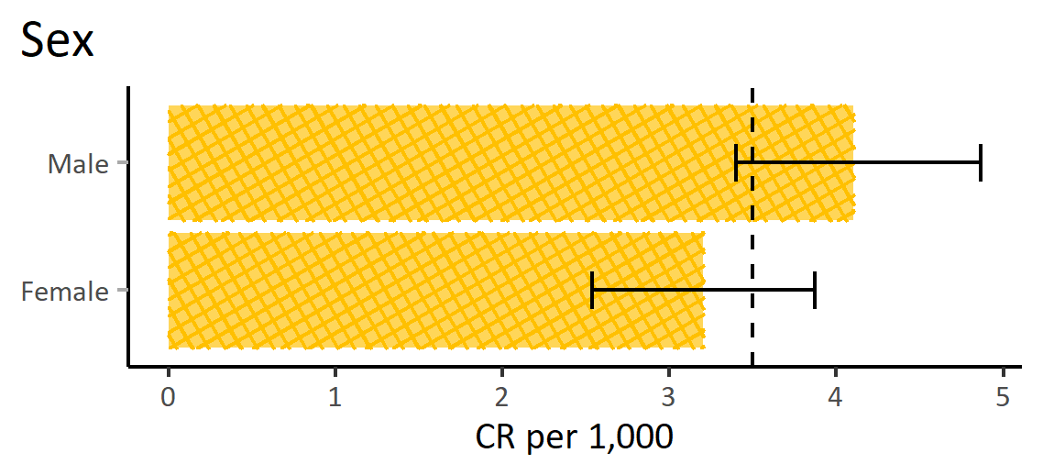



Infant mortality
Version 1.2 © Medway Council, Public Health Intelligence Team, 11/03/2024
Plot by age not available for this indicator
All causes of death in infants under 1 years of age.
Value type: Crude Rate (CR) per 1,000 live births.
Original geography: Lower Super Output Area (LSOA).
Benchmarking method: Byar's method (95%).
Source: Area deaths: NHS Digital. Primary Care Mortality Database (PCMD). Live Births: NHS Maternity Statistics..

Slide 19





Low birth weight
Version 1.2 © Medway Council, Public Health Intelligence Team, 11/03/2024
Plot by age not available for this indicator
Low birth weight (<2500g) of live births to term (37 - 42 weeks gestation).
Value type: Percentage (%) of live births to term.
Original geography: Lower Super Output Area (LSOA).
Benchmarking method: Exact CI method (95%).
Source: Live births: NHS Maternity Statistics..

Slide 20




Emergency admissions of babies under 14 days
Version 1.2 © Medway Council, Public Health Intelligence Team, 11/03/2024
Plot by sex not available for this indicator
Plot by age not available for this indicator
Number of emergency admissions of babies aged 0-13 days (inclusive) compared to the total number of delivery episodes taking place in hospital.
Value type: Crude Rate (CR) per 1,000 deliveries.
Original geography: Lower Super Output Area (LSOA).
Benchmarking method: Byar's method (95%).
Source: NHS Digital, Hospital Episode Statistics (HES).

Slide 21
Severe Mental Illness

Slide 22






Emergency admissions for severe mental illness (SMI)
Version 1.2 © Medway Council, Public Health Intelligence Team, 11/03/2024
ICD-10 codes as a primary diagnosis: F20-25, F28-33.
Completed first episode emergency admissions discounting regular attendees.
Value type: Directly standardised rate (DSR) per 100,000.
Original geography: Lower Super Output Area (LSOA).
Benchmarking method: Exact CI method (95%).
Source: NHS Digital, Hospital Episode Statistics (HES).

Slide 23






Deaths from suicide
Version 1.2 © Medway Council, Public Health Intelligence Team, 11/03/2024
ICD-10 codes as underlying cause of death: X60-X84 (10+), Y10-Y34 (15+)
Value type: Directly Standardised Rate (DSR) per 100,000.
Original geography: Lower Super Output Area (LSOA).
Benchmarking method: Exact CI method (95%).
Source: Area deaths: NHS Digital. Primary Care Mortality Database (PCMD).
England deaths: Nomis. Mortality statistics - underlying cause, sex and age.

Slide 24
Respiratory Diseases

Slide 25






Emergency admissions for respiratory disease
Version 1.2 © Medway Council, Public Health Intelligence Team, 11/03/2024
ICD-10 codes as a primary diagnosis: J00-J99.
Completed first episode emergency admissions discounting regular attendees.
Value type: Directly standardised rate (DSR) per 100,000.
Original geography: Lower Super Output Area (LSOA).
Benchmarking method: Exact CI method (95%).
Source: NHS Digital, Hospital Episode Statistics (HES).

Slide 26






Deaths from respiratory disease
Version 1.2 © Medway Council, Public Health Intelligence Team, 11/03/2024
ICD-10 codes as underlying cause of death: J00-J99
Value type: Directly standardised rate (DSR) per 100,000.
Original geography: Lower Super Output Area (LSOA).
Benchmarking method: Exact CI method (95%).
Source: Area deaths: NHS Digital. Primary Care Mortality Database (PCMD).
England deaths: Nomis. Mortality statistics - underlying cause, sex and age.

Slide 27






Emergency admissions for chronic obstructive pulmonary disease (35+)
Version 1.2 © Medway Council, Public Health Intelligence Team, 11/03/2024
ICD-10 codes as a primary diagnosis: J40-J44.
Completed first episode emergency admissions discounting regular attendees.
Value type: Directly standardised rate per 100,000.
Original geography: Lower Super Output Area (LSOA).
Benchmarking method: Exact CI method (95%).
Source: NHS Digital, Hospital Episode Statistics (HES).

Slide 28






Deaths from chronic obstructive pulmonary disease
Version 1.2 © Medway Council, Public Health Intelligence Team, 11/03/2024
ICD-10 codes as underlying cause of death: J40-J44
Value type: Directly standardised rate (DSR) per 100,000.
Original geography: Lower Super Output Area (LSOA).
Benchmarking method: Exact CI method (95%).
Source: Area deaths: NHS Digital. Primary Care Mortality Database (PCMD).
England deaths: Nomis. Mortality statistics - underlying cause, sex and age.

Slide 29
Cancer

Slide 30






Emergency admissions for all cancer
Version 1.2 © Medway Council, Public Health Intelligence Team, 11/03/2024
ICD-10 codes present in any of the first three diagnosis fields: C00-C97, D00-D09, D33, and D37-48.
Completed first episode emergency admissions discounting regular attendees.
Value type: Directly standardised rate (DSR) per 100,000.
Original geography: Lower Super Output Area (LSOA).
Benchmarking method: Byar's method (95%).
Source: NHS Digital, Hospital Episode Statistics (HES).

Slide 31






Deaths from all cancer
Version 1.2 © Medway Council, Public Health Intelligence Team, 11/03/2024
ICD-10 codes as underlying cause of death: C00-C97
Value type: Directly standardised rate (DSR) per 100,000.
Original geography: Lower Super Output Area (LSOA).
Benchmarking method: Exact CI method (95%).
Source: Area deaths: NHS Digital. Primary Care Mortality Database (PCMD).
England deaths: Nomis. Mortality statistics - underlying cause, sex and age.

Slide 32






Emergency admissions for lung cancer
Version 1.2 © Medway Council, Public Health Intelligence Team, 11/03/2024
ICD-10 codes as a primary diagnosis: C33-C34.
Completed first episode emergency admissions discounting regular attendees.
Value type: Directly standardised rate (DSR) per 100,000.
Original geography: Lower Super Output Area (LSOA).
Benchmarking method: Exact CI method (95%).
Source: NHS Digital, Hospital Episode Statistics (HES).

Slide 33






Deaths from lung cancer
Version 1.2 © Medway Council, Public Health Intelligence Team, 11/03/2024
ICD-10 codes as underlying cause of death: C33-C34
Value type: Directly standardised rate (DSR) per 100,000.
Original geography: Lower Super Output Area (LSOA).
Benchmarking method: Exact CI method (95%).
Source: Area deaths: NHS Digital. Primary Care Mortality Database (PCMD).
England deaths: Nomis. Mortality statistics - underlying cause, sex and age.

Slide 34
Cardiovascular Diseases

Slide 35






Emergency admissions for cardiovascular disease
Version 1.2 © Medway Council, Public Health Intelligence Team, 11/03/2024
ICD-10 codes as a primary diagnosis: I00-I99.
Completed first episode emergency admissions discounting regular attendees.
Value type: Directly standardised rate (DSR) per 100,000.
Original geography: Lower Super Output Area (LSOA).
Benchmarking method: Exact CI method (95%).
Source: NHS Digital, Hospital Episode Statistics (HES).

Slide 36






Deaths from cardiovascular diseases
Version 1.2 © Medway Council, Public Health Intelligence Team, 11/03/2024
ICD-10 codes as underlying cause of death: I00-I99
Value type: Directly standardised rate (DSR) per 100,000.
Original geography: Lower Super Output Area (LSOA).
Benchmarking method: Exact CI method (95%).
Source: Area deaths: NHS Digital. Primary Care Mortality Database (PCMD).
England deaths: Nomis. Mortality statistics - underlying cause, sex and age.

Slide 37






Emergency admissions for hypertensive disease
Version 1.2 © Medway Council, Public Health Intelligence Team, 11/03/2024
ICD-10 codes as a primary diagnosis: I10-15.
Completed first episode emergency admissions discounting regular attendees.
Value type: Directly standardised rate (DSR) per 100,000.
Original geography: Lower Super Output Area (LSOA).
Benchmarking method: Exact CI method (95%).
Source: NHS Digital, Hospital Episode Statistics (HES).

Slide 38






Deaths from hypertensive diseases
Version 1.2 © Medway Council, Public Health Intelligence Team, 11/03/2024
ICD-10 codes as underlying cause of death: I10-I15
Value type: Directly standardised rate (DSR) per 100,000.
Original geography: Lower Super Output Area (LSOA).
Benchmarking method: Exact CI method (95%).
Source: Area deaths: NHS Digital. Primary Care Mortality Database (PCMD).
England deaths: Nomis. Mortality statistics - underlying cause, sex and age.

Slide 39
Methodology and
Resources
Version 1.2 © Medway Council, Public Health Intelligence Team, 11/03/2024

Slide 40
Measures
Version 1.2 © Medway Council, Public Health Intelligence Team, 11/03/2024
The profiles use a range of Public Health measures to best present the data for each indicator:
    Percentage (%): The number of events (e.g. admissions) divided by the total population of interest, multiplied by 100. This is expressed as a number between 0 and 100.
    Crude Rate (CR): A CR is a measure of the total number of events divided by the total population in each area of interest. CRs are not adjusted or standardised for variables such as age that might influence the estimate between groups.
    Directly Standardised Rate (DSR): A DSR is a measure of occurrence or frequency that has been adjusted to account for differences in the age structure of different population groups. It involves applying the age-specific rates of a standard population to the age distribution of the population of interest. This provides a fair comparison between groups that have different age structures. Without using an age-adjusted rate, it would be difficult to determine whether there are true differences in the risk of the event between groups.
Rates are presented as the number of events within a multiple of ten. For example, the rate per 1,000 people.

Slide 41
Deprivation
Version 1.2 © Medway Council, Public Health Intelligence Team, 11/03/2024
Each indicator includes a plot of local relative deprivation. This refers to the lack of resources that are required to maintain the quality of life considered typical within a given socioeconomic group.
The Index of Multiple Deprivation (IMD) 2019 is used to the create local deprivation quintiles.
The IMD 2019 measures deprivation in the UK using the following domain groups: income, employment, education, health, crime, barriers to housing and services and the living environment. This provides a national score and rank of overall deprivation at Lower Super Output Area (LSOA) which are geographic groupings of around 1000 – 1500 households.
To create the local deprivation quintiles, Medway LSOAs were ordered by their national deprivation rank. The LSOAs were then separated into five equal groups to create the local deprivation quintiles.
Quintile one includes LSOAs in Medway with the highest level of local deprivation whereas quintile five includes LSOAs with the lowest level of local deprivation.

Slide 42
Relative Index of Inequality
Version 1.2 © Medway Council, Public Health Intelligence Team, 11/03/2024
The Relative Index of Inequality (RII) is a summary measure used to quantify and compare the degree of inequality between different population groups, such as those based on deprivation.
It takes account of inequalities across the whole range of deprivation and summarises this into a single number.
It represents the proportional difference in the indicator across the whole gradient from most to least deprived.
The RII trend plot shows the relative index of inequality over time, using colours and shapes to aid interpretation.
The RII usually ranges between -2 and 2:
    RII equal to 1 indicates there is no inequality.
    An RII less than 1 indicates inequality exists with worse outcomes (e.g. higher rate/percentage) for those in more deprived areas.
    An RII more than 1 indicates that inequality exists with worse outcomes for those in less deprived areas.

Slide 43
Benchmarking
Version 1.2 © Medway Council, Public Health Intelligence Team, 11/03/2024
A RAG rating (red, amber, green) has been applied to the indicators to show how well a value is performing compared to a benchmark (usually the England average).
The RAG rating is assigned by comparing the value to a reference range, which was created using confidence intervals (CIs).
Confidence intervals are a range of values that measure the level of uncertainty in an estimated value. Uncertainty can be caused by natural variation in the data, as well as the sample size and data quality. A confidence interval has an upper and lower limit which are used to determine whether two groups are statistically similar or different to each other. The wider the confidence interval, the greater the uncertainty in the estimated value.
Green corresponds to a value that is better than England, red to a value that is worse, and amber indicates that there is no difference.
An indicator is shaded grey where it is inappropriate to apply a RAG rating due to the methods used in the calculation or the count is less than 10.

Slide 44
Accessibility
Version 1.2 © Medway Council, Public Health Intelligence Team, 11/03/2024
All plots contain alternative text (alt text), which describes the plot and, where possible, includes values.
To access the alt text: Right-click an image, and then select View Alt Text. This will open the Alt Text pane.
Shapes and patterns have been used to communicate meaning when the colour palette may not be accessible.
For instance, a RAG rating (red, amber, green) is used for most indicators to show how well the value compares to a benchmark, such as the England average.
Green represents better performance, amber represents similarity, and red signifies worse performance.
Shapes are also used to communicate this information, where a circle signifies better performance, a square represents similarity, a triangle indicates worse, and a diamond signifies there has been no comparison.
Additionally, some plots are patterned alongside their RAG rating to communicate this information. Dots signify better performance, single diagonal lines signify worse performance, and crossed diagonal lines represent similarity.

Slide 45
References
Version 1.2 © Medway Council, Public Health Intelligence Team, 11/03/2024
The methodology for each indicator is based on published data and existing measures.
Sources of methodology include Fingertips (Office for Health Improvement and Disparities), Office for National Statistics, and NHS Digital.
Some indicator values may be different from published figures. This may be due to slight differences in numbers extracted or data being grouped into different year intervals.

Slide 46
Further Resources
Version 1.2 © Medway Council, Public Health Intelligence Team, 11/03/2024
  Kent County Council and Medway Council Public Health teams are committed to supporting partners across the Integrated Care System to better understand and address health inequalities through collaborative action.
Kent County Council Public Health
    Each Health and Care Partnership in Kent is supported by Consultants in Public Health and each district council is supported by a Public Health Specialist.
    The Kent Public Health Observatory website contains an extensive collection of Joint Strategic Needs Assessment (JSNA) reports on a wide range of topics relevant to health inequalities.
    Please contact us for more information.
Medway Council Public Health
    Medway's Joint Strategic Needs Assessment (JSNA) website contains a range of resources to summarise the health and social care needs of Medway's residents.
    There over 30 topic specific chapters, including a chapter on health inequalities.
    A range of profiles are also available to provide an overview of the health and wellbeing needs of different areas, such as the Kent and Medway Health and Care Partnerships (HCPs) and Primary Care Networks (PCNs).
Website: www.kpho.org.uk
Website: www.medway.gov.uk/jsna
Email: kpho@kent.gov.uk
Email: jsna@medway.gov.uk

