Slide 1
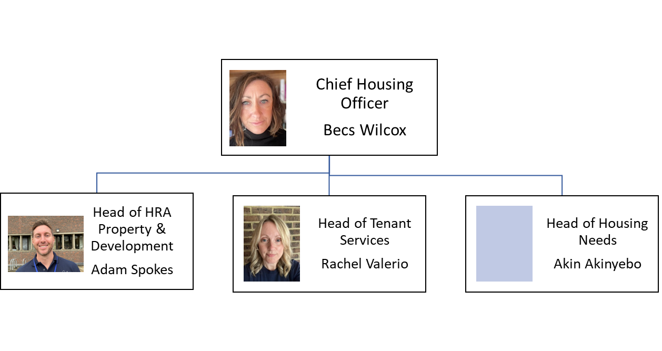
Senior Housing Management Team

Slide 2
Senior Housing Management Team – roles and responsibilities
Rebecca Wilcox
The Chief Housing Officer is responsible for:
Council housing management services including repairs, maintenance and compliance
Responsible person in respect of consumer regulation
Lead for safeguarding in housing
Homelessness and housing advice
The council’s housing waiting list
Disabled facilities grants
Homes for Independent Living
Delivery of new council homes
Enabling the delivery of affordable homes
Resettlement schemes (Ukrainian & Afghan)
Private sector Housing Standards
Akin Akinyebo
Head of Housing Needs is responsible for:
Homelessness and housing advice
The council’s housing waiting list
Disabled facilities grants
Resettlement schemes (Ukrainian & Afghan)
Homes of Multiple Occupancy (HMO) licensing
Mobile home licensing
Private sector Housing Standards

Slide 3
Senior Housing Management Team – roles and responsibilities cont’d
Adam Spokes
Head of HRA Property & Development is responsible for:
Council housing management:
Asset management (looking after the council homes)
Repairs and maintenance of council homes
Health & Safety of council homes which includes compliance
Contract management of the repairs, maintenance and compliance contracts and service level agreements
Delivery of new council homes
Enabling the delivery of affordable homes
Rachel Valerio
Head of Tenant Service is responsible for:
Council housing management:
Income & arrears
Tenancy management
Letting of council homes
Homes for Independent Living
Tenant engagement – including the Tenant & Leaseholders Panel
Leaseholder management
Estate management for council homes
Big Door Knocks
Tenant satisfaction measures
Housing Ombudsman – self assessment
NEC – housing management system
Housing Revenue Account - performance

